Slide 1
Variables
A variable is an empirical measurement of a characteristic.
Every variable has one name and at least two possible values.
Name: region. Values: South, Northeast, Midwest, West
Name: income. Values: $42,000; $42,001; $16,152

Slide 2
3 Levels of Precision
Three levels of measurement or “degrees of precision”
1. Interval level variables have values that are the most precise (eg. Income in dollars).
2. Ordinal-level variables have values that are somewhat less precise (eg. approval of disapproval same-sex marriage).
3. Nominal-level variables have the least precise values (eg., gender: male and female) .

Slide 3
Interval Level Variables
Have values that communicate the exact amount of the characteristic being measured
Use a widely-recognized scale
Comparing two units of analysis
classify into different values of the characteristic
rank by relative amount of the characteristic
compute the exact difference between units
For interval variables, the numeric codes convey the exact quantities of the measured characteristic.
Person A is 21 years old. Person B is 22. The values are the ages, in years. The difference in ages is exactly 1 year.

Slide 4
Ordinal Level Variables
Have values that communicate the relative amount of the characteristic being measured.
may use a scale but the scale measures relative amount, not absolute amount
Comparing units of analysis
classify into different values on the characteristic
rank by relative amount of the characteristic
For ordinal variables, the numeric codes represent relative amounts, not absolute amounts.
Person A “approves” of same-sex marriage (numeric code 1). Person B “disapproves” (numeric code 2). Person B has relatively more disapproval than Person A. But the difference is not 1 unit of approval.

Slide 5
Nominal Level Variables
Have values that communicate differences
may be coded with numbers but the numbers just differentiate between units
Comparing units
Classify into different values on the characteristic
Person A is male (numeric code 1). Person B is female (numeric code 2).
The codes simply represent differences. The numbers have no inherent meaning.
not exact amounts of gender
not relative amounts of gender
only differences in gender

Slide 6
Ordinal scales
A common practice: summing ordinal items into an additive scale
Likert scales the most common
all items in the scale must measure the same concept
The similarity of the questions ensures that only one concept is measured.
The greater the number of questions, the more reliable the scale.

Slide 7
Describing variables
Any variable can be described by its:
1. Central tendency
“average” value
value that best typifies the variable
2. Dispersion
extent to which the units of analysis are distributed across the values of the variable

Slide 8
Measures of Central Tendency
Mode: The “common-most” value
may be used with any level of measurement
for nominal variables, the only measure that may be used
Median: The “middle-most” value
50% of cases fall above / 50% fall below the median
the same as the 50th percentile
for ordinal or interval variables
Mean: The arithmetic average
add up all the values and divide by the number of cases
for interval variables only

Slide 9
Dispersion
a neglected aspect of description
In political discussion, we use dispersion to describe variables.
“polarization,” “consensus,” “equality”
A variable has maximum dispersion if the cases are spread evenly across all values of the variable.
A variable has minimum dispersion if the cases all fall into one value of the variable.

Slide 10
Frequency distributions
3 (sometimes 4) columns
Column 1: labels of the variable’s values
Column 2: raw number of cases in each value
Column 3: percentage of cases in each value
Column 4: cumulative percentages showing the percentage of cases in or below each value
Ordinal and interval variables only

Slide 11
Graphs: Bar charts
The variable’s values appear on the horizontal axis.
The percentage of cases in each value are recorded on the vertical axis.
for variables at all levels of measurement

Slide 12
Examples
Nominal
region of residence
Ordinal
religious attendance
ideological self-placement
Interval
TV hours
support for spending on government programs
feeling thermometers

Slide 13
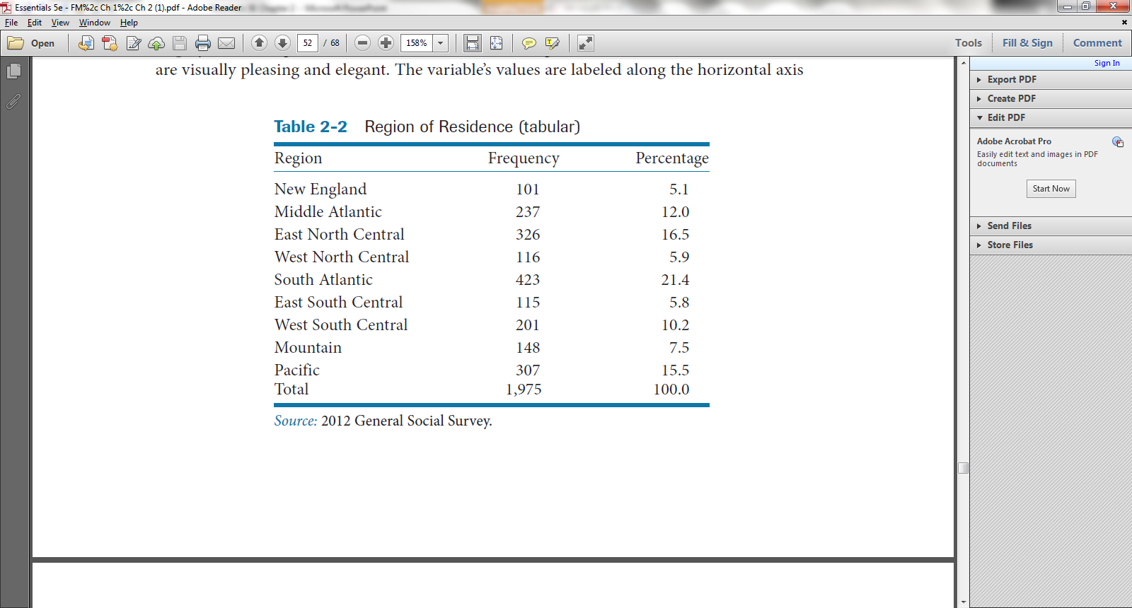
Region of residence (Nominal)

Slide 14
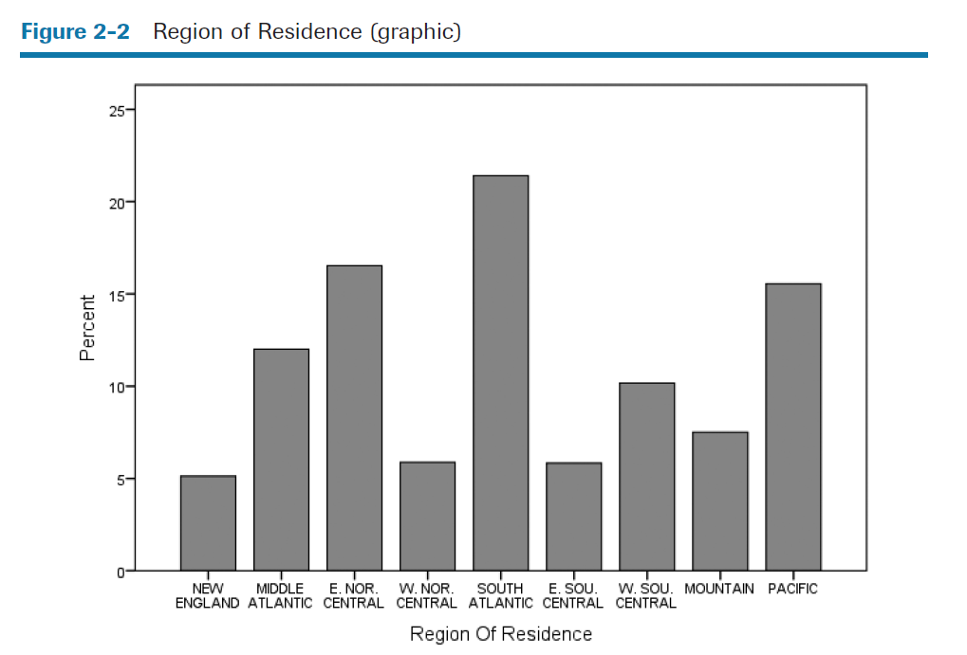
This variable has fairly high variation or dispersion.
The cases are spread out, with many falling in non-modal values.

Slide 15
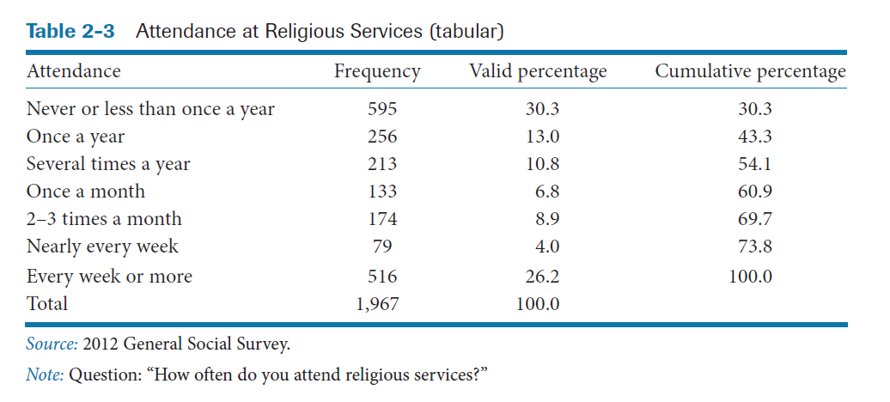
Religious attendance (Ordinal)
Bimodal

Slide 16
Median

Slide 17
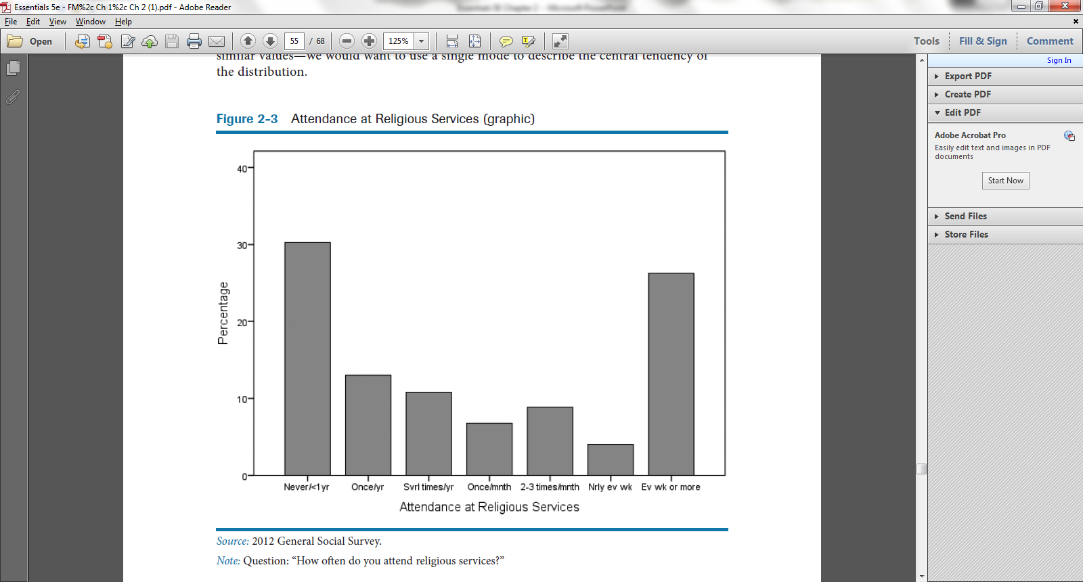
This variable comes closer to the maximum dispersion scenario than the minimum dispersion scenario.

Slide 18
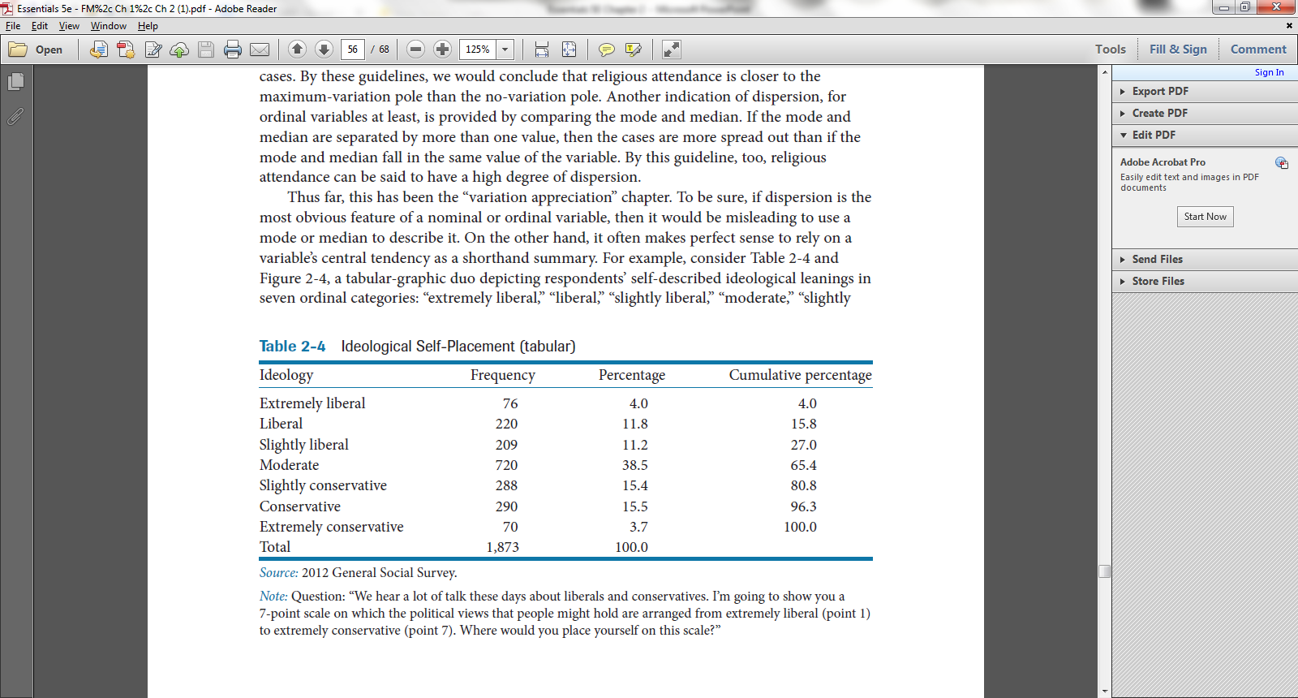
Ideological Self-Placement (Ordinal)
Mode = “Moderate”
Median = “Moderate”

Slide 19
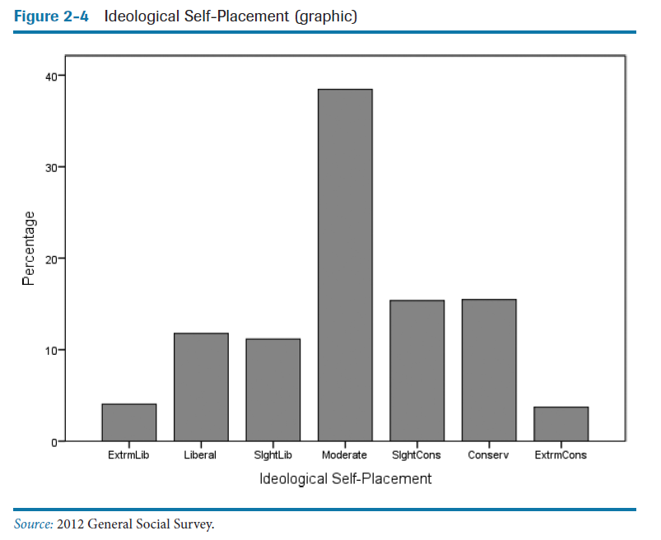
It often makes perfect sense to rely on a variable’s central tendency as a shorthand summary.
This variable comes closer to the minimum dispersion scenario than the maximum dispersion scenario.

Slide 20
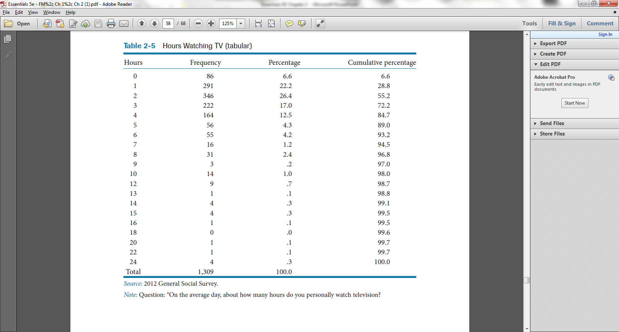
TV hours (Interval)
Mode = 2
Median = 2

Slide 21
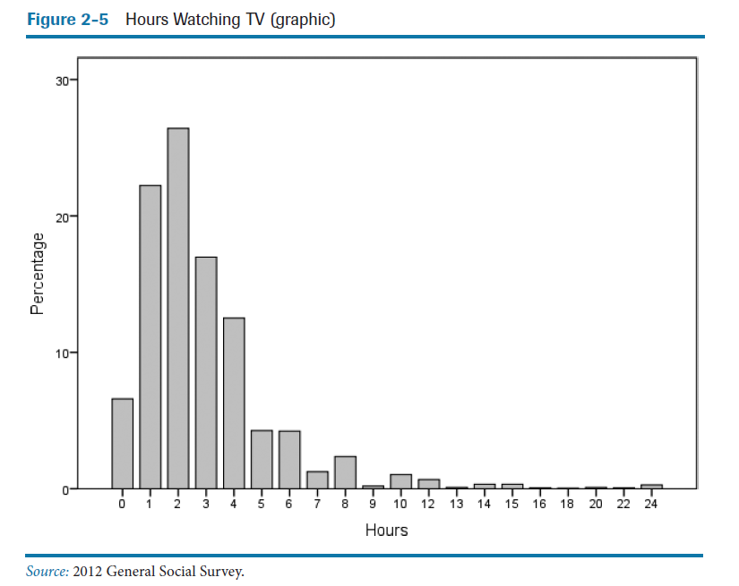
Mode = 2
Median =2
Mean = 2.93
Positive skew: Extreme values in the positive tail pull the mean up, off the center of the distribution.

Slide 22
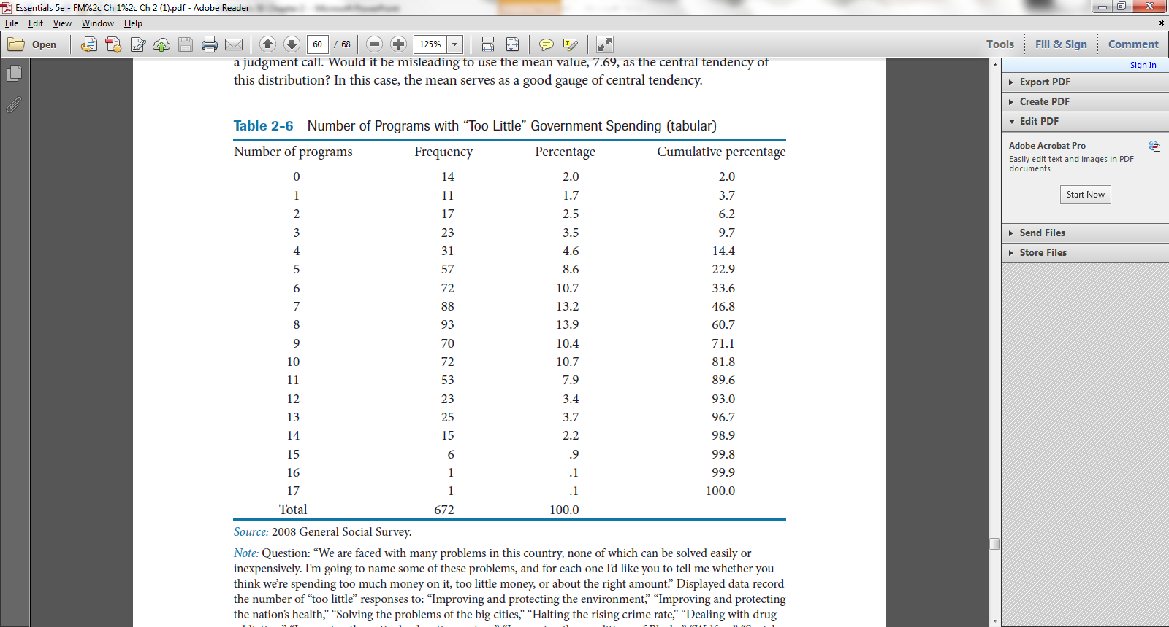
Support for spending on 17 programs (Interval)

Slide 23
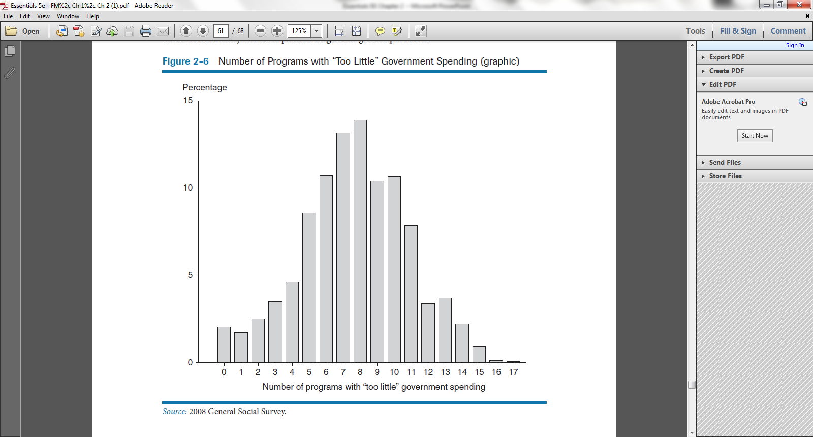
This distribution has a mild negative skew, pulling the mean down slightly, to 7.69. Even so, it would not be misleading to use the mean as the best measure of central tendency.

Slide 24
Interquartile range
non-statistical measure of dispersion for interval (and ordinal) variables
especially informative when two distributions are being compared.
Defined as the range of a variable’s values that defines the “middle half ” of a distribution:
between the upper boundary of the lowest quartile (which is the same as the 25th percentile) and the lower boundary of the upper quartile (the 75th percentile)
graphically depicted by a box plot

Slide 25
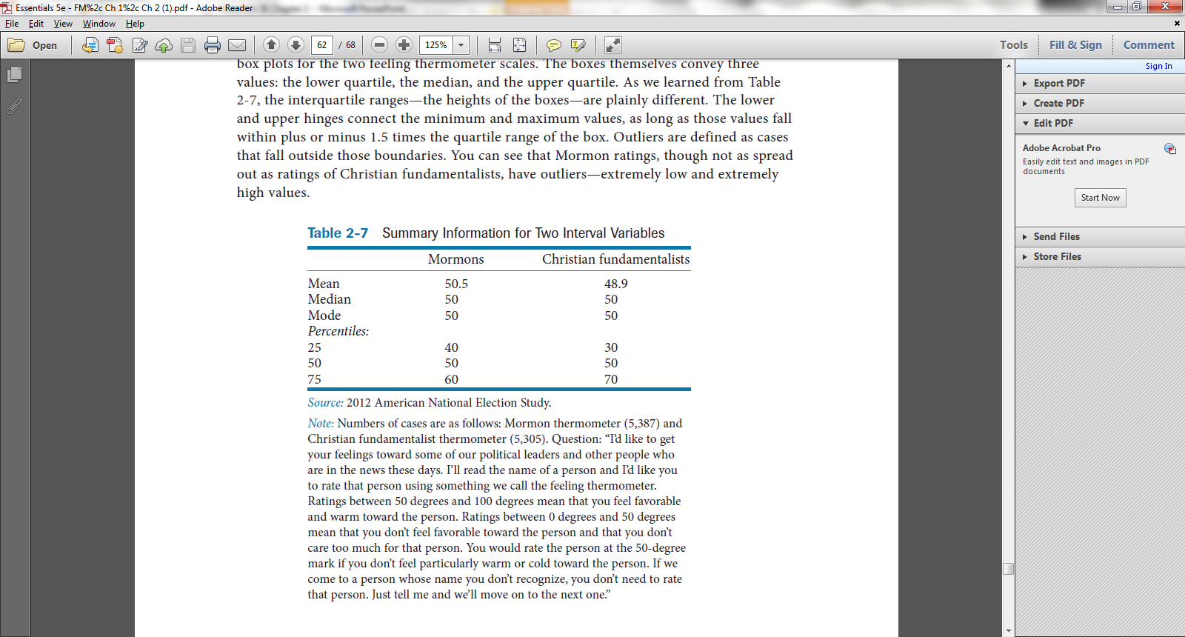
Feeling thermometers (Interval)

Slide 26
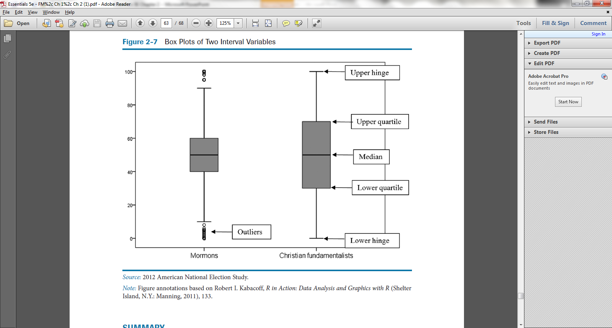
Box plots

