Slide 1
Saving Minutes to Save Millions Cisco Dynamic Reverse Proxy
Cecil Hutchings, Matthew King, William Rooney
September 2017

Slide 2
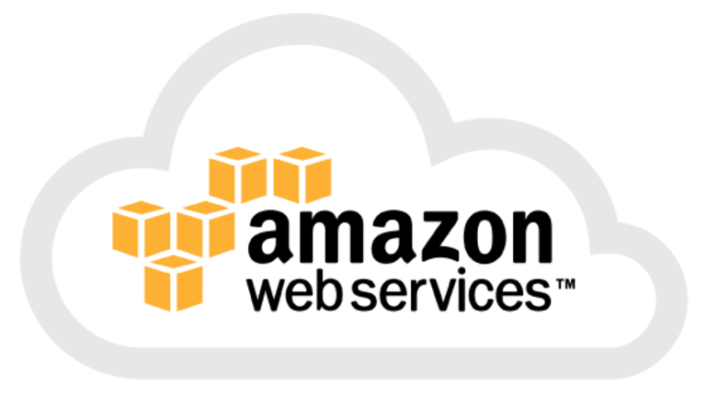

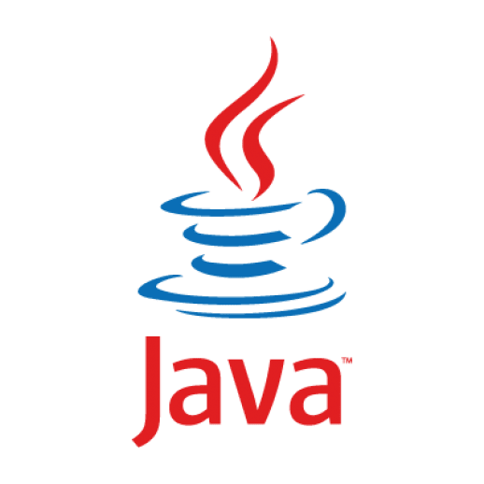
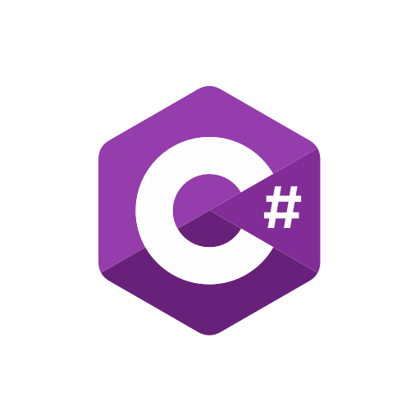
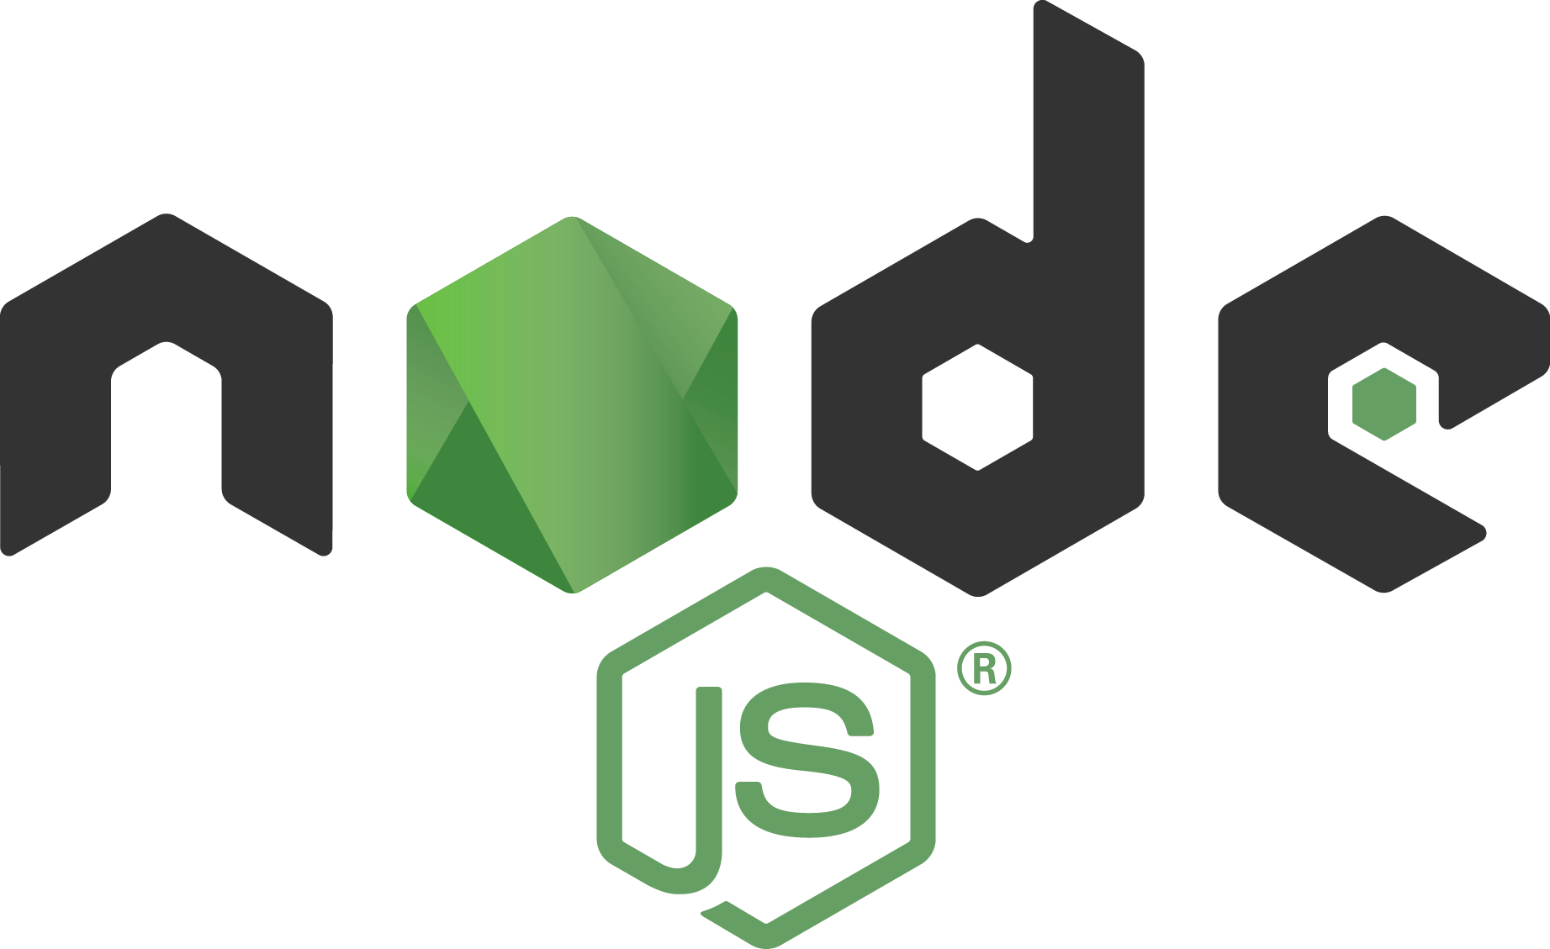
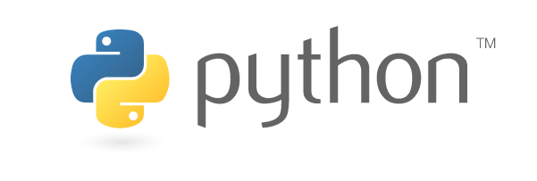
Technical Specifications
Platform
Google Cloud Platform
Amazon Web Services (AWS)
Lambda, CouldTrail, S3, EC2, IAM
No choice here; required by Cisco
Language
Supported languages in AWS Lambda: Node.js, Java, C#, Python
Final Choice: Python
Final Version: Python 3.6

Slide 3
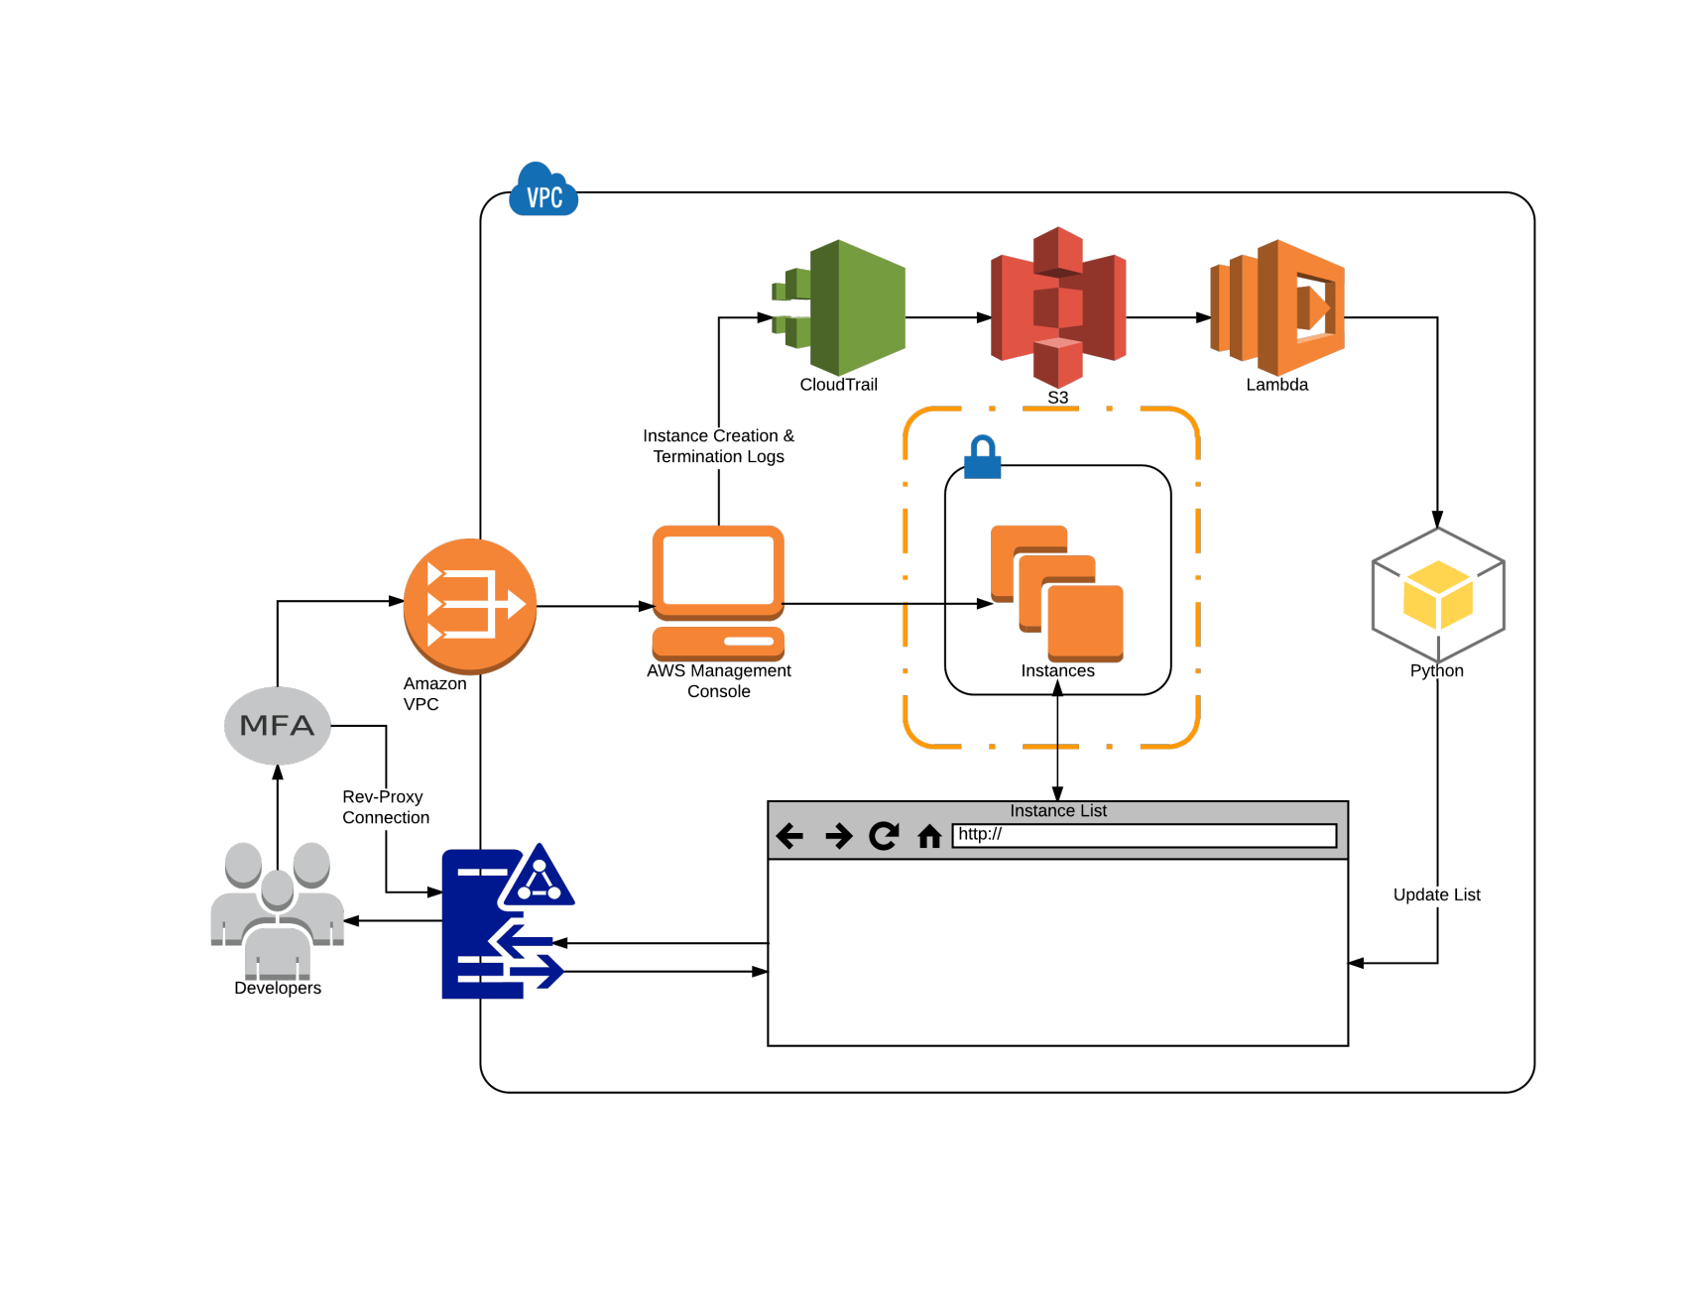
System Overview/Architecture

Slide 4
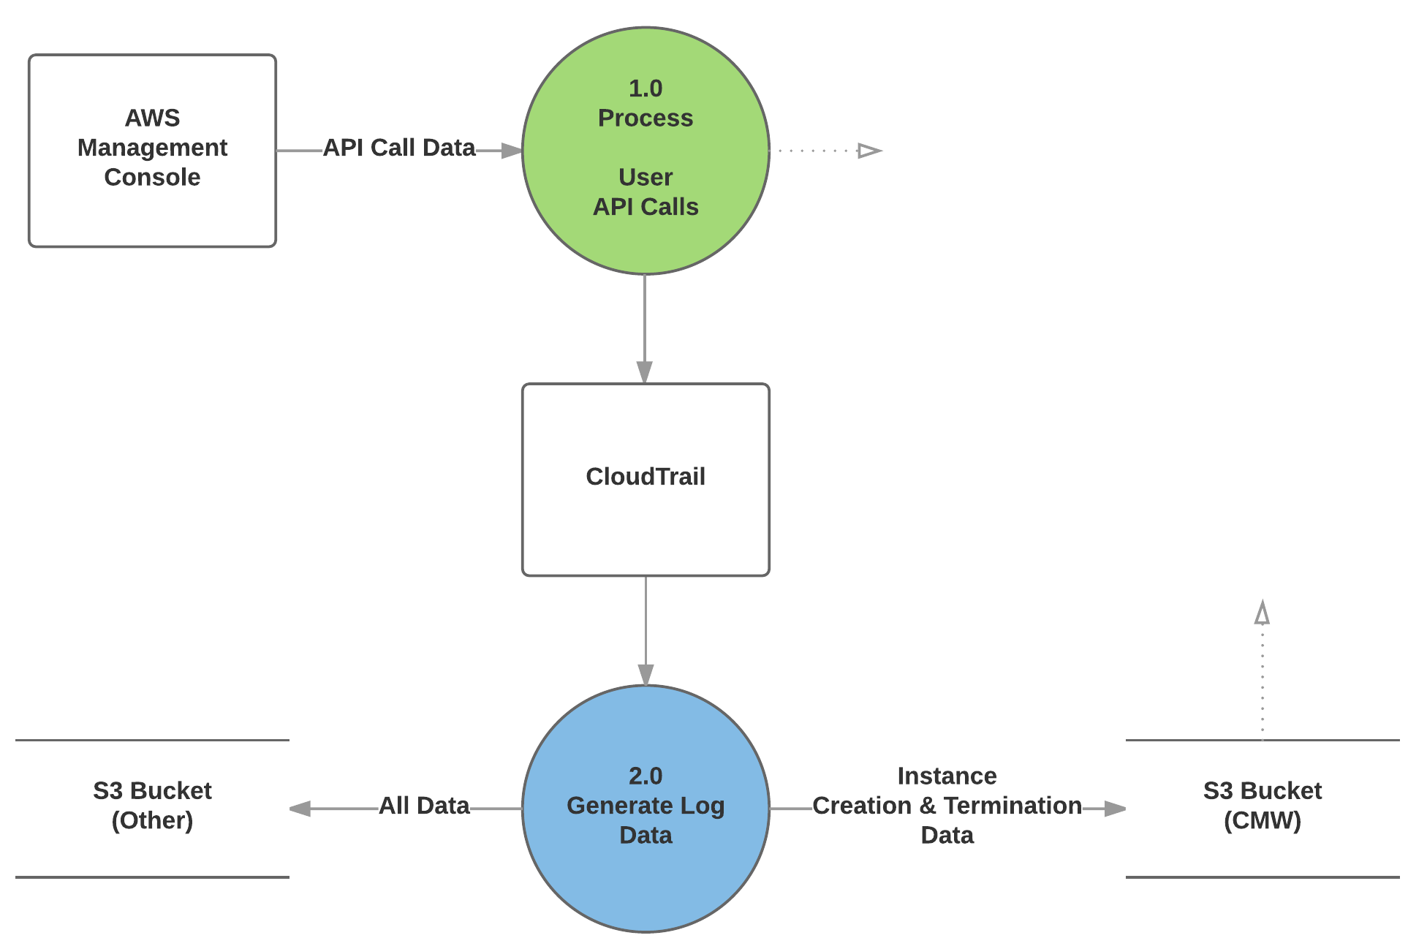
Data Flow – Phase 1

Slide 5
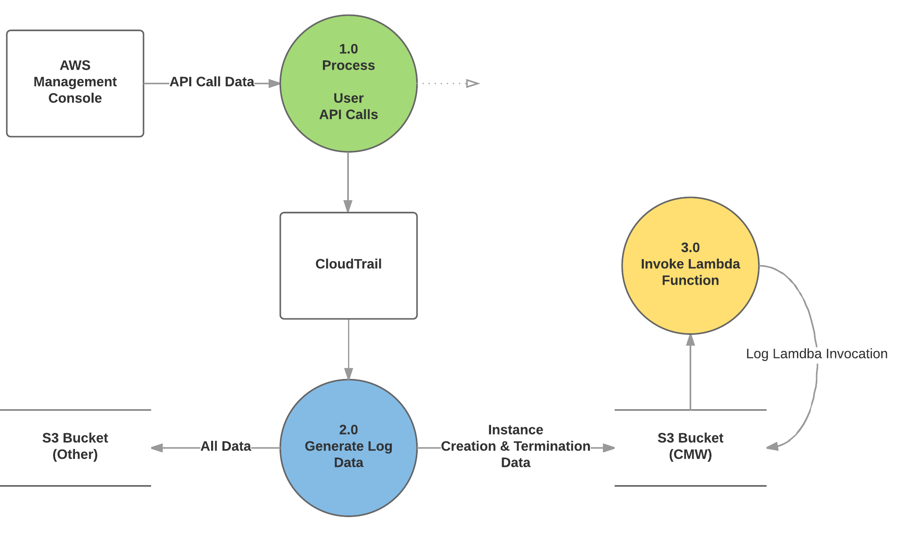
Data Flow – Phase 2

Slide 6
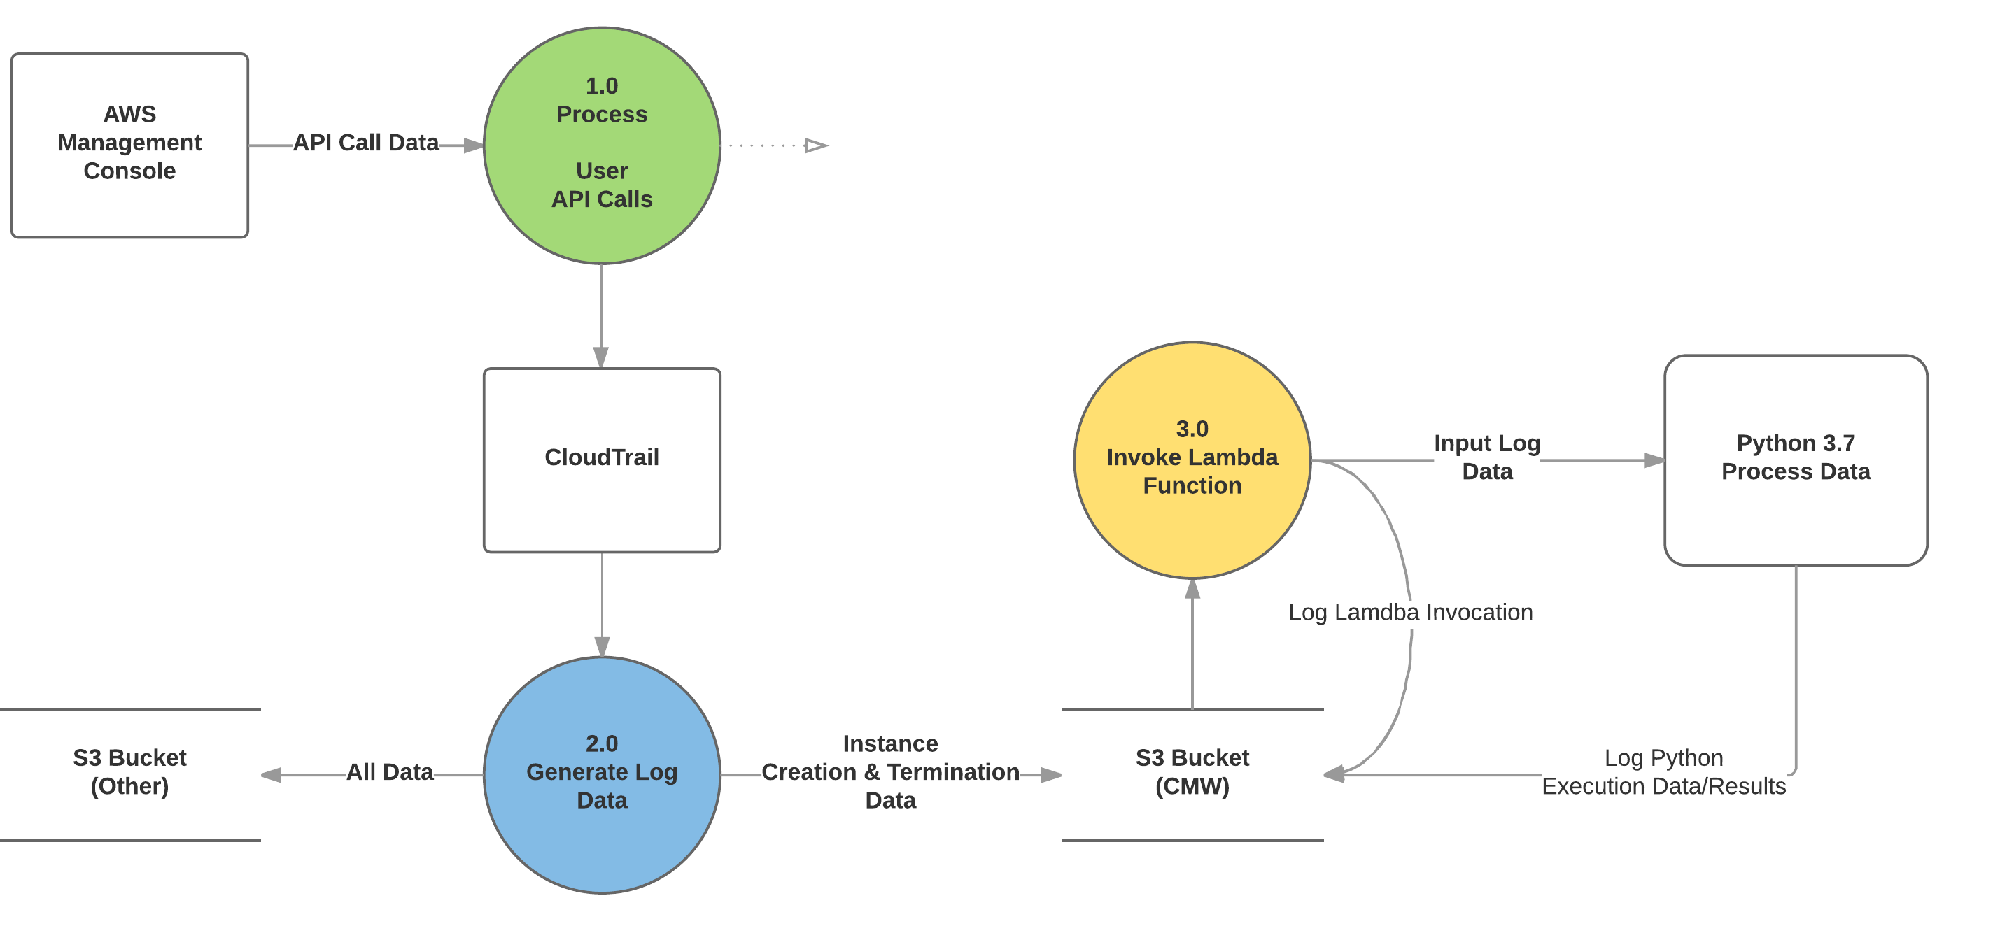
Data Flow – Phase 3

Slide 7
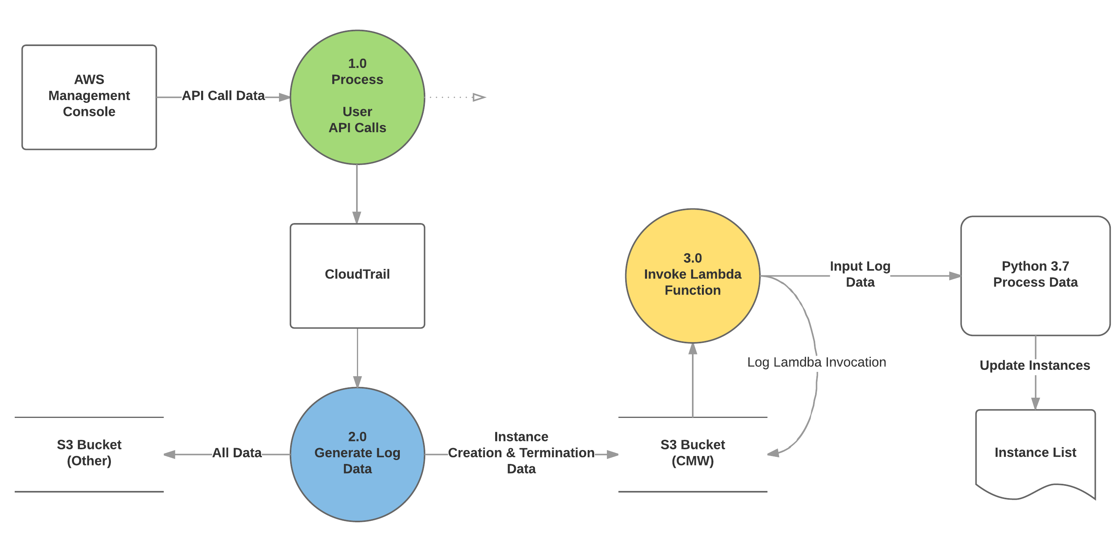
Data Flow – Final Phase

