Slide 1
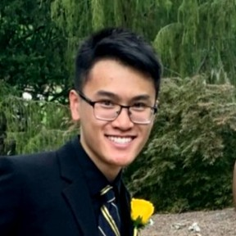


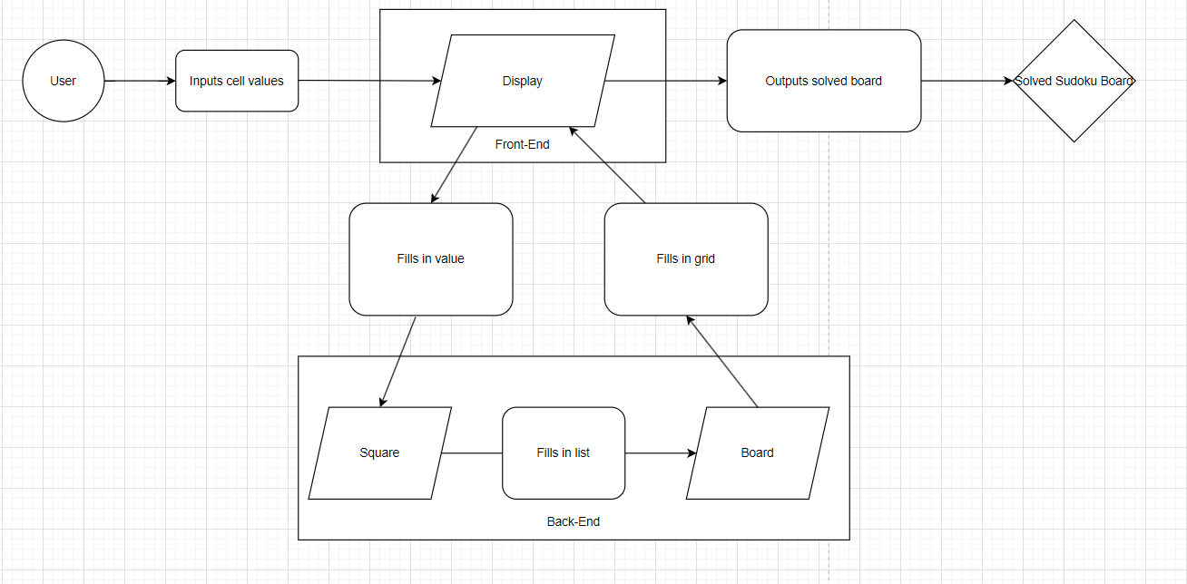
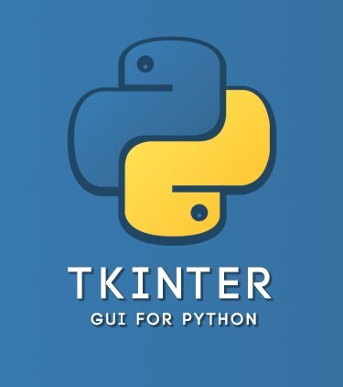



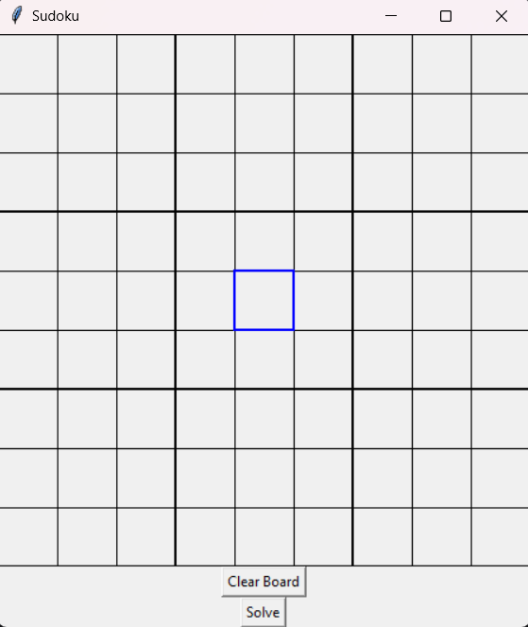
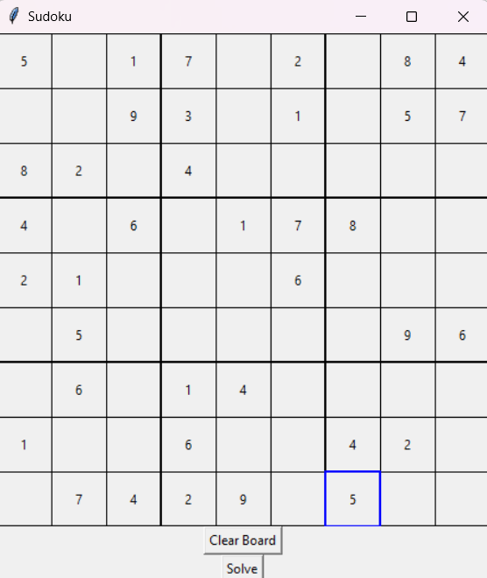
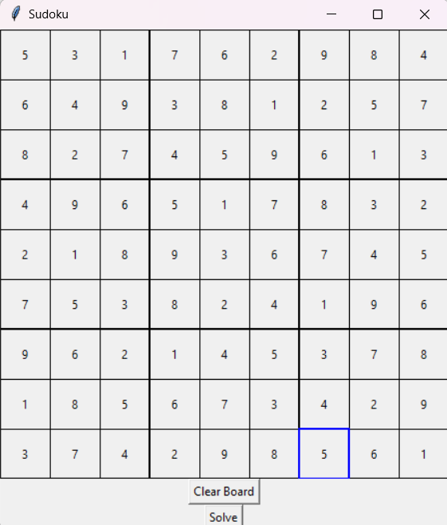

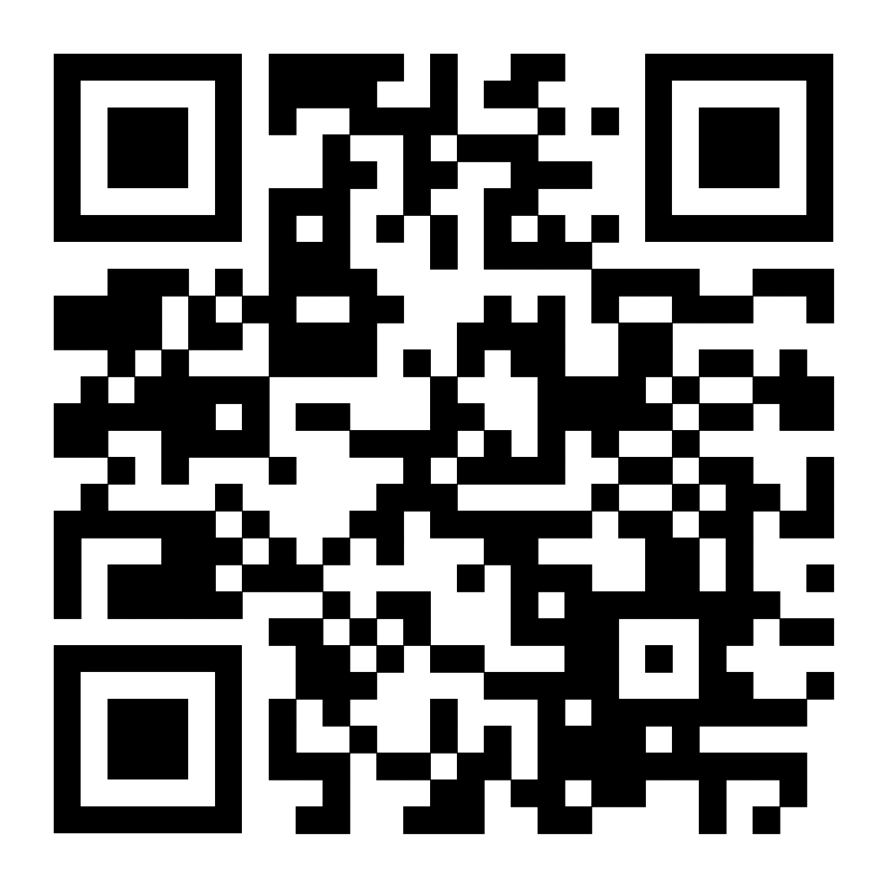
Sudoku Solver
Works in 3 steps!
by The Sudoku Solvers:
Abstract:
This project is centered around the design and development of a Sudoku Solver programmed entirely in Python. This involves the implementation of a user-friendly GUI using TkInter tools that will allow the user to interact with the board and the implementation of functions containing algorithms that will take inputs from the GUI, solve the board based on those inputs, and pass them to the GUI. The main distinction of this project is the utilization of human-solvable algorithms as opposed to computer solvable algorithms, the latter of which rely on brute force tactics while the human-solvable algorithms are more intuitive in nature.
Computer Science ’24
College of Engineering and Applied Science
Michael Lieu
Will Schreiner
Project Advisor: Professor Fred Annexstein
Here’s the problem:
There are plenty of Sudoku solving programs out there… but what if I don’t want to brute-force these solutions?
With this system design!
Our answer:
This program implements human-solvable algorithms!
And we’ll do it using these tools!
So that this… looks like this!
Scan the QR code to check out our GitHub repo!
Pass data in…
Data outputs!
Step 1: Run the program!
Step 2: Input your values…
Step 3: Solve!

