Slide 1
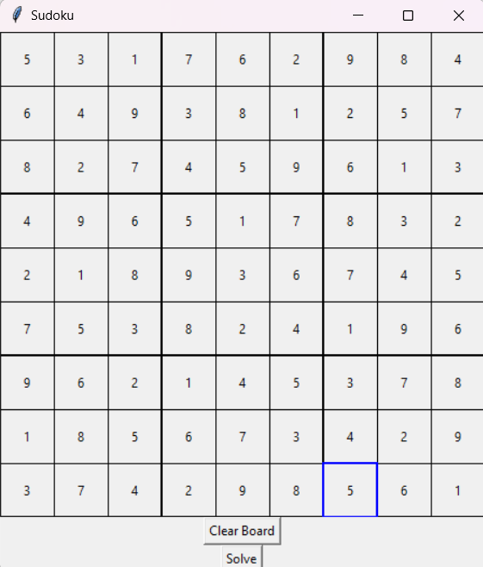
Sudoku Solver
Presented by the Sudoku Solvers: Michael Lieu and Will Schreiner
Faculty Advisor: Fred Annexstein

Slide 2
Purpose and Goals
Purpose: Provide a program for solving Sudoku problems of varying difficulty using human-solvable algorithms
Goals:
Design and develop a Graphic User Interface for a Sudoku Board that allows the user to traverse the board, input values, and display solved board
Design and develop a backend for the Sudoku Board that takes inputs from the GUI, implements solving algorithms to solve the board, and passes solved values to the GUI
Integrate the GUI and backend implementations into a cohesive and fully synthesized product

Slide 3
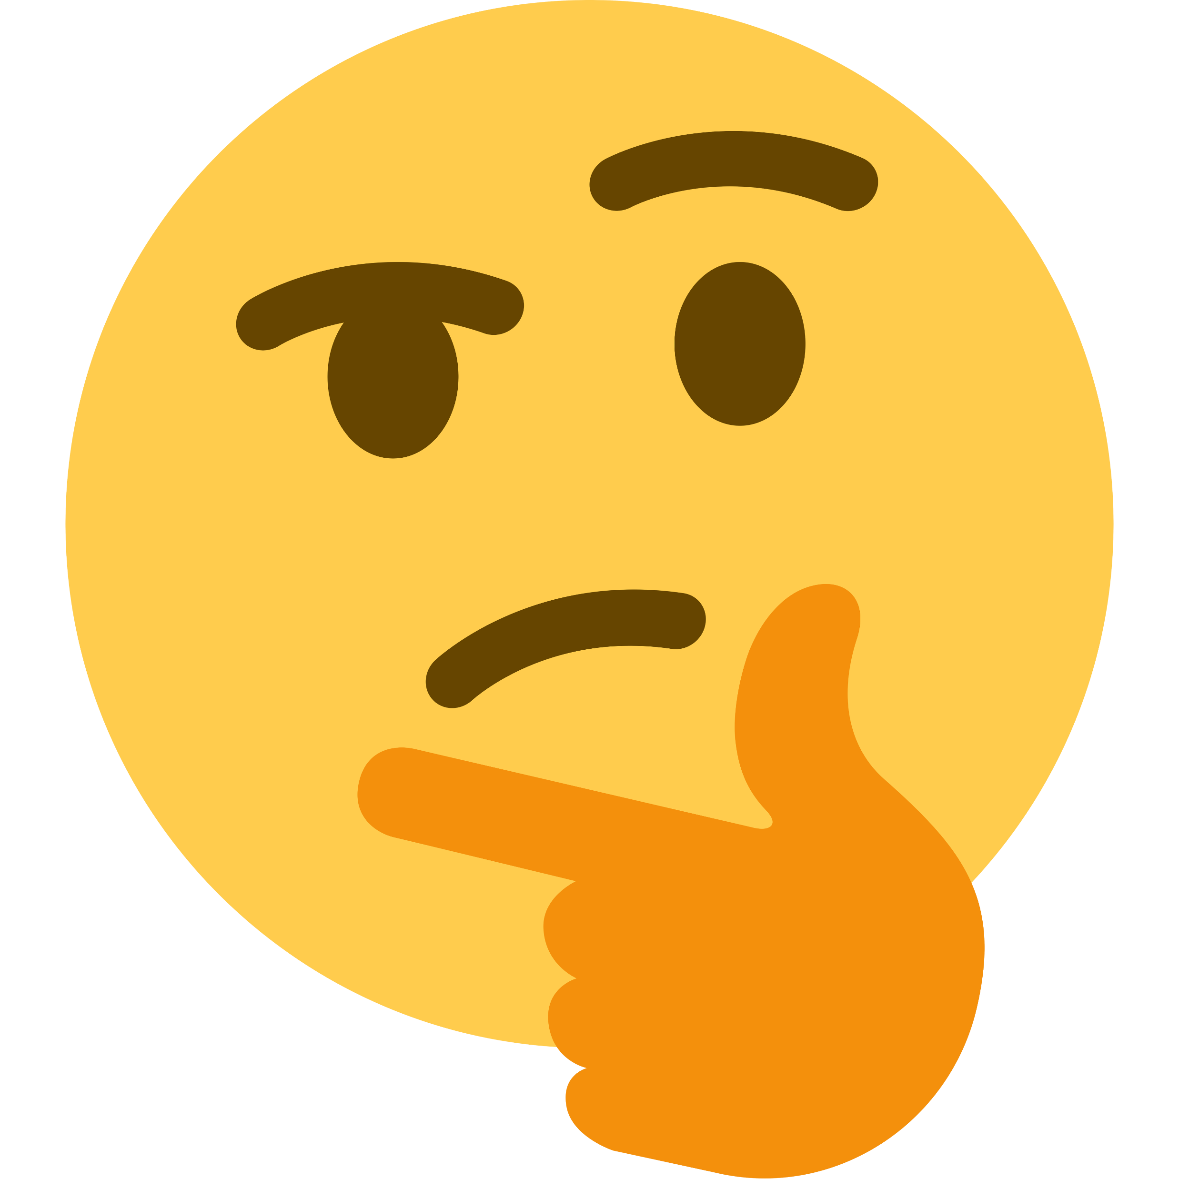
Intellectual Merits
The primary innovation that this project has to offer is the use of human-solvable algorithms
Most Sudoku solvers rely only on brute-force algorithms such as backtracking
Our implementation uses a combination of different human-solvable algorithms with backtracking as a fallback
This Photo by Unknown Author is licensed under CC BY-NC

Slide 4
Broader Impacts
From a user standpoint, this project will help users with solving boards that may be challenging for them
From a developer standpoint, this project may provide insight into the design and implementation of these human-solvable algorithms

Slide 5
Design Specifications: D0 Description
The user inputs the values of cells and the final output is a solved Sudoku board.

Slide 6
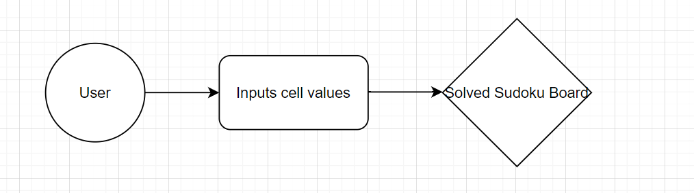
Design Specifications: D0 Diagram

Slide 7
Design Specifications: D1 Description
The user inputs the values of cells into the front-end layer of the program.
The front-end layer of the program passes data to the back-end layer of the program. The back-end layer then passes data back to the front-end layer.
The front-end layer then outputs the solved Sudoku board. The final output is a solved Sudoku board.

Slide 8
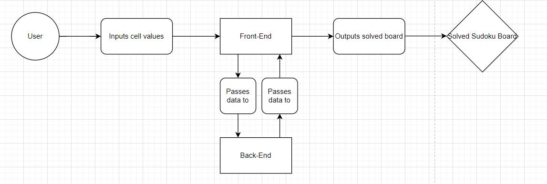
Design Specifications: D1 Diagram

Slide 9
Design Specifications: D2 Description
The user inputs the values of cells into the front-end layer of the program.
The front-end layer of the program consists of the Display class object.
The Display class fills in the value of the Square class object.
The Square class object fills in the Board class object and the Board class object fills in the grid/Display class object.
Finally, the Display class object outputs the solved board.
The final output is the solved Sudoku board.

Slide 10
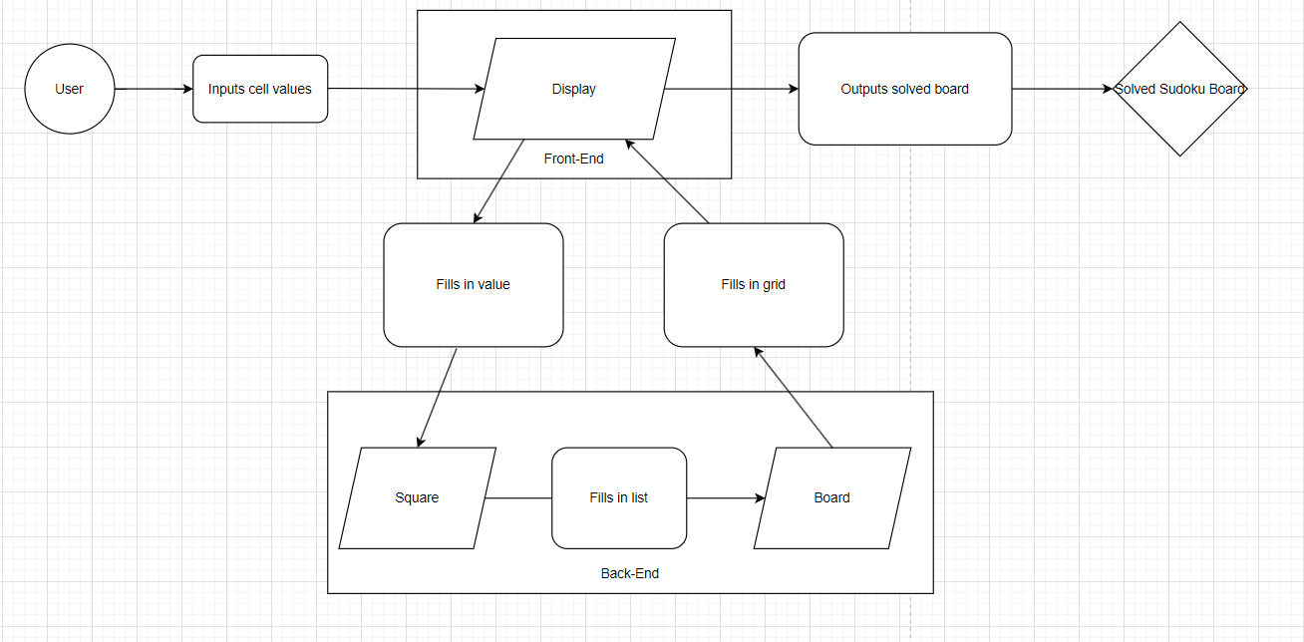
Design Specifications: D2 Diagram

Slide 11




Technologies
Python
Programmed mainly in Python
TkInter
Program used tools from TkInter
Default GUI for Python
Visual Studio Code
Program developed in VS Code
GitHub
Program managed through GitHub

Slide 12
Milestones
Research (Oct. 2023 – Nov. 2023)
Design and Development (Nov. 2023 – Mar. 2024)
Integration (Mar. 2024 – Apr. 2024)
Testing (Dec. 2023 – Mar. 2024)
Production (Apr. 2024)

Slide 13
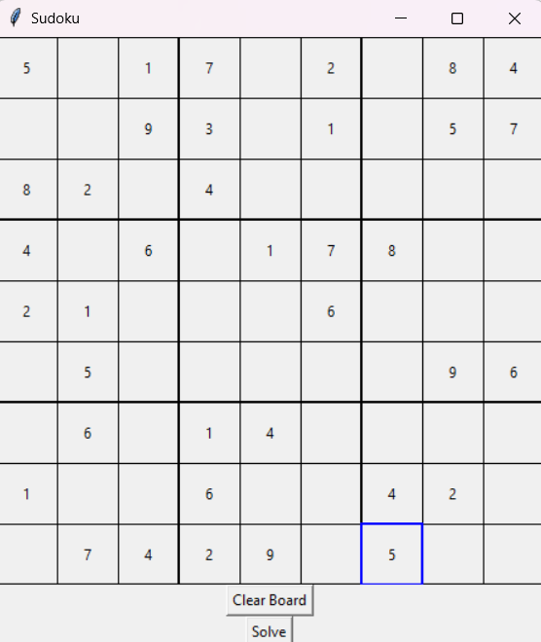
Results
Fully functional Sudoku Solver program
GUI with traversal, input, deleting, replacing, solve board, and clear board functionality
Human-solvable algorithms that can solve boards of varying difficulty
Testing
Multiple unit tests and test cases for program
Next steps:
Refine implementation of human-solvable algorithms
Add more quality of life features to UI

Slide 14
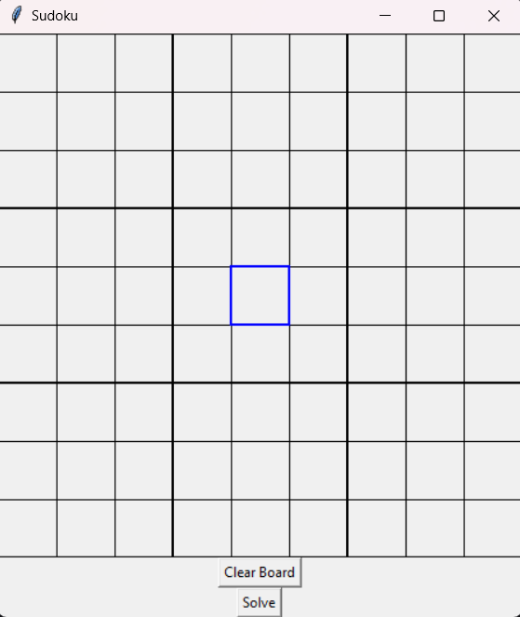
Results: Board Solving

Slide 15
Challenges
Distance
From mid-December to mid-January, we would be working remotely
Discord as communication platform
Integration
Synthesizing both implementations for final product
Worked together to integrate our implementations

Slide 16
References/Links to Images
https://en.m.wikipedia.org/wiki/File:Visual_Studio_Code_1.35_icon.svg
https://en.wikipedia.org/wiki/GitHub
https://en.wikipedia.org/wiki/Python_%28programming_language%29
https://stackoverflow.com/tags/tkinter/info

