Slide 1
SoftMicro Coffee
Devlin Hamill, William Sykes, Josh Melchor

Slide 2
Introduction
For out implementation we created a coffee shop-oriented system that allows for the various needs of a coffee shop such as:
Customers placing orders.
Employees processing order, checking on prices and even inventory.
Managers can manipulate stock and prices to the coffee shop.

Slide 3


Libraries and programming languages used
We decided on using the eclipse IDE and java as our primary programing language for the project.
For our libraries we had to import various AWT(Abstract Window Toolkit), Java Swing and SQL libraries to help with the development of this project.

Slide 4
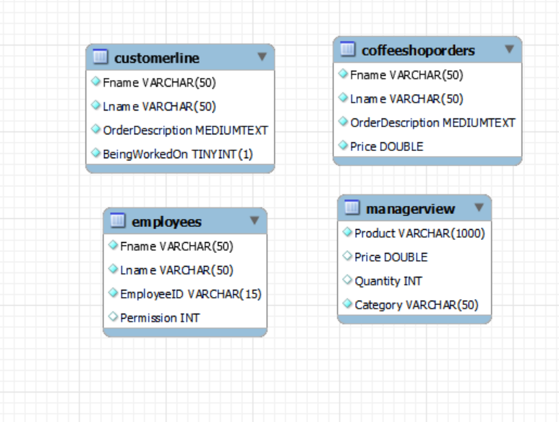
Database
We decided on using a multi single table database that keeps useful coffee shop information such as login info, order information and pricing/ inventory information.

Slide 5
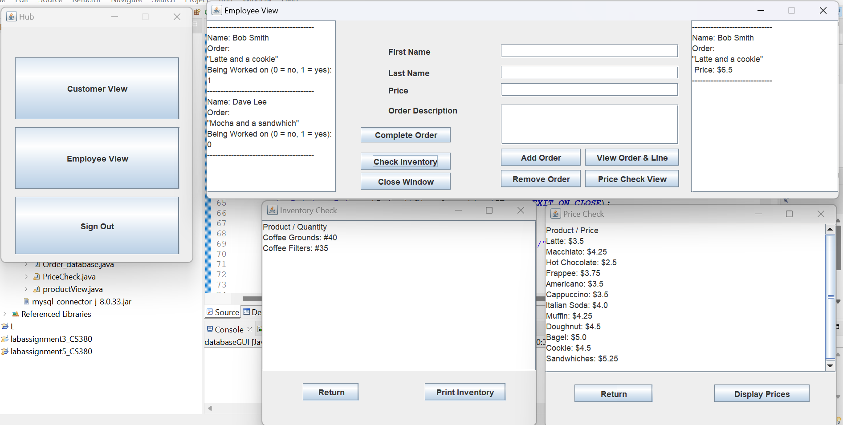
Devlin Hamill – Employee View/ Connection
Worked on the SQL connection, Login and landing page
I also worked on the employee view GUI along with various price checking and inventory GUI’s.

Slide 6
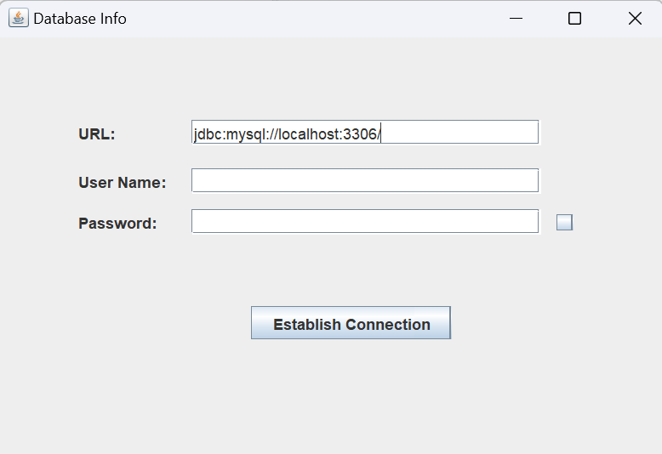
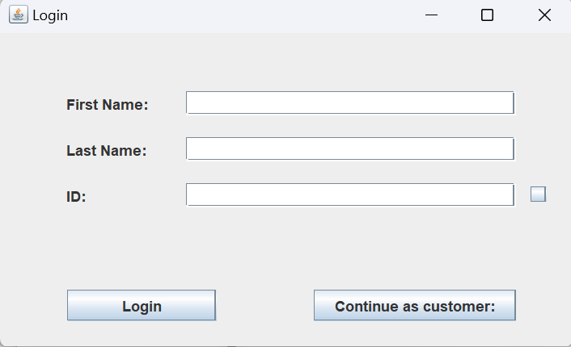
Devlin Hamill- more screenshots
Database connection GUI
Login GUI

Slide 7
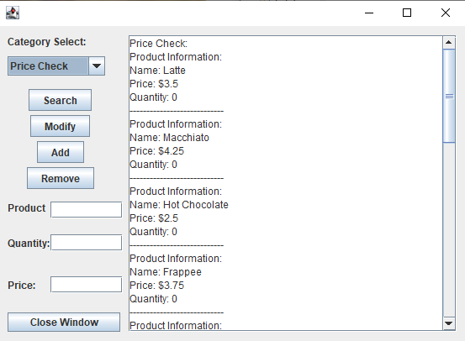
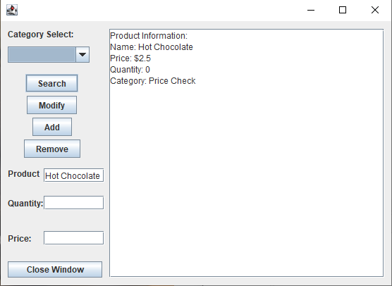
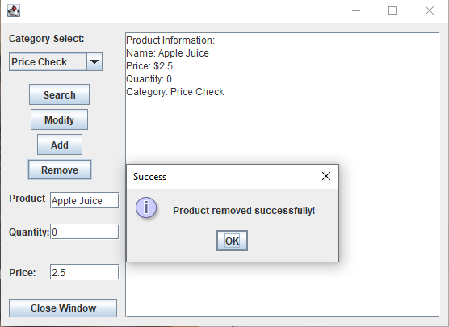
William Sykes
Employee Product View / Inventory and Pricing

Slide 8
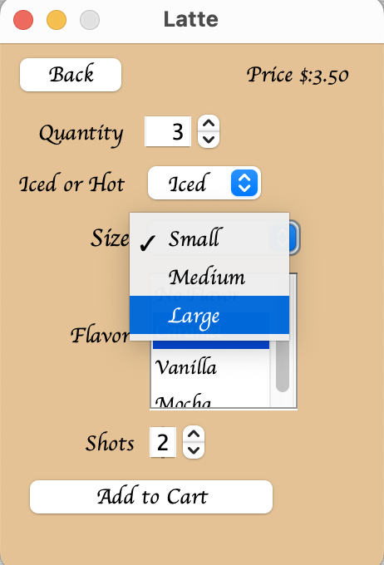
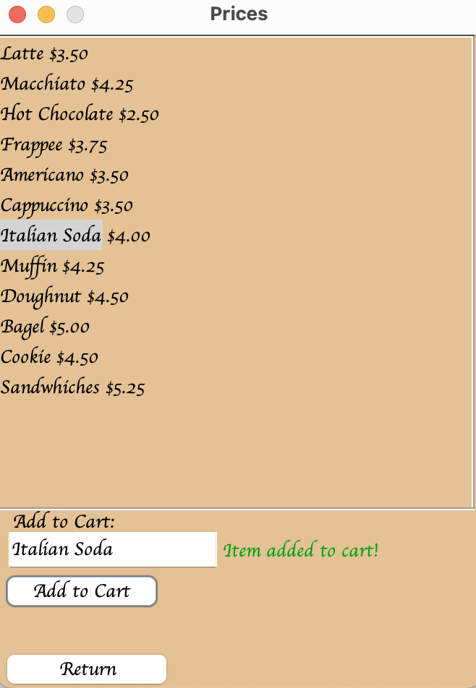
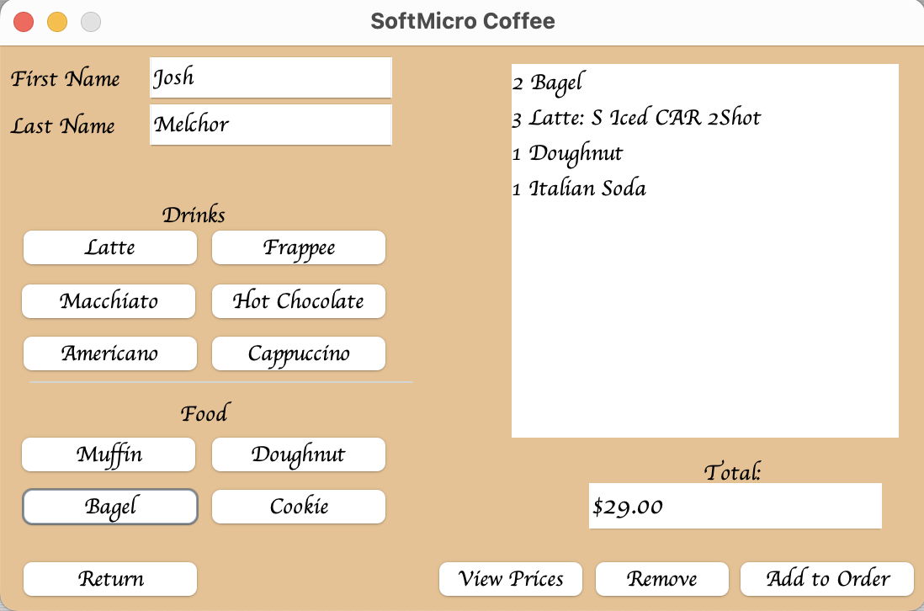
Josh
Customer View
Front end GUI
Backend functionality
Customize
Price checking/Ordering (Devlin)
Ordering

Slide 9
Live Demo
Now we will continue to our live demo.

Slide 10
Questions
Any questions or concerns?

