Slide 1
Data Driven Documents D3 – Data Visualisation
William Blommaert

Slide 2

What is D3.js
Data visualisation library
Transforms raw data into usable information
A tool to handle big data
And it’s quite powerful and flexible at it as well…

Slide 3
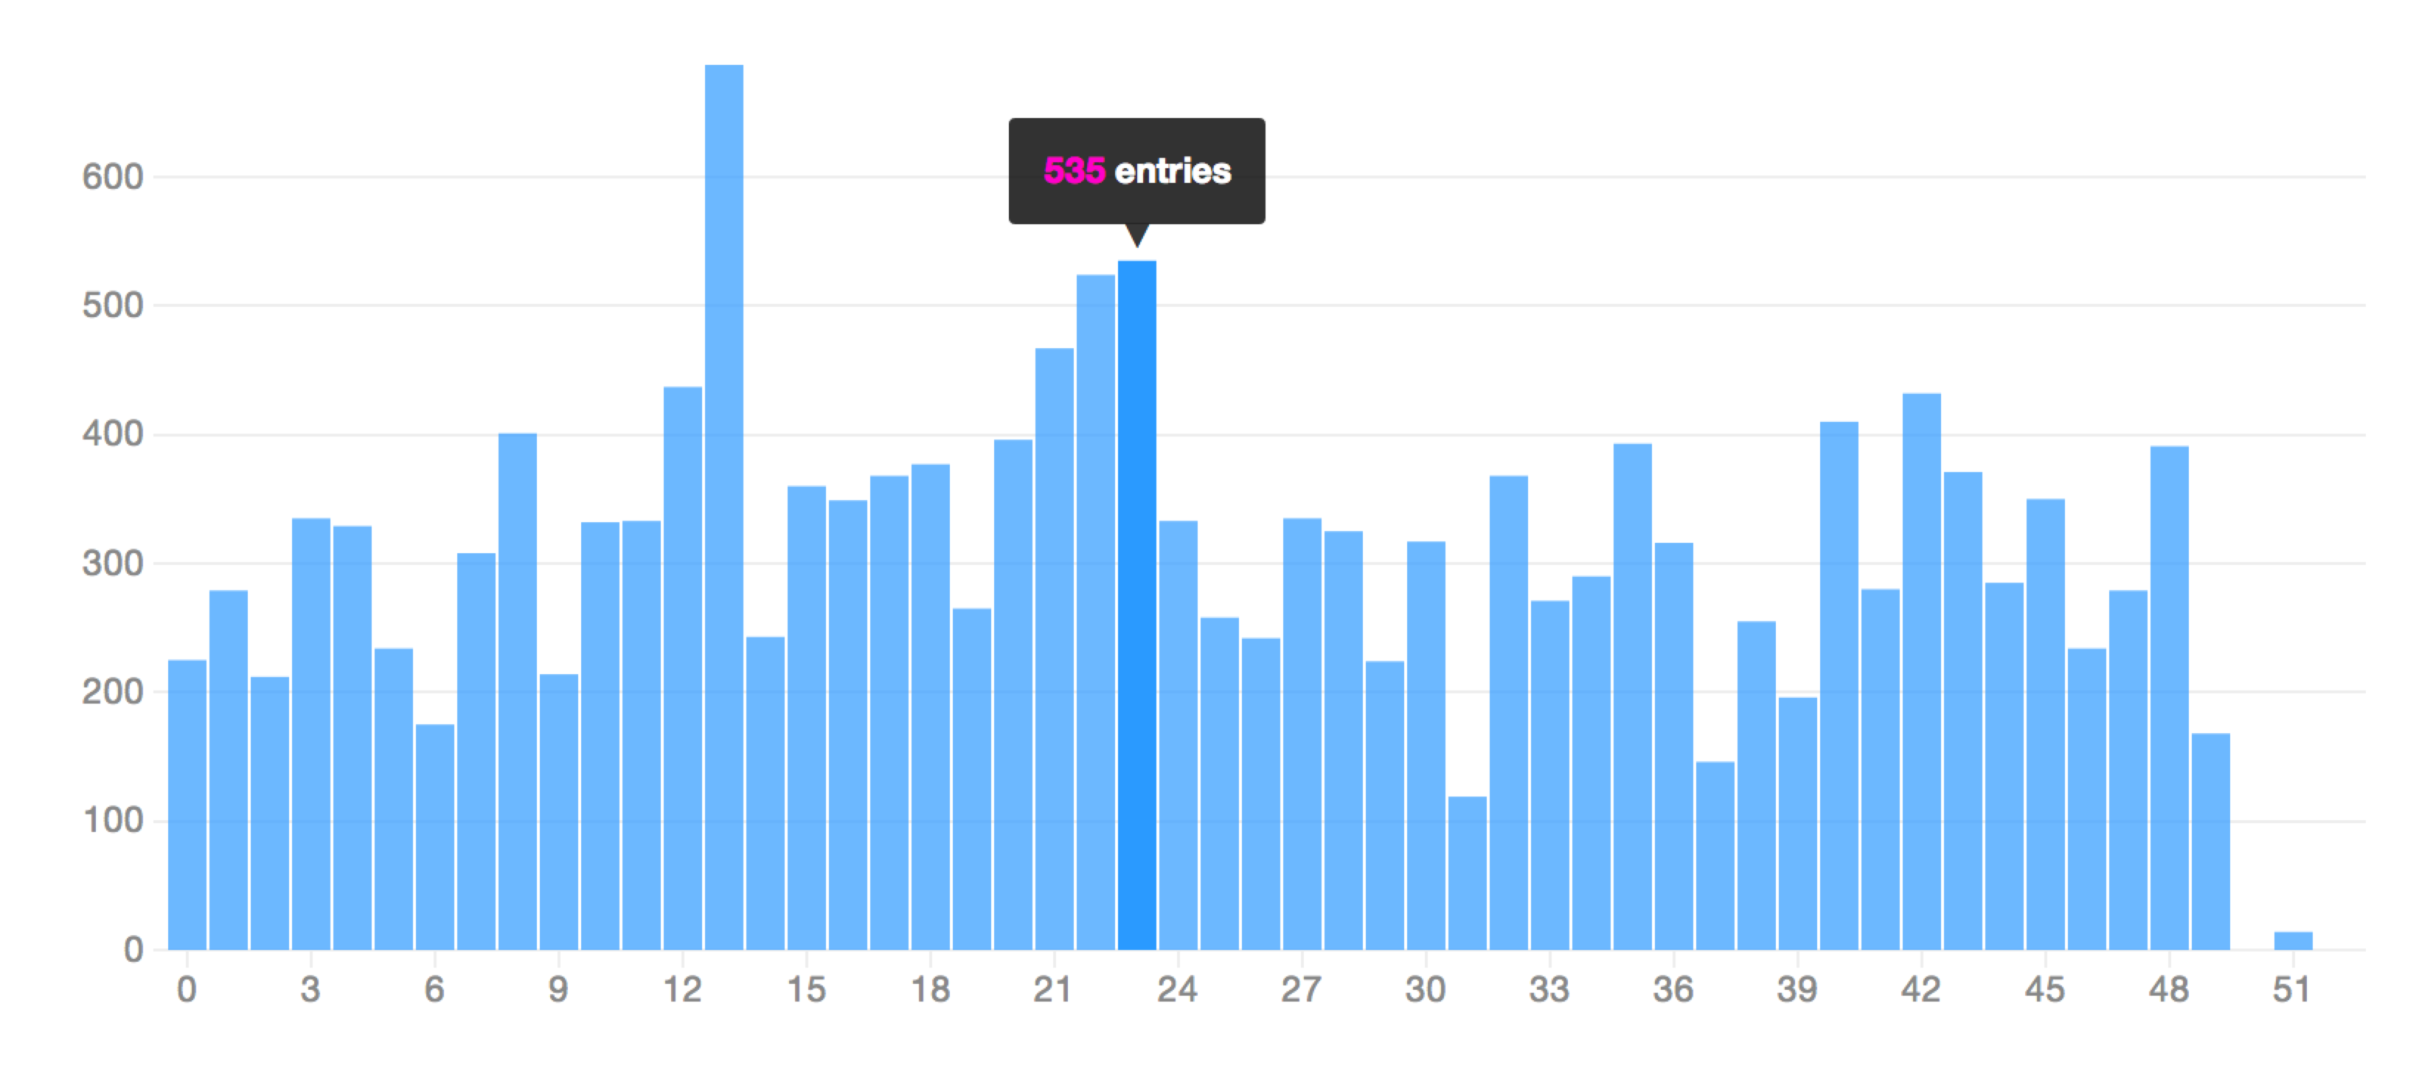
From a ‘simple’ bar chart…

Slide 4
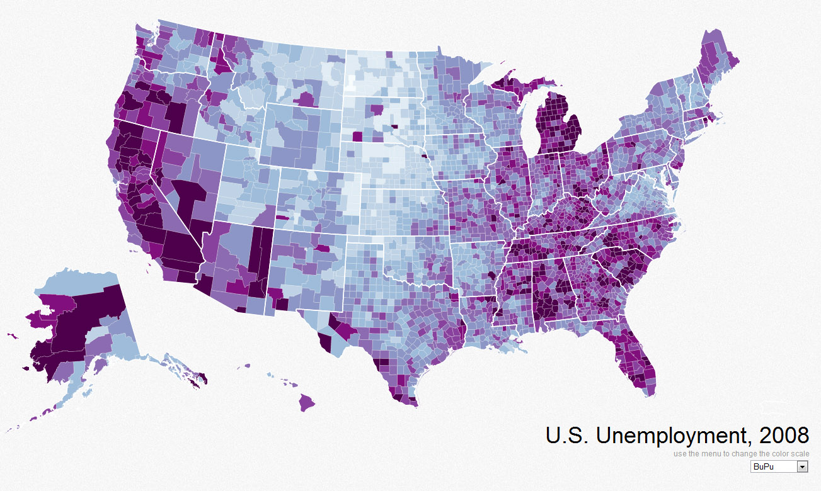
To an extensive map

Slide 5
My research so far
Competing/similar libraries (e.g. Processing.js, Sigma.js) -> There are a lot of them out there…
So why choose this library?
History (Protovis.js)
Looked at some examples/tutorials
Syntax

Slide 6
What I have learned so far
D3.js has a large and, probably most important, active community
It has great documentation available
Loads of tutorials and examples
Syntax is similar to jQuery’s
Works seamlessly in ‘all’ modern browsers
D3 is the tool that connects data to graphics

Slide 7
What I can do to learn even more
Visualise my own data using D3
Try out various ways of showing information
Make a side-by-side of the same result using a different library
Find out what the catch is (there’s always one, e.g. performance)

