Slide 1
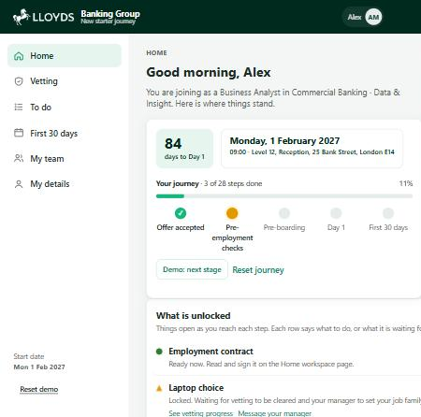
ALL ABOARD HACKATHON | SHOWCASE
From offer to Day 30, in one place
New Starter Journey guides a new hire from an unconditional offer through vetting, Day 1 and their first 30 days, with a portal for their manager and one for their buddy.
3
30
0
linked apps: new starter, manager and buddy
days guided after Day 1, not just up to it
new passwords: single sign-on from the welcome email
Notes:
Joining a bank takes weeks of vetting, and the first 30 days decide whether someone settles in. New Starter Journey guides the new hire the whole way, and gives their manager and buddy a view of their own.

Slide 2
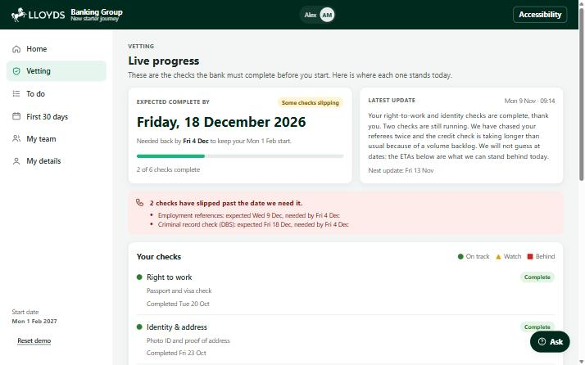
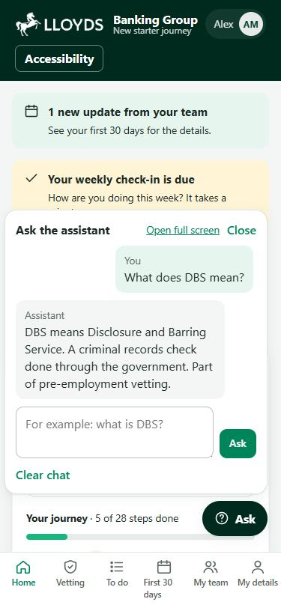
The new starter always knows what is next
1
Honest progress on vetting
Each check shows a real expected date. When one slips past the date we need it, a call back from the manager is requested automatically.
2
Unlocks that explain themselves
Every locked step says what it is waiting for and where to sort it out, so nothing feels withheld.
3
Answers at 9pm on a Sunday
A built-in assistant explains acronyms and how to get things, and points to a person when it cannot help.
Vetting on desktop, and the assistant on a phone
Notes:
Three things the new starter gets: honest dates for each vetting check, unlocks that say what they are waiting for, and an assistant for the out-of-hours questions.

Slide 3
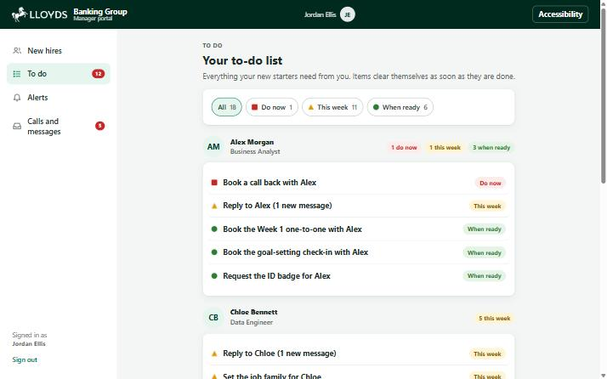
Managers see what is left, and what has slipped
To-do by colleague
Chain reactions
Each task clears itself as soon as it is done.
Vetting cleared prompts onboarding. Goals saved sends the welcome pack.
When plans change
Buddy portal
Move a start date, set cover, or cancel and reverse the set-up.
Chat, quick prompts, and a profile the new starter can read.
The manager to-do list: split by colleague, filtered by urgency
Notes:
The manager portal turns every outstanding item into a to-do, grouped by colleague. One person finishing a step triggers the next step for someone else. The buddy has a portal too.

Slide 4
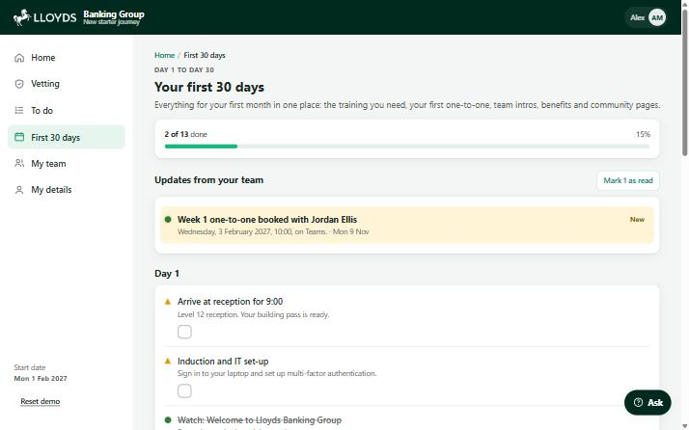
Day 30: connected and confident
1
2
3
4
5
6
Offer
Unlock and choose
Meet your people
Manager ready
Day 1 to Week 1
Day 30
What works today
A working prototype across three linked apps, using sample data: vetting, choices, onboarding, weekly check-ins and a Day 30 review that raises a support plan when someone is struggling.
What comes next
Connect single sign-on, Workday and the vetting feed. Add real training videos, and put policy content behind the assistant.
Notes:
The journey runs through six stages and does not stop at Day 1. Weekly check-ins and a Day 30 review tell us whether it worked. Today this is a prototype on sample data; the next step is connecting the real systems.

