Slide 1
William Stallings
Computer Organization and Architecture
Chapter 14
Control Unit Operation

Slide 2
Micro-Operations
A computer executes a program
Fetch/execute cycle
Each cycle has a number of steps
  see pipelining
Called micro-operations
Each step does very little
Atomic operation of CPU

Slide 3
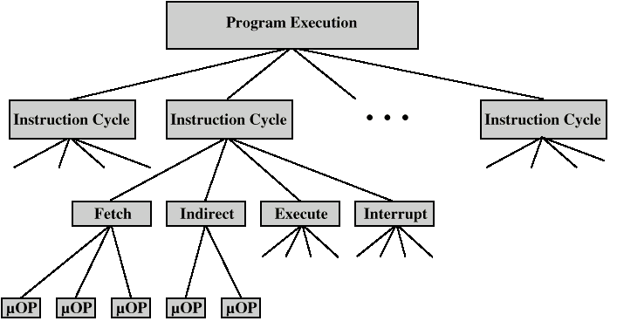
Constituent Elements of Program Execution

Slide 4
Fetch - 4 Registers
Memory Address Register (MAR)
  Connected to address bus
  Specifies address for read or write op
Memory Buffer Register (MBR)
  Connected to data bus
  Holds data to write or last data read
Program Counter (PC)
  Holds address of next instruction to be fetched
Instruction Register (IR)
  Holds last instruction fetched

Slide 5
Fetch Sequence
Address of next instruction is in PC
Address (MAR) is placed on address bus
Control unit issues READ command
Result (data from memory) appears on data bus
Data from data bus copied into MBR
PC incremented by 1 (in parallel with data fetch from memory)
Data (instruction) moved from MBR to IR
MBR is now free for further data fetches

Slide 6
Fetch Sequence (symbolic)
t1: MAR <- (PC)
t2: MBR <- (memory)
PC <- (PC) +1
t3: IR <- (MBR)
(tx = time unit/clock cycle)
or
t1: MAR <- (PC)
t2: MBR <- (memory)
t3: PC <- (PC) +1
IR <- (MBR)

Slide 7
Rules for Clock Cycle Grouping
Proper sequence must be followed
  MAR <- (PC) must precede MBR <- (memory)
Conflicts must be avoided
  Must not read & write same register at same time
  MBR <- (memory) & IR <- (MBR) must not be in same cycle
Also: PC <- (PC) +1 involves addition
  Use ALU
  May need additional micro-operations

Slide 8
Indirect Cycle
MAR <- (IR_{address}) - address field of IR
MBR <- (memory)
IR_{address} <- (MBR_{address})
MBR contains an address
IR is now in same state as if direct addressing had been used
(What does this say about IR size?)

Slide 9
Interrupt Cycle
t1: MBR <-(PC)
t2: MAR <- save-address
PC <- routine-address
t3: memory <- (MBR)
This is a minimum
  May be additional micro-ops to get addresses
  N.B. saving context is done by interrupt handler routine, not micro-ops

Slide 10
Execute Cycle (ADD)
Different for each instruction
e.g. ADD R1,X - add the contents of location X to Register 1 , result in R1
t1: MAR <- (IR_{address})
t2: MBR <- (memory)
t3: R1 <- R1 + (MBR)
Note no overlap of micro-operations

Slide 11
Execute Cycle (ISZ)
ISZ X - increment and skip if zero
  t1: MAR <- (IR_{address})
  t2: MBR <- (memory)
  t3: MBR <- (MBR) + 1
  t4: memory <- (MBR)
  if (MBR) == 0 then PC <- (PC) + 1
Notes:
  if is a single micro-operation
  Micro-operations done during t4

Slide 12
Execute Cycle (BSA)
BSA X - Branch and save address
  Address of instruction following BSA is saved in X
  Execution continues from X+1
  t1: MAR <- (IR_{address})
  MBR <- (PC)
  t2: PC <- (IR_{address})
  memory <- (MBR)
  t3: PC <- (PC) + 1

Slide 13
Functional Requirements
Define basic elements of processor
Describe micro-operations processor performs
Determine functions control unit must perform

Slide 14
Basic Elements of Processor
ALU
Registers
Internal data pahs
External data paths
Control Unit

Slide 15
Types of Micro-operation
Transfer data between registers
Transfer data from register to external
Transfer data from external to register
Perform arithmetic or logical ops

Slide 16
Functions of Control Unit
Sequencing
  Causing the CPU to step through a series of micro-operations
Execution
  Causing the performance of each micro-op
This is done using Control Signals

Slide 17
Control Signals (1)
Clock
  One micro-instruction (or set of parallel micro-instructions) per clock cycle
Instruction register
  Op-code for current instruction
  Determines which micro-instructions are performed

Slide 18
Control Signals (2)
Flags
  State of CPU
  Results of previous operations
From control bus
  Interrupts
  Acknowledgements

Slide 19
Control Signals - output
Within CPU
  Cause data movement
  Activate specific functions
Via control bus
  To memory
  To I/O modules

Slide 20
Example Control Signal Sequence - Fetch
MAR <- (PC)
  Control unit activates signal to open gates between PC and MAR
MBR <- (memory)
  Open gates between MAR and address bus
  Memory read control signal
  Open gates between data bus and MBR

Slide 21
Internal Organization
Usually a single internal bus
Gates control movement of data onto and off the bus
Control signals control data transfer to and from external systems bus
Temporary registers needed for proper operation of ALU

Slide 22
Hardwired Implementation (1)
Control unit inputs
Flags and control bus
  Each bit means something
Instruction register
  Op-code causes different control signals for each different instruction
  Unique logic for each op-code
  Decoder takes encoded input and produces single output
  n binary inputs and 2^{n} outputs

Slide 23
Hardwired Implementation (2)
Clock
  Repetitive sequence of pulses
  Useful for measuring duration of micro-ops
  Must be long enough to allow signal propagation
  Different control signals at different times within instruction cycle
  Need a counter with different control signals for t1, t2 etc.

Slide 24
Problems With Hard Wired Designs
Complex sequencing & micro-operation logic
Difficult to design and test
Inflexible design
Difficult to add new instructions

Slide 25
Required Reading
Stallings chapter 14

