Slide 1
William Stallings
Computer Organization and Architecture
Chapter 15
Micro-programmed Control

Slide 2
Micro-programmed Control
Use sequences of instructions (see earlier notes) to control complex operations
Called micro-programming or firmware

Slide 3
Implementation (1)
All the control unit does is generate a set of control signals
Each control signal is on or off
Represent each control signal by a bit
Have a control word for each micro-operation
Have a sequence of control words for each machine code instruction
Add an address to specify the next micro-instruction, depending on conditions

Slide 4
Implementation (2)
Today’s large microprocessor
  Many instructions and associated register-level hardware
  Many control points to be manipulated
This results in control memory that
  Contains a large number of words
    co-responding to the number of instructions to be executed
  Has a wide word width
    Due to the large number of control points to be manipulated

Slide 5
Micro-program Word Length
Based on 3 factors
  Maximum number of simultaneous micro-operations supported
  The way control information is represented or encoded
  The way in which the next micro-instruction address is specified

Slide 6
Micro-instruction Types
Each micro-instruction specifies single (or few) micro-operations to be performed
  (vertical micro-programming)
Each micro-instruction specifies many different micro-operations to be performed in parallel
  (horizontal micro-programming)

Slide 7
Vertical Micro-programming
Width is narrow
n control signals encoded into log₂ n bits
Limited ability to express parallelism
Considerable encoding of control information requires external memory word decoder to identify the exact control line being manipulated

Slide 8
Vertical Micro-programming diag
Micro-instruction Address
Function Codes
Jump
Condition

Slide 9
Horizontal Micro-programming
Wide memory word
High degree of parallel operations possible
Little encoding of control information

Slide 10
Horizontal Micro-programmed diag
Internal CPU Control Signals
Micro-instruction Address
System Bus
Control Signals
Jump Condition

Slide 11
Compromise
Divide control signals into disjoint groups
Implement each group as separate field in memory word
Supports reasonable levels of parallelism without too much complexity

Slide 12
Control Memory
.
Jump to Indirect or Execute
Fetch cycle routine
.
Jump to Execute
Indirect Cycle routine
.
Jump to Fetch
Interrupt cycle routine
Jump to Op code routine
Execute cycle begin
.
Jump to Fetch or Interrupt
AND routine
.
Jump to Fetch or Interrupt
ADD routine

Slide 13
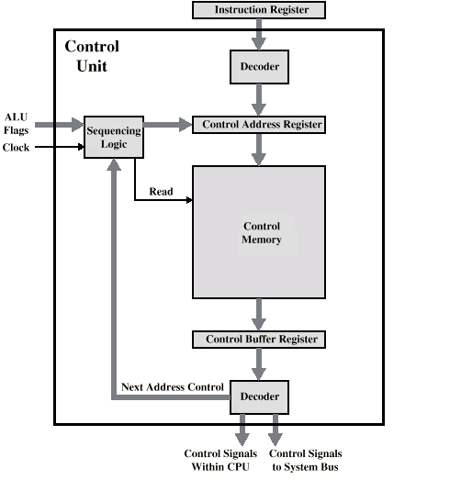
Control Unit

Slide 14
Control Unit Function
Sequence login unit issues read command
Word specified in control address register is read into control buffer register
Control buffer register contents generates control signals and next address information
Sequence login loads new address into control buffer register based on next address information from control buffer register and ALU flags

Slide 15
Advantages and Disadvantages
Simplifies design of control unit
  Cheaper
  Less error-prone
Slower

Slide 16
Tasks Done By Microprogrammed Control Unit
Microinstruction sequencing
Microinstruction execution
Must consider both together

Slide 17
Design Considerations
Size of microinstructions
Address generation time
  Determined by instruction register
    Once per cycle, after instruction is fetched
  Next sequential address
    Common in most designed
  Branches
    Both conditional and unconditional

Slide 18
Sequencing Techniques
Based on current microinstruction, condition flags, contents of IR, control memory address must be generated
Based on format of address information
  Two address fields
  Single address field
  Variable format

Slide 19
Address Generation
Explicit Implicit
Two-field Mapping
Unconditional Branch Addition
Conditional branch Residual control

Slide 20
Execution
The cycle is the basic event
Each cycle is made up of two events
  Fetch
    Determined by generation of microinstruction address
  Execute

Slide 21
Execute
Effect is to generate control signals
Some control points internal to processor
Rest go to external control bus or other interface

Slide 22
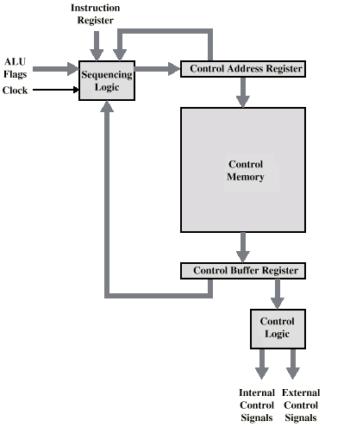
Control Unit Organization

Slide 23
Required Reading
Stallings chapter 15

