Slide 1
William Stallings
Computer Organization and Architecture
Chapter 6
Input/Output

Slide 2
Input/Output Problems
Wide variety of peripherals
  Delivering different amounts of data
  At different speeds
  In different formats
All slower than CPU and RAM
Need I/O modules

Slide 3
Input/Output Module
Interface to CPU and Memory
Interface to one or more peripherals
GENERIC MODEL OF I/O DIAGRAM 6.1

Slide 4
External Devices
Human readable
  Screen, printer, keyboard
Machine readable
  Monitoring and control
Communication
  Modem
  Network Interface Card (NIC)

Slide 5
I/O Module Function
Control & Timing
CPU Communication
Device Communication
Data Buffering
Error Detection

Slide 6
I/O Steps
CPU checks I/O module device status
I/O module returns status
If ready, CPU requests data transfer
I/O module gets data from device
I/O module transfers data to CPU
Variations for output, DMA, etc.

Slide 7
I/O Module Diagram
Systems Bus Interface
External Device Interface
External
Device
Interface
Logic
Data
Data
Lines
Data Register
Status
Status/Control Register
Control
Address
Lines
Input
Output
Logic
External
Device
Interface
Logic
Data
Data
Lines
Status
Control

Slide 8
I/O Module Decisions
Hide or reveal device properties to CPU
Support multiple or single device
Control device functions or leave for CPU
Also O/S decisions
  e.g. Unix treats everything it can as a file

Slide 9
Input Output Techniques
Programmed
Interrupt driven
Direct Memory Access (DMA)

Slide 10
Programmed I/O
CPU has direct control over I/O
  Sensing status
  Read/write commands
  Transferring data
CPU waits for I/O module to complete operation
Wastes CPU time

Slide 11
Programmed I/O - detail
CPU requests I/O operation
I/O module performs operation
I/O module sets status bits
CPU checks status bits periodically
I/O module does not inform CPU directly
I/O module does not interrupt CPU
CPU may wait or come back later

Slide 12
I/O Commands
CPU issues address
  Identifies module (& device if >1 per module)
CPU issues command
  Control - telling module what to do
    e.g. spin up disk
  Test - check status
    e.g. power? Error?
  Read/Write
    Module transfers data via buffer from/to device

Slide 13
Addressing I/O Devices
Under programmed I/O data transfer is very like memory access (CPU viewpoint)
Each device given unique identifier
CPU commands contain identifier (address)

Slide 14
I/O Mapping
Memory mapped I/O
  Devices and memory share an address space
  I/O looks just like memory read/write
  No special commands for I/O
    Large selection of memory access commands available
Isolated I/O
  Separate address spaces
  Need I/O or memory select lines
  Special commands for I/O
    Limited set

Slide 15
Interrupt Driven I/O
Overcomes CPU waiting
No repeated CPU checking of device
I/O module interrupts when ready

Slide 16
Interrupt Driven I/O
Basic Operation
CPU issues read command
I/O module gets data from peripheral whilst CPU does other work
I/O module interrupts CPU
CPU requests data
I/O module transfers data

Slide 17
CPU Viewpoint
Issue read command
Do other work
Check for interrupt at end of each instruction cycle
If interrupted:-
  Save context (registers)
  Process interrupt
    Fetch data & store
See Operating Systems notes

Slide 18
Design Issues
How do you identify the module issuing the interrupt?
How do you deal with multiple interrupts?
  i.e. an interrupt handler being interrupted

Slide 19
Identifying Interrupting Module (1)
Different line for each module
  PC
  Limits number of devices
Software poll
  CPU asks each module in turn
  Slow

Slide 20
Identifying Interrupting Module (2)
Daisy Chain or Hardware poll
  Interrupt Acknowledge sent down a chain
  Module responsible places vector on bus
  CPU uses vector to identify handler routine
Bus Master
  Module must claim the bus before it can raise interrupt
  e.g. PCI & SCSI

Slide 21
Multiple Interrupts
Each interrupt line has a priority
Higher priority lines can interrupt lower priority lines
If bus mastering only current master can interrupt

Slide 22
Example - PC Bus
80x86 has one interrupt line
8086 based systems use one 8259A interrupt controller
8259A has 8 interrupt lines

Slide 23
Sequence of Events
8259A accepts interrupts
8259A determines priority
8259A signals 8086 (raises INTR line)
CPU Acknowledges
8259A puts correct vector on data bus
CPU processes interrupt

Slide 24
PC Interrupt Layout
8259A
8086
IRQ0
IRQ1
IRQ2
IRQ3
INTR
IRQ4
IRQ5
IRQ6
IRQ7

Slide 25
ISA Bus Interrupt System
ISA bus chains two 8259As together
Link is via interrupt 2
Gives 15 lines
  16 lines less one for link
IRQ 9 is used to re-route anything trying to use IRQ 2
  Backwards compatibility
Incorporated in chip set

Slide 26
ISA Interrupt Layout
(IRQ 2)
8259A
8259A
80x86
IRQ0 (8)
IRQ0
IRQ1 (9)
IRQ1
IRQ2 (10)
IRQ2
IRQ3 (11)
IRQ3
INTR
IRQ4 (12)
IRQ4
IRQ5 (13)
IRQ5
IRQ6 (14)
IRQ6
IRQ7 (15)
IRQ7

Slide 27
Foreground Reading
http://www.pcguide.com/ref/mbsys/res/irq/func.htm
In fact look at http://www.pcguide.com/

Slide 28
Direct Memory Access
Interrupt driven and programmed I/O require active CPU intervention
  Transfer rate is limited
  CPU is tied up
DMA is the answer

Slide 29
DMA Function
Additional Module (hardware) on bus
DMA controller takes over from CPU for I/O

Slide 30
DMA Operation
CPU tells DMA controller:-
  Read/Write
  Device address
  Starting address of memory block for data
  Amount of data to be transferred
CPU carries on with other work
DMA controller deals with transfer
DMA controller sends interrupt when finished

Slide 31
DMA Transfer
Cycle Stealing
DMA controller takes over bus for a cycle
Transfer of one word of data
Not an interrupt
  CPU does not switch context
CPU suspended just before it accesses bus
  i.e. before an operand or data fetch or a data write
Slows down CPU but not as much as CPU doing transfer

Slide 32
Aside
What effect does caching memory have on DMA?
Hint: how much are the system buses available?

Slide 33
DMA Configurations (1)
DMA
Controller
I/O
Device
I/O
Device
Main
Memory
CPU
Single Bus, Detached DMA controller
Each transfer uses bus twice
  I/O to DMA then DMA to memory
CPU is suspended twice

Slide 34
DMA Configurations (2)
DMA
Controller
DMA
Controller
Main
Memory
CPU
I/O
Device
I/O
Device
I/O
Device
Single Bus, Integrated DMA controller
Controller may support >1 device
Each transfer uses bus once
  DMA to memory
CPU is suspended once

Slide 35
DMA Configurations (3)
CPU
DMA
Controller
Main
Memory
I/O
Device
I/O
Device
I/O
Device
I/O
Device
Separate I/O Bus
Bus supports all DMA enabled devices
Each transfer uses bus once
  DMA to memory
CPU is suspended once

Slide 36
I/O Channels
I/O devices getting more sophisticated
e.g. 3D graphics cards
CPU instructs I/O controller to do transfer
I/O controller does entire transfer
Improves speed
  Takes load off CPU
  Dedicated processor is faster

Slide 37
Interfacing
Connecting devices together
Bit of wire?
Dedicated processor/memory/buses?
E.g. SCSI, FireWire

Slide 38
Small Computer Systems Interface (SCSI)
Parallel interface
8, 16, 32 bit data lines
Daisy chained
Devices are independent
Devices can communicate with each other as well as host

Slide 39
SCSI - 1
Early 1980s
8 bit
5MHz
Data rate 5MBytes.s⁻¹
Seven devices
  Eight including host interface

Slide 40
SCSI - 2
1991
16 and 32 bit
10MHz
Data rate 20 or 40 Mbytes.s⁻¹
(Check out Ultra/Wide SCSI)

Slide 41
SCSI Signaling (1)
Between initiator and target
  Usually host & device
Bus free? (c.f. Ethernet)
Arbitration - take control of bus (c.f. PCI)
Select target
Reselection
  Allows reconnection after suspension
  e.g. if request takes time to execute, bus can be released

Slide 42
SCSI Signaling (2)
Command - target requesting from initiator
Data request
Status request
Message request (both ways)

Slide 43
SCSI Bus Phases
Reset
Command,
Data,
Status,
Message
Bus
free
Arbitration
(Re)Selection

Slide 44
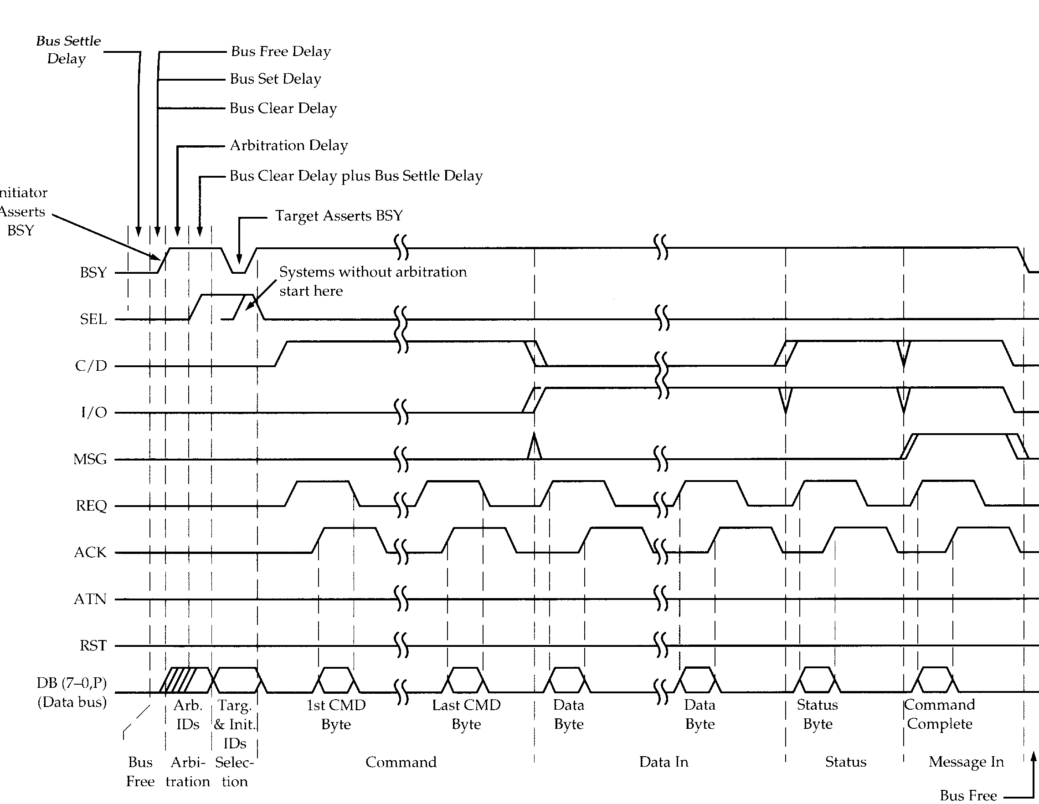
SCSI Timing Diagram

Slide 45
Configuring SCSI
Bus must be terminated at each end
  Usually one end is host adapter
  Plug in terminator or switch(es)
SCSI Id must be set
  Jumpers or switches
  Unique on chain
  0 (zero) for boot device
  Higher number is higher priority in arbitration

Slide 46
IEEE 1394 FireWire
High performance serial bus
Fast
Low cost
Easy to implement
Also being used in digital cameras, VCRs and TV

Slide 47
FireWire Configuration
Daisy chain
Up to 63 devices on single port
  Really 64 of which one is the interface itself
Up to 1022 buses can be connected with bridges
Automatic configuration
No bus terminators
May be tree structure

Slide 48
FireWire v SCSI

Slide 49
FireWire 3 Layer Stack
Physical
  Transmission medium, electrical and signaling characteristics
Link
  Transmission of data in packets
Transaction
  Request-response protocol

Slide 50
FireWire - Physical Layer
Data rates from 25 to 400Mbps
Two forms of arbitration
  Based on tree structure
  Root acts as arbiter
  First come first served
  Natural priority controls simultaneous requests
    i.e. who is nearest to root
  Fair arbitration
  Urgent arbitration

Slide 51
FireWire - Link Layer
Two transmission types
  Asynchronous
    Variable amount of data and several bytes of transaction data transferred as a packet
    To explicit address
    Acknowledgement returned
  Isochronous
    Variable amount of data in sequence of fixed size packets at regular intervals
    Simplified addressing
    No acknowledgement

Slide 52
FireWire Subactions

Slide 53
Foreground Reading
Check out Universal Serial Bus (USB)
Compare with other communication standards e.g. Ethernet

