Slide 1
Chapter 4 Digitiation of analog signal
4.1 Introduction
  Two categories of information sources:
  analog signal, digital signal
  Three steps of A/D conversion:
  sampling, quantization , coding
  Most popular A/D conversion method:
  Pulse Code Modulation (PCM)

Slide 2
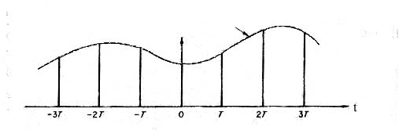
4.2 Sampling of analog signal
4.2.1 Sampling of low-pass analog signal
  Usually sampling at equal time interval T
  Theoretically,
  sampling process ＝ periodical unit impulse × analog signal
  Practically,
  sampling process ＝ periodical narrow pulse × analog signal
  Sampling theorem: If the highest frequency of a continuous analog signal s(t) is less than f_{H} , and if it is sampled by periodic impulses with interval time T ≤ 1/2f_{H} , then s(t) can be completely decided by these samples.
Analog signal
s(t)

Slide 3


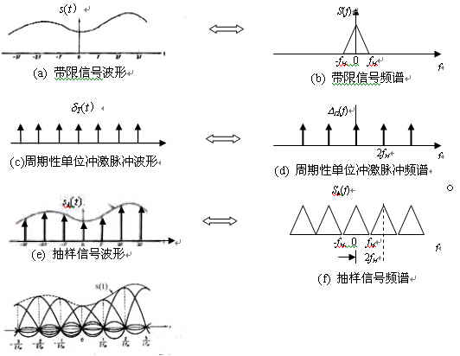
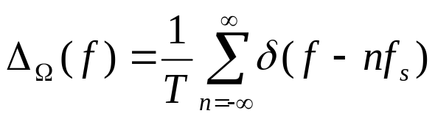
  Proof of sampling theorem
  Let: s(t) － signal with highest frequency less than f_{H}
  δ_{T}(t) － periodical unit impulse with repetition period T and repetition frequency fs = 1/T, then the sampled signal is:
  Let the Fourier transform of s_{k}(t) is S_{k}(f), then
  where,
  S_{k}(f) － spectrum of s_{k}(t)
  S(f) － spectrum of s(t)
  Δ_{Ω}( f ) － spectrum of δ_{T}(t)
  Δ_{Ω}(f ) is the frequency
  spectrum of periodical unit
  impulse, it can be found as

Slide 4
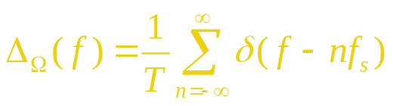

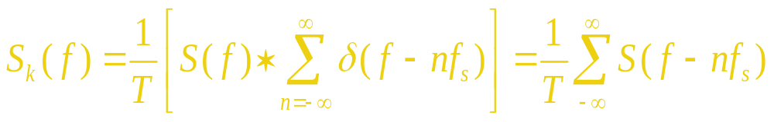

Substituting into
obtain
  The above equation shows that spectrum Sk(f) of the sampled signal is the superposition of infinite spectra S(f) with frequency interval fs, since S(f - nfs) is the result of displacement nfs of the signal frequency spectrum S(f) on the frequency axis.
  The highest frequency of signal s(t) has been assumed less than f_{H}, therefore if frequency interval f_{s} ≥ 2fH, then each displaced spectrum S(f) of the original signal contained in S_{k}(f) is not superposed with each other, as shown in the figure. Thus frequency spectrum S(f) of signal s(t) can be separated from S_{k}(f), and s(t) can be easily obtained from S(f), i.e. the original signal can be restored from the sampled signal.

Slide 5
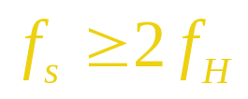
  Here, the condition of restoration of the origial signal is
  2f_{H} is called Nyquist sampling rate. The corresponding smallest sampling time interval is called Nyquist sampling interval.

Slide 6
  Method of restoration of original signal from sampled signal:
    Frequency domain: When f_{s} ≥ 2f_{H} , the original signal can be separated from the sampled signal by an ideal low-pass filer with cut-off frequency f_{H} .
    Time domain: When the ideal low-pass filter is excited by the sampled pulse sequence, the output of the filter is the sum of the impulse responses, as shown in the figure. The sum of these impulse responses composes the original signal.
    The ideal filter is unable to be achieved. The cut-off edge of a practical filter can not be so sharp. Therefore, the practical sampling rate f_{s} must be much larger than 2f_{H}.
    For example, the highest frequency of typical telephone signal is limited to 3,400 Hz, and the sampling frequency used is 8,000 Hz.

Slide 7
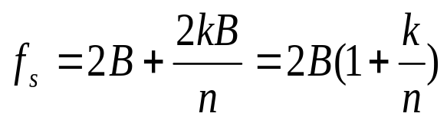
4.2.2 Sampling of band-pass analog signal
  The frequency band of a band-pass signal is limited to between f_{L}and f_{H} , i.e., the cut-off frequency of its frequency spectrum at the lower end is obviously larger than 0.
  The required sampling frequency f_{s} :
  where B － signal bandwidth,
  n － largest integer less than f_{H}/B, 0 < k < 1。
  As can be seen from the figure,
  When f_{L} = 0, f_{s} ＝2B,
  When f_{L} is very large, f_{s}→2B.
  The curve shown in the figure
  expresses the min. required
  sampling frequency f_{s} , but it
  doesn’t mean any sampling frequency larger than that frequency can guarantee mo superposition of spectrum.
f_{s}
0
B
2B
3B
4B
5B
6B
f_{L}

Slide 8
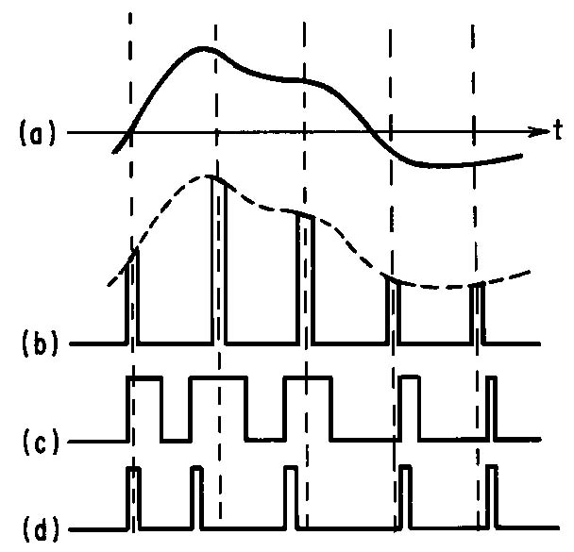
4.2.3 Analog pulse modulation
  PAM
  PDM
  PPM
（a）Baseband signal (b) PAM signal
(c) PDM signal (d) PPM signal
Figure 4.2.6 Analog pulse modulation

Slide 9
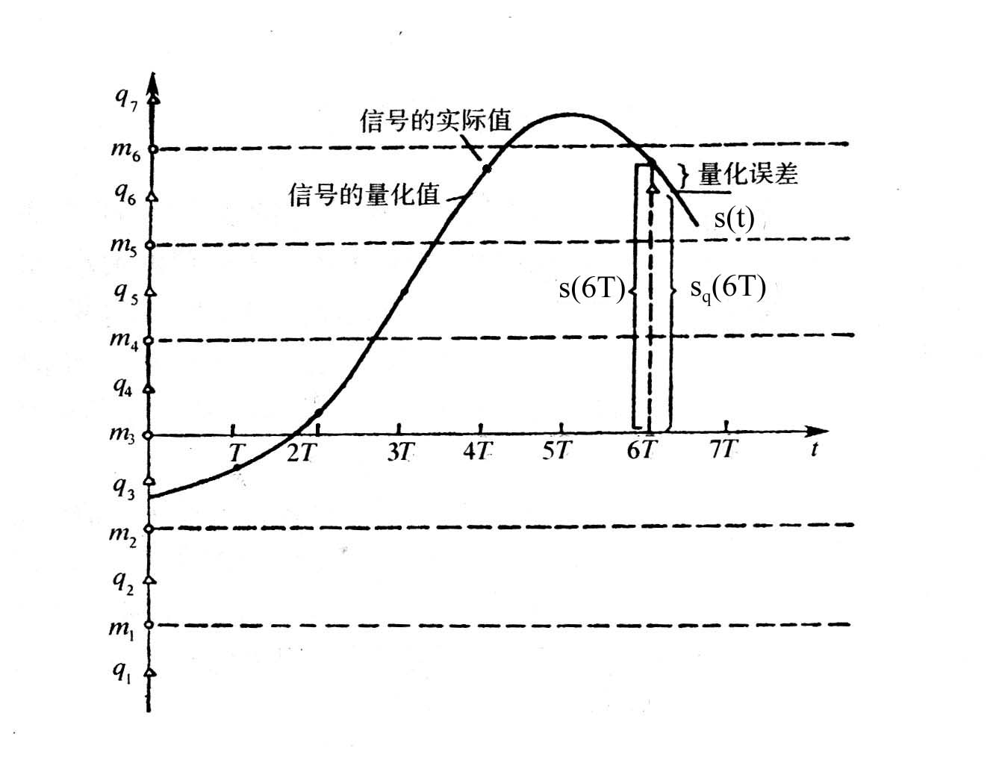
4.3 Quantization of sampled signal
4.3.1 Principles of quantization
  Purpose of quantization:
  To digitize the sampled signal.
  Method of quantization:
  Let s(kT) be the sampled value.
  If N bits of binary symbols are
  used to express it, then only
  M = 2N different sampled values
  can be expressed.
  There are totally M discrete levels. They are called quantization level.
  The method of representing continuous samples by M quantiation levels is called quantization.
  Example: in the figure
  It is uniform quantization in the figure.
图4.3.1 抽样信号的量化

Slide 10

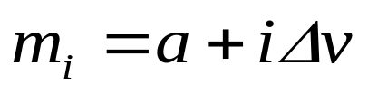
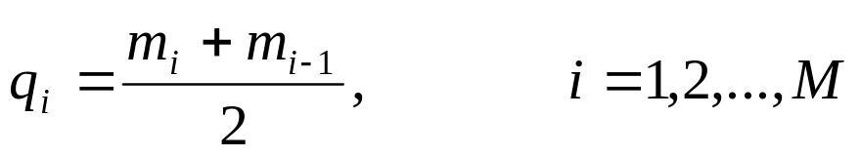
4.3.2 Uniform quantization
  Assume: the magnitude of the analog samples is within a～b,
  and the number of quantization levels ＝ M,
  then the quantization interval is:
  the boundary points are:
  If quantized output level q_{i} is the midpoint of the quantization interval, then
  Quantization noise ＝ difference between quantized output level and sampling value of signal before quantization
  Main characteristics of the quantizer is signal to quantization noise power ratio.
  Find the average signal to quantization noise power ratio:

Slide 11
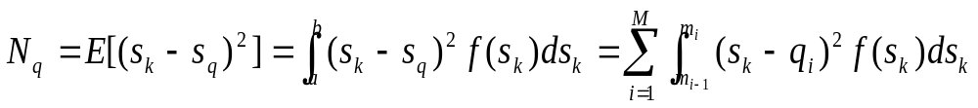

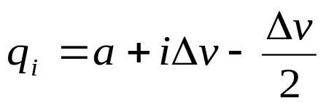
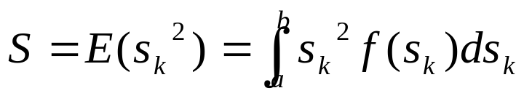
  Find average power of quantization noise N_{q} ：
where, s_{k} is sample of signal, i.e., s(kT)
s_{q} is magnitude of quantized signal, i.e., s_{q}(kT)
f(s_{k}) is probability density of signal sample s_{k}
E expresses operation of statistical mean.
M is number of quantization levels
  Find average power of signal s_{k} :
  Average signal to quantization noise power ratio can be found from the above twe equations.

Slide 12
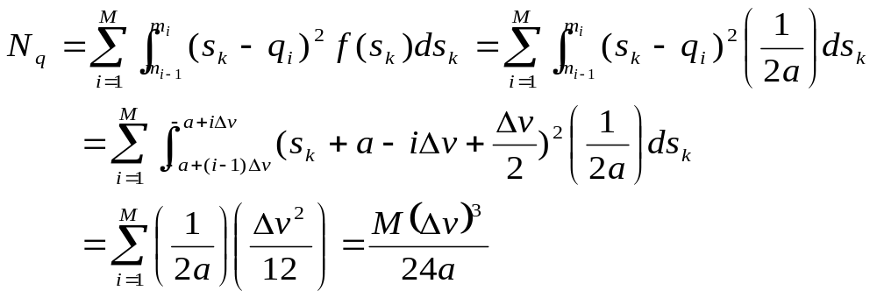

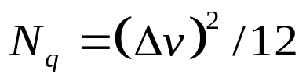
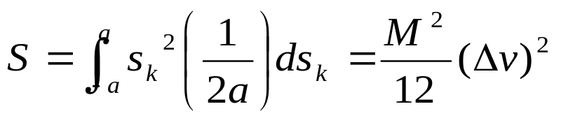
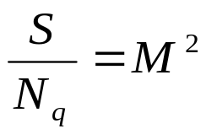
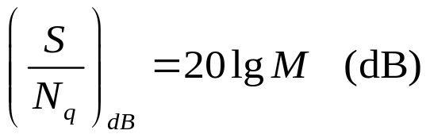
  【Example 4.1】Assume the number of quantization levels for a uniform quantizer is M, and the sample of the input signal has uniform probability density in the interval [-a, a]. Find the average signal to quantization noise ratio for the quantizer.
  Solution: from eq. (4.3-5), we have
  ∵ ∴
  或

Slide 13
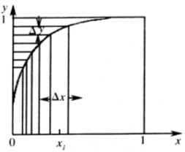
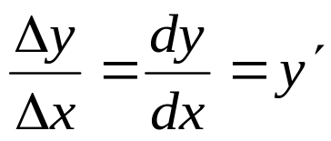
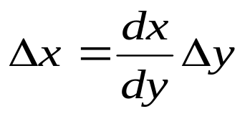
4.3.3 Nonuniform quantization
  Disadvantage of uniform quantization: the quantization noise N_{q} is constant. However, the signal strength may vary with time, e.g., speech signal. When the signal is small, the signal to quantization noise ratio is small. Nonuniform quantization can improve the signal to quantization noise ratio when the signal is small.
  Principles of nonuniform quantization:
  A nonlinear circuit is used to convert
  input voltage x to output voltage y:
  y = f (x)
  When there are many quantization intervals, the curve in the figure in each quantization interval may be regarded approximately as a segment of a straight line. Hence, the slope of the line segment can be written as
  or

Slide 14
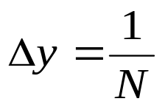
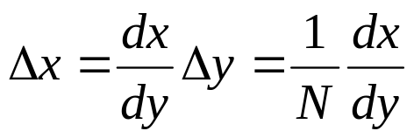
  Assume ranges of the input and the output voltages are limited to between 0 and 1, and the ordinate y is uniformly divided into N quantization intervals, then the interval of each quantization interval would be
  ∴

Slide 15
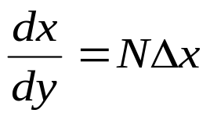



  From , we have
  In order to keep signal to quantization noise ratio constant, require: Δx ∝ x, i.e., require: dx/dy ∝ x or dx/dy = kx, where k = constant. The solution of the above linear differential equation is
  For finding c, substituting the boundary condition (when x = 1, y =1) into the above equation, we obtain k + c =0，i.e., c = -k. Substituting the value of c into the above equation, we obtain
  As can be seen from the above equation, to keep signal to quantization noise ratio constant, theoretically the characteristic of compression is required to be logarithm characteristic.
  For telephone signal, ITU constituted 2 recommendations, i.e., A-law and μ-law, and corresponding approximate algorithms --- 13 broken line method and 15 broken line method.

Slide 16
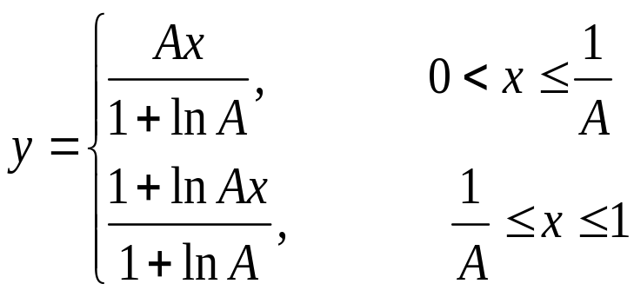
  A-law
  where, x is the normalized input voltage of the compressor
  y is the normalized output voltage of the compressor
  A is a constant deciding the compression extent
  If the constant in A-law is different, then the shape of the compression curve will be different. It will influence the signal to quantization noise ratio when the signal voltage is small. In practice, A is chosen to be equal to 87.6.

Slide 17
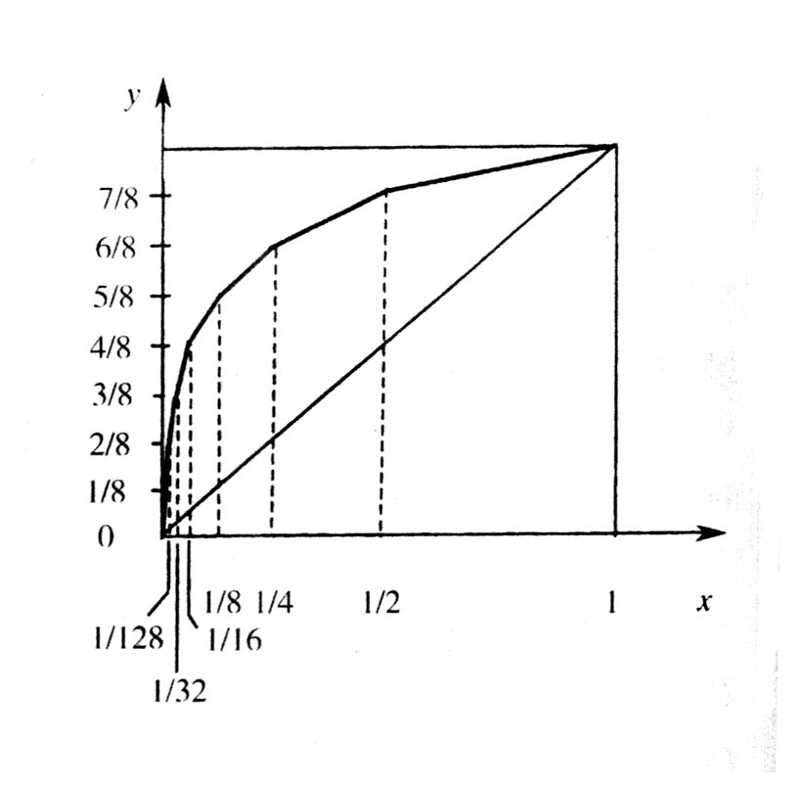
  13 broken line compression characteristic
    A-law is easy to approximately realize by digital circuit.
    The characteristic of 13 broken line is close to that of A-law.
    In the figure, x in interval 0 ~ 1 is nonuniformly divided into 8 segments. Segment between ½ ~ 1 is called the 8th segment; segment between ¼ ~ ½ is called the 7th segment; segment between 1/8~1/4 is called the 6th segment; and so on, until segment between 0~1/128 is called the 1st segment.
    Ordinate y is uniformly divided into 8 segments.
    The corresponding coordinates (x, y) of the 8 segments are connected to form a broken line.
    Except the 1st and the 2nd segments, the slopes of other segments of the broken line are different.
    Segment No. 1 2 3 4 5 6 7 8
    Slope 16 16 8 4 2 1 ½ ¼
    For A.C. signal, the slopes of the
    1st and the 2nd segments of the
    broken line in the 1st quadrant
    and 3rd quadrant are identical,
    so there are 13 segments in total.

Slide 18
Comparison of A-law and 13 broken line method
  i 8 7 6 5 4 3 2 1 0
  y =1-i/8 0 1/8 2/8 3/8 4/8 5/8 6/8 7/8 1
  x of A-law 0 1/128 1/60.6 1/30.6 1/15.4 1/7.79 1/3.93 1/1.98 1
  13 broken 0 1/128 1/64 1/32 1/16 1/8 ¼ ½ 1
  line x=1/2^{i}
  Segment no 1 2 3 4 5 6 7 8
  Slope of seg. 16 16 8 4 2 1 ½ ¼
  As can be seen from the table, 13 broken line method is close to A-law when A = 87.6.

Slide 19
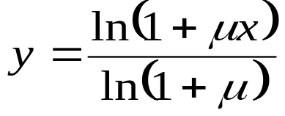
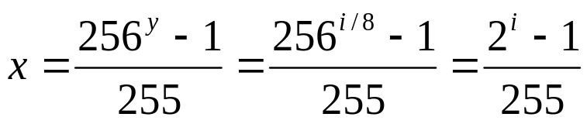
  μ-law and 15 broken line compression characteristics
    In A-law, there are two purposes to select A=87.6:
    1. To make the slope of the curve near the origin equal to 16, and to let 16 segments of broken line reduced to only 13 segments
    2. To let values x on the turning points of line close to 1/2^{i} (i = 0, 1, 2, …, 7)
    If only the second purpose has to be satisfied, then only require to satisfy:
    When x = 1/2^{i} , y = 1 – i/8, --- μ -law can be obtained:
    15 broken line: close to μ-law

Slide 20
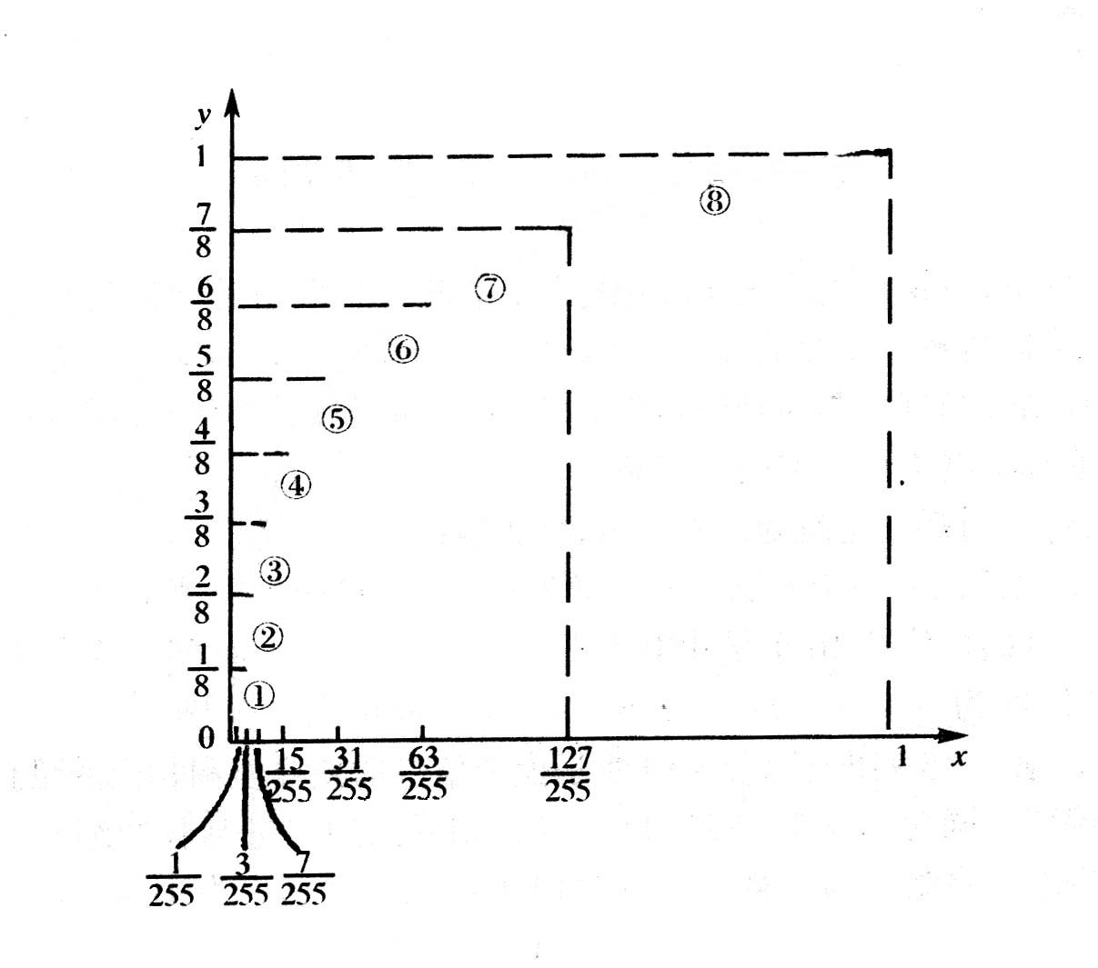
  Coordinates of turning points of 15 broken line method and slope of each segment
  i 0 1 2 3 4 5 6 7 8
  y = i/8 0 1/8 2/8 3/8 4/8 5/8 6/8 7/8 1
  x=(2^{i} - 1)/255 0 1/255 3/255 7/255 15/255 31/255 63/255 127/255 1
  slope × 255 1/8 1/16 1/32 1/64 1/128 1/256 1/512 1/1024
  segment no. 1 2 3 4 5 6 7 8
    The first and second segments can’t be combined into one straight line because their slopes
    are different. When positive and
    negative voltages of signal are
    considered, 15 segments are
    obtained in total.

Slide 21
Comparison of 13 broken line method and 15 broken line method
  It is known from comparison of the slopes of the first segments of 13 and 15 broken line characteristics, the slope (255/8) of the first segment of 15 broken line is about twice the slope (16) of the first segment of 13 broken line characteristic.
  So, signal to quantization noise ratio for small signal given by 15 broken line characteristic is about twice that given by 13 broken line characteristic.
  However, for large signal, the signal to quantization noise ratio given by 15 broken line characteristic will be a little lower than that given by 13 broken line characteristic. As can be seen from the logarithm compression eq. (4.3-22), A equals 87.6 in A-law; but A equals 94.18 in μ-law. The larger the A, the smaller the slope of the large voltage segment of the curve; i.e., the worse signal to quantization noise ratio.

Slide 22
  Comparison of nonuniform and uniform quantizations
Let us use 13 broken line method as an example to compare these two quantization methods. If the min. quantization interval (the 1st and 2nd segments) in 13 broken line method is used as quantization interval for uniform quantization, then the numbers of uniform quantization intervals included in the first segment to the 8th segment of 13 broken line method are respectively 16, 16, 32, 64, 128, 256, 512, 1024, totally 2048 uniform quantization interval; but there are only 128 quantization intervals during nonuniform quantization.
Therefore, under the condition of ensuring equal number of quantization intervals for small signal, uniform quantizaation needs 11 bits for coding, and nonuniform quantization needs only 7 bits.

Slide 23
4.4 Pulse code modulation (PCM)
4.4.1 Basic principles of PCM
  Sampling → quantization → coding
  Example: see the figure
  3.15 → 3 → 011
  3.96 → 4 → 100
7
6
5
4
3
2
1
Practical value of signal
Quantized value of
signal
Quantization error
6.38
6.80
7
6.42
6
6
5.00
Sampled
value
3.96
5
4
3.15
3
Quantized
value
011 100 101 110 111 110
Binary symbol
Figure 4.4.1 Principles of PCM

Slide 24
  Block diagram:
Sample
and
hold
circuit
Quanti-
zer
Encoder
Decoder
Low
pass
filter
Analog
signal
input
Analog
signal
output
PCM
signal
Encoder
Decoder

Slide 25
4.4.2 Natural binary code and fold binary code
  Characteristic of fold binary code
    Image relationship:
    Codeword error has less influence on small voltage.
No. of quantized value
Polarity of quantized voltage
Natural binary codeword
Fold binary codeword
15
14
13
12
11
10
9
8
Positive polarity
1111
1110
1101
1100
1011
1010
1001
1000
1111
1110
1101
1100
1011
1010
1001
1000
7
6
5
4
3
2
1
0
Negative polarity
0111
0110
0101
0100
0011
0010
0001
0000
0000
0001
0010
0011
0100
0101
0110
0111

Slide 26
  Fold binary code used in 13 broken line method
    There are 8 bits in total: c₁ to c₈
      c₁: polarity
      c₂ ～ c₄: segment bits
      － 8 segment slopes
      c₅ ～ c₈：inner-segment bits
      － 16 quantization levels
Quantization interval | Inner-segment bits c₅ c₆ c₇ c₈
15 | 1111
14 | 1110
14 | 1101
12 | 1100
11 | 1011
10 | 1010
9 | 1001
8 | 1000
7 | 0111
6 | 0110
5 | 0101
4 | 0100
3 | 0011
2 | 0010
1 | 0001
0 | 0000
No. of segment | segment bits c₂ c₃ c₄
8 | 111
7 | 110
6 | 101
5 | 100
4 | 011
3 | 010
2 | 001
1 | 000

Slide 27

  4.4.3 Quantization noise in PCM system
  Signal to quantization noise ratio of uniform quantizer has been found in sec. 4.3.2: S / N_{q} = M ²
  For PCM system, when N bit binary codeword is used, M = 2^{N} , hence we have S / N_{q} = 2^{2N}
  From sampling theorem, if the signal is a low-pass signal whose frequency band is limited to f _{H} , then the sampling rate should not be less than 2 f_{H} times per second.
  For PCM system, this is equivalent to not less than 2Nf_{H} b/s. Hence, the required system bandwidth is at least B = Nf_{H} , i.e., N = B/f_{H} . Substituting it into the above equation, we obtain
  The above equation shows that output signal to quantization noise of PCM system increases with the bandwidth B of the system according to exponential rule.

Slide 28
4.5 Differential pulse code modulation (DPCM)
  4.5.1 Principles of DPCM
  Basic principles of linear prediction
    Prediction of the current sample by using linear combination of previous samples in called linear prediction.
    Difference between the current sample and the predicted value is called prediction error.
    The predicted value is close to the sample because there is strong correlation between adjacent samples, i.e., the possible range of the predicted error is small.
    The number of bits may be less for encoding predicted error, and the bit rate is consequently reduced.

Slide 29
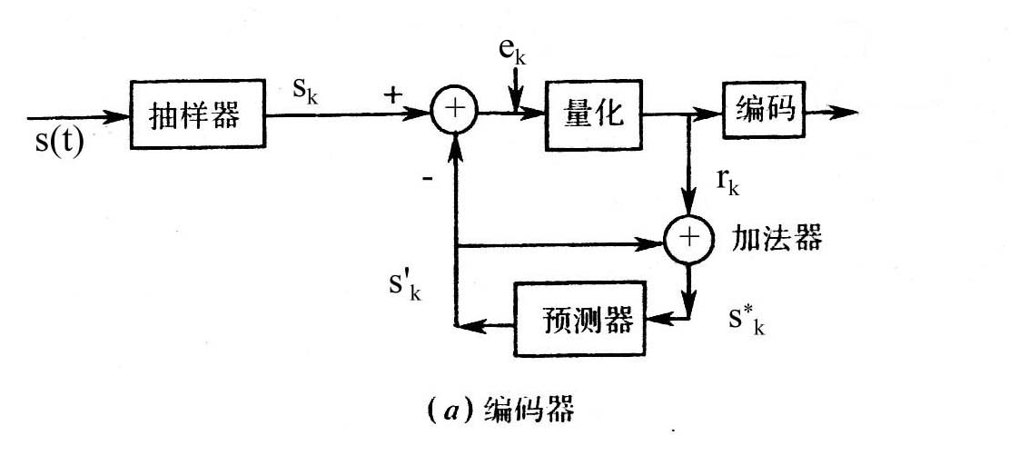
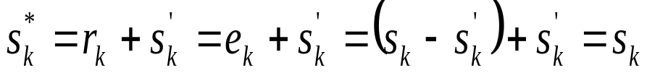
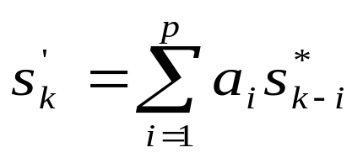
  Block diagram of linear prediction encoder & decoder
    Encoder: see the figure
    s(t) － input signal
    s_{k} ＝ s(kT) － sample of s(t)
    s′_{k} － predicted valur
    e_{k} － prediction error
    r_{k} － quantized prediction error
    s*_{k} － input of predictor
    Meaning of s*_{k} : When there is no error, e_{k} = r_{k} , then as can be seen from the figure:
    s*_{k} is the s_{k} with quantization error
  Input ~ output relationship of predictor:
  where, p is the prediction order
  a_{i} is the prediction coefficient
Sampler
Quantizer
Encoding
Adder
Predictor

Slide 30
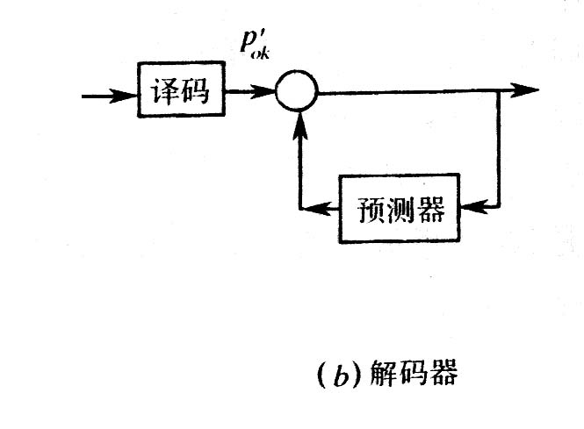
      Decoder: see the figure
      The circuit between the predictor and the adder in the encoder is the same as that in the decoder. Hence, when there is no transmission error, i.e., when the output of the encoder is just the input of the decoder, input signals of the two adders are identical, i.e., r_{k}=r′_{k} . Therefore, output signal s_{k}*′ of the decoder and output signal s_{k}* of the adder in the encoder are identical, i.e., they are equal to signal sample s_{k} with quantization error.
  Basic principle of DPCM: when p = 1，a₁ = 1, s′_{k} = s*_{k-1} , the predictor is reduced to delay circuit, the delay time is T. Now, linear prediction becomes DPCM.
r_{k}'
＋
s*_{k}
Decoding
＋
Predictor

Slide 31
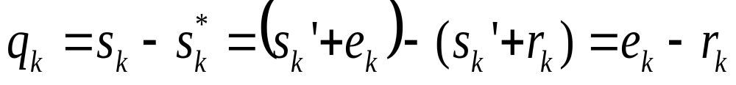
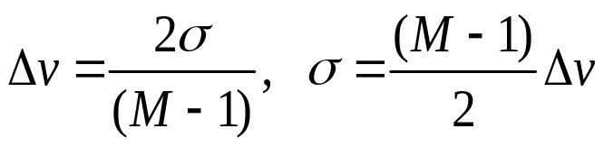
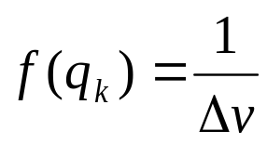
4.5.2 Quantization noise and signal to quantization noise ratio in DPCM system
  Quantization noise: i.e., quantization error q_{k，}its definition:
  where, s_{k} － input analog signal sample of the encoder
  s_{k}* －sample with quantization error
  Assume: (+σ, -σ) － range of prediction error e_{k}
  M － number of quantization levels of the quantizer
  Δv － quantization interval
  the we have
  Assume quantization error q_{k} is uniformly
  distributed in (- Δv, +Δv), then probability
  density q_{k} can be expressed as
+σ
M₄
Δv
M₃
0
Δv
M₂
Δv
-σ
M₁
图4.5.2 σ, 和M之间关系

Slide 32
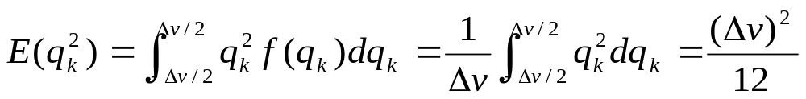
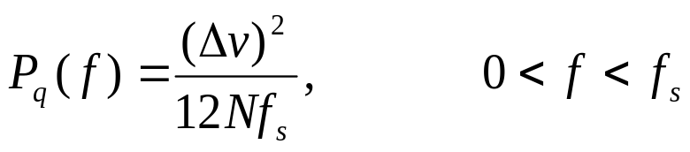
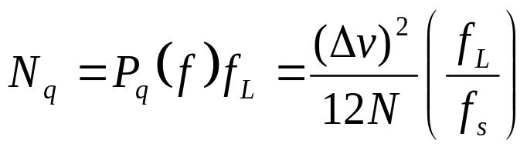
  And, the average power of q_{k} can be expressed as:
  Assume: f_{s} － sampling frequency
  N = log₂ M － number of symbols of the codeword for each sample
  Nf_{s} － symbol rate of the DPCM encoder output
  E(q_{k}²) is uniformly distributed in frequency range ( 0, Nf_{s} )
  then the power spectral density of E(q_{k}²) is:
  The quantization noise power after passing a low-pass filter with cut-off frequency f_{L} equals
  － output quantization noise of the DPCM system

Slide 33

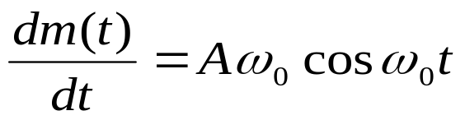


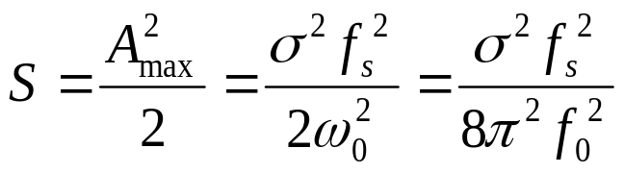
  Signal power
    When the range of e_{k} is limited in (+σ, -σ), varying rate of the signal is also limited.
    That is to say, the increase or decrease of the signal sample at adjacent sampling points cannot exceed this range. Once beyond this range, the encoder will be overloaded. If the interval of the sampling points is T ＝ 1 / f_{s} , then the slope of the signal will be limited to σ / T.
    Assume: the input signal is a sinusoidal wave:
    where A – amplitude, ω₀ – angular frequency, its slope is
    － max. slope is Aω₀
    To avoid overloading, the max. slope of the signal should not exceed σ/T , i.e., require
    Therefore the allowed max. signal amplitude is:
    The max. allowed signal power is:

Slide 34
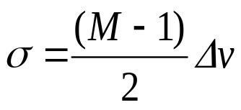
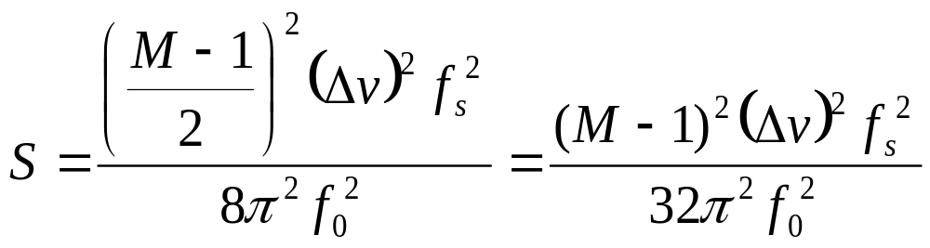
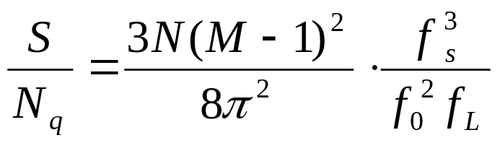
  Substituting
  into
  we obtain
  Signal to quantization noise ratio:
The above equation shows that signal to quantization noise ratio increases with the increase of the bit number N of the codeword and sampling frequency f_{s} .

Slide 35
4.6 Delta modulation (DM)
4.6.1 Principles of delta modulation
  Delta modulation: When the number of quantization levels of the quantizer in a DPCM system is equal to 2 and the predictor is still simply a delay line with the delay time of sampling interval T, the DPCM system is then called delta modulation system.

Slide 36
  Block diagram:
    e_{k} = s_{k} – s_{k}’ is quantized to two levels: +Δ and －Δ .
    the value of Δ is called quantization step.
    r_{k} has only two values: +Δ or －Δ 。
    For example, +Δ is denoted by 1, and －Δ is denoted by 0.
    When there is no transmission error, s_{k}* ’ = s_{k}*。
s_{k}
r_{k}
r_{k}'
s_{k}*'
s(t)
e_{k}
Sampling
2 level quantization
＋
＋
－
＋
delay
s_{k}’
s_{k}*
delay
(a) Encoder (b)Decoder

Slide 37
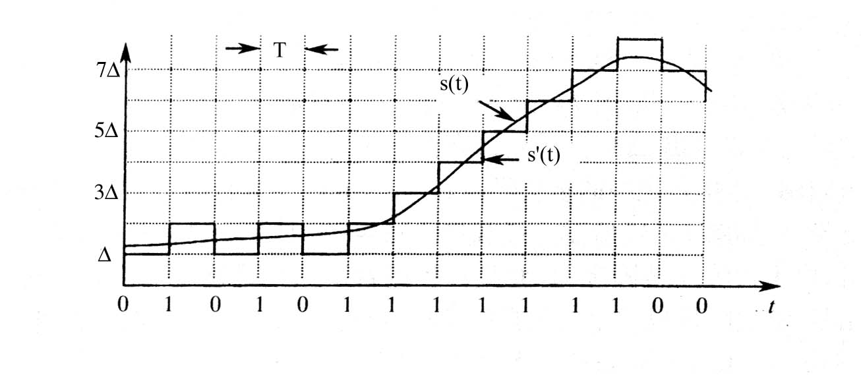
  In fact, for simplicity, an integrator is usually used instead of the above “delay and add circuit” as shown in the figure:
e(t)
d(t)
s(t)
Sampling & decision
＋
d'(t)
s'(t)
－
Integrator
Low-pass
δ_{T}(t)
s’(t)
Integrator
(a) Encoder (b)Decoder
Output binary
waveform

Slide 38
  Principles of decoder
  In the demodulator, output of the integrator increases ΔV after receiving a symbol 1, and decreases ΔV after receiving a symbol 0. In this way, the step-shaped voltage can be restored. The step-shaped voltage passes the low-pass filter for smoothing, and then an analog signal very close to the original input will be obtained.
d'(t)
s'(t)
Integrator
Low-pass
(b) Decoder
Output binary
waveform

Slide 39
4.6.2 Quantization noise in delta modulation system
  Production of quantization noise
    Two kinds of causations producing quantization noise:
      The voltage jump of the step-shaped waveform. It is the basic quantization noise, called e₁(t). It accompanies the signal, and always exists, i.e., the noise exists only if the signal exists.
      The overload quantization noise. It is produced when absolute value of the input signal slope is too large. Since when the sampling frequency and the quantization step are constant, e.g., if the rising slope of the signal exceeds max. possible slope of the step-shaped wave, the rising of the step-shaped wave will be slower than that of the signal, so the overload quantization noise e₂(t) is produced.

Slide 40
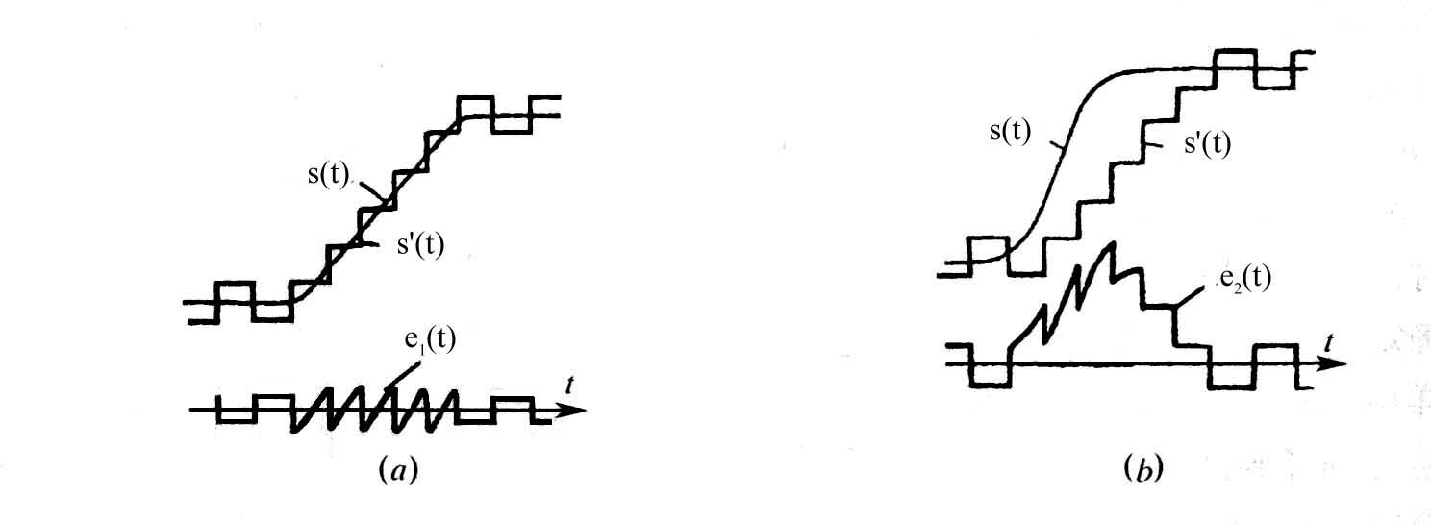
  The two waveforms of the quantization noise shown in the figure have not passed through the output low-pass filter.
(a) Basic quantization noise
(b) Overload quantization noise noise

Slide 41

  The way to reduce quantization noise
    For basic quantization noise: to decrease Δ.
    For overload quantization noise:
    Assume the sampling period is T , the sampling frequency is f_{s} = 1/T , the quantization step is Δ, then the slope k of a step is:
    － max. tracking slope
    When the slope of the input signal exceeds it, overload quantization noise will be generated.

Slide 42
    The way to avoid overload quantization noise is to make Δ ⋅ f_{s} large enough.
    If the value of Δ is large, then the basic quantization noise must also be large. Therefore, only the method of increasing f_{s} to increase Δ ⋅ f_{s} can ensure that the basic quantiation noise and the overload quantization noise don’t exceed the limit.
    In fact, the value of sampling frequency f_{s} used in delta modulation is much larger than that is PCM and DPCM.
    When the input voltage < Δ /2 , the output will be 1 and 0 alternative binary symbol sequence.
    The initial coding level: Δ /2

Slide 43

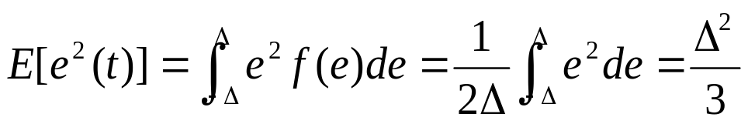
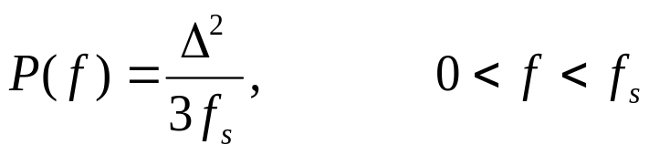
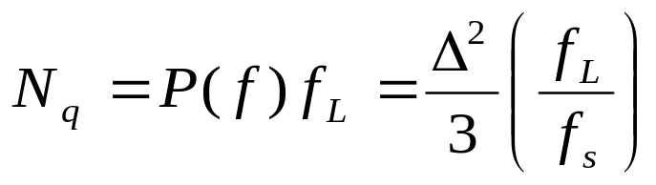
  Quantization noise power
    Assume: There is no overload quantization noise, and only the basic quantization noise is considered. The basic quantization noise e(t) is uniformly distributed:
    then the average power of e(t) is:
    Assume the power is uniformly distributed in 0～f_{s} , then its power spectral density is:
    Hence, the quantization noise power after passed the low-pass filter with cut-off frequency f_{L}is:
    As can be seen from the above equation, it is only related with Δ and (f_{L} / f_{s}) , and is independent of the signal magnitude.

Slide 44






  Signal to quantization noise ratio
    Find signal power: Assume the input signal is:
    then its slope is: 则其斜率为：
    － max. of the slope equals Aω₀
    For ensuring no overload, require:
    ∴ 保证不过载的临界振幅A_{max}应该等于：
    From the above equation, we obtain the max. signal power:
    Find the signal to quantization noise ratio:
    The above equation shows that the max. signal to quantization noise ratio is proportional to f_{s}³ , and is inversely proportional to f₀² . Therefore, increasing sampling frequency can obviously increase signal to quantization noise ratio.

Slide 45
4.7 Brief summary

