Slide 1
Chaper 5 Representation and Transmission of Baseband Digital Signal
5.1 Introduction
  The purpose of representing digital signal by using different methods during transmission:
    To remove D.C. and very low frequency components;
    To obtain information of the beginning and the ending instants of each symbol in the receiver;
    To enable the frequency spectrum of the signal match with the transmission characteristic of the channel.

Slide 2
5.2 Coding method of character
  What are characters: --- Chinese characters, digits, and English letters, …
  Coding method of Chinese characters:
  To use 4 decimal digits denotes one Chinese character.
  For example, in telegraph, “中” → “0022”，“国” → “0948”
  in “zone and location code”,
  “中” → “5448”，“国” → “2590”
  Coding method of English letters and symbols:
  ASCII code ---- 7 binary digits denoting a character.

Slide 3
5.3 Waveform of baseband digital signal
  Unipolar waveform
  Bipolar waveform
  Unipolar return-to-zero
  waveform
  Bipopar return-to-zero
  waveform
  Differential waveform
  Multi-level waveform
0 1 0 1 1 0 0 0 1
+V
(a)
0
+V
(b)
-V
(c)
+V
0
+V
(d)
0
-V
(e)
+3V
+V
(a) Unipolar waveform (b)Bipolar waveform (c)Unipolar return-to-zero waveform
(d) Bipolar return-to-zero waveform (e)Differential waveform
0
-V
-3V
Multi-level waveform

Slide 4
5.4 Symbol code types of baseband digital signals for transmission
  Requirements on the symbol code types for transmission:
    No D.C. component and very small low frequency components;
    Containing timing information of symbols;
    High transmission efficiency;
    Certain error-detecting ability;
    Suitable for various information sources, i.e., the above performance is independent of the statistic characteristic of the information source.

Slide 5
  AMI code --- Alternative Mark Inverse code
    Coding rule: “1” converts into “＋1” and “－1” alternatively, “0” keeps “0”，
    For example: message symbol: 0 1 0 1 1 0 0 0 1
    AMI code: 0 +1 0 -1 +1 0 0 0 -1
    Advantages: no D.C. component, simple decoder, easy to find errors
    Disadvantages: When a long string of 0 appears there will be no way to get timing information in the receiver.
    It is also called “1B/1T” code.

Slide 6
  HDB₃ code
    Coding rule:
      Firstly, the message symbol is convert into AMI code.
      Then, the continuous 0s in AMI code are checked:
        When there are no more than 4 (including 4) continuous 0s, no change will be made, and the AMI code is just HDB₃ code.
        When 4 or more than 4 continuous 0s appear, the fourth 0 will be converted into a symbol which has the same polarity of the previous non-0 (“＋1” or “－1”) symbol.
        This symbol is called “violation symbol”, and is denoted by a V, i.e., +V represents +1, and –V represents -1.

Slide 7
        To guarantee the polarity alternatively inverse of the adjacent Vs:
        * When there are odd non-0 symbols between the adjacent Vs, it can be guaranteed.
        * When there are even non-0 symbols between the adjacent Vs, the requirement cannot be satisfied. To solve this problem, it is necessary to convert the first 0 of the continuous 0 string into a +B or a –B. The sign of B is the inverse of the sign of the previous non-0 symbol; and the sign of the following non-0 symbol begins to alternatively change from symbol V.

Slide 8
    Example:
  Message: 1 0 0 0 0 1 0 0 0 0 1 1 0 0 0 0 1 1
  AMI code: -1 0 0 0 0 +1 0 0 0 0 -1 +1 0 0 0 0 -1 +1
  HDB₃ code: -1 0 0 0 -V +1 0 0 0 +V -1 +1 -B 0 0 -V +1 -1
-1 0 0 0 -1 +1 0 0 0 +1 -1 +1 -1 0 0 -1 +1 -1
Decoding： -1 0 0 0 0 +1 0 0 0 0 -1 +1 0 0 0 0 +1 -1
1 0 0 0 0 1 0 0 0 0 1 1 0 0 0 0 1 1
    Decoding:
      When two continuous “1” with the same sign appear, then the latter “1” and its preceding three symbols will be decoded as “0”.
      Finally, all -1s are converted into +1s, then the original message symbols are obtained.
    Advantages: In addition to the advantages of AMI, HDB₃ code can also let the number of continuous 0s be no more than 3, and be independent of the statistic characteristic of the information source.

Slide 9
  Biphase code － Manchester code
    Coding rule: message symbol “0” → transmission code “01”
message symble “1” → transmission code “10”
For example:
Message symbol: 1 1 0 0 1 0 1
Biphase code: 10 10 01 01 10 01 10
    Decoding rule: There are continuouse two 0s or 1s at the alternative point of the message, it can be used as the boundary of different message symbols.
    Advantages: no D.C. component, a lot of timing information, and simple coding method.
    Disadvantage: occupied frequency bandwidth is doubled.
+E
0 1
1 0
-E

Slide 10
  Miller code
    Coding rule:
    Message symbol “1” → is expressed by the voltage jump at the middle point of the symbol duration. In other words, it is expressed by “01” or “10”.
    Message symbol “0” → 1. the voltage doesn’t change for single “0”; 2. the voltage jumps at the boundary of adjacent 0s for continuous 0s. In other words, it is expressed by “11” or “00”.
Message symbol: 1 0 1 1 0 0 0 1
Bipolar code: 10 01 10 10 01 01 01 10
0
Bipolar code
waveform
Bipolar code phase 0 π 0 0 π π π 0
Miller code
0

Slide 11
    Property: When there is one “0” between two “1s” in the message symbols, the longest duration of the waveform width will appear. It equals twice the duration of the message symbol. This property can be used for error detection.
    Generation: The descending edge of the biphase code is just corresponding to the jump edge of Miller code. Hence, Miller code may be obtained by triggering a bistable trigger/flip-flop using the descending edge of the biphase code.

Slide 12
  CMI code － Coded Mark Inversion code
    Coding rule: message symbol “1” → alternatively use “11” and “00” to express it;
    message symbol “0” → use “01” to express it.
Message symbol: 1 0 1 1 0 0 0 1
Bipolar code: 10 01 10 10 01 01 01 10
Bipolar code
waveform
Bipolar code phase 0 π 0 0 π π π 0
0
Miller code
0
CMI code
0

Slide 13
  nBmB code
    This is a kind of block codes. In this code, n binary symbols in the message stream are combined into a group, and converted into a binary code of m bits, where m > n. The latter has 2^{m} kinds of combination. There are (2^{m} – 2^{n}) combinations more in the latter than those in the former, since m > n. In 2^{m} combinations, a specific part may be selected as allowable codes and the others are forbidden codes for obtaining good coding characteristic.
    Bipolar code, Miller code, and CMI code may be regarded as 1B2B codes. In optical fiber communication system, m = n + 1 is often used, e.g., 5B6B code, and others.
    In addition to nBmB code, there are also such codes as nBmT code and others. nBmT code expresses that n binary symbols are converted into m ternary symbols.

Slide 14

5.5 Frequency characteristic of baseband digital signal
  Power spectral density of binary random signal sequence
    Let waveforms of message symbols 0 and 1 in a binary random signal sequence be g₁ (t) and g₂ (t)，the bandwidth of the symbol equal T.
g₁(t)
g₂(t)
0
0
(a) g₁(t)波形
(b) g₂(t)波形
s(t)
0 0 1 0 1
g₁(t-nt)
t
T
g₂[t-(n+1)]
(c) s(t)波形

Slide 15
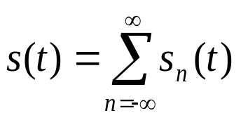
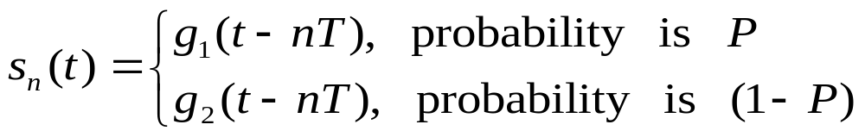
    Assume the random signal sequence is a stationary random process where the occurring probabilities of 0 and 1 are P and (1-P) respectively, and their occurrences are statistically independent from each other,
    then
    where

Slide 16
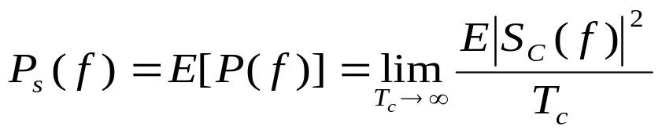

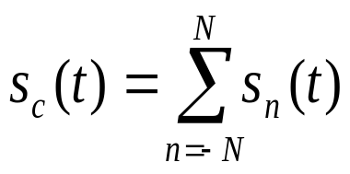
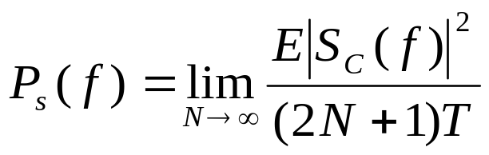
    Its power spectral density:
    where, T_{c} is the duration of a segment of the truncated signal.
    Let it be
    where N is a large enough integer. Thus,
    and
    If frequency spectral density S_{c}(f) of truncatedd signal s_{c}(t) has been found, then power spectral density P_{s}(f) of the signal can be calculated by the above equation

Slide 17
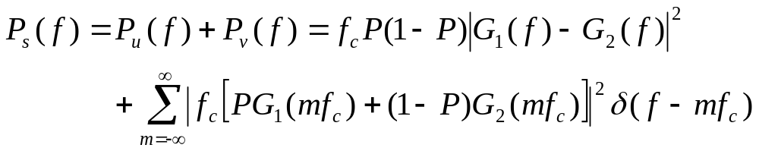
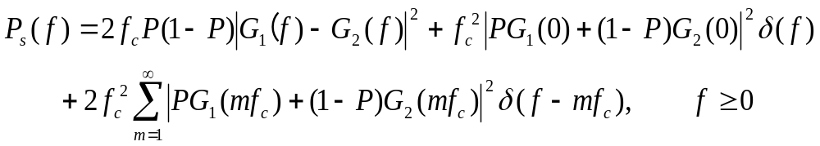
  Calculation result:
  Double-side power spectral density expression:
  Single-side power spectral density expression:

Slide 18
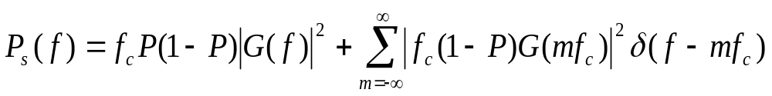
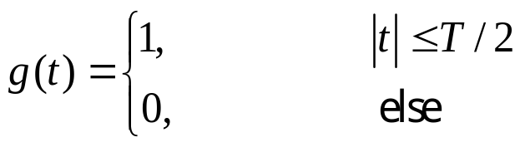
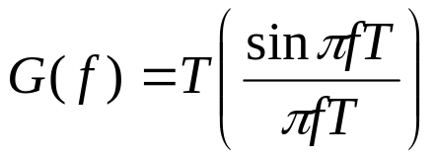
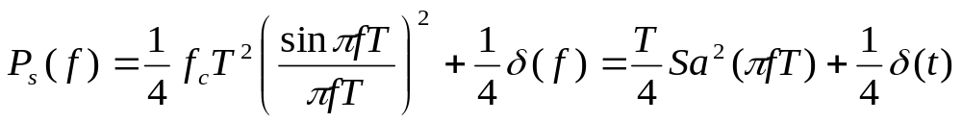

  Examples of power spectral density calculation
    Unipolar binary signal
    Assume the signal g₁(t) = 0, g₂(t) = g(t), then the double-side power spectral density of the random sequence composed of it is:
    where, G( f ) is the frequency spectrum function of g(t).
    When P = 1 / 2 and g(t) is the rectangular pulse:
    the frequency spectrum function of g(t) is
    Therefore
    where

Slide 19
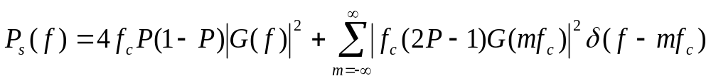

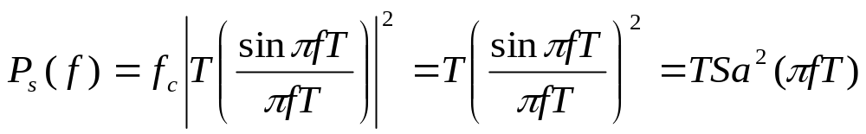
    Bipolar binary signal
    Assume the signal g₁(t) = -g₂(t) = g(t), then the double-side power spectral density of the random sequence composed of it is:
    When P = ½, the above equation can be rewritten as
    If g(t) is a rectangular pulse, then substituting its frequency spectrum G( f ) into the above equation, we obtain

Slide 20
  As can be seen from the above two equations:
  1. Generally speaking, power spectral density of a random pulse signal sequence contains a continuous spectrum and a discrete spectrum. However, for bipolar signal g(t) = -g(t) and when the probability P = ½, there is no discrete spectral component.
  2. If g₁(t) = g₂(t), then there is only discrete spectrum without any continuous component in the power spectral density. That is to say, the signal sequence is a periodic sequence and it doesn’t contain any information.

Slide 21
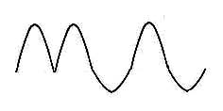
5.6 Transmission and intersymbol interference of baseband digital signal
  5.6.1 Model of baseband digital signal transmission system
  Let: G_{T}(f) － transfer function of transmitting filter,
  G_{R}(f) － transfer function of receiving filter,
  C(f) － transfer function of channel,
  H(f) = G_{T}(f)⋅C(f)⋅G_{R}(f)。
G_{T}(f)
C(f)
G_{R}(f)
Transmitting filter
_{Channel}
Receiv-ing
filter
Sampling & decision
Noise
H(f)
Baseband
transmission
Sampling & decision

Slide 22
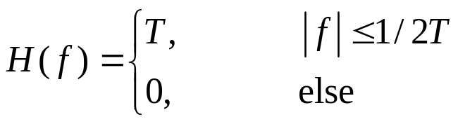
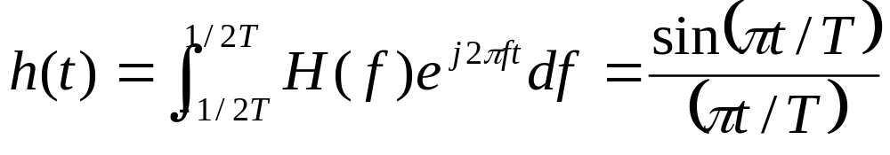
  5.6.2 Intersymbol interference and Nyquist criterion
  Intersymbol interference － overlap of adjacent symbols
  Causation of producing intersymbol interference － limitation of system overall transfer characteristic H(f).
  Characteristic of intersymbol interference － it appears when the signal appears, and disappears when the signal disappears. (multiplicative interference)
  Principles of overcoming intersymbol interference
  Let the system overall transfer function be H(f) which has ideal rectangular characteristic, i.e., let
  where T is the duration of the symbol.
  When the system input is a unit impulse function δ(t), the received signal waveform h(t) before sampling should be the inverse Fourier transform of H(f):

Slide 23
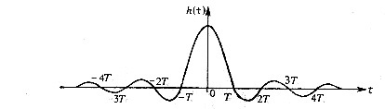
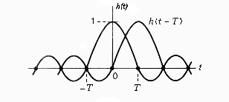
As can be seen from fig. (b), the space between zeros of h(t) equals T, with only the space between the first zeros around the origin equaling 2T. Theoretically we might use the symbols with duration T for transmission without intersymbol interference as shown in fig. (c).
  Now,
  transmission bandwidth W = 1/(2T) Hz
  transmission rate R_{B} = (1/T) Baud
  rate to bandwidth ratio:
  R_{B}/W ＝ 2 Baud/Hz － Nyquist rate
  Problems of ideal transfer
  characteristic
    It can’t be physically realized.
    The “tail” of the waveform has
    large fluctuation and lasts a very
    long time. Hence the sampling
    instant should be very accurate.
H(f)
T
-1/2T
0
1/2T
f
(a) Curve of H(f)
(b) Curve of h(t)
(c) Sketch map of no intersymbol interference between h(t) and h(t-T)

Slide 24
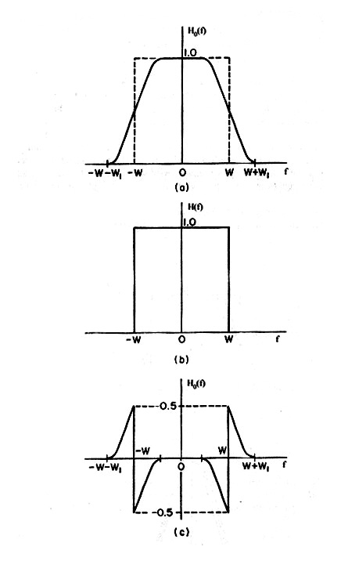
  Practically used no intersymbol interference transfer characteristic requires:
  Transfer function is a real
  function, and is odd symmetric
  at the point f = w.
  －called Nyquist criterion
(a) Transfer function
(b) Rectangular component
(c) odd symmetry component

Slide 25
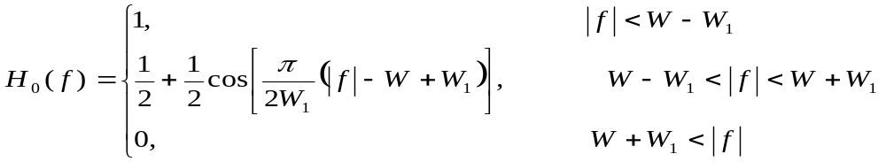
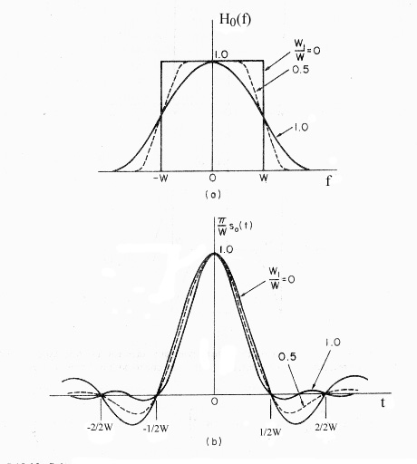
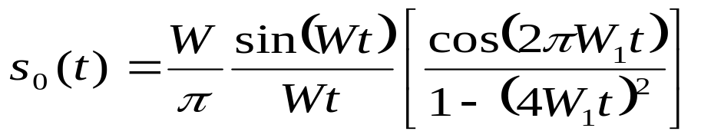
  Example: transfer function with raised-cosine “roll-off” characteristic
  Its impulse response is:
  W₁/W － roll-off coefficient
  When W₁/W = 1, it is called
  raised-cosine characteristic; now the
  sidelobe of s₀(t) is less than 31.5 dB,
  and there are more zeros.
  Roll-off characteristic still keeps
  the transmission rate of 2W Baud,
  but the occupied bandwidth is increased.
(a) Transfer function
(b) Impulse response

Slide 26
  5.6.3 Partial response system
  Problem solved by partial response system:
    Ideal rectangular transfer characteristic: bandwidth is min. but can’t be realized.
    Roll-off characteristic: can be realized but bandwidth is increased.
    Partial response characteristic: can solve the above contradiction.

Slide 27
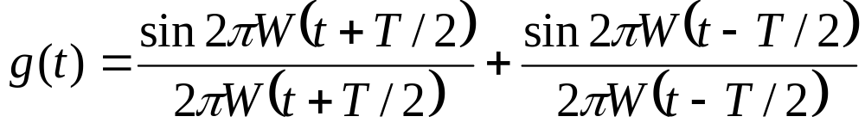
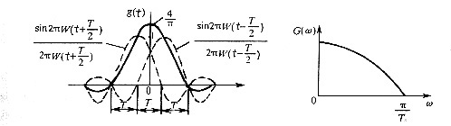
  Principles of partial response characteristic:
  Example: Assume the transfer function H(f) is an ideal rectangular. When two unit impulses with space of one symbol time T are added to the input, output waveform of the system should be the superposition of these two sinx/x waveforms:
  where, W = 1/2T
G(f)
1/2T
f

Slide 28
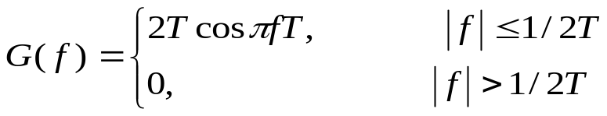
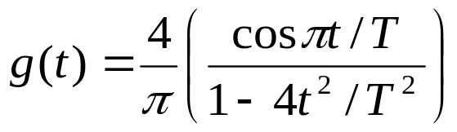
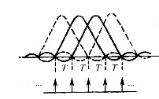
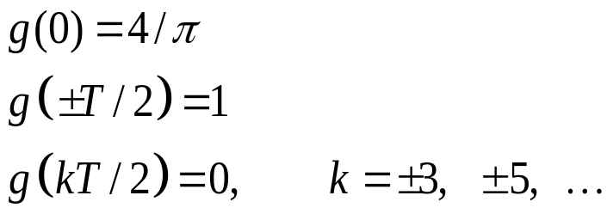
  The frequency spectrum of the above waveform is
  － cosinusoidal, bandwidth =1/2T
  g(t) can be reduced as:
  － g(t) decreases along with increase of t ²
  From the above equation, we obtain
If g(t) is used, and transmitted at the space of one symbol T, then there is mutual interference at the sampling instant only between the two adjacent symbols, and no mutual interference with other symbols at the sampling instant. By superficial observation, it seems impossible to transmit symbols with space T since there is interference between the adjacent symbols. However, correct transmission with rate 1/T Baud is still possible, because this kind of interference is deterministic.
a ₋₁ a₀ a₁ a₂
Sampling instants

Slide 29


  Assume the input binary symbol sequence of the system is {a_{k}}, where a_{k} = ±1. When symbol a_{k} is transmitted, sample C_{k} of the received waveform at the corresponding sampling instant is decided by
  hence, we have
  The possible values of C_{k} are only ＋2, 0, and －2.
  As can be seen from the above equation:
  ∴ If the previous symbol a_{k-1} has already been received and decided, i.e., its value is known, then the value of a_{k} can be found after C_{k} is obtained.
  The above example illuminates that it is possible, in principle, to use the waveform with intersymbol interference to reach the ideal frequency band utilization and to let the “tail” of the symbol waveform attenuating rapidly. However, there is error propagation problem, it can’t be used in practice.

Slide 30


  Practical partial response characteristic
  Let input symbol a_{k} at the transmitter be expressed by binary digits 0 and 1.
  Firstly, a_{k} is converted into b_{k} according to the following equation:
  where ⊕ is the modulo 2 addition; b_{k} is a binary digit 0 or 1.
  Then, {b_{k}} is used for transmission. According to the above principle, we can obtain
  － precoding (correlative coding)
  If the operation of the addition mod 2 is applied on the above equation, then we have
  The above equation shows that if the operation of addition mod 2 is directly applied on C_{k} , then a_{k} can be obtained and there is no need of foreknown a_{k-1} , and no error propagation problem either.

Slide 31
  Example: let {a_{k}} be 1 1 1 0 1 0 0 1，then the decoding process is:
  Initial status b_{k-1}＝0 Initian status b_{k-1}＝1
  Binary sequence {a_{k}} 1 1 1 0 1 0 0 1 1 1 1 0 1 0 0 1
  Binary sequence {b_{k-1}} 0 1 0 1 1 0 0 0 1 0 1 0 0 1 1 1
  Binary sequence {b_{k}} 1 0 1 1 0 0 0 1 0 1 0 0 1 1 1 0
  Sequence {C_{k}} 1 1 1 2 1 0 0 1 1 1 1 0 1 2 2 1
  Binary sequence {[C_{k}]_{mod}} 1 1 1 0 1 0 0 1 1 1 1 0 1 0 0 1
  Bipolar input {a_{k}} ＋＋＋－＋－－＋ ＋＋＋－＋――＋
  Bipolar signal {b_{k}} ＋－＋＋―――＋ －＋――＋＋＋－
  Bipolar signal {b_{k-1}} －＋－＋＋――― ＋－＋――＋＋＋
  Sequence {C_{k}} 0 0 0 2 0 –2 –2 0 0 0 0 –2 0 2 2 0
  Decision criterion: If C_{k} = 0, then the decision is a_{k} = +1; if C_{k} = ± 2, then the decision is a_{k} = -1.

Slide 32
    Block diagram
    The above system is called the first kind of partial response system, and also called duobinary signal transmission system.
＋
Transmitting
filter
Receiving
filter
Addition
^{Decision}
^{mod 2}
T
T
^{Sampling}
^{pulse}
(a) Block diagram
＋
Addition
Transmitting filter
Receiving filter
^{Decision}
^{mod 2}
T
^{Sampling}
^{pulse}
(b) Practical block diagram

Slide 33
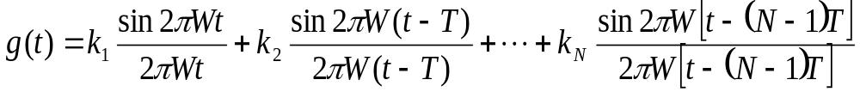
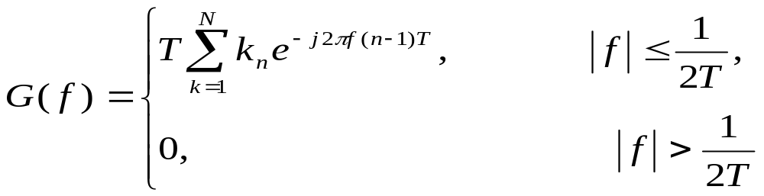
  General partial response characteristic: let
  where, k_{n}( n = 1, 2, …, N) － weighting coefficient, it may take positive value, negative value, or zero.
  The Fourier transform of g(t) in the above equation is its frequency spectrum G(f):
  As can be seen from the above equation, spectrum G(f) still exists within the interval (-1/2T, 1/2T).

Slide 34



  Assume the input sequence is {a_{k}}, and the corresponding coded sequence is {C_{k}}, then we have
  where a_{k} may be L-ary digits.
  The precoding rule is:
  where ⊕ is the addition mod L.
  The correlative encoding rule for b_{k} is:
  At last, the operation of mod L on C_{k} is:
  As can be seen from the above equation, here no error propagation exists. According to the above principle, the partial response waveforms currently presented can be classified into 5 classes.

Slide 35
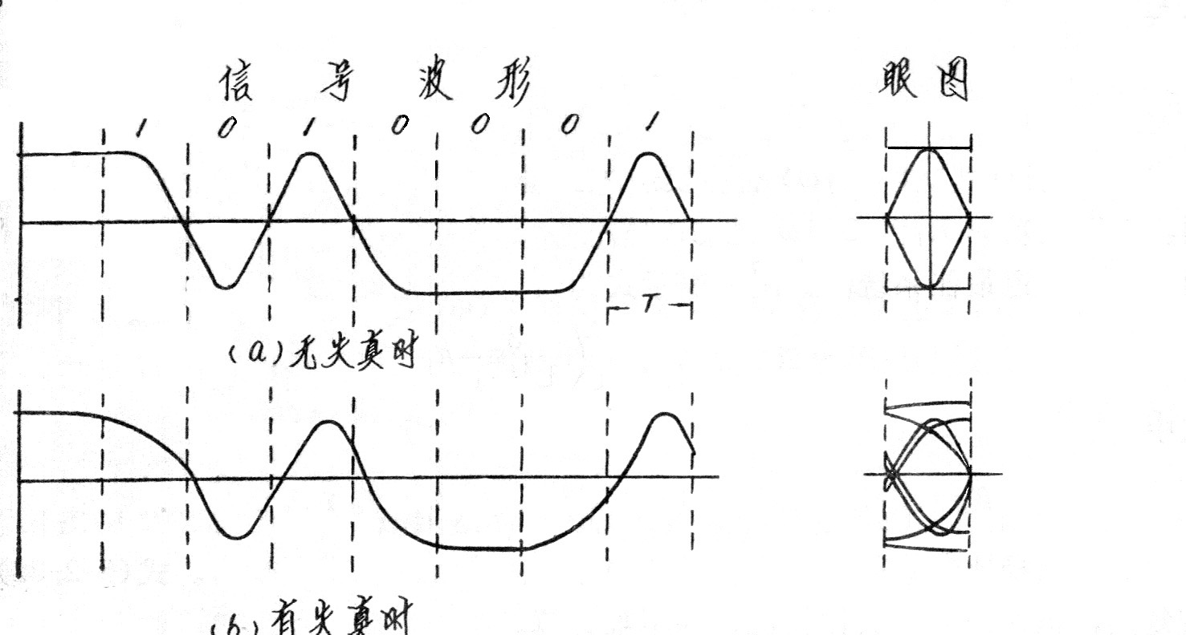
5.7 Eye pattern
  Eye patter － a method of practical observation of the received signal by using a oscilloscope.
  For bipolar binary signal:
    Under ideal situation, the display will be like an opened eye.
    If interference exists, then different degrees of the opening of the “eye” represent the strength of the interference.
Signal waveform
Eye pattern
(a) During no distortion
(b) During distortion exists

Slide 36
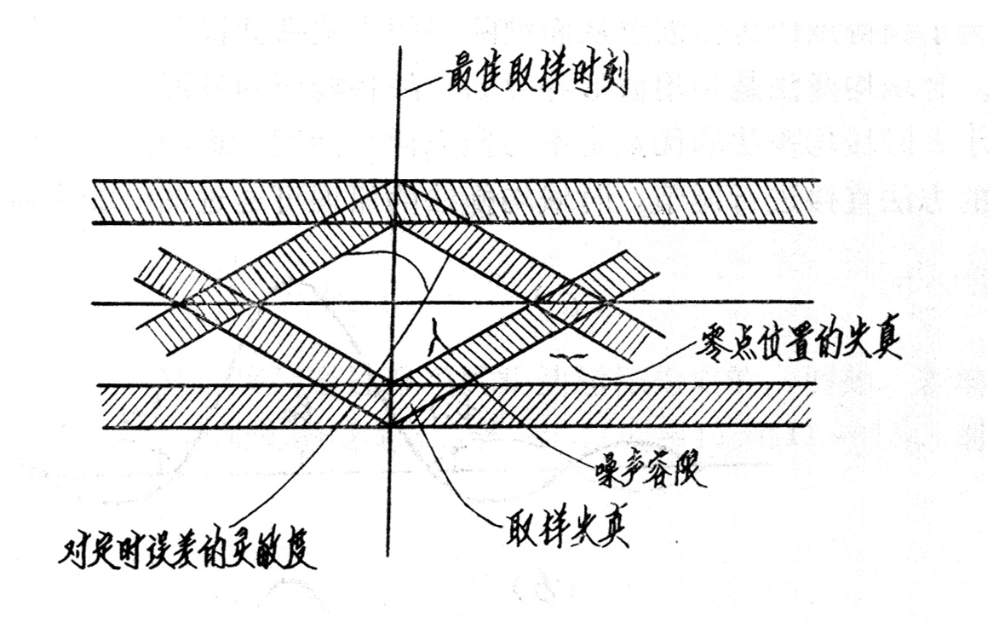
  Model of eye pattern
    The location of the
    central perpendicular
    line is the optimum
    sampling instant.
    The middle horizontal
    line represents the optimum decision threshold level.
    The perpendicular height of the shadow region represents the distortion range of the received signal.
    The slope of the bevel edge of the “eye” represents sensitivity of the sampling instant to the timing error.
    Under no noise situation, the degree of the opening of the “eye is the noise tolerance; if noise at the sampling instant exceeds this tolerance, then error decision may happen.
Optimum sampling instant
Distortion of zero position
Noise tolerance
Sensitivity of timing error
Sampling distortion

Slide 37
5.8 Time-domain equalizer
  5.8.1 Introduction
    Usage － to reduce intersymbol interference
    Classification － frequency-domain equalizer and time-domain equalizer
    Realization of time-domain equalizer － transversal filter
  5.8.2 Fundamental principle of transversal filter
    Overall transfer characteristic: H(f) = G_{T}(f)⋅C(f)⋅G_{R}(f)
    where G_{T}(f) － transfer function of transmitting filter
    G_{R}(f) －transfer function of receiving filter
    C(f) － transfer function of channel
    To cancel intersymbol interference, H(f) should satisfy Nyquist criterion.
    An equalizer is inseted into the system, its transfer characteristic is C_{E}(f), then the above equation becomes:
    H(f) = G_{T}(f)⋅C(f)⋅G_{R}(f) ⋅C_{E}(f)
    C_{E}(f) may be so designed that the H(f) satisfies Nyquist criterion.

Slide 38
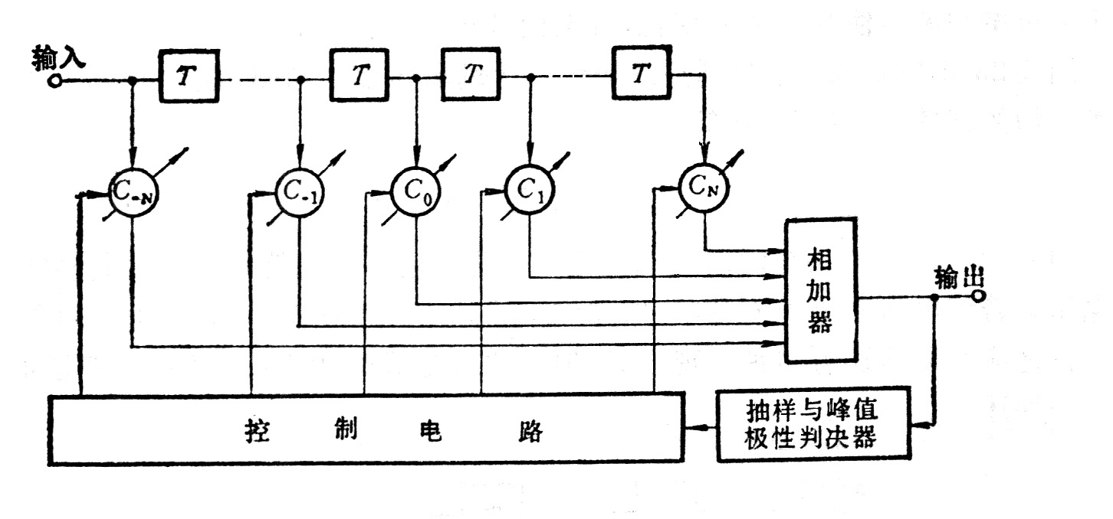
  Block diagram of adjustable transversal filter

Slide 39
  5.9 Brief summary

