Slide 1


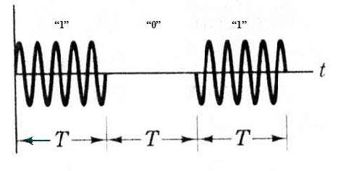
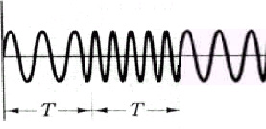

Chapter 6 Elementary Digital Modulation System
6.1 Introduction
  Sinusoidal carrier:
  or
  where A －amplitude (V); f₀ － frequency (Hz);
  ω₀ = 2π f₀ － angular frequency (rad/s); θ － initial phase (rad).
  Basic modulation systems:
    ASK
    FSK
    PSK
“1”
“0”
“1”
T
“1”
“0”
“1”
T
T
T

Slide 2
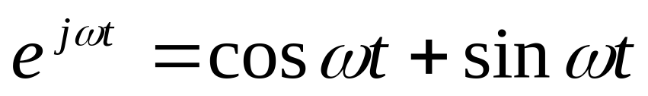
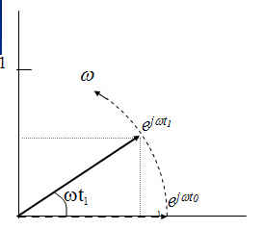
  Vector representation and vector diagram

Slide 3
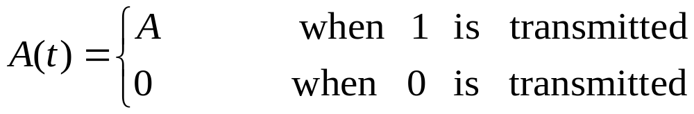
  6.2 2ASK
  6.2.1 Basic principle
    Expression:
    where ω₀ ＝ 2πf₀ --- is the angular frequency of carrier
    Modulation methods
      Multiplier method: envelope may be nonrectangular
      Switching method: envelope is rectangular
A(t)
Multiplier
s(t)
cosω₀t
s(t)
cosω₀t
A(t)

Slide 4
    Demodulation methods
      Envelope detection method － carrier phase information is not used.
      Coherent demodulation method － carrier phase information is used.
Envelope detector
s(t)
A(t)
Bandpass
filter
Full-wave
rectifier
Low-pass
filter
Sampling
& decision
Timing pulse
s(t)
A(t)
Bandpass
filter
Multiplication
circuit
Low-pass
filter
Sampling
& decision
Coherent
carrier cosω₀t
Timing pulse

Slide 5
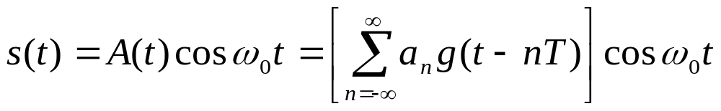
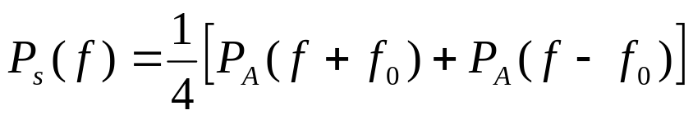
  6.2.2 Power Spectral Density
  Assume the general expression of the 2ASK random signal sequence is
  where a_{n} － binary unipolar random amplitude
  g(t) － symbol waveform
  T － duration of the symbol
  then the power spectral density of the 2ASK signal can be calculated as
  式中， P_{s}(f) － power spectral density of s(t)
  P_{A}(f) － power spectral density of A(t)
  ∴If P_{A}(f) has been found, then P_{s}(f) can be calculated by substituting P_{A}(f) into the above equation.

Slide 6
    Find P_{A}(f): from eq.(5.5-29):
    where f_{c} ＝ 1/T
    G₁(f) － frequency spectrum of g₁(t)
    G₂(f) － frequency spectrum of g₂(t)
    ∵Now, g₁(t) = 0, ∴The above equation becomes
    where G(f) = G₂(f)
    Now, the symbol waveform of the baseband signal is a rectangular pulse, so it is known from Fig. 2.2.3 and eq. (2.2-13), G(nf_{c}) = 0 for all integers of n ≠ 0. Therefore the above equation becomes
    Substituting the eq. of P_{A}(f) into the eq. of P_{s}(f), obtain:

Slide 7
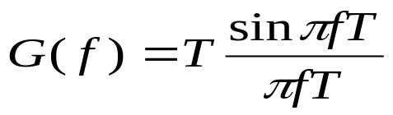

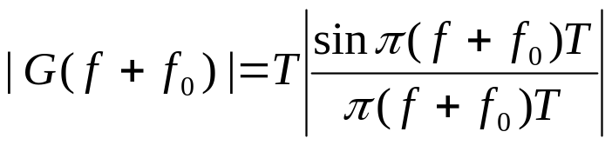
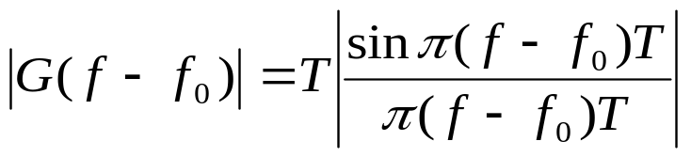
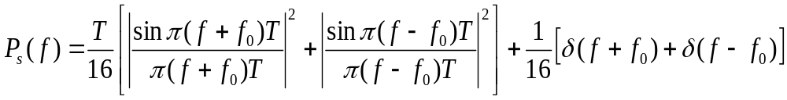
    Find P_{s}(f): from the above equation:
    When P = ½, the above equation becomes
    where
    Therefore, we have
    Finally, we obtain

Slide 8
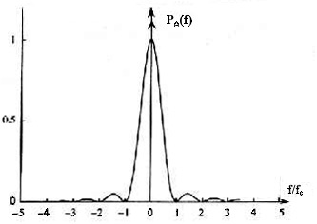
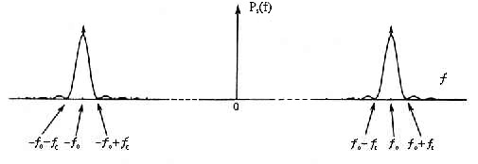
    Curves of P_{A}(f) and P_{s}(f)
P_{A}(f)
f / f_{c}
(a) Curve of P_{A}(f)
(b)Curve of P_{s}(f)

Slide 9

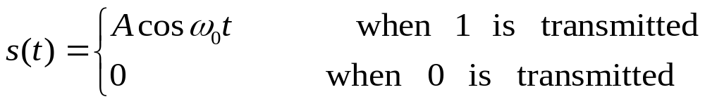

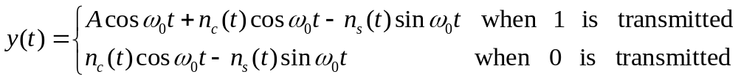
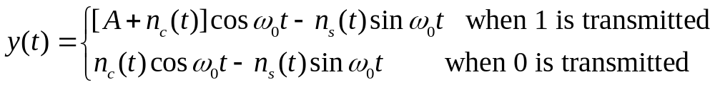
  6.2.3 Symbol Error Probability
  Assume the received signal and the noise voltage after bandpass filtering equal:
  where
  ∵n(t) is a narrow band Gaussian process, we have
  Substituting the above two equations into the equation of y(t), we obtain:
  or
  The above equation is the received voltage after bandpass filtering. It will be used for calculation of symbol error probability.

Slide 10
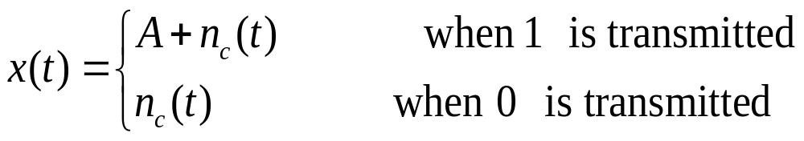
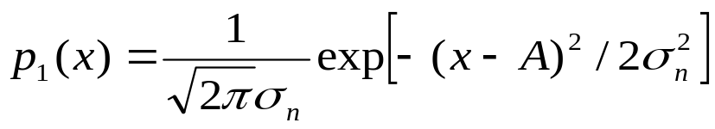
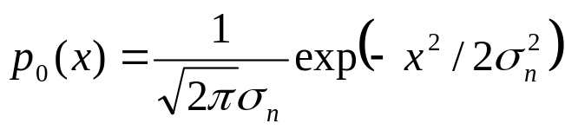
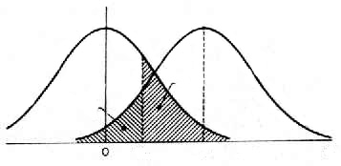
  Coherent demodulation
  The voltage x(t) at the sampling & decision point is
  where n_{c}(t) － Gaussian process
  ∴When 1 is transmitted, the probability of x(t) is
  When 0 is transmitted, the probability of x(t) is
h*
p₀(x)
p₁(x)
P_{e0}
P_{e1}
h
A

Slide 11
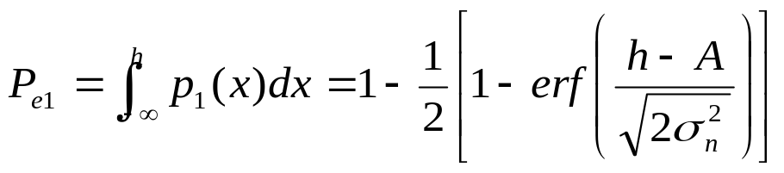
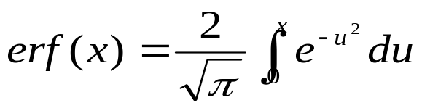
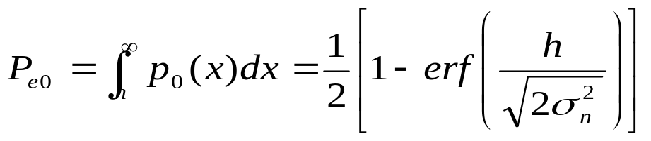
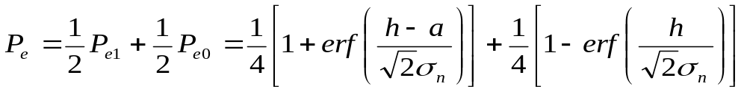

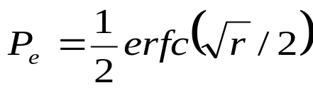
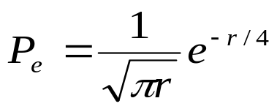
  Let h be the decision threshold, then the probability of the wrong decision of 0 as 1 is equal to
  where
  The probability of wrong decision of 0 as 1 is
  When P(1) = P(0), the total symbol error probability is
  When h equals the optimum threshold h*,
  When r>>1,
p₀(x)
h*
p₁(x)
P_{e0}
P_{e1}
h
A

Slide 12
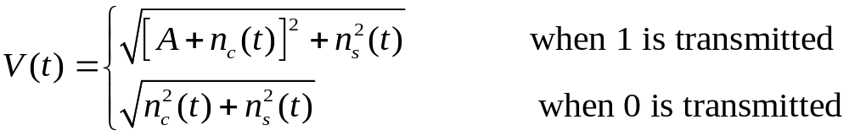
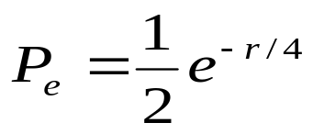
  Envelope detection
  ∵ The output is the envelope of its input voltage y(t), we have
  If the decision thereshold equals h, and it is prescribed that when V > h, the decision is received 1, and when V ≤ h, the decision is received 0, then its symbol error probability can be figured out. When the signal to noise ratio is large, the symbol error probability is:

Slide 13
  【Example 6.1】For a 2ASK signal transmission system, assume the symbol rate is R_{B} = 4.8 × 10⁶ Baud, the amplitude of the received signal A = 1 mV, the single-side power spectral density of the Gaussian noise n₀ =2 × 10⁻¹⁵ W / Hz. Find: 1）the optimum symbol error probability when envelope decision is used; 2）the optimum symbol error probability when coherent demodulation is used.

Slide 14

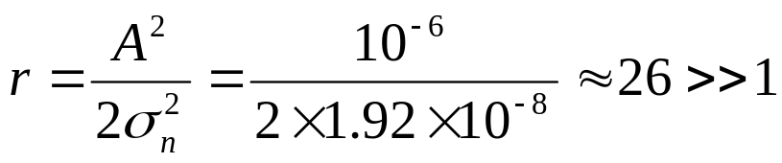
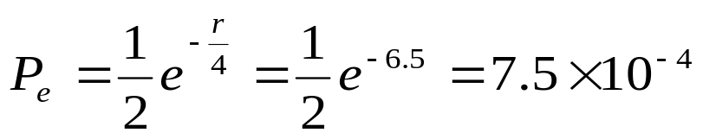
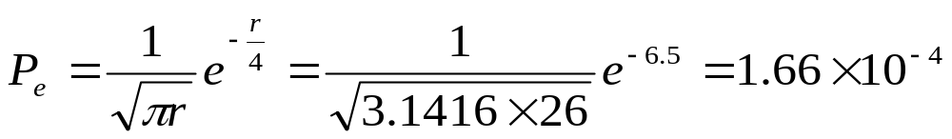
  Solution: The bandwidth of the baseband rectangular pulse can be selected as 1/T Hz. The bandwidth of the 2ASK signal should be twice of it, i.e., 2/T Hz. Hence according to the signal rate, the optimum bandwidth of the bandpass filter in the receiver should be selected as: B ≈ 2/T = 2R_{B} =9.6 × 10⁶ Hz
  Therefore the mean power of the output noise of the bandpass filter is:
  Hence its output signal to noise ratio is:
  ∴（1）the symbol error probability for the envelope detection is
  （2）the symbol error probability for the coherent demodulation is

Slide 15
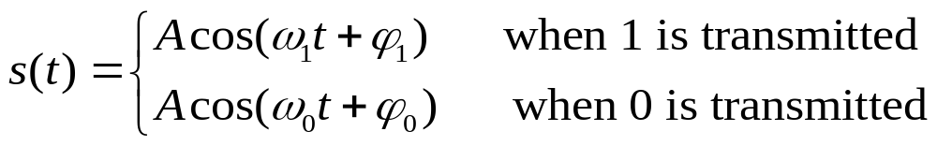
  6.3 2FSK
  6.3.1 Basic Principle
    Expression:
    Generation methods
      Frequency modulation method:
      phase continuous
      Switching method:
      phase discontinuous
A(t)
Frequency modulator
s(t)
Frequency source 0
Switching circuit
f₀
s(t)
Frequency source 0
f₁
A(t)

Slide 16
    Reception methods
      Coherent receiving:
      Noncoherent receiving:
        Envelope detection:
y₀(t)
Lowpass
filter
V₀(t)
^{Band pass}
^{fitering f}₀
_{Multiplier}
Input
cosω₀t
Sampling
&
decision
Output
y₁(t)
Lowpass
filter
^{Band pass}
^{fitering f}₁
_{Multiplier}
V₁(t)
Timing pulse
cosω₁t
^{Bandpass}
^{filtering f}₀
Envelope
detection
V₀(t)
Input
Sampling & decision
Output
^{Bandpass}
^{filtering f}₁
Envelope
detection
V₁(t)
Timing pulse

Slide 17
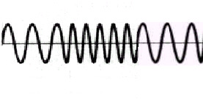
        Zero-crossing point detection
Bandpass
filter
Amplifier
& limiter
Differen-
tial
Recti-
fier
Pulse widening
Low-
pass
a
b
c
d
e
f

Slide 18

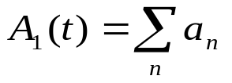
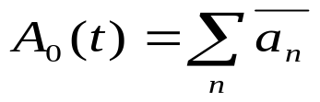

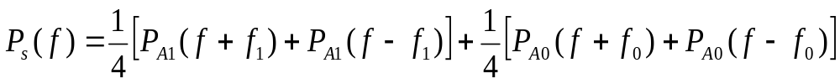
  6.3.2 Power Spectral Density
  The symbol sequence of 2FSK signal produced by the switching method can be regarded as the superposition of two 2ASK signals with different frequencies:
  where
  ∵ Power spectral density of 2ASK signal is
  ∴ the power spectral density of 2FSK signal should be the sum of the power spectral densities of two 2ASK signals:
  ∵the power spectral density of 2ASK signal is known:
  Substituting it into the above equation, the power spectral density of 2FSK signal is obtained as:

Slide 19
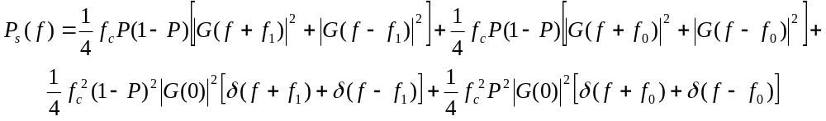
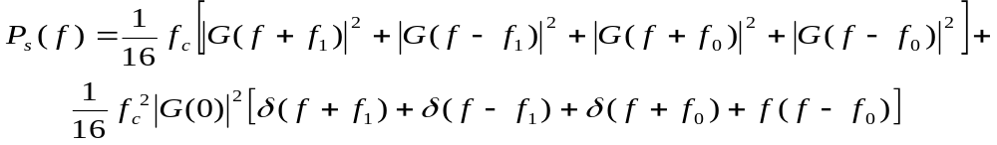

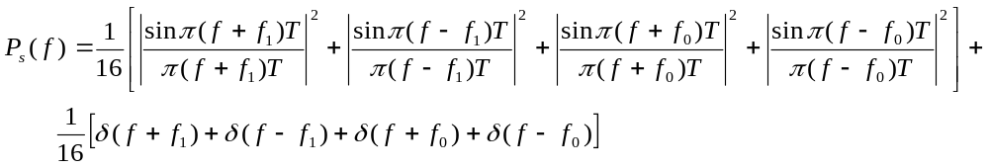
  When the probabilities of transmitting 1 and transmitting 0 are equal, P = ½, the above equation can be reduced as:
  Where G(f) is the frequency spectrum of baseband pulse:
  and
  Substituting G(f) into the above equation, we obtain the final expression of the power spectral density fo the 2FSK signal:

Slide 20
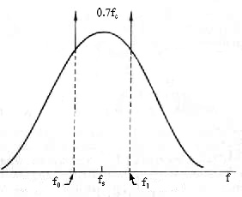
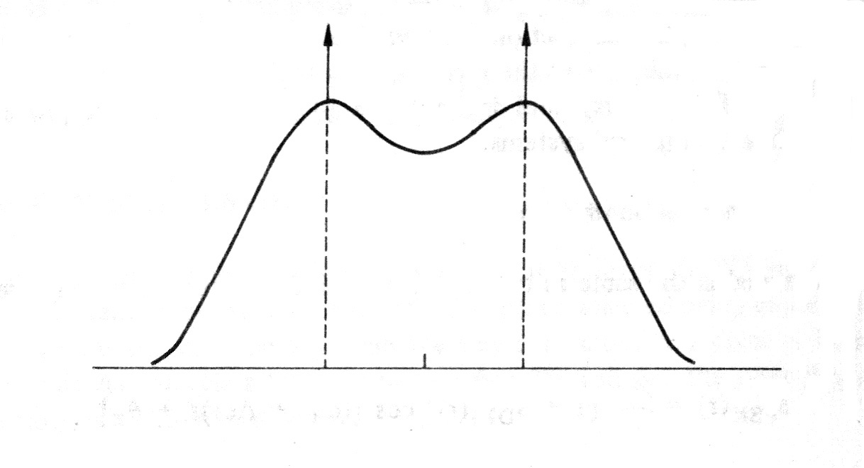
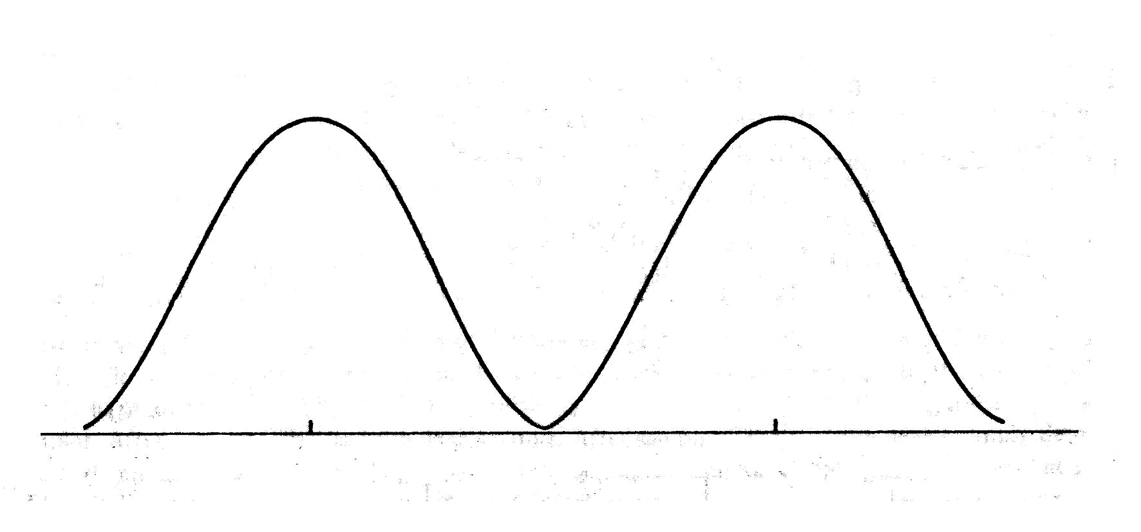

  As can be seen from the above equation, the forgoing 4 terms are the continuous spectrum part and the latter 4 terms are the discrete spectrum part.
    Curves:
    Bandwidth:
f_{s} = (f₀ +f₁) / 2
f_{c}
f_{s} = (f₀ +f₁) / 2
f₀ - f_{c}
f₁ + f_{c}
2f_{c}
f_{s} = (f₀ +f₁) / 2
f₀ - f_{c}
f₀
f_{s}
f₁
f₁ + f_{c}
f
f₀ - f_{c}
f₀
f_{s}
f₁
f₁ + f_{c}
f

Slide 21
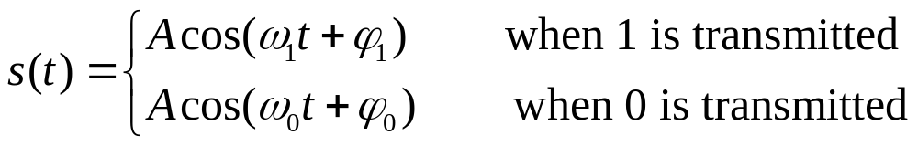
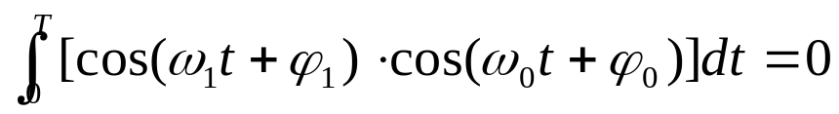
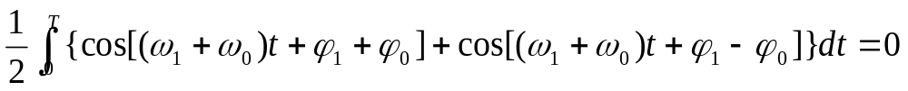
  6.3.3 Minimum Frequency Space
  In principle, if two signals are orthogonal, then they can be separated completely.
    For noncoherent reception: let 2FSK signal be
  for satisfaction of orthogonal condition, require:
  i.e., require
  The integrated result of the above equation is
  Assume the first and third terms equal zero, then the above equation can be reduced to

Slide 22







  Since ϕ₁ and ϕ₀ are arbitrary constants, it must simultaneously have and
  then the above equation equals zero.
  Hence we have and
  where n and m are both integers.
  For simultaneous satisfaction of the both requirements, it should be let
  i.e., require
  Therefore, when m = 1, it gives the minimum frequency space 1 / T.
    For coherent receiving, let then the equation
    can be reduced to
    Hence, it is only required that
    i.e., the minimum frequency space equals 1 / 2T .

Slide 23
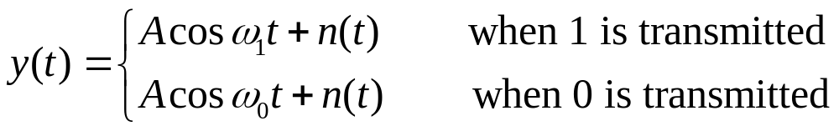


  6.3.4 Symbol Error Probability
  Assume the output voltage waveform of the filter is
  Symbol Error Probability of Coherent Demodulation
  When the symbol 1 is transmitted, the two received voltages after passing the two bandpass filters is:
    They are multiplied by the local carrier, and then low-pass filtered. Hence, we obtain and
y₀(t)
_{Multiplier}
Lowpass
filter
V₀(t)
^{Band pass}
^{fitering f}₀
Input
cosω₀t
Sampling
&
decision
Output
y₁(t)
_{Multiplier}
Lowpass
filter
^{Band pass}
^{fitering f}₁
V₁(t)
Timing pulse
cosω₁t

Slide 24
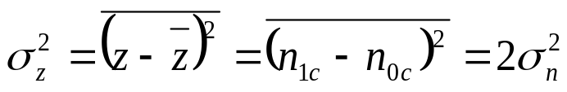
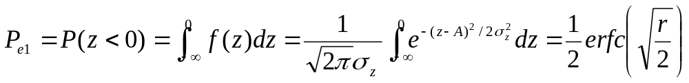

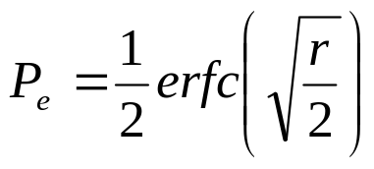
  and
  n_{1c}(t) andn_{0c}(t) are Gaussian process. Hence, their samples V₁ and V₀ are at the sampling instant are both mormal random variables. And, the mean of V₁ is A, the variance is σ_{n}²; the mean of V₀ is 0, and the variance is also σ_{n}².
  During decision, once V₁ < V₀ , the symbol error will be occurred. Therefore the symbol error probability is
  Let (A + n_{1c} - n_{0c}) = z, then z is also a normal random variable, and its mean equals A, its variance is
  Hence, we have
  where
  ∵P_{e0} and P_{e1} are equal, the total symbol error probability is:

Slide 25
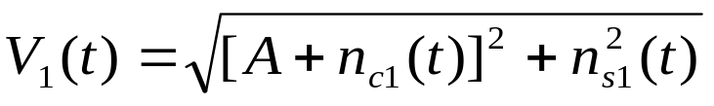

  Symbol Error Probability of Envelope Detection
  When the symbol 1 is transmitted, the two voltages at the sampling & decision device input respectively are
  and
  where V₁(t) － envelope of the signal in the path of frequency f₁; (generalized Rayleigh distribution)
  V₀(t) － envelope of the signal in the path of frequency f₀; (Rayleigh distribution)
^{Bandpass}
^{filtering f}₀
Envelope
detection
V₀(t)
Input
Sampling & decision
Output
^{Bandpass}
^{filtering f}₁
Envelope
detection
V₁(t)
Timing pulse

Slide 26






  Let
  and substituting them into the above equation, after reduction, we get
  Substituting
  into the above equation, we obtain
  where
  — signal to noise ratio
  When 0 is transmitted, the situation of error occurring is the same as above. So, the total symbol error probability is

Slide 27

  Comparison of symbol error probabilities of coherent detection and envelope detection:
    There is no big difference between them under the condition of large signal to noise ratio.
    In practical application, envelope detection is more often used.
  Comparison of symbol error probabilities of 2FSK and 2ASK signals:
    Envelope detection
      2ASK：
      3 dB diference
      2FSK：
    Coherent detection
      2ASK：
      3 dB difference
      2FSK：

Slide 28
  【Example 6.2】Assume there is a 2FSK transmission system, its transmission bandwidth is 2,400 Hz; the apparent carrier frequencies of the 2FSK signal are respectively f₀ = 980 Hz，f₁ = 1580 Hz; the symbol rate is R_{B} = 300 Baud, and the signal to noise ratio at the input of the receiver is 6 dB. Find:
  (1) The bandwidth of the 2FSK signal;
  (2) The error symbol probability during the envelope detection;
  (3) The error symbol probability during the coherent demodulation.

Slide 29

  Solution:
  1. The bandwidth of the signal:
  2. The symbol error probability of envelope detection:
  Bandwidth of the bandpass filter:B = 2R_{B} = 600 Hz
  The bandwidth ratio at the input and output of the bandpass filter: 2400/600 = 4
  The signal to noise power ratio at the output of the bandpass filter: r = 4 × 4 ＝16
  ∴

Slide 30


3. The symbol error probability of coherent demodulation
    Using the error function table in Appendix B, we obtain
    If the approximation equation (6.3-27) is used, then obtain
    The results are approximately the same.

Slide 31




  6.4 2PSK
  6.4.1 Basic Principle
    Expression:
    where
    or

Slide 32






  Waveform － “1 0 1”
    Discontinuous phase: Fig. (a) and Fig. (c)
    There is integer number of carrier periods on a symbol.
    Continuous phase: Fig. (b) and Fig. (d)
    The number of carrier
    periods in a symbol is one
    half period larger than
    integer number of periods.
“1”
“0”
“1”
(a)
(b)
T
T
T
“1”
“0”
“1”
(c)
T
T
T
(d)

Slide 33
    The above example illustrates that the continuity of the adjacent symbol phases should not be confused with the identity of the initial phases of the adjacent symbols.
    Only when a symbol contains integer number of carrier periods, the phase jump at the boundary of the adjacent symbols is the phase variation produced by modulation.

Slide 34
    Generation methods
      Multiplication method
      Use the binary baseband NRZ bipolar rectangular pulse A(t) to multiply the carrier
      Selection method
      Use the baseband signal to control a switching circuit, and the switching circuit selects the input signals.
A(t)
s(t)
Multiplier
Local carrier
Carrier
s(t)
Phase
shift π
A(t)

Slide 35
    Demodulation method
      Coherent receiving must be used.
      Difficulties: (1) The phase of the local carrier is difficult to be determined. － the phase ambiguity of the frequency divider, and the channel instability
      (2) The signal with long continuous sinusoidal waveform may appear, and hence the start and the stop instants of a symbol can’t be identified at the receiver.
      To overcome the above shortcoming, the DPSK system can be used.
V(t)
Bandpass filter
Multiplier
Lowpass filter
Sampling & decision
Local carrier extractor

Slide 36


  6.4.2 Power Spectral Density
  As can be seen from the 2PSK signal equation:
  The 2PSK signal can be regarded as a special 2ASK signal with the amplitudes A and –A.
  ∴The random symbol sequence of the 2PSK signal can also be described by the expression of the 2ASK signal:
  where
  For the simplification of the equation without losing the generality, we will let A = 1.

Slide 37


  Directly from the equation:
  where
  for 2PSK signal, g(t) = -g(t) ，G₁(f) = -G₂(f), hence the above equation becomes
  When P = ½, the above equation becomes
  Substituting it into the above equation of P_{s}(f), we get
  There is no discrete frequency component in the above equation. －－ can’t extract carrier frequency directly from the received signal by filtering method.

Slide 38


  Substituting the frequency spectrum of a rectangular pulse:
  into the equation ,
  we get the final expression of the power spectral density of the 2PSK signal
    Comparison of the power spectral densities of 2PSK and 2ASK signals
    The power spectral density of 2ASK signal:
      The bandwidths of both are identical.
      2PSK signal has no discrete component:
      δ (f + f₀) + δ (f - f₀)

Slide 39


(a) Power spectral density of 2ASK signal
(b) Power spectral density of 2PSK signal

Slide 40


    Relationship between 2PSK and 2ASK signal waveforms
2A
(a) 2ASK
A
(b) 2PSK
(c) carrier
A

Slide 41


  6.4.3 Symbol Error Probability
  The sampling & decision voltage is
  The probability of wrong deciding 0 as 1 is
  P_{e0} = P (V<0 / when 0 is transmitted)
  The probability of wrong deciding 1 as 0 is
  P_{e1} = P (V<0 / when 1 is transmitted)
  Since here P_{e0} = P_{e1} , ∴The total symbol error probability is
V(t)
Bandpass filter
Multiplier
Lowpass filter
Sampling & decision
Local carrier extractor

Slide 42




  The area of the left shadow in the
  figure is
  Hence, the total symbol error probability is
  or
  Under coherent demodulation condition, for obtaining the same signal to noise ratio, the required power of the 2FSK signal is 3 dB larger than that of the 2PSK signal; and that of the 2ASK signal is 6 dB larger.
P_{e1}
P_{e0}
-A
0
A
V

Slide 43

  6.5 2DPSK
  6.5.1 Basic principle
    Expression:
    Assume Δθ is the phase difference of the current symbol and the previous symbol, and let
    then, the signal symbol can be expressed as
    where ω₀ ＝ 2π f₀ --- is the angular frequency of the carrier
    θ --- phase of the previous symbol
    Example:
Baseband signal
1 1 1 0 0 1 1 0 1
1 1 1 0 0 1 1 0 1
Δθ
π π π 0 0 π π 0 π
π π π 0 0 π π 0 π
Initial phase θ
0
π
(θ + Δθ)
π 0 π π π 0 π π 0
0 π 0 0 0 π 0 0 π

Slide 44
  Vector diagram
    A mode: the phase may have no jump point for a long time.
    B mode: there must be phase jump between the adjacent symbols.
π / 2
π
0
•
•
0
Reference phase
0
Reference phase
-π / 2
(a) A mode
(b) B mode

Slide 45
    Indirect generation of 2DPSK signal
      From viewpoint of receiver: can’t distinguish 2DPSK and 2PSK signals. For example: if the received symbol phase is: π 0 π π π 0 π π 0
      for 2DPSK: A = 1 1 1 0 0 1 1 0 1 （initial phase 0°）
      for 2PSK: B = 1 0 1 1 1 0 1 1 0 （1 → π）
      If the sequence to be transmitted is A, and convert it to the sequence B, then the latter is used to modulate the carrier by 2PSK. The result is the same as 2DPSK modulation done directly by A:
Baseband sequence: A = 1 1 1 0 0 1 1 0 1(Absolute code)
Sequence after conversion: B = (0)1 0 1 1 1 0 1 1 0 (Relative code)
Phase after 2PSK modulation: (0)π 0 π π π 0 π π 0
      Conversion rule:
      Absolute symbol “1” → changes the relative symbol;
      Absolute symbol “0” → doesn’t change the relative symbol.

Slide 46
      Convesion method: using a bistable trigger
      Block diagram of indirect modulation of 2DPSK signal
_{Code converter}
_{(Bistable trigger)}
Absolute
code
Relative
code
Carrier
s(t)
Phase
shift π
Code
converter
A(t)

Slide 47
    Demodulation of 2DPSK signal
      Phase comparison method:
      Disadvantage: require very high delay precision; it is difficult to achieve that.
      Coherent demodulation method: The received signal is first coherently demodulated as an absolute phase shift signal; then it is inversely converted to absolute code.
s(t)
s₁(t)
V(t)
A(t)
Bandpass
filter
Multiplier
Low-pass
filter
Sampling & decision
^{s}₀^{(t)}
Delay T
Bandpass
filter
Multiplier
Low-pass
filter
Sampling & decision
Inverse code
conversion
Local carrier
extraction

Slide 48
        Code inverse converter
a
Code inverse conversion
c
Differential
& rectifying
b
Pulse widening
(a) Block diagram
A (0) 1 0 1 1 1 0 1 1 0 (Relative code)
b
c 1 1 1 0 0 1 1 0 1 (Absolute code)
(b) Waveform

Slide 49
  6.5.2 Power Spectral Density
    The power spectral density of 2DPSK signal is the same as that of 2PSK signal.
  6.5.3 Symbol Error Probability
    Symbol error probability of phase comparison method
    Two signals to be compared both contain noise.
    Assume the continuously received two symbols are 00, then
    Where s₀(t) － delayed waveform of the previous symbol
    s₁(t) － waveform of the current received symbol
s(t)
s₁(t)
V(t)
A(t)
Bandpass
filter
Multiplier
Low-pass
filter
Sampling & decision
^{S}₀^{(t)}
Delay T

Slide 50




  After multiplication and lowpass filtering, these two symbols become
  Decision rule:
  If V > 0, then the decision is 0, i.e., the receiving is correct;
  If V < 0, then the decision is 1, i.e., the receiving is wrong.
  Therefore, when the current transmitting symbol is 0, the probability of wrong receiving equals
  By using the identical equation
  the above equantion can be rewritten as
  or rewritten as
  where

Slide 51





    － obeys generalized Rayleigh: distribution:
    － obeys Rayleigh
    distribution:
    Substituting f (R₁) and f (R₂) equations into
    obtain
    The result of integration is:
    where

Slide 52


  When the transmitting symbol is 1, the symbol error probability is the same , hence we have
  ∴When the probabilities of transmitting 0 and transmitting 1 are equal, the total symbol error probability is

Slide 53
    Symbol Error Probability of Polarity Comparison Method
    As can be seen from the above figure, the frontal part of the demodulation process is quite the same as that of the coherent demodulation of the 2PSK, so only the symbol error probability introduced by the inverse code conversion.
Bandpass
filter
Multiplier
Low-pass
filter
Sampling & decision
Inverse code
conversion
Local carrier
extraction

Slide 54



    Symbol error probability introduced by inverse code conversion
    When one and only one of the two adjacent input symbols of the code inverse converter has an error, the output symbol may be in error.
    Assume the symbol error probability of the signal at the input of the code inverse converter is P_{e}; then the probability of the preceding symbol of two symbols in error and the following symbol with no error equals P_{e}(1 – P_{e}); and the probability of the preceding symbol with no error and the following symbol in error is also equal to P_{e}(1 – P_{e}).
    Therefore the symbol error probability of the output symbol is:
      When P_{e} is very small,
      When P_{e} is very large, i.e., when P_{e}≈1 / 2,

Slide 55



      Final symbol error probability equation of phase comparison method
      Substituting the symbol error probability equation of 2PSK signal
      into
      we obtain
      or
      When P_{e} is very small, we have

Slide 56

  【Example 6.3】Assume the tate of 1 Mb/s is required to transmit data by using the 2DPSK system, and the symbol error probability does not exceed 10 ⁻⁴, as well as the single-side power spectral density of the white Gaussian noise at the receiver input is n₀ = 1 × 10⁻¹² W / Hz. Find: (1) the required received signal power for the phase comparison method; (2) the required received signal power for the polarity comparison method.
  Solution: Now the symbol rate is 1 MB. The bandwidth occupied by the 2DPSK signal is the same as that by the ASK signal. Thus, the bandwidth of the receiving bandpass filter is
  B ≈ 2/T = 2 × 10⁶ Hz
  The output noise power of the bandpass filter is

Slide 57








    When phase comparison method is used: according to the requirement
    the required signal to noise ratio is
    and the required signal power is
    When polarity comparison method is used, according to the same requirement,
    i.e.,
    From the error function table we get:
    Therefore the required signal power is

Slide 58
  6.6 Performance Comparison of Binary Digital Keying Transmission System
    Symbol error probability curves
1
10⁻¹
10⁻²
10⁻³
10⁻⁴
10⁻⁵
10⁻⁶
10⁻⁷
Noncoherent FSK
Coherent ASK
Noncoherent ASK
P_{e}
PSK
Noncoherent DPSK
Noncoherent DPSK
Coherent FSK
-6 -3 0 3 6 9 12 15 18
Signal to noise ratio r (dB)

Slide 59







    Symbol error probability equations
Keying modes | Error symbol probability equations
Noncoherent 2ASK | eq. (6.2-46)
Coherent 2ASK | eq. (6.2-26)
Noncoherent 2FSK | eq. (6.3-34)
Coherent 2FSK | eq. (6.3-26)
Noncoherent 2DPSK | eq. (6.5-15)
Coherent 2DPSK | eq. (6.5-25)
Coherent 2PSK | eq. (6.4-13)

Slide 60



  6.7 M-ary Digital Keying
  6.7.0 signal to noise ratio r
  － symbol power to noise power ratio
  －symbol energy to noise single-side power spectral density ratio
  For the M-ary system, one symbol contains k bits of information: k = log₂ M
  The energy E_{b} of each bit equals E/k , where the symbol energy E is equally distributed in each bit. Consequently,
  where r_{b} is the energy per bit to noise single-side power spectral density ratio.
  When studying the symbol error probability for different values of M, it is suitable to use r_{b} as the unit for comparison.

Slide 61

  6.7.1 M-ASK
  Multi-level unipolar NRZ signal
  → M-ASK signal
  （Fig. a → Fig. b）
Multi-level bipolar NRZ signal
→ Suppressed carrier
M-ASK signal
（Fig. c → Fig. d）
  They are 4ASK signals:
  Each symbol contains 2 bits.
10
11
11
10
01
10
01
00
00
0
t
(a) Baseband multi-level unipolar NRZ signal
11
11
10
10
10
01
01
0
00
00
t
(b) M-ASK signal
10
11
11
10
01
01
10
0
00
00
t
(c) Baseband multi-level bipolar NRZ signal
01
10
11
01
00
10
00
11
10
0
t
(d) Suppressed carrier M-ASK signal

Slide 62
  Bandwidth of M-ASK signal
  M-ASK signal can be considered as the superposition of several 2ASK signals.
  ∴The bandwidth of
  them are identical.
  The frequency bandwidth
  utilization of M-ASK signal
  exceeds Nyquist criterion:
  for baseband signal
  － 2 b/s⋅Hz
  for 2ASK signal － 1 b/s⋅Hz
  Disadvantage of M-ASK
  signal:
  It is influenced by
  the channel fading.
11
11
01
10
10
10
01
00
00
0
t
11
11
01
10
10
10
01
00
00
0
t
11
11
01
10
10
10
0
00
00
t
11
11
01
10
10
10
01
00
00
0
t

Slide 63



  Symbol error probability of suppressed carrier MASK signal
where M － magnitude of the base, or the number of amplitudes
  r － signal mean power to noise power ratio
  When M = 2, the above equation becomes
  It is the symbol error probability
  equation for the 2PSK signal
  coherent demodulation.
1
10⁻¹
10⁻²
10⁻³
10⁻⁴
10⁻⁵
¹⁰⁻⁶
P_{e}
r (dB)

Slide 64

  6.7.2 M-FSK
  Basic principle
    The symbols of M-FSK use the carries with M different frequencies.
    Assume f₁ is the lowest carrier frequency, and f_{M} is the highest carrier frequency, then the bandwidth of the M-FSK signal is approximately equal to f_{M} - f₁ + Δ f , where Δ f is the bandwidth of a single symbol, and it is decided by the signal transmission rate.
f₁
f₂
f₃
f₄
T
T
T
T

Slide 65

  Symbol Error Probability for Noncoherent Demodulation
    Block diagram
    Only one of the outputs of the bandpass filters is the signal plus noise, and the others are only noises. Hence, the probability of all the envelopes of the (M-1) noises less than some threshold h equals
    where P(h) － probability of the envelope h of the output noise of one filter; it obeys Rayleigh distribution.
^{Bandpass}
^{filter f}₀
Envelope
detection
V₀(t)
Input
Sampling
&
decision
….
….
Output
^{Bandpass}
^{filter f}_{M－1}
Envelope
detection
V_{M－1}(t)
Timing pulse

Slide 66



    From the Rayleigh distribution equation:
  where N － envelope of the filter output noise
  σ_{n}² － power of the filter output noise
    There will be error decision occurred if any one or more than one of the noise output envelopes exceed the threshold h, and the probability of the error decision equals
    How does it decide the value of h ?
  The output voltage of the bandpass filter which has the symbol output is the sum of the signal and the noise. Its envelope obeys the generalized Rayleigh distribution:
  where x － Envelope of the sum of output signal and the noise
  A － Amplitude of the signal; σ_{n}² － Power of the output noise.

Slide 67



  If any other output voltage exceeds the output voltage containing the signal, then the error decision will occur. So, the probability of wrong decision is
  Substituting the preceding three equations into the above equation, we obtain:
  The above equation is an alternative positive and negative multinomial. It can be proved that its first term has an upper bound, i.e.,

Slide 68





  can be rewritten as
  Substituting r = kr_{b} into the above equation, we get
If M is used instead of (M-1)/2, in the above equation, then the value of the right-hand side will increase, but the inequality still holds. Therefore we have
The following relation has been used in the derivation of the above equation:
As can be seen from the above equation, when k → ∞, P_{e} approches 0 according to the exponential rule, but it should be ensured that
The above condition requires that the signal to noise ratio r_{b} should be larger than 1.39.

Slide 69


    Relationship between P_{e} and P_{b}
  Assume when an M-ary symbol is in error, it will randomly become one of other (M-1) symbols.
  At a given bit location, a 1 occurs in one half of the symbols, and a 0 occurs in another half of the symbols, i.e., there are M/2 different symbols with the information 1 at the given bit location, and M/2 different symbols with the information 0 at the given bit location.
  Example：M ＝ 8，M = 2^{k}，k=3，
  There are four 0s and four 1s in any column.
  Generally speaking, the information on any bit
  location of a given symbol is the same as the
  information on the same location of other (2^{k-1} – 1)
  different symbols, and is different form that of other
  2^{k-1} different symbols. Hence, the relationship
  between P_{b} and P_{e} is
  When k is very large,
M＝8
0 0 0 0
1 0 0 1
2 0 1 0
3 0 1 1
4 1 0 0
5 1 0 1
6 1 1 0
7 1 1 1

Slide 70

    P_{e} ~ r_{b} curve
P_{e}
r_{b}(dB)

Slide 71



  Symbol Error Probability for Coherent Demodulation
  The calculation result is
    As can be seen from the figure, when the information transmission rate and the symbol error probability are given, the signal to noise ratio r_{b} requirement can be decreased by increasing M.
    Upper bound of the symbol
    error probability:
    Comparing the symbol error
    probability curves of coherent
    and noncoherent demodula-
    tions, when k > 7, the difference
    Between them may be
    neglected.
P_{e}
r_{b}(dB)

Slide 72



  6.7.3 M-PSK
    Basic principle: the M-PSK signal symbol can be expressed as
    where θ_{k} － the modulated phase, its value is decided by the value of the baseband symbol;
    A － the signal amplitude, a constant
    k = 1, 2,…, M
    Let A=1, then this equation can be expanded as
    where
    As can be seen from the above equation, the symbol of M-PSK signal can be regarded as a signal composed of sinusoidal and cosinusoidal orthogonal components. Hence, its bandwidth is the same as that of the latter.

Slide 73
    QPSK
      Coding rule: A mode and B mode
      Gray code
        Only one bit difference between adjacent θ_{k}
        Advantage: bit error probability small
 | Gray | Binary
1 2 3 4 | 0 0 0 0 0 0 1 0 0 0 1 1 0 0 0 1 | 0 0 0 0 0 0 0 1 0 0 1 0 0 0 1 0
5 6 7 8 | 0 1 0 1 0 1 1 1 0 1 1 0 0 1 0 0 | 0 1 0 0 0 1 0 1 0 1 1 0 0 1 1 1
9 10 11 12 13 14 15 16 | 1 1 0 0 1 1 1 0 1 1 1 1 1 1 0 1 1 0 0 1 1 0 1 1 1 0 1 0 1 0 0 0 | 1 0 0 0 1 0 0 1 1 0 1 0 1 0 1 1 1 1 0 0 1 1 0 1 1 1 1 0 1 1 1 1
a | b | θ_{k}
 |  | A mode | B mode
0 | 0 | 0° | 225°
1 | 0 | 90° | 315°
1 | 1 | 180° | 45°
0 | 1 | 270° | 135°
10
01
11
00
45°
11
Reference phase
Reference phase
00
10
01
(a) Mode A
(b) Mode B

Slide 74
      Generation methods
        The first method: multiplication method
        Binary symbol 1 → Bipolar pulse +1
        Binary symbol 0 → Bipolar pulse -1
B方式编码
a
Multiplier
01
b(1)
cosω₀t
11
A(t)
Serial/parallel conversion
Carrier
generation
Adder
s(t)
a(0)
a(1)
00
π/2
Phase shift
b(0)
10
cos (ω₀t+π/2) = -sinω₀t
b
Multiplier
Figure 6.7.9 First method of QPSK signal generation

Slide 75
        The second method: selection method
a
Serial/parallel conversion
Phase
selection
Bandpass filter
b
θ₁
θ₂
θ₃
θ₄
4 phase carrier generation
Figure 6.7.11 Second generation method of QPSK signal

Slide 76
      Demodulation method － Coherent demodulation
Multiplier
Lowpass
^{Sampling &}
^{decision}
cosω₀t
a
Carrier extraction
s(t)
Timing extraction
A(t)
Parallel/
serial
π/2
-sinω₀t
b
Multiplier
Lowpass
er
^{Sampling &}
^{decision}
Figure 6.7.12 Block diagram of QPSK signal demodulation

Slide 77


      Symbol Error Probability
  If the phase of the transmitting signal 11 is 45°, then the decision thresholds should be at 0° and 90°.
  Assume: f(θ) － probability density of the received vector, then the symbol error probability is:
  The calculation result of the above
  equation is:
      Bit Error Probability
    As can be seen from the block diagram of demodulation, the coherent demodulation method for two orthogonal signals is the same as that for the 2PSK signal. Therefore, the calculation equation of its bit error probability is also the same as that for the 2PSK signal.
90°
01
11
0°
00
10

Slide 78


    Symbol Error Probability of M-PSK signal
    When the signal to noise ratio r is large enough,
P_{e}
r_{b} （dB）

Slide 79
  6.7.4 M-DPSK
    Basic principle
    To use 4-ary DPSK(QDPSK ) signal as example,
    In the table, Δθ_{k} is the phase change relative to the preceding adjacent symbol.
a | b | Δθ_{k}
 |  | A mode
0 | 0 | 0°
1 | 0 | 90°
1 | 1 | 180°
0 | 1 | 270°

Slide 80
    Generation method
    The inputs of multipliers should be binary NRZ bipolar rectangular pulses 1 and -1, the corresponding relationship is:
    Binary symbol 0 → ＋1
    Binary symbol 1 → －1
Multiplier
c
A(t)
a
^{-π/4}
s(t)
Serial/ parallel converter
Code converter
Adder
b
Carrier generator
d
^{π/4}
Multiplier
Figure 6.7.15 First generation method of QDPSK signal
A mode coding

Slide 81
Conversion relationship of QDPSK code
Current input symbol pair and required relative phase shift |  | Symbol pair after code conversion at previous instant and the phase produced |  | Current symbol pair after code conversion and phase
a_{k} b_{k} | Δθ_{k} | c_{k-1} d_{k-1} | θ_{k-1} | c_{k} d_{k} | θ_{k}
0 0 | 0° | 0 0 1 0 1 1 0 1 | 0° 90° 180° 270° | 0 1 0 1 1 0 1 | 0° 90° 180° 270°
1 0 | 90° | 0 0 1 0 1 1 0 1 | 0° 90° 180° 270° | 1 0 1 1 0 1 0 0 | 90° 180° 270° 0°
1 1 | 180° | 0 0 1 0 1 1 0 1 | 0° 90° 180° 270° | 1 1 0 1 0 0 1 0 | 180° 270° 0° 90°
0 1 | 270° | 0 0 1 0 1 1 0 1 | 0° 90° 180° 270° | 0 1 0 0 1 0 1 1 | 270° 0° 90° 180°

Slide 82
    Demodulation method
      Polarity comparison method
    Its principle is the same as that for the 2DPSK, and the only difference is that two branches of the differential coherent demodulation are necessary since now the received signal has two orthogonal modulated carriers.
Multiplier
Lowpass filter
Sampling & decision
c
^{-π/4}
s(t)
a
A(t)
Carrier extraction
Timing extraction
Inverse code conversion
Parallel/
serial conversion
b
^{π/4}
d
Multiplier
Lowpass filter
Sampling & decision
Figure 6.7.15 Demodulation method for QDPSK signal with mode A

Slide 83






        Principle of code inverse conversion
    Assume the k-th received symbol is expressed by
    The coherent carrier of the multiplication circuit is
    Upper branch:
    Lower branch:
    The output of the multiplication circuit is
  Upper branch:
  Lower branch:
  After lowpass filtering, upper branch:
  lower branch:

Slide 84
  Decision rule:
  “＋” → binary symbol 0
  “－” → binary symbol 1
  The decision output will be sent to the code inverse converter to recover the absolute code.
  Assume the current input symbols of the code inverse converter are c_{k} and d_{k} , the current output symbols are a_{k} and b_{k} , and the previous input symbols are c_{k-1} and d_{k-1} .
Symbol phase θ_{k} | Upper branch output | Lower branch output | Decision device output
 |  |  | c | D
0° 90° 180° 270° | ＋ － － ＋ | ＋ ＋ － － | 0 1 1 0 | 0 0 1 1

Slide 85
Code inverse conversion relationship of QDPSK codes
Input symbol pair at previous instant |  | Input symbol pair at current instant |  | Output symbol pair after inverse conversion at current instant
c_{k-1} | d_{k-1} | c_{k} | d_{k} | a_{k} | b_{k}
0 | 0 | 0 0 1 1 | 0 1 1 0 | 0 0 1 1 | 0 1 1 0
0 | 1 | 0 0 1 1 | 0 1 1 0 | 1 0 0 1 | 0 0 1 1
1 | 1 | 0 0 1 1 | 0 1 1 0 | 1 1 0 0 | 1 0 0 1
1 | 0 | 0 0 1 1 | 0 1 1 0 | 0 1 1 0 | 1 1 0 0

Slide 86




  The code relationship in the table can be classified into two categories:
  When ,
  When ,
  The block diagram fo the code inverse converter according to the above equation is shown below:
c_{k}
a_{k}
＋
交
叉
直
通
电
路
c_{k-1}
延迟T
＋
延迟T
d_{k-1}
d_{k-1}
d_{k}
b_{k}
＋

Slide 87
      Phase comparison method
Multiply
circuit
Lowpass
filter
Sampling & decision
^{-π/4}
s(t)
A(t)
Delay
T
Timing
extracting
S/P
conversion
^{π/4}
Multiply
circuit
Lowpass
filter
Sampling & decision
图6.7.18 Block diagram of A mode QDPSK signal phase comparison demodulation

Slide 88



    Symbol error probability
    Under the condition of large signal to noise ratio, the calculation equation for symbol error probability is
    When M = 4, the above equation becomes
P_{e}
r_{b}（dB）

Slide 89


  6.7.5 APK
  The amplitude and phase of a APK signal are modulated simultaneously as two independent parameters.
  where k = integer; A_{k} and θ_{k} can separately take discrete values.
  The above equation can be expanded as
  Let X_{k} = A_{k}cosθ_{k}
  Y_{k} = -A_{k}sinθ_{k}
  then substitute them into the above equation, we get
  As can be seen from the above equation, s_{k}(t) can be regarded as the sum of two orthogonal amplitude keying signals. If the value of θ_{k} takes 0° and 90°，the value of A_{k} takes +A and –A, then
  APK signal → QPSK signal ＝ 4QAM signal

Slide 90
  The M-QAM is also called constellation modulation.
01
11
A_{k}
θ_{k}
00
10
(a) Vector diagram of 4QAM signal (b) Vector diagram of 16QAM signal
(c) Vector diagram of 64QAM signal (d) Vector diagram of 256QAM signal

Slide 91
  Generation method of 16QAM signal
    Orthogonal amplitude modulation method
    Composite phase shift method
A_{M}
A_{M}
A_{M}
(a) Orthogonal amplitude modulation method (b) Composite phase shift method
Figure 6.7.21 Generation method of 16QAM signal

Slide 92


  Symbol error probability of 16QAM signal and 16PSK signal
    The distance between the end points of adjacent vectors of the 16PSK signal:
    The distance between the end points of adjacent vectors of the 16QAK signal:
A_{M}
A_{M}
(a) 16QAM (b) 16PSK
Figure 6.7.22 Vector diagram of 16QAM and 16PSK signals

Slide 93
  According to the above two equations to calculate, d₂ exceeds d₁ about 1.57 dB, but the difference of average powers between the two systems has not been considered.
  Under the condition of equal average power, the noise tolerance of the 16QAM signal is 4.12 dB larger than that of the 16PSK signal.

Slide 94


  6.7.6 Examples of M-ary Digital Keying Practical Systems
    Several practical constellation and frequency spectra used in modems:
    An improved 9600 b/s rate scheme:
图6.7.23 改进的16QAM方案

Slide 95
  6.8 Brief Summary

