Slide 1
Principles of Communications

Slide 2
Chapter 1 Introduction
1. Information content I =log_{a} [1/P(x)] = -log_{a}P(x)
Usually, set a = 2, the unit of the information content will be called a bit.
For an equal probability binary symbol:
I = log₂ [1/P(x)] = log₂ [1/(1/2)] = 1 bit
For an equal probability M-ary symbol:
I = log₂ [1/P(x)] = log₂ [1/(1/M)]
= log₂ M bit

Slide 3
2. Two kinds of communication systems
• Analog communication system
Requirement － High fidelity
Criterion － Signal to noise ratio
• Digital communication system
Requirement － correct decision
Criterion － Error probability

Slide 4
Specifications of Digital Communication Systems
  Relationship between efficiency & reliability (rate ~ accuracy)
  Transmission rate：
    Symbol rate: R_{B} －Baud
    Information rate: R_{b} － bit/second
  For M-ary system：R_{b} = R_{B} log₂ M
    Error probability：
    Symbol error probability P_{e} = number of received symbols in error/total number of transmitted symbols

Slide 5
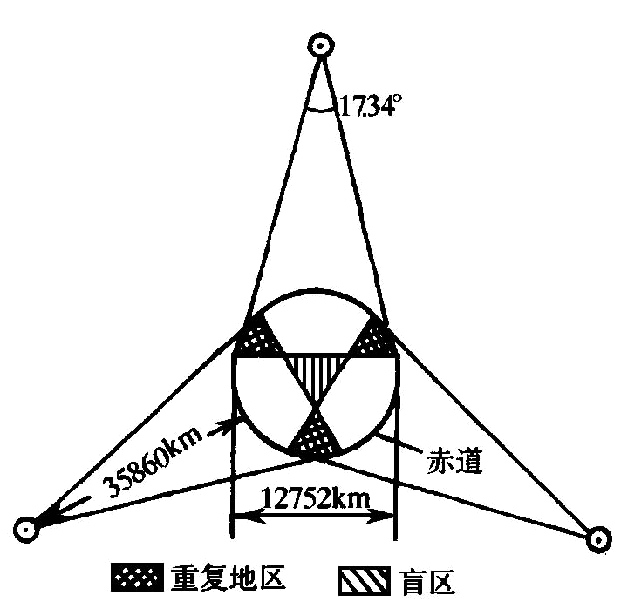
3. Channel
Wireless channel：
Ground wave
Sky-wave
Line-of –sight
propagation
Wired channel：
  Open wires
  Symmetrical cables
  Coaxial cables
equator

Slide 6
Channel models：
Modulation channel model
Coding channel model
4. Noise in Channel

Slide 7

【Example 1】 Assume a signal source produces 4-ary signals with equal probability, and the width of its symbol is 125 . Find its symbol rate and information rate.

Slide 8
【Example 2】 An information source consists of A, B, C, D. These symbols are represented by binary codeword 00, 01, 10, 11. If each binary symbol is transmitted by the pulse with width 5ms, and the 4 symbols have equal probability of occurrence . Find its symbol rate and information rate.

Slide 9
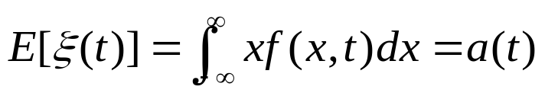
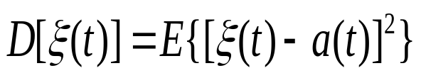
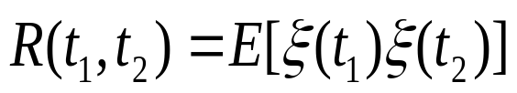
Chapter 2 Signals
Random process
Numerical characteristics of random process:
    Statistical mean:
    Variance:
    Autocorrelation function:

Slide 10

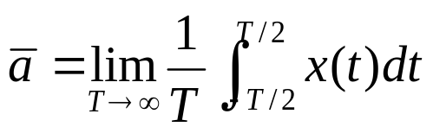
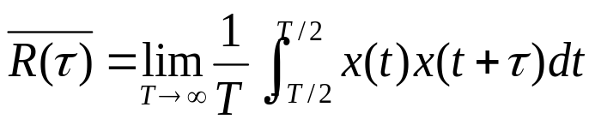
Stationary random process
  Characteristics of generalized stationary random process:
  Ergodicity

Slide 11





Autocorrelation function and power spectral density of stationary random process
  Characteristics of autocorrelation function

Slide 12
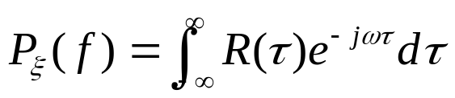
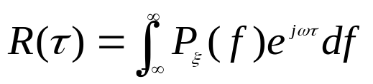
  Relationship between autocorrelation function & power spectral density
  a pair of Fourier transform

Slide 13
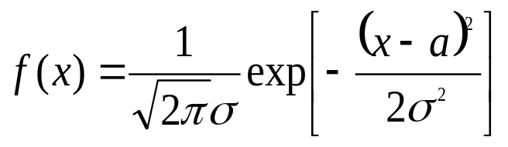
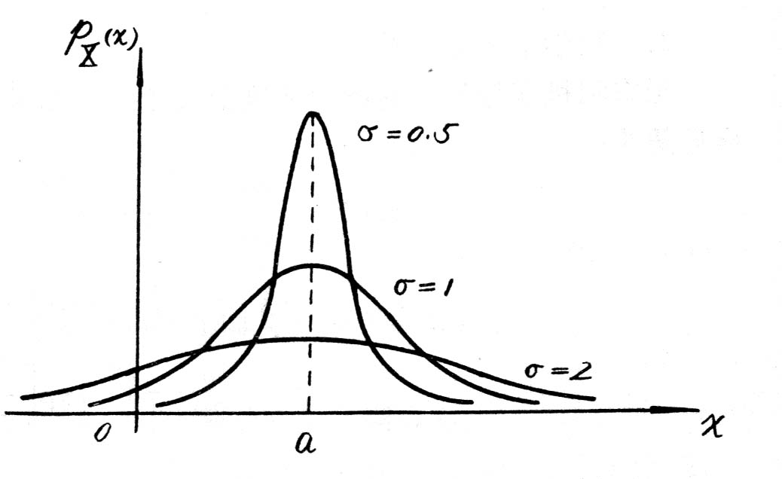
Gaussian process
  Definition
    One dimensional probability density of Gauss process:
    where, a = E[X(t)] --- mean
    σ² = E[X(t) - a]² --- variance
    σ --- standard deviation
    Curve of f (x):

Slide 14


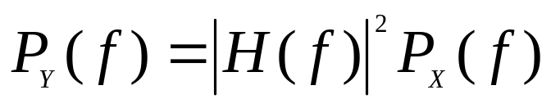
Random signal transfer through linear systems
mathematical expectation of output Y(t):
Autocorrelation function of output Y(t):
Power spectral density P_{Y}( f ) of output Y(t):

Slide 15



【Example 1】 Assume
is a random process, where X₁ and X₂ are statistically independent Gaussian random variables, and their mathematical expectations are 0, variances are . Find:
(1) E[Y(t)]、E[Y²(t)]
(2) The probability distribution density of Y(t)
(3) R(t₁，t₂)

Slide 16


【Example 2】 Assume X₁(t) and X₂(t) are two statistical independent stationary random process and their autocorrelation functions are and respectively. Find the autocorrelation function of their product X(t)= X₁(t)X₂(t).
Notes:
在最有利的条件下（对于最长的波），传播距离不超过3000-4000km。

Slide 17
Chapter 3 Analog modulation system
Analog modulation: modulation of a carrier by a source baseband analog signal
Modulating
signal m(t)
Modulator
Modulated
signal s(t)
Figure 3.1 Modulator

Slide 18
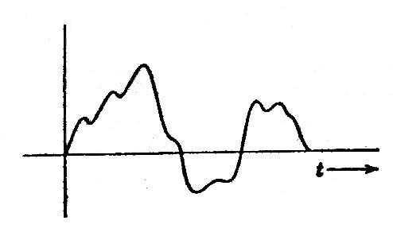
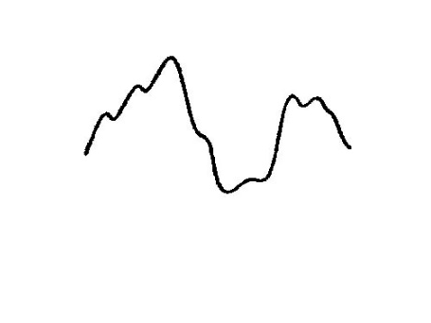

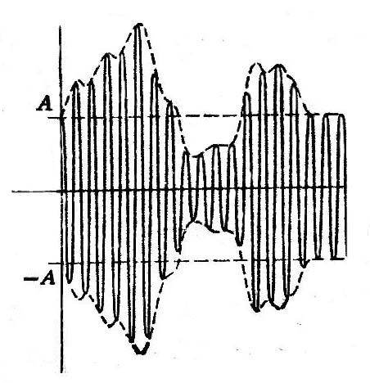
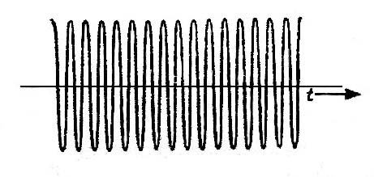
+1=
  × =
AM
m′(t)
1+m′(t)
1
0
1+m′(t)
1
0

Slide 19


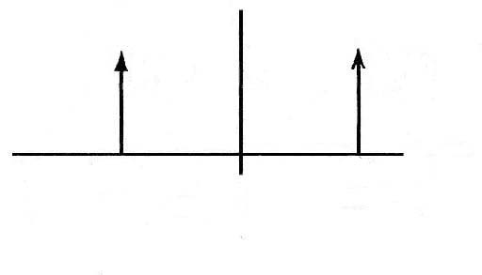

Frequency density
m(t)
M(f)
⇔
t
-f_{m}
f_{m}
f
c(t)
C(f)
A
⇔
t
-f₀
f₀
f
-A
s(t)
S (f)
⇔
f₀
f
t
-f₀
2f_{m}
2f_{m}
Figure 3.2.3 Waveform and spectrum of modulated signal

Slide 20
  Reception of AM signal: envelope detector
    Principle:
_{Rectifier}
_{Low-pass filter}
Figure 3.2.4 Envelope detector

Slide 21
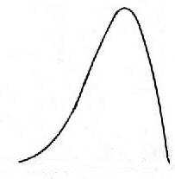
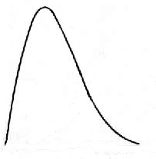


DSB modulation
M(f)
S(f)
Upper-sideband
Upper-sideband
Lower-sideband
0
f
f
-f₀
0
f₀
  (a) Frequency spectral density of modulating signal
  (b) Frequency spectral density of modulated signal
Figure 3.2.5 Spectrum of double-sideband modulation signal

Slide 22
DSB modulation
r′(t)
Received signal
s(t)
×
H(f)
Baseband signal
m(t)
cosω₀t
Figure 3.2.6 Block diagram of DSB signal demodulator

Slide 23


SSB modulation
Lower-sideband
S′(f)
Upper-sideband
Upper-sideband
-f₀
0
f₀
f
(a) Signal frequency spectrum before filtering
H_{H}(f)
S(f)
H_{H}(f)
Upper-sideband
Upper-sideband
-f₀
0
f₀
f
(b) Upper-sideband filter characteristic and signal frequency spectrum
S(f)
H_{L}(f)
Lower-sideband
-f₀
f₀
f
(c) Lower-sideband filter characteristic and signal frequency spectrum
Figure 3.2.7 Frequency spectrum of single-sideband signal

Slide 24

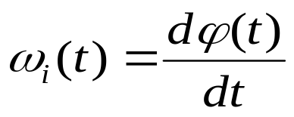
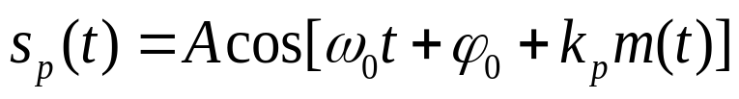
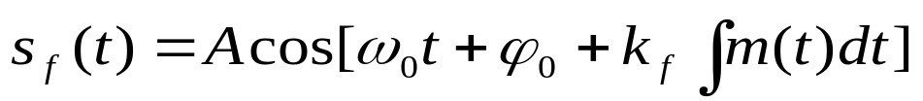
Nonlinear modulation
  ϕ₀ --- initial phase of carrier
      ϕ(t) = ω₀t + ϕ₀ --- instantaneous phase of carrier
      Define instantaneous frequency as:

Slide 25
【Example】: Let the expression of an angular modulated signal be
Find: (1) the maximum frequency deviation of the modulated signal;
(2) the maximum phase deviation of the modulated signal;
(3) the bandwidth of the modulated signal.

Slide 26
Chapter 4 Digitization of analog signal
  Two categories of information sources:
  analog signal, digital signal
  Three steps of A/D conversion:
  sampling, quantization , coding
  Most popular A/D conversion method:
  Pulse Code Modulation (PCM)

Slide 27
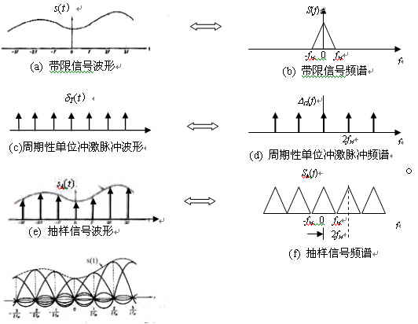

Slide 28
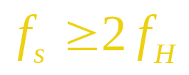
  Here, the condition of restoration of the original signal is
  2f_{H} is called Nyquist sampling rate. The corresponding smallest sampling time interval is called Nyquist sampling interval.
    The ideal filter is unable to be achieved. The cut-off edge of a practical filter can not be so sharp. Therefore, the practical sampling rate f_{s} must be much larger than 2f_{H}.
    For example, the highest frequency of typical telephone signal is limited to 3,400 Hz, and the sampling frequency used is 8,000 Hz.

Slide 29
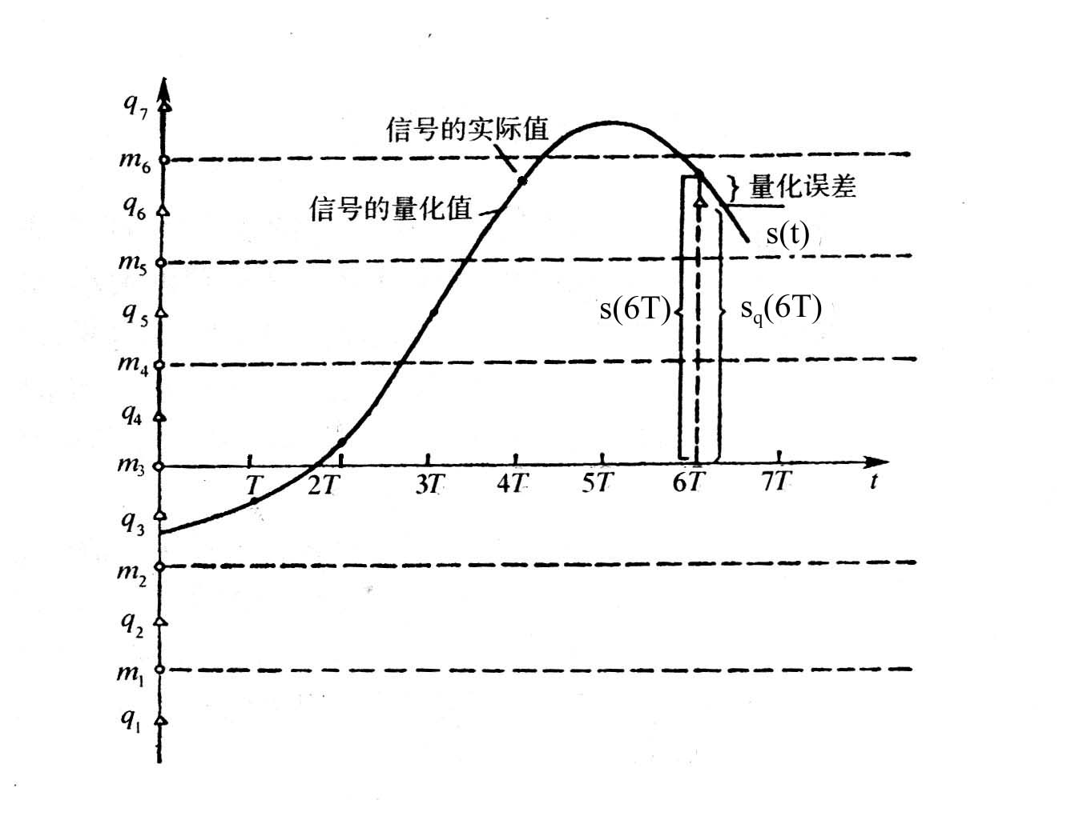
Quantization of sampled signal
图4.3.1 抽样信号的量化

Slide 30
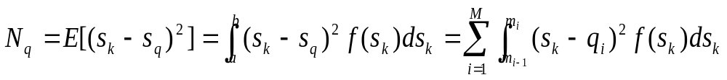
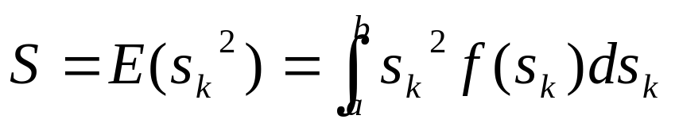
    Uniform quantization
  Average signal to quantization noise power ratio
  can be found from the above two equations.

Slide 31
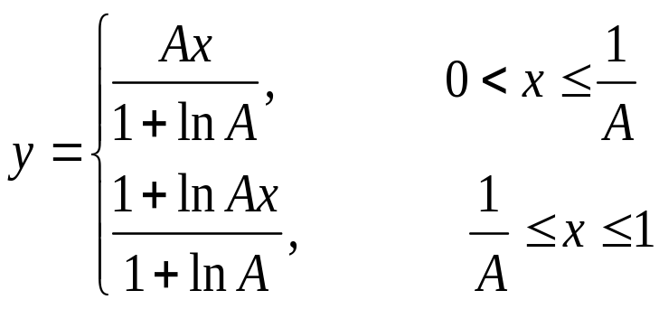
  Nonuniform quantization
  A-law
  where,
  x is the normalized input voltage of the compressor
  y is the normalized output voltage of the compressor
  A is a constant deciding the compression extent(87.6)

Slide 32
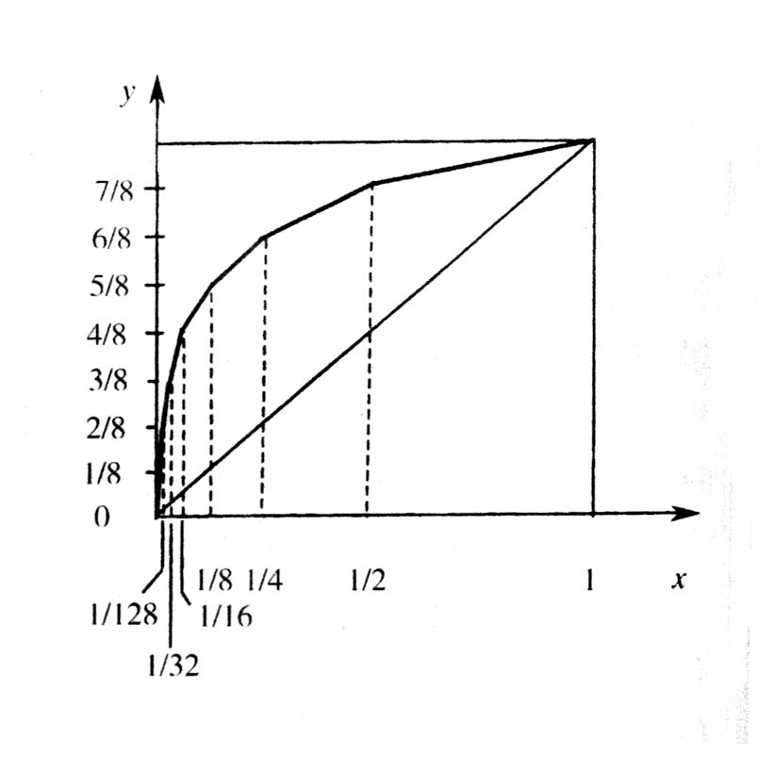
13 broken line compression characteristic

Slide 33
Pulse code modulation (PCM)
There are 8 bits in total: c1 to c8
      c1: polarity
      c2 ～ c4: segment bits
      － 8 segment slopes
      c5 ～ c8：inner-segment bits
      － 16 quantization levels
Notes:
TU-n -- Tributary Unit of level n
TUG-n -- Tributary Unit Group of level n
VC-n -- Virtual Container of level n
Note: G.702 tributaries associated with containers C-x are shown. Other signals eg. ATM can also be accommodated (see 102).

Slide 34
【Example】: Write the output binary codeword when a sample of the normalized input signal is equal to 0.62 in A-law PCM speech communication system.

Slide 35
解：Is=0.62*2048=1270(个量化单位)
设码组为C1 C2 C3 C4 C5 C6 C7 C8
第一次比较：
Is=1270Δ>0，说明信号为正，故c1=“1”；
第二次比较：
Iw1=128Δ,|Is|=1270Δ> Iw1,故c2=“1”；
第三次比较：
Iw2=512Δ,|Is|=1270Δ>Iw2,故c3=“1”；
第四次比较：
Iw3=1024Δ,|Is|=1270Δ> Iw3,故c4=“1”；
第五次比较：
Iw4=1024Δ+8*64Δ=1536Δ,|Is|=1270Δ<Iw4,故c5=“0”；
第六次比较：
Iw5=1024Δ+4*64Δ=1280Δ,|Is|=1270Δ< Iw5,故c6=“0”；
第七次比较：
Iw6=1024Δ+2*64Δ=1152Δ,|Is|=1270Δ> Iw6,故c7=“1”；
第八次比较：
Iw7=1024Δ+3*64Δ=1216Δ,|Is|=1270Δ>Iw7,故c8=“1”；
所以，所编8位码为：11110011

Slide 36
The bandwidth of an ‘N’ bit binary coded PCM signal for modulating a signal having bandwidth of ‘f_{H}’ Hz is Nf_{H} Hz

Slide 37
Chaper 5 Representation and Transmission of Baseband Digital Signal
Waveform of baseband digital signal
0 1 0 1 1 0 0 0 1
+V
(a)
0
+V
(b)
-V
(c)
+V
0
+V
(d)
0
-V
(e)
(a) Unipolar waveform (b)Bipolar waveform (c)Unipolar return-to-zero waveform
(d) Bipolar return-to-zero waveform (e)Differential waveform

Slide 38
  Symbol code types of baseband digital signals for transmission
  【Example】: If message symbol sequence is 1011000000000101, write the corresponding sequence of AMI code and HDB₃ code.
  AMI: +1 0 -1 +1 0 0 0 0 0 0 0 0 0 -1 0 +1
  HDB3：+1 0 -1 +1 0 0 0 +V –B 0 0 –V 0 +1 -1

Slide 39
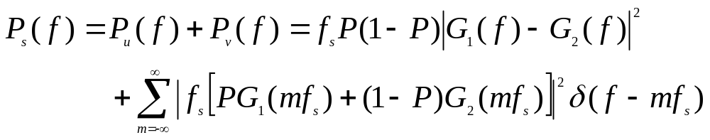
Frequency characteristic of baseband digital signal
  Double-side power spectral density expression:

Slide 40
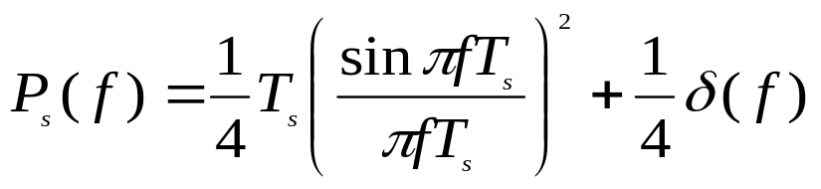
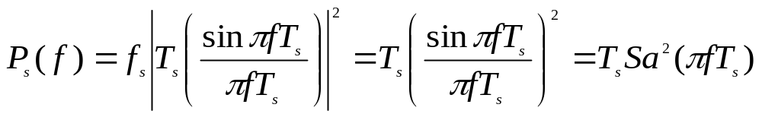
      Unipolar binary signal
      Bipolar binary signal

Slide 41
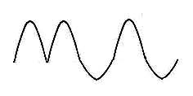
Transmission and intersymbol interference of baseband digital signal
G_{T}(f)
C(f)
G_{R}(f)
Transmitting filter
_{Channel}
Receiv-ing
filter
Sampling & decision
Noise

Slide 42
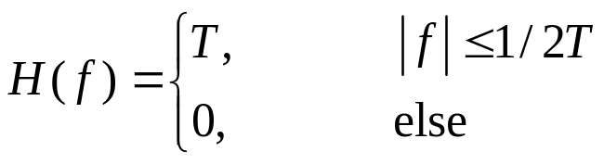
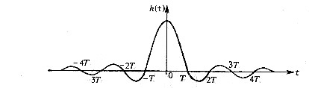
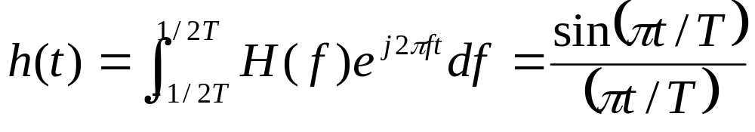
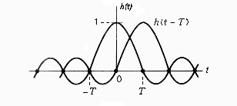
  Intersymbol interference and Nyquist criterion
Systems of overcoming
intersymbol interference :
Ideal rectangular characteristic
H(f)
T
-1/2T
0
1/2T
f
(a) Curve of H(f)
(b) Curve of h(t)
  transmission bandwidth W = 1/(2T) Hz
  transmission rate R_{B} = (1/T) Baud
  rate to bandwidth ratio:
  R_{B}/W ＝ 2 Baud/Hz
(c) Sketch map of no intersymbol interference between h(t) and h(t-T)

Slide 43
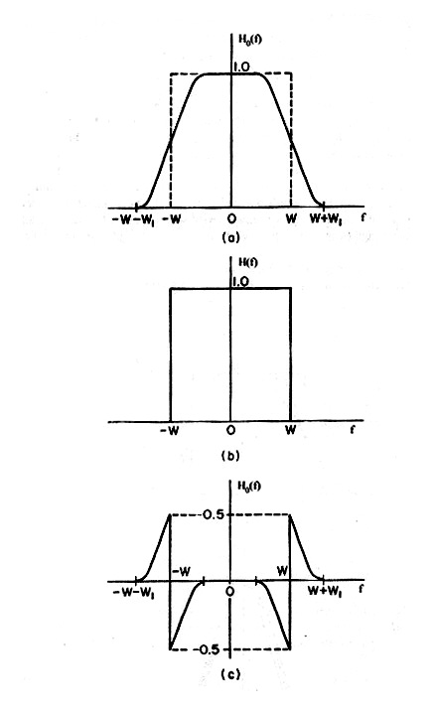
  Practically used no intersymbol interference transfer characteristic requires:
  Transfer function is a real
  function, and is odd symmetric
  at the point f = w.
  －called Nyquist criterion
(a) Transfer function
(b) Rectangular component
(c) odd symmetry component

Slide 44
GOOD LUCK!

