Slide 1
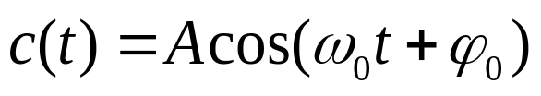
Chapter 3 Analog modulation system
3.1 Introduction
  Analog modulation: modulation of a carrier by a source baseband analog signal
  Carrier: a deterministic periodic waveform － cosinusoidal
  where, A --- amplitude
  ω₀ --- angular frequency
  of carrier
  ϕ₀ --- initial phase
  Definition:
    Modulating signal m(t) －signal from the source
    Modulated signal s(t) － signal after being modulated
    Modulator － the device for modulation
Modulating
signal m(t)
Modulator
Modulated
signal s(t)
Figure 3.1.1 Modulator

Slide 2
  Purpose of modulation
    Frequency spectrum movement --- for accommodating the requirement of channel transmission or for combining several signals for multi-channel transmission
    Improvement of anti-jamming ability
  Classification of analog modulation:
    Linear modulation: AM, SSB, DSB, VSB, …
    Nonlinear modulation (angular modulation): FM, PM

Slide 3


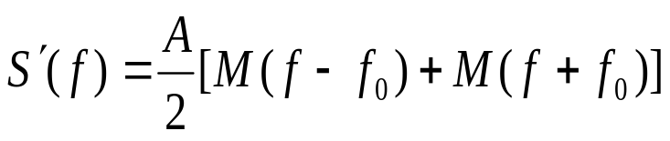
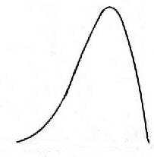
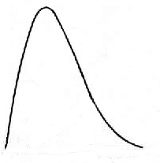
3.2 Linear modulation
3.2.0 Basic concept
Assume: the carrier is: c(t) = Acosω₀ t = Acos2π f₀t
modulating signal is a energy signal m(t), its spectrum is M(f )
carrier: c(t)
multiplication result: s′(t)
filter output: s(t)
“⇔” is used to express Fourier transform:
  where,
s′(t)
Modulating
signal
m(t)
×
H(f)
Modulated signal
s(t)
Acosω₀t
M(f)
S ′(f)
0
f
f
-f₀
0
f₀
  (a) Frequency spectral density of input signal
  (b) Frequency spectral density of output signal

Slide 4
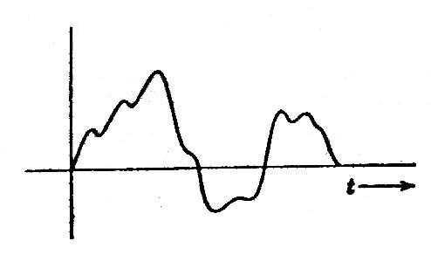
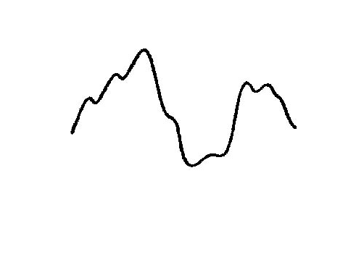
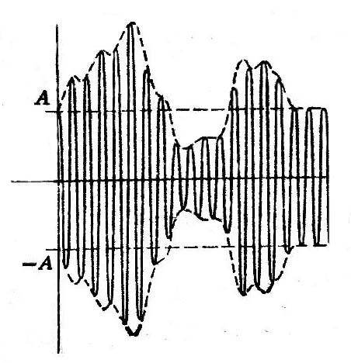
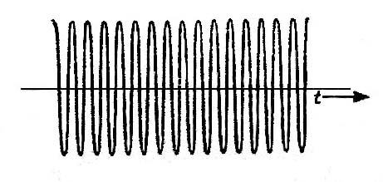
3.2.1 AM
  Basic principles
  Let: m(t) = [1+m′(t)]， |m′(t)| ≤ 1，
  m′(t)|_{max} = m －modulation index, then we have the AM signal
  s′(t) = [1+m′(t)]Acosω₀t，
  where, [1+m′(t)] ≥ 0, i.e., the envelope of s′(t) is non-negative
  +1 =
  × =
m′(t)
1+m′(t)
1
0
1+m′(t)
1
0

Slide 5
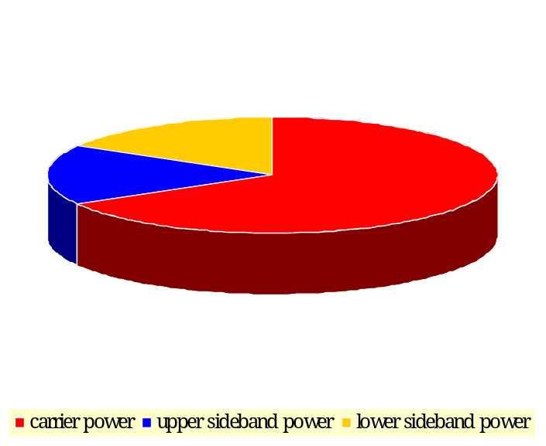

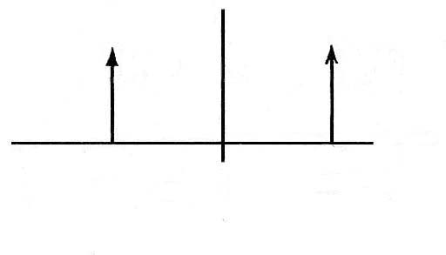
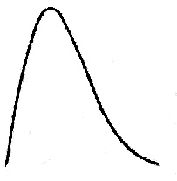
  Frequency density
    Contain discrete carrier component
    When m′(t) is cosinusoidal, and m＝100％,
    sum of the two side band power ＝ half of carrier power
m(t)
M(f)
⇔
t
-f_{m}
f_{m}
f
c(t)
C(f)
A
⇔
t
-f₀
f₀
f
-A
s(t)
S (f)
⇔
f₀
f
t
-f₀
2f_{m}
2f_{m}
Figure 3.2.3 Waveform and spectrum of modulated signal

Slide 6

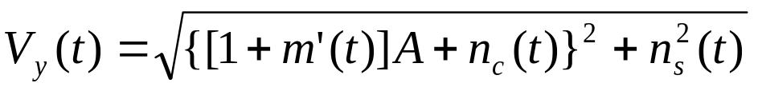
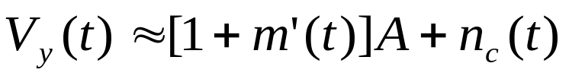
  Reception of AM signal: envelope detecton
    Principle:
    Characteristics: assume the input voltage is
    where
    is the input noise voltage of the detector
    The envelope of y(t):
    For large S/N:
_{Rectifier}
_{Low-pass filter}
Figure 3.2.4 Envelope detector

Slide 7


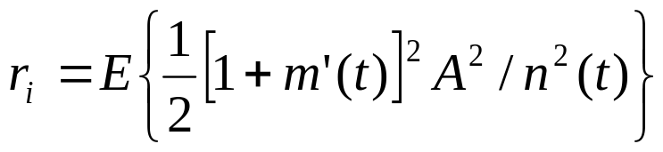
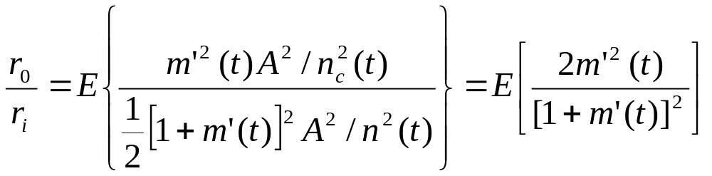
  After detection (D.C. component has been filtered):
  Signal to noise power ratio of output signal:
  ∵signal to noise power ratio before detection equals
  ∴Ratio of S/N before and after detection:
  Since m′(t) ≤ 1，obviously the above ratio r₀/r_{i} is less than 1, i.e., the S/N decreased after detection.

Slide 8
3.2.2 DSB modulation
  Principle: when the modulation signal m(t) has no D.C. component, DSB signal is obtained.
  Frequency spectrum: the two sidebands contain identical information.
M(f)
S(f)
Upper-sideband
Upper-sideband
Lower-sideband
0
f
f
-f₀
0
f₀
  (a) Frequency spectral density of modulating signal
  (b) Frequency spectral density of modulated signal
Figure 3.2.5 Spectrum of double-sideband modulation signal

Slide 9


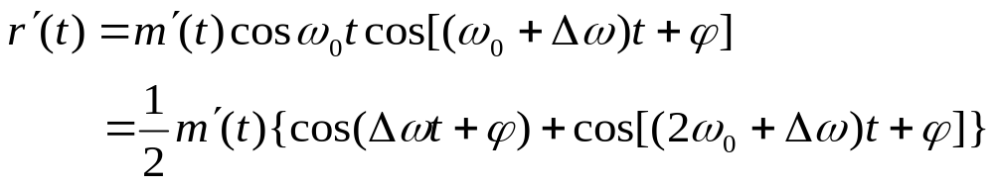
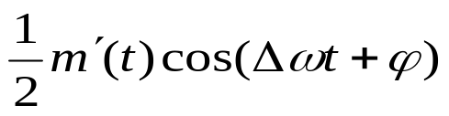
  Demodulation: need local
  carrier
    Let received DSB signal
    be
  local carrier of receiver
  be
  Product of the above two voltages is
  After low-pass filtered, we obtain
  The output signal equals m′(t) / 2, only if the local carrier has no frequency and phase error.
  Advantage & disadvantage: DSB signal can save transmitting power, but the receiving circuit will be rather complicated.
r′(t)
Received signal
s(t)
×
H(f)
Baseband signal
m(t)
cosω₀t
Figure 3.2.6 Block diagram of DSB signal demodulator

Slide 10
3.2.3 SSB modulation
  Principles:
    Two sidebands contain
    identical information
    Only one sidaband
    should be transmitted
    Too low frequency
    components in m(t) is
    not allowed
  Demodulation: local carrier
  is needed
    Since, if
    z(t) = x(t) y(t) ，
    then, we have
    Z(ω) = X(ω) ∗ Y(ω)
    During demodulation of SSB signal, the carrier cosω₀t is multiplied with the received signal; it is equivalent to convolution of carrier and signal spectra in frequency domain.
Lower-sideband
S′(f)
Upper-sideband
Upper-sideband
-f₀
0
f₀
f
(a) Signal frequency spectrum before filtering
H_{H}(f)
S(f)
H_{H}(f)
Upper-sideband
Upper-sideband
-f₀
0
f₀
f
(b) Upper-sideband filter characteristic and signal frequency spectrum
S(f)
H_{L}(f)
Lower-sideband
-f₀
f₀
f
(c) Lower-sideband filter characteristic and signal frequency spectrum
Figure 3.2.7 Frequency spectrum of single-sideband signal

Slide 11
  To use upper sideband as example shows demodulated signal after low-pass filtering.
  Advantages of SSB: smaller transmitting power and bandwidth than DSB signal.
Lower-sideband
S′(f)
Upper-sideband
Upper-sideband
-f₀
0
f₀
f
(a) Signal frequency spectrum before filtering
H_{H}(f)
S(f)
H_{H}(f)
Upper-sideband
Upper-sideband
-f₀
0
f₀
f
(b) Upper-sideband filter characteristic and signal frequency spectrum
S(f)
H_{L}(f)
Lower-sideband
-f₀
f₀
f
(c) Lower-sideband filter characteristic and signal frequency spectrum
Figure 3.2.7 Frequency spectrum of single-sideband signal

Slide 12
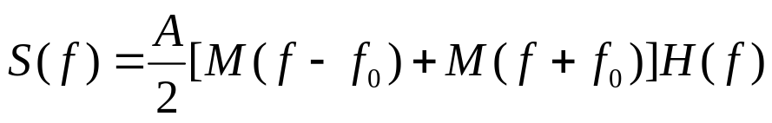
3.2.4 VSB modulation
  Advantages of VSB: During demodulation, no local carrier is necessary; modulating signal may contain very low frequency and D.C. components.
  Principles: VSB is still linear modulation.
  The frequency spectrum of the modulated signal is
  Assume the transfer function of the filter of modulator is H( f )，then the frequency spectrum of the modulated signal after filtering is
s′(t)
Modulating signal
m(t)
H(f)
Demodulated signal
s(t)
Acosω₀t

Slide 13
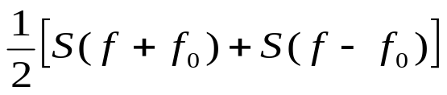
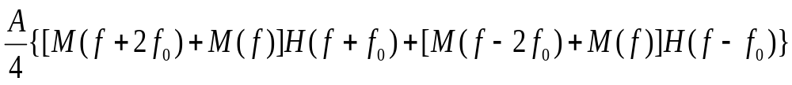
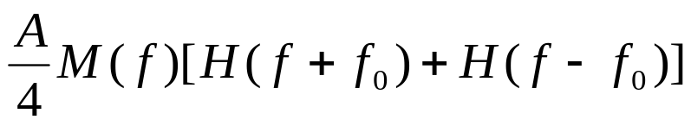
  Let’s find the condition
which should be satisfied by
transfer function H( f ) in the
figure.
  In the figure, the received signal is multiplied by the local carrier, and the frequency spectrum of the resultant signal r ′(t) is:
  Substituting the frequency spectrum
  of the modulated signal into the above equation, the frequency spectrum of r ′(t) is obtained as:
M(f + 2f₀) and M(f – 2f₀) in the above equation may be filtered out by the low-pass filter, hence the spectral density of the demodulated signal from filtering is:
r′(t)
Received signal
s(t)
×
H(f)
Baseband signal
m(t)
cosω₀t

Slide 14


For distortionless transmission, require
Since
The above equation can be rewritten as
The above equation is a prerequistie for the filter characteristic to produce VSB signal.

Slide 15
The above equation requires that the cut-off characteristic of the filter is complementary symmetry with respect to the f₀.
H(f)
-f₀
0
f₀
f₀+f_{m}
f
-(f₀+f_{m})
H(f + f₀)
-2f₀
0
f_{m}
f
H(f - f₀)
0
2f₀
f
H(f + f₀) + H(f – f₀)
f
-2f₀
-f_{m}
0
f_{m}
2f₀

Slide 16

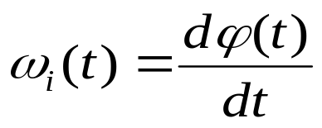
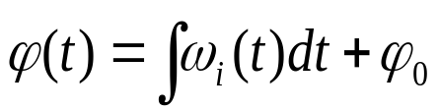
3.3 Nonlinear modulation
3.3.1 Basic principles
  Concept of frequency: strictly speaking, only the sinusoidal wave with constant amplitude, constant phase, and infinite length has single frequency. A carrier after modulated no longer has single frequency.
  Concept of “instantaneous frequency”: let a carrier can be expressed as
  where, ϕ₀ --- initial phase of carrier
      ϕ(t) = ω₀t + ϕ₀ --- instantaneous phase of carrier
      ω₀ = dϕ(t)/dt --- angular frequency of carrier
  Define instantaneous frequency as:
  The above equation can be written as:

Slide 17
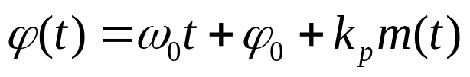
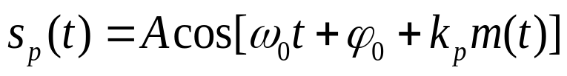
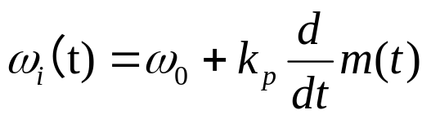
  Definition of angular modulation:
  As can be seen from the following equation,
  ϕ(t) is the phase of carrier. If it varies with modulating signal m(t) according to certain mode, then it is called angular modulation.
    Definition of phase modulation: If phase ϕ(t) linearly varies with m(t), i.e., let
    then it is called phase modulation. Thus, the expression of the modulated signal is
    Now, the instantaneous frequency of the modulated carrier is:
    The above equation shows that the instantaneous frequency in phase modulation linearly varies with the derivative of the modulating signal.

Slide 18

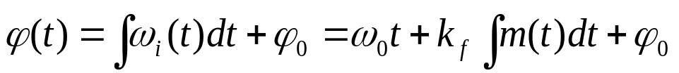
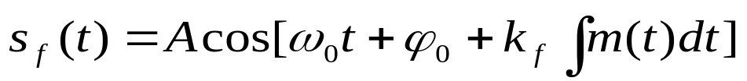
    Definition of frequency modulation: If instantaneous frequency linearly varies with the modulating signal, then frequency modulation is obtained. Now instantaneous angular frequency is
    and instantaneous phase is
    In this way, the expression of the modulated signal obtained is:
    As can be seen from the above equation, the phase of the carrier is linearly varies with the integration of modulating signal.

Slide 19
    Comparison of phase modulation and frequency modulation:
      The carrier phase ϕ (t) in phase modulation linearly varies with the modulating signal m (t), and the carrier phase ϕ (t) in frequency modulation linearly varies with the integral of the modulating signal m (t).
      If m (t) is integrated first, and the phase of carrier is modulated, then frequency modulated signal is obtained. Similarly, if m (t) is differentiated first, and frequency of carrier is modulated, then phase modulated signal is obtained.
      It is impossible to distinguish them by modulated signal waveforms.

Slide 20
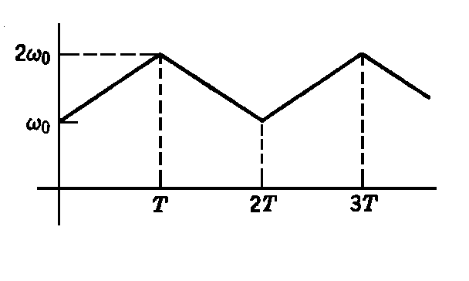
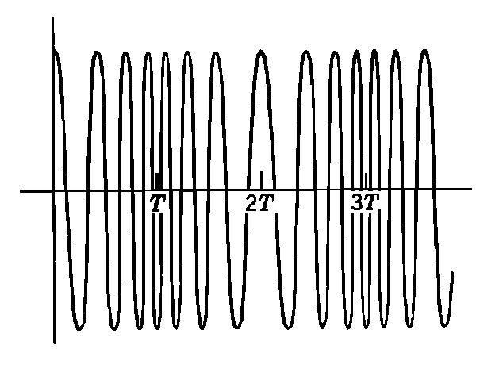
    Waveform of angular modulation
      If m(t) linearly varies, then the modulated signal is frequency modulated signal.
      If m(t) varies with t ², then the modulated signal is phase modulated signal.
ω_{i}

Slide 21

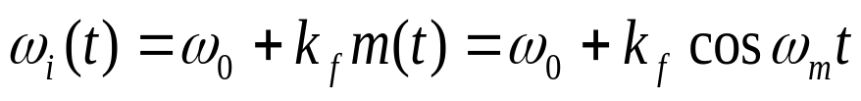
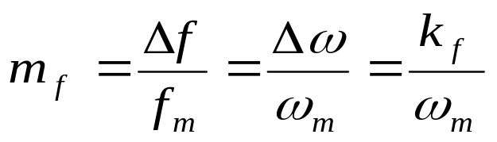
3.3.2 Frequency spectrum and bandwidth of modulated signal
  Assume：modulating signal m(t) is a cosinusoidal wave:
  It is used to modulate the frequency of the carrier, then the instantaneous frequency of the carrier is
  where, k_{f} = Δω －max. angular frequency deviation
    Expression of modulated signal:
  where, Δω ⁄ ω_{m}＝Δf / f_{m} --- ratio of max. frequency deviation to baseband signal frequency, it is called modulation index m_{f} , i.e.

Slide 22
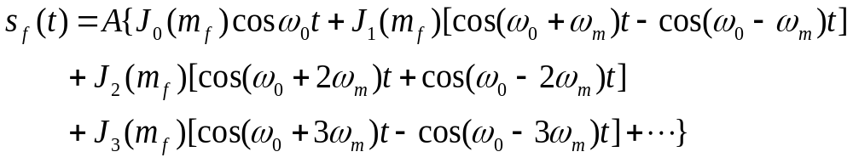
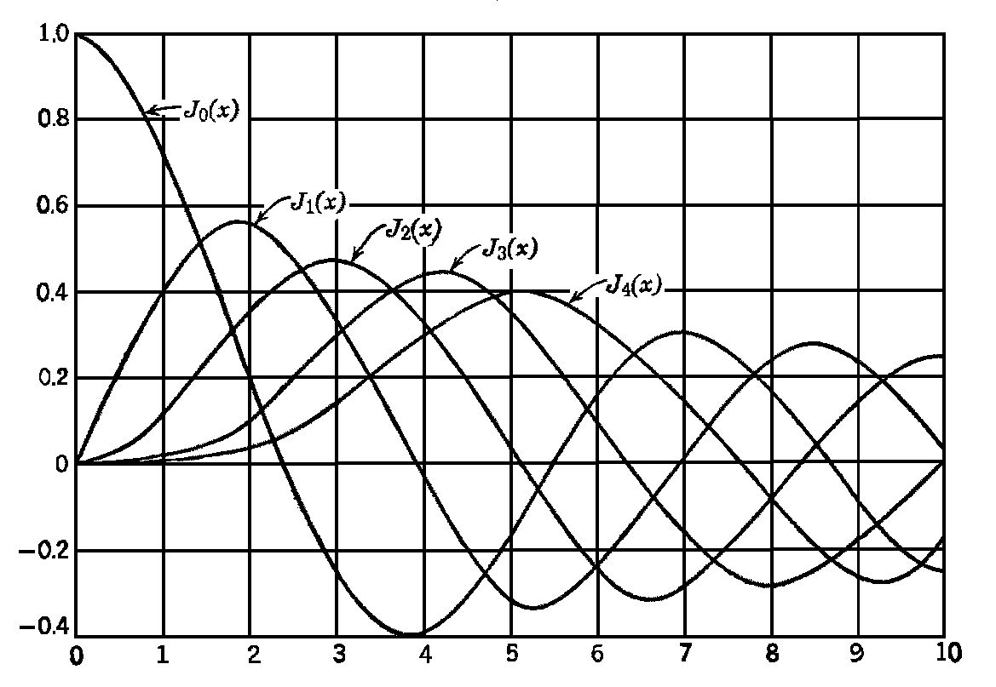
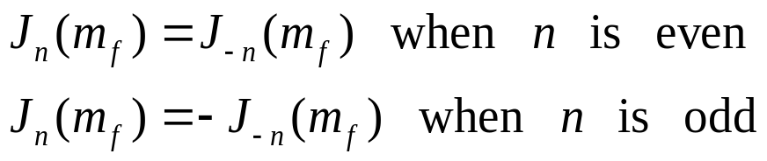
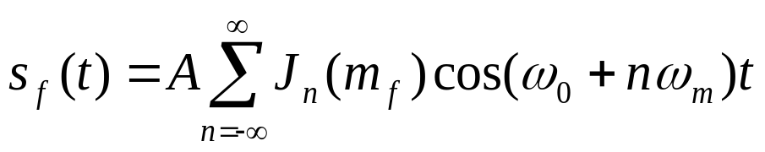
is a cosine function containing sine functions. Its expansion is:
where, J_{n}(m_{f}) is the Bessel function of first kind of n-th order.
It has the following characteristics:
Hence, the above equation can be
rewritten as:
－ Final expression
x

Slide 23
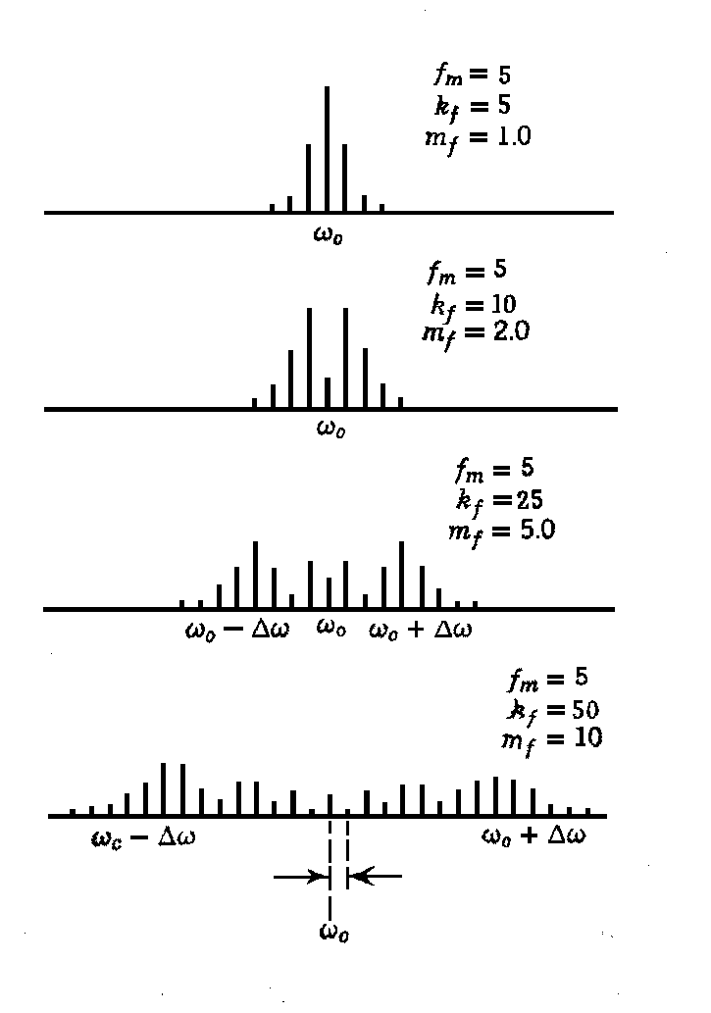


  Characteristics of the frequency spectrum
    Side frequencies in pair
    Most part of power
    concentrates in a finite
    bandwidth.
    When m_{f} <<1, B basically
    equals 2ω_{m} － called
    narrow band FM:
    B ≈ 2ω_{m}
    When m_{f} > 1,
    B：
    where
    Δf － frequency deviation
    f_{m} － frequency of modulation signal
kHz
kHz
ω
kHz
kHz作
ω
kHz
kHz
ω
kHz
kHz
ω
ω_{m}

Slide 24
3.3.3 Reception of angular modulated signal
3.4 Brief summary

