Slide 1
Chapter 7 Synchronization
  7.1 Introduction
  Problems should be solved by synchronization:
    Carrier synchronization
    Bit synchronization
    Group synchronization
    Network synchronization
    The price for solving the synchronization problems:

Slide 2


  7.2 Carrier Synchronization method
  7.2.1 Pilot Insertion Method
  Example: 2PSK signal
    At the transmitter: to insert an orthogonal pilot
  The highest frequency in the spectrum of m(t) is f_{m} .
0
f₀ – f_{m}
f₀
f₀ + f_{m}
f
Pilot

Slide 3
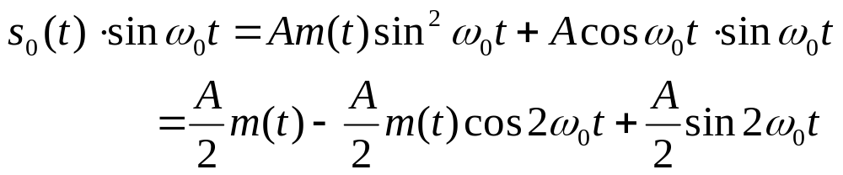
    At the receiver:
    The pilot component is filtered out by a narrowband filter in the receiver, and is phase shifted π/2; then it is multiplied with the received signal.
    Assume the received signal is still expressed by s₀(t), then the product is
  The frequency component 2ω₀ is removed by the lowpass filter, then the original modulating signal m(t) is restored.
    If the pilot is not an orthogonal one, then a D.C. component will be added onto the output.

Slide 4
    Block diagram
Multiplier
Bandpass filter
Adder
Carrier generation
π/2
phase shift
(a) Block diagram of transmitter
Bandpass filter
Multiplier
Low-pass
filter
Narrowband filter
π/2
phase shift
(b) Block diagram of receiver

Slide 5

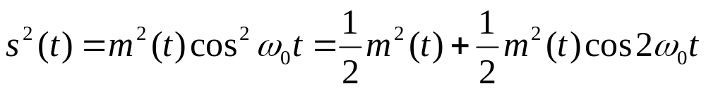
  7.2.2 Direct extraction method
    Square method
      Principle
    For the signals without carrier component, e.g., the 2PSK signal, assume the recived signal s(t) is：
    where m(t) is the modulating signal with no D.C. component.
    After the received signal is squared, we obtain
    The 2f₀ component in the above equation is filtered out by a narrowband filter, and its frequency is divided by 2, then the component with the carrier frequency f₀ is obtained.
    The block diagram is as follows:
S(t)
S²(t)
2f₀
f₀
Square
Narrow band filter
Frequency diivider

Slide 6
      Problem existed: phase ambiguity.
      PLL instead of narrowband filter
        Block diagram
        Advantage: The output signal has better stability, and the incoming signal may be the extensively used discontinuous signal.
S(t)
S²(t)
2f₀
f₀
Square
Multiplier
Loop filter
VCO
Frequency diivider
Phase-locked loop

Slide 7


    Costas loop method
      Block diagram
      Principle
      Assume the received signal is a suppressed carrier double-sideband signal s(t), and the local carrier voltages are
      where θ is the phase difference between the signal and the local carrier.
Multiplier
c
Low-pass
e
g
Demodulation output
a
VCO
Loop
filter
Multiplier
s(t)
π/2 Phase shift
b
Multiplier
d
Low-pass
f

Slide 8
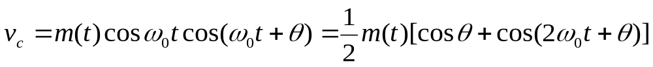
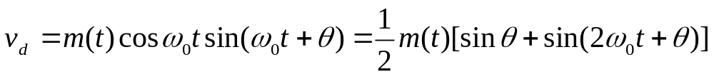
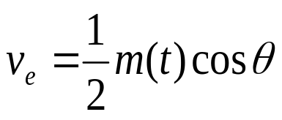
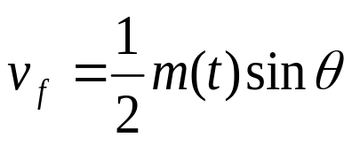
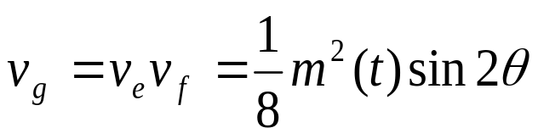
  The incoming signal s(t) is multiplied by the local carrier, and we obtain
  After lowpass filtering, they are respectively:
  and
  The above two voltages are multiplied, obtaining
  Voltage v_{g} after passing the loop filter is added onto the VCO to control its oscillation frequency.
  When θ = 0, v_{g} = 0, the control voltage of the oscillator is also equal to 0.

Slide 9
      Conclusion:
        The output voltage v_{a} of the VCO is the carrier extracted from the received signal, and can be used for coherent reception.
        The voltage v_{e} at point e is is the demodulated output voltage, since it approximately equals m(t)/2.
      Advantages and disadvantages:
        There is no need for the square circuit which is difficult to achieve when the frequency is very high.
        If the Costas loop is required to give the theoretical optimum performance, then the performances of two lowpass filters should be completely the same. It is difficult for analog circuit, but if digital circuit is used, then it is not difficult.
        There also exists the phase ambiguity probleim.

Slide 10



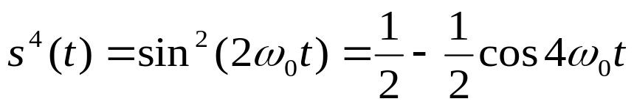
    Extraction of carrier frequency from M-ary signal
      QPSK signal is used for example to illustrate the principle of the square method.
    Assume a QPSK signal is expressed as
    where
    After it is squared, we obtain
    For equal a priori probability QPSK signal, the sign “±” in the above equation represents that the average power of the component with the frequency 2ω₀ equals zero, i.e., there is no component with frequency 2ω₀ in the spectrum. Hence, it is necessary to square again after filtering out its D.C. component; then obtain
    There is 4f₀ component in the above equation. It is filtered and frequency divided by 4 to obtain the carrier component with frequency f₀ .

Slide 11
      Block diagram
Demodulation output
Multipier
Lowpass
•
•
Multipier
Lowpass
Multipier
s(t)
π/4 Phase shift
•
•
Multipier
Lowpass
•
π/2 Phase shift
•
Multipier
Low-pass
3π/4 Phase shift
•
VCO
Loop filter
Figure 7.2.5 Block diagram of QPSK Costas loop demodulation

Slide 12
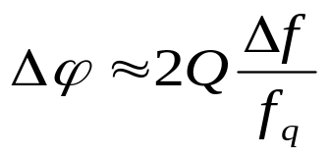
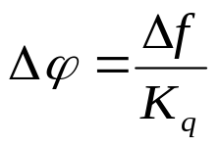
  7.2.3 Performance of carrier synchronization
    Precision of carrier synchronization:
    Two kinds of phase error θ ：
      Invariant error
        Introduced by circuit parameters
        Assume the narrowband filter consists of a single resonance circuit; then the appended phase shift introduced by it equals
        Introduced by the PLL
        Assume the error introduced by the PLL is Δϕ，then we have
        where Δf － the difference between f_{q} and f₀
        K_{q} － D.C. gain of the PLL

Slide 13
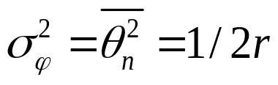
      Random error: introduced by the noise
      In the additive Gaussian noise channel, the relationship between the variance of the random phase error θ_{n} and the signal to noise ratio r is
      where σ_{ϕ} － phase jittering
      r － signal to noise power ratio
      The requirements on the value of Q by the invariant phase error and the random phase error are contrary.
    Establishing time and holding time of synchronization
      Synchronization establishing time － the time needed from the beginning of receiving the signal, or from the system lost-synchronization status, to the steady carrier frequency extracted － the shorter, the better.
      Synchronization holding time － the time from the beginning of lost signal to lost carrier synchronization － the longer, the better.
      They are contrary each other.

Slide 14
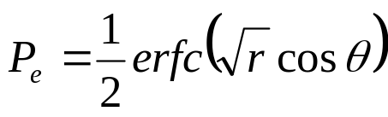
    Influence of carrier synchronization error on symbol error probability
      The phase error θ includes two parts:
      θ ＝ Δϕ ＋ σ_{ϕ}
      where Δϕ － invariant error
      σ_{ϕ} － random error
      ∵The demodulation output is
      where cosθ is the voltage drop introduced by the phase error.
      ∴ The signal to noise ration r descends to cos²θ times.
      Hence, the symbol error probability is reduced to
      where r is the signal to noise power ratio.

Slide 15

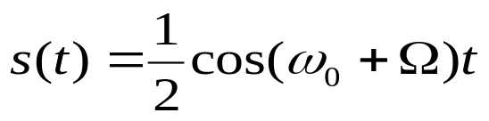
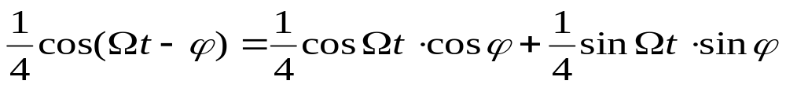
Waveform distortion introduced by carrier synchronization error
    For example, the SSB signal may be distored.
    Assume s single frequency baseband signal is
    A carrier cosω₀t is SSB modulated by it, and the upper-side band signal is
    If the local coherent carrier of the receiver has the phase error ϕ , then the multiplied result of the SSB signal by the local carrier is
    The low frequency component filtered out by the lowpass filter is
    where the first term is attenuated by the factor cosϕ ; the second term is orthogonal to the first term, and causes the received signal distortion. This distortion may cause inter-symbol interference.

Slide 16
  7.3 Bit Synchronization
  7.3.1 External synchronization
    Principle: A bit synchronization signal is inserted into the transmitting signal, whose frequency equals the symbol rate (1/T) or several times of the symbol rate.
    It will be filtered out by a narrowband filter in the receiver, thus forming the symbol timing pulses.
    Methods of the bit synchronization insertion
      Time domain: continuous insertion or preamble added
      Frequency domain: insertion outside the signal frequency band or in the “gap” of the signal spectrum.
    Advantage: simple equipment
    Disadvantage: occupies certain bandwidth and power.
  7.3.2 Self synchronization
    Open-loop synchronization method － the synchronization circuit extracts the clock of the transmitted symbol stream directly from the incoming symbol stream.
    Three practical schemes are given below.

Slide 17
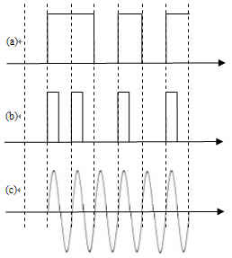
      Waveform transform method
a
b
c
Waveform transform
Narrow band filtering
Phase shift
Pulse shaper

Slide 18
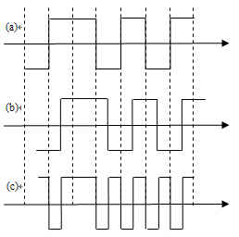
      Delay multiply method
a
c
Multiplier
Narrow band filtering
Amplifier & amplitude limiter
b
Delay T/2

Slide 19
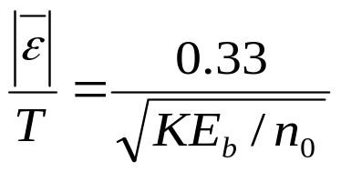
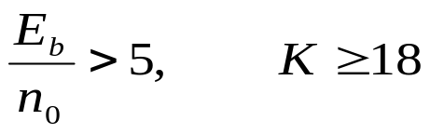
      Differential rectify method
    Error: If the bandwidth of the narrowband filter equals 1/KT , then the magnitude of the fractional mean time error is
        when
    where ε － synchronization error time
    T － symbol duration
    E_{b} － bit energy
    n₀ － single-side noise power spectral density
    Hence the above scheme can guarantee that symbol synchronization is accurate enough only if the received signal to noise ratio is large.
      Disadvantage: existing nonzero mean synchronization tracking error.
Lowpass
Differential
Rectifier
Narrow band filtering
Amplifier & amplitude limiter

Slide 20

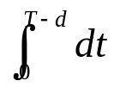
    Closed-loop symbol synchronization
u₁
|u₁|
Multiplier
| •|
Late gate
-
m(t)
VOC
Loop filter
e=|u₂|-|u₁|
+
Gate waveform
generation
Early gate
+
u₂
|u₂|
Multiplier
| •|
+1
+1
T
T
-1
-1
d
Δ
d+Δ
Early gate
Early gate
d
Late gate
Late gate
2Δ
Integration time
(a) Synchronization status
(b) Early status

Slide 21
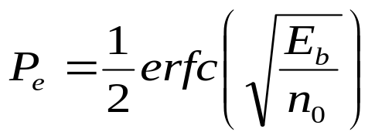
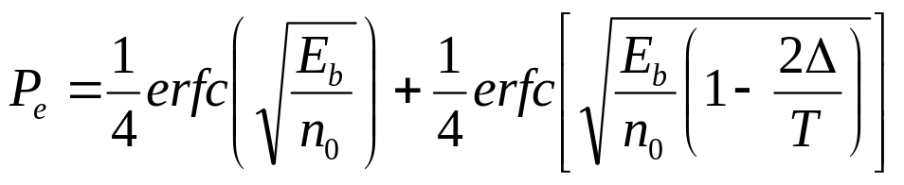
  7.3.3 Influence of bit synchronization error on symbol error
  If the error of the bit synchronization time is Δ, then the integration interval will lose by 2Δ, and the symbol energy obtained by integration will be decreased to E_{b}(1-2Δ/T); when there are no jump edges of the adjacent symbols, the integration interval will suffer no loss. For the random symbol with equal a priori probability, the proportions of jump edges and jumpless edges are ½ respectively.
  Example: The optimum symbol error probability of 2PSK signal equals
  Therefore, when there is phase error, the mean symbol error probability is

Slide 22
  7.4 Group Synchronization
  7.4.1 Introduction
  The transmission methods of group synchronization information:
  1. The codeword contains the grouping information
  2. Specific symbols are inserted in the transmitting sequence:
  (1) concentrated insertion, and (2) dispersed insertion
Signal symbol group
Signal symbol group
Signal symbol group
Group synchronization code
Group synchronization code
Group synchronization code
Group synchronization code
(a) Concentrated insertion
Signal symbol group
Signal symbol group
Signal symbol group
Group synchronization symbol
Group synchronization symbol
Group synchronization symbol
Group synchronization symbol
… …
… …
…
Group synchronization sequence
(b) Dispersed insertion

Slide 23
    Concentrated insertion: is suitable for places where the rapid establishment of the synchronization is required or the information is intermittently transmitted and each transmission time is very short.
    Dispersed insertion: needs a rather long synchronization establishment time. Therefore, it is suitable for continuous signal transmission, e.g., in the digital telephone system.
    Two statuses: acquisition status and holding status
    Start-stop synchronization:
    It is mainly suitable for teletypes which are hand operated at low speed.
    It is sometimes called asynchronization communication because its symbol durations are unequal.
stop
start
stop
1
2
3
4
5

Slide 24
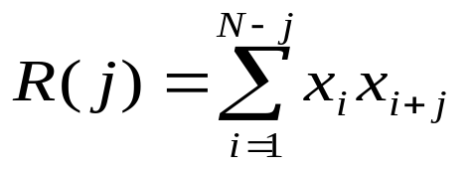


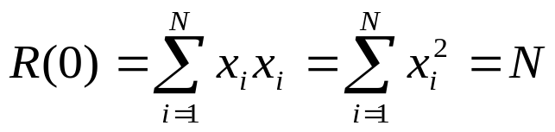
  7.4.2 Concentrated insertion method
    Principle
  Assume a codeword is composed of N symbols {x₁, x₂, … , x_{N}}, then its local auto-correlation function equals
  where N － symbol number in the codeword
  x_{i} － value of the symbol, and can be +1 or -1
  When j = 0,
  It has been defaulted that when 1 > i and i >N, x_{i} = 0.
  If the peak of a code only appears at R(0), R(j)s are very small at other points, then the location of the code can be determined by searching the peak using the method of calculation the auto-correlation function of the received symbol sequence.

Slide 25
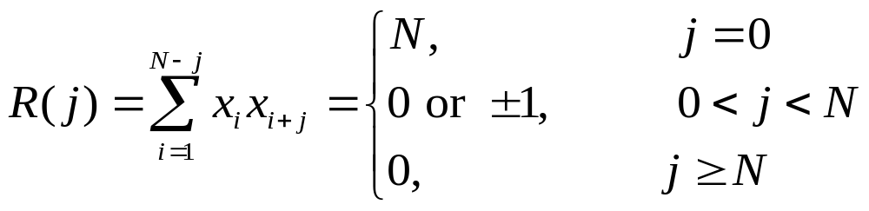
    Barker code
      Definition:
    General construction method for Barker code hasn’t been found yet.
N | Barker code
1 | ＋
2 | ＋＋ or ＋－
3 | ＋＋－
4 | ＋＋＋－ or ＋＋－＋
5 | ＋＋＋－＋
7 | ＋＋＋――＋－
11 | ＋＋＋―――＋――＋－
13 | ＋＋＋＋＋――＋＋－＋－＋

Slide 26
      Values of auto-correlation function:
      The Barker code with N = 5 is used as an example.
x_{i}
x_{i+1}
x_{i+2}
x_{i+3}
x_{i+4}
x_{i}
x_{i}
x_{i}
x_{i}
x_{i}
x_{i}²
x_{i}x_{i+1}
x_{i}x_{i+2}
x_{i}x_{i+3}
x_{i}x_{i+4}
R (0) = 5
R (1) = 0
R (2) = 1
R (3) = 0
R (4) = 1
R(j)
•
5
3
2
•
•
1
•
•
•
•
•
•
-4
-3
-2
-1
0
1
2
3
4
j
-1

Slide 27
    Willard code
    It gives the minimum false synchronization probability for random adjacent symbols.
N | Willard code
1 | ＋
2 | ＋－
3 | ＋＋－
4 | ＋＋－－
5 | ＋＋－＋－
7 | ＋＋＋―＋――
11 | ＋＋＋―＋＋―＋―――
13 | ＋＋＋＋＋――＋－＋―――

Slide 28
    Realization of concentrated insertion
      Once the value of the auto-correlation founded is equal to the length N of the synchronization codeword, it is regarded the synchronization has been acquired, and then the system will convert into the holding status from the acquisition status.
      Thereafter, the received codewords at the synchronization location are still continuously examined for whether its auto-correlation value equals N.
      When the system loses synchronization, the value of the auto-correlation function immediately drops.
      Noise can also cause the auto-correlation drop, therefore for protecting the synchronization status against interruption by the interference, such as noise, the requirement on the auto-correlation value should be decreased during holding status.
      After the system is determined to be lost synchronization, the system is switched to the acquisition status, and to acquire the synchronization codeword again.

Slide 29
  7.4.3 Dispersed insertion method
    Example: The 1/0 alternative code is often used in the digital telephone symtem.
P
P
P
Signal symbol group
Signal symbol group
Signal symbol group
Group synchronization symbol
Group synchronization symbol
Group synchronization symbol
Group synchronization symbol
… …
….. 1 0 1 0 1 0 1 0 1 0 …
Group synchronization sequence
Figure 7.4.5 “1/0” alternative code dispersive insertion method

Slide 30
    Searching method of synchronization code
      Shift searching method
Start
Set synchronization status to acquisition status
Set each counter to 0
Initialization
Status switch
Holding status
Synchronization status
Acquisition status
Y
Is
synchronization symbol？
Counter C is added 1
Shift 1 bit
N
Counter B is added 1
Set 0
Is counter C
counted to n?
N
Is
synchronization symbol？
Y
Set 0
Is counter B
counted to m?
CounterA is added 1
Y
Is counter A
counted to n?
N
Y

Slide 31
      Storage detection method
33 34 35 36 37 38 39 40
New incoming
symbol
x x x x x x x 0
25 26 27 28 29 30 31 32
x x x x x x x 1
17 18 19 20 21 22 23 24
Examine whether
1/0 alternative
x x x x x x x 0
09 10 11 12 13 14 15 16
x x x x x x x 1
Old outgoing symbol
01 02 03 04 05 06 07 08
x x x x x x x 0
  Figure 7.4.7 Sketch map of storage detection method

Slide 32
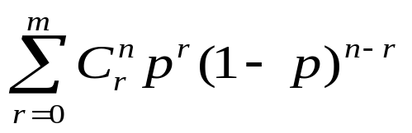
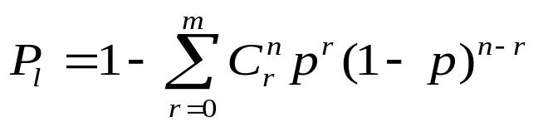

  7.4.4 Performance of group synchronization
    Lost synchronization probability P_{l} ：
    Assume: p is the probability of received wrong symbols.
    n is the number of synchronization symbols should be examined.
    m is the allowed maximum number of wrong symbols during examination
    then the probability that the codeword doesn’t miss recognition as the synchronization codeword equals
    So, the lost synchronization probability is
    When there is no error allowed, namely assume m = 0, then the above equation becomes

Slide 33
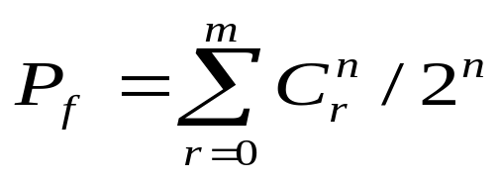
    False synchronization probability P_{f} :
    Assume the a priori probabilities of 1 and 0 occurred are equal; the length of synchronization codeword is n, then
    the information codewords with n bits have permutations. The probability of mistaken as the synchronization codeword is related to the allowed error symbol number m.
    If no error symbol is allowed, i.e., m = 0, then there is only one possibility, namely every symbol in the information codeword is identical with the synchronization symbol.
    If m = 1, then there are C₁^{n} possibilities. Hence, the total probability of the false synchronization is
    where the donominator 2^{n} is the total number of the information codewords which can occur.
    When m increases, the lost synchronization probability will decrease, but the false synchronizatio probability will increase. So, they are contrary to each other.

Slide 34
  7.5 Network Synchronization
  7.5.1 Introduction
    Purpose: to solve problems on carrier synchronization, bit synchronization, and group synchronization in a network.
    For unidirection communications: it is solved by receivers
    For multi-user access system: it is the work of the whole terminal.
    Transmitter synchronization methods:
      Open-loop method: it is not necessary to depend on any measurement of the received signal parameters at the central station. It is dependent on the accurate predictable link parameters.
        Advantages: rapid acquisition, no need of return link, and small amount of real-time pjrocessing.
        Disadvantages: need of the link parameter data provided by the external relevant section and the lack of agility.

Slide 35
      Closed-loop method: It is not necessary to know the link parameter data in advance. It is necessary for the central station to measure the synchronization accuracy of the incoming signal from the terminal, and the measured result should be sent to the terminal through the backward channel for adjustment.
        Advantages: there is no need for data related to the link parameters provided by the external section and it is easy to adapt to the situation variation of the path and the link.
        Disadvantages: the terminal needs the higher ability of real-time processing , and there should be bidirection links between each terminal and the central station. In addition, the acquisition of synchronization also needs longer time.

Slide 36


  7.5.2 Open-loop method
    Two categories: 1. doesn’t utilize the information provided by the backward link. 2. utitize that information.
    Example:
    1. Satellite communication system － doesn’t utilize the information provided by the backward link
      Precorrection of time: the terminal transmitter needs to calculate the arrival time of the signal at the central station:
      where T_{t} －the beginning time of practical transmitting
      d － transmission distance; c － velocity of light
      Precorrection of transmitting frequency: considered the Doppler shift, the transmitting frequency should be
      where V － relative velocity; f₀ － nominal transmitting frequency.

Slide 37
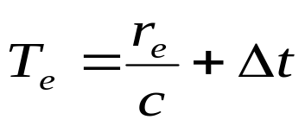
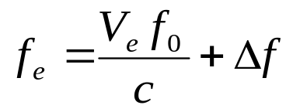
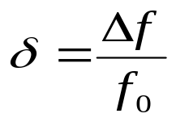
      Error of the time prediction
      where r_{e} － error of the distance estimation
      Δt － difference between the reference times at the transmitter and the receiver.
      Error of the frequency prediction
      where V_{e} － error of measured value or forecasting value of the relative velocity between the transmitter and the receiver
      Δ f － error between the reference frequencies of the transmitter and the receiver.
      Maximum tolerant error of the reference frequency:
(Hz / Hz / day)

Slide 38
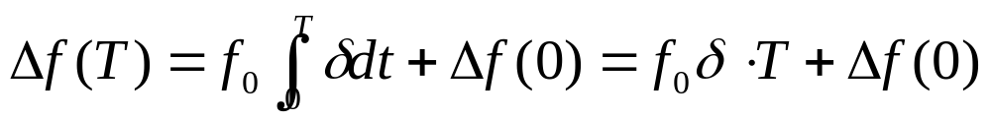
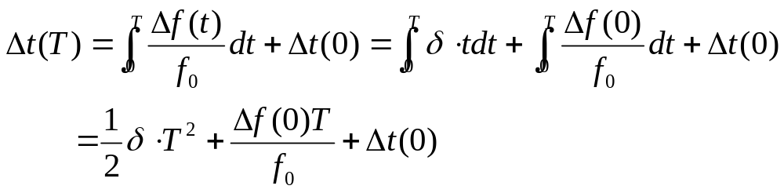
      The frequency offset will linearly increase with time:
      where Δf(T) － frequency offset increased within time T
      Δf(0) － initial (when t = 0) frequency offset
      T － time (day)
      Accumulated time offset Δ t (T)
      As can be seen from the above equation, the time-reference can grow quadratically with time.
      Usually the terminal’s knowledge of receiver timing should be updated termly, or the receiver’s and the transmitter’s time reference should be both reset to nominal.

Slide 39
    2. Satellite communication system － utilize the information provided by the backward link
      The errors Δt and Δf measured on the downlink can be used to compute appropriate corrections to the uplink transmissions.
      If a terminal has access to a backward link connecting the central station, and can compare the parameters of the local reference and the incoming signal, then the interval between recalibrations can be much longer.
      The method of synchronization where a terminal utilize measurements made on a backward link signal is sometimes called quasi-closed-loop transmitter synchronization.
      If the time and frequency references are known to be accurate, but the path of the link has variation, then the same measurement of the downlink can also be used for solving the distance or velocity uncertainty problem. This measurement of distance and relative velocity can be used for calibrating the timing and frequency of the uplink signal in advance.

Slide 40
  7.5.3 Closed-loop method
    Closed-loop method needs the terminal to transmit a special synchronization signal which is used for determination of the signal’s time or frequency error. The results of this determination are then fed back to the transmitter on a backward link.
    If the central station has enough processing capacity, then the central station may make an actual error measurement; and the measured error would be returned to the transmitter on a backward link.
      Advantages: 1. Results of the error measurements that are transmitted on the backward link can be a short digital sequence.
      2. The error-measuring capability in the central station can be shared by all terminals communicating through the central station. This can amount to a large saving in system processing capability.

Slide 41
    If the central station has little processing capability, the special synchronization signal may simply be returned to the transmitter on the backward link. In this case, it becomes part of the transmitter’s task.
      Advantages: 1. The central station may not be easily accessible.
      2. Reliability consideration may dictate a simple design of the central station.
      3. The response can be quicker because there is little processing delay in the central station.

Slide 42
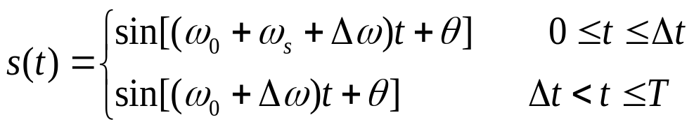
      Disadvantages:
      1.The inefficient use of the backward channel and the the return signals may be difficult to interpret.
      2.The central station may influence the symbol decision.
      Example: Assume a terminal transmits the signal to the central station by using 2FSK,and the central station adopts the noncoherent demodulation. The signal received at the central station can be expressed by
      where T － symbol duration
      ω₀ － angular frequency of one symbol of the 2FSK signal
      (ω₀ + ω_{s}) － angular frequency of another symbol of the 2FSK signal
      Δω － angular frequency error of the received signal at the central station
      Δt － arrival time error of the received signal at the central station
      θ － an arbitrary phase

Slide 43
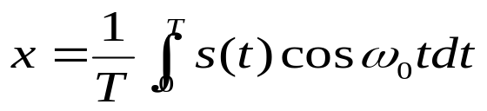
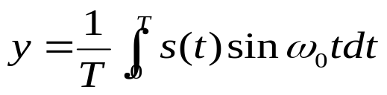
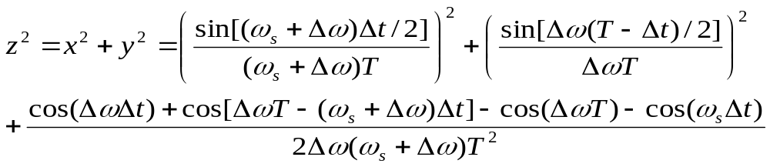
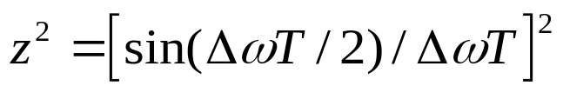
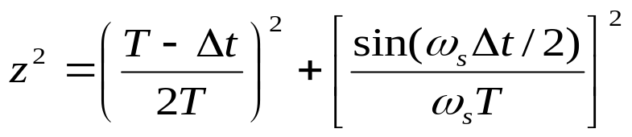
  If two orthogonal component outputs of the demodulator at the central station are
  then the energy of the demodulated signal is
  When the time error Δ t = 0, the above equation becomes
  When the frequency offset Δ f = 0, the above equation becomes
  It can be seen from the above three equations that any time error or frequency offset or combination of both will decrease the signal energy in the correct symbol integrator, and hence increase the symbol error probability.

Slide 44
    Method of frequency precorrection for 2FSK system
      Transmit a continuous sinusoidal wave at the terminal, the frequency of which equals the average of the two symbol frequencies of the 2FSK signal.
      Such a sinusoidal wave should produce a random binary sequence on the backward link.
      Utilizing this principle can find the central frequency, and consequently correctly precorrect the frequency at the terminal.

Slide 45
      Once the correct frequency is found, the terminal transmitter can alternatively transmit the two symbols in order to discover the correct timing.
      By varying the timing of the transmission through a range of half-a-symbol interval, the transmitter can look for the timing that provides the worst error performance.
      The terminal transmitter can use this principle to calculate the correct timing.
      This method is better than to find the best point of error performance. Any well-designed system will have sufficient transmission energy to allow for slight riming offset, so an error-free backward signal could be achieved with less than perfect timing.

Slide 46
  7.6 Brief Summary

