Slide 1
Principles of Communications

Slide 2
Chapter 1 Introduction
1.1 Historical Review of Communication
  Origin of ancient communication
  Two modes of communication
  Development of modern communication

Slide 3
1.2 Message, information & signal
  Message：speech, letters, figures, images…
  Information：effective content of message. Different types of messages may contain the same information
  Signal：the carrier of message
What transmitted in a communication system is signal.

Slide 4
  Measurement of information：
# “quantity of message” ≠ information content
# Ex: “Rainfall will be 1 mm tomorrow” – information content small
“Rainfall will be 1 m tomorrow” – information content large
“The sun will rise in the east tomorrow morning” – information content equals zero
# Information content I = I [ P(x) ]，P(x) – Occurrence probability
# Definition：I = log_{a} [1/P(x)] = -log_{a}P(x)
# Usually, set a = 2, the unit of the information content will be called a bit.
# For an equal probability binary symbol:
I = log₂ [1/P(x)] = log₂ [1/(1/2)] = 1 bit

Slide 5
# For an equal probability M-ary symbol:
I = log₂ [1/P(x)] = log₂ [1/(1/M)]
= log₂ M bit
If M = 2^{k} ，then I = k bit

Slide 6
1.3 Digital Communication
1.3.1 Basic concept
Two categories of signals
• Analog signal：Its voltage or current can be expressed by a continuous function of time. For example, speech signal.
• Digital signal： Its voltage or current can only take finite number of discrete values. For example, digital computer data signal.

Slide 7
Analog Signal & Digital Signal
s(t)
s(t)
t
t
Analog signals
s(t)
s(t)
Symbol
t
t
Digital signals

Slide 8
Two kinds of communication systems
• Analog communication system
Requirement － High fidelity
Criterion － Signal to noise ratio
Basic issue － parameter estimation
• Digital communication system
Requirement － correct decision
Criterion － Error probability
Basic issur － statistical decision theory

Slide 9
1.3.2 Advantages of Digital Communication
  Finite number of possible values of signals
  Correct decision may be achieved
(a) Waveforms of distored digital signal
(b) Waveforms of digital signal after shaping
Fig. 1.3.2 Distortion and restoration of digital signal waveforms

Slide 10
  Error correcting techniques can be used.
  Digital encryption can be used.
  Different kinds of analog & digital message can be integrated to transmit
  Digital communication equipment:
    Design and manufacture are easier
    Weight & volume are smaller
  Digital signal can be compressed by source coding to reduce redundency.
  Out put S/N increases with bandwidth according to exponential law.

Slide 11
1.3.3 Digital Communication System Model
Information source
Compression
coding
Encryption
coding
Channel coding
Modulation
Channel
Demodulation
Channel decoding
Encryption decoding
Compression
decoding
Information destination
Source coding
Noise
Synchro-nization
Source decoding
Transmitter
Receiver
Digital communication system model

Slide 12
Information source
Modulation
Channel
Demodulation
Information destination
Noise
Transmitter
Receiver
Analog communication system model

Slide 13
1.3.4 Specifications of Digital Communication Systems
  Relationship between efficiency & reliability (rate ~ accuracy)
  Transmission rate：
    Symbol rate: R_{B} －Baud
    Information rate: R_{b} － bit/second
  For M-ary system：R_{b} = R_{B} log₂ M
    Message rate: R_{M}
• Error probability：
    Symbol error probability P_{e} = number of received symbols in error/total number of transmitted symbols

Slide 14
    Bit error probability P_{b} = number of received bits in error/total number of transmitted bits
    Word error probability P_{w} =number of received words in error/total number of transmitted words
    Relationship between symbol error probability and bit error probability
    P_{b} = P_{e} x M / [2(M-1)] ≈ P_{e} /2

Slide 15
    Relationship between word error probability and bit error probability
For binary system,
If a word is consisted of k bits, then P_{w}＝1 – (1 – P_{e})^{k}
  Utilization factor of frequency band
  Utilizaition factor of energy

Slide 16
1.4 Channel
1.4.1 Wireless channel
  Origin of wireless communication
  Requirement of electromagnetic wave emission on wavelength
  Division of frequency band (wavelength)

Slide 17
Division of frequency band
Frequency Name Typical application
band (kHz)
3 – 30 Very low frequency Long-distance navigation,
(VLF) Underwater comm. Sonar
30 – 300 Low frequency Navigation, underwater comm.
(LF) radio beaconing
300 – 3000 Medium frequency Broadcasting, maritime comm.
(MF) direction-finding, distress
calling, coast guard

Slide 18
Division of frequency band
Frequency Name Typical application
band (MHz)
3 – 30 High frequency Long-distance broadcasting, telegraph,
(HF) telephone, fax, search and lifesaving, comm. between aircrafts & ships, and
between ship & coast, amateur radio
30 – 300 Very high frequency TV, FM broadcasting, land traffic, air
(VHF) traffic, control, taxi, police, navigation,
aircraft communication
300 – 3000 Ultra high frequency TV, cellular phone network, microwave
(UHF) link, , radio sounding, navigation,
satellite communication, GPS,
surveillance radar, radio altimeter

Slide 19
Division of frequency band
Frequency Name Typical application
band (GHz)
3 – 30 Super high frequency Satellite comm., radio altimeter,
(SHF) microwave link, aircraft radar,
meteorological radar, public
land vehicle communication
30 – 300 Extremely high Radar landing system, satellite
frequency (EHF) comm., vehicle comm., railway
traffic
300 – 3000 Submillimeter wave Experiment, not designated
（0.1 – 1 mm）

Slide 20
Division of frequency band
Frequency Name Typical application
band (THz)
43 – 430 Infrared Optical communication
(7 – 0.7 μm)
430 – 750 Visible light Optical communication
(0.7 – 0.4 μm)
750 – 3000 Ultraviolet Optical communication (0.4 – 0.1 μm)
Note: kHz = 10³ Hz, MHz = 10⁶ Hz, GHz = 10⁹ Hz,
THz = 10¹² Hz, mm = 10⁻³ m, μm = 10⁻⁶ m
Notes:
THz ＝ 10¹² － 太拉

Slide 21
Ground wave
  Frequency：below 2MHz
  Diffraction：
  Propagation distance：hundreds to thousands of km
Ground surface
Notes:
在最有利的条件下（对于最长的波），传播距离不超过3000-4000km。

Slide 22
Ionosphere Structure
  D layer: 60 ~ 80 km
  E layer: 100 ~ 120 km
  F layer: 150 ~ 400 km
    F₁ layer: 140 ~ 200 km
    F₂ layer: 250 ~ 400 km
  At night:
    D layer: disappears
    F₁ layer: disappears
(Or, F₁ and F₂ are combined as F layer)
F₂
F₁
F
E
D
Ground surface

Slide 23
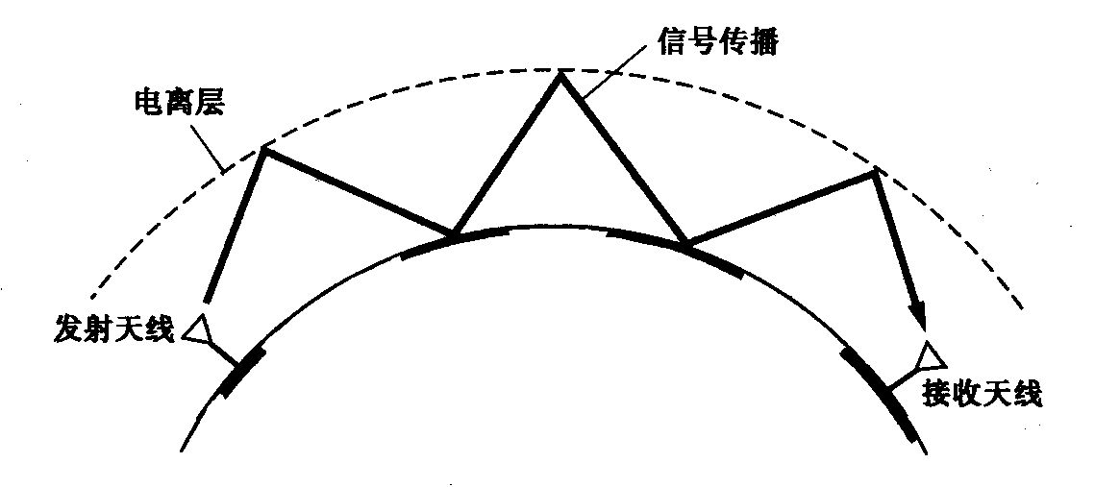
Sky-wave
  Ionosphere Height ：60 ～ 400 km
  One hop max. propagation distance：4000 km
  Propagation distance by multi-hops: >10000 km
  Frequency：2 ～ 30 MHz
Propagation path of signal
Ionosphere
Ground
Transmitting
antenna
Receivng
antenna
Figure 1.4.2 Sky-wave propagation

Slide 24
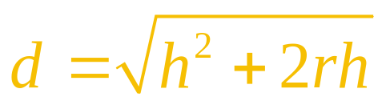
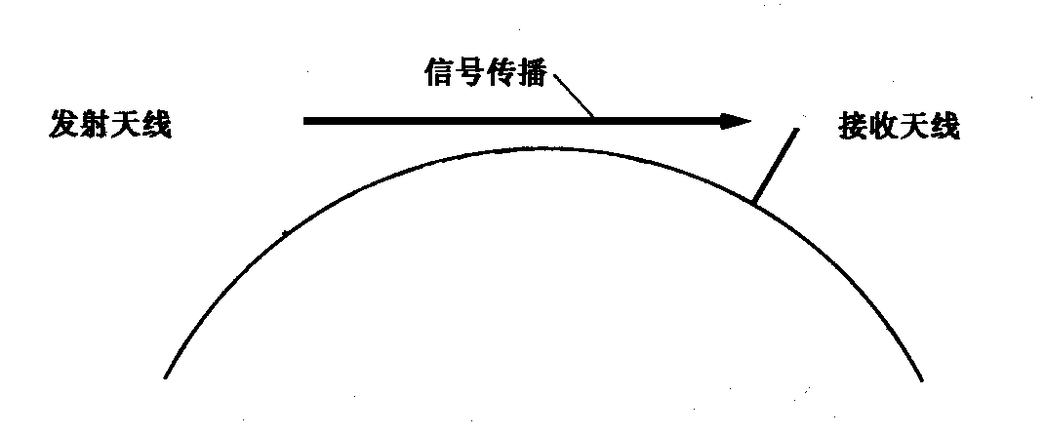
Line-of -sight propagation
  Frequency：> 30 MHz
  Propagation distance: d ² + r ² =(h+r)²,
  or
  h ≈ D ²/50 (m)
  where D － km
Signal Propagation
Transmitting antenna
Receiving antenna
h
d
d
D
Ground
r
Figure 1.4.3 Line-of-sight propagation

Slide 25
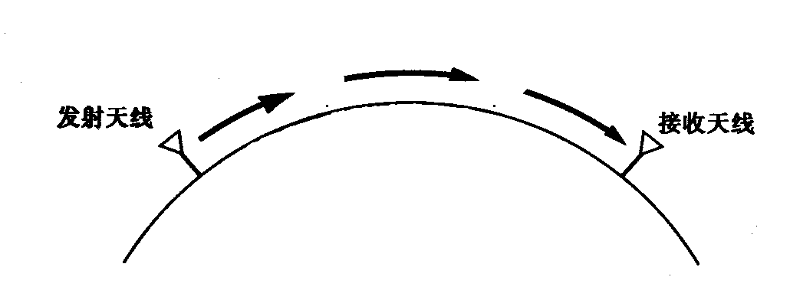
Radio relay
Transmitting antenna
Receiving antenna
Figure 1.4.4 Radio relay

Slide 26
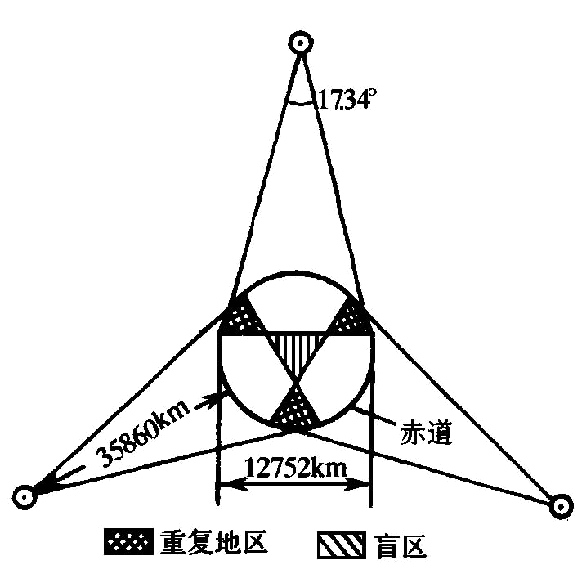
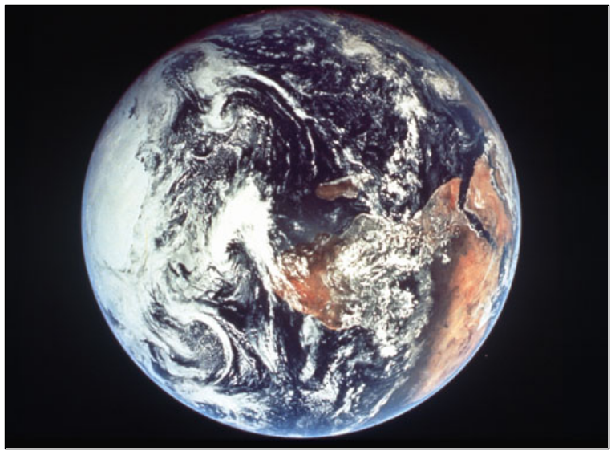
Geostationary satellite
equator

Slide 27
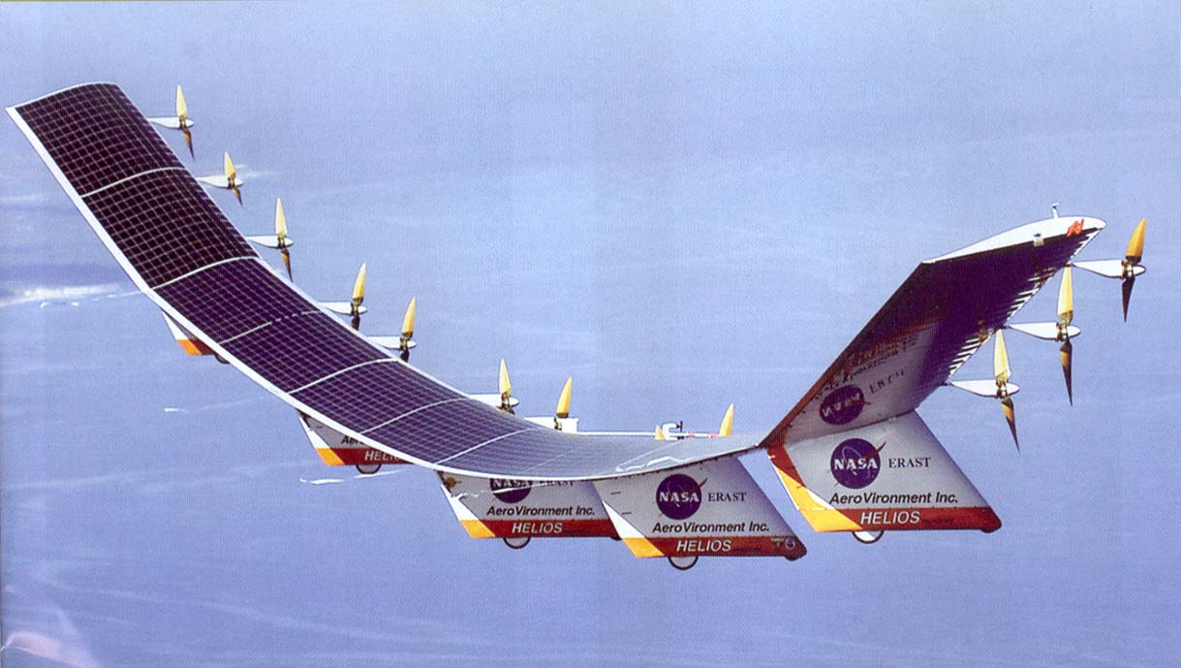
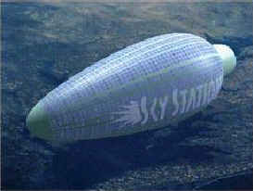
Stratosphere communication
HAPS(High Altitude Platform Station)

Slide 28
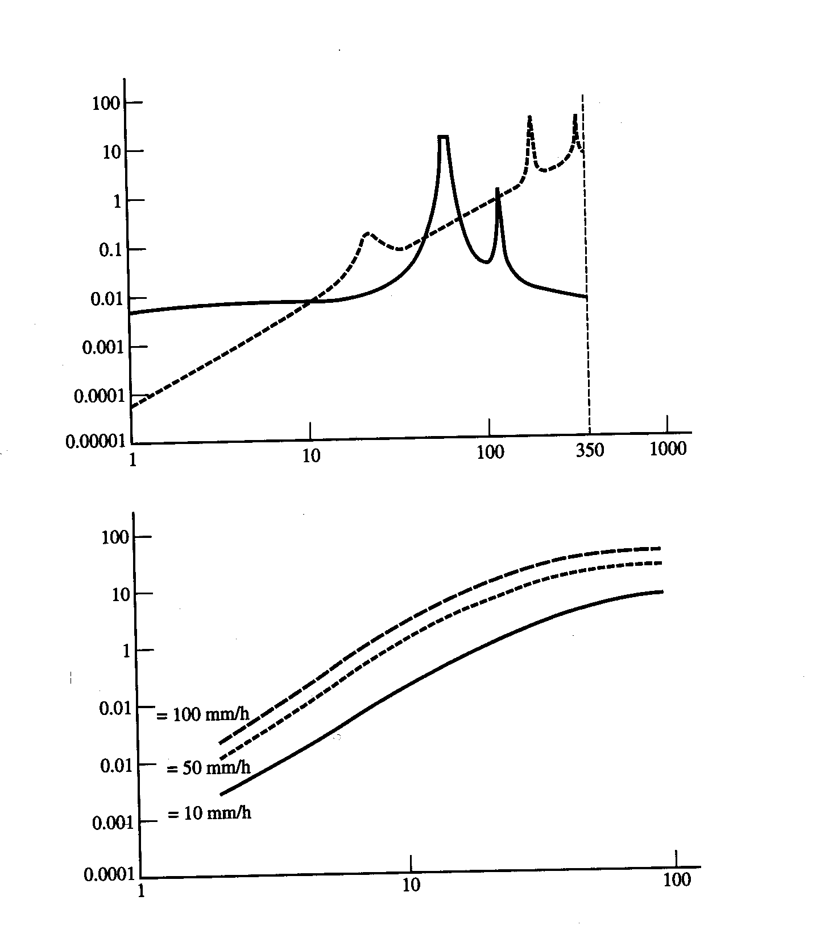
Atmosphere attenuation
Attenuation (dB/km)
Vapor
Oxygen
Frequency (GHz)
(a) Attenuation of oxygen & vapor（concentration 7.5 g/m³）
Attenuation (dB/km)
Rainfall rate
Frequency (GHz)
(b) Attenuation of rainfall
Figure 1.4.5 Atmosphere attenuation

Slide 29
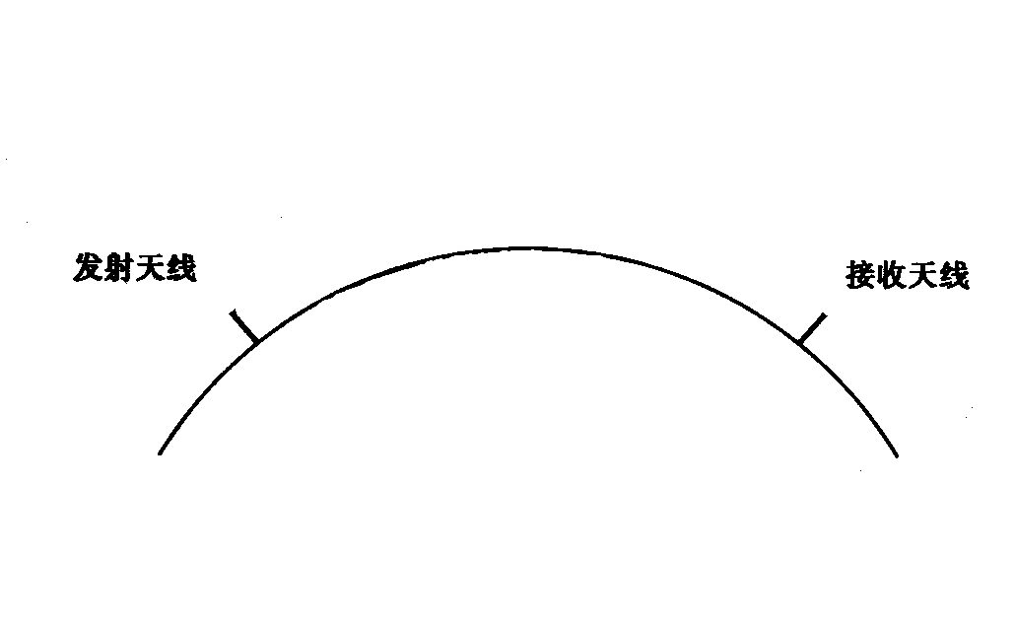

Scatter communication
Ionosphere scattering
  Frequency: 30 ~ 60 MHz
Troposphere scattering
  Frequency: 100 ~ 4000 MHz
Meteor-tail scattering
  Frequency: 30 ~ 100 MHz
Effective scattering region
Transmitting antenna
Earth
Receiving antenna
Ground
Figure 1.4.7 Meteor-tail scattering communication
Figure 1.4.6 Troposphere scattering communication

Slide 30
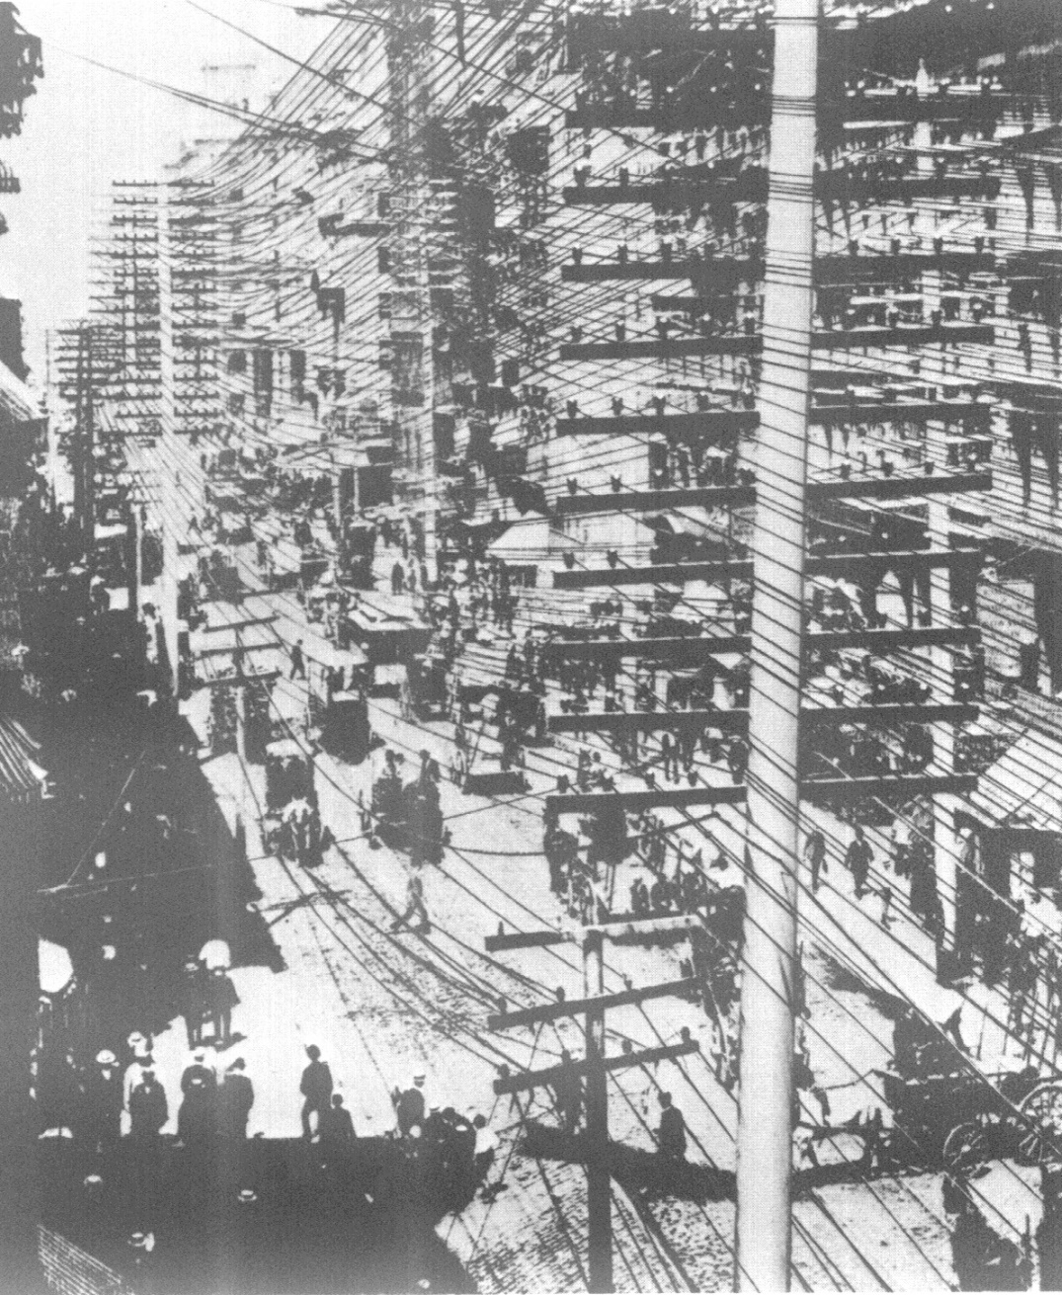
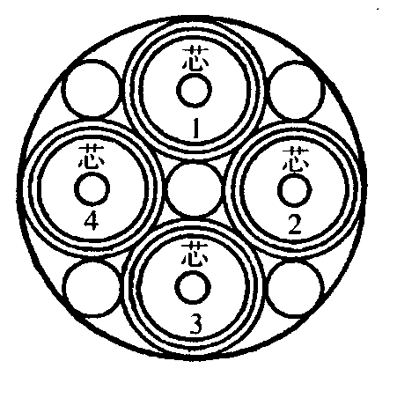
1.4.2 Wired channel
  Open wires
  Symmetrical cables
  Coaxial cables
Fig. 1.4.8

Slide 31
Table 1.4.3 General electrical characteristics of wired channels
Kinds of channel | Communication capacity (channels) | Frequency range (kHz) | Transmission distance (km)
Open wire | 1+3 | 03.~27 | 300
Open wire | 1+3+12 | 0.3~150 | 120
Symmetrical cable | 24 | 12~108 | 35
Symmetrical cable | 60 | 12~252 | 12~18
Small coaxial cable | 300 | 60~1300 | 8
Small coaxial cable | 960 | 60~4100 | 4
Medium coaxial cable | 1800 | 300~9,000 | 6
Medium coaxial cable | 2700 | 300~12,000 | 4.5
Medium coaxial cable | 10800 | 300~60,000 | 1.5

Slide 32
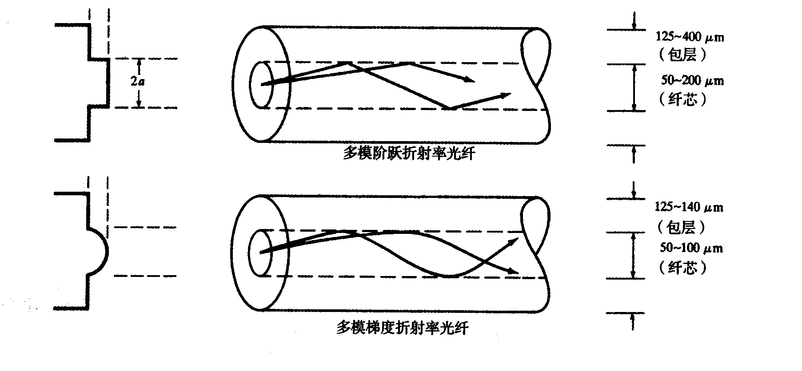
  Optical fiber
    Structure
n₂
n₁
Reflection index
(Cladding)
(Core)
n₂
n₁
Reflection index
Multimode step-index optical fiber
(Cladding)
2a
(Core)
Multimode graded-index optical fiber
Figure 1.4.9 Sketch of the structure of multimode optical fibers

Slide 33
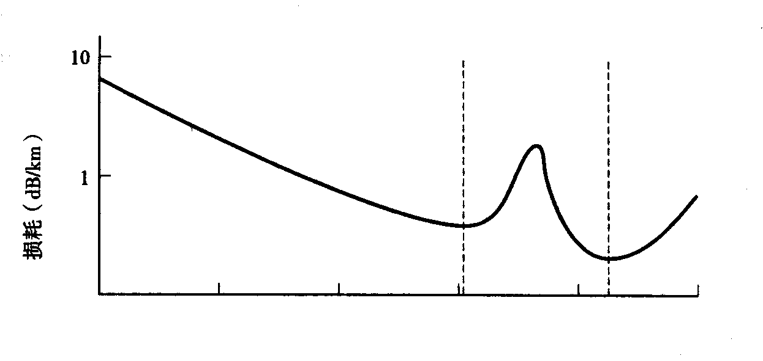
    Transmission loss
1.31 μm
1.55 μm
Loss (dB/km)
0.7 0,9 1.1 1.3 1.5 1.7
Wavelength of light waves（μm）
Figure 1.4.10 Relationship between loss and wavelength

Slide 34
1.4.3 Channel models
  Modulation channel model:
e_{o}(t) = f [e_{i}(t)] + n(t)
式中 e_{i}(t) － input signal
e_{o}(t) － output signal
n(t) － additive noise
f [e_{i}(t) ] －function relating input and output signals
e_{i}(t)
Time-variant
linear network
e_{o}(t)

Slide 35
Usually, assume f [e_{i}(t) ] can be expressed as k(t) e_{i}(t)
So, e_{o}(t) = k(t) e_{i}(t) + n(t)
where k(t) is called multiplicative interference, and is a complicated function which reflects the characteristics of the channel.
In the simplest condition: k(t) = const., expressing attenuation.
When k(t) = const., it is a constant parameter channel.
For example, coaxial cable.
When k(t) ≠ const., it is called a random parameter channel.
For example, vehical cellular network communication channel.

Slide 36
  Coding channel model:
    Binary coding channel model
where, P(0/0), P(1/1) －corrrect transfer probabilities
P(0/1), P(1/0) －error transfer probabilities
P(0/0) = 1 - P(1/0)
P(1/1) = 1 - P(0/1)
P(0/0)
0
0
P(0/1)
P(1/0)
1
1
P(1/1)
Notes:
TU-n -- Tributary Unit of level n
TUG-n -- Tributary Unit Group of level n
VC-n -- Virtual Container of level n
Note: G.702 tributaries associated with containers C-x are shown. Other signals eg. ATM can also be accommodated (see 102).

Slide 37
  4-ary coding channel model
0
0
1
1
Transmitting end
Receiving end
2
2
3
3
Figure 1.4.12 4-ary coding channel model

Slide 38
1.4.4 Influence of channel characteristics on signal transmission
  Constant parameter channel ~ time-invariant linear network
    Link：a segment of physical line where no exchange exists
    Amplitude ~ frequency characteristics:
Attenuation (dB)
Typical characteristic of a telephone channel
Ideal characteristic
0
f (Hz)
300
3000

Slide 39
      Compensation of frequency distortion
A
A
A
0
f
0
f
0
f
(a) Channel characteristic with frequency distortion
(b) Characteristic of linear compensation network
(c) Channel characteristic after compensation

Slide 40
    Phase ~ frequency characteristics:
    Ideal characteristic: phase --- ϕ (ω) = k ω ;
group delay --- τ (ω) = dϕ(ω)/dω = k
Influence of distortion: waveform distortion, inter-symbol interference
    Linear distortion including frequency distortion & phase distortion can be corrected by linear compensation network.
    Nonlinear distortion: nonlinear amplitude characteristic, frequency deviation, phase jittering, …
ϕ (ω)
τ (ω)
Ideal characteristic
Ideal characteristic
0
ω
0
ω

Slide 41
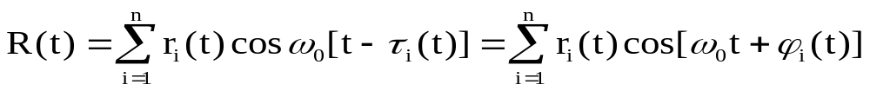
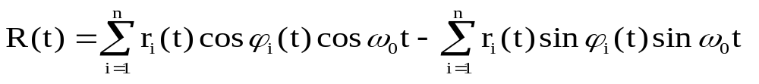
  Random parameter channel
    Common characteristics － attenuation: varying with time
transmission delay: varying with time multi-path propagation: fast fading
    Characteristics of received signal:
Let transmitting signal be A cos ω₀t，after transmission through n paths, the received signal R(t) can be expressed as:
where r_{i} (t) － amplitude of received signal passing over i-th path
τ_{i} (t) － delay of the received signal passing over i-th path
ϕ _{i} (t) = - ω₀ τ_{i} (t)
  X _{c} (t) X _{s} (t)

Slide 42
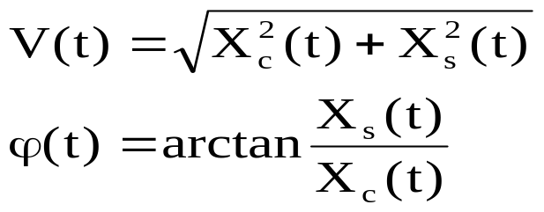
where V(t) － envelope of the received signal R(t)
ϕ(t) － phase of the received signal R(t)
i.e.,
Because r_{i}(t) and ϕ_{i}(t) are slowly varied, r_{i}(t) and ϕ_{i}(t) are also slowly varied. Hence, X_{c}(t), X_{s}(t) and V(t), ϕ(t) are also slowly varied.
Hence, R(t) can be considered a narrow band signal (random process).

Slide 43
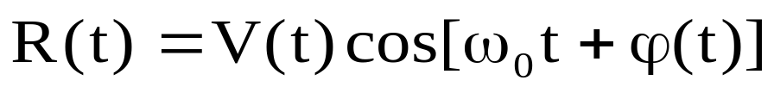
It can be seen from the following equation
After transmission, the transmitting signal A cos ω₀t：
* amplitude A becomes slowly varied amplitude V(t);
* phase 0 becomes slowly varied phase ϕ(t)；
* spectrum becomes narrow band spectrum from single frequency.
f
t
f₀
Notes:
# At a given interface, in a given direction, the different Virtual Path (VP) links multiplexed at the ATM layer into the same physical layer connection are distinguished by the VPI. The different Virtual Channel (VC) links in a Virtual Path Connection (VPC) are distinguished by the VCI as indicated in Figure 1.

Slide 44

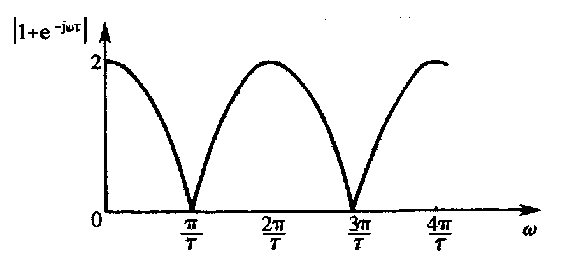
    Frequency selective fading
    Assume: there are only two paths with identical attenuation and different delays,
    Transmitting signal is f(t)，received signals are af(t - τ₀) and af(t - τ₀ - τ)；spectrum of transmitting signal is F(ω)。
    then f(t) ⇔ F(ω)
    af(t - τ₀) ⇔ a F(ω) e^{-jωτ0}
    af(t - τ₀ - τ) ⇔ a F(ω) e^{-jω(τ0 + τ)}
    af(t - τ₀) + af(t - τ₀ - τ) ⇔ a F(ω) e^{-jωτ0} (1+e^{-jωτ})
    H(ω) = a F(ω) e^{-jωτ0} (1+e^{-jωτ})/F(ω) = ae^{-jωτ0} (1+e^{-jωτ})
    |1+e^{-jωτ}| = |1+cosωτ-jsinωτ|=|[(1+cosωτ⁾²+sin²ωτ]^{1/2}|
    =2|cos(ωτ/2)|
    3 categories of signal：
    * deterministic signal
    * random phase signal
    * fluctuation signal

Slide 45
1.5 Noise in Channel
  Classified according to origins：
    Man-made noise：electric sparks, …
    Natural noise：lightning, atmosphere noies, thermal noise,...
  Classified according to characteristics:
    impulse noise
    narrow band noise
    fluctuation noise
  Main noise involved in the following discussion on communication systems is:
  white noise – thermal noise is a kind of typical white noise
1.6 Brief Summary

