Slide 1
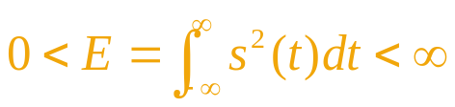
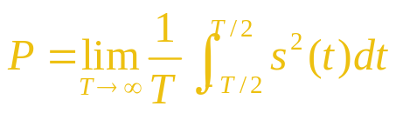
Chapter 2 Signals
2.1 Classification of Signals
  2.1.1 Deterministic signals and random signals
    What is deterministic signal?
    What is random signal?
  2.1.2 Energy signals and power signals
    Signal power: Let R = 1, then P = V²/R = I²R = V² = I²
    Signal energy：Let S represent V or I，if S varies with time，then S can be rewritten as s(t),
    Hence, the signal energy E = ∫ s²(t)dt
    Energy signal satisfies
    Average power: , then P = 0 for energy signal.
    For power signal: P ≠ 0, i.e., power signal has infinite duration.
    Energy signal has finite energy, but its average power equals 0.
    Power signal has finite average power, but its energy equals infinity.

Slide 2

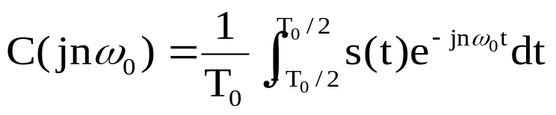
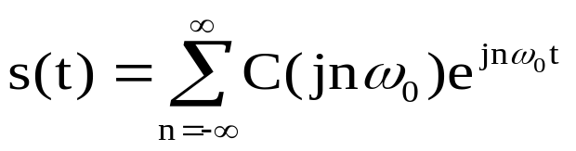
2.2 Characteristics of deterministic signals
  2.2.1 Characteristics in frequency domain
  Frequency spectrum of power signal: let s(t) be a periodic power signal, its period is T₀, then we have
  where ω₀ = 2π / T₀ = 2πf₀
  ∵ C(jnω₀) is a complex function, ∴ C(jnω₀) = |C_{n}|e^{jθn}
  where |C_{n}| － amplitude of the component with frequency nf₀
  θ_{n} － phase of the component with frequency nf₀
    Fourier series of signal s(t):

Slide 3
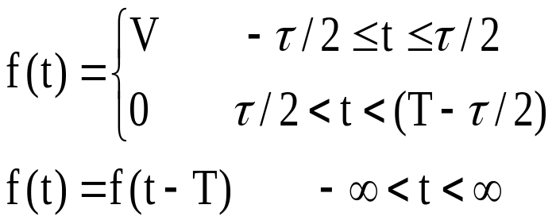
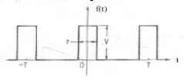
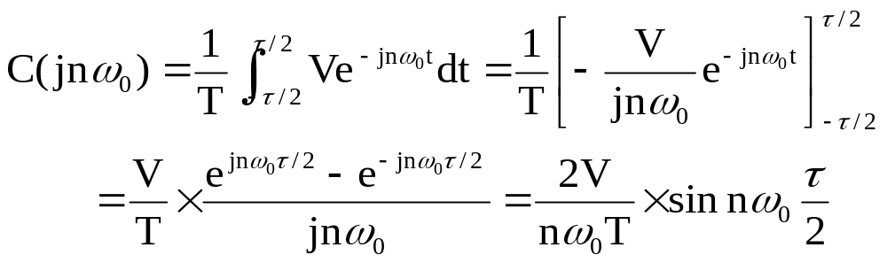
【Example 2.1】 Find the spectrum of a periodic rectangular wave.
Solution: Assume the period of a periodic rectangular wave is T , the width is τ, and the amplitude isV, then
Its frequency spectrum is

Slide 4
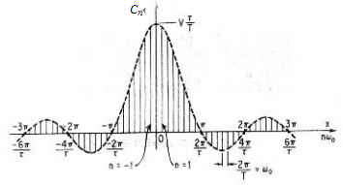
  Frequency spectrum figure

Slide 5
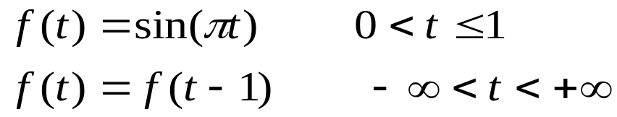
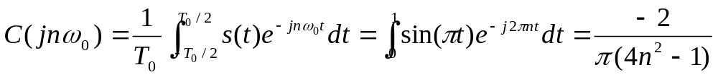
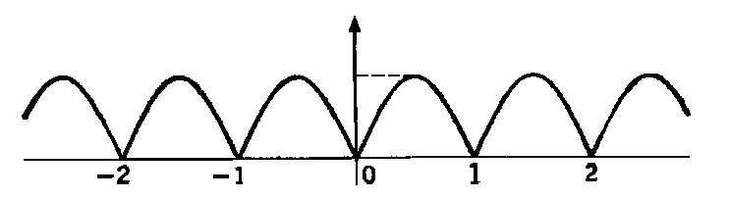
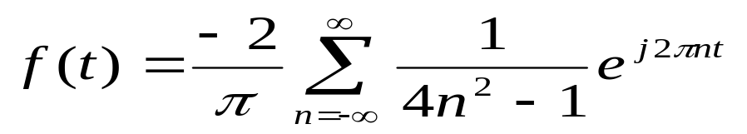
【Example 2.2】Find the frequency spectrum of a sinusoidal wave after full-wave rectification.
Solution：Assume the expression of the signal is
Its frequency spectrum:
The Fourier series of the signal is:
f(t)
1
t

Slide 6
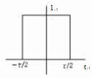
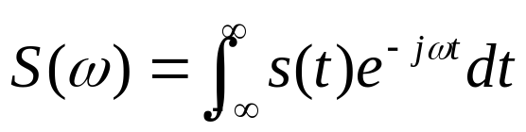
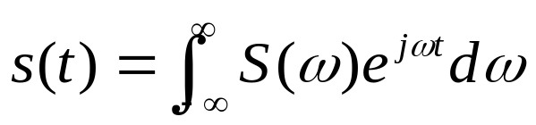
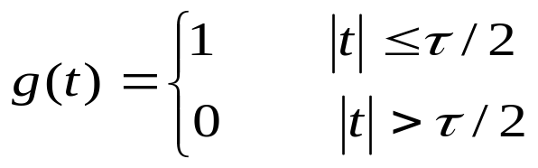
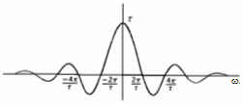
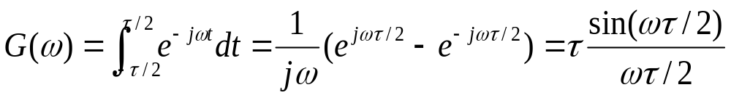
  Frequency spectral density of energy signals
  Let an energy signal be s(t), then its frequency spectral density is
  The inverse Fourier transform of S(ω) is the original signal:
  【Example 2.3】Find the frequency spectral density of a rectangular pulse.
  Solution: Let the expression of the rectangular pulse be
  Then its frequency spectral density is
  its Fourier transform:

Slide 7
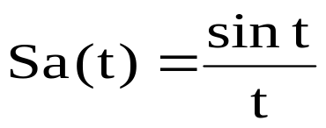
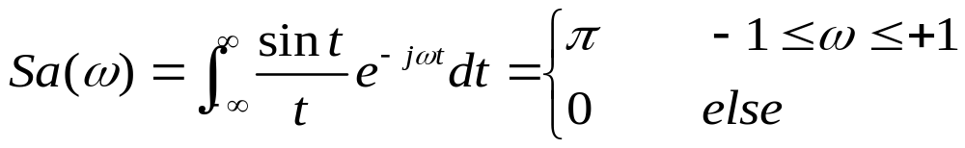
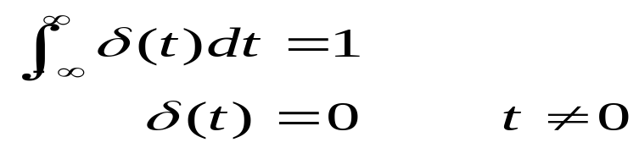
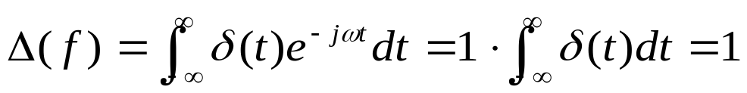
【Example 2.4】Find the waveform and the frequency spectral density of a sample function.
Solution: The definition of the sample function is
the frequency spectral density Sa(t) is:
From the above equation, we see that Sa(ω) is a gate function.
【Example 2.5】Find the unit impulse function and its frequency spectral density.
Solution: Unit impulse function is usually called δ function δ(t). Its definition is
The frequency spectral density of δ(t):

Slide 8
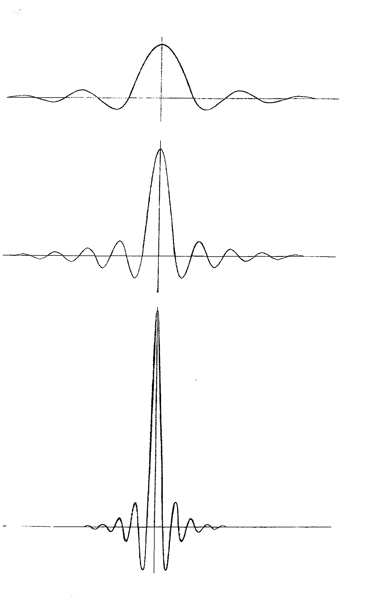
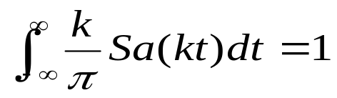
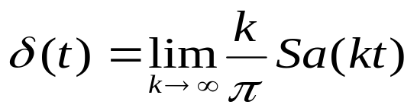
    δ(t) and its frequency spectral density:
    Physical meaning of δ function:
    It is a pulse with infinite height, infinitesimal width, and unit area.
    Sa(t) has the following property:
    When k → ∞, amplitude → ∞, and
    the zero-spacing of the waveform → 0，
    Hence,
Δ(f)
δ(t)
1
0
t
f
0
t
t
t

Slide 9
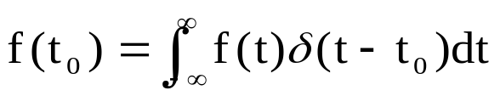

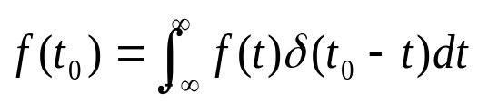
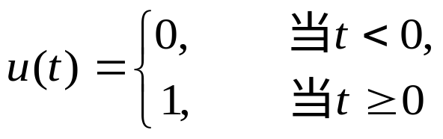
    Characterisitics of δ(t)
      δ(t) is an even function:
      δ(t) is the derivative of unit step function:
    Difference between frequency spectral density S(f) of energy signal and frequency spectrum of periodic power signal:
      S(f ) － continuous spectrum； C(jnω₀) － discrete
      Unit of S(f ): V/Hz； Unit of C(jnω₀): V
      Amplitude of S(f ) at a frequency point ＝ infinitesimal
1
u′(t) = δ(t)
0
t
Fig. 2.2.6 Unit step function

Slide 10
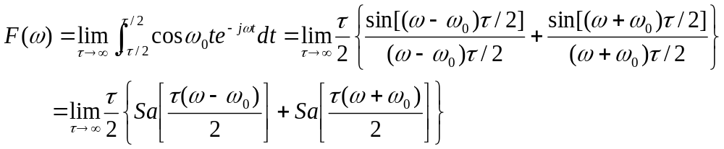

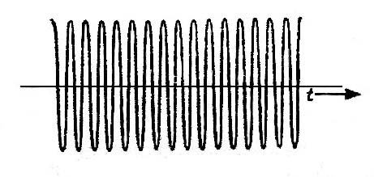
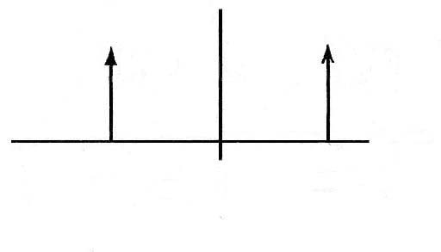
【Example 2.6】Find the frequency spectral density of a cosinusoidal wave with infinite length.
Solution: Let the expression of a cosinusoidal wave be f (t) = cosω₀t, then according to eq. (2.2-10), F(ω) can be written as
Referencing eq.(2.2-19), the above equation can be written as:
    Introducing δ(t), the concept of frequency spectral density can be generalized to power signal.
t
－ω₀
0
ω₀
(a) 波形
(b) 频谱密度

Slide 11
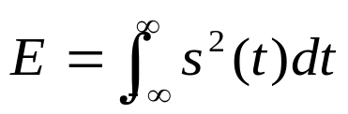
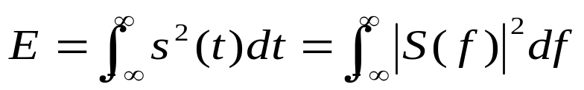
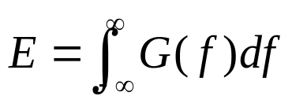
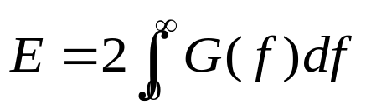
  Energy spectral density
Let the energy of an energy signal s(t) be E, then the energy of the signal is decided by
If its frequency spectral density is S(f ), then from Parseval’s theorem we have
where |S(f )|² is called energy spectral density.
The above equation can be rewritten as：
where G(f )＝|S(f)|² （J / Hz） is energy spectral density.
    Property of G(f ): Since s(t) is a real function, |S(f )|² is an even function,∴

Slide 12
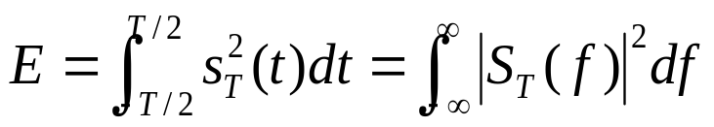
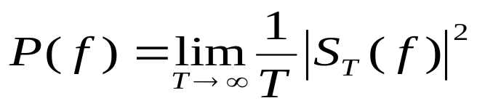
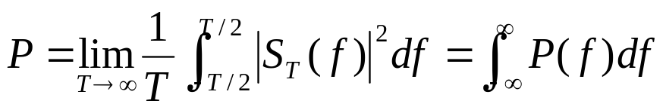
  Power spectral density
Let the truncated signal of s(t) is s_{T}(t)，-T/2 < t <T/2, then
To define the power spectral density of the signal as:
obtain the signal power:

Slide 13
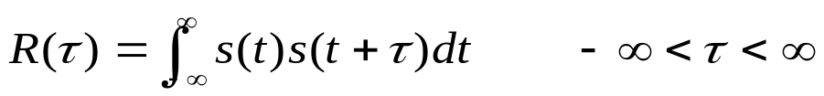
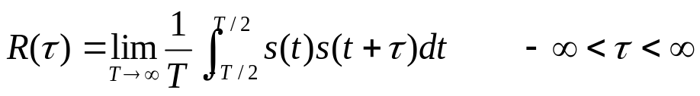
2.2.2 Characteristics in time domain
  Autocorrelation function
    Definition of the autocorrelation function for energy signal:
    Definition of the autocorrelation function for power signal:
    Characteristics:
      R(τ) is only dependent on τ, but independent of t.
      When τ = 0, R(τ) of energy signal equals the energy of the signal, and R(τ) of power signal equals the average power of the signal.

Slide 14
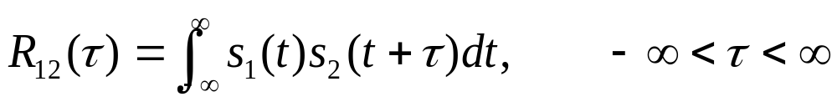
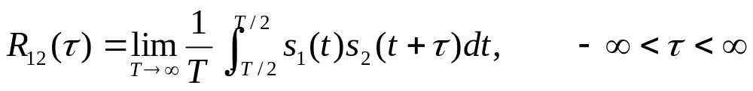

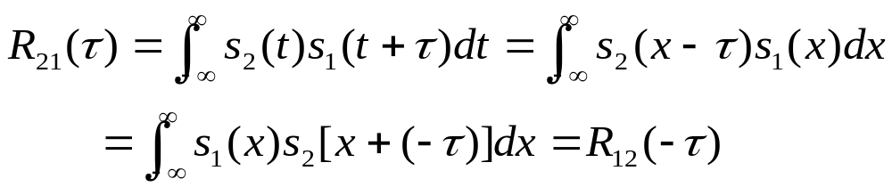
  Cross-correlation function
    Definition of the cross-correlation function for energy signal:
    Definition of the cross-correlation function for power signal:
    Characteristics:
      1. R₁₂(τ) is dependent on τ, and independent of t.
      2.
      Proof: Let x = t + τ，then

Slide 15
2.3 Characteristics of random signals
  2.3.1 Probability distribution of random variable
  Concept of random variable: If the random outcome of a trial A is expressed by X, then we call X a random variable, and let its value be x.
  For example, the number of calls received within a given period of time at the telephone exchange is a random variable.
  Distribution function of random variable
    Definition: F_{X}(x) = P(X ≤ x)
    Characteristics: ∵ P(a < X ≤ b) + P(X ≤ a) = P(X ≤ b),
    P(a < X ≤ b) = P(X ≤ b) – P(X ≤ a)，
    ∴ P(a < X ≤ b) = F_{X}(b) – F_{X}(a)

Slide 16
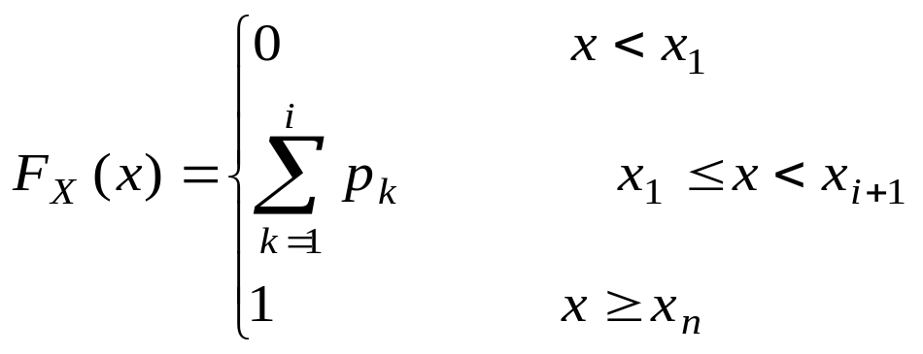
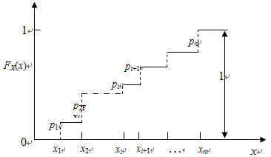
    Distribution function of discrete random variable:
      Let the values of X be: x₁ ≤ x₂ ≤ … ≤ x_{i} ≤ x_{n}，their probabilities are respectively p₁, p₂, … , p_{i}, … , p_{n}, then
      P (X < x₁) = 0, P(X ≤ x_{n}) = 1
      ∵P(X ≤ x_{i}) = P(X = x₁) + P(X = x₂) + … + P(X = x_{i}),
      ∴
      Characteristics:
        F_{X}(- ∞) = 0
        F_{X}(+∞) = 1
        If x₁ < x₂, then F_{X}(x₁) ≤ F_{X}(x₂) --- monotonic increasing function.

Slide 17
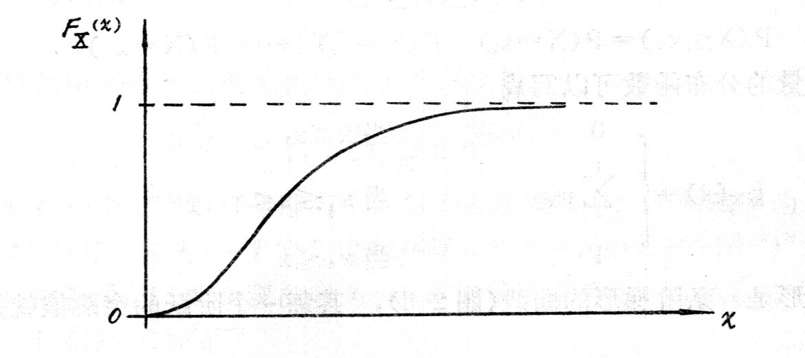
    Distribution function of continuous random variable:
    When x is continuous, from the definition of distribution function
F_{X}(x) = P(X ≤ x)
we know that F_{X}(x) is a continuous monotonic increasing function.

Slide 18
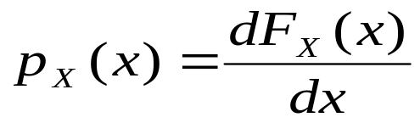
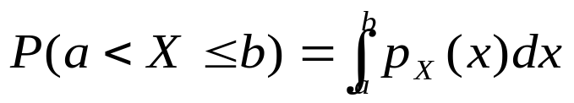
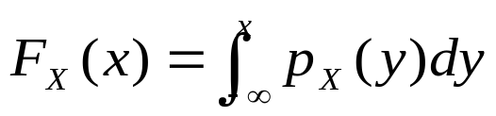
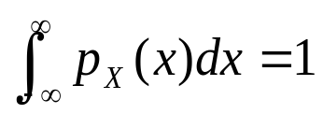
  2.3.2 Probability density of random variable
  Probability density of continuous random variable p_{X} (x)
    Definition of p_{X} (x):
    Meaning of p_{X} (x):
      p_{X} (x) is the derivative of F_{X} (x), and is the slope of the curve of F_{X} (x)
      P(a < X ≤ b) can be found from p_{X} (x):
    Characteristics of p_{X} (x):
p_{X}(x) ≥ 0

Slide 19


  Probability density of discrete random variable
  Distribution function of discrete random variable can be written as:
  where p_{i} － probability of x = x_{i}
  u(x) － unit step function
  Finding the derivatives of the two sides of the above equation, we obtain its probability density:
    Characteristics:
    When x ≠ x_{i} , p_{x} (x) = 0
    When x = x_{i} , p_{x} (x) = ∞

Slide 20


2.4 Examples of frequently used random variables
  Random variable with normal distribution
    Definition: Probability density
    where σ > 0, a = const.
    Probability density curve:

Slide 21

  Random variable with uniform distribution
    Definition: probability density
    where a, b are constants.
    Probability density curve:
p_{A}(x)
0
a
b
x

Slide 22


  Random variable with Rayleigh distribution
    Definition: Probability density
    where a > 0, and is a constant.
    Probability density curve:

Slide 23






2.5 Numerical characteristics of random variable
2.5.1 Mathematical expectation
  Definition: for continuouse random variable
  Characteristics:
    If X and Y are independent of each other, and E(X) and E(Y) exist, then

Slide 24




2.5.2 Variance
  Definition:
  where
    Variance can be rewritten as:
    Proof:
    For discrete variable:
    For continuous variable:
  Characteristics:
    D( C ) = 0
    D(X+C)=D(X)，D(CX)=C²D(X)
    D(X+Y)=D(X)+D(Y)
    D(X₁ + X₂ + … + X_{n})=D(X₁) + D(X₂) + … + D(X_{n})

Slide 25






2.5.3 Moment
  Definition: the k-th moment of a random variable X is
    k-th origin moment is the moment when a = 0:
    k-th central moment is the moment when :
  Characteristics:
    The first origin moment is the mathematical expectation:
    The second central moment is the variance:

Slide 26
2.6 Random process
2.6.1 Basic concept of random process
  X(A, t) － ensumble consisting of all possible “realizations” of an event A
  X(A_{i} , t) － a realization of event A, it is a determined time function
  X(A, t_{k}) － value of the function at the given time t_{k}
    Denote for short: X(A, t) → X(t)
    X(A_{i} , t) → X_{i} (t)

Slide 27




  Example: receiver noise
  Numerical characteristics of random process:
    Statistical mean:
    Variance:
    Autocorrelation function:

Slide 28

2.6.2 Stationary random process
  Definition of stationary random process:
  A random process whose statistical characteristics is independent of the time origin is called a stationary random process. (or, strict stationary random process)
  Definition of generalized stationary random process:
  The random process whose mean, variance and autocorrelation function are independent of the time origin
  Characteristics of generalized stationary random process:
  A strict stationary random process must be a generalized stationary random process; but a generalized stationary random process is not always a strict stationary random process.

Slide 29


2.6.3 Ergodicity
  Significance of ergodicity
    A realization of a stationary random process can go through all states of the process.
  Characteristic of ergodicity: time average may be replaed by statistical mean. For example,
    Statistical mean of ergodic process m_{X}：
    Autocorrelation function of ergodic process R_{X}(τ):
    If a random process has ergodicity, then it must be a strict stationary random process. However, a strict stationary random process is not always ergodic.

Slide 30
  Ergodicity of stationary communication system
  If the signal and the noise are both ergodic, then
    First origin moment m_{X} = E[X(t)] － D. C. component of signal
    Square of first origin moment m_{X} ² － power of normalized D.C. component of signal
    Second origin moment E [X ²( t )] － normalized average power of signal
    Square root of second origin moment {E [X ²(t)]}^{1/2} － root mean square of signal current or voltage
    Second central moment σ_{X}² － normalized average power fo A. C. component of signal
    If m_{X} = m_{X} ² = 0, thenσ_{X}² = E [X ²( t )] ；
    Standard deviation σ_{X} － root mean square of A. C. component of signal
    If m_{X} = 0, then σ_{X} is root mean square of signal

Slide 31





2.6.4 Autocorrelation function and power spectral density of stationary random process
  Characteristics of autocorrelation function

Slide 32




  Characteristics of power spectral density
    Review: power spectral density of deterministic signal
    Similarly, power spectral density of stationary random process equals:
    Average power:

Slide 33




  Relationship between autocorrelation function & power spectral density
  From
  where,
  Let τ =t – t’，k =t + t’, then the above equation can be reduced to
  Hence,

Slide 34



The above equation demonstrates that P_{X}(f ) and R(τ ) are a pair of Fourier transform.
    Characteristics of P_{X}(f ):
    P_{X}(f ) ≥ 0, and P_{X}(f ) is a real function.
    P_{X}(f ) ＝P_{X}(-f ), i.e., P_{X}(f ) is an even function
    【Example 2.7】Let a binary signal be x(t) as shown in the figure. Its amplitude is +a or –a; and the number k of its sign changes in time interval T obeys Poisson distribution:
    where, μ is average number
    of sign changes of amplitude
    in unit time.
    Find its autocorrelation function R(τ) and power spectral density P(f).
x(t)
t-τ
t
+a
0
t
-a
τ

Slide 35



Solution: It can be seen from the above figure, x(t)x(t-τ) has only two possible values: a² or -a². Hence, equation
can be reduced to
R(τ) = a² × [occurrence probability of a²] + (-a²) × [occurrence probability of (-a²)]
where, the occurrence probability can be calculated according to Poisson distribution P(k).
If the number of sign changes of x(t) is even in τ second, then +a² occurs; if the number of sign changes of x(t) is odd in τ second, then -a² occurs。Therefore
Use τ instead of T in Poisson distribution, then obtain

Slide 36




The τ in Poisson distribution is a time interval, so it should be non negative. Hence, when the value of τ is negative, the above equation should be rewritten as
Combining the above two equations, finally obtain:
The P( f ) can be obtained from the Fourier transform of the R(τ ):
Curves of P( f ) and R(τ):

Slide 37




【Example 2.8】Assume the power spectral density P( f ) of a random process is shown as in the figure. Find its autocorrelation function R(τ).
Solution:
∵P( f ) is known,
∴
where,
    Curve of autocorrelation
    function:

Slide 38


【Example 2.9】Find the autocorrelation function and the power spectral density of white noise.
Solution: White noise has uniform power spectral density P_{n}( f ):
P_{n}( f ) ＝ n₀/2
where, n₀ --- single –side power spectral density（W/Hz）
The autocorrelation function of white noise can be obtained from its power spectral density:
As can be seen the samples of white noise at any two adjacent
instants (i.e., τ ≠ 0) are uncorrelated.
Average power of
white noise:
The above equation shows that the average power of white noise is infinity.
P_{n}(f)
R_{n}(τ)
n₀/2
n₀/2
0
f
0
τ

Slide 39


  Power spectral density & autocorrelation function of band-limited white noise
    Power spectral density of bandlimited white noise:
    If the bandwidth of a white noise in limited in the interval (-f_{H}, f_{H}), then we have
    P_{n}(f) = n₀ / 2, -f_{H} < f < f_{H}
    = 0, else
    its autocorrelation functin is:
    Curves:
P_{n}(f)
R_{n}(τ)
n₀/2
-f_{H}
0
f_{H}
f
0
τ
-1/2f_{H}
1/2f_{H}

Slide 40


2.7 Gaussian process
  Definition
    One dimensional probability density of Gauss process:
    where, a = E[X(t)] --- mean
    σ² = E[X(t) - a]² --- variance
    σ --- standard deviation
    ∵Gauss process is a stationary process, hence its probability density p_{X} (x, t₁) is independent of t₁
    i.e., p_{X} (x, t₁) ＝ p_{X} (x)
    Curve of p_{X} (x):

Slide 41



    Strict definition of Gaussian process: Joint probability density of arbitrary dimension satisfying the following condition:
    where, a_{k} --- mathematical expetaction of x_{k}
    σ_{k} --- standard deviation of x_{k}
    |B| --- determinant of the normalized covariance matrix:
    |B|_{jk} --- algebraic cofactor of b_{jk} in |B|
    b_{jk} --- normalized covariance function, i.e.

Slide 42

  Characteristics of n-dimensional Gauss process
    p_{X} (x₁, x₂, … , x_{n}; t₁, t₂, … , t_{n}) is decided only by a_{i} , σ_{i} , and b_{jk} of every random variables, so it is a generalized stationary random process.
    If x₁, x₂, … , x_{n} are uncorrelated one another, then when j ≠ k, b_{jk} = 0. Now,
    i.e., the n-dimensional joint probability density equals the
    product of each one dimensional probability density.
    If the cross-correlation function of two random variables equals 0, then they are uncorrelated to each other; if the two dimensional joint probability density of two random variables is equal to the product of the one dimensional probability densities, then it is independent of each other. Two uncorrelated random variables are not always independent of each other; and two independent random variables are certainly uncorrelated.
    Random variables of Gaussian process are uncorrelated and independent of one another.

Slide 43





  Characteristics of probability density of normal distribution
    p(x) is symmetrical to x = a，i.e.,
    p(x) is monotonically increasing in (-∞, a), and monotonically decreasing in (a, ∞), and reaches its max. at a. The maximum value is
    When x → - ∞ or x → + ∞, p(x) → 0.
    If a = 0, σ = 1，then the distribution is called standard normal distribution:

Slide 44


  Normal distribution function
    The integral of normal probability density function is defined as normal distribution function. It can be expressed as:
    where, φ (x) --- probability integral function:
    This integral is difficult to calculate. Usually table-lookup method is used instead of calculation.

Slide 45



  Normal distribution expressed by error function
    Definition of error function:
    Definition of Complementary error function:
    Expression of normal distribution

Slide 46


2.8 Narrow band random process
2.8.1 Basic concept of narrow band random process
  What does it mean narrow band?
  Assume the bandwidth of a random process is Δf , the central frequency is f_{c} . If Δf << f_{c} , then the random process is called a narrow band random process.
  Waveform and expression of narrow band random process
    Waveform and spectrum:
频率近似为f_{c}

Slide 47



    Expression
    where, a_{X}(t) － random envelope of narrow band random process
    ϕ_{X}(t) － random phase of narrow band random process
    ω₀ － angular frequency of sinusoidal wave
    The above equation can be rewritten as:
    where,
    － inphase component of X (t)
    － orthogonal component of X (t)

Slide 48


2.8.2 Characteristics of narrow band random process
  Statistical characteristics of X_{c}(t) and X_{s}(t)
  If X(t) is a stationary narrow band Gaussian process with zero mean, then
    X_{c}(t) and X_{s}(t) are also Gaussian processes.
    X_{c}(t) and X_{s}(t) have identical variance, and the variance is equal to the variance of X(t)
    X_{c} and X_{s} at the same instant are uncorrelated and statistically independent.
  Statistical characteristics of a_{X}(t) and ϕ_{X}(t)
    Probability density of a_{X}(t):
    Probability density of ϕ_{X}(t):

Slide 49


2.9 Sinusoidal wave plus narrow band Gaussian process
Expression of sinusoidal wave plus noise:
where, A － deterministic amplitude of sinusoidal wave
ω₀ － angular frequency of sinusoidal wave
θ － random phase of sinusoidal wave
n(t) － narrow band Gaussian noise
Probability density of the envelope of r (t ):
where, σ ² － variance of n(t)
I₀(•) － zero-order modified Bessel function
p_{r}(x) is called generalized Rayleigh distribution, or Rician distribution.
When A = 0, p_{r}(x) becomes Rayleigh probability density

Slide 50





Conditional probability density of the phase of r (t ):
where, ϕ － phase of r( t ) including the phase θ of sinusoidal wave and the phase of noise
p_{r}(ϕ /θ ) － conditional probability density of the phase of r ( t ) under the condition of giver θ
Probability density of the phase of r (t ):
  When θ = 0,
  where,

Slide 51


Curves of Rician
distribution
  WhenA/σ = 0,
  Envelope →Rayleigh
  distribution
  Phase →Uniform
  distribution
  When A/σ is
  very large,
  Envelope → normal
  distribution
  Phase →impulse
  function
^{Rayleigh distribution}
Probability density
r
Envelope r
(a) Probability density of the envelope with Rician distribution
Probability density
Uniform phase
Phase
(b) Probability density of the phase with Rician distribution
Figure 2.9.1 Racian distribution curves

Slide 52


2.10 Signal transfer through linear systems
2.10.1 Basic concept of linear systems
  Characteristics of the linear systems discussed here
    Have a pair of input and a pair of output
    Passive
    Memoryless
    Time-invariant
    Causality
    Linear: satisfying superposition principle
    If when input is x_{i}(t), output is y_{i}(t), then when input is
    the output is
    where, a₁ and a₂ are both arbitrary constants.

Slide 53
  Sketch of linear system
Input
Linear system
Output
x(t)
h(t)
y(t)
X(f)
H(f)
Y(f)
Figure 2.10.1 Linear system sketch
δ(t)
0
t
h(t)
0
t

Slide 54


  2.10.2 Deterministic signal transfer through linear systems
  Time domain analysis method
  Let h(t) － impulse response of the system
  x(t) － input signal waveform
  y(t) －output signal waveform
  then we have:
For physically realizable systems:

Slide 55


  Frequency domain analysis method
    Assume input is a energy signal, let
    x( t ) － input energy signal
    H( f ) － Fourier transform of h( t )
X( f ) － Fourier transform of x( t )
y( t ) － output signal
  then the frequency spectral density Y( f ) of the output signal y( t ) of the system is:
      y( t ) can be found from the inverse Fourier transform of Y( f ):

Slide 56



    Assume: the input x( t ) is a periodic power signal, then
  where,
  the output is:
    If the input x( t ) is a non periodical power signal, then it will be processed as a random signal.
ω₀ = 2π/T₀
T₀ － period of the signal
f₀ = ω₀ / 2π --- fundamental frequency of signal

Slide 57

    【Example2.10】There is a RC low-pass filter as shown in Fig. 2.10.4. Find its impulse response and the expression of its output signal when the input is exponentially attenuated.
    Solution: Assume x(t) － input energy signal
    y(t) － output energy signal
    X(f) － frequency spectral density of x(t)
    Y(f) － frequency spectral density of y(t)
    then the transfer function of the circuit is:
R
x(t)
C
y(t)
图2.10.4 RC滤波器

Slide 58





The impulse response h(t) of the filter:
The relationship between the output and the input of the filter:
Assume the input x(t) equals:
then the output of the filter is:

Slide 59





  Conditions of distortionless transmission
  There is a distortionless linear transmission system, and its input is an energy signal x(t), then its distortionless output signal y(t) will be
  where, k － attenuation constant
  t_{d} － time of delay
    Find the transfer function of the system:
  Fourier transform of the above equation:
  ∴
  where
    Condition of distortionless transmission:
      Amplitude characteristic is independent of frequency
      Phase characteristic is a straight line via origin
      (In practice, usually we measure t_{d} instead of measure θ, because θ is difficult to measure.)
|H(f)|
θ
k
0
f
0
f

Slide 60






2.10.3 Random signal transfer through linear systems
  For a physical realizable linear system, if input is a deterministic signal, then we have
  If input is a stationary random signal X(t), then, output Y(t) is
  Mathematical expectation E [Y(t)] of output Y(t):
  Since input is a stationary random process,
  ∵
  ∴ mathematical expectation of output:
E[X(t-τ)] = E[X(t)] = k，k = 常数。

Slide 61

  Autocorrelation function of output Y(t)
  Based on the definition of autocorrelation function, we have
  The integrand is independent of t₁ because of the stationarity of X(t), hence we have
  ∴
  Y(t) is a generalized stationary random process because the mathematical expectation and autocorrelation function of Y(t) are independent of t₁.

Slide 62


  Power spectral density P_{Y}( f ) of output Y(t):
  Since power spectral density is the Fourier transform of autocorrelation function, we have
  Let τ′ = τ +u – v, and substitute it into the above equation, we have
  ∴ The power spectral density of the output signal equals the power spectral density of the input signal multiplied by |H( f )|²。

Slide 63



【Example 2.11】 Given the double-sided power spectral density of white noise n₀/2, find the power spectral density, the autocorrelation function, and the noise power of the white noise after passing through an ideal low-pass filter.
Solution: The transfer characteristic of an ideal low-pass filter is
Hence, we have
The power spectral density of the output signal is
The autocorrelation function of the output signal is
The output noise power: P_{Y} ＝ R_{Y}(0) = k² n₀ f_{H}

Slide 64
  2.11 Brief summary

