Slide 1
AIR-FRYER MARKET INTELLIGENCE
Demand, Features & Profitability
Business intelligence from 2019–2023 Amazon purchase data across 10 air-fryer brands.
50
10
5 yrs
brand-year observations
brands tracked
coverage window

Slide 2
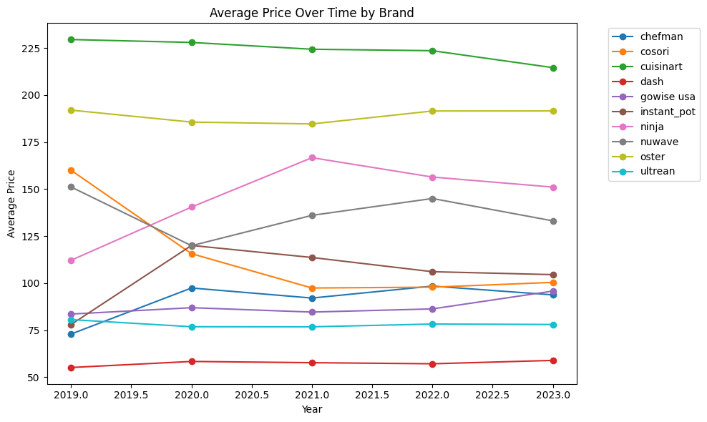
Market overview: clear price tiers
The dataset covers every brand in every year from 2019 through 2023.
10×5
4.3–4.8
$224+
complete panel
tight ratings
premium ceiling
MARKET READ
Premium brands sit well above the market: Cuisinart and Oster anchor the high-price tier.
Value brands remain materially cheaper, especially Dash and Ultrean.
Ratings are consistently strong, so brand position and product features matter more than quality gaps alone.
Air-Fryer Market Intelligence | 2

Slide 3
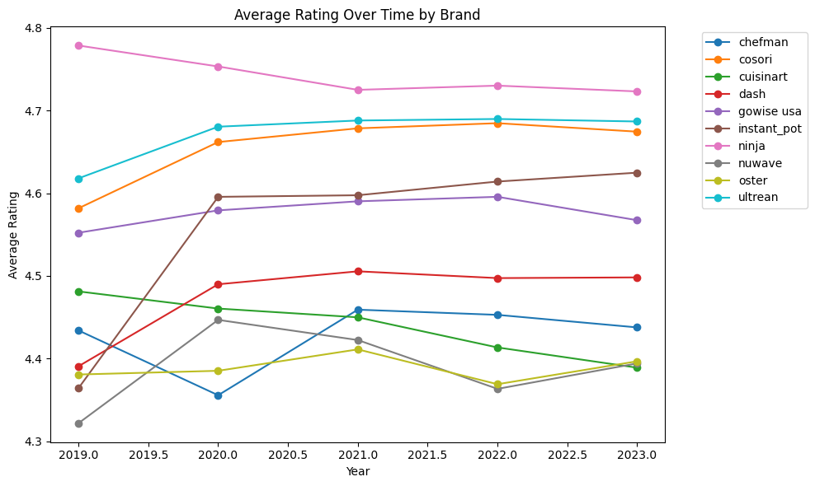
Prices and ratings: persistent tiers, compressed quality
A few brands maintain persistent price leadership, while ratings stay compressed across brands.
IMPLICATION
Pricing is a stronger differentiator than ratings. Ninja, Ultrean, and Cosori rate highly, but their prices and share trajectories differ, indicating demand is not explained by rating alone.
Air-Fryer Market Intelligence | 3

Slide 4
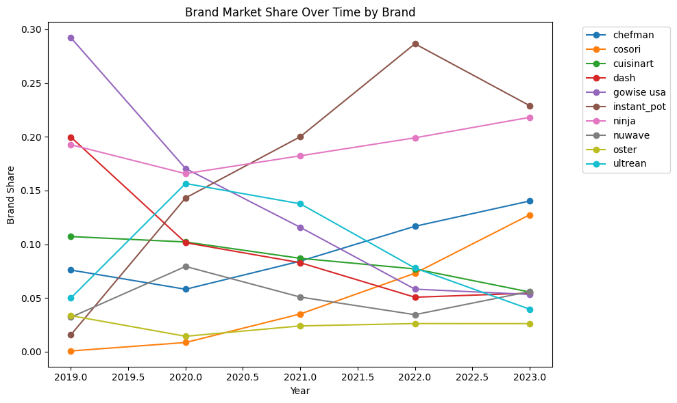
Market share: leadership shifted toward Instant Pot and Ninja
The market became more dynamic over time, with sharper share movements than price or rating changes.
KEY MOVEMENTS
GoWise USA fell from roughly 29% share in 2019 to nearly 5% by 2023.
Instant Pot rose from a small share position to the 2023 market leader at roughly 23%.
Ninja built a consistently rising position and reached roughly 22% in 2023.
Cosori and Chefman gained momentum by 2023, while Oster stayed niche.
BUSINESS MEANING
Market share shifted toward brands that combine strong ratings with accessible-but-not-low-end pricing.
Air-Fryer Market Intelligence | 4

Slide 5
Demand model: negative price sensitivity
Multinomial-logit style demand was estimated with linear regression on log market share.
Model structure
-0.0377
log(brand share) = price + rating + product features + brand effects + year effects
Estimated price coefficient
p = 0.002
OLS regression explains 76.3% of variation in log brand share; adjusted R² is 60.0%.
WHY THE SIGN MATTERS
Brand and year controls separate persistent brand strength from market-wide time shifts.
Negative sign confirms demand slopes downward: higher price is associated with lower market share.
The model is intentionally simple, but useful for market intelligence and strategic comparison.
That validates using the demand slope to infer markups and unit costs.
A positive sign would undermine the core economic interpretation and the cost/profit exercise.
Air-Fryer Market Intelligence | 5

Slide 6
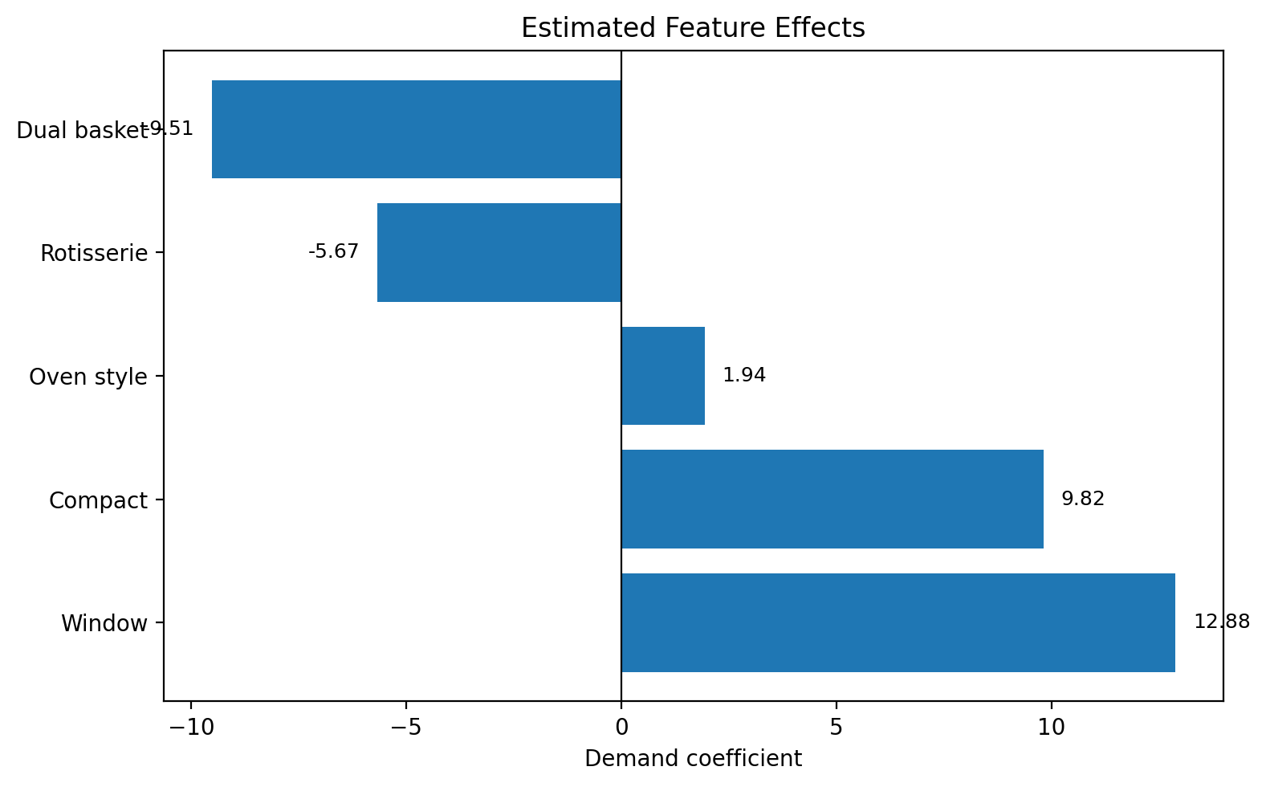
Features: compact and window designs screen favorably
Feature estimates should be read directionally because some features are rare in the data.
Feature
Avg prevalence
Demand coefficient
Compact
98.0%
+9.82
Oven style
56.3%
+1.94
Window
3.7%
+12.88
Rotisserie
7.1%
−5.67
Dual basket
0.2%
−9.51
READOUT
Window and compact features have the largest positive estimates; compact is nearly universal, while windows are rare but potentially differentiating.
Oven-style designs are common and modestly positive, suggesting a mainstream feature rather than a sharp differentiator.
Rotisserie and dual-basket coefficients are negative in this model; dual-basket is too rare to overinterpret.
Air-Fryer Market Intelligence | 6

Slide 7
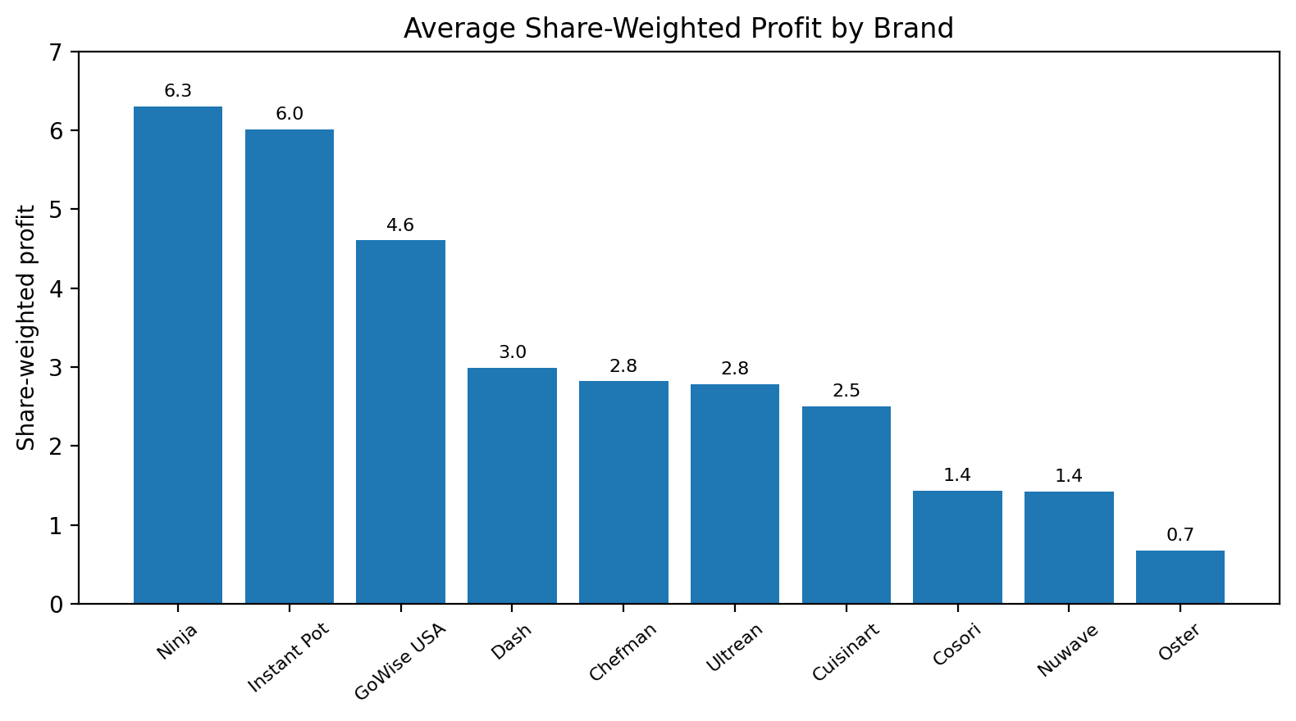
Conclusion: Ninja and Instant Pot have strongest economics
Model-implied economics separate premium pricing from profit leadership.
Brand
Unit cost
Markup
Share-weighted profit
Ninja
$112.49
$32.85
6.31
Instant Pot
$71.90
$32.56
6.01
GoWise USA
$56.30
$31.15
4.61
Dash
$27.94
$29.54
2.99
Chefman
$61.57
$29.37
2.82
ECONOMIC STORY
Markups are relatively similar across brands, mostly in the high-$20s to low-$30s.
POSITIONING CALL
Leaders: Ninja and Instant Pot. Premium niches: Cuisinart and Oster. Value players: Dash and Ultrean. Watchlist: Cosori and Chefman as share gainers.
Ninja and Instant Pot win because their markups are paired with high market share.
Cuisinart and Oster have the highest implied unit costs, but their small shares limit share-weighted profit.
No negative inferred unit costs appear, so the demand-based cost exercise is internally plausible.
Air-Fryer Market Intelligence | 7

