Slide 1

Information Security: Term Project
By Group 8:
ABDULAZIZ ALSADRANI 202159170
SAIFULLAH BUKHARI 202177630
JAWAD ALSHABIB 202157750

Slide 2

01
Setup And Compromise

Slide 3
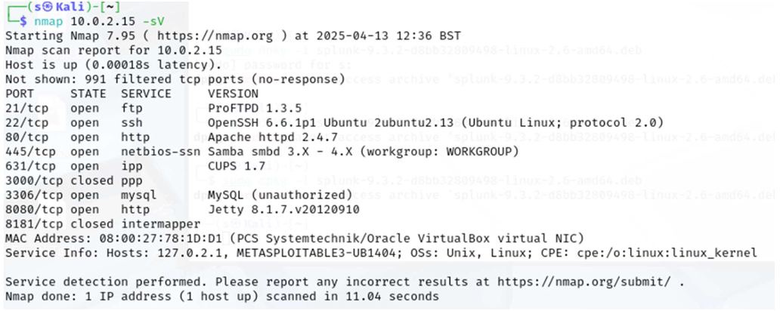
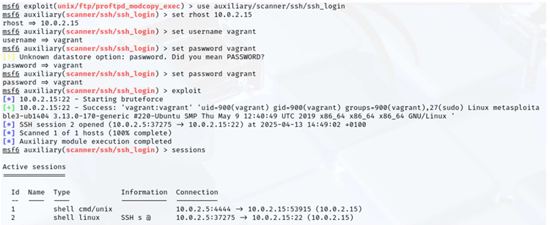
Set up both Kali and Metasploitable3
Using nmap for open ports
Exploring and Exploiting:
FTP
SSH
Scripts

Slide 4
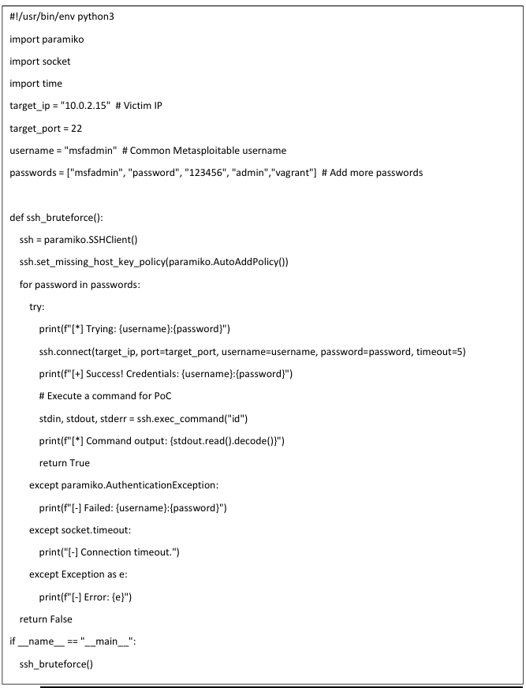
Screenshots

Slide 5

02
Visual Analysis

Slide 6
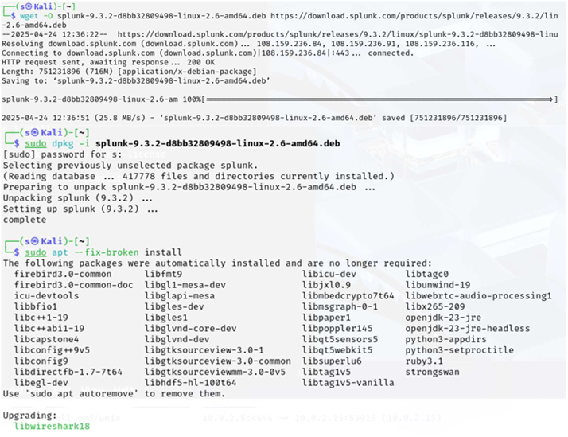
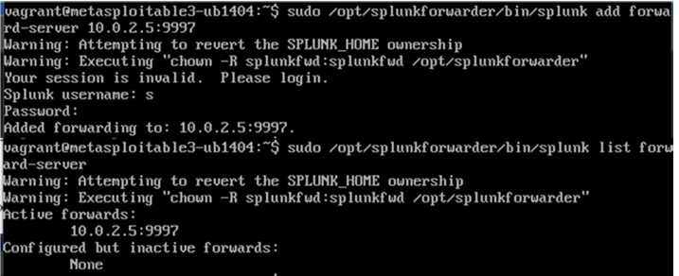
Set up Splunk and SplunkForwarder
Forwarding data

Slide 7
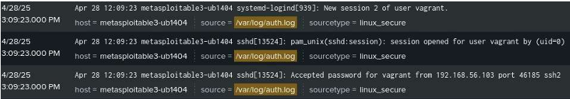
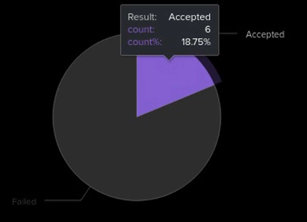
Visualizing analysis

Slide 8

03
Defense Mechanism

Slide 9
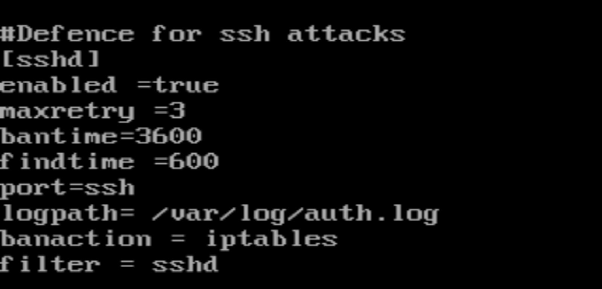
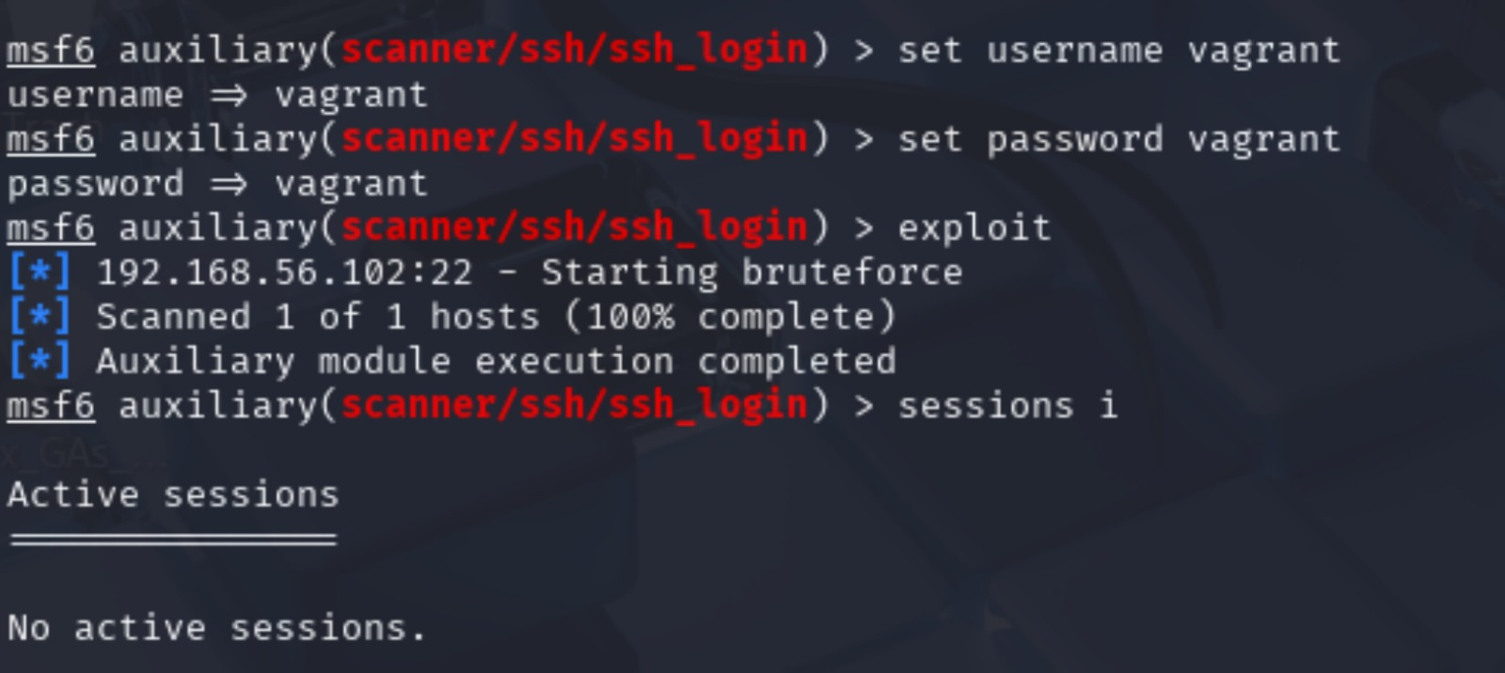
Understanding our attack
Implementation
Software used

Slide 10
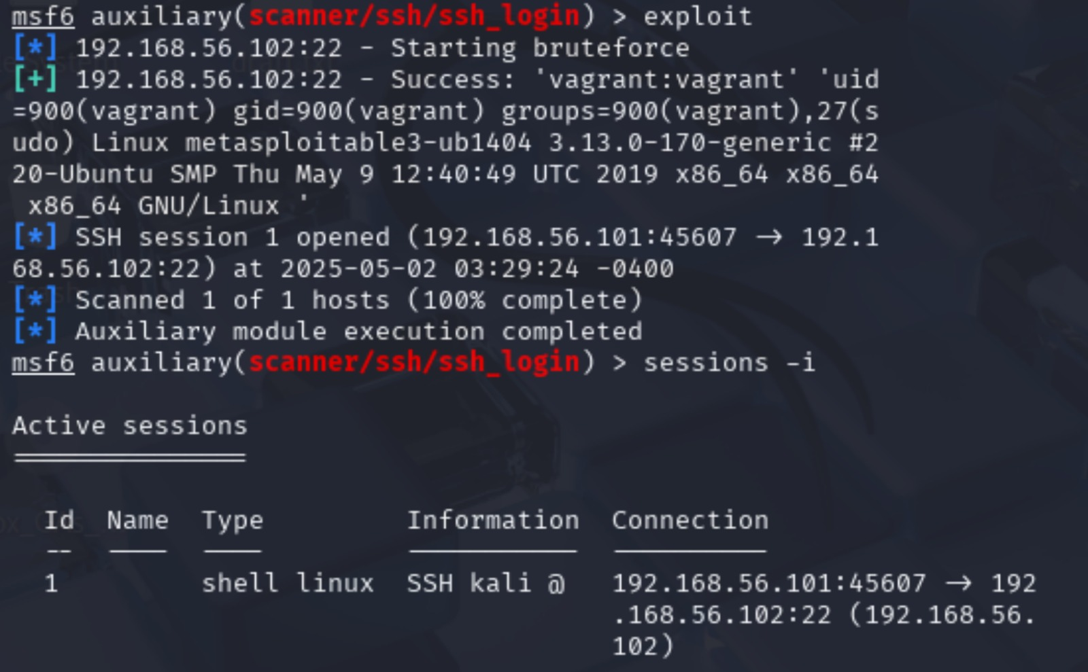
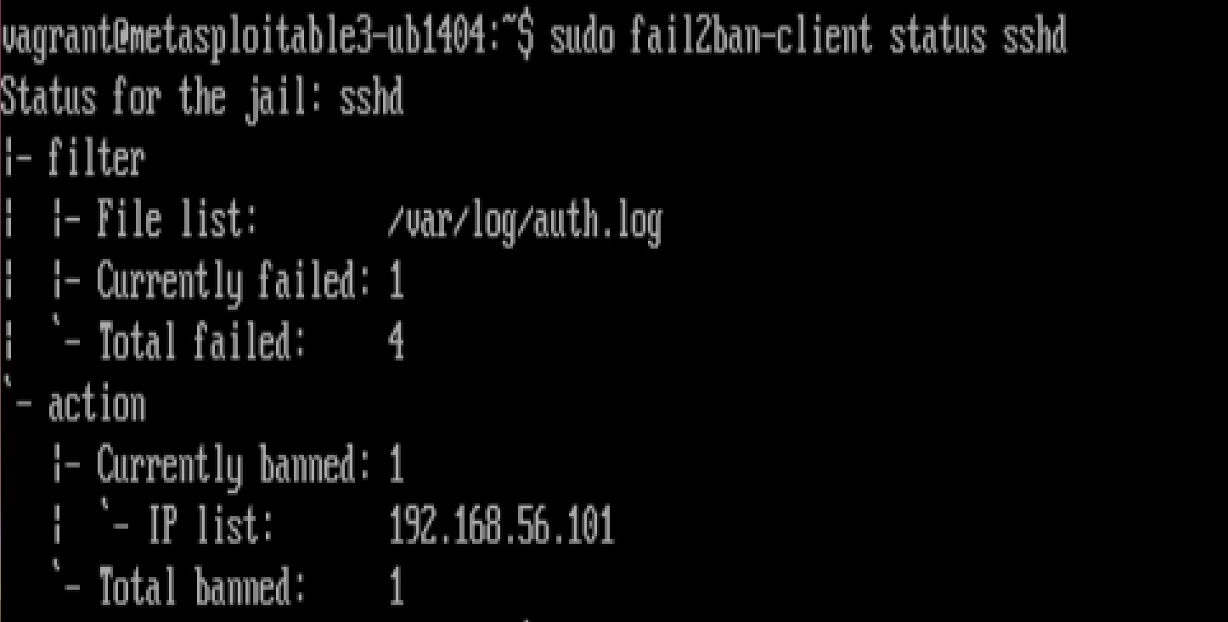
Before:
After:

Slide 11
IN CONCLUSION
Setting up Devices and applications
Attack SSH
Stop Brute Force
Work Distribution

