Slide 1
Q-Learning
I’m like Code Bullet, but not as cool, and not as Australian.

Slide 2
What is Q-Learning?

Slide 3
What is Q-Learning?
Reinforcement Learning method
Iteratively trained over multiple generations
Learns sequences of actions
Reaches goal by maximizing reward
All the cool kids are doing it
Notes:
Q-Learning is a method of reinforcement learning that trains an AI model to do some action by giving it a reward or punishment. The model learns iteratively over the course of many generations, slowly learning what the rewards and punishments are for various sequences of actions, before eventually getting to a point where it can optimally perform a specific goal by maximizing it’s reward along the way.

Slide 4
Reinforcement Learning
Actions have Rewards and Punishments
Rewards increase as the agent gets closer to the Goal
These rewards are stored in a State-Action-Value table

Slide 5
Iterative Training
Training takes place of multiple Generations
In early generations, the agent acts randomly.
As the agent explores more of the environment, it makes more optimal moves.
It still may move randomly later on, but only if there are unexplored actions.

Slide 6
Actions are Learned in Sequence
The State-Action-Value table stores rewards for actions.
These are then put together into a Q-Table, which stores the rewards of the current actions and factors in future actions.
This allows the entire sequence of best moves to be taken into account.

Slide 7
Maximizes Rewards
The Agent makes moves based on the Q-Table, maximizing it’s current and future rewards as it goes.
Finally, a Goal is reached and the process restarts.

Slide 8
The Technical Stuff

Slide 9
The Technical Stuff
Bellman’s Equation updates the Q-Table
How rewards/punishments are calculated
What I did (Pathfinding :D)
In a world of pure imagination

Slide 10
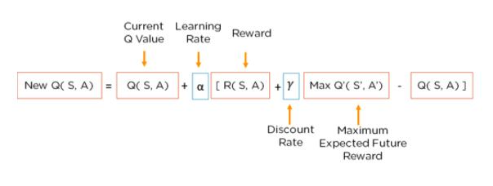
Bellman’s Equation

Slide 11
Calculating Rewards and Punishments
100/(Distance from Goal) - 100/(Start Squares Distance from Goal)
Any square close than the starting square gets rewards, and gets higher and higher rewards the closer it gets
Conversely, squares further away than the start square get punishments in the form of a negative number returned by this function.

Slide 12
Code Review!!!!!!!

