Slide 1
Optimal Blackjack through Dynamic Programming
By Will Gray

Slide 2
Rules of Blackjack
Cards are valued at their number, face cards are valued at 10, and Aces can be 1 or 11.
Object is to get to or as close to 21 as possible, without going over (Bust).
Win by beating the dealer.

Slide 3
Rules of Blackjack
Player and dealer are dealt two cards each.
Players can “Hit” to be dealt another card.
When a player is does not want to “Hit,” they “Stand” and the dealer begins their turn.
Dealer hits until his total is > 17
Payouts are given by total

Slide 4
Blackjack Payouts
Win = Beating the dealer’s total without “Busting.” Your bet is payed back 1:1
Push = Tie. You match the dealer’s total without “Busting.” Your bet is returned.
Lose = You go over 21, or the dealer beats your total. You lose your bet.

Slide 5
Sub-Optimal Blackjack
Player against the Dealer.
Bet $1 every hand.
Hit until you reach 17 and then stand.

Slide 6
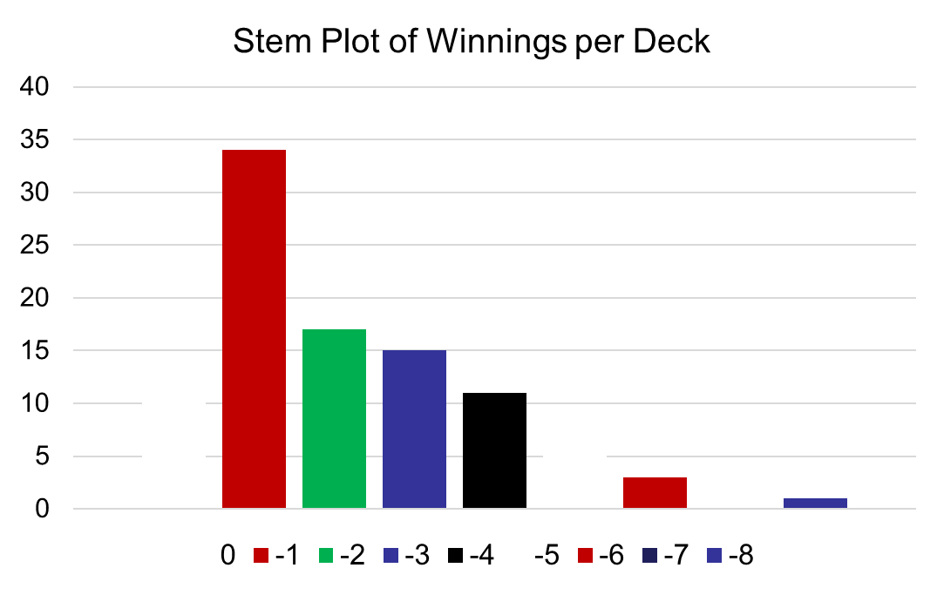
Sub-Optimal Blackjack
Total Winnings
-$61

Slide 7
Optimal Blackjack
Player against the Dealer.
Bet $1 every hand.
We need to know the entire deck.
We need to know the dealer’s hand.

Slide 8
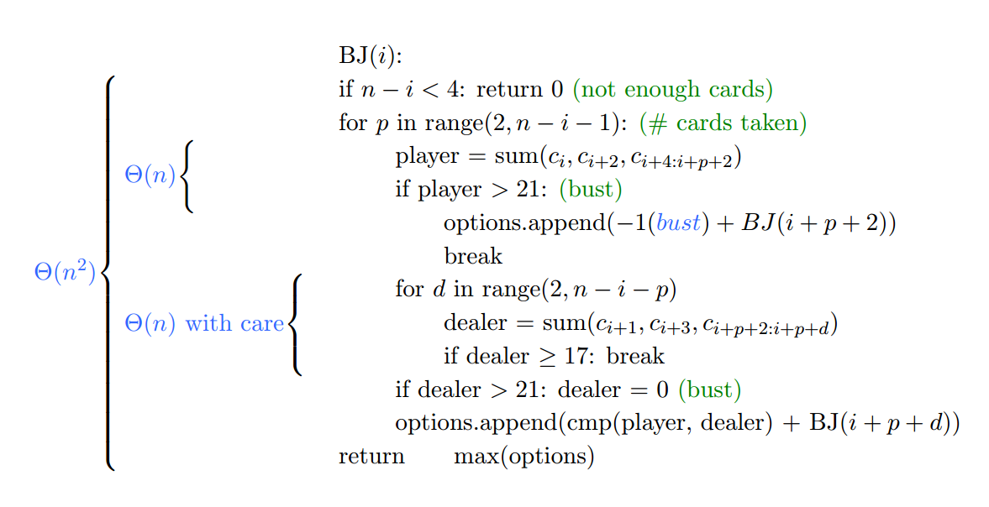
Optimal Blackjack

Slide 9
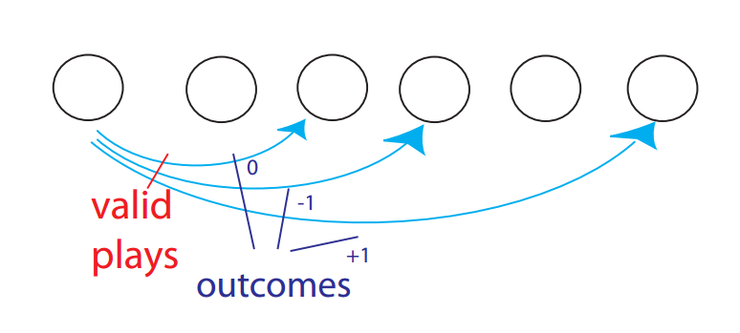
Optimal Blackjack

Slide 10
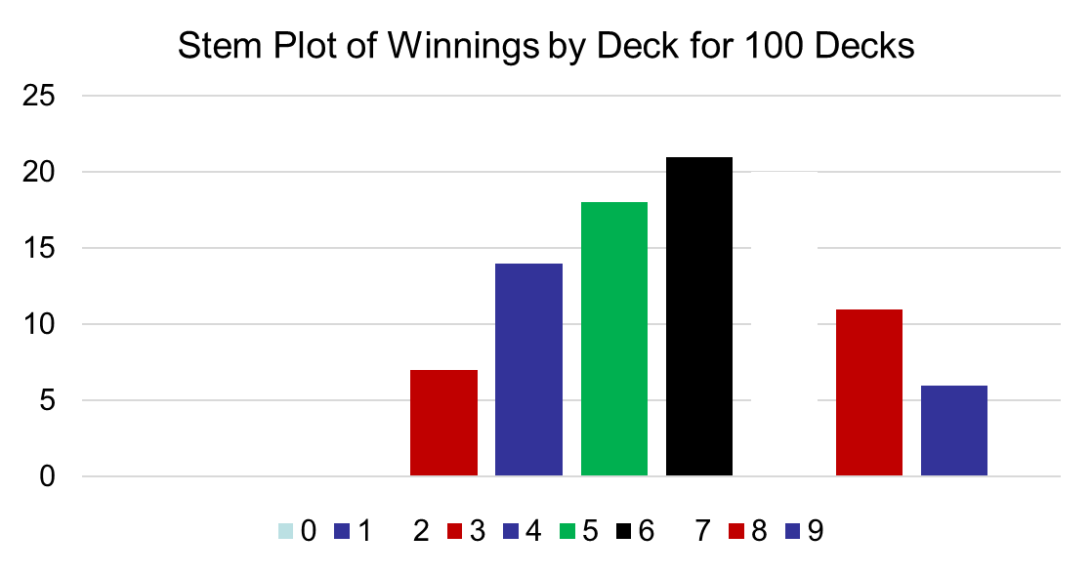
Optimal Blackjack
Total Winnings:
$581

Slide 11
Comparison of Results
Sub-Optimal $-61
Dynamic (Optimal) $528

Slide 12
Demonstration

Slide 13
References
https://youtu.be/ENyox7kNKeY?list=PLfMspJ0TLR5HRFu2kLh3U4mvStMO8QURm
https://ocw.mit.edu/courses/electrical-engineering-and-computer-science/6-006-introduction-to-algorithms-fall-2011/lecture-videos/MIT6_006F11_lec20.pdf

Slide 14
Questions?

