Slide 1
Koan
Clinical Registries on Amazon HealthLake
Migrating REDCap registers onto Health New Zealand's FHIR data foundation
Opportunity brief for the AWS and HealthX proof of concept
Koan Limited | 28 September 2026 | Draft v0.1

Slide 2
The opportunity in one slide
~50%
700+
5
Dec 2026
of the health system runs on local registers outside any core platform
Access databases, hundreds of spreadsheets, tens of REDCap projects at HNZ
REDCap registries to migrate in the proof of concept
HealthX wants it proven before Christmas, roughly three months
What AWS has: a defined pattern (FLOW) and a working demo for building clinical registries directly on HealthLake, which HealthX has adopted as its unified FHIR data foundation.
What HealthX wants: a partner to take ownership and prove the pattern on real REDCap registers before Christmas, then launch a new registry every fortnight in the new year.
What Koan brings: an HNZ Integration Panel MSA, relationships with Heath, Raj and Ken, delivery credibility from HSAAP, and the agility AWS says larger partners lack. Funded through AWS partner POC funding with Koan as partner of record.
Koan | Clinical Registries on HealthLake | Draft for discussion, 28 September 2026
Confidential. AWS material shared under NDA.

Slide 3




The problem: clinical white space
Half the health system is not supported by a core platform and never will be
Health is many services, not one
Primary, population health, acute, ambulatory, rare disease, specialist, allied. Each has different data needs. Building a bespoke EMR workflow for every one is uneconomic.
So clinicians build their own registers
Spreadsheets, Access, local SQL, REDCap. Eddie knows of five ovarian cancer registers in NZ, two on spreadsheets. It is rational, and it is fragile.
That data is invisible to the rest of the system
A GP learns a rare-cancer patient's status by letter. Rhapsody moves messages between systems but holds no persistent state anyone can query.
Customising the EMR is not the answer
Backlog, cross-unit approvals, release bundling. No change is trivial, so the long tail stays on local tools.
Koan | Clinical Registries on HealthLake | Draft for discussion, 28 September 2026
Confidential. AWS material shared under NDA.

Slide 4




Where HNZ is today
HealthLake is live as the unified FHIR data foundation. Registries are the missing layer.
HealthLake in production
Bedrock services on top
Managed FHIR R4 store, OpenSearch query layer, Iceberg export to Snowflake. Firely FHIR server being ported in.
Patient summary, guided triage and NLP, built or in pipeline under the HealthX "AI Foundation". Opinionated AI architecture.
Rhapsody moves events
The gap
HL7 v2 messaging between EMR, PAS and labs. Event-based only. No unified persistent state.
Nothing knows a patient's pathway or status for a given clinical context, and nothing brings local registers into HealthLake.
Koan | Clinical Registries on HealthLake | Draft for discussion, 28 September 2026
Confidential. AWS material shared under NDA.

Slide 5
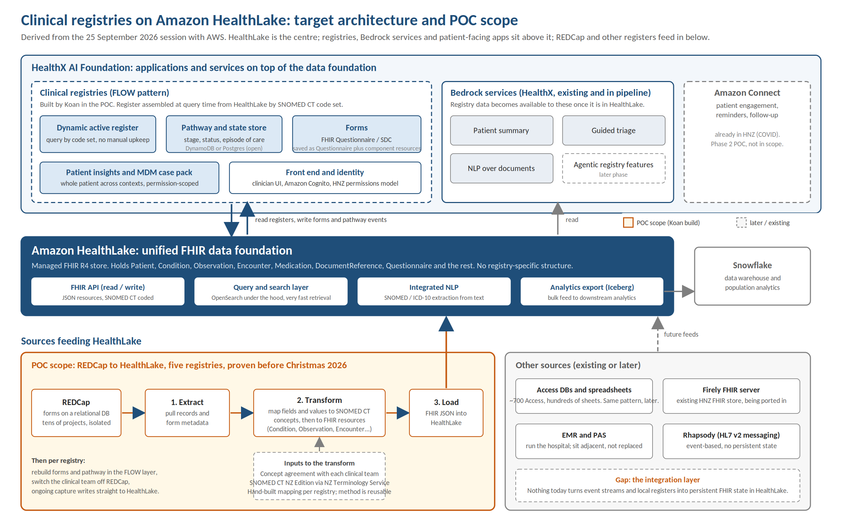
Target architecture and POC scope
Koan | Clinical Registries on HealthLake | Draft for discussion, 28 September 2026
Confidential. AWS material shared under NDA.

Slide 6
The FLOW pattern
FHIR-based Longitudinal Operational Workflow. Eddie built the demo in four days; the pattern is what HealthX has adopted.
1
Data
2
Dynamic active register
3
Pathway and state store
HealthLake holds every core FHIR resource. No registry-specific structure lives here.
Assembled at query time from HealthLake by a SNOMED CT code set. Always current, no manual upkeep.
Stage, status and episode of care per clinical context. DynamoDB in the demo; Postgres is fine.
4
Forms
5
Workflow
6
Patient insights
Per-register data entry defined by clinicians. FHIR Questionnaire / SDC. Saved as the questionnaire plus its component resources.
Pathway stages, MDM case pack, immutable decision records, next actions. Connect for patient engagement later.
The whole patient across contexts, permission-scoped. Registry data flows on to patient summary and other HealthX services.
Koan | Clinical Registries on HealthLake | Draft for discussion, 28 September 2026
Confidential. AWS material shared under NDA.

Slide 7
What is fixed and what is Koan's to decide
Eddie was explicit. Re-litigating the architecture is the fastest way to lose the engagement.
Not up for grabs
Open, Koan decides with Craig
HealthLake as the data layer
FHIR as the data model
Registers assembled by code set from HealthLake
A pathway with persistent state per clinical context
Working with what exists rather than restarting
Proven before Christmas
How the pathway is built and structured
State store: DynamoDB or Postgres, driven by the data
Forms engine: SDC recommended, open source implementations exist
Registry functionality, which is the clinicians' call
Migration pathway off REDCap (Eddie has opinions, no access)
How Koan's build fits HealthX's AI architecture
Koan | Clinical Registries on HealthLake | Draft for discussion, 28 September 2026
Confidential. AWS material shared under NDA.

Slide 8

REDCap to HealthLake: the critical path
Hand-built per registry. The method becomes repeatable; the mapping does not.
1
2
3
4
5
Extract
Agree concepts
Design mapping
Load
Rebuild and switch
Pull records and form metadata from each REDCap project. Koan needs access; Eddie has none.
Each clinical team agrees how fields and values map to SNOMED CT. Clinical decision, not technical.
Which FHIR resources each form and field becomes. Condition, Observation, Procedure, Encounter, Questionnaire.
Write FHIR JSON into HealthLake, linking to existing Patient, Practitioner and Medication resources.
Recreate forms and pathway in the FLOW layer, move the team off REDCap. Ongoing capture writes to HealthLake.
Step 2 is the schedule risk. Five registries means five clinical teams agreeing SNOMED mappings inside three months. Pick registries with engaged owners and simple data, get Heath to broker access in the first fortnight, and run discoveries in parallel. If a registry touches cancer, ICD-O-3 coding and the Deloitte cancer-register stream both come into play.
Koan | Clinical Registries on HealthLake | Draft for discussion, 28 September 2026
Confidential. AWS material shared under NDA.

Slide 9



Proposed proof of concept
POC to pilot. Scope to what proves the pattern, not to a finished product.
Scope
Timeline
Five REDCap registries chosen with Heath and the REDCap user group. Discovery, mapping, migration, and a working registry with pathway and forms on FLOW. Connect and agentic Bedrock features out of scope.
Proven before Christmas 2026. Suggested shape: one registry fully migrated and live, four mapped and loaded. Agree the definition of "proven" with Heath before starting.
Roles
Starting position
Koan owns delivery. Eddie provides the pattern, spec files and content, and reviews. Craig helps scope AWS services and reviews design. Heath brokers clinical access and sponsors.
Architecture, demo, spec files and content from AWS. No demo code. Open source SDC implementations avoid building a forms engine. Koan's HSAAP Step Functions patterns reusable for pipelines.
Koan | Clinical Registries on HealthLake | Draft for discussion, 28 September 2026
Confidential. AWS material shared under NDA.

Slide 10

Funding and commercial
AWS partner POC funding with Koan as partner of record. Customer money: none.
Mechanism
Partner Opportunity Acceleration (POA) funding. Koan registers the HNZ opportunity in ACE and submits the fund request. AWS cannot fund itself; ProServe is not funded for this.
Sizing
Eddie quoted 15% of year-one platform ARR; Craig put consumption at 15 to 20k. The standard construct is about 10%, capped near US$25K. To be reconciled: roughly US$150K ARR is needed for US$15K of funding at 10%.
Process
Scope AWS services (Craig), run the pricing calculator, write the SoW, submit the request. Credits and cash follow milestones via Payee Central. Ingram is Koan's channel if MAP funding is needed later.
Context
Deloitte is in conversation with Eddie on cancer registers, not REDCap. AWS wants a global reference case (NHS, Australia). Heath has no budget and wants a partner to own it.
Koan | Clinical Registries on HealthLake | Draft for discussion, 28 September 2026
Confidential. AWS material shared under NDA.

Slide 11
Risks to manage before we start
Flagged now so they are handled in the SoW, not discovered in December.
Funding not confirmed
Probity and procurement
Patient data and privacy
Treat as gating. Agree ARR basis and amount with Eddie and Craig. No unfunded build.
AWS-funded POC, AWS-chosen partner, pre-built solution. Contract under the Panel MSA as a zero-dollar SoW with HealthX sponsorship and a no-preference statement.
REDCap holds identifiable data with NHI. Confirm HealthLake governance covers new sources; use de-identified data until sign-off.
Clinical concept agreement
Single champions
No code from AWS
Critical path. Choose engaged owners, broker access in week one, run in parallel.
Eddie and Heath carry this. Build Chris Watts and REDCap user group leads as secondary relationships; keep Ken informed.
Pattern and spec files only. Insist on the deck and content before the Heath meeting.
Koan | Clinical Registries on HealthLake | Draft for discussion, 28 September 2026
Confidential. AWS material shared under NDA.

Slide 12
Next steps
Move at the tempo Eddie set. If it is Monday, it is Monday.
This week
Early October
Mid October
Before Christmas
Deck walk-through with Eddie and Koan seniors
Eddie shares sanitised deck, spec files, content
Identify five candidate REDCap registries with Heath
Meeting with Heath: sponsorship, registries, definition of done, contract vehicle
Raise probity and privacy approach
Scope AWS services and ARR model with Craig
Draft SoW under Panel MSA
Submit POA fund request
Mobilise discovery with first clinical teams
Registry one live on FLOW
Four registries mapped and loaded
Heath demonstrates the HealthX model works
Koan | Clinical Registries on HealthLake | Draft for discussion, 28 September 2026
Confidential. AWS material shared under NDA.

Slide 13
Koan
Registers are the forgotten half of healthcare.
The data problem is solved by HealthLake. The remaining problem is operational: sit with clinicians, agree the codes, build the register, switch them over. Then do it again every fortnight.
Koan Limited | 60 Willis Street, Wellington

