Slide 1
Cyclistic Trip Presentation
Analysis done by Will Pepper

Slide 2

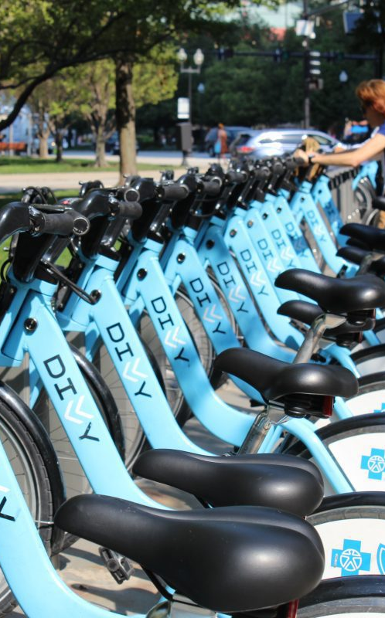
How do Annual Subscribers and Casual Riders use Cyclistic Bicycles differently?

Slide 3
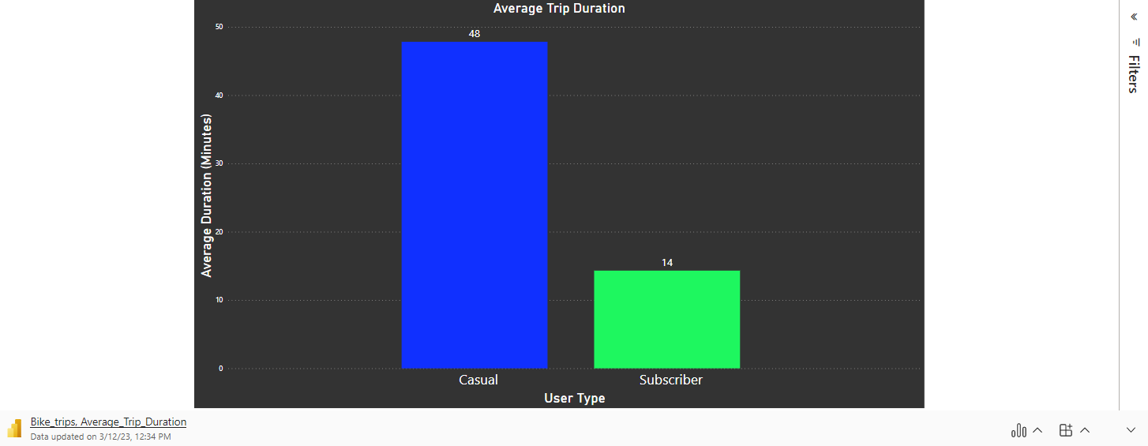
How long are the average trips of Casual and Subscriber Riders?
The Trip Duration of Casual Rider is on average 3X longer than a Subscriber’s trip.
Casual riders seem to make longer trips, which is logical because Subscribers are more likely to use the service for short trips at no extra cost.

Slide 4
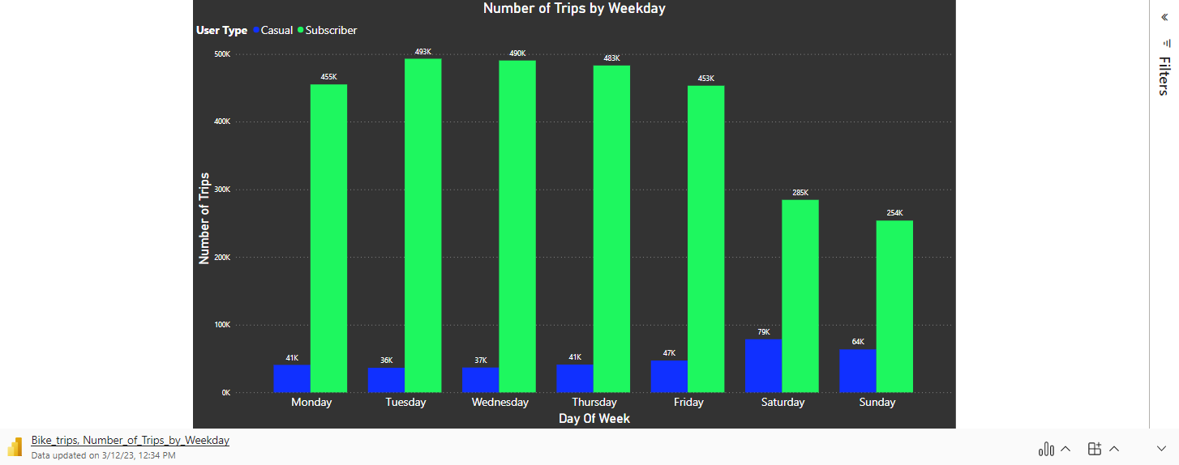
What days of the week are popular for Casual and Subscriber Riders?
Subscribers decrease their number of trips on weekends by 43%.
Casual Riders increase their number of trips on weekends by 75%.
This leads me to believe that Subscribers are more likely to use service for commuting to work or school, whereas Casual Riders are more likely to use the service for leisure activities.

Slide 5
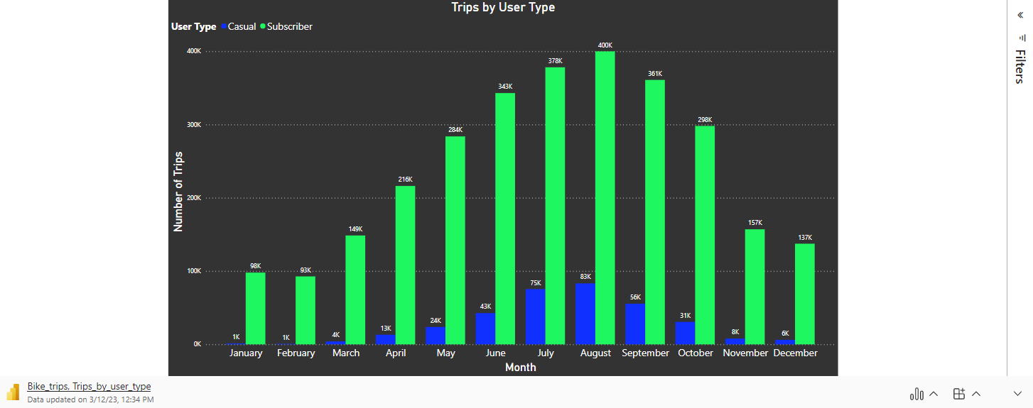
What time of year are Cyclistic trips popular for Casual and Subscriber Riders?
In Winter months, we see reduced activity by both groups which can be expected with cold winter in Chicago.
Casual Riders trips decreases dramatically more than Subscriber trips.
There are about 20,000 trips for Casual Riders from the months of November to March.
Supports thesis that Casual Riders typically use service for leisure instead of regular commutes.

Slide 6
How do annual members and Casual Riders use Cyclistic bikes differently?
Casual Riders use Cyclistic bikes for leisure activities whereas Members use them for regular commutes.
Casual Riders rarely take trips in winter months, but some subscribers still use bicycles for transportation.
Data is limited in that it does not allow us to understand how many Casual Riders are visitors or Chicago residents

Slide 7
How can we convert Casual Riders to Subscribers?
Visitors of Chicago are not incentivized to subscribe, unless they have access to the same service in their home city or if they travel to other cities enough with the service provided. Expanding service to other cities will increase subscribers for travelers and workers who frequently travel.
Adding another type of subscription service may be beneficial. Whether it be for weekend use or seasonal. However, this may discourage people to sign up annually and choose the smaller commitment.
Increasing the cost of weekend rides could make Casual Riders more inclined to switch to subscription service if they frequently use the bikes on weekends.

Slide 8
Data sources
Data provided by Motivate International Inc.
https://divvy-tripdata.s3.amazonaws.com/index.html

