Slide 1

Software Carpentry: Medical Imaging Image Processing Example
By William Scott-Jackson

Slide 2
Outline
Final exercise of the course (phew!)
A chance to hone your skills collaboratively
This is a real life, tangibly applicable example.

Slide 3
Radon Transform
Algorithm which turns a 2D image into another image as a function of summation at a rotation angle.
Useful in medical imaging for image reconstruction and acquisition modelling.
Figure 7: Rotation Based Projector: The sinogram is built up in columns as the object rotates about its centre.

Slide 4
Your Task
Get the image “Phantom.jpg” from the Git Repository “https://github.com/WillScottJackson/SheppLoganSCWExamples.git”
In small groups and using the worksheet provided; implement a Radon Transform algorithm.
Try using all of the skills you’ve acquired during the course such as unit testing, defensive programming and source control.

Slide 5
Your Task
Any functions used to implement a model solution and details on how to use them are provided in the worksheet.
Test it strenuously by varying parameters for the algorithm and stress testing the user interface (if any).

Slide 6
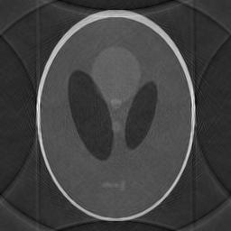
Where to Next?
A Radon Transform is a good way of producing a basic model of acquiring a medical image data set. However it needs to be reconstructed.
It’s possible to reconstruct an image using information derived from the 2D Fourier Transform.

Slide 7
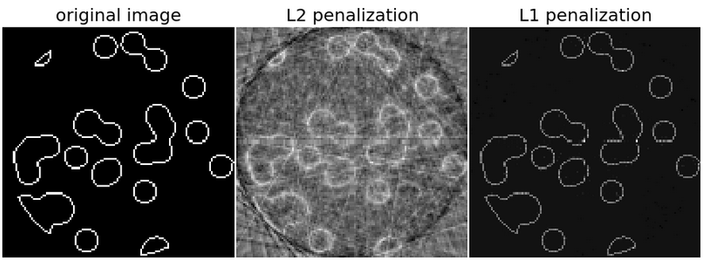
Where to Next?
Using more sophisticated methods; it’s possible to reconstruct an image using far few projections in the Radon Transform.
The below example requires up to 1/7th of the projections as per the previous example.
http://scikit-learn.sourceforge.net/dev/auto_examples/applications/plot_tomography_l1_reconstruction.html

Slide 8
Where to Next?
Carry on where you left off and try additional challenges with files and Notebooks found in the Git Repository:
https://github.com/WillScottJackson/SheppLoganSCWExamples.git

