Slide 1

Impacts of Promotion Nights, Weekends, and Team Strength on FC Cincinnati Attendance
How can we use these factors to project attendance in 2023?
What other factors significantly impact attendance?
By Will Sivolella

Slide 2
Data Collection
Collected attendance data from all MLS regular season matches in 2021 and 2022 (31 data points)
Variables in data set:
Attendance, Promotion night (binary), Weekend (binary), Day of Week,
FCC Rank (position in the Eastern Conference table prior to the match),
Opponent Rank (position in their Conference table prior to the match),
Date (for forecast model and organizational purposes)
Excluded matches:
First two home games of 2021 season – reduced capacity due to COVID-19
U.S. Open Cup game and friendly in 2022 season – extreme low outliers, fans care more about the MLS

Slide 3
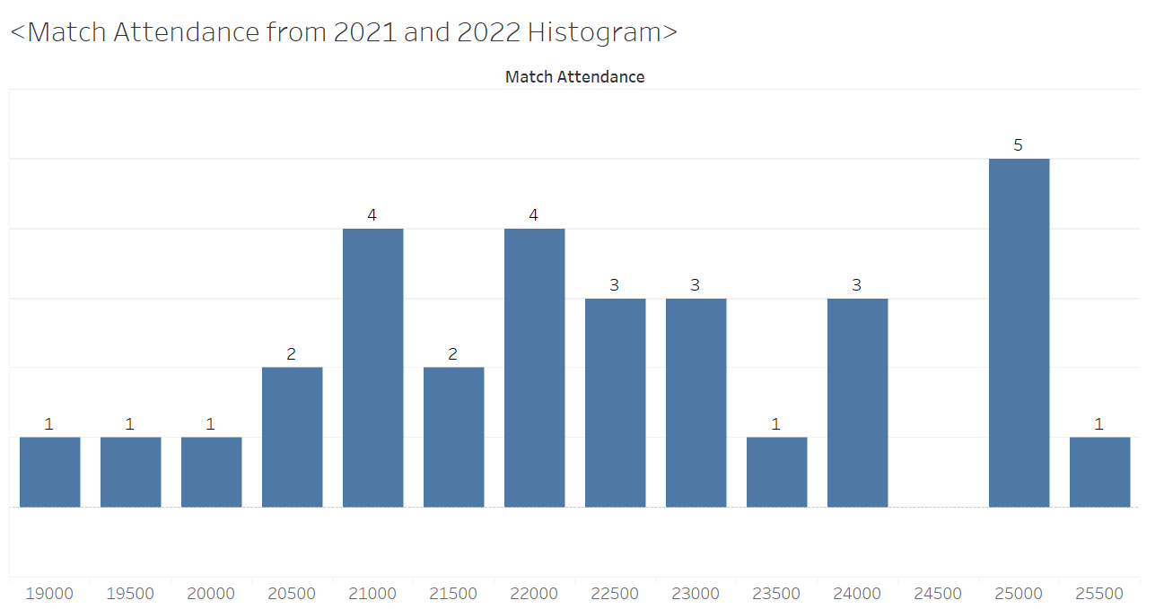
Attendance Data (2021 & 2022)
Minimum | 1st Quartile | Median | Mean | 3rd Quartile | Maximum
19365 | 21212 | 22557 | 22705 | 24188 | 25701
No outliers in the data: using IQR rule outliers are below 16,748 and above 28,652

Slide 4
Promotion Night Significance Test
Performed Two-Sample to Test with 5% significance level:
Null Hypothesis: average attendance on promotion nights = average attendance on non-promotion nights
Alternative Hypothesis: the average attendance on promotion nights > average attendance on non-promotion nights
Test statistic: -0.45, P-Value: 0.67
Interpretation: Assuming null hypothesis is true, there is a 67% chance of obtaining the sample I did or a sample that is more extreme
Conclusion: We do not have sufficient evidence to reject the null hypothesis since 0.67 (p-value) > 0.05 (significance level)
Calculated Confidence Interval:
We are 95% confident that the difference in true mean attendances for weekend matches on promotion nights and matches not on promotion nights is between -1737.17 and 1143.78.
Note: Small sample size (19 promotion nights, 12 non-promotion nights)
Results may not accurately represent population data
Would not expect promotion nights have a negative impact on attendance with larger samples

Slide 5
Weekend vs Weekday Significance Test
Split promotion night data (19 samples) into weekend (16 samples) and weekday (3 samples) matches
Performed Two-Sample to Test with 5% significance level:
Null Hypothesis: average attendance of weekend matches = average attendance on weekday matches on promotion nights
Alternative Hypothesis: the average attendance on weekends > average attendance weekday promotion nights
Test statistic: 1.26, P-Value: 0.1674
Interpretation: Assuming null hypothesis is true, there is a 16.74% chance of obtaining the sample I did or a sample that is more extreme
Conclusion: We do not have sufficient evidence to reject the null hypothesis since 0.1674(p-value) > 0.05 (significance level)
Calculated Confidence Interval:
We are 95% confident that the difference in mean attendances for matches on weekend versus weekday promotion nights is between -2784.716 and 5091.174.
Note small samples size (16 weekend promotion nights, 3 weekday promotion nights)
Results may not accurately represent population data
Would expect to weekend promotion nights to have greater attendance than weekday – fans have more time on weekends

Slide 6
Team Performance Significance Test
Split promotion night data (19 samples) into 4 subgroups, small sample sizes:
FCC high performance, Opponent high performance (3 samples)
FCC high performance, Opponent low performance (2 samples)
FCC low performance, Opponent high performance (5 samples)
FCC low performance, Opponent low performance (6 samples)
Threshold for high performance: in a first-round playoff spot before the matchday (7 or higher in their conference)
For rankings in matches at the beginning of the season, I used the previous years table
Performed ANOVA test with 5% significance level:
Null Hypothesis: All population means for the 4 groups are equal
Alternative Hypothesis: At least one of the population mean is significantly different
P-val: 0.537, 0.537 > 0.05 (significance level). Thus, we do not sufficient evidence to reject the null hypotheses, which states that the means of each group are equal
According to the ANOVA test, team performance (both FCC & opponent) does not have a statistically significant impact on attendance of promotion nights.
ANOVA results:
 | DF | Sum Square | Mean Square | F-Value | P-Value
Team Strength | 3 | 8,395,850 | 2,798,617 | 0.761 | 0.537
Residuals | 12 | 44,149,722 | 3,679,144

Slide 7
FCC Team Strength Significance Test
Assumed that fans value home team performance more than away team performance
Decided to perform two sample t test on FCC team strength
Two samples, high performance FCC and low performance FCC
Same criteria as ANOVA test
Now with larger samples: low performance: 11, high performance: 5
Two-Sample t test:
Performed Two-Sample to Test with 5% significance level:
Null Hypothesis: average attendance when FCC is performing well = average attendance when FCC is performing poorly on promotion nights.
Alternative Hypothesis: average attendance when FCC is performing well > average attendance when FCC is performing poorly on promotion nights
Test statistic: 1.58, P-Value: 0.094
Interpretation: Assuming null hypothesis is true, there is a 9.4 % chance of obtaining the sample I did or a sample that is more extreme
Conclusion: We do not have sufficient evidence to reject the null hypothesis since 0.094 (p-value) > 0.05 (significance level
Calculated Confidence Interval:
We are 95% confident that the difference in mean attendances for matches when FCC is high performing versus low performing on promotion nights is between -1052.493 and 3845.329.
Most significant impact observed so far (smallest p-value)

Slide 8
Attendance Forecast Model for 2023
Performed linear regression on 2021 & 2022 attendance data (training data)
Used full dataset (2021, 2022 & 2023 matches) to predict 2023 attendance base on the regression
2023 data has all variables set besides attendance
Used current table standings for team strength rankings in matches that have yet to occur
Excluded promotion nights as a factor in the regression
Don’t want model where promotion nights have negative impact
Team strength in the model is their position in their conference standings
Inverse relationship between position and attendance is expected
Note, as assumed before, FCC team strength has a greater impact that opponent team strength
Weekend versus weekday is statistically significant (P-Value = 0.012)
For whole data set, not just promotion nights
 | Estimate std | Error | T-Value | P-Value
Intercept | 22480.41 | 1296.94 | 17.333 | 3.7e-16
Weekend | 1995.23 | 740.86 | 2.693 | 0.012
FCC position | -98.15 | 92.85 | -1.057 | 0.300
Opp. position | -55.91 | 74.41 | -0.751 | 0.459

Slide 9
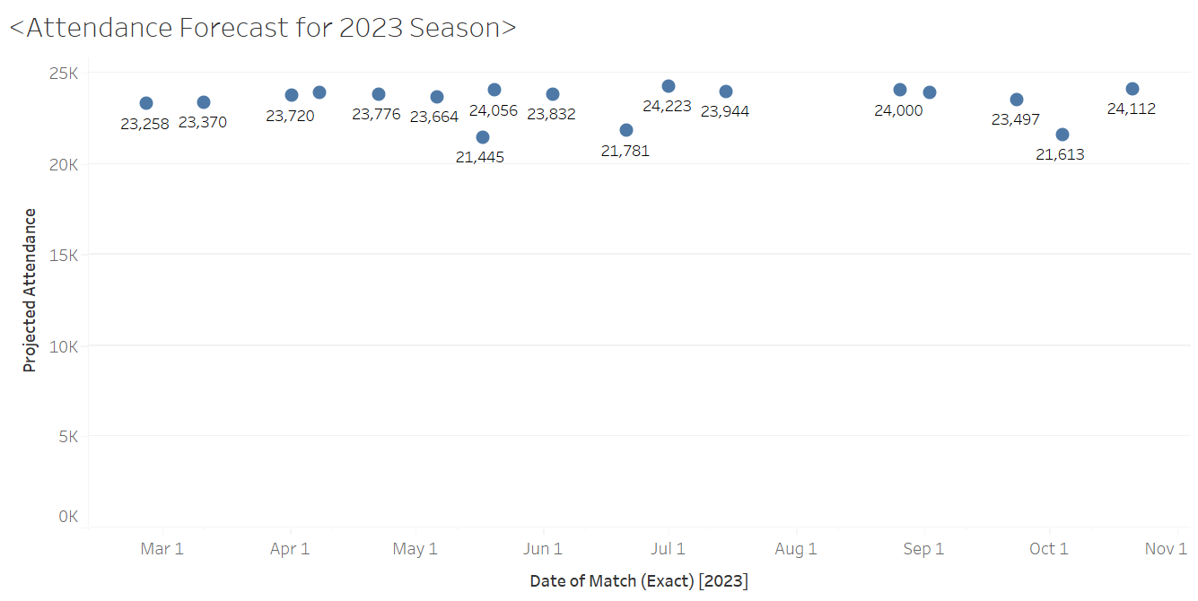
Attendance Forecast Model for 2023
Attendance projected for only MLS regular season matches, plotted in Tableau

Slide 10
Conclusions/Further Considerations
Weekend versus weekday has largest impact that we observed
Makes sense, fans have more time on weekends
FCC team strength has an impact, Opponent team strength has a lesser impact
Surprisingly, promotion nights do not have an impact on attendance according to our data
Seek more data to see if promotion nights have a significant impact
In future, only look at weekend data on promotion versus non-promotion night since weekend is the most significant variable observed
More attendance factors:
Weather – better weather, more attendance
Pricing - cheaper tickets, more attendance
Incline collective – work closely with fan groups, more attendance
Star player factor – sign famous player, other team has famous player, more attendance
Recommendations:
Continue with promotion nights to gather more data
Since weekends have high attendance, have more weekday promotion nights to increase weekday attendance

