Slide 1

Defenders Beat by Pass
A new insight on the most effective and direct passers of the ball during the 2022 FIFA World Cup
By Will Sivolella

Slide 2
What is the Defenders Beat by Pass Statistic?
Definition: Difference between the number of opponent players behind the location of the ball when it was played and the location of the ball when it was received for a forward pass
Data: Access to Defender (i.e. opponent player) location data at time of pass and at time when ball was received
Note: Chose to use Defender location at time when ball was received to account for defensive recovery while pass is traveling
Used x-coordinates, goal-to-goal axis of the soccer field
Why?: Indicates how well a pass advances the ball, how many Defenders are temporarily taken out of the play and end up behind the ball

Slide 3
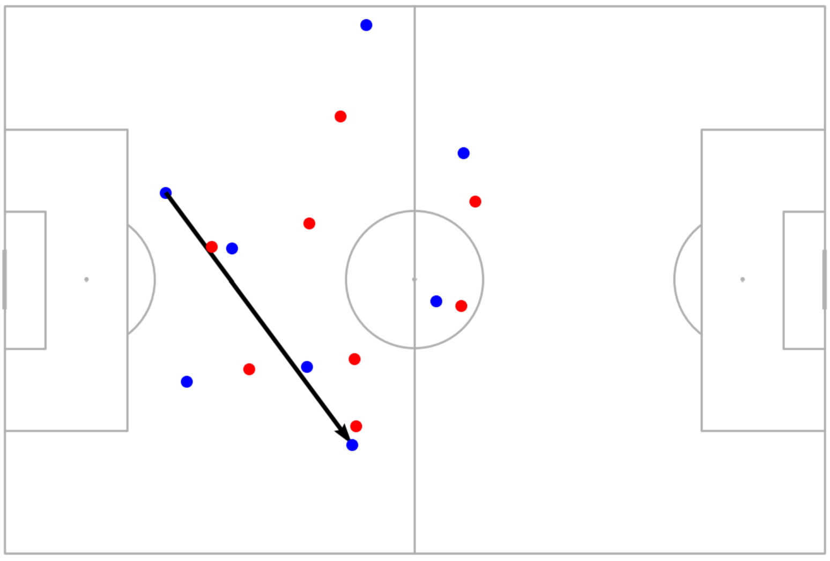
Visualization of Statistic
Team in possession: Blue
Team Defending: Red
Pass Vector: Black
Pass beats 4 Defenders in this instance
In other words, between the time the pass is played and received, 4 more Defenders are behind the ball
4
1
3
2
Pass by Dayot Upamecano to Ousmane Dembele during the 2022 World Cup Final

Slide 4
Overview of StatsBomb Free Data
Has seasonal data of 70 different high-level competitions
Seven competitions with matches from 2022 and after
Corresponding match data for matches in each competition
For a lot of competitions does not contain all matches or is very limited in the amount of matches
Corresponding event data for each match
Corresponding event360 data that can be paired with events
Extremely limited

Slide 5
Why 2022 World Cup Data?
Want relatively recent competition so that Defenders Beat by Pass statistic provides insight to currently relevant players
StatsBomb free data has complete event data for all 64 matches of the 2022 World Cup
Has event360 data for all 64 matches
Necessary to get off-ball player location information
Limitation: Not all forward completed passing events have corresponding ball recipient data and off-ball player location data (covers 79.25% of relevant events)
79.25% of relevant events is still extremely significant and insightful

Slide 6
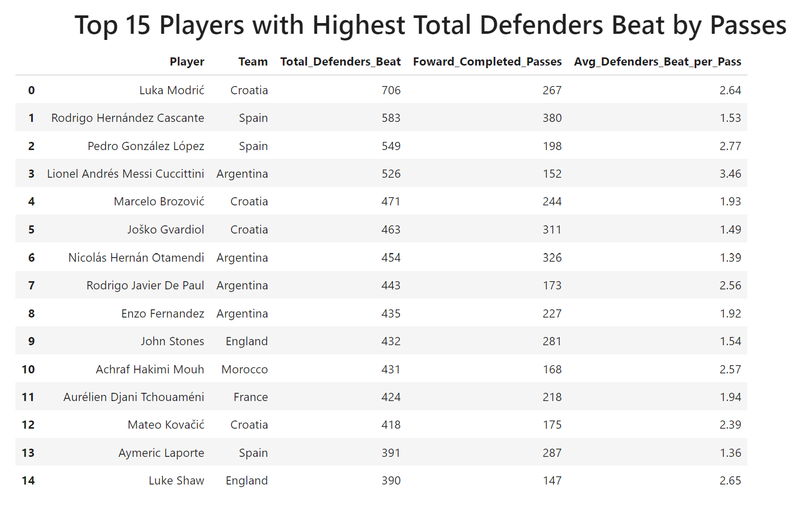
Results Part and Analysis, Part 1
These players were most influential (in terms of sheer volume) when it comes to advancing the ball through passing
High Total_Defenders_Beat and low (relatively) Avg_Defenders_Beat_per_Pass indicates how often players get on the ball
Applies to 2/3 of Spanish players on this list, makes sense as Spain is famously a possession based-side
Top 15 Players all on teams that made it to knockout-phase of tournament
Makes sense as more games means more opportunities
All world-class or elite players
A lot of midfield players, only one forward, Messi (no surprise there)
Messi drops into midfield a lot

Slide 7
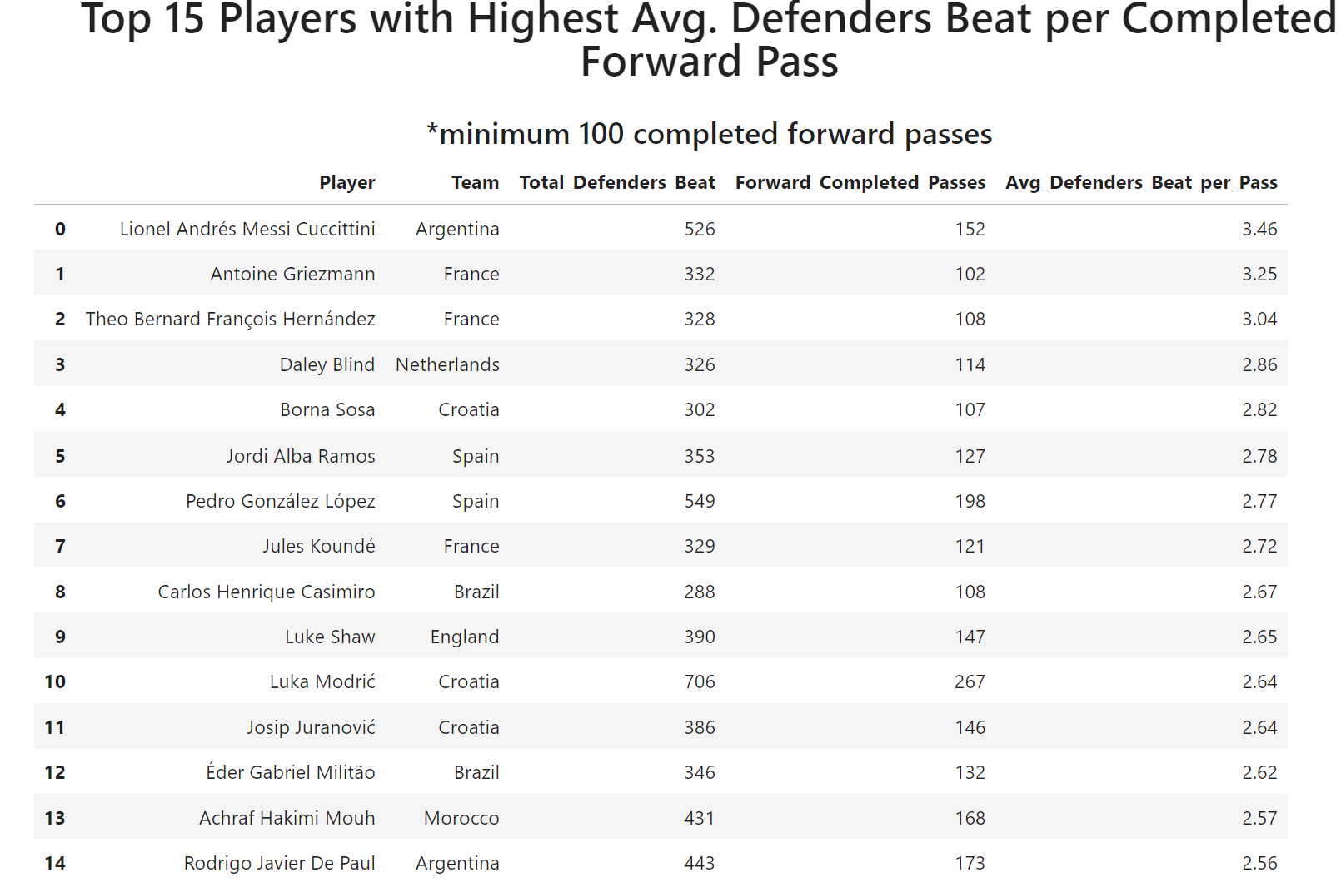
Results Part and Analysis, Part 2
Indicates players who were most efficient in terms of completed forward passes
Players who may not have been on the ball as much as players at the top of the list on the previous slide, but did the most with it in terms of advancing play with passes
Again, Top 15 Players on teams who made the knockout-phase of the tournament
Again, all world-class or elite players
Again, mostly midfielders and defenders, only two forwards, Messi and Griezmann
Both players play as 10s for their respective teams

Slide 8
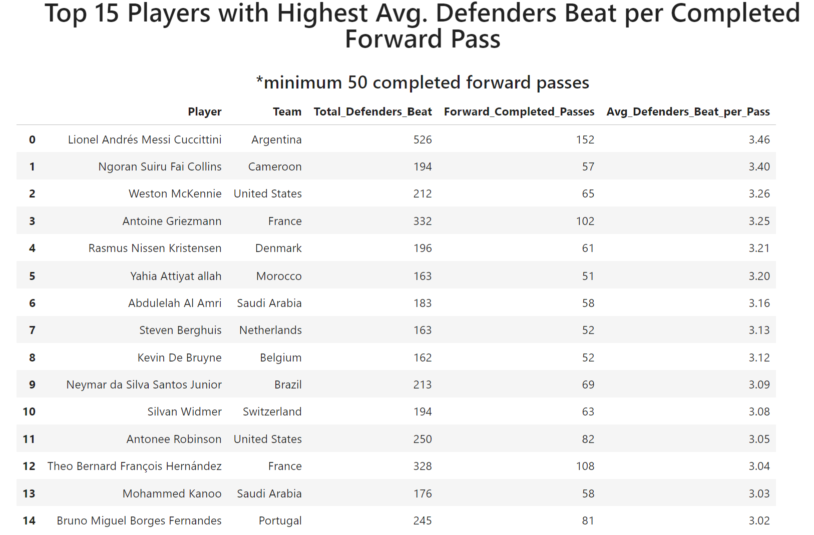
Results Part and Analysis, Part 3
New criteria of fewer completed forward passes
Insight on players who were on teams that were not as successful or did not have as much of the ball as the teams of players shown in the previous two slides
Insight on underappreciated players
Interesting to notice players from Cameroon, USA and Denmark in top 5
Important to still be aware of smaller sample size
Cool to see two USA players on this list!

Slide 9
Conclusions/Further Considerations
Defenders Beat by Pass indicates how well a pass advances the play and bypasses the opponents
Cumulative version of statistic applied to each player shows how well a player is able to accomplish this
Shows how direct a player is with their passing
Important to consider bias of players on top teams
These teams usually have a large share of possession
These teams have players who can effectively create space and open passing lanes more frequently than lesser teams
Player scouting implications
If soccer operations department is looking to find players with a very direct style of play, Defenders Beat by Pass statistic can be a good metric to measure this criteria
Further development and implementation of statistic
Consider forward passes that beat defenders/opponents and lead to goal/shot on target within same possession (not all passes are created equal)
Consider horizontal passes where recipients are able to carry the ball in open space to bypass defenders
Apply to player performances in other competitions

