Slide 1
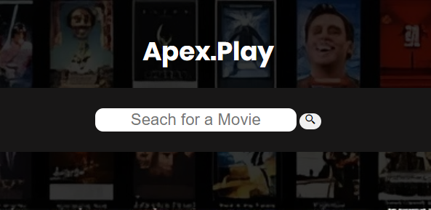
Apex.Play
BY : Wilson Muchiri.
ON: 10/14/2024

Slide 2
Problem Solved:
If you’re the type of person who likes his/her movie references in one place, don’t worry Apex.Play is here to help.
The web app Apex.Play is a platform for all movies and shows.
One can search for specific movies or a field of movies with related names.
Brief Intro:

Slide 3
Apex.Play Overview: with features provided:
Apex.Play is a movie search platform where you can find a huge number of movies from the early days of film to the latest movies.
It gives one a summary of the movie looked up, and a link to the original film website, as their main features in the website.
We all know how annoying adds are and so Apex.Play is an add free platform for you to take a smooth ride into the platform and out.
For those who like their data kept safe, Apex.Play does not require registration, securing the user info like mails ,personal items like passwords and more.
The above features make it stand out from many similar web platforms making it unique.

Slide 4
My Audience:
Open to the Movie guru’s, up to date Anime fans, all time Comedy fans and TV show fans.
The platform has a search bar to go to the movie or show required.
Provided brief summary just for confirmation on the movie or a brief summary on the movie genre.
Direct links to the source platform of the movie film makes , #NOTE non of the movie platforms are pirate sites.

Slide 5
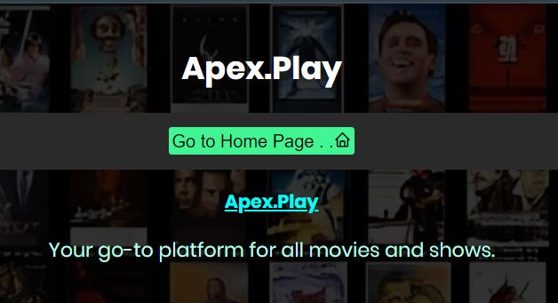
User Interface:
The Main page:
Gives you needed info about the page and web app.
The Home page:
Gives you a search bar to get to your needed movie.

Slide 6
Functionality:
Will be manually shown:

Slide 7
Technology Stack:
The application was basically created using JavaScript, HTML and CSS.
The HTML and CSS for creating the UI.
JavaScript for the functionality by using a simple API called ‘TV.MAZE’, where the data is harvested from.

Slide 8
Development process.
I started off with a basic HTML and CSS structure for the layout and user interface of the pages provided.
I later took JavaScript for the functionality of the whole website.
Using fetch API I was able to harvest movie data from the API provider TV.MAZE and organize it in a simple structure readable by the HTML.
I created a loop that would iterate over the given data and assign similar data to relative parts of HTML which made it easier and faster.
The biggest challenge :

Slide 9
Marketing & revenue:
Future Enhancements:

