Slide 1
DSC 200 Final Project
Will St. Onge, Ganga Adhikari, and Guysnove Lutumba

Slide 2
Our dataset – S&P 500 Index
The S&P 500 Index (S&P for short) is a stock market index that measures the stock performance of the 500 largest companies.
The S&P was officially founded in 1957, but data is available back to 1870.
Our dataset contains data about the S&P between 1871 and 2017.
Dividends, earnings, consumer price index, etc.
Dataset on GitHub: https://github.com/datasets/s-and-p-500

Slide 3
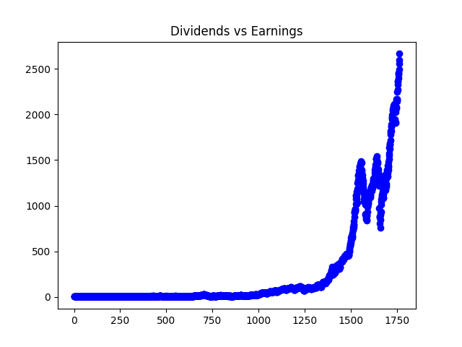
Dividends vs Earnings over time
Year 0 = 1871 CE

Slide 4
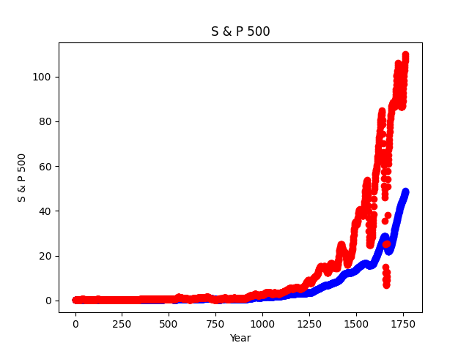
S&P 500 Value over time
Year 0 = 1871 CE

Slide 5
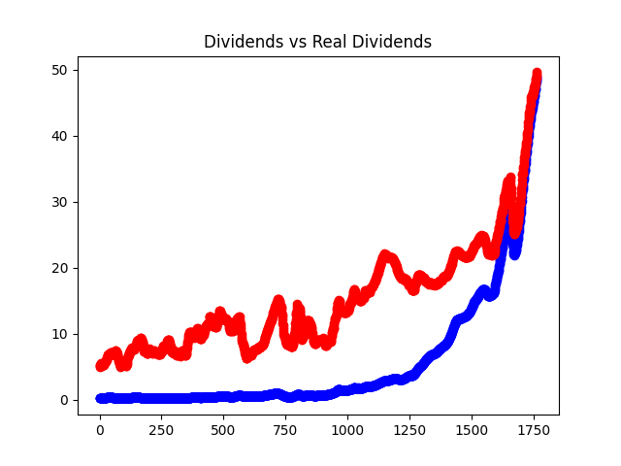
Dividends vs Real Dividends over time
Year 0 = 1871 CE

Slide 6
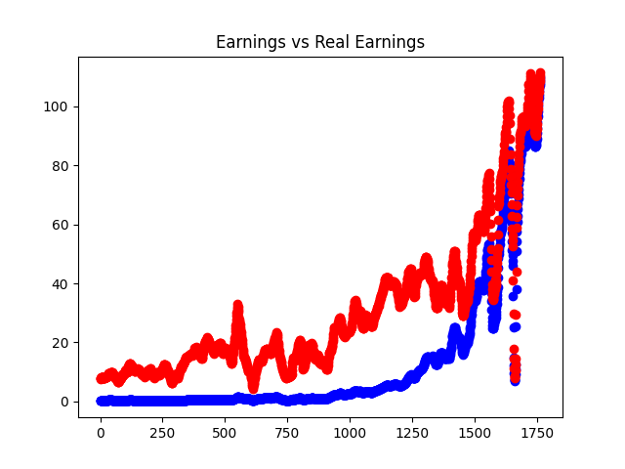
Earnings vs Real Earnings over time
Year 0 = 1871 CE

Slide 7
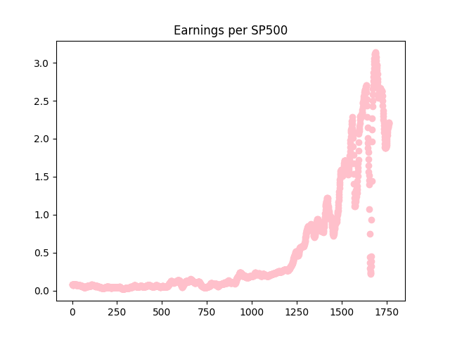
Earnings per S&P 500 over time
Year 0 = 1871 CE

Slide 8
Responsibilities
Will
Main function
PowerPoint slides
Ganga
Matplotlib code
Presentation

