Slide 1
GA Image Evolution Service
William Strickland
COP 6938 Fall 2012
University of Central Florida
12/2/2012

Slide 2
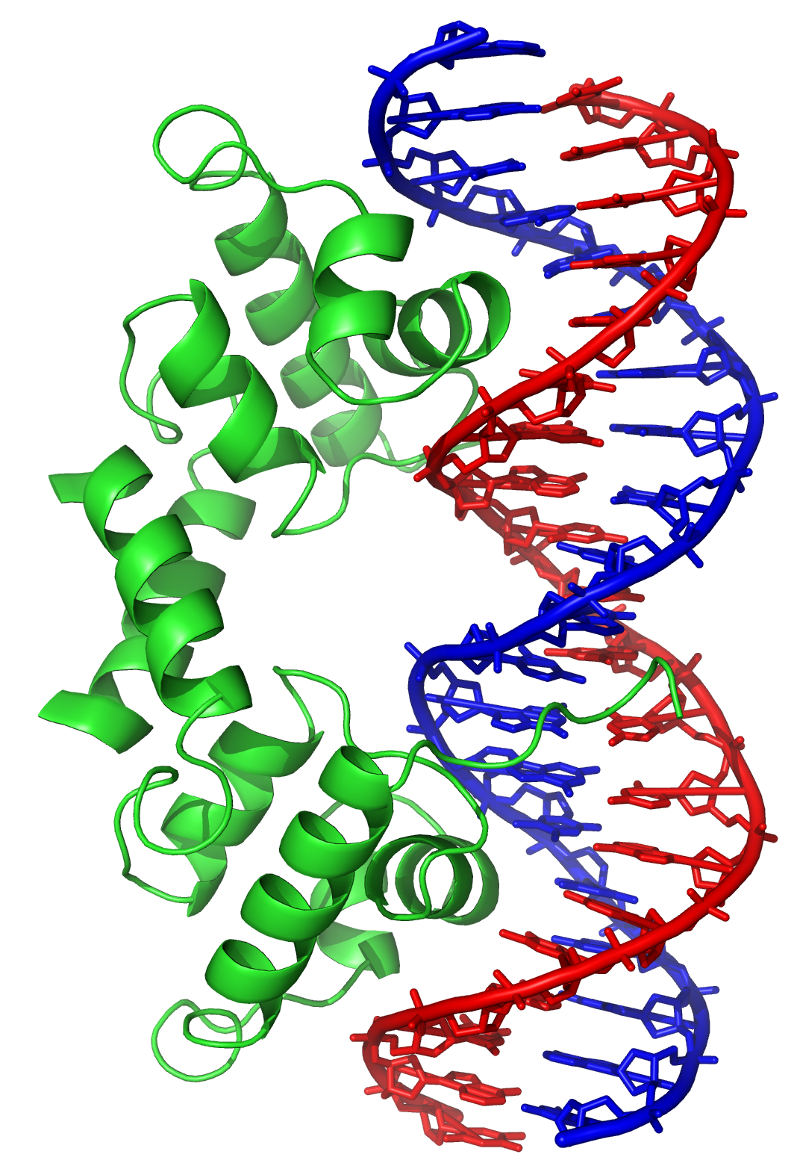
Overview
Concept and Motivation
Previous Work
Design Goals
Core Problem
Web Application
Cloud Infrastructure
Evolution Workflow
Dataflow
Example Runs
Interesting Features
Future Work
Project Links

Slide 3

Concept and Motivation
The Idea for this project comes from an aesthetic novelty.
For some time rotoscoping has been used as a way to add surrealism to images.
The idea for rotoscoping is to sample down the image and
try to best fit with a series of large shapes. Hard lines define
the style.
Humans are the the evaluators of the 'best fit' in
rotoscoping though.
What would this idea look like if a computer
was in charge?
rotoscoping example from film
“A Scanner Darkly”, 2006

Slide 4

Previous Work
My first exposure to applying evolutionary computing to a rotoscoping style image processing was by Roger Alsing and a project to “Evolve the Mona Lisa”.
http://rogeralsing.com/2008/12/07/genetic-programming-evolution-of-mona-lisa/
Later others came along following the same concept but different ideas for implementation.
http://alteredqualia.com/visualization/evolve/
http://blog.nihilogic.dk/2009/01/genetic-mona-lisa.html
Final result from
“Evolve the Mona Lisa”

Slide 5
Design Goals
My goal for this project was to design this service to maximize scale, not speed.
Not processing a few evolutions as quickly as possible, but many evolutions simultaneously.
The focus was to build a 'portal' with more than just the algorithm.
Adding storage and hosting to the service.
Also, the idea was for the processing to not involve the user. They submit work and it gets done. They don't need to leave their computer running or a browser window open.

Slide 6
Core Problem
The first problem for this project was to implement the algorithm to evolve toward a target image.
The previous examples were a diverse mix of technologies, styles and techniques.
  Generic hill climbers, simulated annealing, genetic algorithms
  Javascript, C#
  Web application, Client application

Slide 7


My Implementation is a native Java library which has the capability to function as a hill climber or genetic algorithm with a variety of options for tuning performance.
A great deal of time was spent running simulations to try and understand the behavior and strengths of the different techniques.
Sample output: hill climber; 1,206,408; 93.17% fitness

Slide 8
Web Application
A web application was built to encapsulating the core image evolution library developed.
Provides the evolution library as a service to users.
Web delivery make application portable to many platforms and form factors.
Users are able to login, view previous evolutions, request new evolutions (from user submitted images) and delete unwanted evolutions.

Slide 9
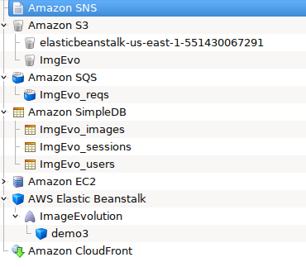
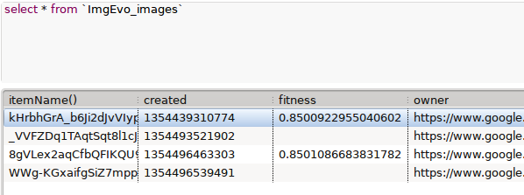
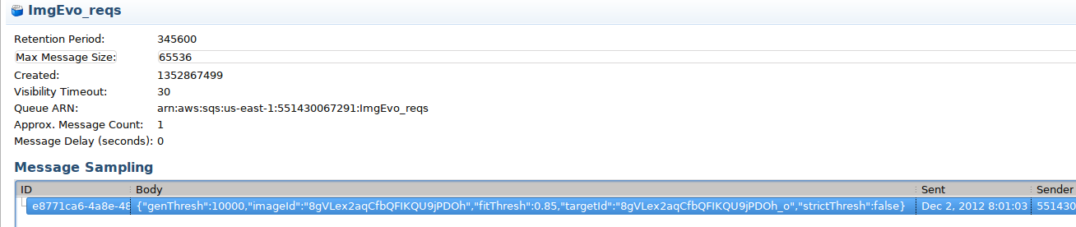
Cloud Infrastructure
Amazon Web Services
Database
Queues

Slide 10
Evolution Workflow
2b) add request message to queue
1) Evolve Request
User
Back-end
Front-end
SQS
3) Please wait reply
4) read request message from queue
5) put file on S3 and write back evolution info
2a) Acquire next imgId, put image item and fill in basic attributes
S3
SimpleDB

Slide 11

Dataflow
ImgEvo_users
ImgEvo_users
itemName (key)
owner
usr_name
usr_description
created
isDeleted
deleted
target
fitness
generation
reqFitness
reqGeneration
itemName (key)
email
friendlyName
canEvoRequest
ImgEvo_sessions
itemName (key)
jSession
userId
lastActivity
S3
Web
Application
Data sent
Reference

Slide 12
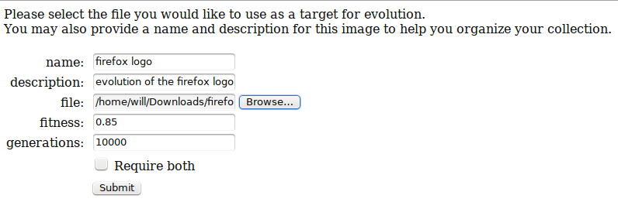
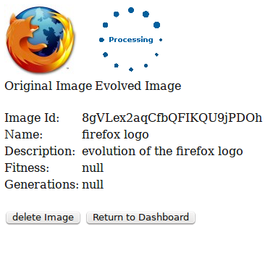
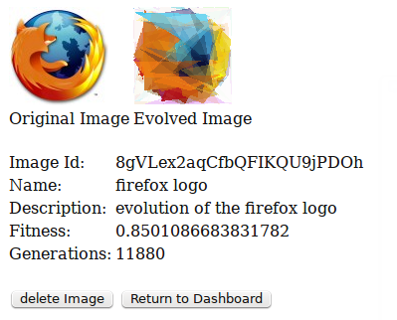
Example Runs

Slide 13
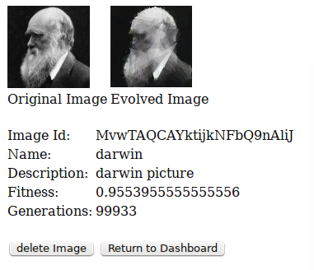
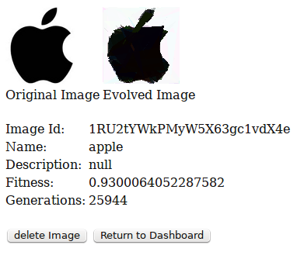

Slide 14
Interesting Features
Tomcat 7 application hosted in Elastic Beanstalk
OpenId Authentication and user management
SimpleDB as the database back-end and primary communication/coordination.
Custom session management persisted to SimpleDB
S3 for bulk data storage
SQS for computation distribution and balancing
Single WAR application despite distinct front-end and back-end threads

Slide 15
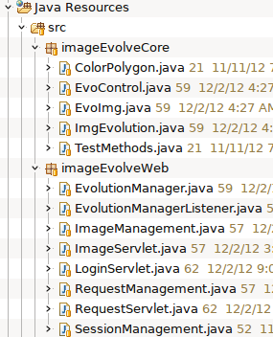
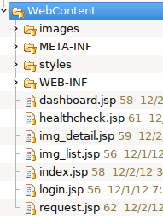
Tomcat application
Web application was designed a with a java Servlet and JSP front-end.
Back-end scheduled job that polls SQS for evolution requests to process.

Slide 16
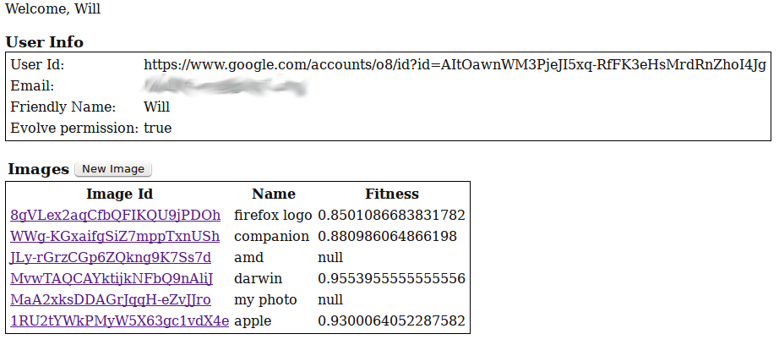

Slide 17
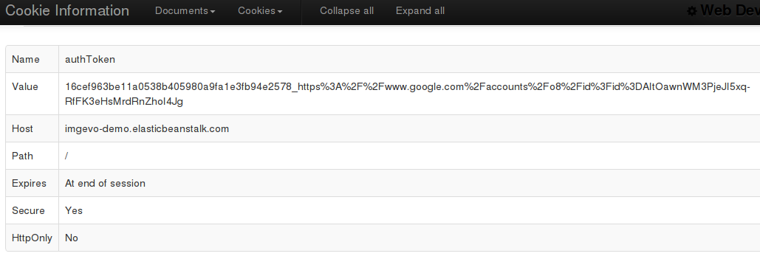
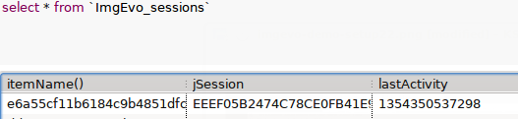
Session Management
Due to issues with how Elastic Beanstalk is configured and the issues and difficulty of off-the-shelf session management for Tomcat; a custom session management scheme was implemented.
It leverages a custom session cookie and database table associated to users are used to identify the user.
Unlike sticky sessions set in the load balancer, this allows requests to be sent to the least loaded server while still robustly identifying the user.

Slide 18
Elastic Beanstalk
The Amazon Web Services answer to PaaS products from Google and Microsoft.
Supports standard web application platforms such as Apache Tomcat.
Provides auto-scaling, load balancing and a managed application platform.
For Tomcat applications, one can either upload a WAR file from the web management console or use the Eclipse AWS plug-in to build and upload the WAR and configure the application.

Slide 19
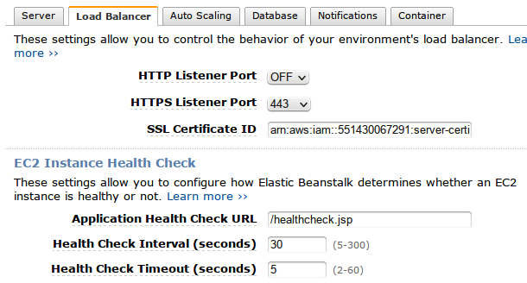
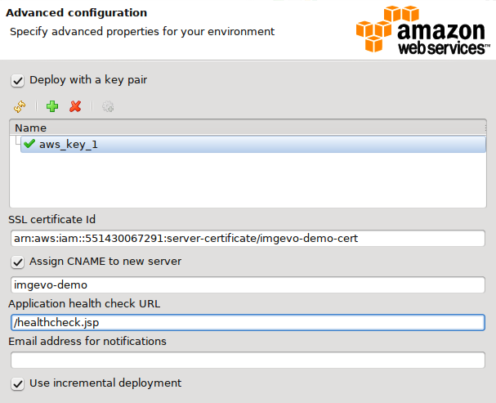
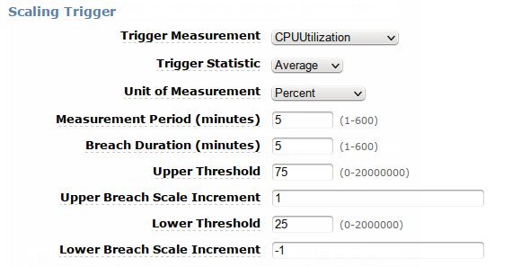

Slide 20
SimpleDB
AWS SimpleDB is a non-relational database as an AWS service.
Provides extreme scalability and handles distributed load well.
Schema-less, no predefined set of attributes (columns).
Many attributes values possible for a single attribute of a single object (record).
Not particularly fast.
Difficult semantics, requires application to handle basic tasks like joins and aggregation.
Not supported in generation 3 IDEs (drag and drop MVC IDEs)

Slide 21
OpenId
OpenId is a well known standard for federating internet applications.
Uses browser redirections to not only authenticate a user with a trusted third party (e.g. google, yahoo), but also securely retrieve user information from that third party.
Using the OpenId4Java library.

Slide 22
Future work
Several features originally planned have not been implemented due to time constraints:
Evolution service
  Saving image DNA after round of evolution
  Doing evolution in stages a previous evolution (checkpointing, better response time and better load balancing).
  Editing or continuing a previous evolution.
  Full selection of evolution parameters on request screen
  Giving thread priority to web service (over evolution back-end)
  Dynamic logic for taking on request jobs in back-end (based on system specs and load)

Slide 23
User interface
  AJAX pages for better user experience
  Scaling and partitioning large user images
  Email or other notification on evolution complete
  Session timeout security
  Proper sanitation of user inputs on request
  More robust image deletion logic
Social aspect
  Building friend lists of other users
  Sharing images to friends
  Making images public

Slide 24
Project Links
The application can be accessed at:
https://imgevo-demo.elasticbeanstalk.com/
This application is not open to the world. To request image evolutions you must login to setup a userId and then be manually given permissions.
For more information or to view the source code; visit the google code page for this project:
http://code.google.com/p/cop6938-image-evolution/

