Slide 1
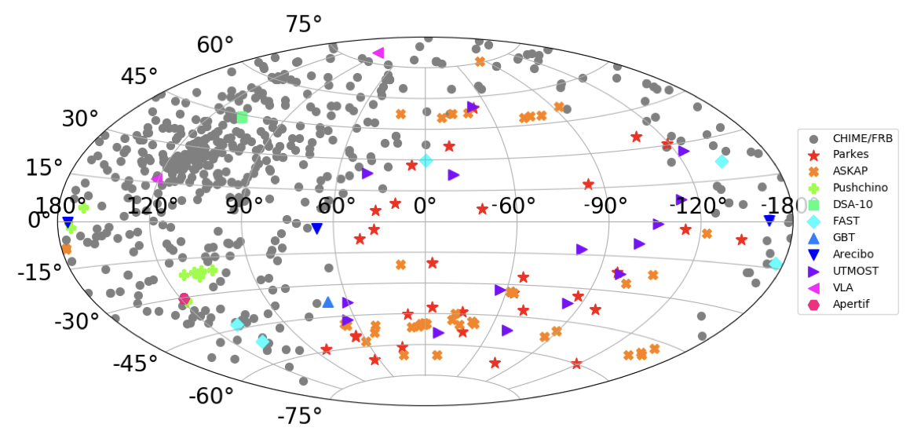
BACHELOR THESIS
Probing Fast Radio
Burst Environments
Cross-correlating deep and shallow FRB surveys with KiDS DR5
WILL RUPPERT
TU Dortmund University | 2026
What can spatial clustering reveal about FRB progenitors?
Notes:
Good morning, and thank you for being here. Today I will present my bachelor thesis on Fast Radio Bursts, or FRBs, and their spatial correlation with galaxies. FRBs are extremely short radio flashes originating at cosmological distances. Although several thousand sources are now known, the astrophysical objects that produce them have not yet been conclusively identified. Rather than studying individual bursts, my thesis investigates their statistical distribution across the sky. The central question is whether cross-correlations between FRBs and galaxies can distinguish between different progenitor models. To answer it, I developed a numerical pipeline for angular power spectra and used a Fisher analysis to forecast how accurately the relevant model parameters could be measured.

Slide 2
02
MOTIVATION
Why Fast Radio Bursts?
< 1 ms
4,539
TYPICAL DURATION
BURSTS IN CHIME/FRB 2
Extreme radio luminosity
Dispersion implies cosmological distances
3,641 distinct sources
Astrophysical origin remains uncertain
Will Ruppert | Bachelor Thesis
2
Notes:
Fast Radio Bursts last only milliseconds or less, but release an enormous amount of energy during that short interval. One important observable is dispersion: lower radio frequencies arrive later than higher frequencies because the signal travels through ionised matter. For many FRBs, the resulting dispersion measure is much larger than the contribution expected from the Milky Way alone. This shows that most sources are extragalactic and are often located at cosmological distances.
CHIME has dramatically increased the number of observations. The latest catalogue considered in this thesis contains 4,539 bursts from 3,641 distinct sources. Nevertheless, their emission mechanisms and progenitors remain uncertain. Precisely localising individual bursts and assigning them to host galaxies is difficult. A statistical approach therefore offers an alternative: even without an individual redshift for every FRB, the population as a whole can be compared with the known large-scale distribution of galaxies.

Slide 3
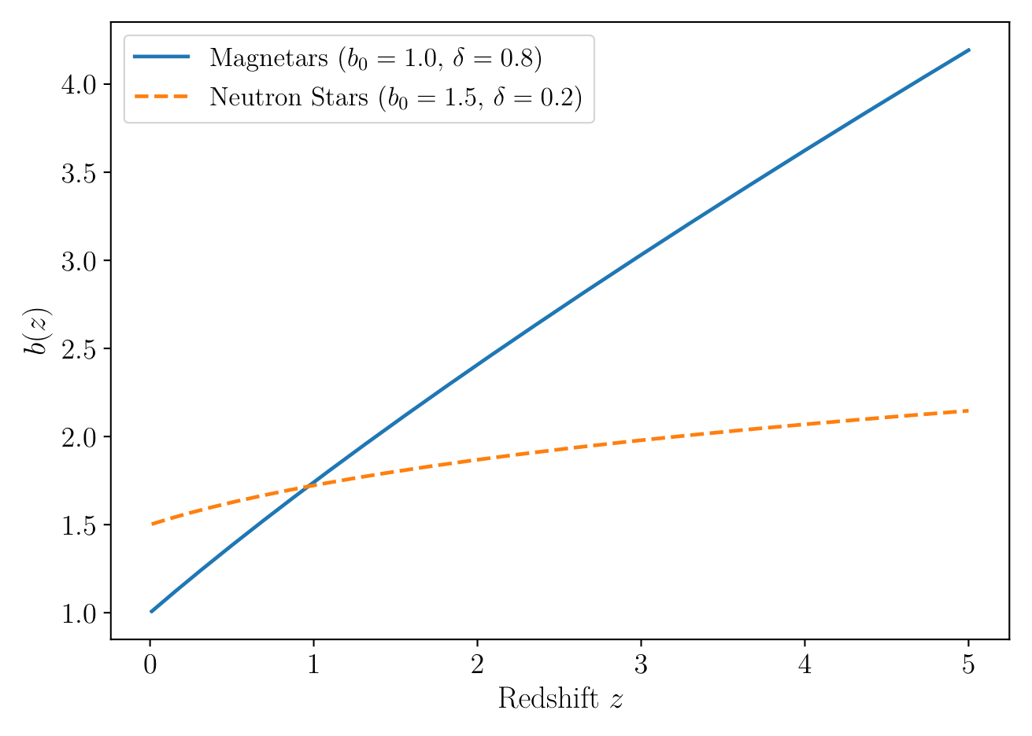
03
PHYSICAL PICTURE
Two Possible Progenitor Models
YOUNG MAGNETARS
Active star formation
Short delay time
b₀ = 1.0 | δ = 0.8
DELAYED CHANNELS
Older populations
Long delay time
b₀ = 1.5 | δ = 0.2
Bias model: b(z) = b₀(1+z)ᵟ
Will Ruppert | Bachelor Thesis
3
Notes:
In this thesis, I compare two simplified classes of possible progenitors. The first model describes young magnetars. They are primarily formed through the collapse of massive stars and should therefore follow the cosmic star-formation rate with little delay. This interpretation is also supported by the detection of an FRB-like burst from the Galactic magnetar SGR 1935+2154.
The second model represents delayed neutron-star channels, such as compact-object mergers or accretion-induced collapse. These events may occur billions of years after the original star formation and can therefore also be found in older galaxy populations.
Their different evolution is represented by a linear tracer bias, $b(z)=b_0(1+z)^\delta$. Here, $b_0$ sets the present-day amplitude, while $\delta$ determines how strongly the bias grows with redshift. The two models consequently leave different signatures in their spatial distributions. The goal of the cross-correlation analysis is to constrain these two bias parameters.

Slide 4
04
METHOD
The Basic Idea of Cross-Correlation
SAME SKY
FRBs and galaxies trace the same underlying matter field.
FRB
A cross-signal appears only where their redshift distributions overlap.
Galaxy
redshift →
tomography separates amplitude b₀ from evolution δ
Will Ruppert | Bachelor Thesis
4
Notes:
The basic idea is that both galaxies and FRB host objects trace the same underlying matter distribution. If a region of the sky contains more galaxies than average and we also observe more FRBs there, this produces a positive cross-correlation signal.
This signal is quantified by the angular power spectrum, $C_\ell$. Small multipoles correspond to large angular structures, while large multipoles probe small angular scales. The overlap along the line of sight is crucial: a low-redshift galaxy population only correlates with the fraction of FRBs located in the same redshift range.
KiDS divides its galaxies into six tomographic redshift bins. This means that FRB clustering is measured through six different radial weighting functions instead of one integrated projection. The resulting redshift information should help separate the overall bias amplitude, $b_0$, from its redshift evolution, $\delta$.

Slide 5
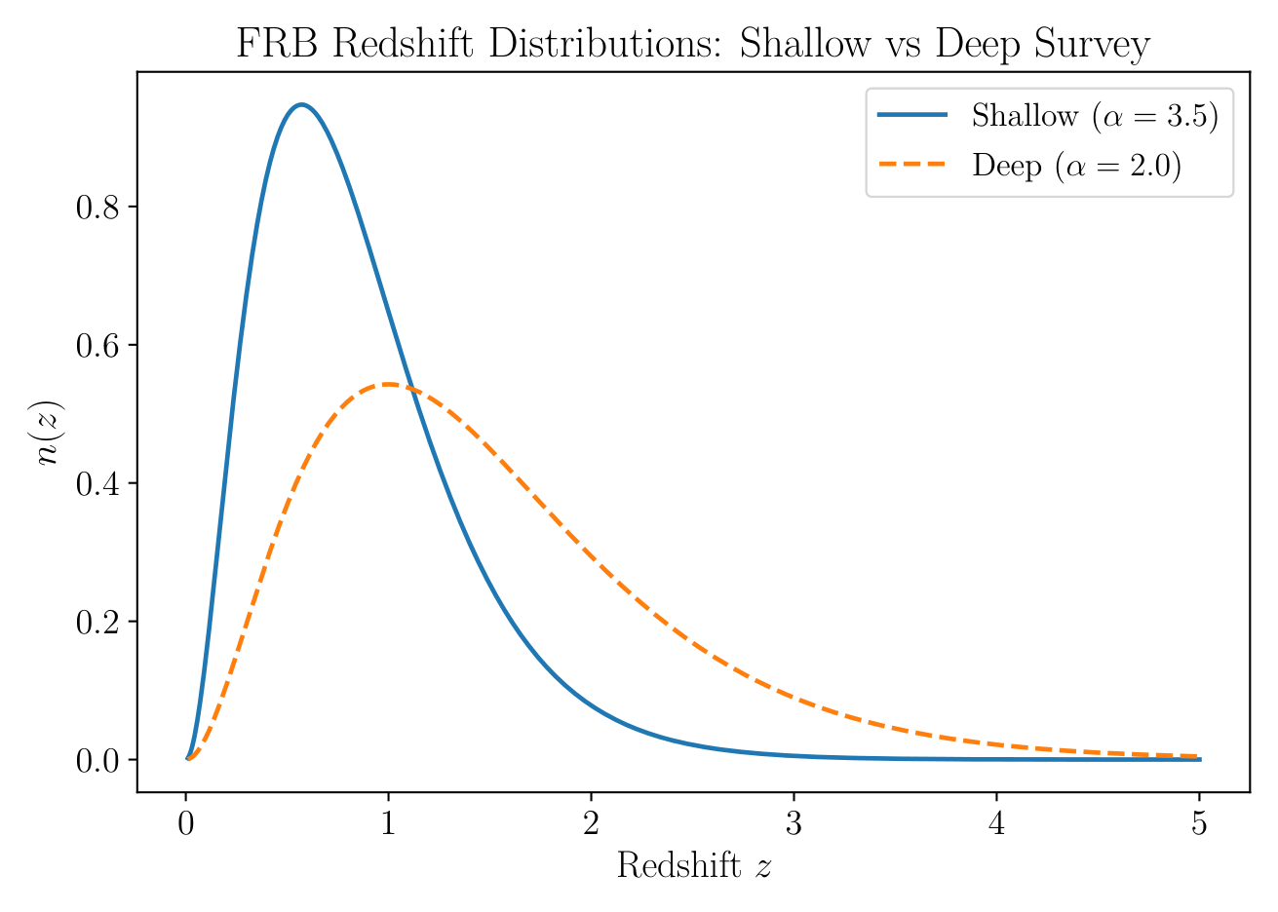
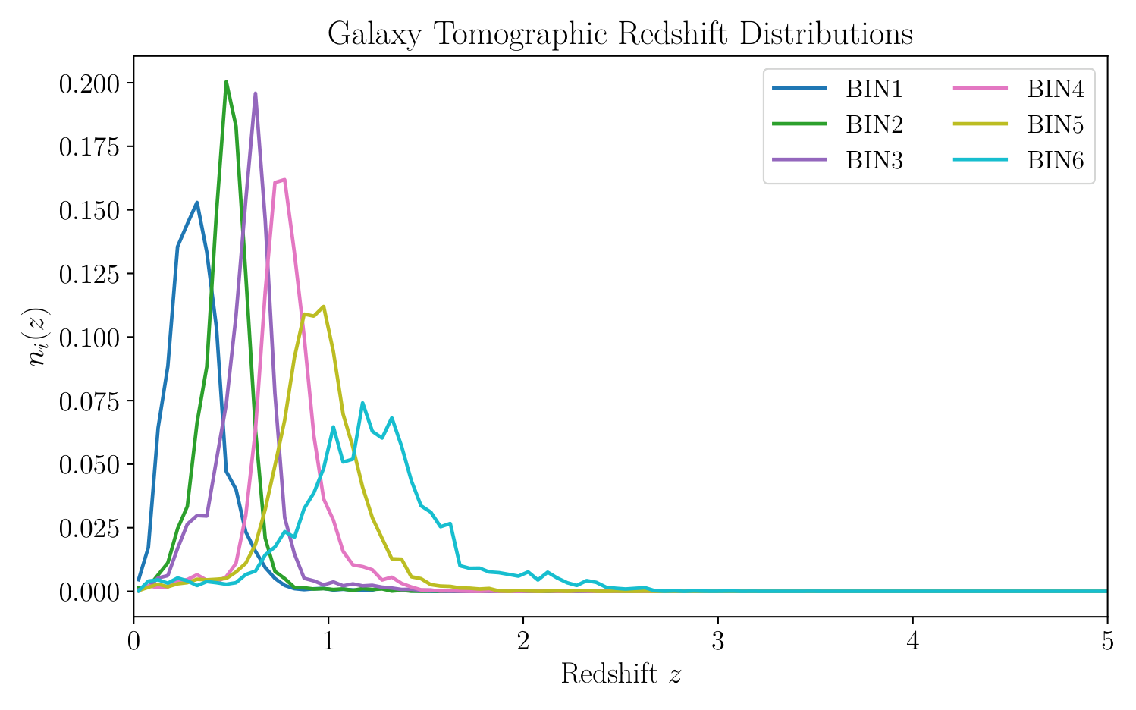
05
INPUTS
Data and Survey Scenarios
5,000
50,000
1,347 deg²
Radial overlap determines the available cross-signal.
SHALLOW FRBs | α = 3.5
DEEP FRBs | α = 2.0
KiDS DR5 | 6 BINS
Will Ruppert | Bachelor Thesis
5
Notes:
Because individual redshifts are not assumed to be available for the FRB population, I model its normalised distribution as $n(z)\propto z^2\exp(-\alpha z)$. I consider two scenarios. The shallow survey contains 5,000 bursts and is more strongly concentrated at low redshift. The deep survey contains 50,000 bursts and has a substantially longer high-redshift tail. Both are assumed to cover 90 percent of the sky.
For the galaxy sample, I use the published redshift distributions from KiDS DR5. The survey covers 1,347 square degrees and is divided into six tomographic bins. These plots already indicate which combinations should provide the strongest signal. The lower KiDS bins overlap considerably with both FRB scenarios, whereas the higher bins benefit mainly from the deep survey. Alongside the number of objects, this radial overlap is the key factor determining the eventual parameter constraints.

Slide 6
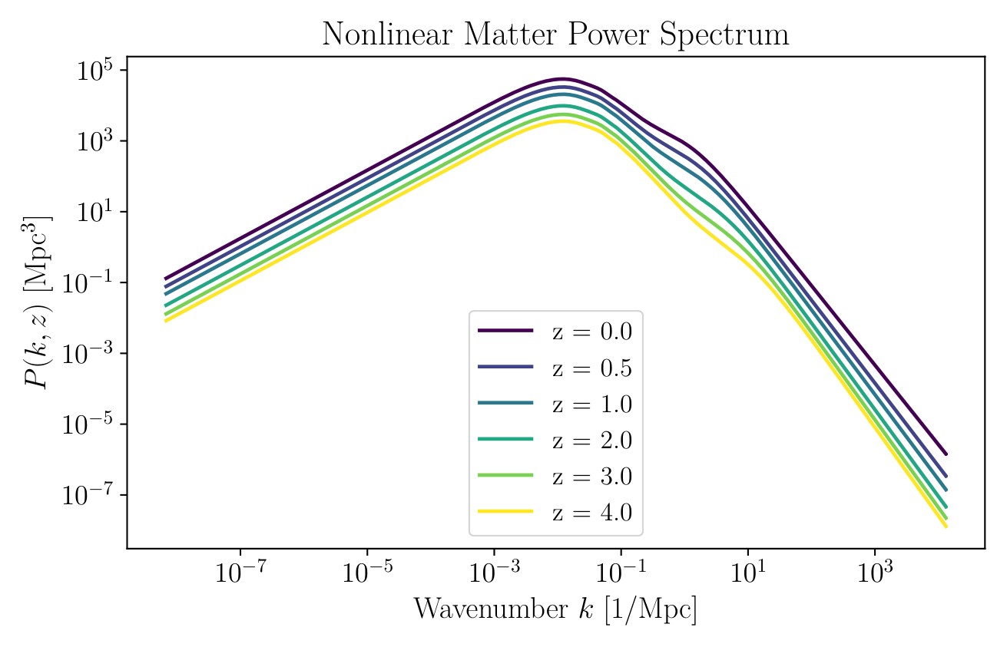
06
COMPUTATION
Numerical Pipeline
01
02
03
04
05
Planck 2018
→
Matter field
→
Radial kernels
→
Projection
→
Forecast
ΛCDM cosmology
non-linear P(k,z)
selection × bias
Limber → Cℓ
noise + Fisher
LIMBER PROJECTION
Cℓᴬᴮ ≈ ∫ dχ / χ² Wᴬ(χ) Wᴮ(χ) × P((ℓ + 1/2) / χ, z)
ℓ = 10 ... 1,000 | 24 cross-spectra
Will Ruppert | Bachelor Thesis
6
Notes:
The calculation starts with a flat $\Lambda$CDM cosmology using the Planck 2018 parameters. I calculate the non-linear three-dimensional matter power spectrum, $P(k,z)$, with the Python package `hmf`. All quantities are evaluated on a common redshift grid from 0.01 to 5.
For each population, I then construct a radial kernel. It is essentially the product of the normalised redshift distribution and the bias. The angular power spectrum is obtained through the Limber projection shown here, which combines both radial kernels with the matter power spectrum. I calculate multipoles from $\ell=10$ to 1,000 because the Limber approximation is unreliable on the very largest angular scales.
The pipeline produces auto-spectra for the FRBs and for each KiDS bin, as well as all FRB-galaxy cross-spectra. With two progenitor models, two FRB surveys, and six galaxy bins, this gives 24 cross-spectra. In the final step, these spectra and their noise contributions enter the Fisher forecast.

Slide 7
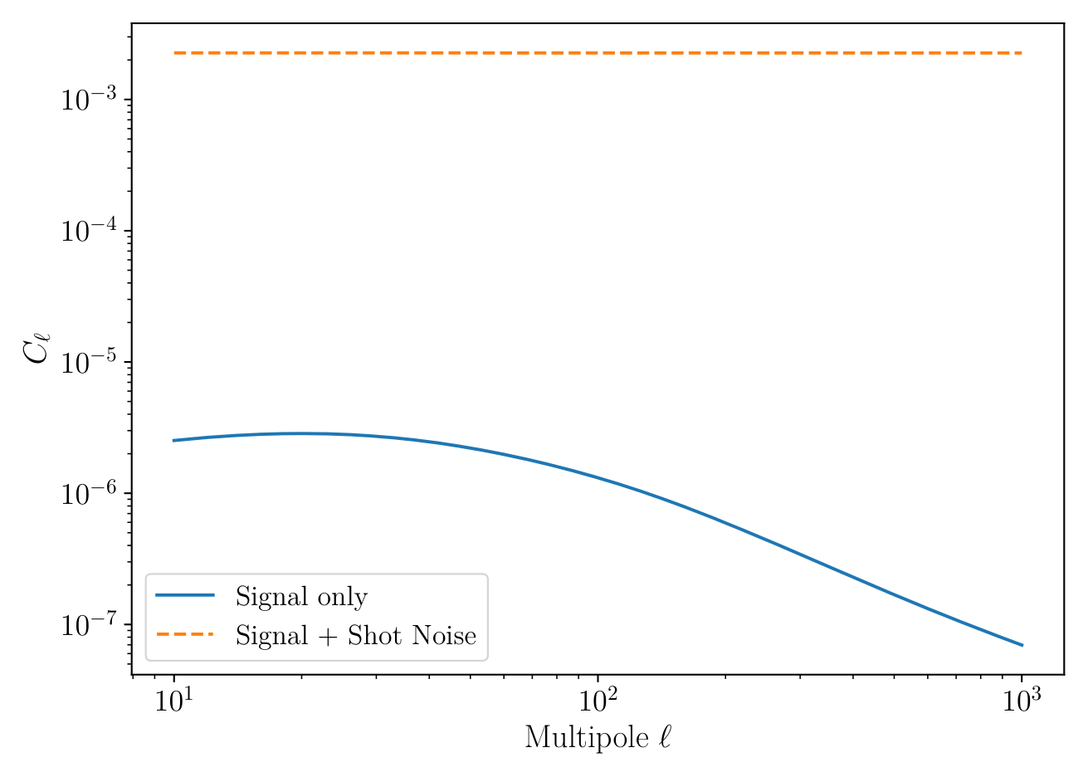
07
NOISE FLOOR
Why FRB Auto-Correlation Is Not Enough
SHOT NOISE
Nℓ = 1 / n̄
~10³
above the clustering signal
in the shallow survey
Cross-correlation is the core method, not a small optimisation.
Will Ruppert | Bachelor Thesis
7
Notes:
Before considering the cross-correlation, the FRB auto-correlation reveals the central problem. FRBs are discrete and rare compared with galaxies. The measured auto-spectrum therefore contains a constant Poisson contribution of $1/\bar n$.
For the shallow survey with 5,000 bursts, this shot noise lies roughly three orders of magnitude above the clustering signal throughout the multipole range considered. In principle, the auto-spectrum contains information about the host bias, but in practice that information is overwhelmed by noise.
The deep survey reduces shot noise through its ten times larger source count. Its projected clustering signal is also slightly smaller because of the broader redshift distribution. The essential point remains that more FRBs help, but the auto-correlation still relies on a sparse sample. Combining it with the much denser galaxy population is therefore not a minor optimisation; it is the central element of the method.

Slide 8
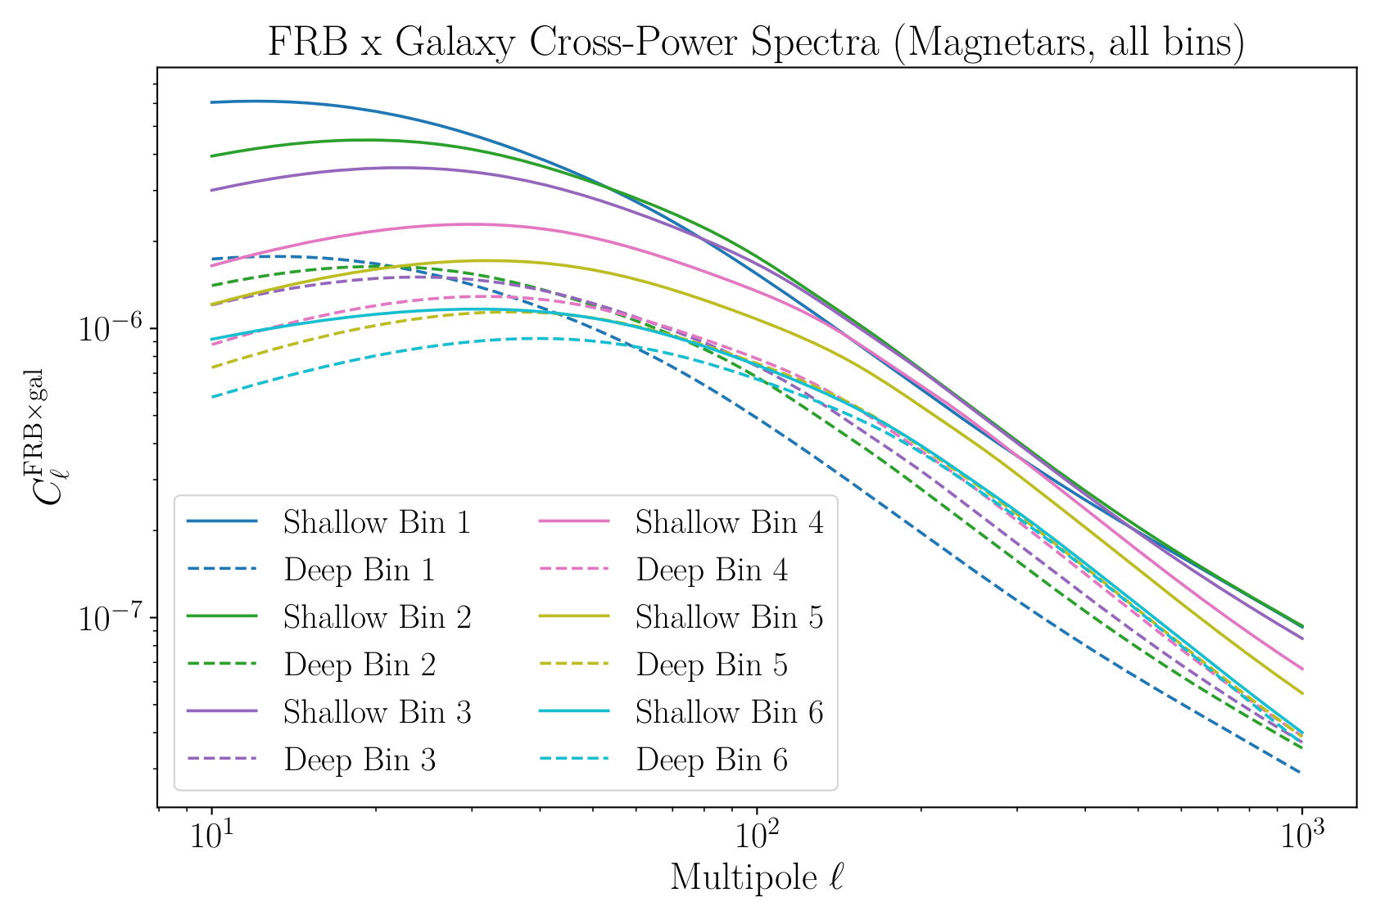
08
RESULT I
Tomographic Cross-Signal
24
CROSS-SPECTRA
LOW z
Shallow survey
has more signal
HIGH z
Deep survey
retains information
Will Ruppert | Bachelor Thesis
8
Notes:
Here we see the cross-spectra for the magnetar model, including all six KiDS bins and both FRB surveys. Their amplitudes depend directly on the overlap between each galaxy distribution and the corresponding FRB distribution.
The shallow survey is concentrated at low redshift and therefore produces a stronger signal in the lower KiDS bins. The deep survey spreads its sources across a wider radial range. This broad projection dilutes its low-redshift signal, but leaves comparatively more signal in the higher bins.
Each galaxy bin therefore observes the FRB bias through a different redshift window. This is the value of tomography. A change in $b_0$ rescales all windows, while a change in $\delta$ affects high redshifts differently from low redshifts. The cross-correlation can consequently separate the two parameters more effectively.

Slide 9
09
INFERENCE
Fisher Forecast
Parameters θ = (b₀, δ)
1% central finite differences
Cosmology held fixed
Local Gaussian likelihood
δ
FoM = 1 / √det(Cov)
b₀
smaller ellipse → stronger joint constraint
Will Ruppert | Bachelor Thesis
9
Notes:
To translate the spectra into expected parameter uncertainties, I use a Fisher matrix. It measures how sensitively all auto- and cross-spectra respond to small changes in $b_0$ and $\delta$. I calculate the derivatives numerically using central differences with a relative step size of one percent, while holding the cosmological parameters fixed.
The inverse Fisher matrix gives the expected covariance. Its diagonal elements provide the marginalised one-sigma uncertainties, while the shape and orientation of the ellipse show the degeneracy between the two parameters. I also summarise the joint two-dimensional precision with a Figure of Merit. It is inversely proportional to the area of the error ellipse, so a larger value indicates a stronger constraint.
It is important to note that a Fisher analysis assumes a locally Gaussian likelihood. These results should therefore be interpreted as optimistic forecasts rather than uncertainties that have already been measured.

Slide 10
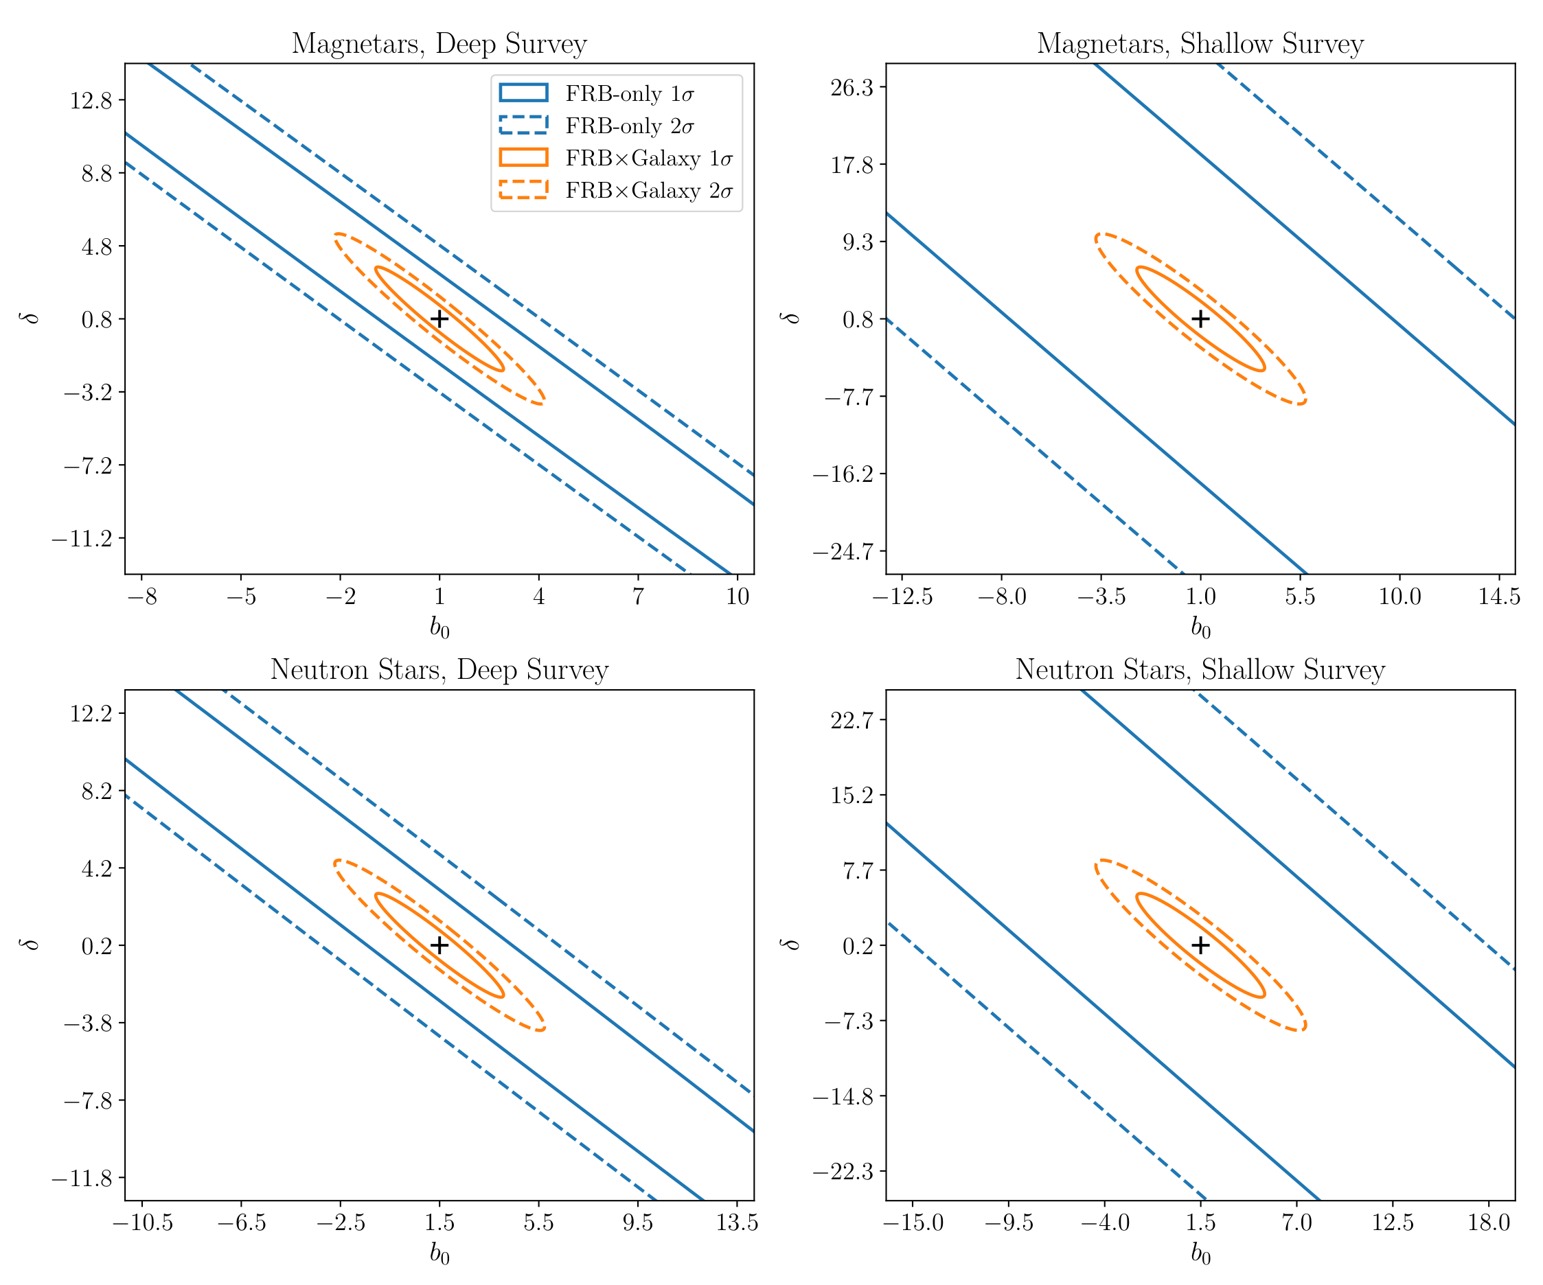
10
MAIN RESULT
Cross-Correlation Enables the Measurement
17-51×
SMALLER 1 Sigma ERRORS
61-449×
LARGER FIGURE OF MERIT
KiDS result
Bias becomes measurable,
but the models still overlap.
Only 3.3% sky overlap
Will Ruppert | Bachelor Thesis
10
Notes:
This is the central result of the thesis. The blue contours show the forecasts from FRB auto-correlation alone, while the orange contours show the joint analysis with the six KiDS bins. In all four cases, the blue contours extend far beyond the plotted range. This quantitatively confirms that the FRB auto-correlation cannot meaningfully constrain the host bias.
Adding the cross-correlations reduces the marginalised uncertainties on the two parameters by factors between 17 and 51. The two-dimensional Figure of Merit improves by factors between 61 and 449. This is particularly notable because the joint analysis uses only the small KiDS overlap area, about 3.3 percent of the sky, whereas the FRB auto-correlation assumes 90 percent sky coverage. The additional tracer and redshift information more than compensates for the loss of area.
The deep survey provides tighter constraints in every case, mainly because it contains ten times as many bursts. Once cross-correlation mitigates the shot-noise problem, however, its relative advantage becomes smaller. At that point, the overlap of the redshift distributions and the limited KiDS area become the dominant restrictions.
Despite the considerable improvement, the two fiducial progenitor models still lie within the one-sigma contours. KiDS makes a meaningful bias constraint possible, but it cannot yet reliably distinguish between the magnetar and delayed neutron-star scenarios.

Slide 11
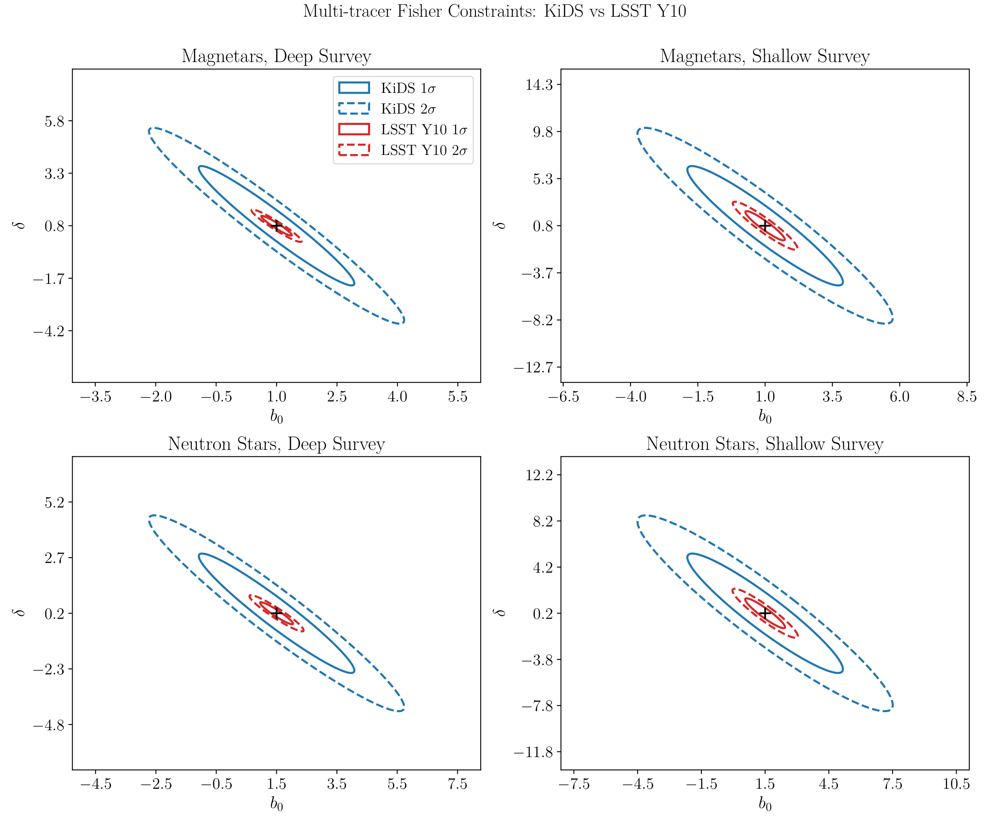
From KiDS to LSST
SURVEY SCALE
1,347 → 18,000 deg²
6 → 10 bins
DEEP MAGNETAR
σ(b₀) 1.27 → 0.43
FoM 1.59 → 14.56
Models separate at 1σ
Will Ruppert | Bachelor Thesis
11
Notes:
The most direct next step is to use a larger galaxy survey. LSST will cover approximately 18,000 square degrees, around thirteen times the area of KiDS. It will also provide ten rather than six tomographic bins and a deeper galaxy sample.
I therefore ran the same pipeline with an LSST Year 10 model distribution. In the deep magnetar scenario, the uncertainty on $b_0$ decreases from 1.27 with KiDS to 0.25 with LSST. The Figure of Merit increases from 1.59 to 42.01, a factor of about 26. Most of this improvement follows directly from the larger sky area, with additional information coming from finer tomography and greater depth.
In this forecast, the separation between the two progenitor models lies outside their respective one-sigma contours for the deep survey. Cross-correlating FRBs with an LSST-like data set could therefore genuinely distinguish between a prompt and a delayed progenitor population.

Slide 12
12
INTERPRETATION
Limitations
ℓ ≥ 10
Gaussian
n(z), b(z)
Limber approximation
Optimistic Fisher bounds
Model assumptions
fsky
Ncross ≈ 0
Simplified geometry
Cross-shot noise neglected
Forecasts are informative, but should be read as best-case precision.
Will Ruppert | Bachelor Thesis
12
Notes:
The forecast relies on several simplifications. First, I use the Limber approximation and therefore start at $\ell=10$. However, the largest angular scales may be particularly sensitive to differences between the radial models.
Second, the Fisher method assumes a Gaussian likelihood and Gaussian covariance. Non-linear structure formation and potentially non-Gaussian posterior shapes are not fully captured, so the reported uncertainties should be regarded as optimistic lower bounds.
Third, the FRB redshift distribution and the fiducial bias parameters are model assumptions rather than direct measurements. Survey geometry is also represented only through the factor $f_\mathrm{sky}$; a real analysis would require a mask or pseudo-$C_\ell$ treatment. Finally, a small cross-shot-noise term may arise if FRB host galaxies are themselves included in the KiDS catalogue. This contribution was neglected because the source densities differ so strongly.

Slide 13
CONCLUSION
FRB environments can be studied
without localising every burst.
01
02
03
Auto-correlation
KiDS tomography
LSST scale
Shot-noise limited
FoM improves 61-449×
Progenitor models separate
FRBs + galaxy tomography → progenitor physics
Thank you
Notes:
To conclude, my thesis demonstrates three main points. First, the auto-correlation of current or near-future FRB samples is strongly limited by shot noise. Second, cross-correlation with a dense and tomographically divided galaxy sample recovers a substantial amount of the clustering information. With KiDS, the Figure of Merit improves by factors between 61 and 449, although the limited survey area is not yet sufficient to distinguish the two assumed progenitor models.
Third, the LSST forecast shows that the next generation of wide-area surveys can reach the required precision. The main take-home message is therefore that we do not need to localise every Fast Radio Burst individually to learn about its typical environment and origin. Its statistical connection to the large-scale galaxy distribution already provides an independent and promising route. Thank you for your attention.

