Slide 1
PVB and Lean Canvas

Slide 2
PVB
During the inception which is the first meeting in Scrum one of the thing you have (or should) to build is a Product Vision Board
The Product Vision Board helps you describe, visualise, and validate your product vision and your product strategy.
It captures the target group, the user needs, the key product features, and the business goals.
Having a clear and inspiring Product vision helps in motivating and inspiring people, like the Development Team, the stakeholders and customers and users

Slide 3
Product Vision Board
Designed by :
On [Date] :
Iteration # : [x]
VISION // What is your purpose for creating the product? // Which positive change should it bring about? Purpose: Positive change:
TARGET GROUP // Which market or segment does the product address? // Who are the target customers and users? | NEEDS // What problem does the product solve? // Which benefit does it provide? | PRODUCT // What product is it? // What makes it stand out? // Is it feasible to develop the product? | BUSINESS GOALS // How is the product going to benefit the company? What are the business goals?
 | Problem(s) solved: Benefits: | Product: Features: Feasibility: | Business Goals:

Slide 4
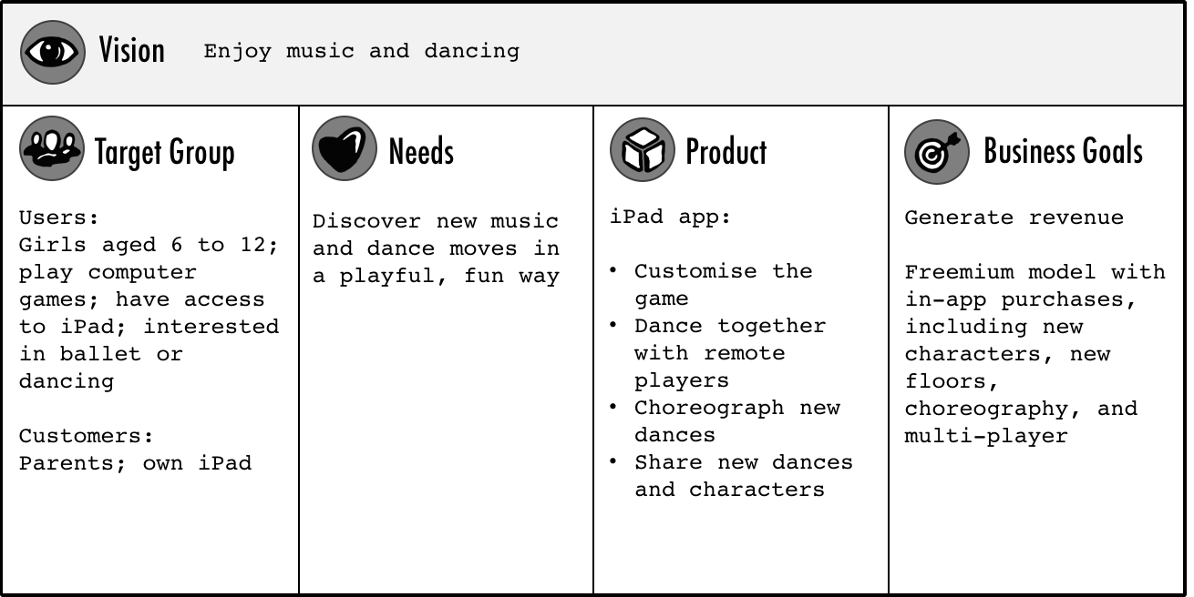

Slide 5
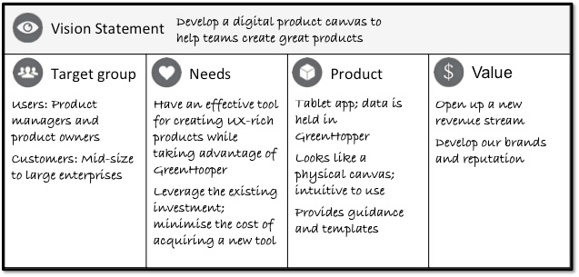

Slide 6
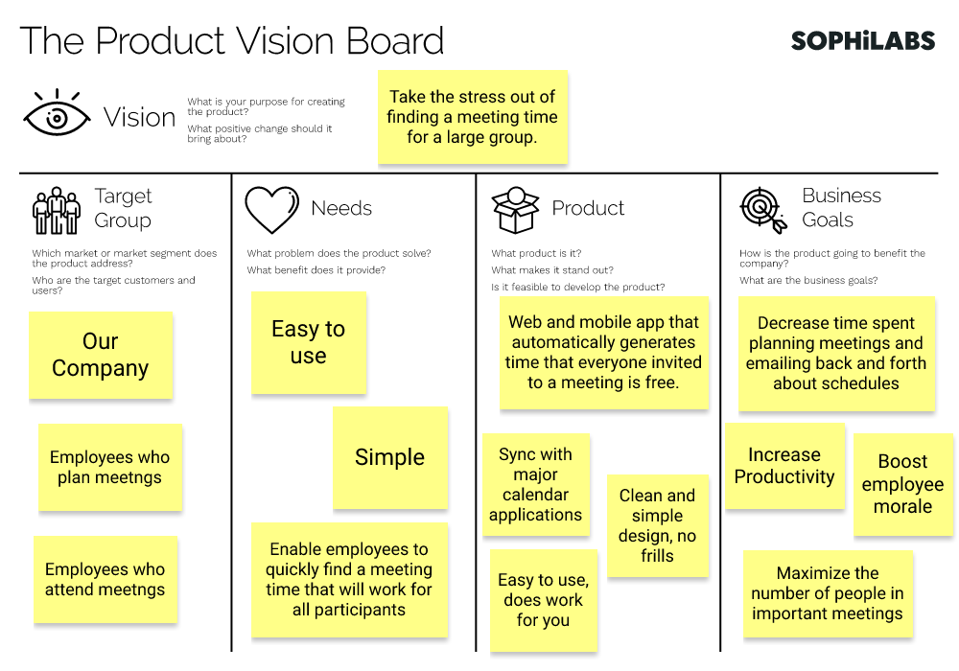

Slide 7
Lean Canvas
One of the biggest challenges for entrepreneurs can be turning your ideas into plans.
Lean Canvas is a one-page business plan method that helps you to get to the heart of your idea.
puts everyone on one page, helping to set out the key information needed, without any of the unnecessary details.
The plan features a number of blocks to help you map out some key points that will help you turn a business idea into something more concrete.
created especially for entrepreneurs to make it easier for them to get a clear and simple idea of what they’re doing.

Slide 8
Lean Canvas
PROBLEM Top 3 problems [Xx] - Not enough stores to deliver pastries - Using online platform by elder people | SOLUTION Top 3 features [Xx] | UNIQUE VALUE PROPOSITION Single, clear, compelling message that states why you are different and worth buying [Xx] Special organic Homemade Pastries | UNFAIR ADVANTAGE Cannot be easily copied or bought [Xx] | CUSTOMER SEGMENTS Target customers (incl. Country specific customers) [Xx] Pastry lovers Delivery orders
 | -Deliver all across Lebanon |  | - Unique ingredients
 | -Hosting server/website development
 | KEY METRICS Key activities we measure [Xx] - Number of website visitor - Number of orders/week - User duration when surfing the website |  | CHANNELS Path to customers [Xx] Distributors
On [Date] : dd/mm/yyyy
Iteration # : [x]
Designed by :
XXX
User Profile / Customer Segment :
XXX
3
3
1
2
1
4
5
6
6

Slide 9
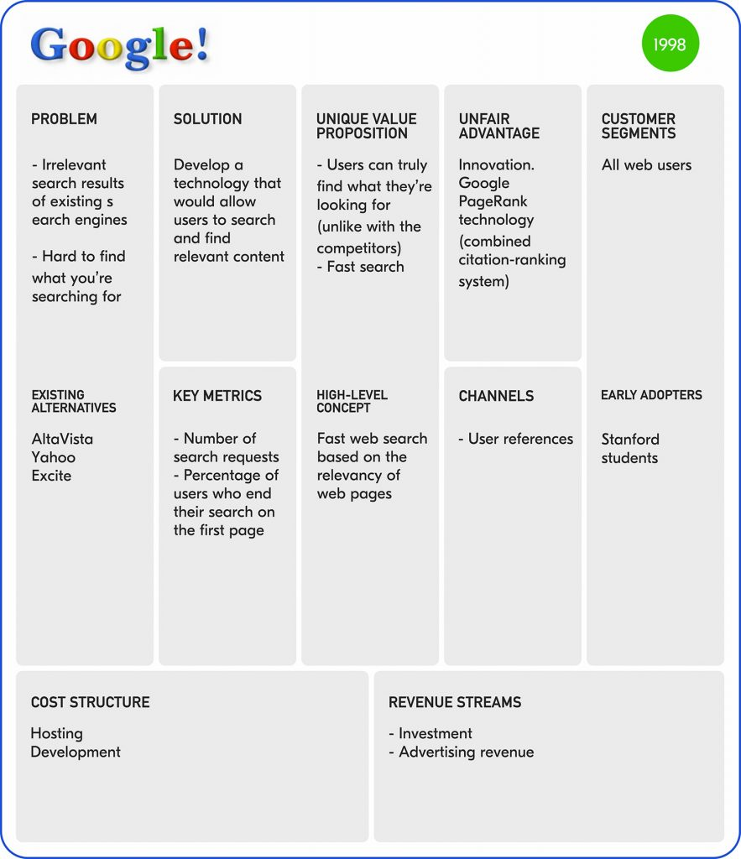

Slide 10
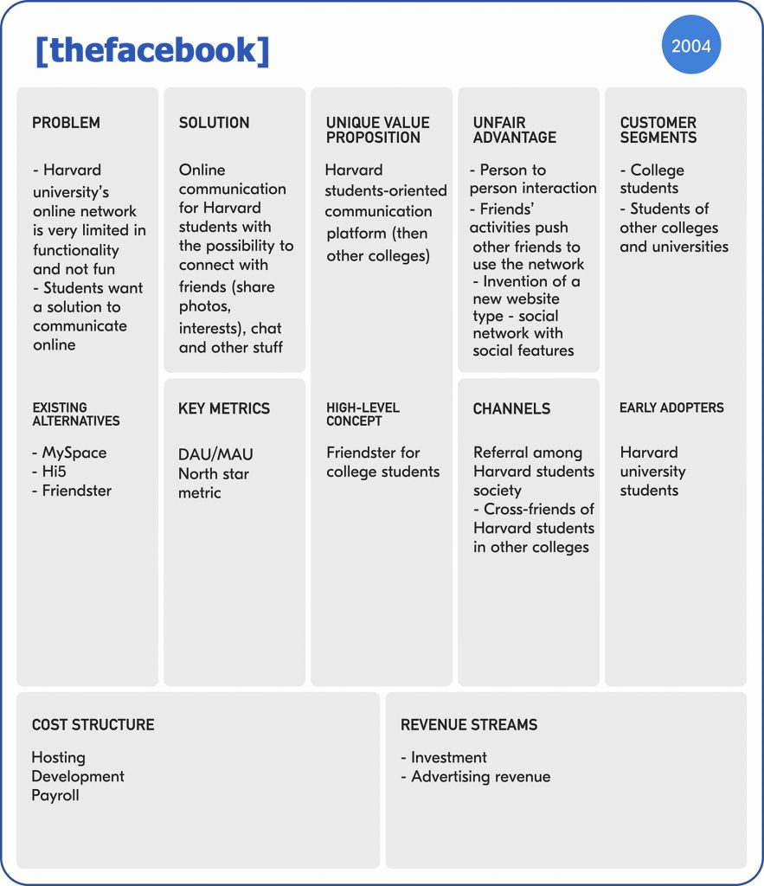

Slide 11
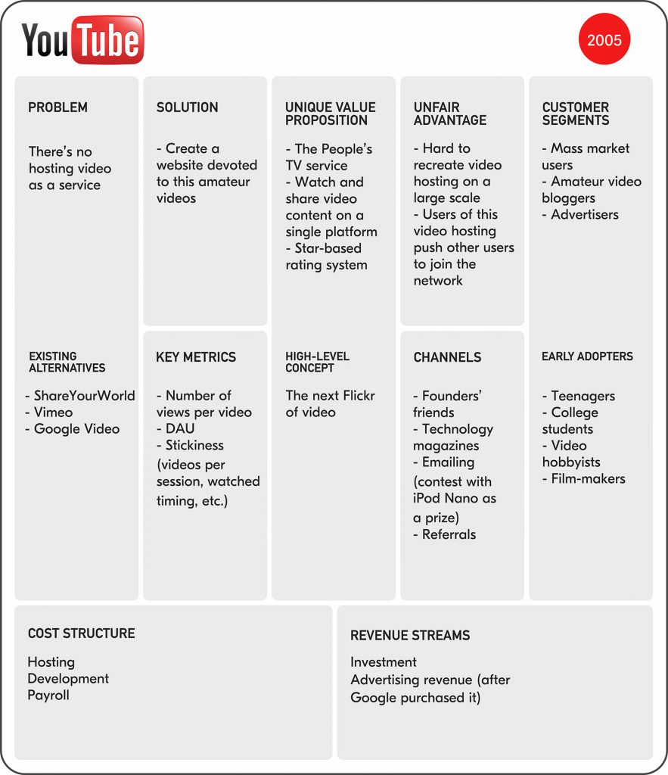

Slide 12
