Slide 1
PROJECT PRESENTATION
Maize Disease Detection &
Kenya Maize Advisory Chatbot
WHAT THIS DECK COVERS
The farmer problem
RAG architecture
Guardrails & safety
A bilingual, offline RAG assistant for maize farmers
Measured results
By: Willard Owiti Odongo
Security & roadmap
English | Kiswahili · Source-grounded answers · Local models · Guardrails
15 slides · Project defence
Notes:
Title slide. Project: Maize Disease Detection & Kenya Maize Advisory Chatbot. Presenter: Willard Owiti Odongo. The deck covers the problem, the RAG architecture, the guardrails, measured results, security and the roadmap. The assistant is bilingual (English and Kiswahili), runs locally, and grounds its advice in a curated maize corpus.

Slide 2
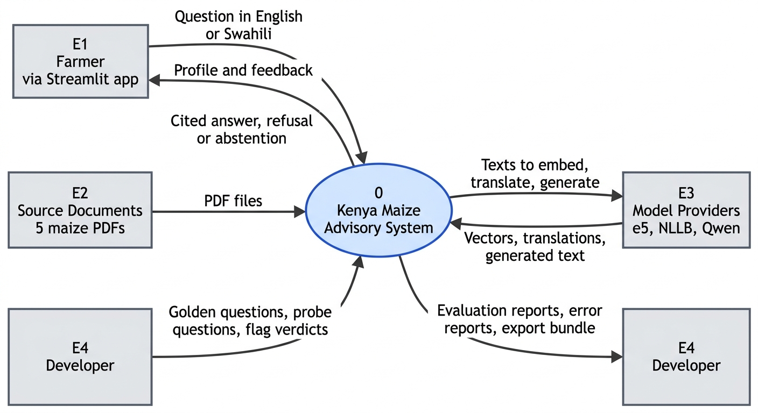
The Problem: Late Diagnosis, Scarce Advice
PROBLEM
Maize foliar diseases can cut yields by 30–50%.
Diagnosis depends on scarce agronomists: visual, slow and subjective.
Farmers lack trusted advice on fertiliser, pests, harvest and storage.
Advice is rarely available in local languages or offline.
Takeaway: The farmer is central, but the current flow has no trusted advisory path.
Maize Disease Detection & Kenya Maize Advisory Chatbot
02 / 15
Notes:
Problem framing. Maize is a staple crop in Kenya, and foliar diseases such as MLN, MSV, grey leaf spot and rust can cause severe losses. Diagnosis usually requires an agronomist, which is slow, expensive and unavailable in many areas. The context DFD shows the farmer as the key external entity; the advisory path is the gap this project fills. The solution must work in English and Kiswahili, and ideally offline.

Slide 3
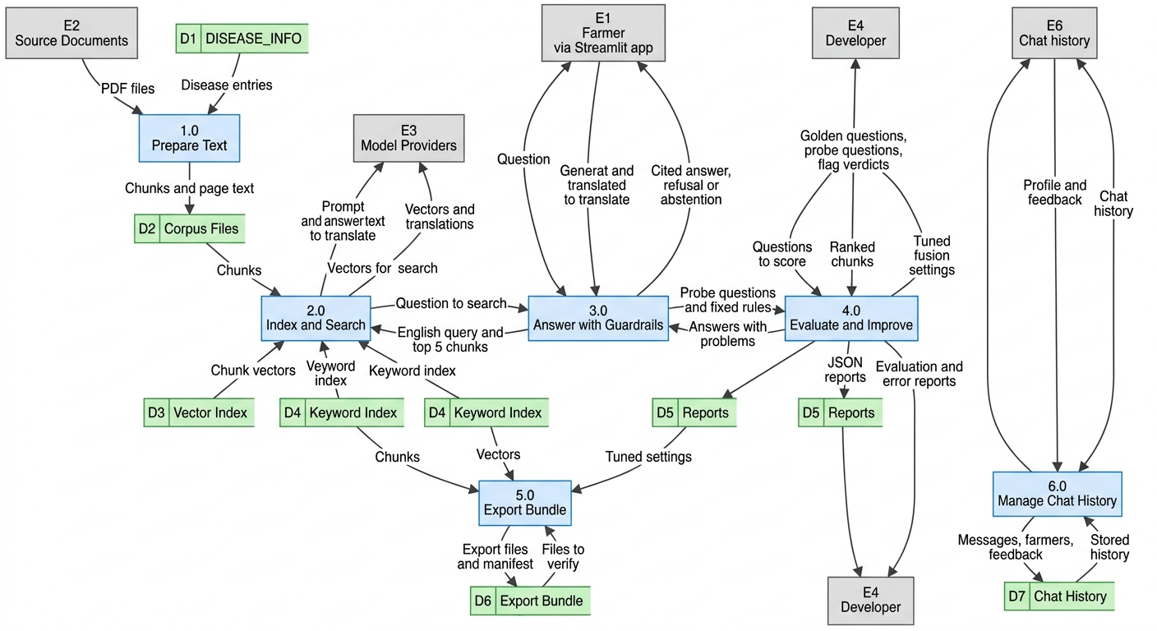
The Solution: A Local, Bilingual Advisory Assistant
SOLUTION
RAG chatbot answers maize-farming questions from 24 curated PDFs plus disease seed knowledge.
Supports English and Swahili through a translation pivot.
Answers are grounded in retrieved sources and carry citations.
Runs locally with no API keys, beside image-based diagnosis.
Takeaway: One connected system: intake, retrieval, generation, validation and storage.
Maize Disease Detection & Kenya Maize Advisory Chatbot
03 / 15
Notes:
High-level solution. The system combines a Streamlit interface, a curated maize corpus, a hybrid retriever, a local instruction-tuned generator and a validation layer. It sits beside the image-based disease detector. Swahili questions are translated to English for retrieval, then the answer is generated in the user's language. No external API is required.

Slide 4
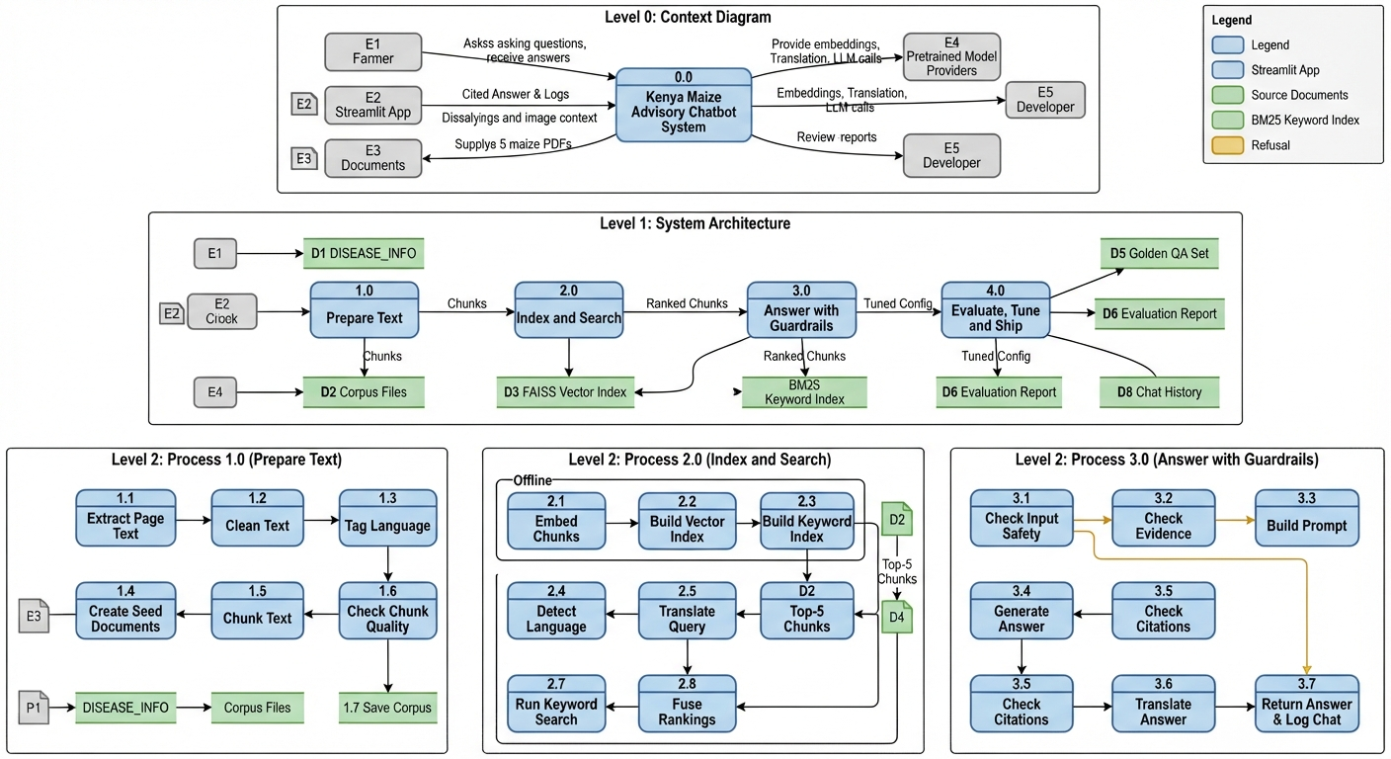
System Overview: One Farmer Journey
SYSTEM OVERVIEW
Detection tab: leaf photo → disease class and confidence.
Advisory tab: follow-up chat continues from the diagnosis.
Login and MySQL history save sessions, messages and feedback.
Detection and advice share one local model stack.
Takeaway: The full data flow from farmer input to stored, validated advice.
Maize Disease Detection & Kenya Maize Advisory Chatbot
04 / 15
Notes:
System overview. A farmer logs in, uploads or captures a leaf photo, and receives a disease prediction. The advisory tab carries the diagnosis into a chat, retrieves relevant passages, generates a grounded answer, validates it and saves the exchange. The same local model stack supports both detection and advice, which keeps deployment simple.

Slide 5
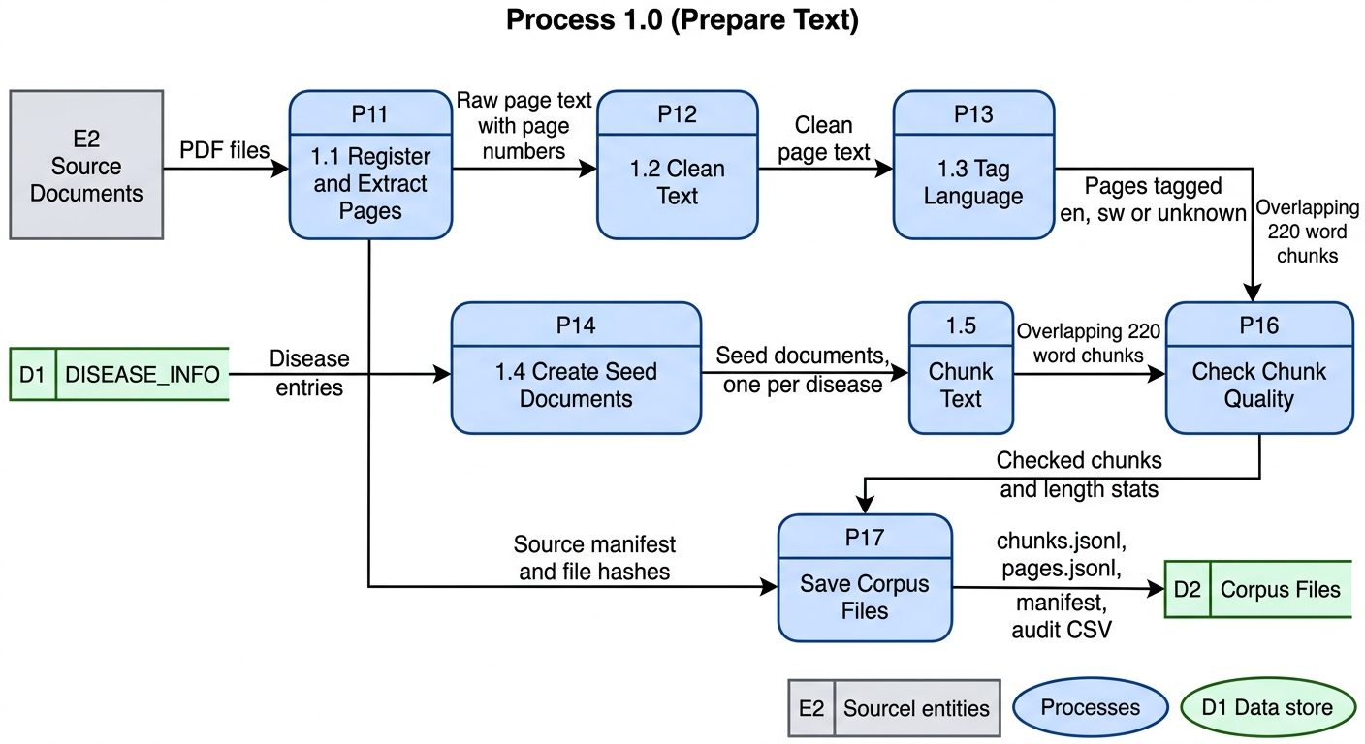
RAG Architecture: Ingestion Pipeline
RAG ARCHITECTURE
Extract text from 24 curated PDFs covering agronomy, pests, storage and policy.
Clean pages, tag language, and add four disease seed documents.
Chunk at 220 words with 40-word overlap.
Persist corpus and chunks for reproducible rebuilds.
Takeaway: Where PDFs become clean, chunked evidence — the foundation of answer quality.
Maize Disease Detection & Kenya Maize Advisory Chatbot
05 / 15
Notes:
Ingestion. The corpus contains 24 curated documents plus four short disease seed documents. Text is extracted with PyMuPDF, cleaned, language-tagged and chunked at 220 words with a 40-word overlap. The overlap preserves context across chunk boundaries. The chunks and corpus are persisted so the index can be rebuilt reproducibly.

Slide 6
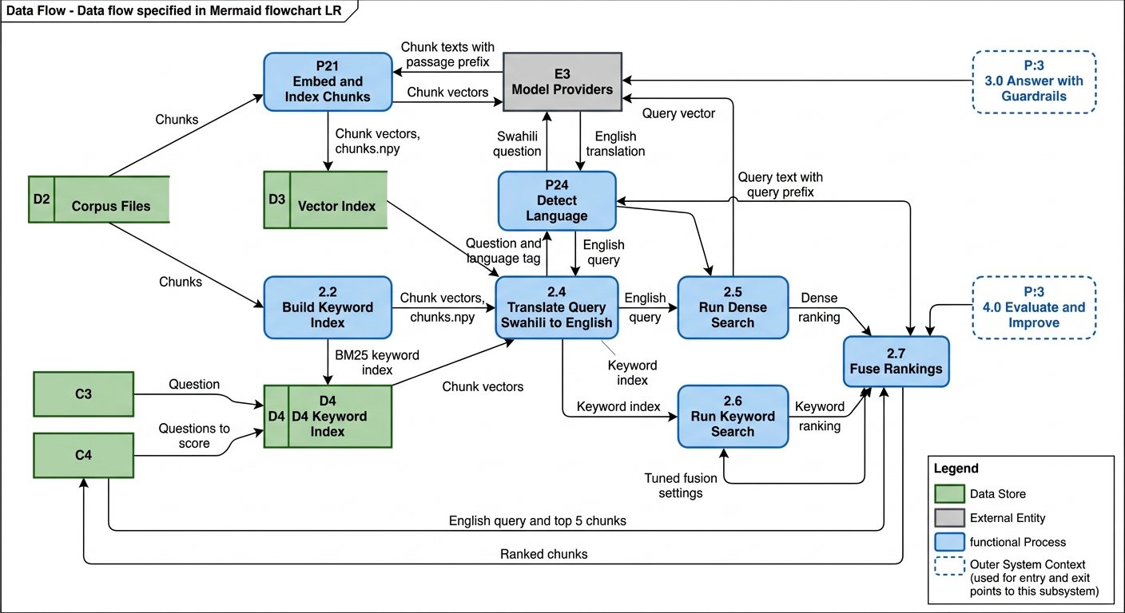
RAG Architecture: Vector Store & Embeddings
RAG ARCHITECTURE
multilingual-e5-small embeds chunks and questions into 384 dimensions.
Normalised NumPy index enables cosine search without an external vector database.
About 3,447 chunks are indexed alongside a BM25 sparse index.
Swahili queries are translated to English for retrieval.
Takeaway: Two indexes, one query path: dense semantics plus sparse keyword matching.
Maize Disease Detection & Kenya Maize Advisory Chatbot
06 / 15
Notes:
Vector store. The dense index uses multilingual-e5-small, a compact model that produces 384-dimensional embeddings. Vectors are L2-normalised, so cosine similarity is a dot product. The sparse BM25 index captures exact terms such as pesticide names and rates. Using NumPy avoids a separate vector database and keeps the stack portable.

Slide 7
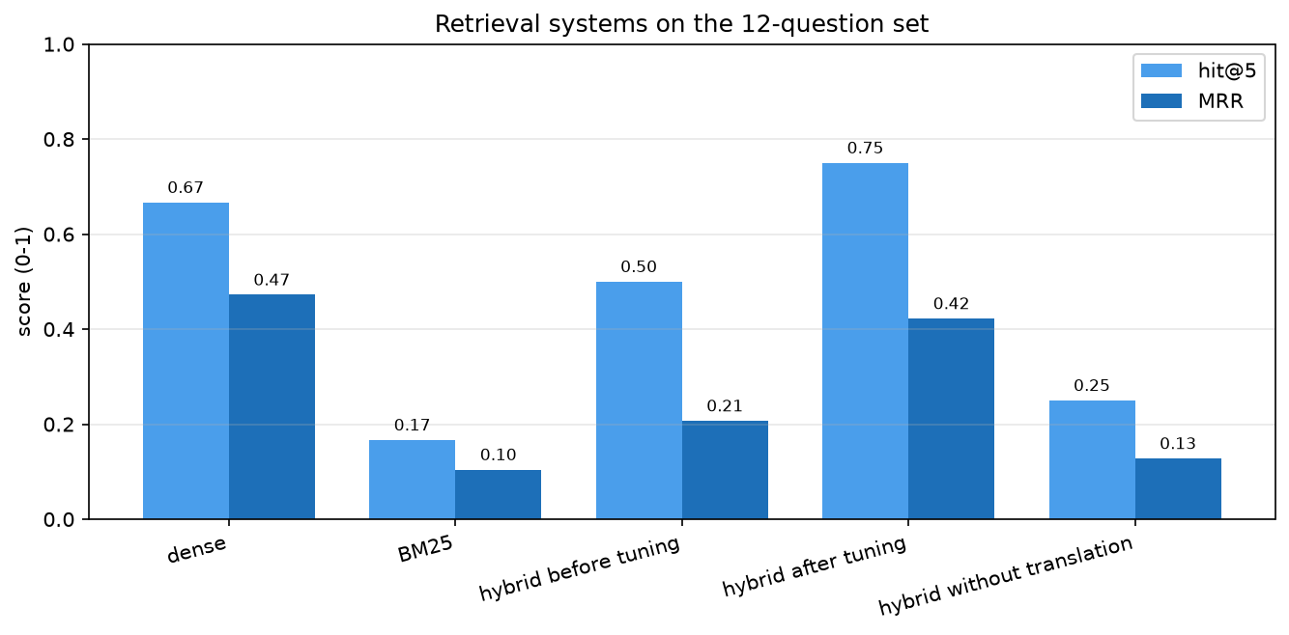
RAG Architecture: Retrieval Mechanism
RAG ARCHITECTURE
Dense and BM25 results are fused with tuned rank fusion.
Best settings: dense weight 0.9, depth 10, RRF k = 30.
Tuning lifted hit@5 from 0.50 to 0.75 and MRR from 0.21 to 0.42.
Removing the Swahili pivot drops hit@5 to 0.25.
Takeaway: Tuned hybrid retrieval gives the best hit@5; dense-only still has a slight MRR edge.
Maize Disease Detection & Kenya Maize Advisory Chatbot
07 / 15
Notes:
Retrieval. Dense and sparse rankings are combined with weighted reciprocal rank fusion. The tuned configuration uses a dense weight of 0.9, a candidate depth of 10 and RRF k=30. Hit@5 rises from 0.50 to 0.75, and MRR from 0.21 to 0.42. Removing the Swahili-to-English pivot drops hit@5 to 0.25, which shows the pivot is essential for bilingual retrieval.

Slide 8
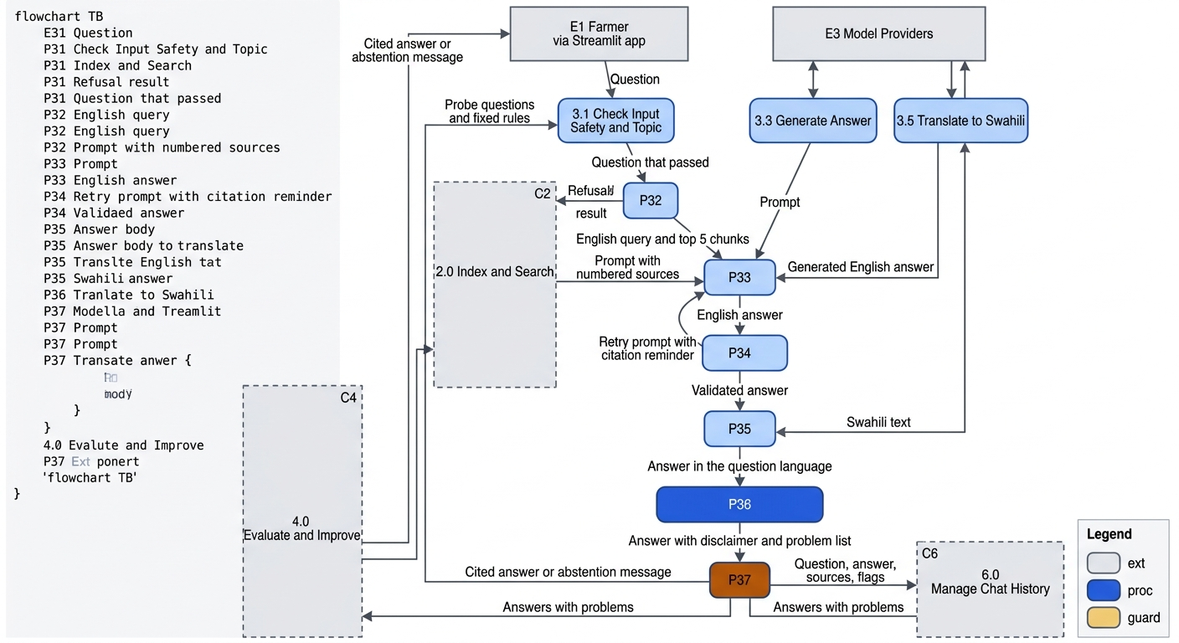
RAG Architecture: Generation Layer
RAG ARCHITECTURE
Qwen2.5-1.5B-Instruct generates answers from retrieved context only.
The prompt enforces citations, language matching, a disclaimer and pesticide caution.
Greedy decoding (temperature 0) is the default for reproducible answers.
Output is capped at 400 new tokens, with one validation retry.
Takeaway: Generation is not a free-standing model call: it sits inside a validation loop.
Maize Disease Detection & Kenya Maize Advisory Chatbot
08 / 15
Notes:
Generation. Qwen2.5-1.5B-Instruct is small enough to run locally and strong enough for grounded answer synthesis. The prompt restricts it to retrieved context and requires citations, language matching, a short disclaimer and caution around pesticide rates. Greedy decoding is the default because it is reproducible. A validation retry catches missing citations or language mismatches.

Slide 9
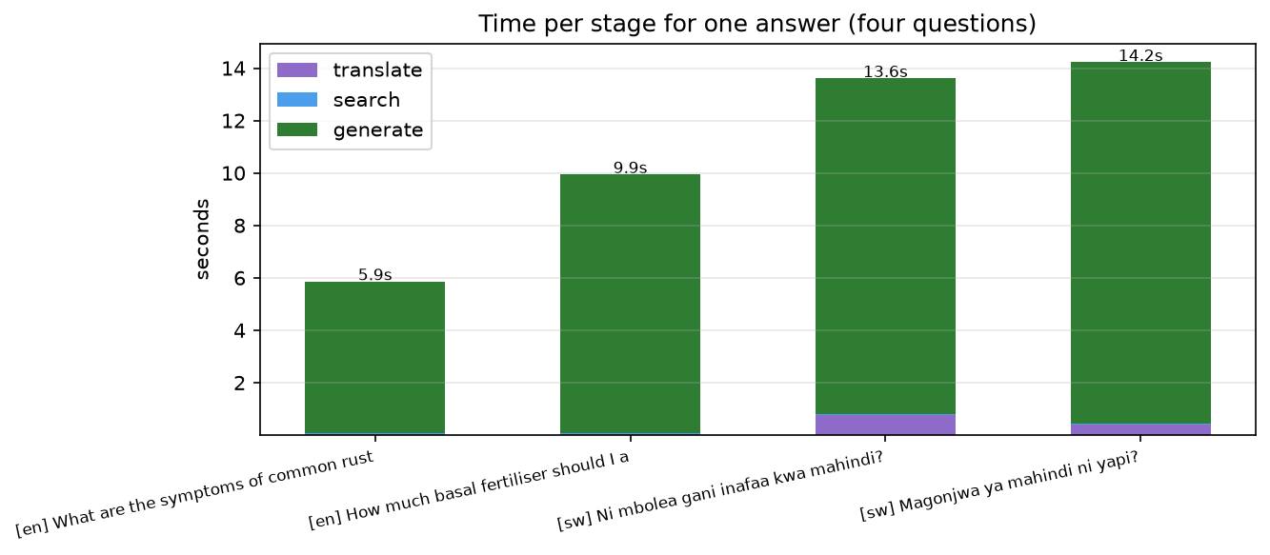
Technical Stack: Free, Local, Mac-Friendly
TECHNICAL STACK
Python and Streamlit for the interface.
PyMuPDF, pandas, NumPy and rank_bm25 for ingestion and search.
sentence-transformers, NLLB-200 and Qwen2.5 for embeddings, translation and generation.
MySQL stores accounts, sessions, messages and feedback.
Takeaway: The stack in action: translation, retrieval and generation are separate stages; generation dominates latency.
Maize Disease Detection & Kenya Maize Advisory Chatbot
09 / 15
Notes:
Technical stack. The interface is Streamlit. Ingestion and search use PyMuPDF, pandas, NumPy and rank_bm25. Embeddings come from sentence-transformers, translation from NLLB-200, and generation from Qwen2.5. MySQL stores accounts, sessions, messages and feedback. The timing chart shows that generation dominates latency, while retrieval is comparatively cheap.

Slide 10
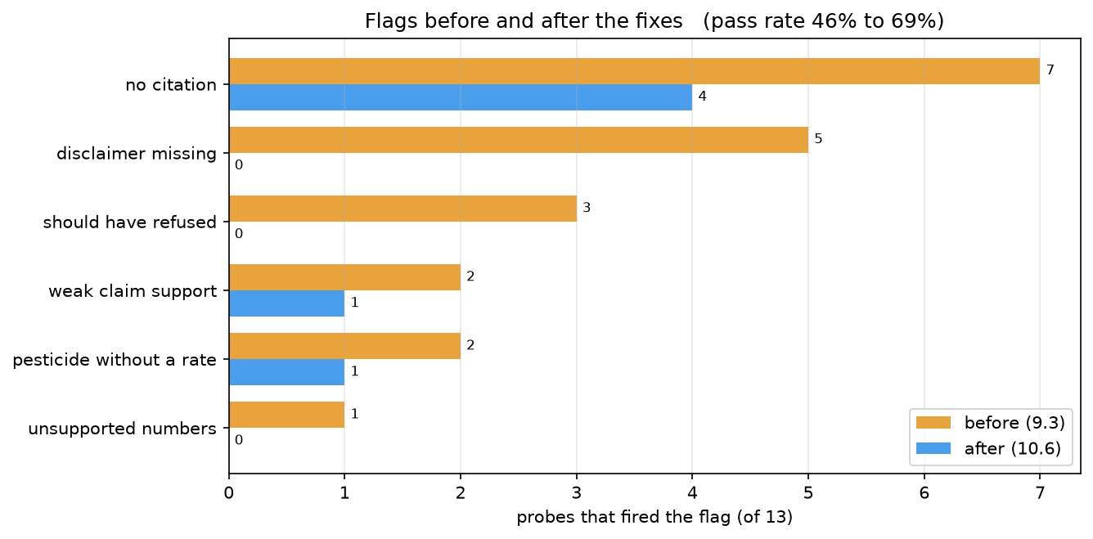
Advisory Logic & Guardrails
GUARDRAILS
Rule-based refusal blocks off-topic, live-price and human-medicine questions.
Validation checks citations, disclaimer, language, certainty and pesticide rates.
The pipeline abstains when sources do not contain the answer.
Guardrail pass rate improved from 46% to 69% across 13 probes.
Takeaway: Fewer real violations after targeted guardrail fixes.
Maize Disease Detection & Kenya Maize Advisory Chatbot
10 / 15
Notes:
Guardrails. The first line is a rule-based refusal layer for out-of-scope questions: live market prices, human medicine, and topics outside maize agronomy. The second line validates citations, disclaimer, language, certainty and pesticide rates. If the retrieved context does not support an answer, the system says so instead of guessing. Across 13 probes, the pass rate improved from 46% to 69%.

Slide 11
User Experience & Key Use Cases
USER EXPERIENCE
Login, profile and a sidebar of saved conversations.
Upload a leaf photo or capture one with the camera; answers show sources and store feedback.
Disease symptoms, fertiliser, planting, pests, harvest and storage questions.
Swahili-first support for farmers, extension officers and training sessions.
Takeaway: Farmer-facing interaction points: login, chat, photo upload and saved history.
Maize Disease Detection & Kenya Maize Advisory Chatbot
11 / 15
Notes:
User experience and use cases. The interface is designed for a farmer with a phone: a simple login, a profile, a sidebar of saved conversations, and a camera or upload path for leaf photos. Answers show their sources, and feedback is stored per response. The main use cases are disease symptoms and management, fertiliser and planting decisions, pest control, harvest and storage. The same system supports extension officers and training sessions.

Slide 12
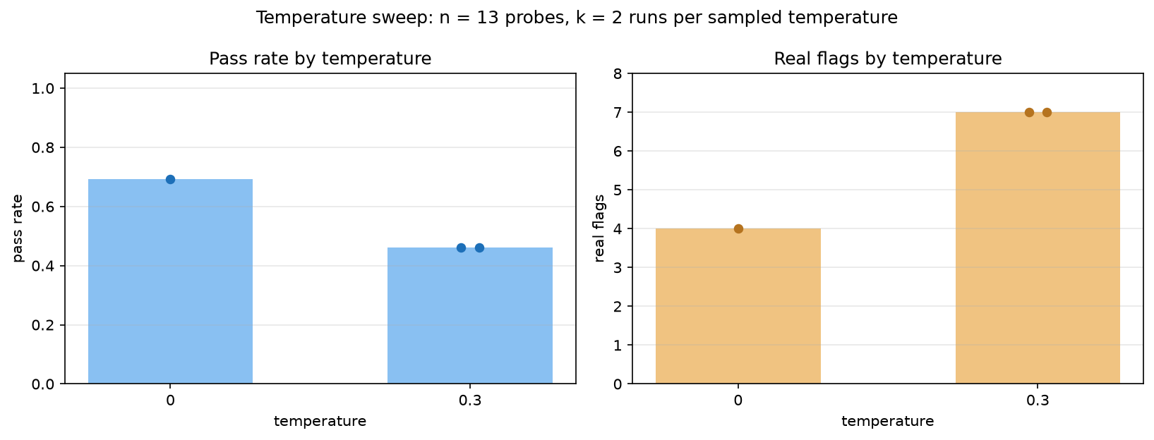
Performance Metrics: Measured, Not Assumed
METRICS
Retrieval: tuned hybrid hit@5 = 0.75, MRR = 0.42; dense-only still has a slight MRR edge.
Guardrails: pass rate improved from 0.46 to 0.69.
Unsupported numbers fell from 1 to 0; should-have-refused fell from 3 to 0.
Greedy temperature 0 beat 0.3 on pass rate, so the default was kept.
Takeaway: Retrieval improved; sampling at 0.3 lowered pass rate, so greedy decoding stayed.
Maize Disease Detection & Kenya Maize Advisory Chatbot
12 / 15
Notes:
Performance metrics. Retrieval: hit@5 is 0.75 and MRR is 0.42 for tuned hybrid retrieval. Dense-only still has a slight MRR edge, which suggests room for further fusion tuning. Guardrails: pass rate rose from 0.46 to 0.69; unsupported numbers fell from 1 to 0 and should-have-refused fell from 3 to 0. A temperature sweep showed that 0.3 reduced pass rate from 0.69 to 0.46, so greedy decoding remains the default.

Slide 13
Security & Compliance
SECURITY
All models run locally; farmer data is not sent to third parties.
Passwords are stored as salted PBKDF2-HMAC-SHA256 hashes.
Opaque login tokens expire after 30 minutes of inactivity.
Out-of-scope and human-health questions are explicitly refused.
LOCAL ONLY · NO EXTERNAL APIs
Takeaway: Every data flow stays inside the local trust boundary.
Maize Disease Detection & Kenya Maize Advisory Chatbot
13 / 15
Notes:
Security and compliance. All models run locally, so farmer data never leaves the machine or local network. Passwords use salted PBKDF2-HMAC-SHA256; login tokens are opaque and expire after 30 minutes of inactivity. The guardrails explicitly refuse out-of-scope and human-health questions. The DFD shows the local trust boundary: the app, the model files and MySQL all sit inside it.

Slide 14
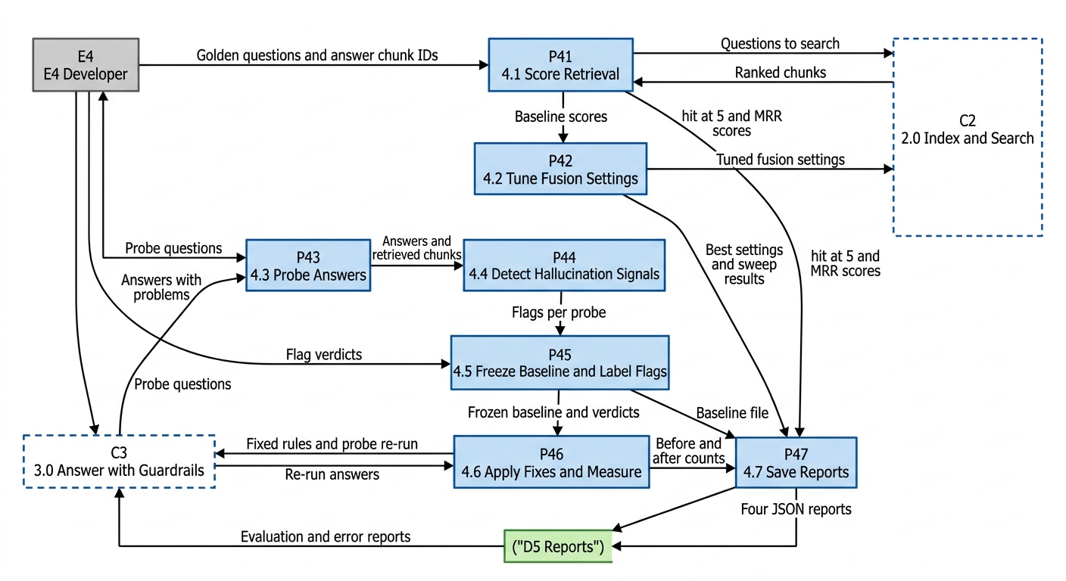
Roadmap / Future Improvements
ROADMAP
Strengthen citation discipline and answer faithfulness.
Explore fine-tuning, larger local generators and constrained decoding.
Expand the corpus to more crops, regions and updated guidance.
Package for county-level deployment and monitor user feedback.
Takeaway: The roadmap is an existing loop: measure → fix → re-measure.
Maize Disease Detection & Kenya Maize Advisory Chatbot
14 / 15
Notes:
Roadmap. The next improvements follow the same evaluation loop already used in the project: measure, fix, re-measure. Priorities are citation discipline, faithfulness, and constrained decoding. Larger local generators and fine-tuning are options if hardware allows. The corpus can expand to more crops and regions, and the app can be packaged for county-level deployment with feedback monitoring.

Slide 15
Conclusion & Q&A
CONCLUSION
RAG plus guardrails make local language models useful for farmer advice.
Bilingual hybrid retrieval is measurable and tunable.
Offline design keeps cost, privacy and connectivity under control.
Next step: stronger grounding and wider deployment.
Thank you — questions welcome.
Takeaway: Safer answers are measurable: guardrail pass rate rose from 46% to 69%.
Maize Disease Detection & Kenya Maize Advisory Chatbot
15 / 15
Notes:
Conclusion. The project shows that a small local model, combined with retrieval and guardrails, can give useful, source-grounded maize advice in English and Kiswahili without cloud APIs. The results are measurable: hit@5 improved to 0.75 and guardrail pass rate to 0.69. The next steps are stronger grounding and wider deployment. Thank you — questions welcome.

