Slide 1
Maize Leaf Disease Classification
YOLO26 versus a Custom CNN
Four classes | 4,186 images | 70 / 15 / 15 split
95.68%
0.2 ms
3.2 MB
test accuracy, YOLO26s-cls
per image
model size
Transfer learning buys 5.1 points of macro F1 over training from scratch
Full pipeline and every number in this deck: Maize_Disease_Detection_YOLO.ipynb

Slide 2



Why classify a maize leaf at all
30–50%
Diagnosis is visual inspection by a human agronomist: slow, subjective, and impossible to scale across large plantations.
of yield can be lost to maize foliar disease, and it spreads fast
Many smallholder farmers have no access to a plant pathologist, so disease is caught only after the damage is irreversible.
Objective: classify one leaf photo into Blight, Common Rust, Gray Leaf Spot or Healthy.
This is a classification problem, not a detection problem.
The dataset gives one label per photograph and contains no bounding boxes, so the model is asked what disease this is, not where on the leaf the lesion sits.

Slide 3
Five questions this project answers
1
How accurately can a pretrained YOLO26 classifier separate these four classes?
2
How close does a small custom CNN get, and how much of YOLO's edge is transfer learning?
3
Which classes get confused with each other, and is it lighting, blur or genuine visual overlap?
4
What do model size, augmentation and a bigger backbone actually buy on 4,186 images?
5
Which pixels drive the final model's decision: the lesion, or the background?
The last question is the one a confusion matrix cannot answer.
A model can be 95% right and still be reading the soil instead of the leaf.

Slide 4
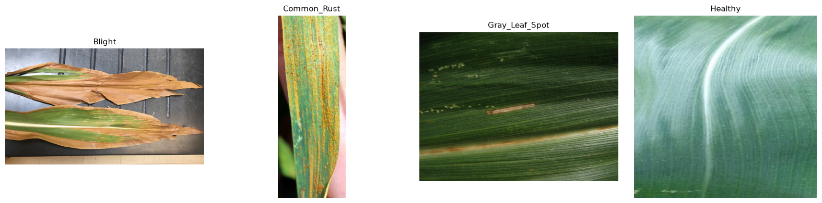
The dataset
Section 1.3: the first image of each class folder, before any cleaning
Gray Leaf Spot has only 572 images, about half the size of the other three classes.
Common Rust, Healthy and Blight each hold 27–31% of the data, so the rest is fairly balanced.
Backgrounds, lighting and resolution vary widely, which is the variation a real field deployment would face.
Kaggle Corn or Maize Leaf Disease Dataset

Slide 5
Data hygiene, then a split
4,188 → 4,186
Split 70 / 15 / 15, seed 42, one job per part
Train 70%
Val 15%
Test 15%
files in, usable images out (Sections 1.2 and 2.1)
Indexed by content hash first: 2 byte-identical photographs sat in two class folders under different labels, so one label was wrong.
Hundreds of files end in uppercase .JPG, which a lowercase *.jpg glob silently misses.
4 images are RGBA and 1 is CMYK; resolutions range from 180×116 to 5184×5184.
3,664
train
levelled to 916 per class by repetition
625
val
natural distribution; every selection decision is made here
625
test
natural distribution; read once, with the final model
Levelling the training split does not create new photographs.
Gray Leaf Spot is still the hardest class underneath; that limitation is documented, not hidden.

Slide 6
Two models, one split
 | Model A | Model B
Model | yolo26n-cls.pt | custom CNN, 2 conv/pool blocks
Starting weights | ImageNet-pretrained | random
Framework | PyTorch (ultralytics) | TensorFlow / Keras
Input | 256 × 256 | 128 × 128
Epochs run | 5 (early enough) | 16 (early stopped)
Model A only has to learn four leaf classes; Model B has to learn vision too.
Running both measures what the pretraining is really worth.
Neither model ever sees the test split during training or tuning.
Section 5 trains them identically
so the comparison isolates architecture and pretraining, not training effort.

Slide 7
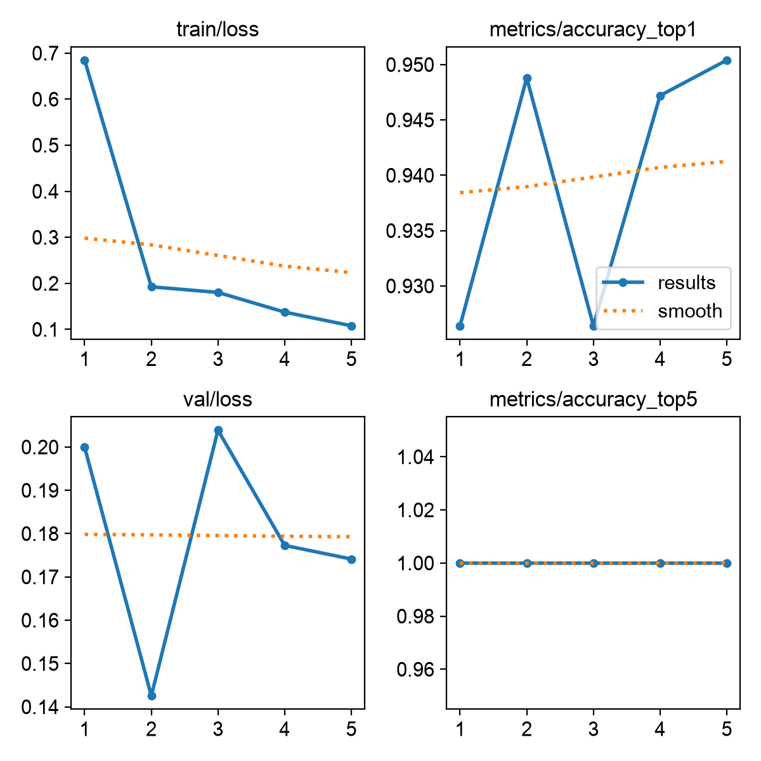
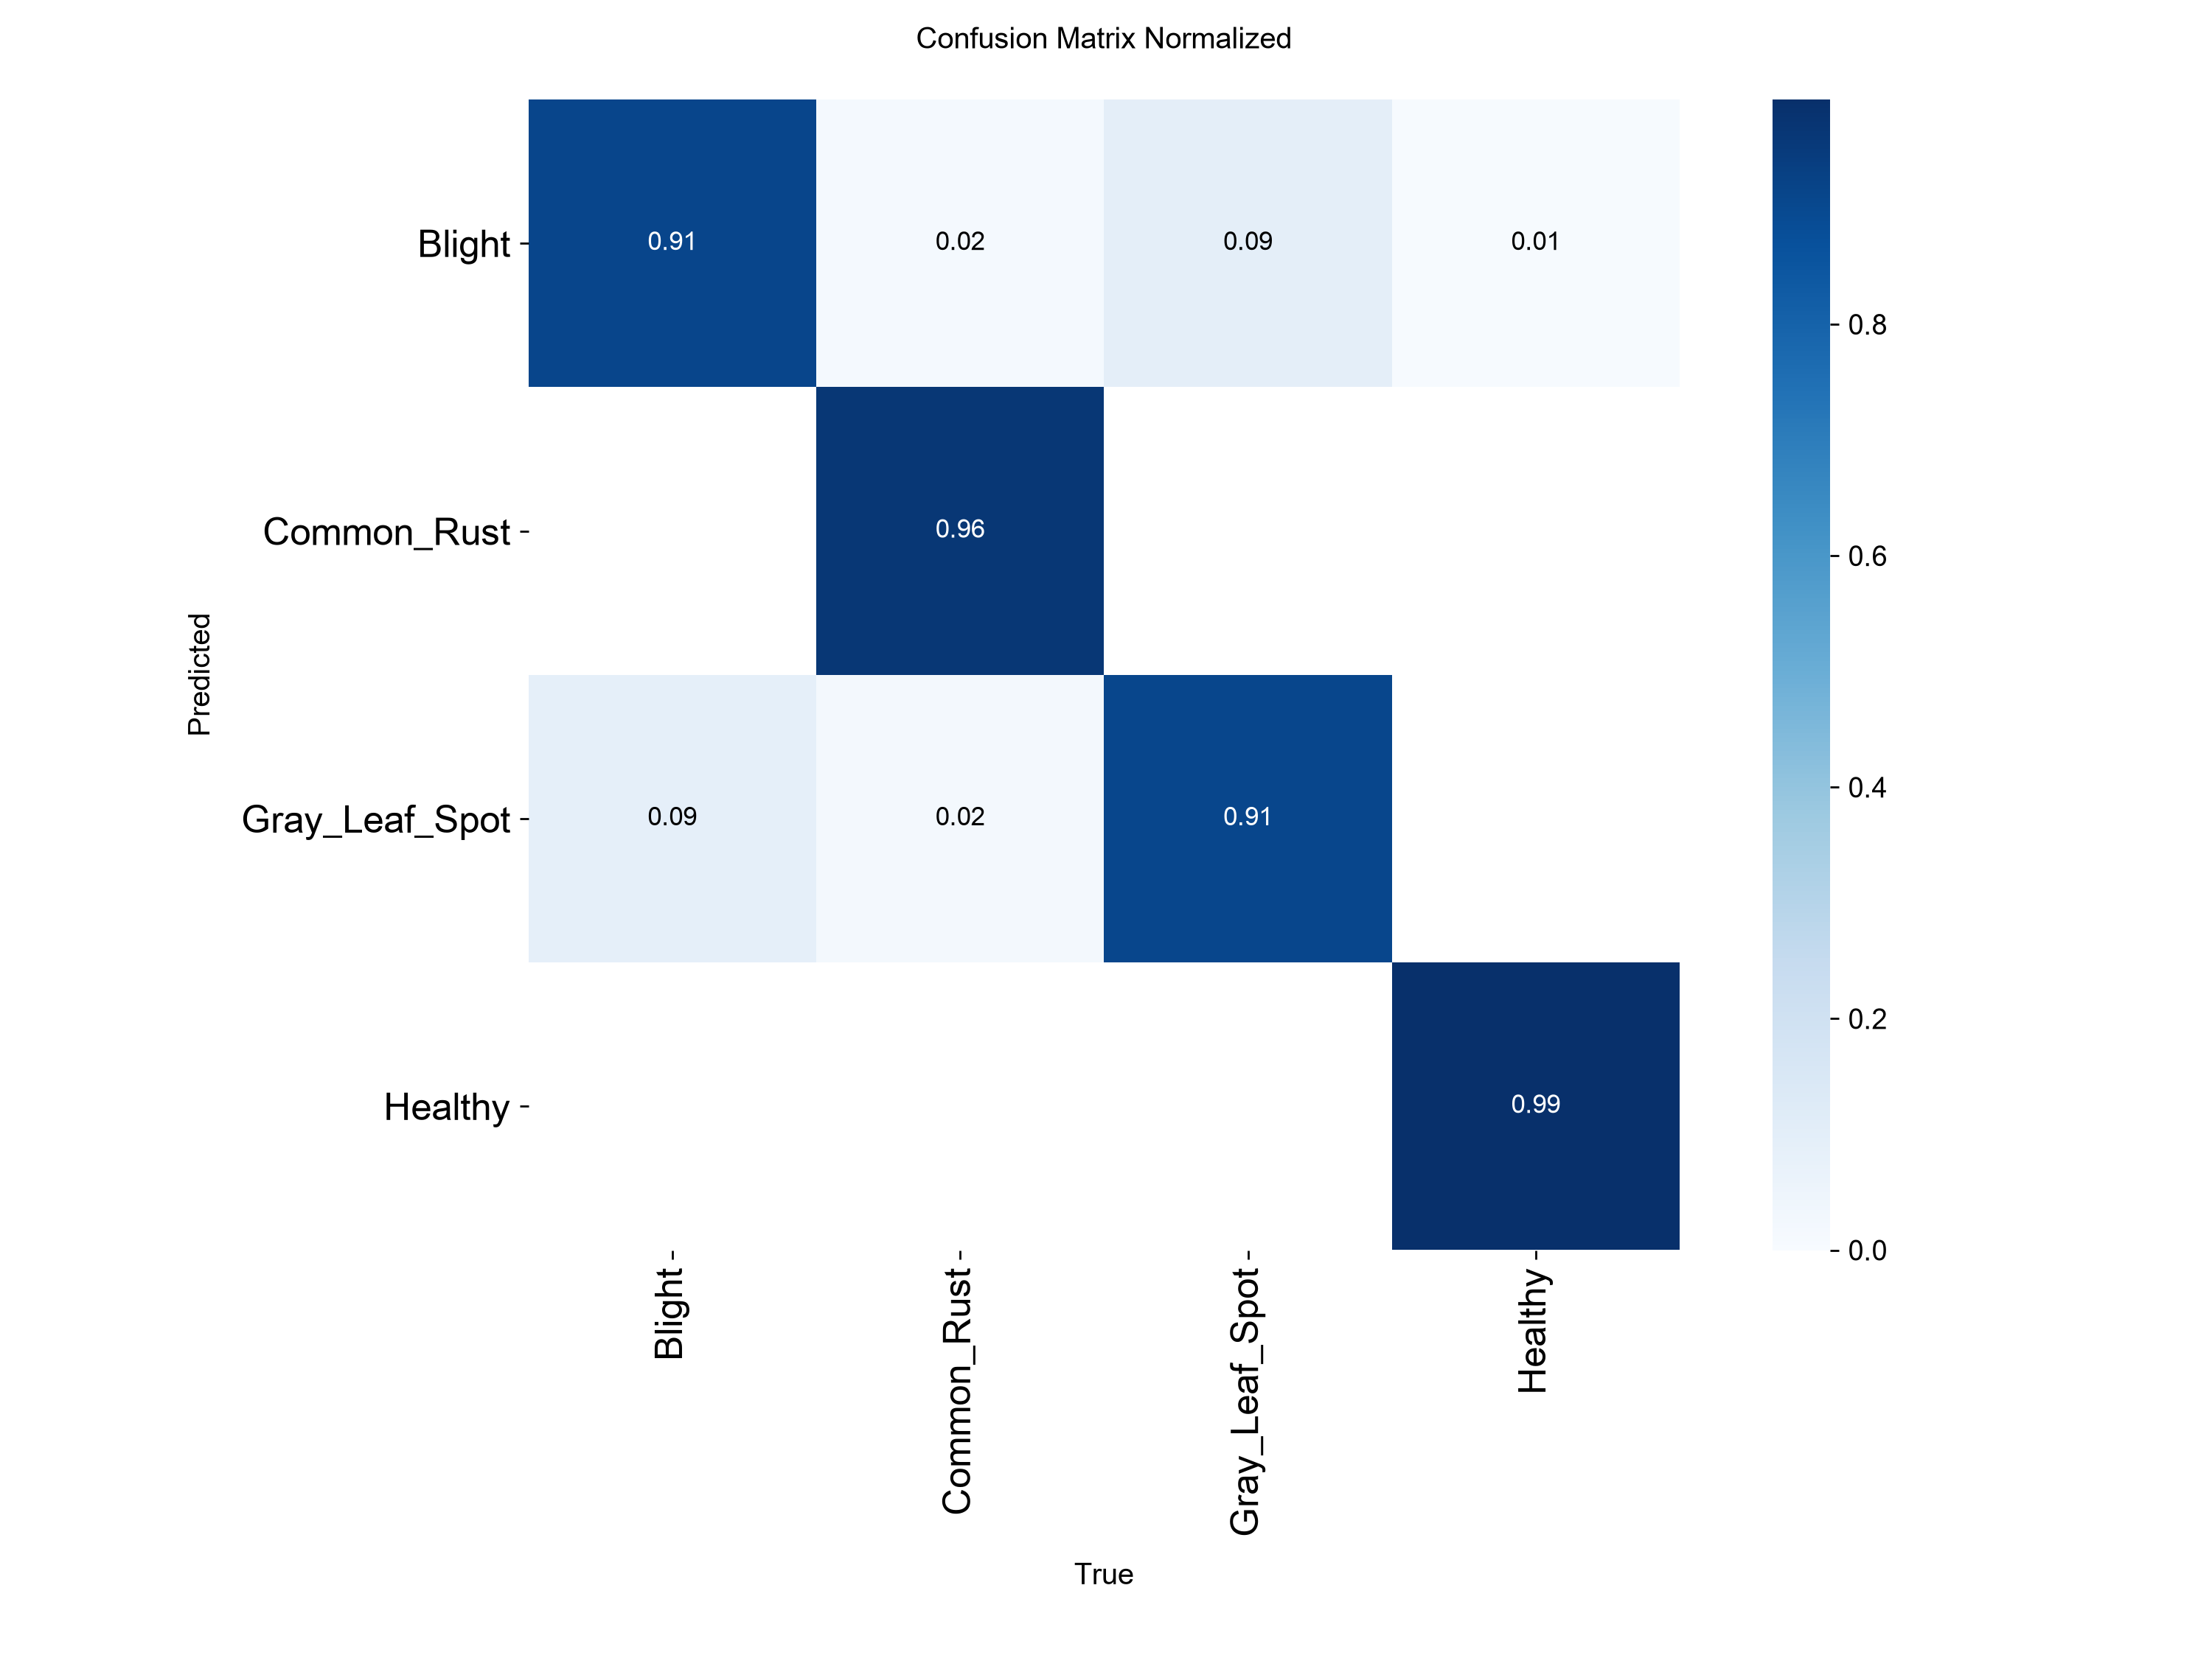
Model A: pretrained YOLO26n
93.75%
val macro F1
591 / 625
test images correct
168 s
for 5 epochs on MPS
Section 3.4: training curves
Section 3.7: confusion matrix
Training loss fell from 0.68 to 0.11 in five epochs while validation accuracy reached about 95%, so the pretrained model had little left to learn.
Common Rust and Healthy are almost always right, at 0.96 and 0.99 on the matrix diagonal.
Blight and Gray Leaf Spot trade errors in both directions, and that pair is the only real weakness.

Slide 8
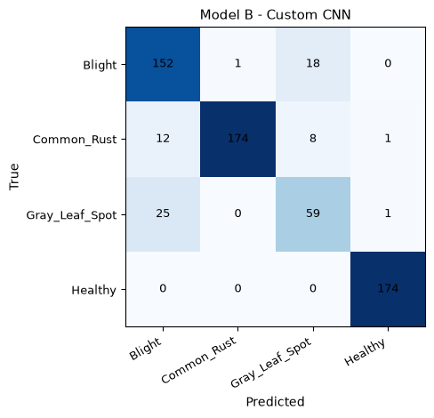
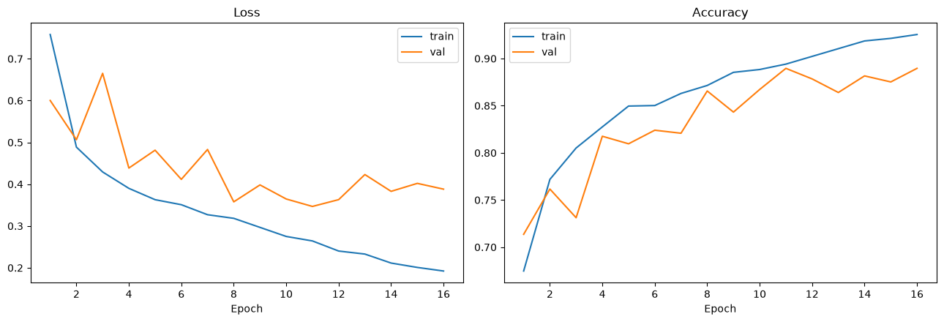
Model B: custom CNN from scratch
326 s
16 epochs, early stopped
88.65%
val macro F1
559 / 625
test images correct
25 of 85
Section 4.6: training curves
Gray Leaf Spot read as Blight
Section 4.8: confusion matrix
Validation accuracy was still climbing when early stopping fired at epoch 16 of 20, so the CNN is limited by capacity, not by undertraining.
Gray Leaf Spot is the weakest class: only 59 of 85 are right, and 25 are read as Blight.
Common Rust also leaks into Blight (12) and Gray Leaf Spot (8), the same trouble spots as Model A.

Slide 9
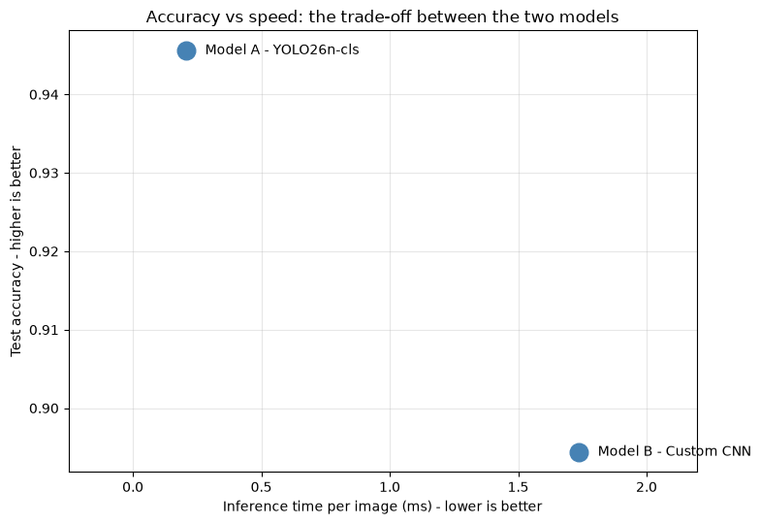
Head to head
Model | Val macro F1 | Test accuracy | Train time | Size | Inference
A: YOLO26n-cls | 93.75% | 94.56% | 2.8 min | 3.2 MB | 0.2 ms
B: Custom CNN | 88.65% | 89.44% | 5.4 min | 100.9 MB | 1.7 ms
31×
8×
smaller
faster
YOLO is more accurate (94.56% vs 89.44%) and trains in half the time.
On the plot it sits in the best corner for both accuracy and speed.
There is no trade-off to argue about: Model B is not a cheaper alternative, it is a worse one.
Section 5.5: accuracy against inference cost

Slide 10
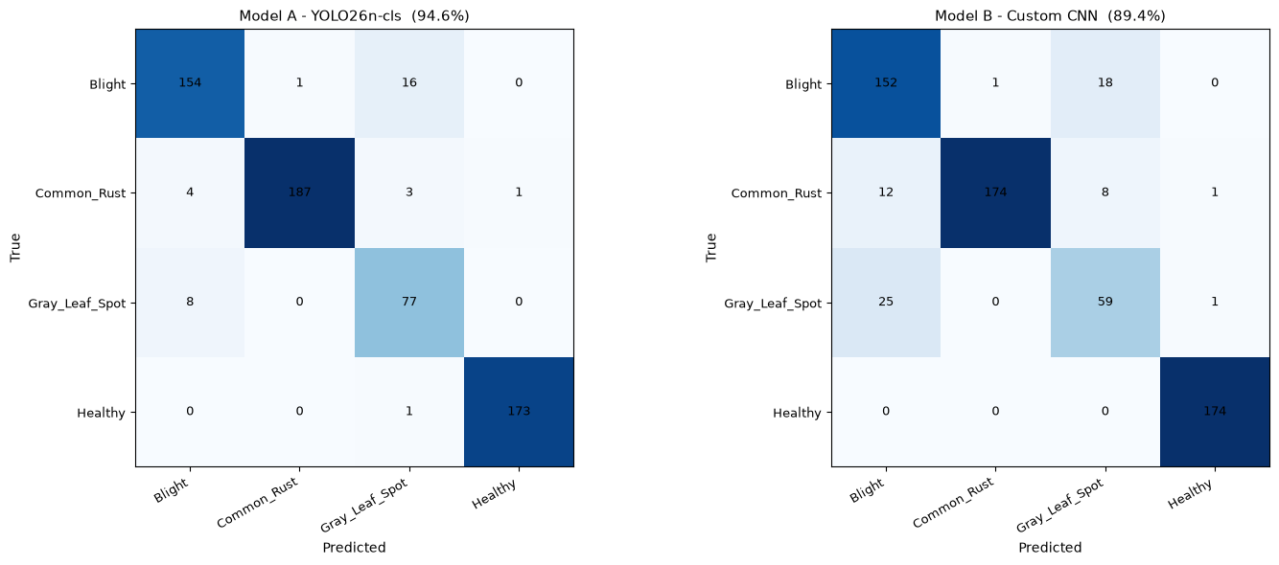
Where both models fail
Confusion pair | YOLO26n | Custom CNN
Blight ↔ Gray Leaf Spot | 24 + 34 | 43 + 66
Common Rust read as Blight | 3 | 21
Healthy misread at all | 1 | 0
Section 5.6: confusion matrices side by side, on the test split
Both models fail the same way, on Blight and Gray Leaf Spot, so the problem is the data, not the architecture.
The two diseases leave genuinely similar necrotic patches, which is hard to separate even for a stronger model.
Common Rust is where the custom CNN loses far more leaves than YOLO, while Healthy is almost never misread by either.

Slide 11
Selecting the winner
Criterion: validation macro F1, fixed in advance (Section 5.7)
Why validation and not test
Model A
Model B
93.75%
88.65%
Choosing a winner on test turns the final test number into a selection artefact rather than an honest estimate. Sections 3.8 and 4.10 read test once each, for a like-for-like reference figure, but no model, epoch, recipe or threshold was ever chosen using those numbers.
YOLO26n-cls. Winner: 3.2 MB, 0.2 ms per image.
Custom CNN
+5.10 points
gap in favour of Model A
Model A wins by 5.1 macro-F1 points.
That gap is transfer learning, measured rather than assumed.

Slide 12
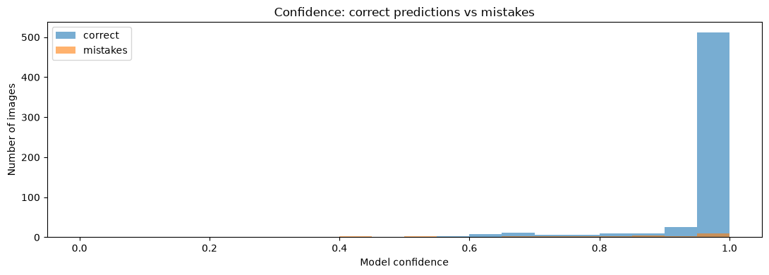
Error analysis on the winner
Class | Val images | Errors | Error rate
Gray Leaf Spot | 85 | 8 | 9.4%
Blight | 171 | 15 | 8.8%
Common Rust | 195 | 7 | 3.6%
Healthy | 174 | 1 | 0.6%
Section 6.4: confidence when right vs when wrong
96.8%
79.0%
Sections 6.2 to 6.4
confident when right
confident when wrong
The model is 96.8% confident when right and still 79.0% confident when wrong.
Only 3 of 31 mistakes fall below 50% confidence, so a confidence threshold would miss almost every error.
Errors concentrate in Gray Leaf Spot (9.4%) and Blight (8.8%), while Healthy is essentially solved at 0.6%.

Slide 13
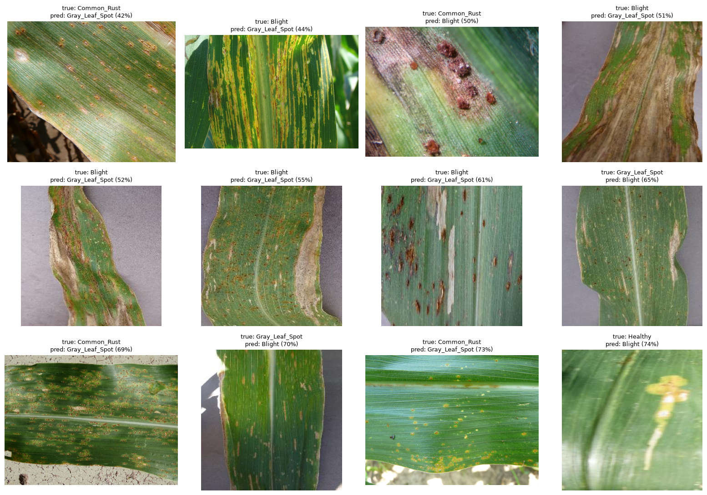
Looking at what it gets wrong
Measured on | 31 mistakes | 594 correct
Brightness | 0.465 | 0.468
Saturation | 0.493 | 0.498
Sharpness | 1034 | 1998
~2×
lower sharpness on mistakes
Section 6.5: a sample of the 31 misclassified validation images
Brightness and saturation are almost identical for right and wrong predictions, so lighting is not the cause.
Sharpness is about half on mistakes (1034 vs 1998): the errors are the blurry photographs.
Blur destroys the texture cues that separate Blight from Gray Leaf Spot, which is why a bigger model helps more than augmentation.

Slide 14
Reducing the errors
Sections 7.1 to 7.4, all selected on validation
Configuration | Val macro F1 | Val accuracy | vs baseline
baseline (section 5 winner) | 93.75% | 95.04% | n/a
exp_a: stronger augmentation | 94.68% | 95.84% | +0.93%
exp_b: YOLO26s (larger) | 95.01% | 96.00% | +1.26%
+1.26%
val macro F1 from the larger backbone
exp_a: augmix, stronger crop and colour jitter. Inside the noise band, and labelled as such.
exp_b: swap yolo26n-cls for the larger yolo26s-cls backbone.
Only exp_b clears the sub-1% noise threshold, so it is the one that ships.
The gain that mattered was capacity, not augmentation.
A change under a point on 625 validation images is noise, so the notebook labels it as noise instead of banking it.

Slide 15
The final model
Sections 7.5 and 9.3
Final model | YOLO26s-cls (larger variant)
Validation macro F1 | 95.01%
Validation accuracy | 96.00%
Test accuracy | 95.68% (of 625, scored once)
Target | 96%: met on validation, not on test
Cost | 0.2 ms per image, 3.2 MB
95.68%
test accuracy, scored once on 625 images
96.00% on validation is exactly the target, with no room to spare.
95.68% on test is 0.32 points under it.
The honest reading: the target is met, but not robustly, and not where it counts.
Reporting 96.00% and stopping would have been the easy answer.
The test number is lower, and that gap is the most useful thing in the project.

Slide 16
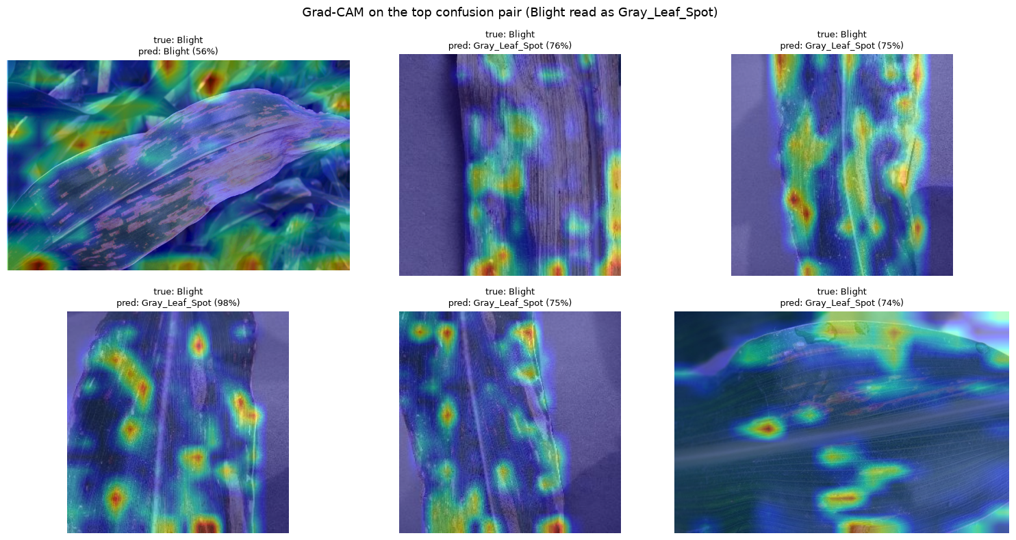
Grad-CAM on the final model
25
mistakes, down from 31 for the baseline
3.4%
of the frame highlighted on mistakes
5.6%
highlighted on correct predictions
9.0%
highlighted on Healthy leaves
Section 8.1: Blight read as Gray Leaf Spot, 13 of the final model's 25 mistakes. Heatmap on the C3k2 block, 16×16.
On mistakes the model looks at a narrower area (3.4% of the frame) than on correct predictions (5.6%), so it is not sweeping the background.
The heat sits on the leaf lesions, not on the soil, which is the reassuring reading.
Healthy leaves need the widest look (9.0%), which fits with it being the easiest class.

Slide 17
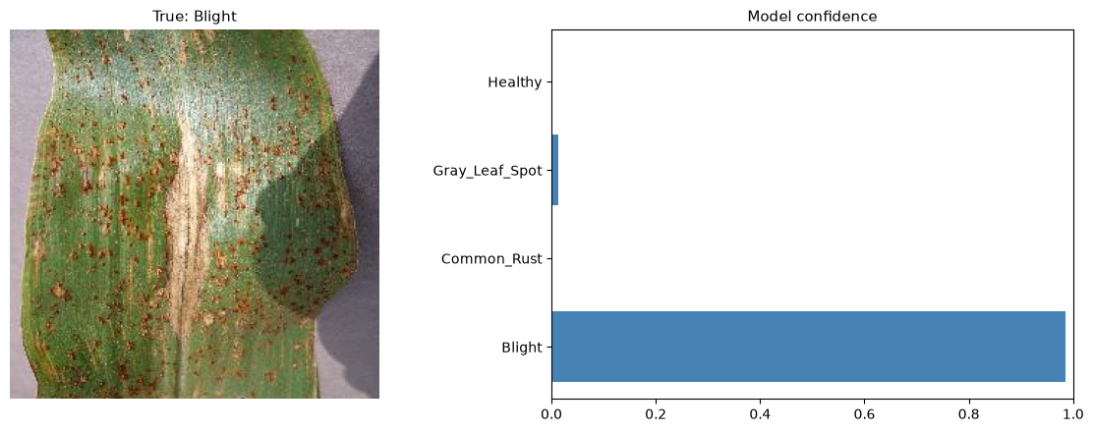
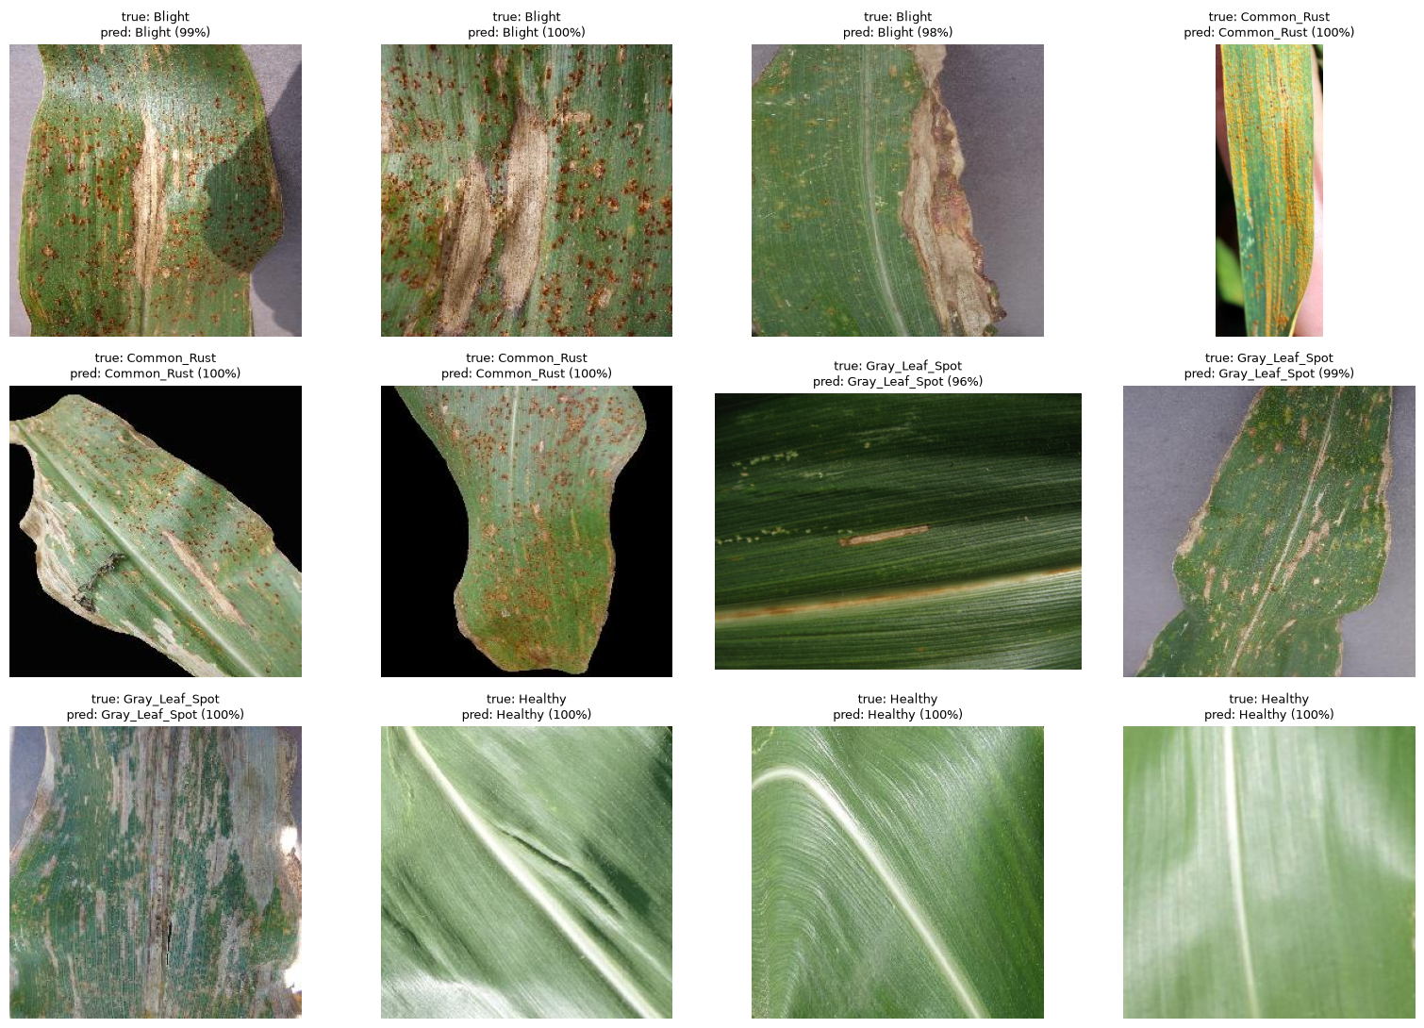
Inference and visual QA
Section 9.1: single image, Blight predicted Blight at 99%
Section 9.2: batch prediction
A single leaf is classified as Blight with 99% confidence in 0.2 ms on MPS.
A full 625-image split scores in well under a second, so speed was never the bottleneck.
Manual QA over a labelled sample confirms the printed numbers and surfaces the blurry cases.
Accuracy on field photographs is the real challenge, not inference cost.

Slide 18

Limitations and intended use
625 held-out images from one public compilation of PlantVillage and PlantDoc: no field-trial data, no geographic or seasonal metadata.
The score does not predict performance on a new farm. It predicts performance on this dataset.
Gray Leaf Spot stays the weakest class at 9.4% error even after levelling, because repetition creates no new photographs.
Blight and Gray Leaf Spot overlap visually by nature; 13 residual errors sit in that one pair.
Validation is 625 images, so differences under about 1 point are noise, which is why exp_a was not banked.
INTENDED USE
Triage and prioritisation with agronomist confirmation. Not standalone diagnosis, not automated treatment decisions.
A tool that flags the leaf worth looking at is useful today. A tool that says 'do not spray' is not, and this one must not be sold as if it were.

Slide 19
Conclusion
1
Transfer learning is the headline result.
93.75% vs 88.65% validation macro F1, 31× smaller and 8× faster at the same time.
2
The confusion is structural, not architectural.
Both models fail on Blight ↔ Gray Leaf Spot. More data of that pair is the fix.
3
Errors are a sharpness problem.
Brightness and saturation are flat between right and wrong; blur is the whole signal.
4
The target was met on validation and missed on test.
96.00% then 95.68%. Reporting only the first would have been dishonest.
5
The model does read the lesion.
Grad-CAM highlights 3.4% of the frame on mistakes vs 5.6% on correct predictions.
NEXT STEP Field photographs from a real planting, and a shadow/lighting normalisation step. The sharpness result says the ceiling here is image quality, not architecture.

