Slide 1
链接世界 link the world
Global-link supply chain (China) Limited
环联供应链（中国）有限公司
Contact us: partner.globallink.sc@gmail.com
→ 欢迎进入

Slide 2
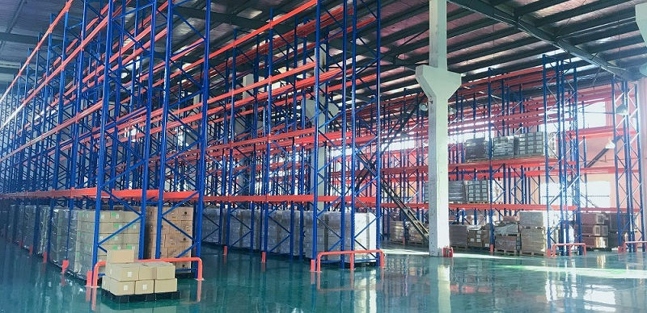
Global-link supply chain (China) Limited
环联供应链（中国）有限公司
链接世界 | link the world

Slide 3




关于我们 About us
Specializing in providing global order fulfillment solutions for DTC brands（Direct-to-Consumer Brand）. operating in the global e-commerce sector, particularly those leveraging Chinese manufacturing capabilities while serving international markets, to help DTC brands reduce supply chain costs.
专注于为全球电子商务领域的 DTC 品牌提供全球订单履约解决方案，主要服务依托中国制造业能力，同时面向国际市场的 DTC 品牌，助力其降低供应链成本！
Reduce Fulfillment Costs by up to 40%​​
Scale Operations
without Hiring​
Improve Customer Satisfaction Scores​
​Having more time to focus on Marketing & Product Innovation​
降低高达40%的
履约成本
无需额外招聘
即可扩展运营
提升客户满意度评分
有更多时间专注于
市场营销与产品创新

Slide 4
核心优势 Competition advantage
E-commerce Fulfilment
电商履约服务
Crowdfunding Fulfillment
众筹履约服务
Amazon Fulfillment
亚马逊履约服务
B2B Fulfillment
B2B履约服务
Your online order, fulfilled. We manage storage, picking, packing & shipping directly to your customers.
消费者下单后，直接为您完成从仓储、拣货、打包到将商品配送至最终消费者手中的全流程服务。
Provides rewards fulfillment for crowdfunding projects, helps startup brands complete product delivery.
为众筹项目提供 rewards 履约,助力初创品牌完成产品交付。
FBA Prep services for Amazon warehouse replenishment and overseas warehousing.
为亚马逊仓库补货提供FBA预处理服务及海外仓储。
Streamlined order fulfillment and distribution for bulk, business-to-business transactions.​​
为大批量的企业间交易提供简化的订单履行与分销服务
link the world
link the world
link the world
link the world

Slide 5
尾程派送是影响客户体验的关键环节 Last-mile delivery is a key link affecting customer experience.
北美市场
USA
欧洲市场
英国市场
EU UK
其他市场
Other markets
亚洲市场
ASIA
​
Hongkong Post香港邮政
Japan Post日本邮政
Sagawa Express佐川急便
Yamato Transport (Black Cat Delivery)
黑猫宅急便（雅玛多）
Korea Post韩国邮政
CJ Korea Express
CJ大韩通运​
​Aramex​
SingPost新加坡邮政
Kerrry嘉里物流（泰国）等​
USPS（美国邮政）
FedEx（联邦快递）
​​
UPS（联合包裹）
​​
DHL Express​
Local Logistics Service Provider本地服务商​
OnTrac, LaserShip​​
DPD / DHL PARCEL /GLS
Royal Mail（英国皇家邮政）​​
FedEx（联邦快递）
​Hermes（德国）
Deutsche Post
Evri（英国）​​
PostNL（荷兰邮政）
La Poste（法国邮政）​​
Correos
SDA（意大利）
PostNord
​​
​iMile​
​SMSA Express
​Correios（巴西邮政）
​​
​Chilexpress
Mexpost
Naqel Express​
link the world
link the world
link the world
link the world

Slide 6
品牌理念 Brand philosophy
Stop Worrying About Fulfillment，Start Scaling Your Brand。​
告别履约烦恼，专注品牌增长。
The Hidden Cost of Selling Globally
全球销售的隐藏成本
All-in-One Fulfillment PartnerGlobal-link
一站式履约伙伴​-环联通
❌ High Shipping Costs & Complex Logistics
高额运费与复杂的物流流程
Seamlessly connect your e-commerce store.​
无缝对接您的电商店铺。
❌ Time Wasted on Manual Order Processing
手动处理订单，浪费时间
We store, pick, pack, and ship globally.​
我们负责仓储、拣货、打包和全球配送
❌ Difficulty Managing Inventory from China​
难以有效管理来自国内库存
You and your customers track every step.
您和您的客户可追踪每一步。

Slide 7
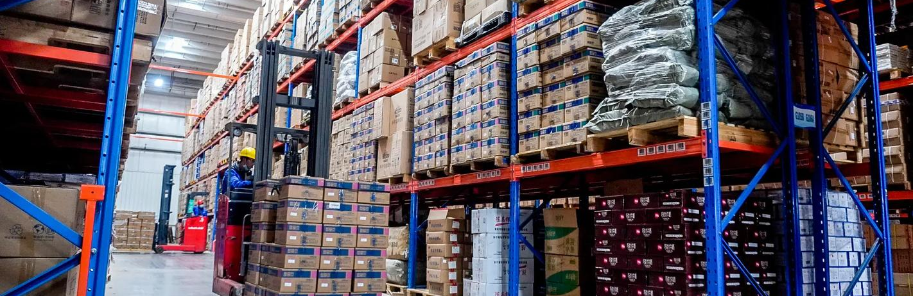
四步核心流程 / 4-Step Core Workflow​
1. 连接与同步 Connect & Sync​
2. 智能履约
Smart Fulfillment​
3. 全球运输与追踪
Global Transit & Tracking​
4.数据闭环
Data Loop​
Orders auto-sync from your store to our system.
独立站订单自动同步至系统
System automates: Picking, Packing, Shipping out.
系统自动处理：拣货、打包、出库
Delivery confirmation with full data report.
妥投确认，提供完整履约报告
Optimal shipping routes with full visibility.最优物流路线，全程实时可视
What you can get? 您可获得什么好处？
​Reduce Costs & Boost Efficiency​ 降本增效​
Enhance Customer Experience ​ 提升客户体验​
Focus on Your Core Business: Brand & Growth 专注核心业务：品牌与增长​

Slide 8
卓越服务​ Service Excellence​
24/7 Customer Service: Multilingual support team providing round-the-clock assistance
24/7客户服务​：多语言支持团队提供全天候协助。
Target Market & Customer Base 目标市场与客户群​
​Primary Customers​ 主要客户​
​Professional Logistics Team: Experienced team across e-commerce specialties
专业物流团队​：拥有跨电商领域的经验丰富的团队。
DTC Brands: 70% of overseas DTC brands have their supply chain
DTC品牌​：70%的海外DTC品牌其供应链位于中国。
Green Packaging Options: Environmentally friendly, recyclable, and biodegradable packaging materials
绿色包装选项​：提供环保、可回收、可生物降解的包装材料。
Geographic Distribution 地域分布​：
50% North American brands（50%为北美品牌）
30% European brands （30%为欧洲品牌）
20% Asian brands (Malaysia, Singapore, etc.) （20%为亚洲品牌（如马来西亚、新加坡等））
Full Process Tracking: Complete logistics trajectory tracking and monitoring
全流程追踪​：完整的物流轨迹跟踪与监控。
​

Slide 9
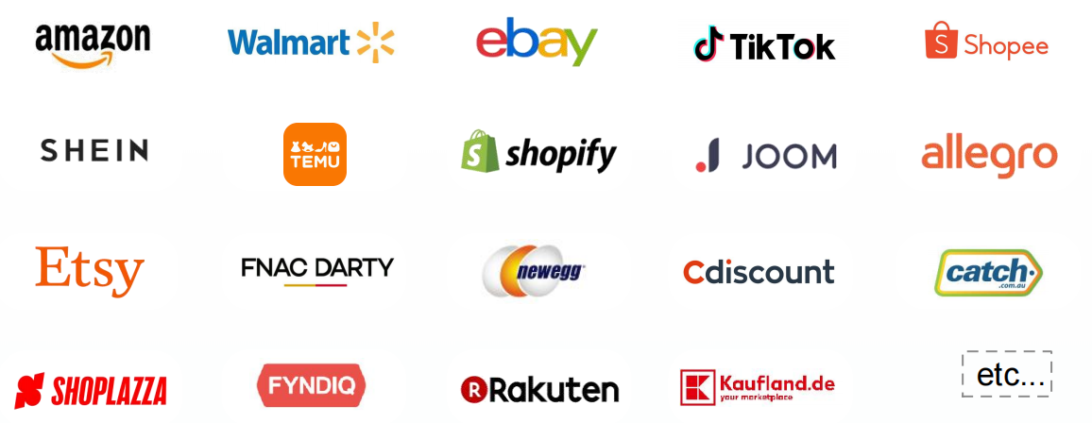
主流电商平台如下Cross-border e-commerce platforms mainly cover the following

Slide 10
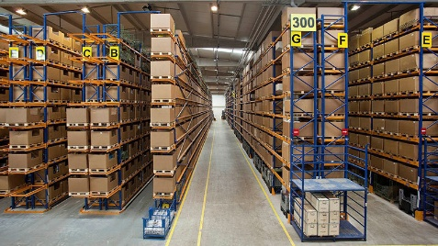
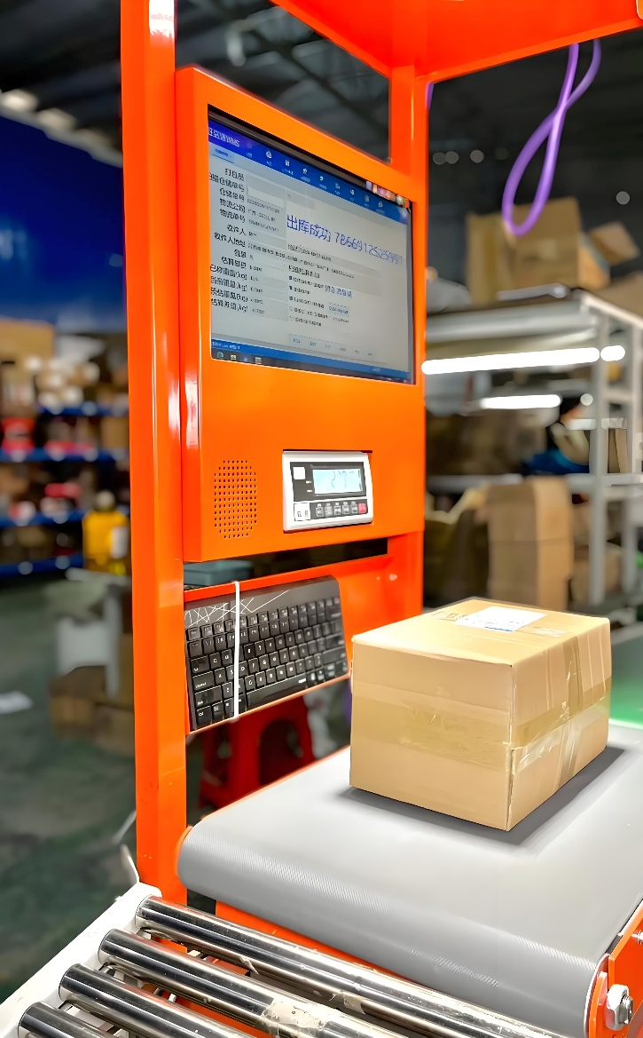
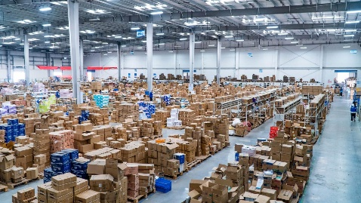
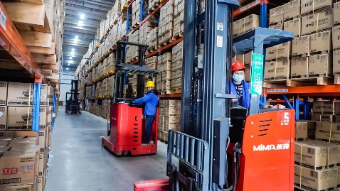

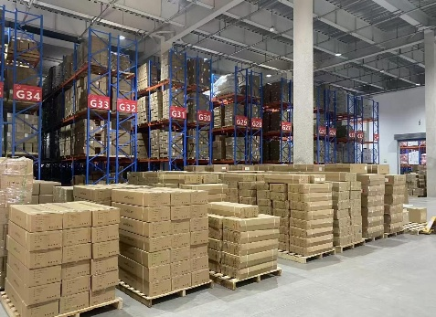
核心价值​ Core Value
Behind every great brand is a powerful supply chain. We are that foundation for your global success.
Helping your brand reach the world and build its reputation.
每一个卓越品牌的背后，都有一条强大的供应链。我们正是您全球成功的基石，助力您的品牌畅行全球。
Schedule a Free Consultation​
预约免费咨询
​Get a Custom Quote in 24 Hours​
24小时内获取定制报价
Ccontact Information联系方式
Email: partner.globallink.sc@gmail.com
Ava Phone: + 86 191 5232 9812

Slide 11
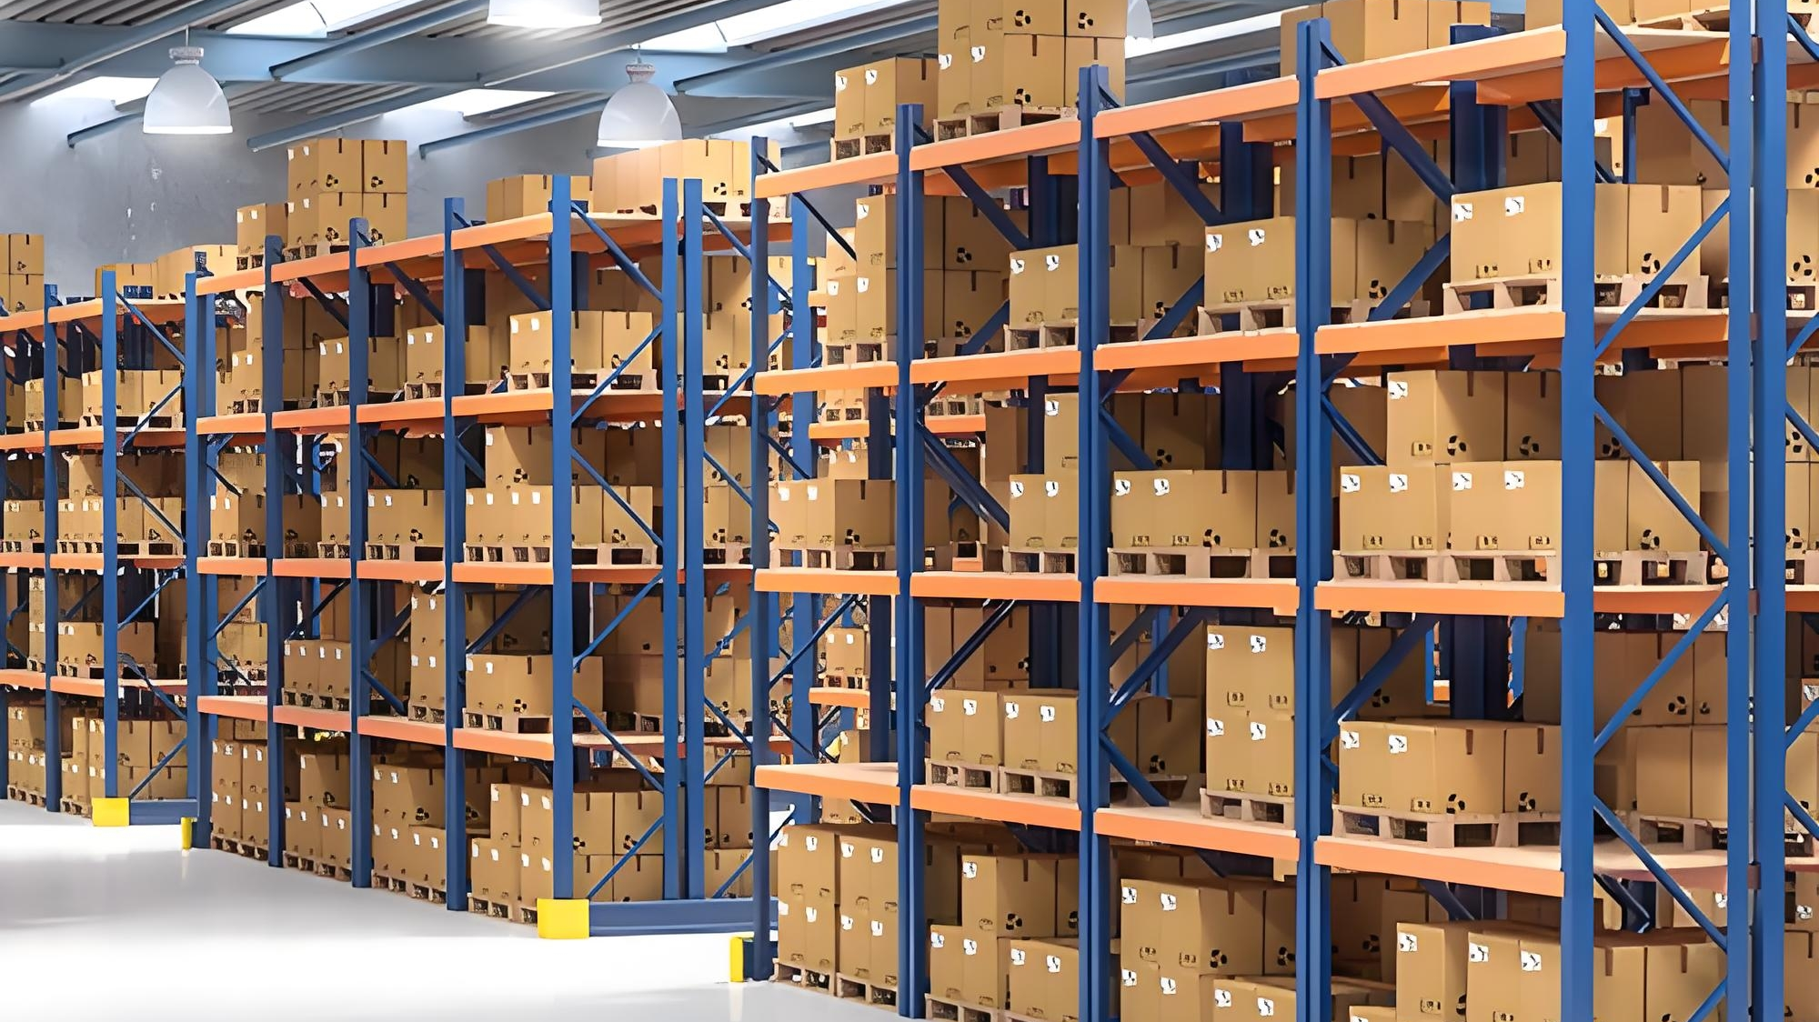
FAQ
链接世界 | link the world
What’s included in your standard handling fees?
标准手续费包括哪些内容？
Our standard handling fee includes: Item receiving → item inspection → scanning into our system → storage in our warehouse → sync orders → pick → pack → ship to other country
我们的标准手续费包括：物品接收→物品检查→扫描到我们的系统→存储在我们的仓库中→同步订单→拣选→包装→发货到其他国家
What sort of customized services do you provide?
你们提供什么样的定制服务？
· Custom packaging定制包装
· Kitting and assembly配套和组装
· Labeling标签 and more
· and more以及更多

Slide 12
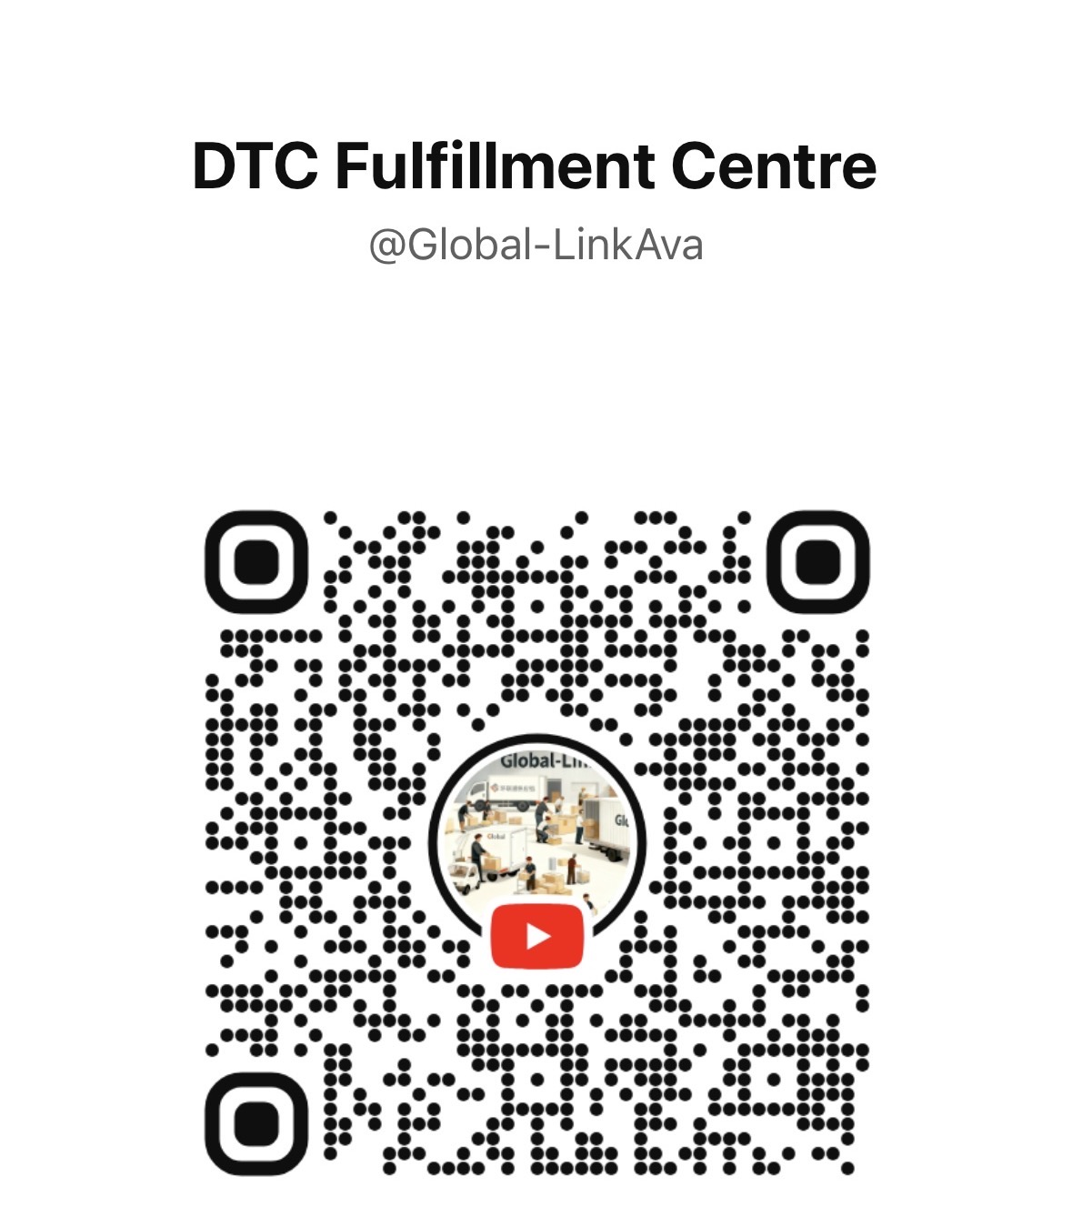

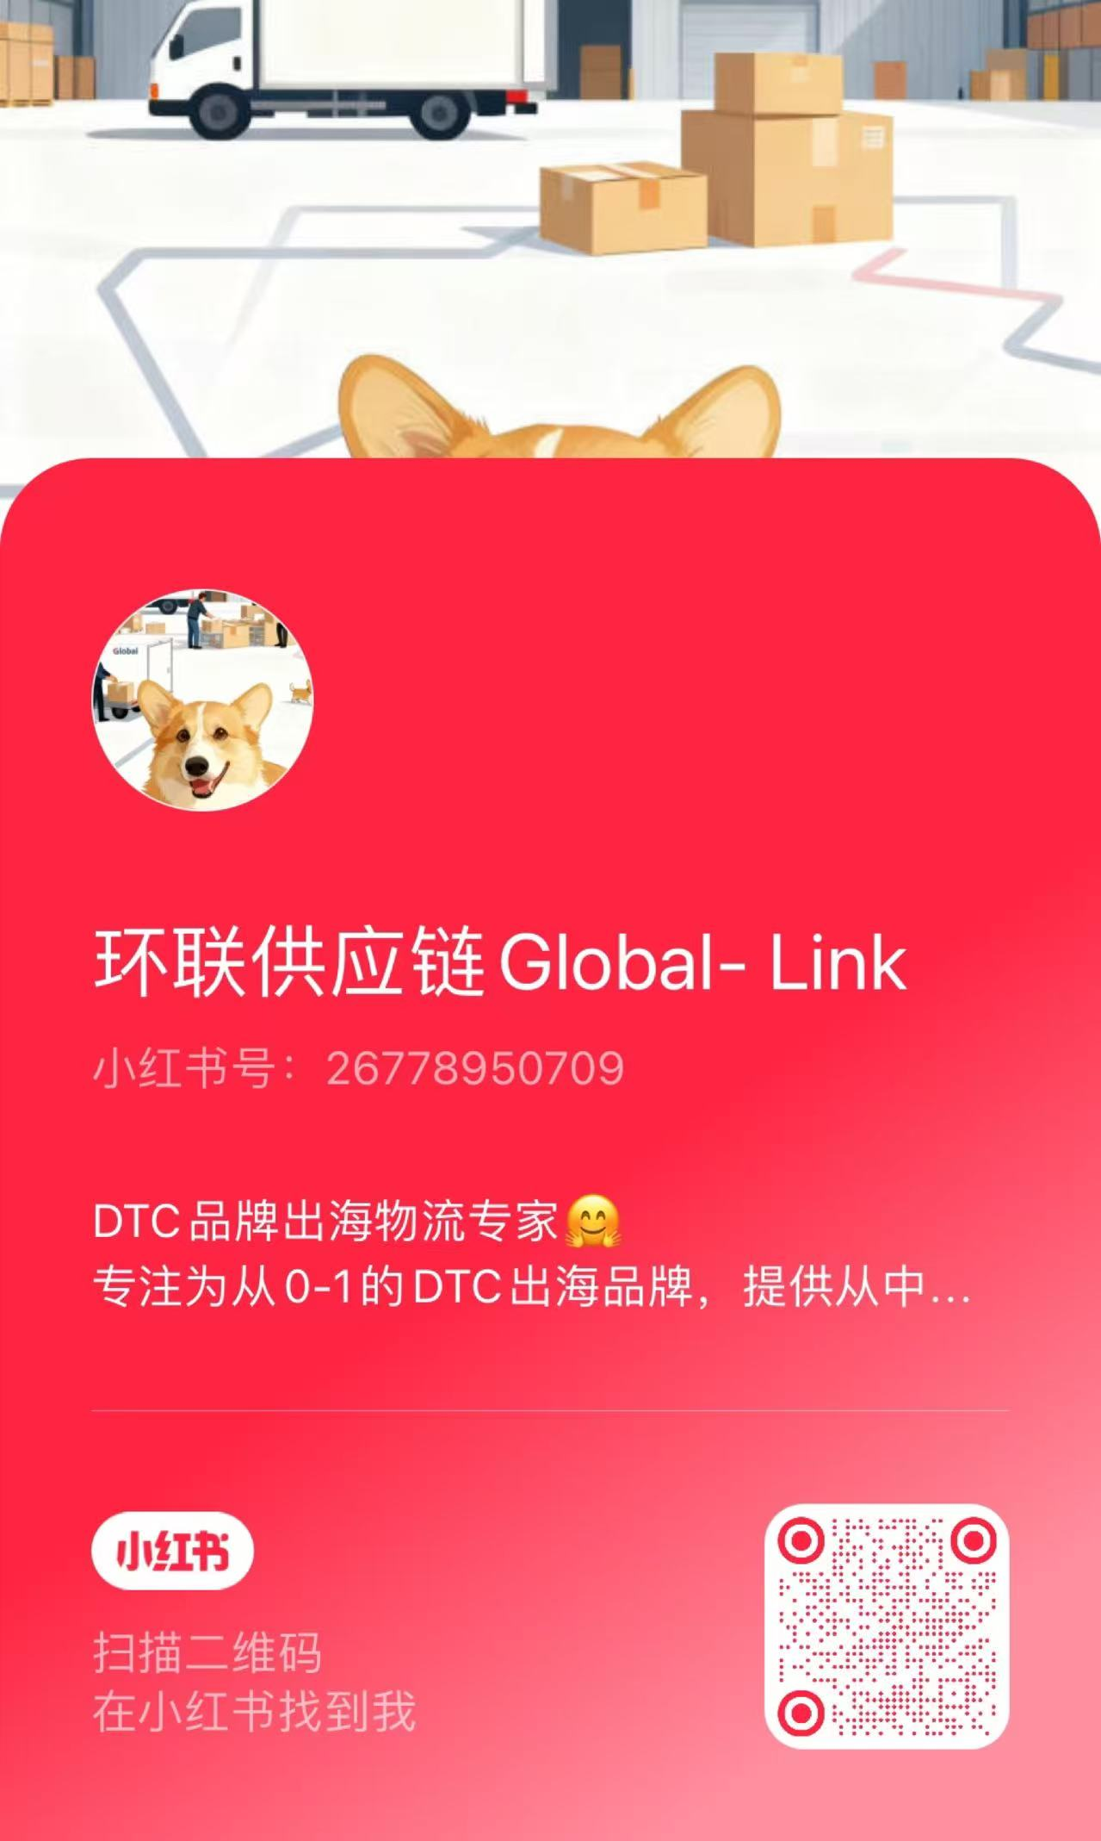
Contact us : partner.globallink.sc@gmail.com
Phone: + 86 191 5232 9812
THANKS
YouTube
Wechat微信
Instagram
Xiaohongshu小红书

