Slide 1
SESSION 02
Prompting
in Practice
Two hours. Hands on the keyboard.
The software is the same for everyone. The asking is not.
Kretz Lumber · Antigo, Wisconsin
Notes:
Welcome participants. Set the expectation that this session is practice, not lecture. The room should be signed in and ready to type.

Slide 2
TODAY
What we are practicing
The same prompting skill moves from images to spreadsheets, research, decisions, monitoring, and a working tool.
1
Generic → specific
2
Object → intention
Remove wrong answers with the details that matter.
Say who it is for and what happens next.
3
Data → verification
4
Problem → tool
Ask for formulas, sources, assumptions, and warnings.
Describe a narrow workflow and refine without restarting.
Notes:
Briefly preview the arc. Do not teach the details yet.

Slide 3
CARRIED FROM SESSION 1
Four rules still apply
Prompting skill does not replace governance. It makes governance worth having.
1
You own what it says
2
Confident is not correct
3
Where data goes matters
4
A person signs off
Anything leaving the building carries Kretz’s name.
Check every name, number, formula, source, and citation.
Practice uses synthetic or non-sensitive information.
External, safety, legal, pricing, and landowner work gets human review.
Notes:
Use this as a ninety-second callback, not a repeat of Session 1. [Sources] - https://www.americanbar.org/groups/business_law/resources/business-law-today/2024-february/bc-tribunal-confirms-companies-remain-liable-information-provided-ai-chatbot/ - https://law.justia.com/cases/federal/district-courts/new-york/nysdce/1%3A2022cv01461/575368/54/ - https://techcrunch.com/2023/05/02/samsung-bans-use-of-generative-ai-tools-like-chatgpt-after-april-internal-data-leak/ [/Sources]

Slide 4
THE CORE LESSON
AI fills in what you leave blank.
When the prompt is vague, the model chooses the statistical middle.
GENERIC INPUT
GENERIC OUTPUT
GENERIC BRAND
→
→
The same average is available to everyone—including competitors.
Notes:
This slide sets up Activity 1. Ask participants what the model has to decide when the user provides almost no direction.

Slide 5
01
Bowl of fruit
Ten minutes · Run the same prompt together.
RUN IT TOGETHER
Create an image of a bowl of fruit.
Do not add details yet.
Notes:
Have everyone generate the image at the same time. Walk the room and look for repeated fruit, bowls, lighting, backgrounds, and camera angles.

Slide 6
ACTIVITY 1 DEBRIEF
What did the tool decide for you?
Similar output is not a failure of the image tool. It is the expected result of missing direction.
1
Which fruits appeared most often?
2
What material was the bowl?
Write down one repeated detail you saw across the room.
Write down one repeated detail you saw across the room.
3
What light and camera angle?
4
Whose style or values did it reflect?
Write down one repeated detail you saw across the room.
Write down one repeated detail you saw across the room.
Generic work is easy to spot.
It looks competent, polished, and interchangeable.
Notes:
Land the homogenization point. Do not imply all model outputs will be identical; the point is that they cluster around familiar averages when the user leaves the decisions blank.

Slide 7
02
House in Wisconsin
Eighteen minutes · Generic first, then structured.
GENERIC VERSION
STRUCTURED VERSION
Create an image of a house in Wisconsin.
Create a realistic image of a house in Wisconsin using: house style, exterior color, roof, setting, season, time of day, yard details, and purpose. Do not include address, license plates, mailbox numbers, or identifying personal details.
Notes:
Run the generic version first. Then have participants fill the structured template for their own house or a fictional house. Remind them not to include identifying details.

Slide 8
SPECIFICITY
Each useful detail removes wrong answers.
Longer is not automatically better. Choose the details that actually change the result.
What it is
Style / era
Materials / colors
Features
Surroundings
Location
Season / time
Vantage / format
Color, material, season, vantage point, and purpose usually do more work than a paragraph of adjectives.
Notes:
Let participants build the house prompt from the handout slots. Encourage concrete nouns and constraints rather than vague quality words.

Slide 9
DO NOT RESTART
Use a correction loop.
Preserve the parts that worked and change only what is wrong.
TARGETED CORRECTION
Keep everything exactly as it is, but change the siding from white to tan, remove the porch swing, and move the garage to the left side of the house.
1
KEEP
2
CHANGE
3
REVIEW
Everything already correct
Two or three named details
What moved unexpectedly?
Notes:
People often rewrite the entire prompt after one bad detail. Stop that pattern early. Iteration preserves progress and makes the effect of each change visible.

Slide 10
03
Intention changes output
Ten minutes · Same object, different reason.
FOR A CHILD
FOR A REMODEL CONVERSATION
Transform the same house into a black-and-white coloring page for a child.
Transform the same house into an architectural concept image for a remodel conversation.
Same object. Different user. Different next step. Different output.
Notes:
Ask what changed even though the object stayed the same. Bridge to written work: “summarize this meeting” versus “summarize it into five bullets the yard crew can use at the start of shift.”

Slide 11
THE INTENTION TEMPLATE
Tell it who this is for and what happens next.
TEMPLATE
[Do this thing] for [who will use it], because [what happens next]. Keep it [length and format]. Leave out [anything unsafe or unnecessary].
1
MEETING NOTES
2
CUSTOMER MESSAGE
3
CHECKLIST
Five bullets for the yard crew before shift.
Plain language for a landowner who has not discussed price.
Steps a new employee can follow without guessing.
Notes:
This is the highest-leverage template in the session. Encourage participants to use “for” and “because” explicitly.

Slide 12
04
Spreadsheets by prompt
Seventeen minutes · Structure, formulas, assumptions, warnings.
Use: spreadsheet_builder_haul_costs_synthetic.csv
BUILD THE PLAN
Create a spreadsheet plan for tracking haul costs. Include columns, sample rows, formulas, cost per mile, cost per MBF, assumptions, and review warnings.
Notes:
Participants upload the synthetic haul-cost file. Have them ask for the workbook plan before showing the reference workbook.

Slide 13
ASK FOR THE LOGIC
Formulas, not a pile of unexplained answers.
THE ONE THAT MATTERS MOST
THE COLLAPSE
Now give me the actual Excel formulas in the cells — do not give me the calculated numbers. Flag anything you had to assume.
Looking back at everything we just built together, how could I have gotten all of this from a single prompt? Write me that prompt, then explain which parts of it were doing the work.
AI is not a calculator.
Use it to propose structure, formulas, and analysis methods. Make it show its work, let Excel perform the arithmetic, and verify the result.
Notes:
Keep the absolute employee rule. Explain the nuance verbally: tools may run calculations, but the employee still has to verify method, assumptions, rows, formulas, and results.

Slide 14
FOUR PLANTED PROBLEMS
A tidy workbook can still hide bad inputs.
1
HL-1007 · 0 board feet
2
HL-1014 · Blank fuel gallons
Cost/MBF divides by zero.
Fuel cost can disappear.
3
HL-1020 · 3 miles to Stevens Point
4
HL-1023 · 26.5 driving hours
Mileage and destination conflict.
Review before any compliance conclusion.
Ask the room: Did the model catch them before producing polished totals?
Notes:
Show the raw CSV problems first. The 11-hour workbook value is a training screening flag for driving time, not a complete HOS compliance determination. [Sources] - https://www.fmcsa.dot.gov/regulations/hours-service/summary-hours-service-regulations [/Sources]

Slide 15
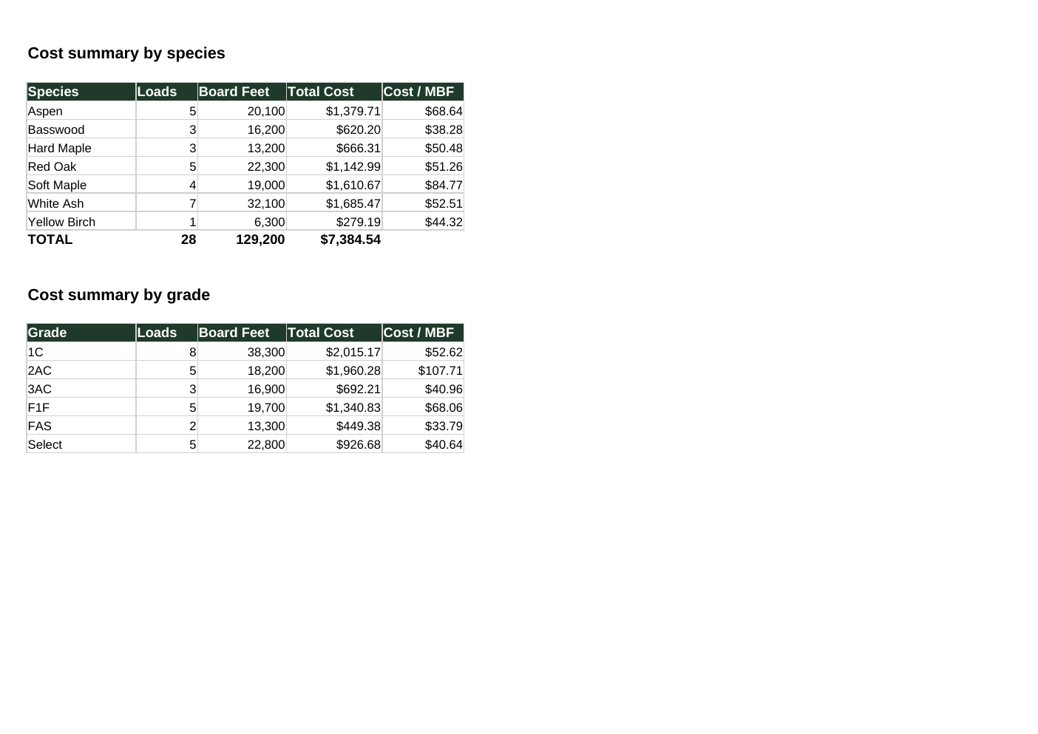
REFERENCE WORKBOOK
Show this after participants build theirs.
The answer key labels assumptions, uses formulas, summarizes by species and grade, and keeps warnings visible.
1
Inputs are labeled
Yellow cells are assumptions—not truth.
2
Formulas stay visible
Excel performs the arithmetic.
3
Warnings stay separate
Questionable rows do not disappear inside totals.
Notes:
Open the actual workbook after this slide. Emphasize that the answer key is a model of transparent assumptions and review—not a production cost model.

Slide 16
05
Landowner research boundaries
Fifteen minutes · Research first, synthetic practice second.
1
Find the source
2
Narrow carefully
3
Add the forestry layer
4
Practice safely
Who publishes it? How current is it?
Which fields and class codes matter?
What is public and how can it be joined?
Use the synthetic CSV for outreach drafting.
Notes:
Open Claude Parcel Finder and the refined Landowner Prospecting Tool side by side if they are available. The lesson is prompt-to-process evolution, not that the prototype is an approved system.

Slide 17
THREE RESEARCH SHOTS
Ask the model where to look—then verify every named source.
SHOT 1
How can I find landowners in one Wisconsin county using free public data? Who publishes it, what format, what cost, how current?
SHOT 2
Which parcel field identifies forest land, what are the class codes, and what acreage threshold makes sense?
SHOT 3
Where is Wisconsin MFL spatial data, what layer and join field, and what is or is not public?
Notes:
Have someone open the current portal while the answer is still on screen. The current training reference is V12, but current county or municipal records remain the authority. [Sources] - https://www.sco.wisc.edu/parcels/data/ - https://www.sco.wisc.edu/parcels/data-county/ - https://dnr.wisconsin.gov/topic/forestlandowners/mfl [/Sources]

Slide 18
PUBLIC DOES NOT MEAN ANYTHING GOES.
Availability is not the same thing as appropriate use.
1
SNAPSHOT
2
AUTHORITY
V12 uses county data collected in the first half of 2026; most tax-roll records are from 2025.
County and municipal records remain the current source.
3
BOUNDARIES
4
OUTREACH
The statewide map is not a legal survey.
Avoid protected records, follow approved practices, allow respectful opt-out, and require human review.
Notes:
Do not turn this into legal advice. The training boundary is operational: verify the record and follow approved practices before contact. [Sources] - https://www.sco.wisc.edu/parcels/data/ - https://www.sco.wisc.edu/parcels/data-county/ [/Sources]

Slide 19
SYNTHETIC PRACTICE
Draft carefully without pretending the public record is verified.
USE THE SYNTHETIC CSV
Using the synthetic landowner research CSV, create a verification checklist and a careful outreach draft. Do not estimate timber value, imply Kretz inspected the property, or treat public data as verified.
□ Owner and address verified
□ Acreage/class checked
□ MFL/FCL status verified
□ No inspection/value/harvest claim
□ Qualified person reviews and signs
Notes:
Use only the fictional CSV. The file intentionally contains duplicates, missing fields, and questionable rows.

Slide 20
06
Operational efficiency
Ten minutes · Decide what kind of solution the problem needs.
CLASSIFY FIRST
Using the operational efficiency CSV, classify each task as existing software first, narrow Custom GPT, automation, process cleanup, vendor system, or do not use AI yet.
THEN ADD CONSTRAINTS
Now redo the top three with my actual constraints: who is on shift, what equipment is down, and what has a hard deadline this week. If a constraint makes your recommendation wrong, say so instead of working around it.
Notes:
Use the Kretz AI Decision Guide if available. If every task comes back as AI, the classification was too loose.

Slide 21
SIX POSSIBLE ANSWERS
“Use AI” is only one category.
1
Existing software first
2
Narrow Custom GPT
3
Automation / workflow
Use what already exists.
Repeated language task.
Move data or trigger steps.
4
Process cleanup first
5
Vendor / enterprise system
6
Do not use AI yet
Fix ownership and process.
Needs scale/support/integration.
Risk or readiness is wrong.
Notes:
The point is diagnosis. A good prompt can help classify the problem, but the organization still decides what to fund, approve, and maintain.

Slide 22
07
Price movement scenarios
Eight minutes · Pattern finding, not prophecy.
ANALYZE THE SUPPLIED DATA
Using the synthetic lumber price movement data, identify patterns and possible leading indicators. Do not make a prediction as fact. Give scenarios, assumptions, confidence, and source-verification needs.
Notes:
This activity is the first cut if time slips. Protect the final tool-building activity.

Slide 23
THE BEHAVIOR RULE
AI cannot forecast lumber prices.
Use it to organize supplied evidence and build a monitoring process—not to invent the next price.
Market intelligence, not prophecy.
Any market number must trace back to a source someone supplied and verified.
Zillow had far more data and a purpose-built system. It still shut down Zillow Offers after home-price forecasting proved more unpredictable than anticipated.
Notes:
Keep the absolute employee rule. The nuance is that a validated forecasting system is different from asking a general chatbot for a number. [Sources] - https://investors.zillowgroup.com/news-and-events/news/news-details/2021/Zillow-Group-Reports-Third-Quarter-2021-Financial-Results--Shares-Plan-to-Wind-Down-Zillow-Offers-Operations/default.aspx [/Sources]

Slide 24
THE PLANTED DATASET LESSON
A plausible explanation can still be invented.
1
Planted signal
Housing starts lead the synthetic price index by three months.
2
Weaker signal
The same-month relationship exists but fits less well.
3
Red herrings
Diesel, exports, and log supply correlations round to 0.00.
4
The test
Will the model find the lag—or tell a convincing story about noise?
DELIVERABLE WORTH KEEPING
Turn the analysis into a one-page monitoring template: driver, source, check frequency, meaningful-change threshold, assumptions, and verification needs.
Notes:
Say explicitly that the relationship is planted in synthetic data. Do not imply it is a verified real-world hardwood-market relationship.

Slide 25
08
Build a tiny HTML tool
Fifteen minutes · One problem, one file, two refinements.
BUILD
Build a single-file HTML tool to help with this problem: [describe problem]. It should have inputs, output, review warning, no external dependencies, and a print button. Ask up to five questions before coding if needed.
REFINE
Two changes only. [First change.] [Second change.] Leave everything else exactly as it is.
Notes:
Participants may choose their own problem or follow the Timber Sale Tracker example. Keep the build narrow enough to finish.

Slide 26
A TOOL REQUEST NEEDS SIX THINGS
If the request is vague, the code will be vague too.
1
Problem
2
User
3
Input
One sentence
Who actually operates it
What data goes in
4
Output
5
Constraints
6
Review
What must come out
Single file, offline, no login, etc.
What a human must check
Notes:
Use the handout worksheet. If the problem takes three sentences to describe, it may be more than one tool.

Slide 27
FOLLOW-ALONG EXAMPLE
Timber Sale Tracker
A narrow one-file prototype: add prospects, filter by stage or forester, flag overdue follow-up, export CSV, and print.
TIMBER SALE TRACKER
1
What it proves
Landowner
Town
Acres
Stage
Due
A good description can become a working prototype quickly.
D. Bergstrom
Neva
88
Walked
Late
M. Kowalczyk
Elcho
41
Contacted
2 days
2
What it does not prove
G. Thibodeau
Polar
127
Contract
9 days
That the tool is secure, durable, approved, or maintainable.
L. Vanderhoof
Summit
22
Bid
Late
3
Next requirement
Decide ownership, persistence, testing, access, and support.
Notes:
Open kretz_prompt_to_tool_builder_example.html. Explain the known limitation: it does not persist between sessions. That is a feature for the lesson because it reveals the difference between a prototype and a production system.

Slide 28
BEFORE ANYTHING LEAVES YOUR SCREEN
The prompt never owns the outcome.
Audience and purpose are clear
Names, dates, numbers, formulas, sources, and commitments are checked
Unsupported claims are removed
Approved tools and approved data only
A person signs off
Notes:
Have the room read the final line together: A person signs off.

Slide 29
FIVE HABITS TO TAKE BACK TO WORK
The software will change. These habits will not.
1
Be specific
2
State the intention
3
Ask for the logic
Choose the details that remove wrong answers.
Say who it is for and what happens next.
Formulas, sources, assumptions, and warnings.
4
Verify the evidence
5
Refine, do not restart
Click the source. Check the row. Recalculate the number.
Change two things and preserve everything else.
Notes:
Use this as the spoken recap. Ask each participant which habit they are most likely to use tomorrow.

Slide 30
PROMPTING IN PRACTICE
Specificity beats volume.
Say who it is for. Ask for formulas, not magic answers. Verify every number and source. Refine instead of restarting.
The final rule
A person signs off.
Open the participant page, practice files, prompt pack, and example tool from the Kretz training portal.
Notes:
Close on time. Point participants to the portal resources and ask them to use one template on a real low-risk task this week.

