Slide 1
NLP – Twitter Sentiment Analysis
The building blocks of object detection: methods, tools and frameworks
Will Block
D&A Chicago

Slide 2
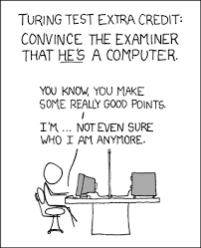
NLP Background
Earliest ML algorithms, such as decision trees, used hand-written rules to encode and predict the meaning of a word. In the late 1980s and 1990s, relied on a large “corpus” of documents with human or computer annotations to represent words. In the 2010s, deep learning took over and utilized word embeddings to capture semantic properties of words, and an increase in end-to-end learning of a higher-level task (e.g., question answering).
NLP today:
Word2vec
LSTM (version of RNN)
Attention Mechanism

Slide 3
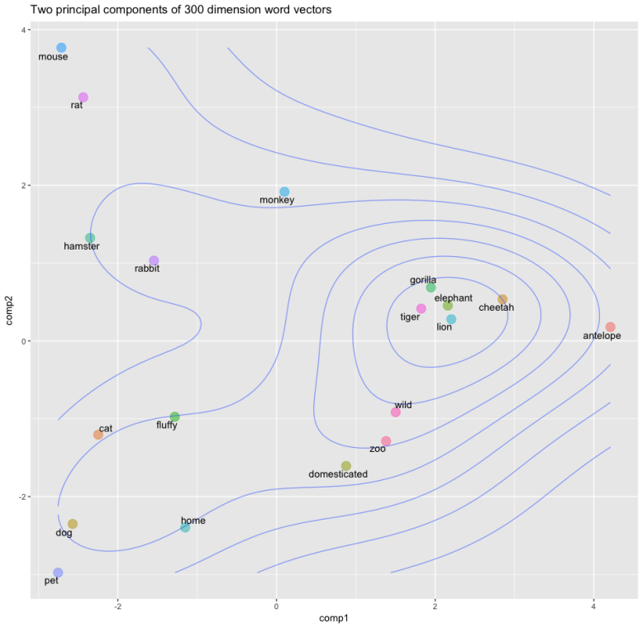
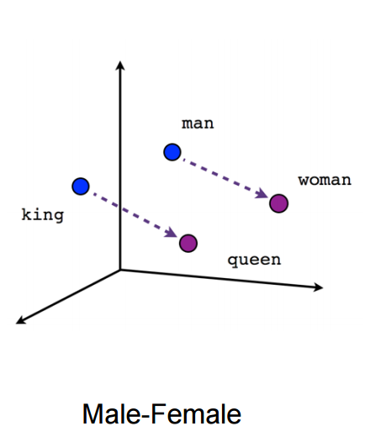
Methodology Word Embeddings
Like all other neural networks, DL models don’t take as input raw text: they only work with numeric tensors(matrices with 3D+).
Vectorizing text is the process of transforming the text into this numeric tensors. This can be done in many ways but we are only going to talk about two ways, which are:
Segment text into words, and transform each word into a vector.
Segment text into characters, and transform each character into a vector.
Word embeddings are low dimensional floating-point vectors and a powerful way to associate a vector with a word. They are meant to map human language into a geometric space, and the geometric relationships between word vectors should reflect the semantic relationships between these words.

Slide 4
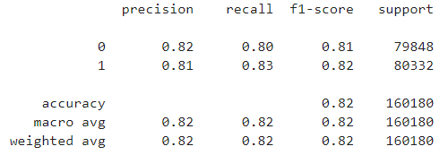
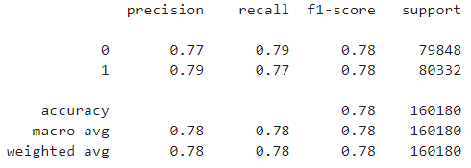
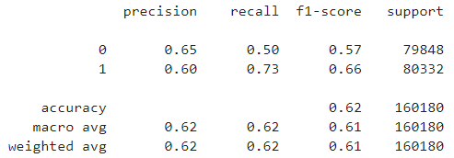
Results
SVM
SVM: Simple yet effective way of classifying a label/group (which in this case is positive or negative sentiment). Uses scikit-learn’s TfidfVectorizer to find word frequencies to highlight words that are more interesting (excluding stop words from nltk). SVM then draws a hyperplane based on this vectorized pre-labeled training data to differentiate between the two classes.
CNN w/ word2vec: word2vec model is simply a neural network with a single hidden layer that is designed to reconstruct the context of words by estimating the probability that a word is “close” to another word given as input. The word’s “meaning” becomes embedded in the weight learned by each neuron in the hidden layer of the network.
TextBlob: Linguistic researchers have labeled the sentiment of words based on their domain expertise. Sentiment of words can vary based on where it is in a sentence. The TextBlob module allows us to take advantage of these labels. TextBlod finds all the words and phrases that it can assign polarity and subjectivity to, and average all of them together
CNN w/ word2vec
TextBlob
Future study: LSTM

Slide 5
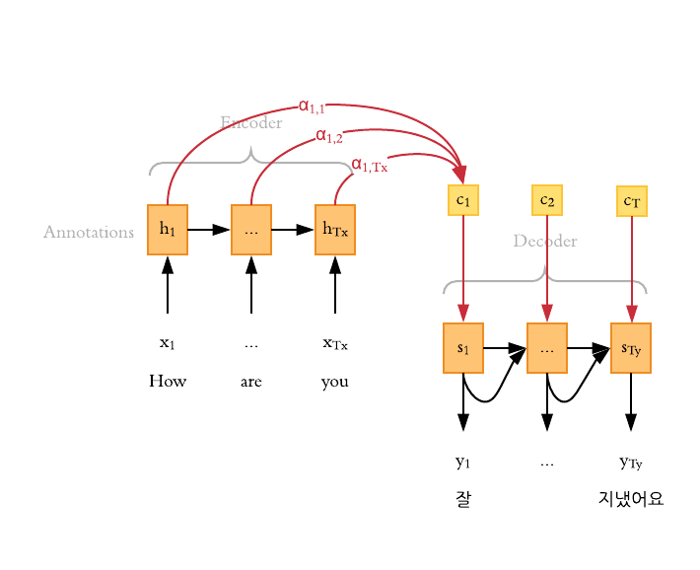
Future of NLP
Breakthrough of NLP: Attention Mechanism
Allowed for the creation of powerful language DL models:
Transformer
BERT and ERNIE 2.0
GPT-2 and GPT-3
How it works:
Each time the model predicts an output word, it only uses parts of an input where the most relevant information is concentrated instead of an entire sentence. In other words, it only pays attention to some input words.
Example to explore: here and here
Notes:
All GPT-3 models use the same attention-based architecture as their GPT-2 predecessor. The smallest GPT-3 model (125M) has 12 attention layers, each with 12x 64-dimension heads. The largest GPT-3 model (175B) uses 96 attention layers, each with 96x 128-dimension heads.
GPT-3 expanded the capacity of its GPT-2 by three orders of magnitudes without significant modification of the model architecture — just more layers, wider layers, and more data to train it on.

