Slide 1


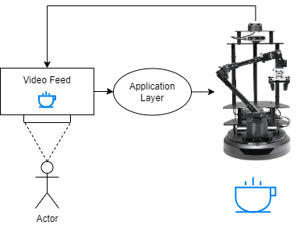

Robotic End Effector Navigation Via Eye Gaze
Future Student(s), Mentored by Dr. Lisa Milkowski
Department of Computer Science, Seattle University
Abstract
Methods/Experimental design
Results
The research aims to prototype a novel method of human-robot interaction, specifically focusing on controlling a robotic arm's end effector through intention inference via eye gaze tracking. This is motivated by a lack of accessible options for quadriplegics to realize self efficacy.
Copy and paste your text content here, adjusting the font size to fit.
Introduction
The functional goal of the research was to integrate real time eye tracking via a Tobii eye tracker with a Trossen robotic arm. The subject could then look at a video feed of what was in front of the robot and the software we developed would infer intention via gaze fixation and subsequently command the robots end effector to the location of the object. As a subsequent project we plan to work with Dr. Han in the mechanical engineering department to integrate soft robotics to grasp the object. The research challenge primarily consisted of two parts:
Developing a software layer in ROS2 that interfaces with the Trossen drivers, the Tobii API, and the eye gaze algorithm.
Adapting post-processing eye gaze analysis algorithms to work in real time.
Conclusion
Copy and paste your text content here, adjusting the font size to fit.
References
Journal Article, Name of Journal, etc.
Journal Article, Name of Journal
Journal Article, Name of Journal
Journal Article, Name of Journal
Github & Demo
Acknowledgements
This should include your funding source, mentors and/or anyone you’d like to acknowledge!

