Slide 1






VIDE GAME SALES EDA
WILLIAM BAAKLINI S34859

Slide 2


TABLE OF CONTENTS
Data Cleaning
Explorations
Modeling Regressors
Modeling Classificators
Clustering

Slide 3
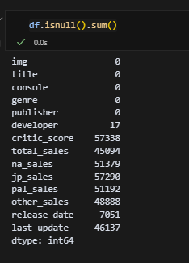
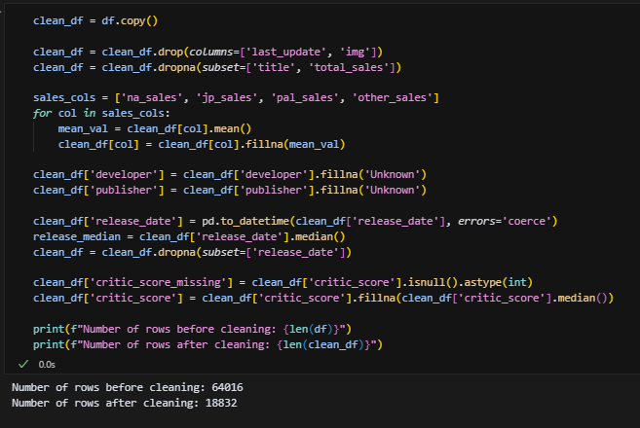

DATA CLEANING

Slide 4
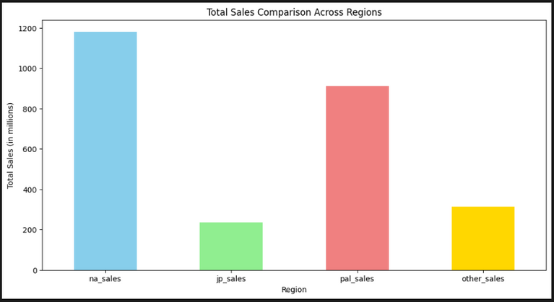


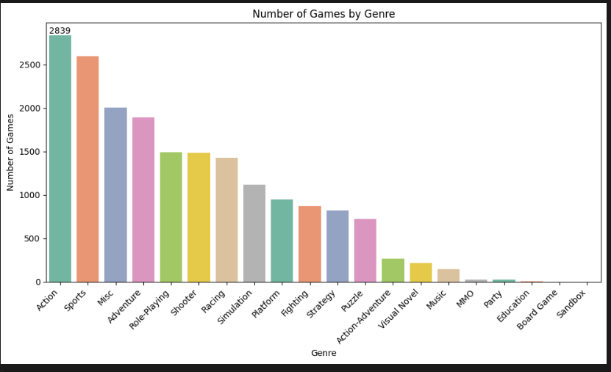
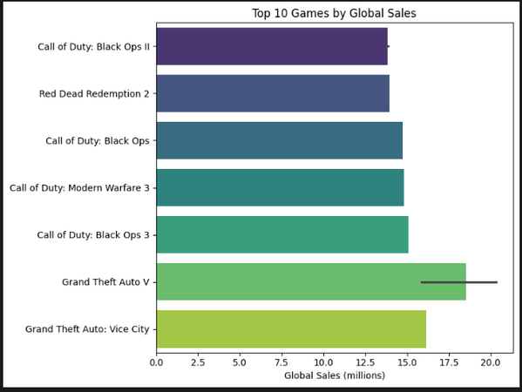
EXPLORATIONS

Slide 5
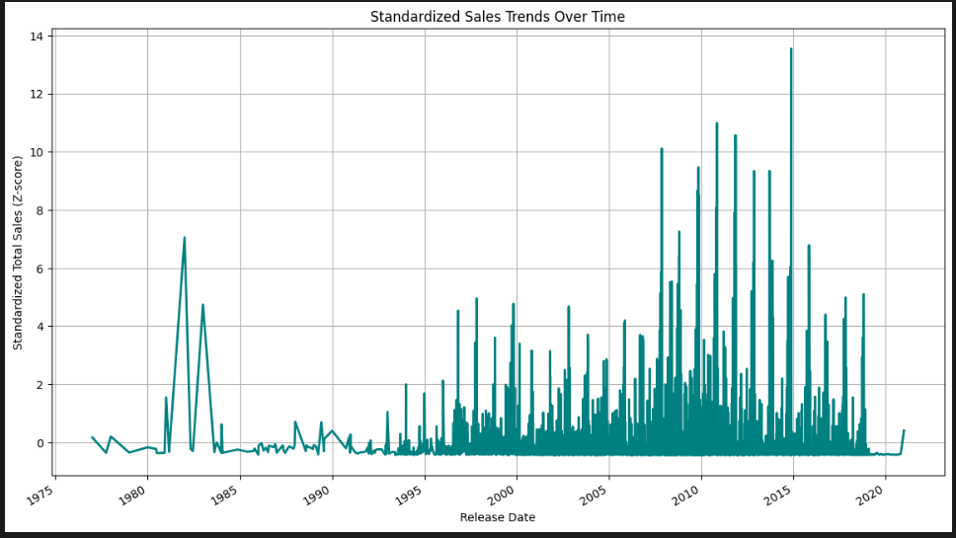
EXPLORATIONS

Slide 6
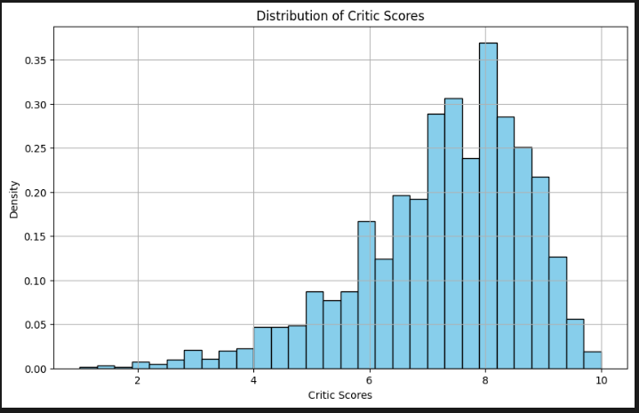
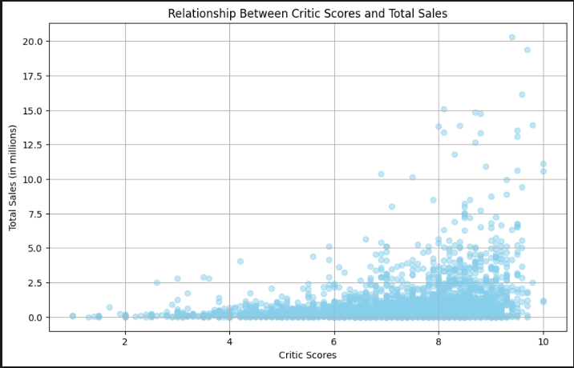
EXPLORATIONS

Slide 7
MODELING

Slide 8
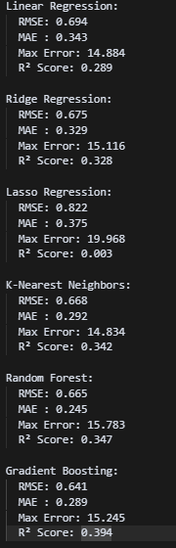

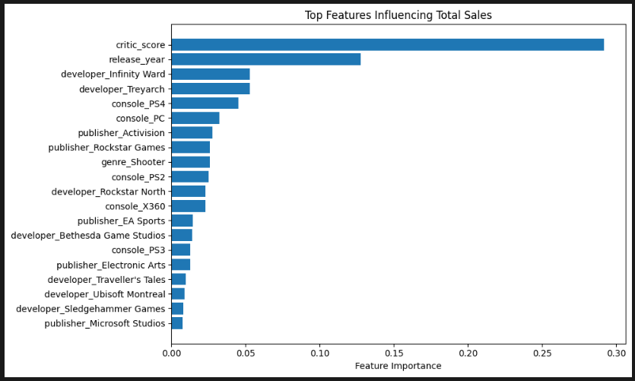
Regressors

Slide 9
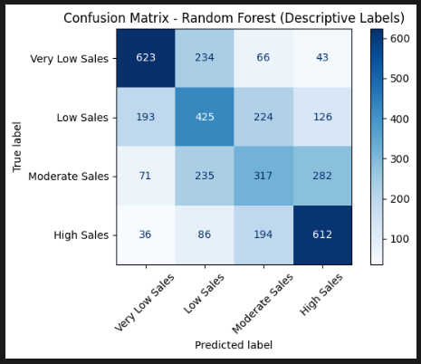
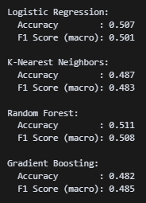
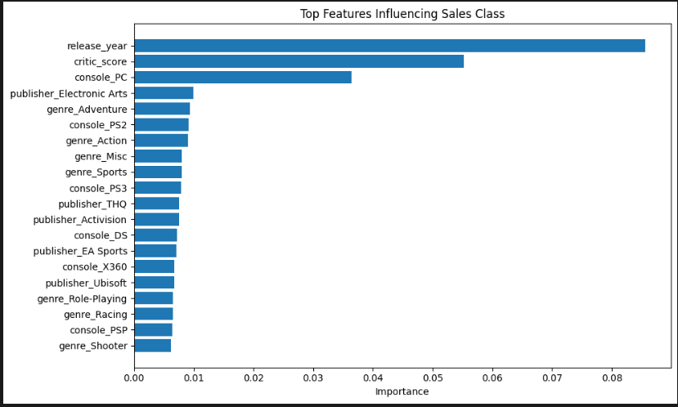


CLASSIFICATORS

Slide 10
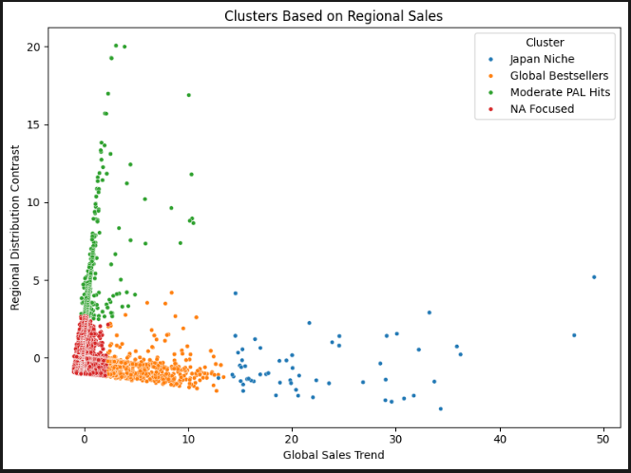
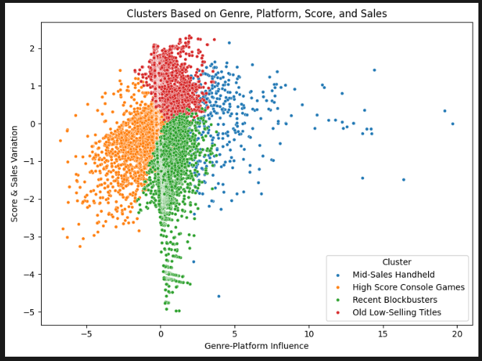

CLUSTERING
CLUSTERS GAMES BASED ON REGIONAL AND TOTAL SALES. KMEANS FINDS 4 GROUPS (E.G. NA-FOCUSED, GLOBAL HITS), PCA REDUCES DIMENSIONS, AND THE SCATTER PLOT VISUALIZES CLUSTER PATTERNS WITH READABLE LABELS.
CLUSTERING GAMES INTO 4 GROUPS USING GENRE, CONSOLE, CRITIC SCORE, RELEASE YEAR, AND SALES. PCA REDUCES FEATURES TO 2D, AND THE SCATTER PLOT SHOWS CLUSTERS WITH READABLE LABELS.

Slide 11


THANK YOU!
Any Questions?

