Slide 1
Model
r/lyftdrivers r/uberdrivers

Slide 2
Spacy pretrained multi-task CNN (en_core_web_md 2.2.5)
Vectorized post
Title +
text (body)
Spacy CNN

Slide 3
Cluster post vectors
Vectorized posts
Clusters
Clustering algo.
(Kmeans)

Slide 4
Interesting results
Cluster word clouds

Slide 5
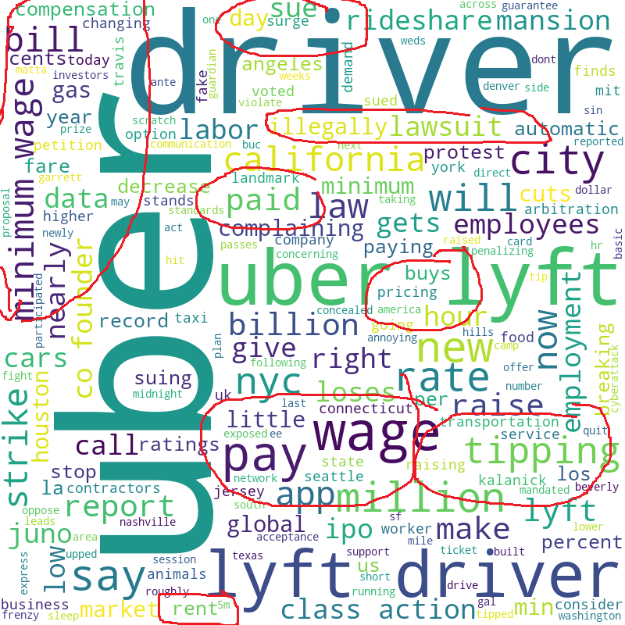

Slide 6
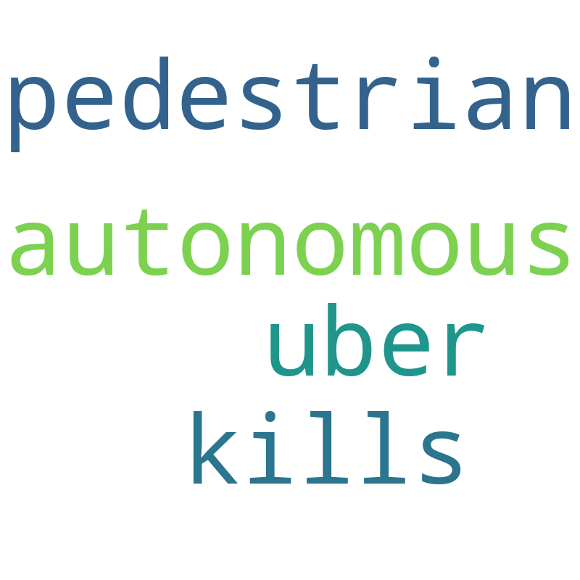

Slide 7
Query-posts proximity
Vectorized posts
15 closest posts to the query
Vectorized query (ex: car insurance)

Slide 8
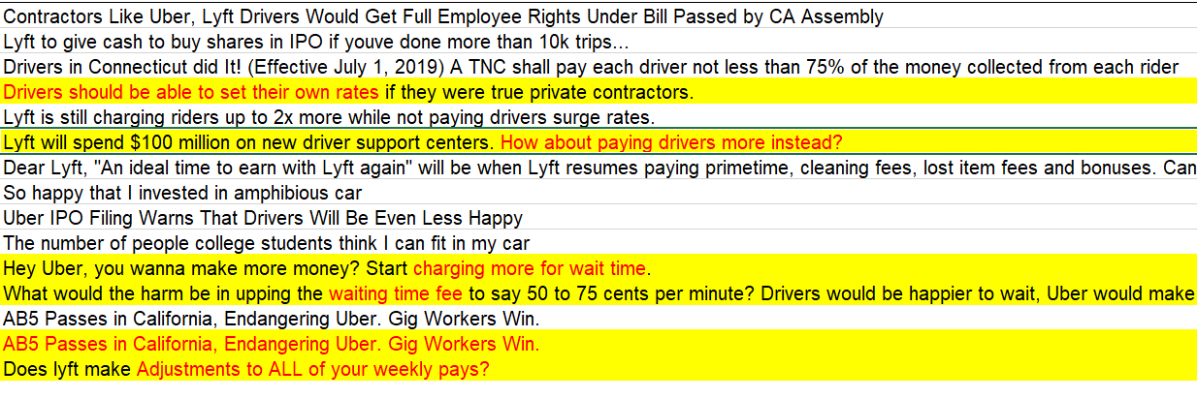
Query : Insurer

Slide 9
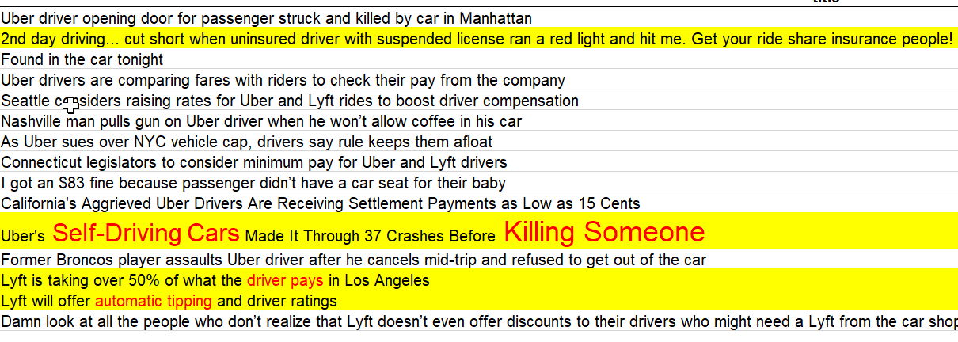
Query : car insurance

Slide 10
Conclusion
2 main « concerns » found
Money/wage and tipping
Fear of autonomous/ self-driving cars

Slide 13

Depression

Slide 14

Fun : Celebrations

Slide 15
Sentiment
Split post based on polarity of title + post text

