Slide 1

Stock Forecasting Model
——Eclipse Loom Forecast
Team J
Zhang Yanxiao 23222069
Zhou Zixuan 23271558
Zhang Zhenghan 23267925
Zeng Weiming 23267062
Zou Boyu 23258527
Cui Zexu 23259175

Slide 2
01.
Problem Statement
* Making Investments is a complicated procedure to process
While investors can identify target stock types and initial combinations, they lack clarity on two key dimensions of their investments:
1. Forward-looking Performance (e.g., expected returns)
2. Potential market shifts (e.g., sector volatility, macroeconomic events)
Our project aims to resolve these gaps by developing a Portfolio Return Prediction System

Slide 3
02.
Solution Overview
Data Sources
Feature Engineering
Prediction Models
Data Testing
Report & Email Delivery

Slide 4
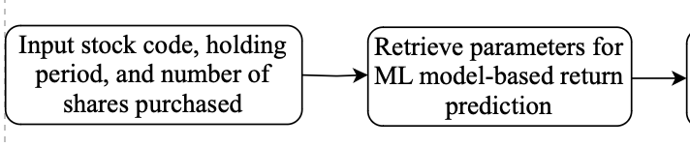
03.
Stock Forecasting – Preparation Stage
2. Data Source Extraction
1. User Inputs

Slide 5
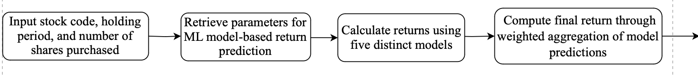
03.
Stock Forecasting – Processing Stage
3. Expected Returns Calculations & Predictions
(Through Machine Leaning Models)
Preparations

Slide 6
03.
Stock Forecasting – Output & Reporting Stage
4. Prediction Results Generation
& Financial Report Delivery
Preparations
Processing

Slide 7
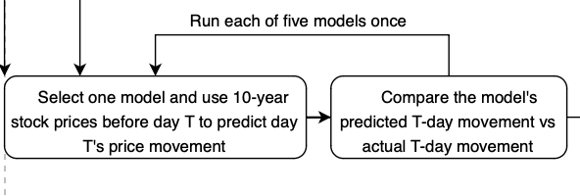
03.
Testing
We use “Back-Testing” to validate model performance:
1. Select T days back as an example
2. Use (10-year sources – T days sources) to train and predict the return on the T’s day (where index i = 0)
3. Compare the actual return with our predicted return
4. Increment i + 1

Slide 8
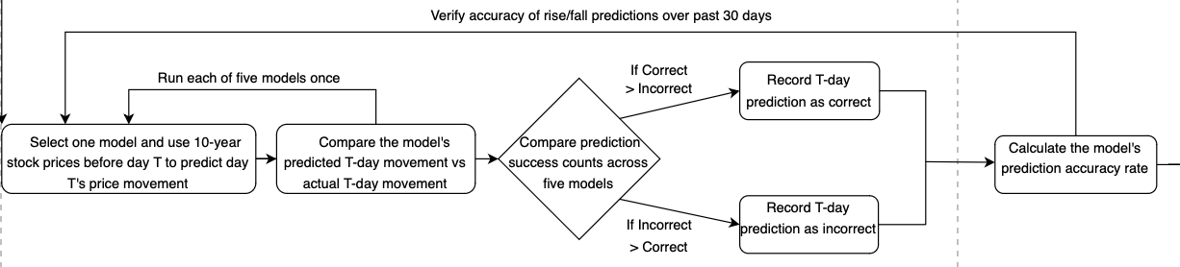
03.
Testing
Back-Testing Setup
Record the ratio of all correct predictions over the total number of comparisons to acquire the estimated prediction accuracy of our system. (one-stock-simulation)

Slide 9
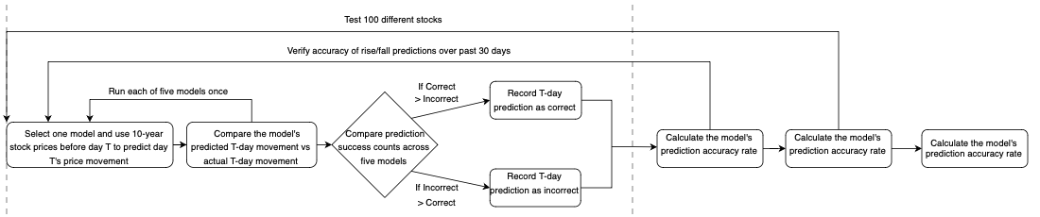
03.
Testing
Back-Testing Setup
Accuracy Rate (one-stock-simulation)
Do a hundred-stock-simulation to reduce randomness and get the final average prediction accuracy rate of our system

Slide 10
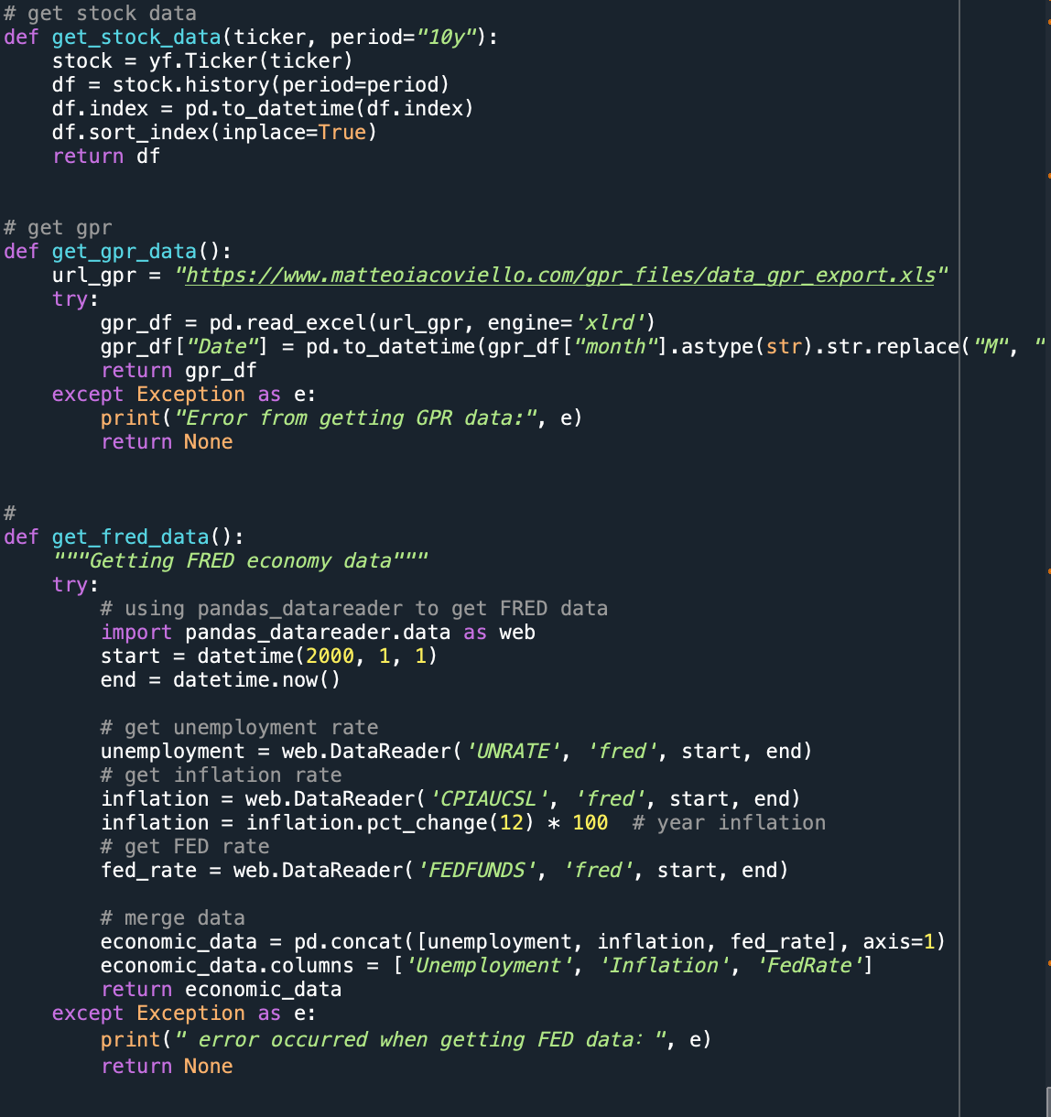
04.
Complex Logic Highlights – Retrieve Data
By using yfinance library to get real time stock data
Using a url and the excel reader to retrieve Geopolitical Risk (GPR) Index data
Import pandas_datareader .data library to read FRED economy data

Slide 11
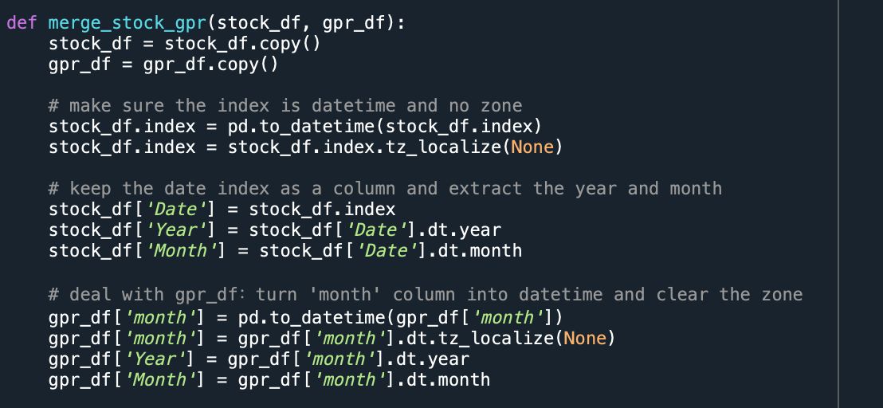
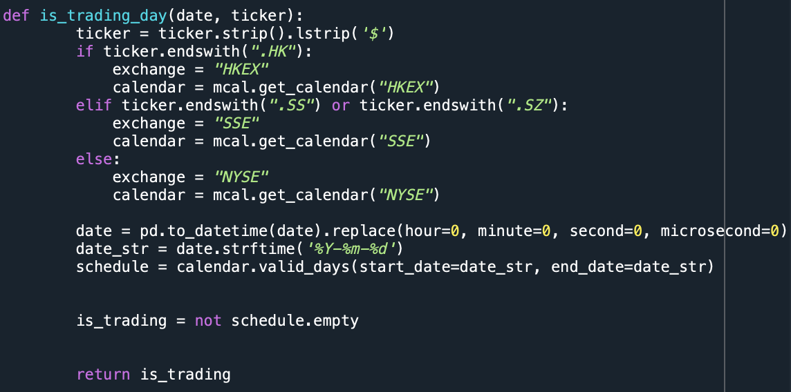
04.
Complex Logic Highlights – Check & Merge Data
Aligning different time formats and resampling data across varying frequencies (daily, monthly) requires robust data handling logic.
Import pandas_market_calendars library to check whether a given date is a valid trading day for a specific stock exchange

Slide 12
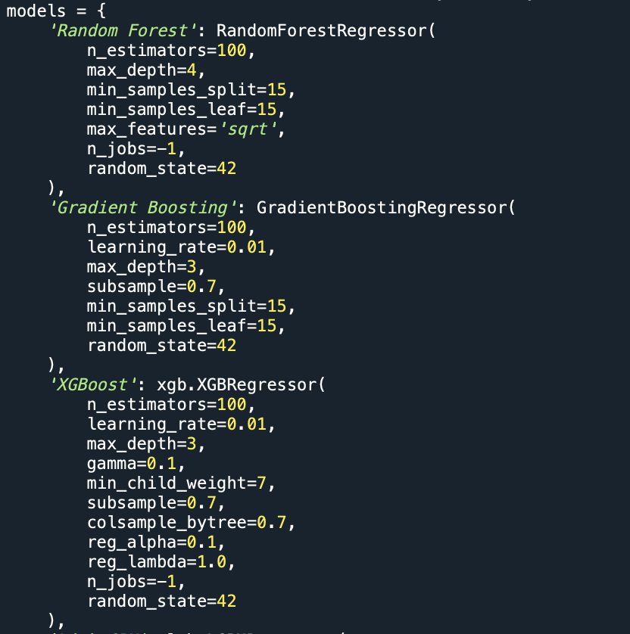
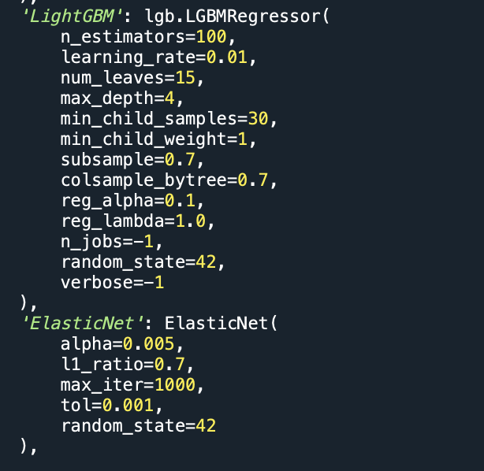
04.
Complex Logic Highlights – Train Models
Import five predictive model libraries from sklearn:
1. RandomForestRegressor
2. GradientBoostingRegressor
3. XGBoost
4. LightGBM
5. ElasticNet
to predict future returns

Slide 13
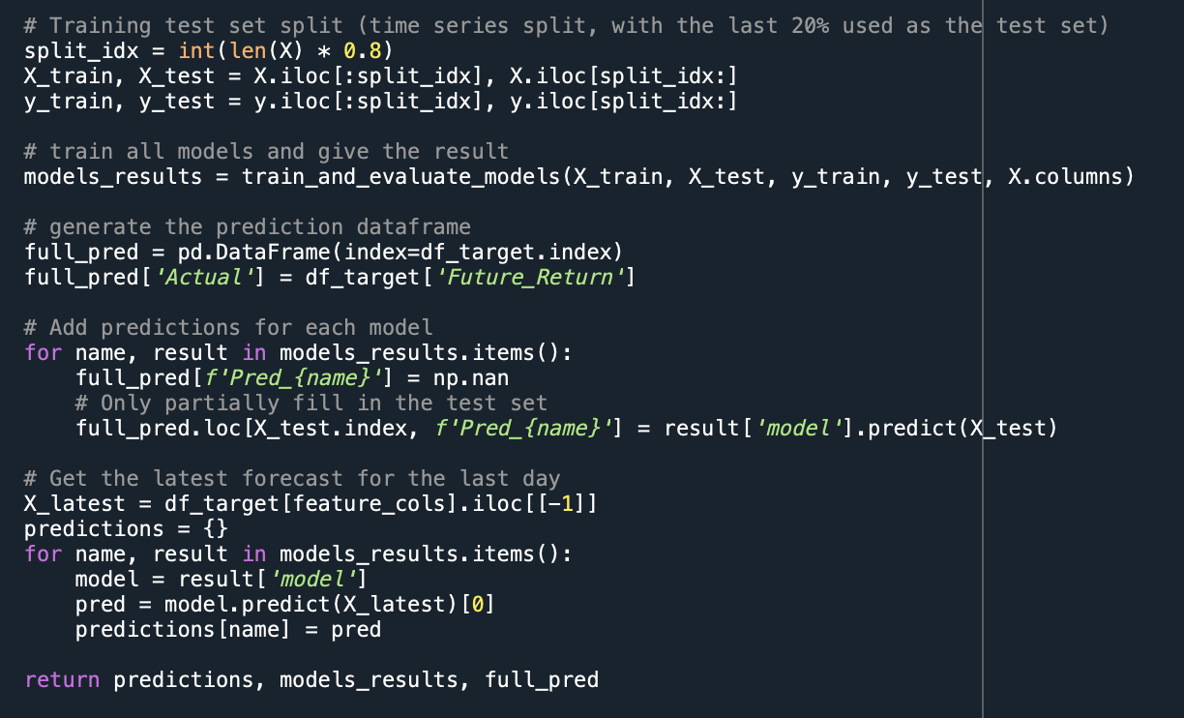
04.
Complex Logic Highlights – Prediction in Action
Split data into training set and test set (80%/20%)
Train all five predictive models
Extract the features of the last day as X_latest and let models use latest data to predict what will happen in the next N days

Slide 14
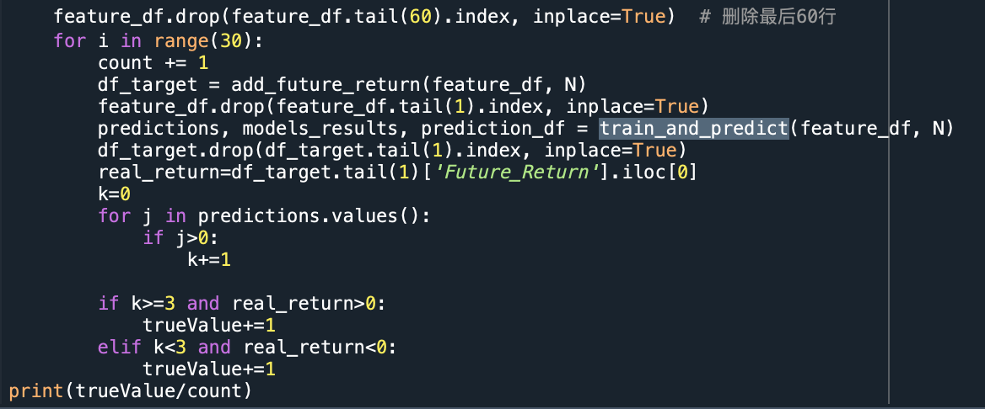
04.
Complex Logic Highlights – Testing
Reduce the impact of the recent tariff events
Compare the predicated returns with actual returns in the past 30 days and record the final accuracy ratio

Slide 15
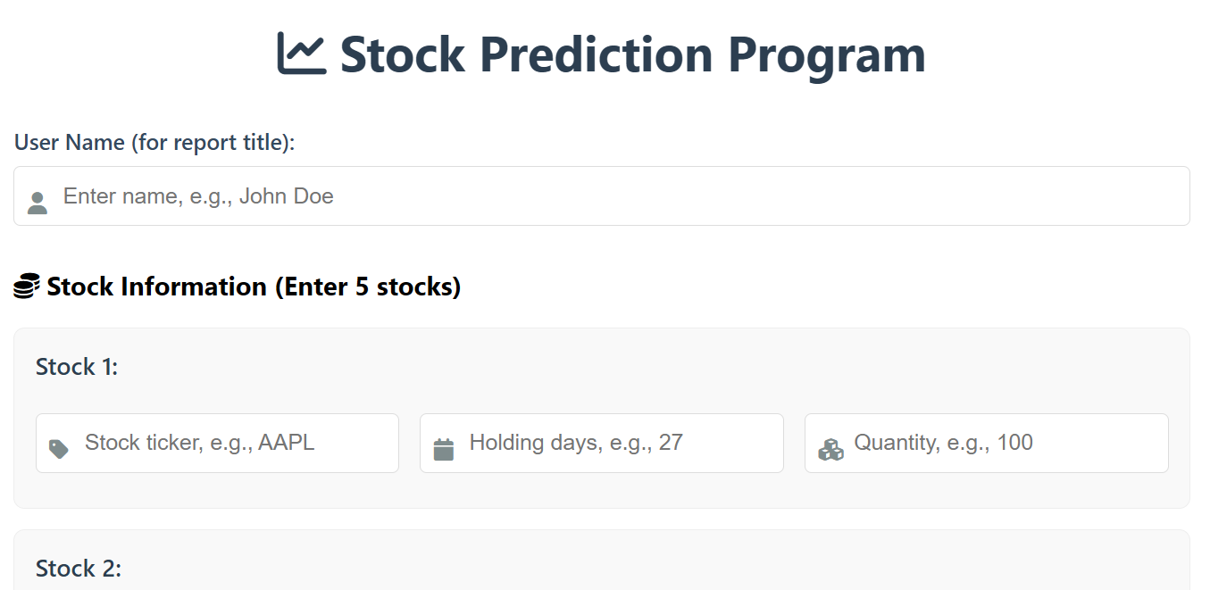
05.
Other Interesting Features
User Input Interface

Slide 16

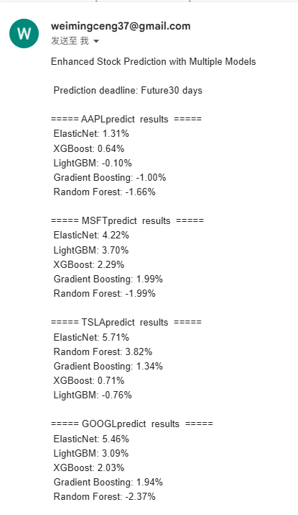
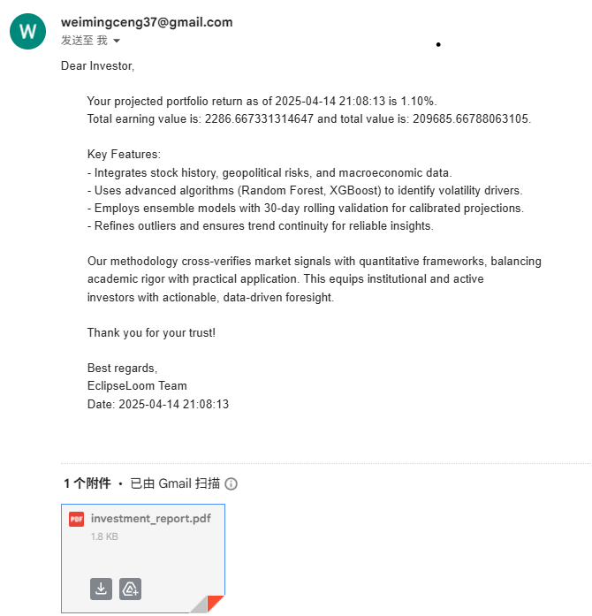

05.
Other Interesting Features
Results Delivery via Email
(with PDF attachment)

Slide 17
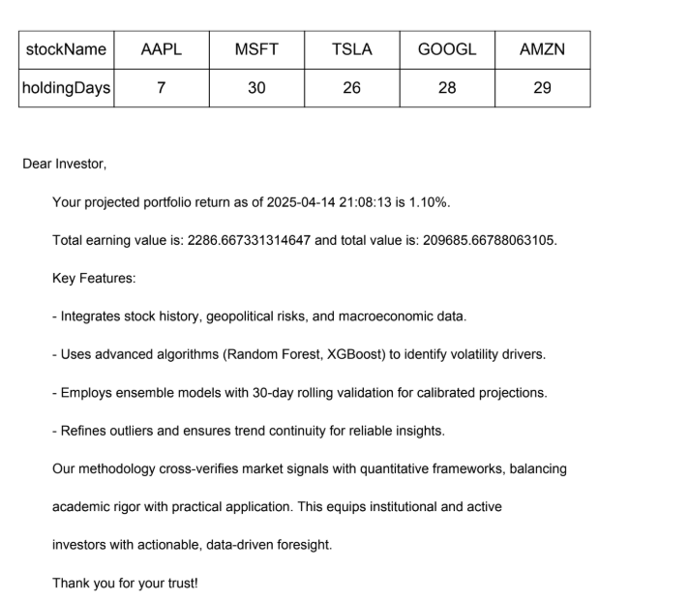
05.
Other Interesting Features
Input Stock Names & Holding Days
Predicted Portfolio Return Rate
Expected Earning Prices
Key Features Illustration
Predicted Portfolio Report

Slide 18
Demo

Slide 19

THANK YOU

