Slide 1
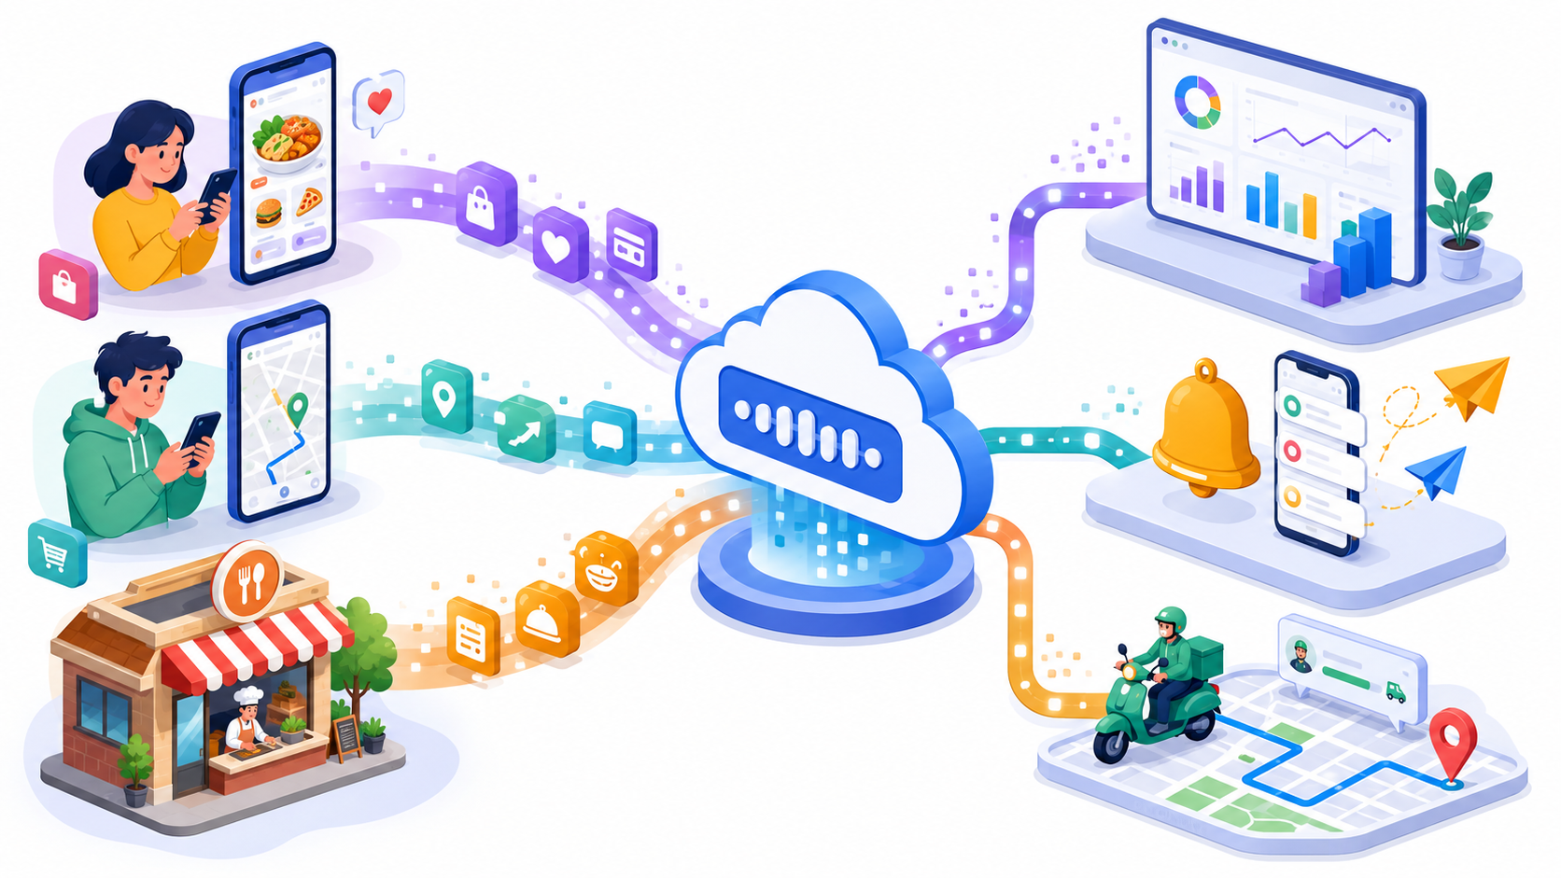
BEGINNER-FRIENDLY DATA ENGINEERING
Pub/Sub Messaging
Kafka vs Pub/Sub
Topics • Subscriptions • Push vs Pull • Real-world food delivery example
One event. Many consumers. Decoupled systems.
Notes:
- Module focus: publish/subscribe messaging pattern, Google Cloud Pub/Sub topic-subscription model, delivery options, and Kafka comparison. - Real-world anchor example: food delivery application. - Event used throughout: order placed, payment completed, rider assigned, delivery location updated. - Core idea: producer sends once; multiple downstream systems receive independently. - Outcome for freshers: identify topic, subscription, publisher, subscriber, push, pull, Kafka topic, partition, broker, consumer group. - Sources: Google Cloud Pub/Sub overview; Apache Kafka documentation and quickstart.

Slide 2
PROBLEM FIRST
Why messaging is needed
Without messaging, one application waits for every other application.
Payment
Food app
publishes event
Tightly coupled request chain
Loosely coupled event flow
Food app
Restaurant
Messaging layer
Payment
Rider
If any service is slow, the main app feels slow.
App publishes and moves on. Consumers process independently.
Restaurant
Analytics
Rider
Analytics
Pub/Sub Messaging • Kafka vs Pub/Sub
Notes:
- Problem: one application directly calling many services creates waiting, retries, failures, and tight dependency. - Food delivery example: order placement should not wait for analytics, notification, loyalty, and reporting systems. - Messaging layer receives an event and distributes it to interested systems. - Producer does not need to know how many consumers exist. - Consumers can be added later without changing the producer. - Beginner takeaway: messaging reduces coupling and absorbs traffic bursts.

Slide 3
REAL-WORLD SCENARIO
Food delivery event stream
One customer action triggers many downstream business actions.
💳
Payment checks
OrderPlaced event
🍳
Kitchen screen
🛵
Rider matching
🔔
Customer notification
📊
Analytics dashboard
The same event feeds multiple independent business flows.
Pub/Sub Messaging • Kafka vs Pub/Sub
Notes:
- Example event: OrderPlaced. - Event means something meaningful happened in the business. - Publisher: food app or order service. - Topic: order-events or food-orders. - Subscribers: payment, kitchen, rider matching, notification, analytics. - Every consumer focuses on its own responsibility. - The producer does not directly call each consumer. - This real-world example will be reused across Pub/Sub, push, pull, Kafka, and comparison slides.

Slide 4
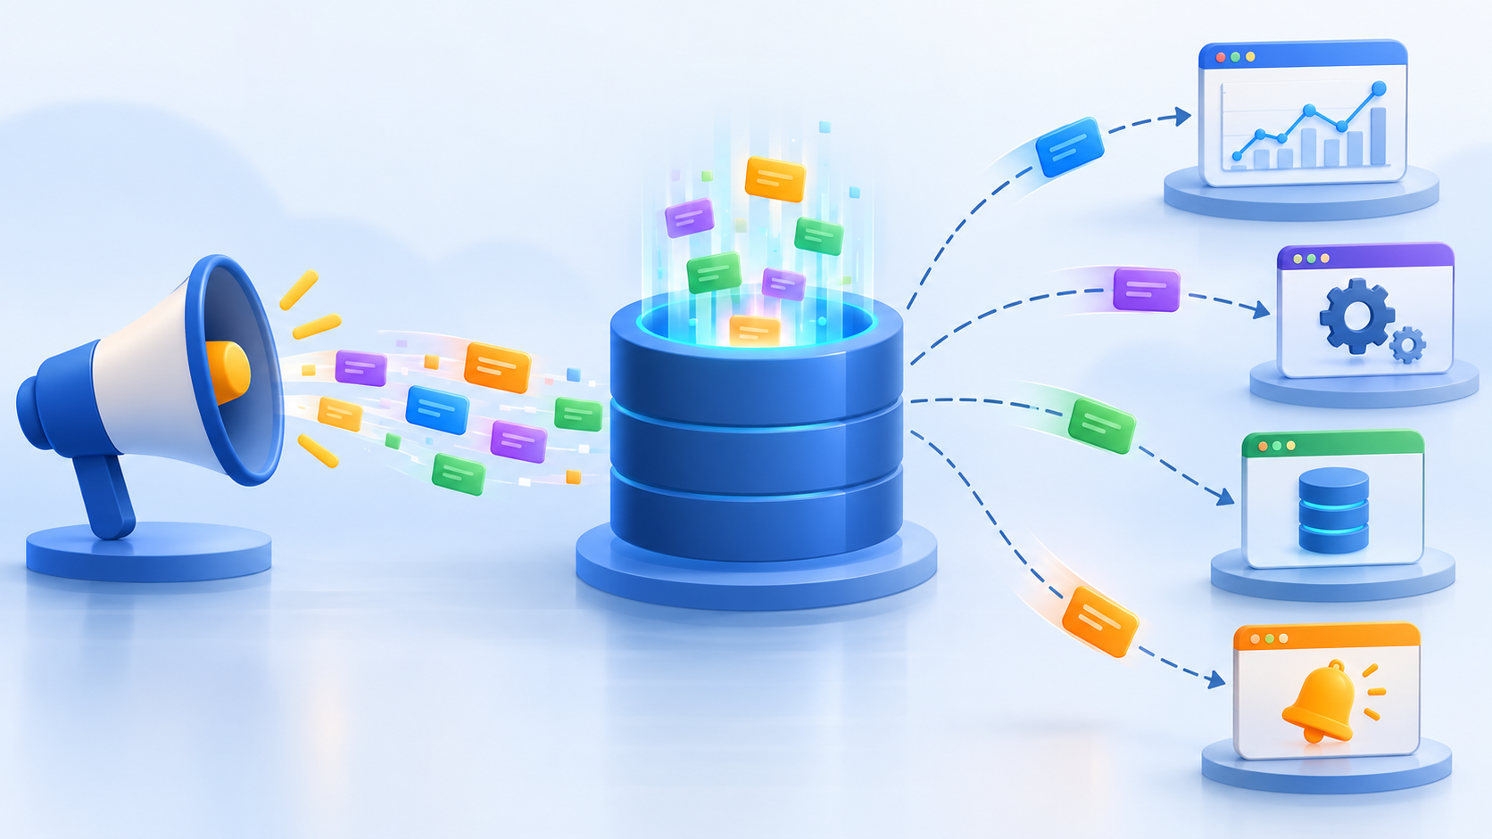
DEFINITION
Pub/Sub messaging in simple words
Publishers broadcast messages; subscribers receive messages asynchronously.
Publish
Broker / Service
Subscribe
Publisher does not wait for subscriber processing.
Pub/Sub Messaging • Kafka vs Pub/Sub
Notes:
- Pub/Sub = publish/subscribe messaging pattern. - Publisher creates and publishes a message to a topic. - Subscriber receives messages through a subscription. - Communication is asynchronous: producer and consumer do not need to run at the same speed. - Google Cloud Pub/Sub describes publishers and subscribers as communicating asynchronously by broadcasting events rather than synchronous remote procedure calls. - Example: order service publishes OrderPlaced once; payment, kitchen, notification, and analytics consume independently. - Good for event-driven systems, microservices integration, data pipelines, and real-time notifications.

Slide 5
BUILDING BLOCKS
Core roles in Pub/Sub messaging
Four simple parts explain most systems.
Publisher
creates event
Topic
named stream
Subscription
delivery path
Subscriber
processes event
Publisher
Topic
Subscription
Subscriber
Food app publishes OrderPlaced
food-orders collects related events
analytics-sub or notification-sub
analytics service, email service, mobile app
Pub/Sub Messaging • Kafka vs Pub/Sub
Notes:
- Publisher: source application that sends messages. - Topic: named channel or stream where messages are published. - Subscription: independent delivery configuration attached to a topic. - Subscriber: application that receives messages through the subscription. - A topic can have multiple subscriptions. - Each subscription receives its own copy of messages from the topic. - Example subscriptions for food-orders: payment-sub, kitchen-sub, rider-sub, analytics-sub.

Slide 6
TOPIC & SUBSCRIPTION
One topic, many subscriptions
Each subscription is a separate read path from the same topic.
payment-sub
Payment worker
food-orders
TOPIC
kitchen-sub
Kitchen display
Order service
publishes
rider-sub
Dispatch engine
analytics-sub
Dashboard job
Important: subscriptions are not consumers. They are delivery paths consumed by subscriber applications.
Pub/Sub Messaging • Kafka vs Pub/Sub
Notes:
- Topic stores the category of events: food-orders. - Subscriptions are attached to the topic. - A subscription represents one independent delivery path. - If the same message must go to payment, kitchen, dispatch, and analytics, create separate subscriptions. - Each subscription can have its own acknowledgment state. - Slow analytics does not block kitchen processing. - Google Cloud Pub/Sub supports topic and subscription resources as separate concepts.

Slide 7
MESSAGE LIFECYCLE
What happens to one message?
Publish → store → deliver → process → acknowledge.
1
2
3
4
5
Publish
Store
Deliver
Process
Ack
Order service sends JSON event
Messaging service records the message
Subscription makes it available
Subscriber runs business logic
Successful processing is confirmed
If no ack arrives, the system can redeliver according to delivery settings.
Pub/Sub Messaging • Kafka vs Pub/Sub
Notes:
- Message example: OrderPlaced. - Publish: producer sends message to topic. - Store: messaging layer keeps message durably based on service configuration. - Deliver: subscription exposes the message to a subscriber. - Process: subscriber updates payment, kitchen status, analytics, or notification. - Ack: subscriber confirms successful processing. - Without ack, Pub/Sub-style systems can redeliver messages. - Beginner point: acknowledgment is different from publishing; it belongs to consumption progress.

Slide 8
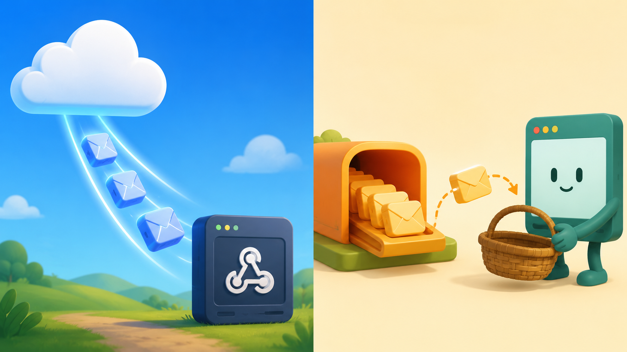
DELIVERY STYLES
Push vs pull delivery
The difference is who starts the delivery interaction.
Push: Pub/Sub calls subscriber endpoint
Pull: subscriber requests messages
Pub/Sub Messaging • Kafka vs Pub/Sub
Notes:
- Push and pull are subscription delivery models. - Push: Pub/Sub initiates the request to the subscriber application, commonly through an HTTPS endpoint or webhook. - Pull: subscriber client initiates requests to Pub/Sub to fetch messages. - Same topic can support different subscriptions with different delivery modes. - Food delivery example: push for webhook notification service; pull for analytics worker that wants controlled batch processing. - Google Cloud documentation defines push delivery as Pub/Sub initiating requests to the subscriber application. - Google Cloud documentation defines pull delivery as subscriber client requesting messages from the Pub/Sub server.

Slide 9
PULL DELIVERY
Pull delivery: consumer controls the pace
Subscriber asks for messages when it is ready.
Pub/Sub service
food-orders topic
Pull request
Analytics worker
subscriber
Messages + ack IDs
Ack after processing
Best fit
Main benefit
Example
Batch jobs, analytics, workers, controlled throughput
Subscriber can slow down or speed up
Dashboard job pulls 100 order events at a time
Pub/Sub Messaging • Kafka vs Pub/Sub
Notes:
- Pull delivery: subscriber asks for available messages. - Subscriber controls rate, batch size, worker scaling, and retry behavior more directly. - Useful for background workers, analytics pipelines, batch processors, and systems without public HTTPS endpoints. - Processing sequence: pull request, receive message and ack ID, process message, acknowledge. - Example: analytics worker pulls food-order messages every few seconds and updates dashboards. - Fresher comparison: pull is like collecting parcels from a pickup counter when ready.

Slide 10
PUSH DELIVERY
Push delivery: service calls your endpoint
Pub/Sub sends messages to a reachable HTTPS endpoint.
Pub/Sub service
food-orders topic
Webhook / Cloud Run
notification API
HTTPS POST with message
2xx response = success
Best fit
Main benefit
Example
Webhooks, serverless APIs, low-latency notification flow
Less polling code inside subscriber application
Send mobile notification after order status changes
Pub/Sub Messaging • Kafka vs Pub/Sub
Notes:
- Push delivery: Pub/Sub sends each message to subscriber endpoint. - Endpoint must be reachable by Pub/Sub, typically HTTPS. - Subscriber acknowledges by returning a successful HTTP response. - Useful for webhook-style integrations and serverless applications. - Example: order-status topic pushes to notification service when rider is assigned. - Freshers: push is like courier delivery to your door. - Consider endpoint security, authentication, retry behavior, and idempotent processing.

Slide 11
CHOOSING DELIVERY
Push vs pull: quick decision guide
Choose based on who should control timing and scaling.
Question
Push
Pull
Who starts delivery?
Pub/Sub service
Subscriber application
Subscriber endpoint?
Public/reachable HTTPS endpoint needed
No public endpoint required
Good example
Order notification webhook
Analytics batch worker
Control over pace
Service pushes to endpoint
Worker controls request rate
Fresh analogy
Courier comes to door
You collect from counter
Pub/Sub Messaging • Kafka vs Pub/Sub
Notes:
- Push and pull are both valid; choice depends on architecture. - Push: best when application exposes a stable HTTPS endpoint and wants event delivery initiated by Pub/Sub. - Pull: best when subscriber controls throughput, batching, worker concurrency, and timing. - Food delivery push example: notification service receives status changes immediately. - Food delivery pull example: data pipeline pulls order events in batches for reporting. - Neither is universally better; the use case decides.

Slide 12
RELIABILITY
Acknowledgment, retry, and duplicates
Messaging systems aim for reliable delivery; applications must handle repeats.
Message received
Process business logic
Ack success
No ack / error
redelivery possible
Design subscribers to be idempotent: processing the same order event twice should not double-charge or double-notify.
Pub/Sub Messaging • Kafka vs Pub/Sub
Notes:
- Ack confirms successful message processing. - If subscriber crashes before ack, message can appear again. - Duplicate handling is part of good consumer design. - Idempotent processing means repeated event processing produces the same final result. - Example: payment service checks order_id before charging; notification service checks message_id before sending duplicate SMS. - Retry is useful but can amplify bugs if consumers are not safe for duplicates. - Dead-letter queues are often used when messages repeatedly fail processing.

Slide 13
KAFKA FOUNDATION
Kafka as an event streaming platform
Kafka stores event streams durably and lets consumers read them.
Kafka broker cluster
Partition 0
Consumer group
Producer
Partition 1
Partition 2
Kafka clients communicate with brokers over the network. Brokers store events in topics for the configured retention period.
Pub/Sub Messaging • Kafka vs Pub/Sub
Notes:
- Kafka is a distributed event streaming platform. - Producers write events to topics. - Brokers store events and serve client requests. - Topics are split into partitions. - Consumers read events from topics, often in consumer groups. - Kafka quickstart describes Kafka as letting applications read, write, store, and process events across machines. - Food delivery example: order-service writes to food-orders topic; analytics and dispatch consumers read from it.

Slide 14
KAFKA INTERNALS
Topic, partition, broker, consumer group
Kafka scales by splitting topics into partitions and assigning them to consumers.
food-orders topic
Broker 1
Consumer group: analytics
P0 offsets 0,1,2...
Consumer A
reads P0
Broker 2
Consumer B
reads P1
P1 offsets 0,1,2...
Broker 3
Consumer C
reads P2
P2 offsets 0,1,2...
One partition is processed by one consumer inside the same group at a time.
Pub/Sub Messaging • Kafka vs Pub/Sub
Notes:
- Kafka topic is divided into partitions. - Partition is the unit of ordering and parallelism. - Broker stores partitions and serves reads/writes. - Consumer group divides partitions among group members. - A consumer group allows parallel processing while preserving per-partition order. - Apache Kafka documentation describes topics as partitioned across brokers. - Food delivery example: REST-01 events can be keyed to a partition for ordered processing by restaurant.

Slide 15
SAME EXAMPLE
Kafka flow for food orders
Producer writes events; broker stores them; consumers read at their own pace.
Analytics group
Kafka topic
food-orders
P0: OrderPlaced
offset 0
Dispatch group
Order service
Producer
P1: OrderPlaced
offset 1
P2: OrderPlaced
offset 2
Notification group
Fraud group
Kafka retains events; new consumers can read historical data if retention allows.
Pub/Sub Messaging • Kafka vs Pub/Sub
Notes:
- Producer writes OrderPlaced events to Kafka topic food-orders. - Kafka broker appends the event to a partition and assigns an offset. - Multiple consumer groups can read the same topic independently. - Analytics, dispatch, notification, and fraud can each keep their own offsets. - Kafka is strong when applications need durable ordered streams and replay within retention. - Example: analytics group can reprocess yesterday's order stream if messages are retained.

Slide 16
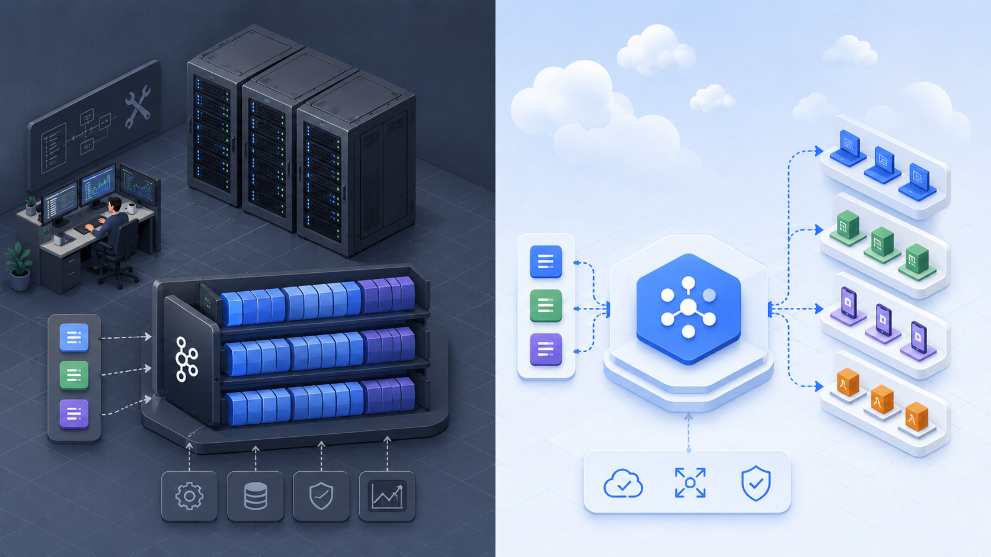
COMPARISON
Kafka vs Pub/Sub
Both move events, but the operating model is different.
Kafka
Pub/Sub
Self-managed or managed clusters
Topics + partitions + brokers
Strong stream processing ecosystem
Cloud-managed messaging service
Topics + subscriptions
Push/pull delivery options
Pub/Sub Messaging • Kafka vs Pub/Sub
Notes:
- Kafka and Pub/Sub both support event-driven communication. - Kafka model: producers, topics, partitions, brokers, consumer groups, offsets. - Pub/Sub model: publishers, topics, subscriptions, subscribers, acknowledgments. - Kafka gives more control over partitions, brokers, retention strategy, and stream-processing architecture. - Pub/Sub reduces infrastructure operations because it is a cloud-managed service. - Kafka often appears in platform engineering and self-managed or managed streaming ecosystems. - Pub/Sub fits Google Cloud-native asynchronous application integration and event distribution.

Slide 17
DECISION MATRIX
How to choose: Kafka or Pub/Sub?
Map the tool to the responsibility your team wants to own.
Need / Question
Kafka
Pub/Sub
Team wants deep control over partitions, brokers, retention
Strong fit
Less direct control
Google Cloud-native app integration
Possible with managed options
Strong fit
Webhook push delivery
Needs extra services/connectors
Built-in push subscription
Simple event fanout with low ops
More operational responsibility
Strong fit
Stream processing ecosystem
Very strong ecosystem
Works with cloud data services
Beginner mental model
Distributed commit log
Managed message delivery service
Pub/Sub Messaging • Kafka vs Pub/Sub
Notes:
- Use Kafka when stream architecture needs partition control, offset management, replay patterns, ecosystem integrations, or self-managed platform control. - Use Pub/Sub when building cloud-native event fanout with less operational setup, especially in Google Cloud. - For freshers: Kafka feels like a durable event log; Pub/Sub feels like a managed delivery layer. - Both can be correct for food delivery; decision depends on cloud platform, team skills, operations, integration needs, and retention/replay requirements. - Avoid choosing only by popularity; choose by requirements.

Slide 18
TRAINER RECAP
Interview-ready recap
The minimum vocabulary every fresher should remember.
1
Pub/Sub messaging
2
Topic
Producer publishes once; many subscribers can receive independently.
Named stream/channel for related messages.
3
Subscription
4
Push
Independent delivery path from a topic to a subscriber.
Service delivers to subscriber endpoint.
5
Pull
6
Kafka
Subscriber asks for messages when ready.
Distributed event log with topics, partitions, brokers, and consumer groups.
One food-order event can trigger payment, kitchen, dispatch, notification, and analytics without direct service-to-service dependency.
Pub/Sub Messaging • Kafka vs Pub/Sub
Notes:
- Pub/Sub is a communication pattern that decouples producers and consumers. - Topic is the place where events are published. - Subscription is the independent route by which a subscriber receives messages. - Push: messaging service calls the subscriber endpoint. - Pull: subscriber requests messages from the messaging service. - Kafka: event streaming platform based on topics, partitions, brokers, offsets, and consumer groups. - Strong fresher explanation: order service publishes OrderPlaced; every downstream system receives through its own mechanism without changing the order service.

Slide 19
REFERENCES
Reference sources
Official sources used for presenter notes and terminology.
1
Google Cloud Pub/Sub overview
Publishers and subscribers communicate asynchronously through events.
2
Google Cloud Pub/Sub push subscriptions
Push delivery initiates requests to subscriber application endpoints.
3
Google Cloud Pub/Sub pull subscriptions
Pull delivery lets subscriber clients request messages from Pub/Sub.
4
Apache Kafka documentation and quickstart
Kafka reads, writes, stores, and processes events; topics are partitioned.
5
Apache Kafka KRaft and design documentation
Broker/controller roles, partitions, offsets, and consumer groups.
Deck designed for fresher-level explanation using the food delivery event-stream scenario.
Pub/Sub Messaging • Kafka vs Pub/Sub
Notes:
- Sources used: Google Cloud Pub/Sub overview, Google Cloud Pub/Sub push subscription documentation, Google Cloud Pub/Sub pull subscription documentation, Apache Kafka documentation, Apache Kafka quickstart, Apache Kafka KRaft/design pages. - Important source-backed points: Pub/Sub asynchronous publisher/subscriber communication; push delivery initiated by Pub/Sub; pull delivery initiated by subscriber client; Kafka topics are partitioned; Kafka brokers store events and consumers read them. - Reference slide included for transparency.

