Slide 1
Using Python with Data

Slide 2
Outline
NumPy
Pandas
MatPlotLib

Slide 3

NumPy

Slide 4
NumPy
NumPy (Numerical Python) is a foundational library for scientific computing
Install via PIP: pip install numpy
Conventionally imported as np: import numpy as np
Core data structure: ndarray (n-dimensional array)
Arrays are faster and more memory-efficient than Python lists for numeric data
Provides a large library of mathematical functions: np.sqrt(), np.mean(), np.sum(), etc.
Supports multi-dimensional arrays
Foundational library that many others (pandas, Matplotlib, TensorFlow, etc…) are built on
Essential for data science, machine learning, image processing and scientific computing.

Slide 5
Common NumPy Methods – Array Creation
Method | Description | Example
np.array(a) | Creates an ndarray from a Python list or tuple | np.array( [1,2], [3,4])
np.zeroes(shape) np.ones(shape) np.full(shape) | Creates an array of the given size, pre-filled with a value (zeroes, ones, or given value) | np.zeroes((2,3)) np.ones((2,4)) np.full((2,2),5)
np.arange(start, stop, step) | Creates an array of evenly spaced values within a given interval | np.arrange(1, 10, 2) # 1, 3, 5, 7, 9
np.empty(shape, dtype) | Creates an array of a given shape, without initializing items | np.empty(2,2) # 2x2 array of arbitrary values
np.linspace(start, stop, num) | Creates an array of num evenly spaced numbers over a specified interval | np.linspace(0, 1, 5) # [0.0,0.25,0.5,0.75,1.0]
np.fromstring(string, sep=‘’) | Creates an array from a string of values, separated by a delimiter. The sep argument is required for text string. | np.fromstring(‘1 2 3’, dtype=int, sep=‘ ‘) # [1, 2, 3]
Note: This list assumes we use ‘np’ as the alias for the numpy import. i.e. import numpy as np
More information can be found here:

Slide 6
Common NumPy Methods – Array Properties & Manipulation
For these examples, lets assume we have an array that looks like this:
arr = np.array([
[1, 2, 3],
[4, 5, 6]
])
Method | Description | Example
np.split(arr, sections) | Splits an array into multiple sub-arrays. | np.split(arr, 2) # [array([1,2,3]), array([4,5,6])]
np.asarray(arr) | Converts an input (list, ,tuple, or existing array) to an array. | np.asarray([1,2,3]) # new 1x3 array
np.reshape() | Returns an array with the same data, but a new shape. The total number of elements must remain the same | np.reshape(arr, (3,2)) # array with 3 rows and 2 columns
np.size(arr, axis) | Returns the total number of elements in an array, if axis is specified, returns the size along that axis only | np.size(arr) # 6 np.size(arr,0) # 2
np.shape(arr) | Returns the dimensions of an array as a tuple of integers. For a 2D array, returns (rows, columns) | np.shape(arr) # (2,3)
arr.dtype | A property of NumPy array objects which return the data type of an array’s elements. | arr.dtype # int64 (or float64)

Slide 7
Common NumPy Methods - Statistics
Method | Description
mean(a, axis=None) | Calculates the arithmetic mean (average) of all elements of the given array. If axis is specified, the mean is computed along that axis only.
sum(a, axis=None) | Calculates the sum of all elements of an array. If an axis is specified, calculated sum across axis.
min(a, axis=None) and max(a, axis=None) | Returns the minimum / maximum value in an array. If axis is specified, returns the minimum along that axis
std(a, axis=None) | Calculates the standard deviation of all elements (a measure of how spread-out values are from the mean). If an axis is specified, calculates only across that axis.
median(a, axis=None) | Returns the median value (the middle value when an array is sorted). If an axis is provided, only returns the median across that axis.
percentile(a, q, axis=None) | Returns the value at the qth percentile of an array. Q can be a single value or a list of percentiles.
Note: This list assumes we use ‘np’ as the alias for the numpy import. i.e. import numpy as np
Note: This is not a full list of available methods

Slide 8
Pandas

Slide 9
Pandas – Intro
Powerful open-source data analysis and manipulation library.
Name is derived from ‘Panel Data’.
Built on top of NumPy
Install via PIP: pip install pandas
Conventionally, imported using ‘pd’ alias: import pandas as pd
Core data structures: Series (1D) and DataFrame (2D)
A series represents a single column or row of data
A DataFrame is a table of data with labelled rows and columns
Pandas is widely used in data science, analytics, finances and machine learning pipelines

Slide 10
Pandas – DataFrames & Series
A Series is a one-dimensional labelled array. It has both values and an index
A DataFrame is a two-dimensional table of rows and columns (think of it as a collection of Series sharing a common index)
Every column in a DataFrame is a Series; every row can also be accessed as a Series.
The index is the row label (integer starting at 0 by default). The row label can be set to a meaningful name
Columns are accessed using bracket notation or dot notation
Note: dot notation does not work with multi-word column names. Bracket notation is preferred

Slide 11
Pandas – DataFrames & Series
Selecting multiple columns returns a DataFrame, selecting a single column returns a Series
Rows are selecting using .loc[] (location based) or iloc[] (position-based)
A boolean mask is a series of True/False values used to filter rows
The dtype of a column determines what operations are available. Common types include:
Int64, float64, object (string), bool, and datetime
DataFrames can be constructed from dictionaries, lists of dictionaries, CSV files, JSON files or other sources.

Slide 12
Pandas – Reading & Writing CSV
Pandas reads CSV files using pd.read_csv(). This is one of the most commonly used functions in this library.
The result of this function is always a DataFrame
Note: CSVs are human-readable and universally supported (no data typing) – pandas infers the dtypes on load
pd.read_csv() has a large number of optional parameters to handle real-world messiness (rarely is a CSV perfectly clean out of the box)
Common parameters: sep (delimiter), header (row to use as column names), index_col (column to use as index), usecols (select specific columns), dtype (force column types), na_values (define what counts as null)

Slide 13
Pandas – Reading & Writing CSV (cont)
nrows and skiprows are useful for inspecting or skipping portions of very large files
parse_dates can instruct pandas to interpret a column as a datetime on load (this saves a conversion step later)
DataFrames can be written to a CSV using df.to_csv()
Note: index=False is almost always passed to to_csv(), without it, the DataFrame index is written as an extra column.
For large files, chunksize allows reading in chunks, rather than loading the entire file into memory at once

Slide 14
Pandas – Reading & Writing JSON
Pandas reads JSON using pd.read_json() and writes using df.to_json()
JSON is more flexible than CSV, but more complex, the structure can vary significantly between sources
The orient parameter is the most important when reading and writing json. It informs pandas how the JSON is structured
Common orient values:
Records: list of row objects
Columns: dict of column arrays
Index: dict of row dicts, with index as top-level keys
Split: separate keys for index, columns and data
“Records” is the most common format encountered in the wild (what most REST APIs return)
Each element is an object representing one row of data

Slide 15
Pandas – Reading & Writing JSON (cont)
Nested JSON (objects within objects) are not automatically flattened, you must call pd.json_normalize() on it.
pd.json_normalize() handles nested structured with record_path and meta parameters for deeply nested data.
JSON preserves more type information than CSV, numbers and booleans are types, but dates area still stored as strings or timestampes
JSON is larger on disk than CSV for the same data, so typically you don’t want to keep your data as raw JSON (read JSON, write to CSV or other type – normalization & cleaning data is important!)

Slide 16
Pandas – Reading and Writing Parquet Files
Parquet is a columnar storage format – data is stored column-by-column, rather than row-by-row.
It was designed by Apache for the Hadoop ecosystem; and is now the defector standard for data storage at large.
Pandas reads parquet using pd.read_parquet() and writes using df.to_parquet()
Unlike CSV and JSON, Parquet preserves dtype information – column types are stored in the file’s schema and restored exactly on read
Parquet files are typically much smaller than equivalent CSVs due to built-in compression
Reading only the columns you need is highly efficient – unneeded columns are never read from disk
Parquet is the native storage format of most modern data platforms: AWS S3 + Athena, Google BigQuery, Databrickes, Apache Spark

Slide 17
Pandas – Summary Statistics & Exploration
The first step when a new dataset arrives is always exploration.
Before performing operations, you should understand the shape, types, and quality of the data.
Df Method/Attribute | Purpose
df.shape | Get a tuple of rows, columns to understand the size of the dataset
df.info() | Get a concise summary of the dataset (column, names, non-null counts, dtypes) to understand the data at a high-level
df.describe() | Get summary statistics for all numeric columns, count, mean, standard deviation, min, max, quartiles
df.head(n) | df.tail(n) | Return the first n or last n rows
df.value_counts() | Get the frequency of each unique value in a Series – important to understand categorical columns
df.nunique() | Understand the number of distinct values/column
df.isnull().sum() | Count of null values per column (initial check for data quality)
df.sample(n) | Randomly select n rows – less biased look at rows than than head() or tail()

Slide 18
Pandas – Cleaning & Preparing Data
Cleaning data is rarely glamorous, but is one of the most critical skills in a Data Engineer’s toolkit
If we take garbage data in, we will get garbage data out
Df Method/Attribute | Purpose
df.isnull() | df.notnull() | Get a Boolean mask to filter null or non-null values
df.dropna() | Removes rows/columns containing nulls
df.fillna() Ffill | bfill | Fills null values with a specified value, can use forward fill (ffill) or backward fill (bfill) strategies
df.astype() | Converts a column to a specified type
df.rename() | Renames columns – accepts a dictionary mapping old names to new names
df.drop_duplicates() | Removes duplicate rows
df.drop() | Removes specified rows or columns
df.replace() | Replaces specific values across a column or entire DataFrame
df.clip() | Caps values at a specified minimum or maximum

Slide 19
Pandas – Manipulating Text
Pandas exposes string methods on a Series via the .str accessor. This avoids the need for loops or apply() for more text operations
All .str methods return NaN for null values rather than raising an error – this makes for null-safe checks by default.
.str Methods | Purpose
.str.lower() | .str.upper() | Standardize casing
.str.strip() | Removing trailing or leading whitespaces
.str.replace() | Replace substrings
.str.contains() | Filter rows when columns contain a substring or pattern
.str.startswith() .str.endswith() | Test for specific prefixes or suffixes
.str.split() | Split strings on a delimiter
.str.extract() | Use regular expressions to extract part of a string
.str.len() | Returns the number of characters in a string

Slide 20
Pandas – Reshaping Data
Reshaping transforms the layout of a DataFrame without changing the underlying data
The two fundamental shapes are wide formant (many columns, fewer rows) and long format (fewer columns, more rows)
Understanding when data should be wide vs long is a core data engineering skill – different tools and operations expect different shapes
Long format is generally preferred for storage and pipelines; wide format is often preferred for reporting and displays
Methods | Purpose
df.pivot() | Reshapes from long to wide (requires specifying index, columns and values). Duplicate entries may cause this to fail.
df.pivot_table() | Extends pivot with aggregation – handles duplicate entries that could cause pivot to fail
df.melt() | Reshapes from wide to long (inverse of pivot())
df.stack() | Moves column labels into the row index (producing multi-level index)
df.unstack() | Inverse of stack() – moves a level of the row index back into columns
df.transpose() | Filps rows and columns entirely

Slide 21
Pandas – Combining Data from Multiple Sources
Pandas provides three primary ways to combine DataFrames:
pd.merge(): pandas equivalent of SQL JOIN.
4 merge types, inner (default), left, right and outer
left_on and right_on are used when key columns have different names in each DataFrame
df.join(): Convenience methods for joining on the index, rather than a column
pd.concat(): stacks DataFrames together (either vertically or horizonally
axis=0 (default) stacks rows; axis=1 stacks column side-by-side
Note: Combining data always requires care around duplicate column names, mismatches dtypes, and null values (potentially introduced by outer joins)

Slide 22
Pandas – Time Series Data
Pandas has first-class support for time series data – datetime handling is one of it’s strongest features
pd.to_datetime() converts a column to datetime64 dtype. This is the foundation of all time series work in pandas.
The .dt accessor exposes datetime properties on a series (.dt.year, .dt.month, .dt.day, .dt.day_name(), .dt.quarter, etc…)
df.set_index() with a datetime column creates a DatetimeIndex which enables time-based slicing and resampling
df.resample() groups time series data into regular time buckets (time series equivalent of group-by)
Common resample frequencies: “D” (day), “W” (week), “ME” (month), “QE” (quarter end), “YE” (year end)
Time series is a deep topic – this covers the basics, but you should explore more on your own!

Slide 23
MatPlotLib

Slide 24
MatPlotLib - Intro
Matplotlib is python’s foundational plotting library, most other data visualization tools are built on top of it.
pandas .plot() is a wrapper around Matplotlib
MatPlotLib is accessed via the pyplot submodule. The typical import looks like this:
Import matplotlib.pyplot as plt
The two core objects are Figure (the overall canvas) and the Axes (the individual plot area within it.
A Figure can contain one or more Axes
You can save a plot using savefig(“path-to-file”)
There are two coding styles: the plt. interface (quick and concise, good for simple, single plots) and the ax. Object-oriented interface (more explicit, better for complex or multi-panel figures)

Slide 25
MatPlotLib – Plot Types & When to Use Them
There are near countless way to visualize your data.
Visualizations allow you to understand data more easily at a glance.
Choosing the correct visualization is important, the wrong visualization can produce incorrect assumptions and analysis.
Chat Type | When to use | Matplotlib method
Line Chart | Best for showing trends over time; each point is connected to show continuity | ax.plot()
Bar Chart | Best for comparing values across categories; use horizontal bars (barh) when category labels are long | ax.bar()
Scatter Plot | Best for showing the relationship between two numeric columns; revealing correlations and outliers | ax.scatter()
Histogram | Best for showing the distribution of a single numeric column; reveals spread, skew and outliers | ax.hist()

Slide 26
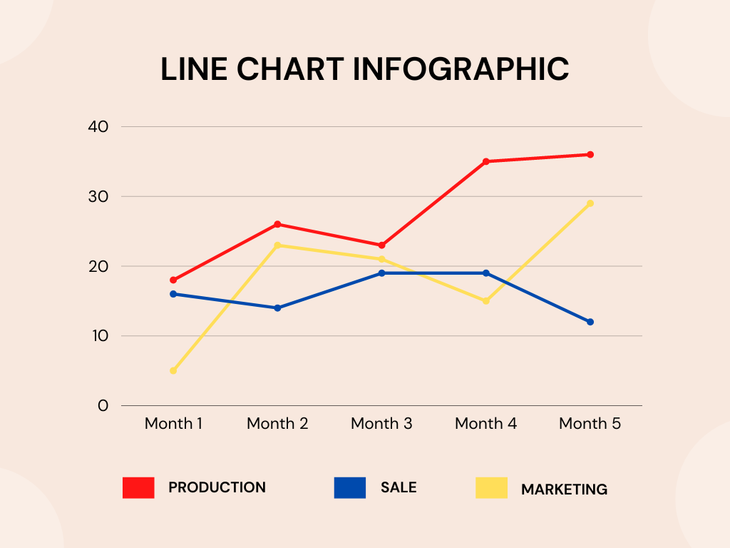
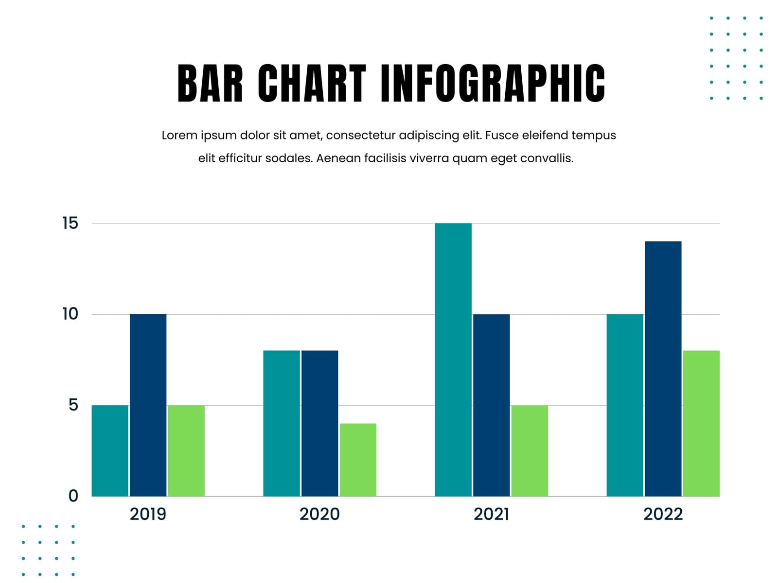
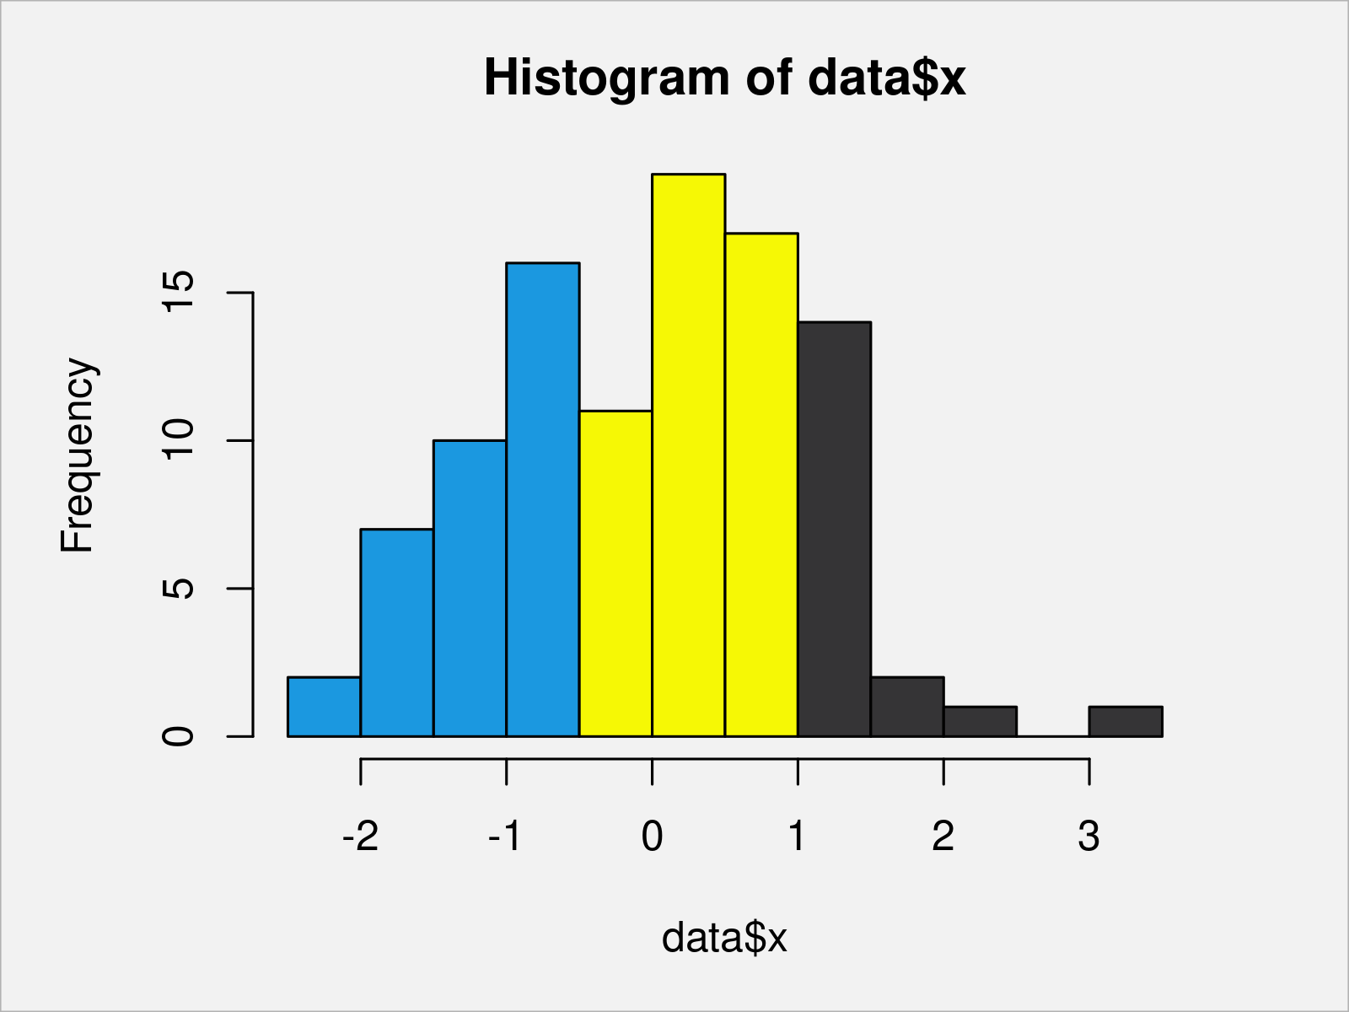
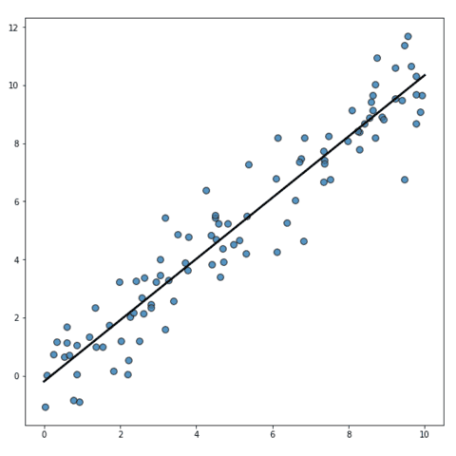
MatPlotLib – Plot Types and When to Use Them (cont)

Slide 27
MatPlotLib – Formatting and Labelling
Good formatting transforms a rough exploratory chart into something communicable and readable
Titles and axis labels are the minimum required for any chart that will be shared (ax.set_title(), ax.set_xlabel(), ax.set_ylabel())
ax.legend() adds a legend – essential when a chart contains multiple lines, bars or series
Line properties: color, linestyle (“-”, “—”, “-.”, “:”), linewidth, and marker (“o”, “s”, “^”, “x”)
Bar and Scatter properties: color, edgecolor, alpha (transparency between 0-1)
ax.set_xlim() and ax.set_ylim() control the visible range of each axis
ax.tick_params() and plt.xticks(rotation=45), control tick label formatting
plt.tight_layout() automatically adjusts spacing to prevent labels and titles from being clipped

Slide 28
MatPlotLib – Subplots & Plotting from pandas
Subplots are the standard pattern for presenting related charts together, a common output when summarizing processed pandas data.
plt.subplots(nrows, ncols) creates a Figure with multiple Axes arranged in a grid. This returns a fig and an array of ax objects
Each ax in the array is an independent plot area, formatted and populated individually
figsize on plt.subplots() controls the size of the entire Figure, not individual panels
ax.flatten() converts a 2D array of axes into a 1D array. This simplifies iteration when creation many subplots
fig.suptitle adds a title to the overall Figure, distinct from individual subplot titles set with ax.set_title()

Slide 29
MatPlotLib – Subplots & Plotting from pandas
Pandas .plot() accepts an ax parameter, passing an existing axes object tells pandas exactly where to draw the chart
The ax object returned by pandas.plot() is a standard matplotlib Axes – all Matplotlib formatting methods apply directly to it
plt.subplots_adjust() gives manual control over spacing between subplots when tight_layout() is not sufficient

