Slide 1
UW-Madison GI Tract Image Segmentation
Presentation 3 — Model Architecture & Training Results
William Ohonba · Sofia Rojas · Peyton Wade
Florida State University | Spring 2026

Slide 2
Agenda
01
Project Recap & Update
04
Preliminary Interpretation
02
Model Architecture (U-Net)
05
Planned Improvements
03
Training & Validation Results
06
Final Remarks & Next Steps
2

Slide 3
01 | Project Recap & Update
Last Presentation
This Presentation
Outlined the dataset anatomy with its attributes and specifications
Established the necessary loss function (DICE and HAUSDORFF)
Went through Dataloader Preprocessing and Verification Process
Established the 2D U-Net Baseline for initial segmentation
Used a 2.5D Stack with 3 Slices as input channel for pseudo-3D spacial context
Implemented calcStats.json to standardize validation
38,496
85
3
2.47 GB
MRI Slices
Patients
Target Classes
Dataset Size
3

Slide 4
02 | Model Architecture — U-Net
Input
[B,1,320,320]
Enc 1
64 ch
Output
[B,3,320,320]
Enc 2
128 ch
Skip
Connections
Enc 3
256 ch
Bottleneck
512 ch
Dec 1
64 ch
Dec 2
128 ch
Dec 3
256 ch
Input / Output
Architecture Details
2.5D Extension (Planned)
Input: [B, 1, 224, 224]
Normalized float32 (μ=0, σ=1)
Output: [B, 3, 320, 320]
Per-class binary sigmoid masks
2D U-Net (encoder-decoder)
Skip connections preserve edges
Batch Norm + ReLU per block
Pre-trained backbone: EfficientNet-B4
Stack N=3 adjacent slices
as input channels [B, 3, H, W]
Adds depth context without
3D convolution overhead
4

Slide 5
03 | Training & Validation Results
Training Setup
Sample Output from Epoch 52 –> Epoch 53
Class | Dice ↑ | Hausdorff ↓ | Notes
Stomach | 0.793 -> 0.808 |  | Strongest performance
Small Bowel | 0.714 -> 0.710 |  | High shape variability
Large Bowel | 0.685 -> 0.685 |  | Major BottleNeck
Mean | 0.731 -> 0.734 | 0.2026 -> 0.2001 | Comp Score: 0.7708 ->0.7737
Optimizer: AdamW (lr=1e-4)
Scheduler: CosineAnnealing
Batch Size: 16 | Workers: 2
Image Size: 224 x 224
Epochs Run: 100
Loss: BCEWithLogitsLoss
5

Slide 6
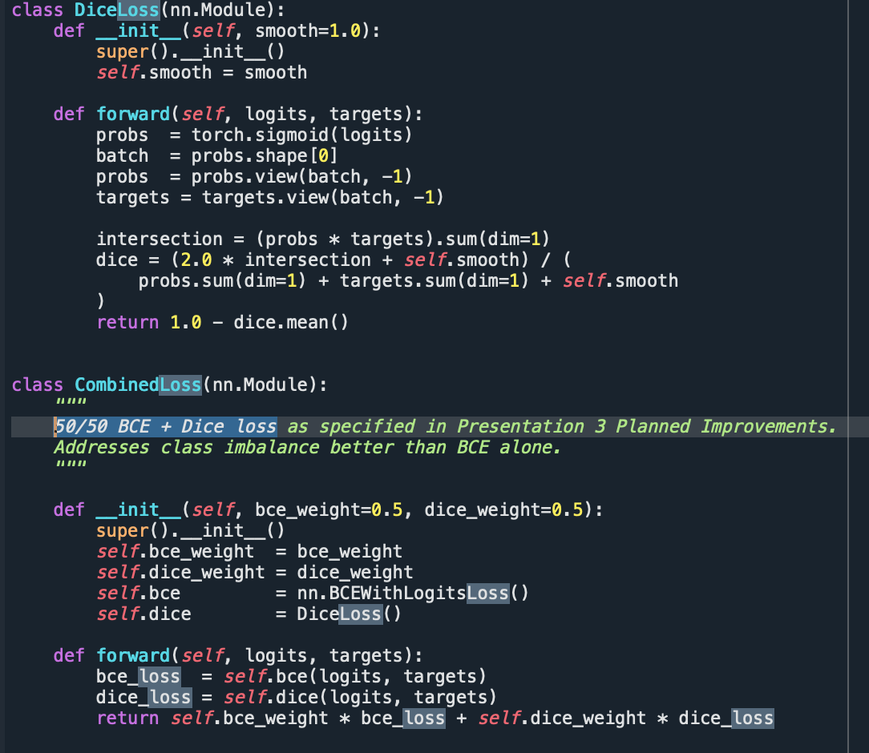
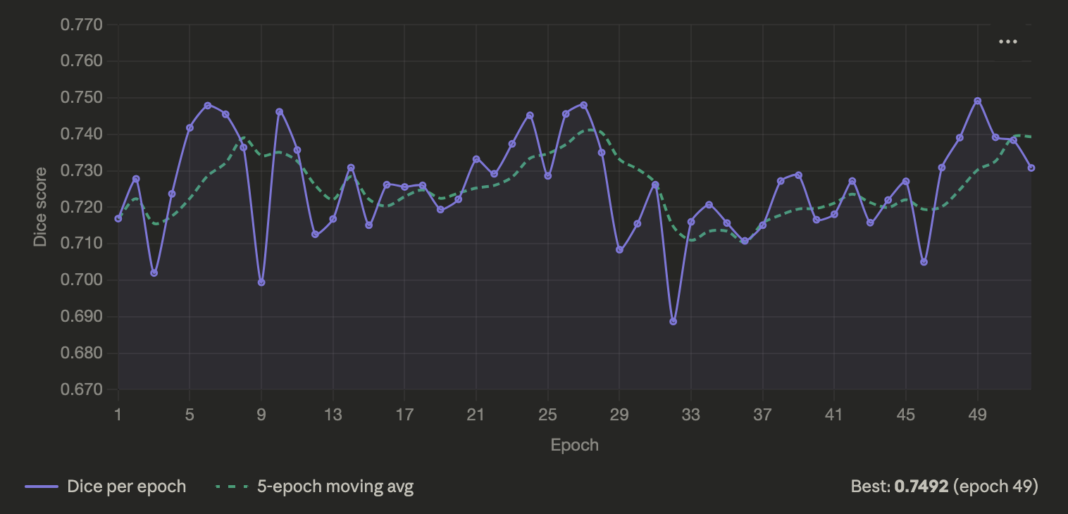
04 | Visualizing Training Issues
Getting Deep into Code
50 Epoch training snippet of Dice
6

Slide 7
05 | Preliminary Interpretation
What's Working
What's Struggling
Hausdorff mean is doing well, decreasing at a rate of around .003 per Epoch
Stomach — consistently 0.79-0.81 Dice, easiest anatomy for the model to find. Well-defined shape, large surface area, appears frequently in slices.
Loss curves converge smoothly; no training instability detected, so architecture isn't a problem.
Global normalization (calcStats.json) consistent across train/val split
DataLoader pipeline verified — images and masks align correctly
Composite Score – Since HD Mean takes up 60% this is still relatively high
Implements 50/50 BCE + Dice loss for Combined Loss
Small bowel: High shape variability leads to lower shape recognition than stomach
Large Bowel improvements stop possibly due to lack of annotation in the dataset
Low worker amounts of 2 potentially means unoptimized parallelization when training
The loss function — DiceLoss was flattening across all classes before averaging, meaning large bowel was never getting targeted pressure.
7

Slide 8
06 | Planned Improvements
S
Training Strategy
B
Preprocessing
Compute per-class loss before averaging for per class weighting based on frequency in slices
Run a 5 slice 2.5D for depth comparisons
Increase number of workers from 2 – 4+ for gpu optimization
Apply CLAHE to normalize MRI scanner intensity drift
Increase target resolution from a downscaled 224 to a to-scale 320 and potential upscale comparison of 448
C
Data Augmentation
C
Quality of Life
Automation of Setup process for reproducibility and parallelization
Set up Tensorboard for visualizations during and post training
Checkpointing and tmux for crashing & internet connectivity measures
Elastic Transform + Grid Distortion to simulate organ deformation
Random ROI cropping focused on non-zero mask regions
8

Slide 9
07 |Questions?
9

