Slide 1
Trees（树）

Slide 2
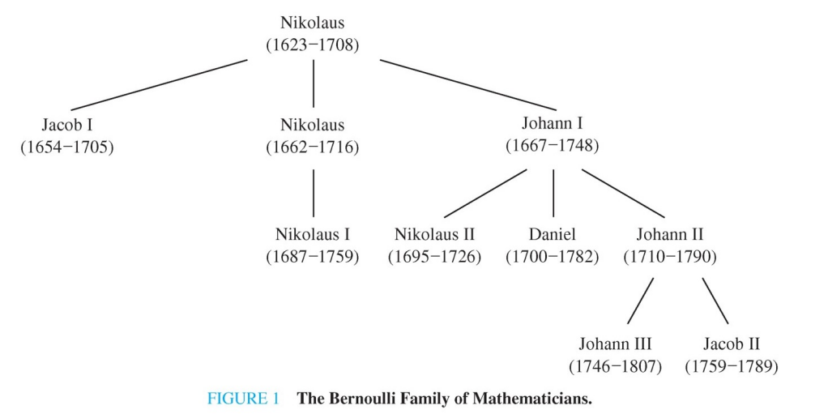
A Genealogical Chart
The Bernoulli family of mathematicians

Slide 3
Application
家谱
图书十进制分类
一个组织结构的层次体系
各种运算表达式
判断树
School of Computer Science, BUPT

Slide 4
§11.1: Introduction to Trees
A tree is a connected undirected graph with no simple circuits.
  Theorem: There is a unique simple path between any two of its vertices.
A (not-necessarily-connected) undirected graph without simple circuits is called a forest.
  You can think of it as a set of trees having disjoint sets of nodes.
A leaf node in a tree or forest is any pendant or isolated vertex. An internal node is any non-leaf vertex (thus it has degree ≥ ___ ).
School of Computer Science, BUPT

Slide 5
Tree and Forest Examples
Leaves in green, internal nodes in brown.
A Tree:
A Forest:
School of Computer Science, BUPT

Slide 6

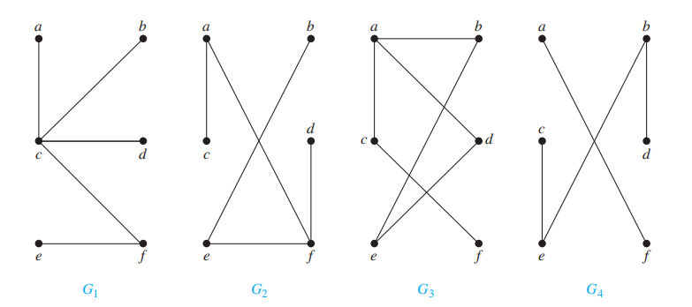
多选题
1分
Which of the graphs shown in the figure are trees?
A
G₁
B
G₂
C
G₃
D
G₄
提交

Slide 7
Rooted Trees
A rooted tree is a tree in which one node has been designated the root.
  Every edge is (implicitly or explicitly) directed away from the root.
You should know the following terms about rooted trees:
  Parent, child, siblings, ancestors, descendents, leaf, internal node, subtree.
School of Computer Science, BUPT

Slide 8
Rooted Trees
If v is a vertex in T other than the root, the parent of v is the unique vertex u such that there is a directed edge from u to v
When u is the parent of v, v is called a child of u.
Vertices with the same parent are called siblings.
The ancestors of a vertex other than the root are the vertices in the path from the root to this vertex, excluding the vertex itself and including the root.
The descendants of a vertex v are those vertices that have v as an ancestor.
School of Computer Science, BUPT

Slide 9
Rooted Trees
A vertex of a rooted tree is called a leaf if it has no children. Vertices that have children are called internal vertices.
  The root is an internal vertex unless it is the only vertex in the graph, in which case it is a leaf.
If a is a vertex in a tree, the subtree with a as its root is the subgraph of the tree consisting of a and its descendants and all edges incident to these descendants.
School of Computer Science, BUPT

Slide 10
Rooted Tree Examples
Note that a given unrooted tree with n nodes yields n different rooted trees.
Same tree
except
for choice
of root
root
root
School of Computer Science, BUPT

Slide 11
Rooted-Tree Terminology Exercise
Find the parent,
children, siblings,
ancestors, &
descendants
of node f.
o
n
h
r
d
m
b
root
a
c
g
e
i
q
f
p
j
k
l
School of Computer Science, BUPT

Slide 12
n-ary trees
A rooted tree is called n-ary if every vertex has no more than n children.
  It is called full if every internal (non-leaf) vertex has exactly n children.
A 2-ary tree is called a binary tree.
  These are handy for describing sequences of yes-no decisions.
    Example: Comparisons in binary search algorithm.
School of Computer Science, BUPT

Slide 13
Which Tree is Binary?
Theorem: A given rooted tree is a binary tree iff every node other than the root has degree ≤ ___, and the root has degree ≤ ___.
School of Computer Science, BUPT

Slide 14
Ordered Rooted Tree
This is just a rooted tree in which the children of each internal node are ordered.
In ordered binary trees, we can define:
  left child, right child
  left subtree, right subtree
For n-ary trees with n>2, can use terms like “leftmost”, “rightmost,” etc.
School of Computer Science, BUPT

Slide 15
Trees as Models
Can use trees to model the following:
  Saturated hydrocarbons
  Organizational structures
  Computer file systems
  Tree-Connected Parallel Processors
In each case, would you use a rooted or a non-rooted tree?
School of Computer Science, BUPT

Slide 16
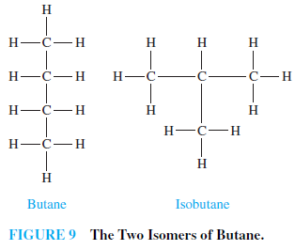
Trees as Models
  Saturated hydrocarbons
School of Computer Science, BUPT

Slide 17
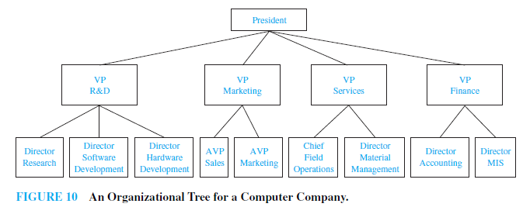
Trees as Models
  Organizational structures
School of Computer Science, BUPT

Slide 18
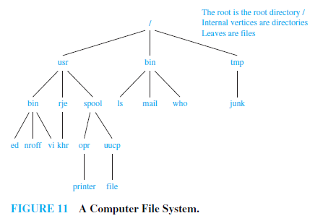
Trees as Models
  Computer file systems
School of Computer Science, BUPT

Slide 19
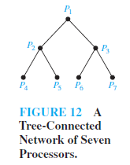
Trees as Models
  Tree-Connected Parallel Processors
School of Computer Science, BUPT

Slide 20
Some Tree Theorems
Any tree with n nodes has e = n−1 edges.
  Proof: Consider removing leaves.
A full m-ary tree with i internal nodes has n=mi+1 nodes, and =(m−1)i+1 leaves.
  Proof: There are mi children of internal nodes, plus the root. And,  = n−i = (m−1)i+1.
Thus, when m is known and the tree is full, we can compute all four of the values e, i, n, and , given any one of them.
  i=(n-1)/m , l=[(m-1)n+1]/m
  n=mi+1 , l=(m-1)i+1
  n=(ml-1)/m-1, i=(l-1)/(m-1)
School of Computer Science, BUPT

Slide 21
Example 9
Suppose that someone starts a chain letter. Each person who receives the letter is asked to send it on to four other people. Some people do this, but others do not send any letters.
  How many people have seen the letter, including the first person, if no one receives more than one letter and if the chain letter ends after there have been 100 people who read it but did not send it out?
  How many people sent out the letter?
School of Computer Science, BUPT

Slide 22
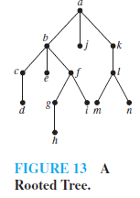
Some More Tree Theorems
Definition: The level of a node is the length of the simple path from the root to the node.
  The height of a tree is maximum node level.
School of Computer Science, BUPT

Slide 23
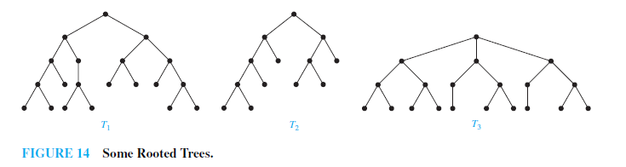
Some More Tree Theorems
  A rooted m-ary tree with height h is called balanced if all leaves are at levels h or h−1.
    Example 11
School of Computer Science, BUPT

Slide 24
Theorem: There are at most m^{h} leaves in an m-ary tree of height h.
  Corollary: An m-ary tree with  leaves has height h≥⎡log_{m}⎤ . If m is full and balanced then h=⎡log_{m}⎤.
School of Computer Science, BUPT

Slide 25
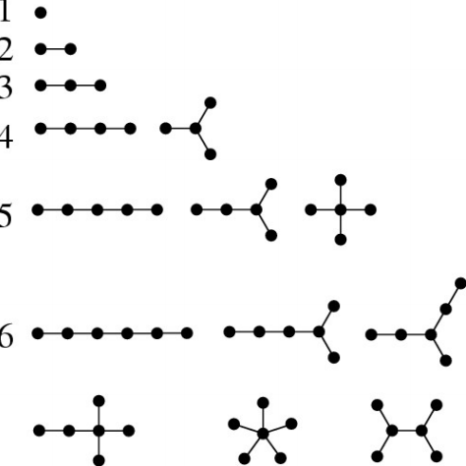
Nonisomorphic trees of order n=1,2,3,4,5,6

Slide 26
Homework
§11.1
  4, 20,28
School of Computer Science, BUPT

