Slide 1
§11.2: Applications of Trees
Binary search trees
  A simple data structure for sorted lists
Decision trees
  Minimum comparisons in sorting algorithms
Prefix codes
  Huffman coding
Game trees
School of Computer Science, BUPT

Slide 2
Binary Search Trees
A binary search tree is an ordered binary tree in which each child of a vertex is designated as a right or left child, no vertex has more than one right child or left child, and each vertex is labeled with a key, which is one of the items.
  the key of a vertex is both larger than the keys of all vertices in its left subtree and smaller than the keys of all vertices in its right subtree.

Slide 3
Binary Search Trees
A representation for sorted sets of items.
  Supports the following operations in Θ(log n) average-case time:
    Searching for an existing item.
    Inserting a new item, if not already present.
  Supports printing out all items in Θ(n) time.
Note that inserting into a plain sequence a_{i} would instead take Θ(n) worst-case time.
School of Computer Science, BUPT

Slide 4
Binary Search Tree Format
Items are stored at individual tree nodes.
We arrange for the tree to always obey this invariant:
  For every item x,
    Every node in x’s left subtree is less than x.
    Every node in x’s right subtree is greater than x.
Example:
7
3
12
1
5
9
15
0
2
8
11
School of Computer Science, BUPT

Slide 5
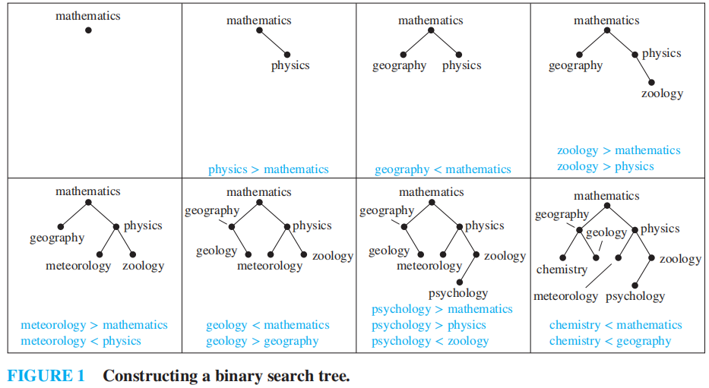
Constucting a binary search tree
Form a binary search tree for the words mathematics, physics, geography, zoology, meteorology,geology, psychology, and chemistry (using alphabetical order).

Slide 6
Recursive Binary Tree Insert
procedure insert(T: binary tree, x: item)
v := root[T]
if v = null then begin
root[T] := x; return “Done” end
else if v = x return “Already present”
else if x < v then
return insert(leftSubtree[T], x)
else {must be x > v}
return insert(rightSubtree[T], x)
School of Computer Science, BUPT

Slide 7
Decision Trees
A decision tree represents a decision-making process.
  Each possible “decision point” or situation is represented by a node.
  Each possible choice that could be made at that decision point is represented by an edge to a child node.
In the extended decision trees used in decision analysis, we also include nodes that represent random events and their outcomes.
School of Computer Science, BUPT

Slide 8
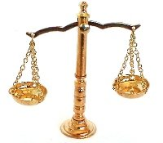
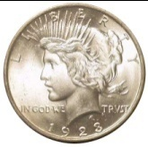
Coin-Weighing Problem
Imagine you have 8 coins, one
of which is a lighter counterfeit,
and a free-beam balance.
  No scale of weight markings
  is required for this problem!
How many weighings are
needed to guarantee that the
counterfeit coin will be found?
?
School of Computer Science, BUPT

Slide 9
As a Decision-Tree Problem
In each situation, we pick two disjoint and equal-size subsets of coins to put on the scale.
The balance then
“decides” whether
to tip left, tip right,
or stay balanced.
A given sequence of
weighings thus yields
a decision tree with
branching factor 3.
School of Computer Science, BUPT

Slide 10
Applying the Tree Height Theorem
The decision tree must have at least 8 leaf nodes, since there are 8 possible outcomes.
  In terms of which coin is the counterfeit one.
Recall the tree-height theorem, h≥⎡log_{m}⎤.
  Thus the decision tree must have height
  h ≥ ⎡log₃8⎤ = ⎡1.893…⎤ = 2.
Let’s see if we solve the problem with only 2 weighings…
School of Computer Science, BUPT

Slide 11
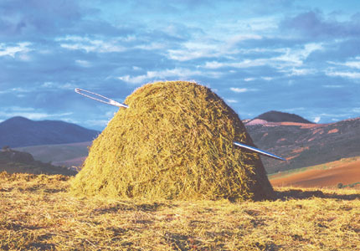
General Solution Strategy
The problem is an example of searching for 1 unique particular item, from among a list of n otherwise identical items.
  Somewhat analogous to the adage of “searching for a needle in haystack.”
Armed with our balance, we can attack the problem using a divide-and-conquer strategy, like what’s done in binary search.
  We want to narrow down the set of possible locations where the desired item (coin) could be found down from n to just 1, in a logarithmic fashion.
Each weighing has 3 possible outcomes.
  Thus, we should use it to partition the search space into 3 pieces that are as close to equal-sized as possible.
This strategy will lead to the minimum possible worst-case number of weighings required.
School of Computer Science, BUPT

Slide 12
General Balance Strategy
On each step, put ⎡n/3⎤ of the n coins to be searched on each side of the scale.
  If the scale tips to the left, then:
    The lightweight fake is in the right set of ⎡n/3⎤ ≈ n/3 coins.
  If the scale tips to the right, then:
    The lightweight fake is in the left set of ⎡n/3⎤ ≈ n/3 coins.
  If the scale stays balanced, then:
    The fake is in the remaining set of n − 2⎡n/3⎤ ≈ n/3 coins that were not weighed!
Except if n mod 3 = 1 then we can do a little better by weighing ⎣n/3⎦ of the coins on each side.
You can prove that this strategy always leads to a balanced 3-ary tree.
School of Computer Science, BUPT

Slide 13
Coin Balancing Decision Tree
Here’s what the tree looks like in our case:
left:
123
123 vs 456
balanced:
78
right:
456
1 vs. 2
4 vs. 5
7 vs. 8
L:1
R:2
B:3
L:4
R:5
B:6
L:7
R:8
School of Computer Science, BUPT

Slide 14
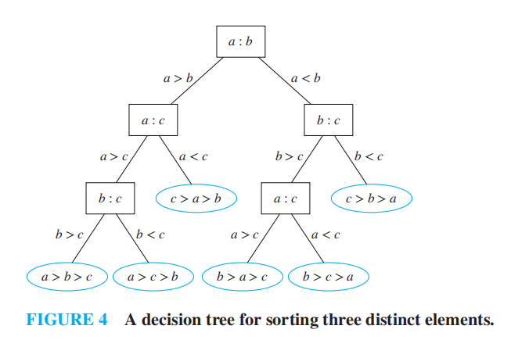
Sort 3 distinct elements

Slide 15
Prefix Codes & Huffman Coding
pp. 798-800
School of Computer Science, BUPT

Slide 16
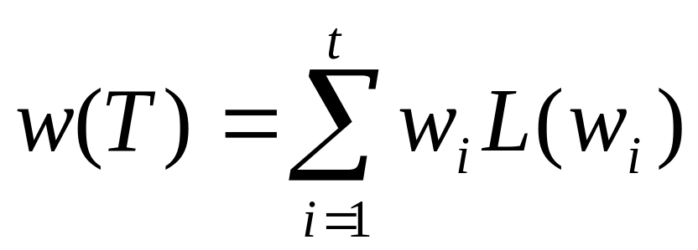
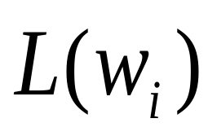
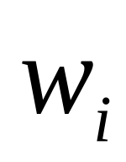
一. 最优树问题
带权二叉树: 每片树叶都带权的二叉树.
带权二叉树的权:
其中 为：
带权 的树叶的通路长度.
School of Computer Science, BUPT

Slide 17
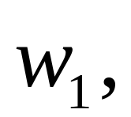
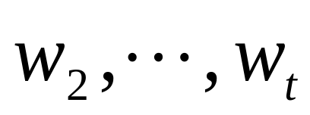
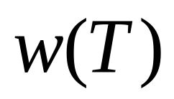

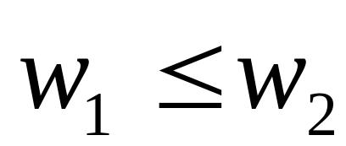
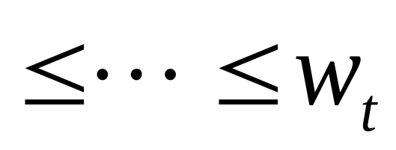
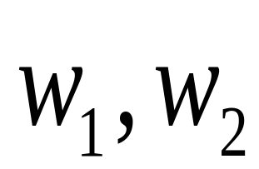
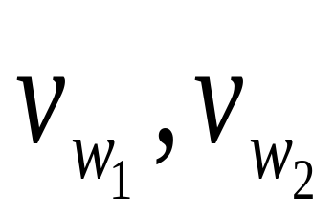
最优树: 在所有带权 的二叉树中, 最小的那棵树.
定理 为带权的最优树,
则
a) 带权 的树叶 是兄弟.
School of Computer Science, BUPT

Slide 18

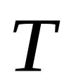



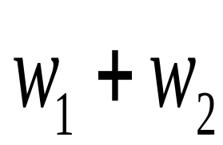
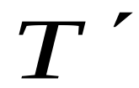
b) 以树叶 为儿子的分枝点,其通路长最长.
定理 为带权 的最优树,若将以带权 的树叶为儿子的分枝点改为带权 的树叶，得到一新树 ,也是最优树.
School of Computer Science, BUPT

Slide 19






例题
求带权7,10,11,13,17的最优树.
解
求解过程如下
School of Computer Science, BUPT

Slide 20
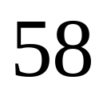
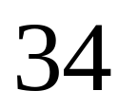
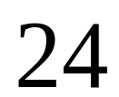
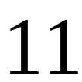
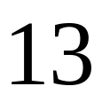
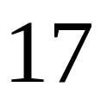

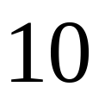
School of Computer Science, BUPT

Slide 21
例
有权 2,3,5,7,11,13,17,19,23
29,31,37,41求相应的最优树.
School of Computer Science, BUPT

Slide 22

























School of Computer Science, BUPT

Slide 23
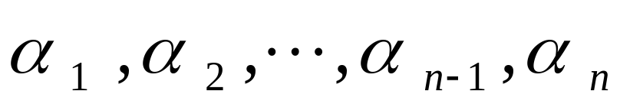

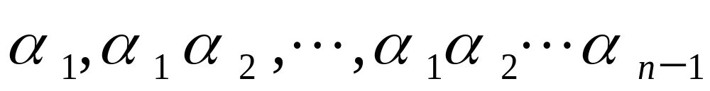

二、二元前缀码
设 是长为
的符号串,
均为该符号串的前缀，它们
的长度分别为 1,2, , -1。
School of Computer Science, BUPT

Slide 24
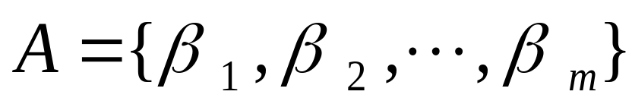
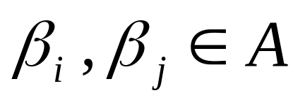
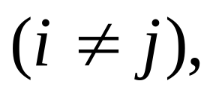
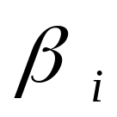
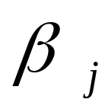

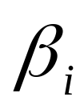
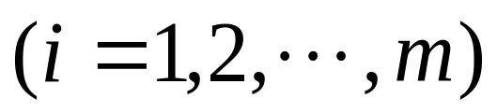
为一个符号
串集合,对于任意的
与 互不为前缀,则
称 为前缀码。
若符号串
中只
出现0,1 两个
符号, 则称 为二
元前缀码。
School of Computer Science, BUPT

Slide 25
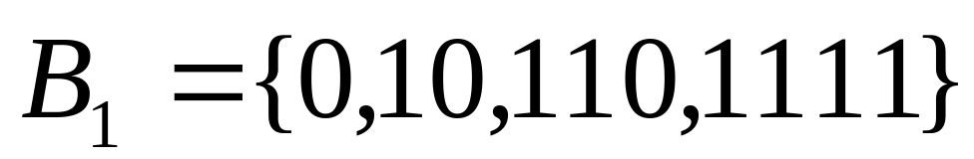
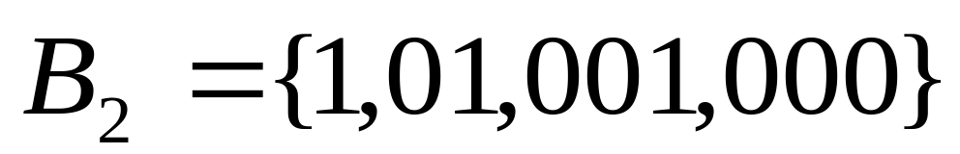
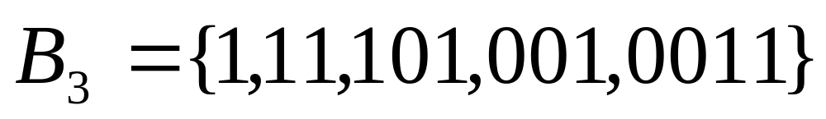
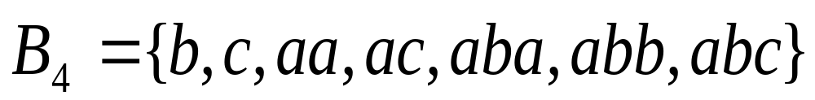
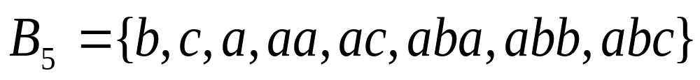
√
√
×
√
×
School of Computer Science, BUPT

Slide 26
定理
任意一棵二叉树都可产生一 个前缀码。
定理
任何一个前缀码都对应一棵二叉树。
School of Computer Science, BUPT

Slide 27


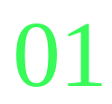
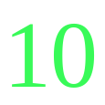
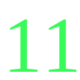
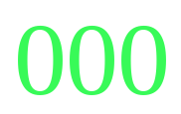
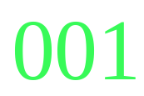
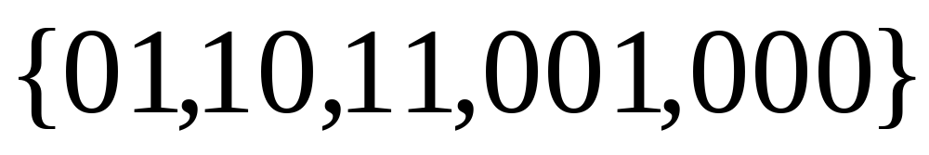
School of Computer Science, BUPT

Slide 28
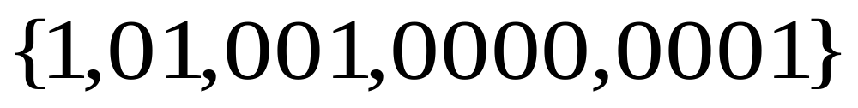
School of Computer Science, BUPT

Slide 29





例
已知字母A，B，C，D，E，F，G出现的频率如下：
A－ B－ C－ D－
E－ F－ G－
1) 求带权
5,5,10,10,15,20,35
的最优二叉树。
School of Computer Science, BUPT

Slide 30
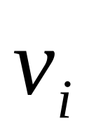
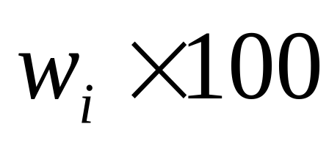
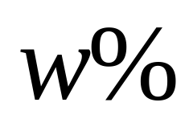
2)求T所对应的前缀码
3)设树叶 带权
求 处的符号串表示出
现频率为 的字母
School of Computer Science, BUPT

Slide 31
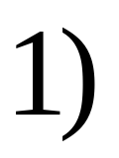
















School of Computer Science, BUPT

Slide 32



School of Computer Science, BUPT

Slide 33



























School of Computer Science, BUPT

Slide 34















School of Computer Science, BUPT

Slide 35

Prefix Codes & Huffman Coding
pp. 798-800
School of Computer Science, BUPT

Slide 36
Example 5
Use Huffman coding to encode the following symbols with the frequencies listed: A: 0.08, B:0.10, C: 0.12, D: 0.15, E: 0.20, F: 0.35. What is the average number of bits used to encode a character?
  Figure 6 displays the steps used to encode these symbols. The encoding produced encodes A by 111, B by 110, C by 011, D by 010, E by 10, and F by 00.
  The average number of bits used to encode a symbol using this encoding is 3 ⋅ 0.08 + 3 ⋅ 0.10 + 3 ⋅ 0.12 + 3 ⋅ 0.15 + 2 ⋅ 0.20 + 2 ⋅ 0.35 = 2.45

Slide 37


Slide 38

Game Trees
Nim
School of Computer Science, BUPT

Slide 39

Tic-tac-toe
School of Computer Science, BUPT

Slide 40
§11.2
  6, 30
School of Computer Science, BUPT

