Slide 1

多选题
1分
Which of the binary operation * is commutative?
A
On Z，where a*b is ab.
B
On Z，where a*b is a×|b|.
C
On R，where a*b is the minimum of a and b.
D
On a lattice A，where a*b is a∨b.
提交

Slide 2
多选题
1分
Which of the binary operation * is associative?
A
On Z，where a*b is ab.
B
On Z，where a*b is a×|b|.
C
On R，where a*b is the minimum of a and b.
D
On a lattice A，where a*b is a∨b.
提交

Slide 3
Semigroups and Groups （半群与群）

Slide 4
Content
Application of semigroups and groups
Binary operations（二元运算）
Semigroups（半群）
Products and quotients of semigroups
（积半群和商半群）
Groups（群）
Products and quotients of groups（积群和商群）

Slide 5
Content
Binary operations
Binary operation on a set A
Properties of binary operations
Semigroups
Semigroup
Free semigroup generated by A
Monoid（独异点）
Subsemigroup（子半群）and submonoid（子独异点）
Isomorphism （同构）

Slide 6
Semigroup – 半群
A semigroup is a nonempty set S together with an associative binary operation * defined on S.
Denote the semigroup by (S, *) or S.
a*b is referred as the product of a and b.
The semigroup (S, *) is said to be commutative if * is a commutative operation.

Slide 7
Examples
(Z, +)
The set P(S), where S is a set, together with the operation of union
The set Z with the binary operation of subtraction

Slide 8
Example 4
Let S be a fixed nonempty set, and let S^{s} be the set of al1 functions f : S→S. If f and g are elements of S^{s}, we define f *g as f□g, the composite function.
* is a binary operation on S^{s}
* is associative.
(S^{s}, *) is a semigroup.
The semigroup S^{s} is not commutative.

Slide 9
Example 5
Let (L, ≤) be a lattice. Define a binary operation on L by
a*b = a∨b.
Then L is a semigroup.

Slide 10
Example 6
Let
A = {a_{l}, a₂,..., a_{n}} be a nonempty set.
A* is the set of all finite sequences of elements of A.
α and β be elements of A*.
The catenation is a binary operation ⋅ on A*.
if α = a₁a₂...a_{n} and β = b₁b₂…b_{k}
α ⋅ β = a₁a₂...a_{n}b₁b₂…b_{k}
if α, β, and γ are any elements of A*,
α ⋅ (β ⋅ γ) = (α ⋅ β) ⋅ γ.

Slide 11
Example 6
⋅ is an associative binary operation, and (A*, ⋅) is a semigroup.
The semigroup (A*, ⋅ ) is called the free semigroup generated by A(由A生成的自由半群).

Slide 12
Theorem 1
If a₁, a₂,..., a_{n}, n ≥3, are arbitrary elements of a semigroup, then all products of the elements a_{l}, a₂,..., a_{n} that can be formed by inserting meaningful parentheses arbitrarily are equal.
Proof are omitted

Slide 13
Note
Theorem 1 shows that the products
((a_{l}*a₂)*a₃)*a₄
a_{l}*(a₂*(a₃*a₄))
(a_{l}*(a₂*a₃))*a₄
are all equal.
If a_{l}, a₂,..., a_{n} are elements in a semigroup (S, *), then the product can be written as
a_{l}*a₂*... *a_{n}

Slide 14
Identity – 单位元、幺元
An element e in a semigroup (S, *) is called an identity element if e*a = a*e = a for all a ∈S.
an identity element must be unique.
Example 8,9
(Z, +)
(Z⁺, +)

Slide 15
Monoid – 独异点、含幺半群
A monoid is a semigroup (S, *) that has an identity.
Example 10
The semigroup (P(S) ∪)
∅ is the identity, since for any element A∈P(S), ∅*A = ∅ ∪ A = A = A ∪ ∅ = A*∅
Hence P(S) is a monoid.

Slide 16
Example 11,12,13
The semigroup S^{s} defined in Example 4
It has the identity l_{s}, since l_{s}*f = l_{s}□f = f□l_{s} = f * l_{s} for any element f∈ S^{s} , we see that S^{s} is a monoid.
The semigroup A* defined in Example 6
It has the identity ε, the empty sequence, since α•ε= ε•α = α for all α∈ A* .
The set of all relations on set A with the operation of composition
It is a monoid . The identity element is the equality relation ∆.

Slide 17
多选题
1分
Which of the sets together with the binary operation are monoid?
A
Z⁺，a*b is defined as max{a,b}.
B
Z⁺，a*b is defined as a.
C
S={1,2,3,6,12},where a*b is defined as GCD(a,b).
D
P(S),with S a set, where * is defined as intersection.
提交

Slide 18
Subsemigroup – 子半群
Let
(S, *) be a semigroup and
T be a subset of S.
if T is closed under the operation *, then
(T, *) is called a subsemigroup of (S, *).

Slide 19
Submonoid – 子独异点
Let
(S, *) be a monoid with identity e, and
T be a nonempty subset of S.
If T is closed under the operation * and e∈T,then
(T, *) is called a submonoid of (S, *).

Slide 20
Note
The associative property holds in any subset of a semigroup so that a subsemigroup (T, *) of a semigroup (S, *) is itself a semigroup.
Similarly, a submonoid of a monoid is itself a monoid.

Slide 21
Examples
If (S, *) is a semigroup, then (S, *) is a subsemigroup of (S, *).
Let (S,*) be a monoid, then (S, *) is a submonoid of (S, *).
If T= {e}, then (T, *) is a submonoid of (S, *)

Slide 22
Powers（幂） of a
Suppose
(S, *) is a semigroup,
a∈S
n ∈ Z⁺
Define the powers of a^{n} recursively as follows:
a^{l} = a, a^{n} = a^{n-1} * a, n ≥2.
a⁰ = e if (S, *) is a monoid
if m and n are nonnegative integers, then
a^{m} * a^{n} = a^{m+n}

Slide 23
Example 16
If (S, *) is a semigroup, a∈S, and T = {a^{i}|i ∈ ⁺}, then
(T, *) is a subsemigroup of (S, *).
If (S, *) is a monoid, a ∈ S, and T = {a^{i}| i ∈ ⁺ or i = 0}, then
(T, *) is a submonoid of (S, *).
generated by a(由a生成的)

Slide 24
Isomorphism – 同构映射
Let
(S, *) and (T, *') be two semigroups.
A function
f : S→T
is called an isomorphism from (S, *) to (T, *')
if
it is a one-to-one correspondence from S to T, and
f(a*b) = f(a)*'f(b) for all a and b in S.

Slide 25
Note
If f is an isomorphism from (S, *) to (T, *'), then, since f is a one-to-one correspondence, f⁻¹ exists and is a one-to-one correspondence from T to S.

Slide 26
f⁻¹ is an isomorphism
Let a' and b' be any elements of T.
Since f is onto, there exist a and b in S such that
f(a) = a' and f(b) = b'.
Then a = f⁻¹(a') and b = f⁻¹(b').
f⁻¹(a' *' b') = f⁻¹(f(a)*'f(b))= f⁻¹(f(a*b))
= (f⁻¹□f) (a*b) = a*b = f⁻¹(a') * f⁻¹(b').
Hence f⁻¹ is an isomorphism.

Slide 27
Isomorphic semigroups （半群同构）
If f is an isomorphism from (S, *) to (T, *'), the semigroups (S, *) and (T *') are said to be isomorphic and write as S ≅ T

Slide 28
Isomorphic?
STEP 1: Define a function f :S→ T with Dom(f) = S.
STEP 2: Show that f is one-to-one.
STEP 3: Show that f is onto.
STEP 4: Show that f(a*b) = f(a)*'f(b)

Slide 29
Example 17
Let T be the set of all even integers.
Show that the semigroups (Z ,+) and (T, +) are isomorphic.

Slide 30
Example 17 - Solution
Step 1: define the function f : Z → T by
f(a) = 2a.
Step 2: f is one-to-one.
Suppose that f(a₁) =f(a₂).
Then 2a₁ = 2a₂,
so a₁ = a₂.
Hence f is one-to-one

Slide 31
Example 17 - Solution
Step 3: f is onto.
Suppose that b is any even integer.
Then a = b/2∈Z and
f(a) = f(b/2) = 2(b/2) = b,
so f is onto.
Step 4: f(a+b) = 2(a+b) = 2a+2b = f(a)+f(b) .
Hence (Z, +) and (T, +) are isomorphic semigroups
Q.E.D.

Slide 32
Theorem 2
Let
(S, *) and (T, *') be monoids with identities e and e', respectively.
f :S→ T be an isomorphism.
Then
f(e) = e'.

Slide 33
Theorem 2 - Proof
Let b be any element of T.
Since f is onto, there is an element a in S such that
f(a) = b.
Since a = a*e,
b = f(a) = f(a*e) = f(a)*'f(e)= b*'f(e).

Slide 34
Theorem 2 - Proof
Similarly, a = e*a,
b = f(e)*'b.
Thus for any b∈T,
b = b *' f(e) = f(e) *' b,
which means that f(e) is an identity for T.
the identity is unique,
f(e) = e'
Q.E.D.

Slide 35
Note
If (S, *) and (T, *') are semigroups such that S has an identity and T does not, it then follows from Theorem 2 that (S, *) and (T, *') cannot be isomorphic.

Slide 36
Example 19
Let T be the set of all even integers and let ∗ be ordinary multiplication.
the semigroups (Z, ∗ ) and (T, ∗ ) are not isomorphic, since Z has an identity and T does not.

Slide 37
Homomorphism – 同态
Let
(S, *) and (T, *') be two semigroups.
An everywhere-defined function
f :S→ T
is called a homomorphism from (S, *) to (T, *')
If
f(a*b) = f(a) *' f(b) for all a and b in S.
If f is also onto, we say that T is a homomorphic image(同态像) of S.

Slide 38
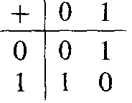
Example 20
Let
A = {0, l}
(A*, • ), • is the catenation operation
(A, +), + is defined by the table above
Define the function f : A*→A by
It is easy to verify that if α and β are any elements of A*, then f(α•β) = f(α)+f(β).
Thus f is a homomorphism.

Slide 39
Note
For both an isomorphism and a homomor-phism, the image of a product is the product of the images.

Slide 40
Theorem 3
Let
(S, *) and (T, *') be monoids with identities e and e', respectively.
f :S→ T be a homomorphism from (S, *) onto (T, *').
Then
f(e) = e'
Proof: similarly to the proof of theorem 2.

Slide 41
Theorem 4
Let
f be a homomorphism from a semigroup (S, *) to a semigroup (T. *').
If S' is a subsemigroup of (S, *),
Then
f(S') = {t ∈ T | t = f(s) for some s ∈S'}, the image of S' under f, is a subsemigroup of (T, *').

Slide 42
Theorem 4 - Proof
Let t_{l} and t₂ are any elements of f(S'),
there exist s_{l} and s₂ in S' with t_{l} = f(s_{l}) and t₂ = f(s₂).
t_{l} *' t₂ = f(s_{l} ) *' f(s₂) = f(s₁ * s₂) = f(s₃).
Hence t_{l} *' t₂ ∈ f(S').
Thus f(S') is closed under the operation *'.
Since the associative property holds in T, it holds in f(S').
So f(S') is a subsemigroup of (T. *’)

Slide 43
Theorem 5
If f is a homomorphism from a commutative semigroup (S, *) onto a semigroup (T, *'), then (T, *') is also commutative.

Slide 44
Theorem 5 - Proof
Let t_{l} and t₂ be any elements of T. There exist s_{l} and s₂ in S such that
t_{l} = f(s_{l}) and t₂= f(s₂)
Therefore
t_{l}*'t₂ = f(s_{l})*'f(s₂) = f(s_{l}*s₂) = f(s₂*s₁) = f(s₂)*'f(s₁) = t₂*'t₁.
Hence (T, *') is also commutative.

Slide 45
Please feel free
to ask questions!
((( )))

Slide 46
单选题
1分
Let A={0,1},and consider the semigroup(A*,•), where • is the operation of catenation. Let T be the subset of A* consisiting of all sequences having an odd number of 1′s.
Is (T, •) a subsemigroup of (A*,•)?
A
YES
B
NO
提交

Slide 47
单选题
1分
Let A={a,b}. Are there two semigroups (A,*) and (A,*′) that are not isomorphic?
A
YES
B
NO
提交

Slide 48
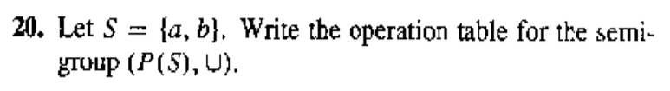
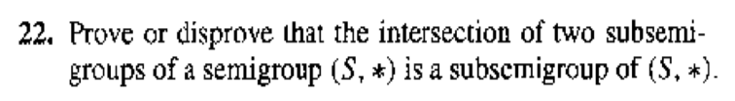
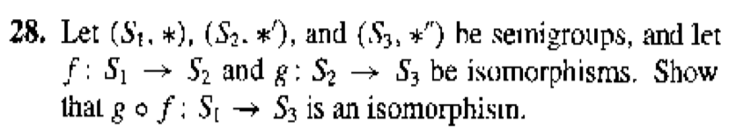
Homework
20,22,28@331

Slide 49
Products and Quotients of Semigroups
（乘积半群、商半群）

Slide 50
Theorem 1
If (S, *) and (T, *') are semigroups, then (S×T, *") is a semigroup, where *" is defined by (s₁, t_{l})*"(s₂, t₂) = (s_{l}*s₂, t_{l}*'t₂)
Proof: omitted.
What about monoid?
if S and T are monoids with identities e_{S} and e_{T}, respectively then S×T is a monoid with identity (e_{S}, e_{T}).

Slide 51
Congruence relation – 同余关系
An equivalence relation R on the semigroup (S, *) is called a congruence relation
if
a R a' and b R b'
Imply
(a*b) R (a'*b')

Slide 52
Example 1
Consider the semigroup (Z, +) and the equivalence relation R on Z defined by
a R b if and only if a ≡ b (mod 2).
If a ≡ b (mod 2), then 2|(a-b).
Show that this relation is a congruence relation。

Slide 53
Example 1 - Solution
R is an equivalence relation (omitted).
R is a congruence relation
If a ≡ b (mod 2) and c ≡ d (mod 2)
2 | a-b and 2 | c-d.
So a-b = 2m and c-d = 2n, where m and n are integers.
(a-b) + (c-d) = 2m + 2n
(a+c) - (b+d) = 2(m+n),
so a+c ≡ b+d (mod 2).
Hence the relation is a congruence relation.

Slide 54
Example 3
Consider the semigroup (Z, +)
f(x) =x²-x-2.
Define
a R b if and only if f(a) = f(b).
It is easy to verify that R is an equivalence relation, but R is not a congruence relation
-1 R 2, since f(-1) = f(2) = 0
-2 R 3, since f(-2) = f(3) = 4
but (-1 +-2) R(2 + 3), since f(-3) = 10 and f(5) = 18

Slide 55
Note
Recall that an equivalence relation R on the semigroup (S, *) determines a partition of S.
Let [a] = R(a) be the equivalence class containing a .
S/R denote the set of all equivalence classes.

Slide 56
Theorem 2
Let R be a congruence relation on the semigroup (S, *).
Consider the relation  from S/R × S/R to S/R in which the ordered pair ([a], [b]) is, for a and b in S, related to [a*b].
([a], [b]) = [a][b] = [a*b], is a function from S/R×S/R to S/R
(S/R, ) is a semigroup. S/R is called the quotient semigroup(商半群) or factor semigroup

Slide 57
Proof
 is a binary operation
Suppose that ([a], [b]) = ([a'], [b']).
a R a' and b R b',
a*b R a'*b', since R is a congruence relation.
Thus [a*b] = [a'*b'];
 is a function, is a binary operation on S/R.
 is an associative
[a]([b][c]) = [a][b*c] = [a*(b*c)] = [(a*b)*c] = [a*b][c] = ([a][b])[c].
Hence S/R is a semigroup.

Slide 58
Corollary
Let R be a congruence relation on the monoid (S, *). If we define the operation  in S/R by [a][b] = [a*b], then (S/R, ) is a monoid.
Proof
If e is the identity in (S, *), then it is easy to verify that [e] is the identity in (S/R, ).

Slide 59
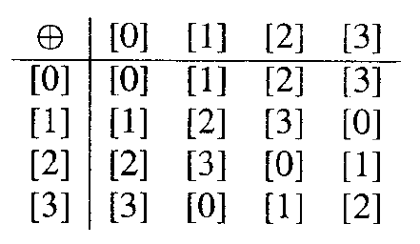
Example 5
(Z, +)
a R b if and only if a  b (mod n).
R is an equivalence relation
≡ (mod 4) is a congruence relation
[0] = {..., -8, -4, 0, 4, 8, l2,… } = [4] = [8] =…
[1] = {..., -7, -3, l, 5, 9, l3,… } = [5] = [9] =…
[2] = {..., -6, -2, 2, 6,10, l4,… } = [6] = [10] =...
[3] = {..., -5, -l, 3, 7, 11, 15, …}= [7] = [11] =…
Z/ ≡ (mod 4) or Z₄ is a monoid with identity [0] and operation [a][b] = [a+b].

Slide 60
Theorem 3
Let
R be a congruence relation on a semigroup (S, *), and
(S/R, ) be the corresponding quotient semigroup.
Then the function
f_{R}: S→S/R
defined by
f_{R}(a) = [a]
is an onto homomorphism, called the natural homomorphism(自然同态).

Slide 61

Theorem 3 - Proof
If [a]∈ S/R, then
f_{R}(a) = [a],
so f_{R} is an onto function.
if a and b are elements of S, then
f_{R}(a*b) = [a*b] = [a][b] = f_{R}(a)f_{R}(b)
so f_{R} is a homomorphism.

Slide 62
Fundamental Homomorphism Theorem – 同态基本定理
Let
f: S→T be a homomorphism of the semigroup (S, *) onto the semigroup (T, *').
R be the relation on S defined by
a R b if and only if f(a) = f(b), for a and b in S.
Then
R is a congruence relation.
(T, *') and the quotient semigroup (S/R, ) are isomorphic.

Slide 63
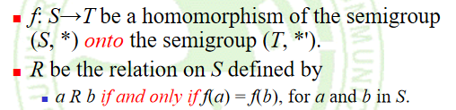
Proof
R is an equivalence relation
a R a for every a∈ S, since f(a) = f(a).
if a R b, then f(a) = f(b), so b R a.
if a R b and b R c,
f(a) = f(b) and f(b) = f(c),
so f(a) = f(c) and a R c.
Hence R is an equivalence relation.

Slide 64
Proof
R is a congruence relation.
Suppose that a R a₁ and b R b₁.
f(a) = f(a₁) and f(b) = f(b₁).
f(a*b) = f(a)*'f(b) = f(a₁)*'f(b₁) = f(a₁*b₁), since f is a homomorphism,
Hence (a*b) R (a₁*b₁)

Slide 65
Proof
Define a relation f = {([a], f(a)) | [a] ∈ S/R} from S/R to T, then
f is a function.
Suppose that [a] = [a'].
a R a', so f(a) = f(a'), which implies that f is a function.
write f: S/RT, where f([a]) = f(a) for [a] ∈ S/R.
f is one to one.
Suppose that f([a]) = f([a']).
f(a) = f(a'), so a R a', which implies that [a] = [a'].
Hence f is one to one.
f is onto.
Suppose that b ∈T.
f(a) = b for some element a in S, since f is onto,
f([a]) = f(a) = b, so f is onto.

Slide 66
Proof
f is an isomorphism.
f([a][b])
= f([a*b])
= f(a*b)
= f(a)*'f(b)
= f([a])*'f([b]).
Q.E.D.

Slide 67
Note
f
S
T
f_{R}
f
S/R
Theorem 4(b) can be described by the diagram above
f_{R} is the natural homomorphism.
It follows from the definitions of f_{R} and f that
f□f_{R} = f
since
(f□f_{R} )(a) = f(f_{R}(a)) = f([a]) = f(a).

Slide 68
Please feel free
to ask questions!
((( )))

Slide 69
多选题
1分
Which of the following relations R on the semigroup S are congruence relation?
S=Z under the operation of ordinary addition;
A
aRb if and only if 2 does not divide a-b
B
aRb if and only if a and b are both even or a and b are odd .
C
aRb if and only if a+b is even.
提交

Slide 70
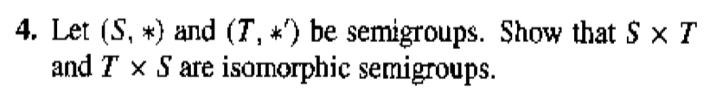
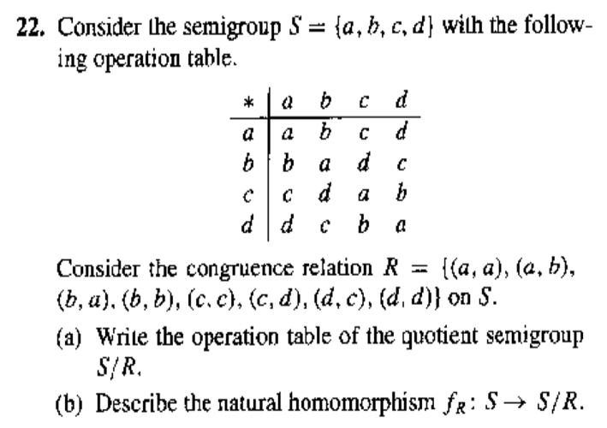
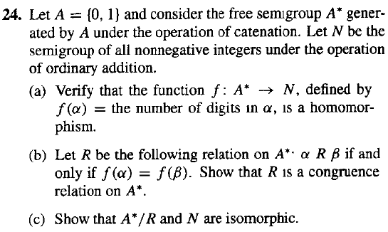
Homework
4, 22, 24@338

