Slide 1
离散数据及其应用 Discrete Mathematics and Its Applications （Eighth Edition/Kenneth H.Rosen） 郭少勇 (syguo@bupt.edu.cn) 北京邮电大学 2021.9
Notes:
1

Slide 2
9.6.1 Example
Example 1:
Show that the greater than or equal to relation (≥) is a partial ordering on the set of integers.
Solution: Because a ≥ a for every integer a, ≥ is reflexive. If a ≥ b and b ≥ a, then a = b. Extra ≥ is antisymmetric. Finally, ≥ is transitive because a ≥ b and b ≥ c imply that a ≥ c. It follows that ≥ is a partial ordering on the set of integers and (Z, ≥) is a poset.

Slide 3
9.6.1 Introduction
A relation R on A is called a partial ordering or partial order if it is reflexive, antisymmetric, and transitive.
We often use a symbol looking something like ≼ (or analogous shapes) for such relations.
Examples: ≤, ≥ on real numbers, ⊆, ⊇ on sets.
Another example: the divides relation | on Z⁺.
Note it is not necessarily the case that either a≼b or b≼a.
A set A together with a partial order ≼ on A is called a partially ordered set or poset and is denoted (A, ≼).

Slide 4
9.6.1 Example
Example 2:
The divisibility relation ∣ is a partial ordering on the set of positive integers, because it is reflexive, antisymmetric, and transitive, as was shown in Section 9.1. We see that (Z⁺, ∣) is a poset. Recall that (Z⁺ denotes the set of positive integers.)

Slide 5
9.6.1 Example
Example 3:
Show that the inclusion relation ⊆ is a partial ordering on the power set of a set S.
Solution: Because A ⊆ A whenever A is a subset of S,⊆ is reflexive. It is antisymmetric because A ⊆ B and B ⊆ A imply that A = B. Finally, ⊆ is transitive, because A ⊆ B and B ⊆ C imply that A ⊆ C. Hence, ⊆ is a partial ordering on P(S), and (P(S),⊆) is a poset.

Slide 6
9.6.1 Example
Example 4:
Let R be the relation on the set of people such that xRy if x and y are people and x is older than y. Show that R is not a partial ordering.
Solution: Note that R is antisymmetric because if a person x is older than a person y, then y is not older than x. That is, if xRy, then yRx. The relation R is transitive because if person x is older than person y and y is older than person z, then x is older than z. That is, if xRy and yRz, then xRz. However, R is not reflexive, because no person is older than himself or herself. That is, xRx for all people x. It follows that R is not a partial ordering.

Slide 7
9.6.1 Introduction - Partial ordered sets （偏序集合）
Partial order（偏序关系）:A relation R on a set A is called a partial order if R is reflexive（自反）, antisymmetric（反对称）, and transitive（传递）.
Partially ordered set:The set A together with the partial order R is called a partially ordered set, or simply a poset, and we will denote this poset by (A, R).

Slide 8
9.6.1 Introduction - Linear Order（线序关系）
If (A, ≤) is a poset, the elements a and b are said to be
Comparable（可比的） if a ≤ b or b ≤ a.
incomparable (不可比的）if neither a ≤ b nor b ≤ a.
Example 5:
In the poset (Z⁺, ∣), are the integers 3 and 9 comparable? Are 5 and 7 comparable?
Solution: The integers 3 and 9 are comparable, because 3 ∣ 9. The integers 5 and 7 are incomparable, because 5 ̸| 7 and 7 ̸| 5.

Slide 9
9.6.1 Introduction - Linear Order（线序关系）
If every pair of elements in a poset A is comparable, we say that A is a linearly ordered set（全序集合）, and the partial order is called a linear order（全序关系或线序关系）. We also say that A is a chain（链）.
Example 6:
The poset (Z,≤) is totally ordered, because a ≤ b or b ≤ a whenever a and b are integers.
Example 7:
The poset (Z⁺, ∣ ) is not totally ordered because it contains elements that are incomparable, such as 5 and 7.

Slide 10
9.6.1 Introduction - Well ordered （良序关系）
Example 8:
The set of ordered pairs of positive integers, Z⁺× Z⁺, with (a1, a2) (b1, b2) if a1 < b1, or if a1 = b1 and a2 ≤ b2 (the lexicographic ordering), is a well-ordered set. The verification of this is left as Exercise 53. The set Z, with the usual ≤ ordering, is not well-ordered because the set of negative integers, which is a subset of Z, has no least element.
(S,≤) is a well-ordered set if it is a poset such that ≤ is a total ordering and every nonempty subset of S has a least element.

Slide 11
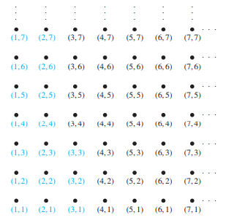
9.6.2 Lexicographic order - Example
Example 9:
Determine whether (3, 5) ≺ (4, 8), whether (3, 8) ≺ (4, 5), and whether (4, 9) ≺ (4, 11) in the poset (Z × Z, ≤), where is the lexicographic ordering constructed from the usual ≤ relation Z.

Slide 12
9.6.2 Example
Solution: Because 3 < 4, it follows that (3, 5) ≺ (4, 8) and that (3, 8) ≺ (4, 5). We have (4, 9) ≺ (4, 11), because the first entries of (4, 9) and (4, 11) are the same but 9 < 11. In Figure the ordered pairs in Z⁺ × Z⁺ that are less than (3, 4) are highlighted. A lexicographic ordering can be defined on the Cartesian product of n posets (A1, 1), (A2, 2), … , (An, n). Define the partial ordering on A1 × A2 × ⋯ × An by (a1, a2, … , an) ≺ (b1, b2, … , bn) if a1≺1 b1, or if there is an integer i > 0 such that a1 = b1, … , ai = bi , and ai+1 ≺i+1 bi+1. In other words, one n-tuple is less than a second n-tuple if the entry of the first n-tuple in the first position where the two n-tuples disagree is less than the entry in that position in the second n-tuple.

Slide 13
9.6.2 Lexicographic order（词典顺序）
The words in a dictionary are listed in alphabetic, or lexicographic, order, which is based on the ordering of the letters in the alphabet. This is a special case of an ordering of strings on a set constructed from a partial ordering on the set. We will show how this construction works in any poset.
This ordering is called lexicographic, or “dictionary” order.
Extended to Cartesian products A₁XA₂…XA_{n}
_{O}

Slide 14
9.6.2 Example
Example 10:
Note that (1, 2, 3, 5) ≺ (1, 2, 4, 3), because the entries in the first two positions of these 4-tuples agree, but in the third position the entry in the first 4-tuple, 3, is less than that in the second 4-tuple, 4. (Here the ordering on 4-tuples is the lexicographic ordering that comes from the usual less than or equal to relation on the set of integers.)

Slide 15
9.6.2 Example
Example 11:
Consider the set of strings of lowercase English letters. Using the ordering of letters in the alphabet, a lexicographic ordering on the set of strings can be constructed. A string is less than a second string if the letter in the first string in the first position where the strings differ comes before the letter in the second string in this position, or if the first string and the second string agree in all positions, but the second string has more letters. This ordering is the same as that used in dictionaries. For example,

Slide 16
9.6.2 Example
discreet ≺ discrete,
because these strings differ first in the seventh position, and e ≺ t. Also,
discreet ≺ discreetness,
because the first eight letters agree, but the second string is longer. Furthermore,
discrete ≺ discretion,
because
discrete ≺ discreti.

Slide 17
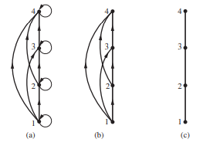
9.6.3 Hasse Diagrams（哈斯图）
Many edges in the directed graph for a finite poset do not have to be shown because they must be present. For instance, consider the directed graph for the partial ordering {(a, b) ∣ a ≤ b} on the set {1, 2, 3, 4}, shown in Figure (a). Because this relation is a partial ordering, it is reflexive, and its directed graph has loops at all vertices. Consequently, we do not have to show these loops because they must be present; in Figure (b) loops are not shown. Because a partial ordering is transitive, we do not have to show those edges that must be present because of transitivity. For example, in Figure (c) the edges (1, 3), (1, 4), and (2, 4) are not shown because they must be present. If we assume that all edges are pointed “upward” (as they are drawn in the figure), we do not have to show the directions of the edges; Figure (c) does not show directions.

Slide 18
9.6.3 Hasse Diagrams（哈斯图）
Hasse Diagram is the digraph of a partial order on a finite set A that
deletes all self-cycles
eliminates all edges that are implied by the transitive property
draws the digraph with all edges pointing upward

Slide 19
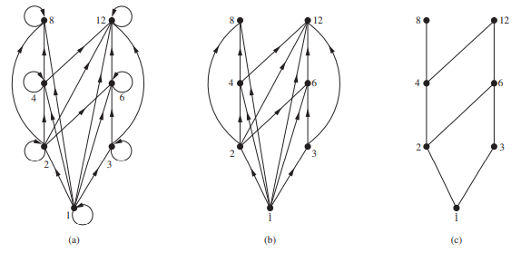
9.6.3 Example
Example 12:
Draw the Hasse diagram representing the partial ordering {(a, b)∣a divides b} on {1, 2, 3, 4, 6, 8, 12}.

Slide 20

9.6.3 Example
Solution: Begin with the digraph for this partial order, as shown in Figure (a). Remove all loops, as shown in Figure (b). Then delete all the edges implied by the transitive property. These are (1, 4), (1, 6), (1, 8), (1, 12), (2, 8), (2, 12), and (3, 12). Arrange all edges to point upward, and delete all arrows to obtain the Hasse diagram. The resulting Hasse diagram is shown in Figure (c).

Slide 21
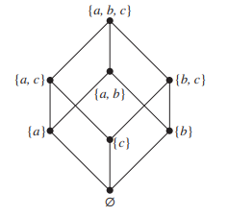
9.6.3 Example
Example 13:
Draw the Hasse diagram for the partial ordering {(A, B) ∣ A ⊆ B} on the power set P(S), where S = {a, b, c}.

Slide 22
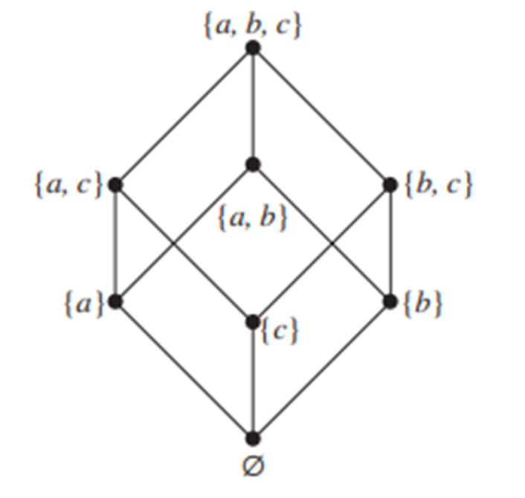
9.6.3 Example
Solution: The Hasse diagram for this partial ordering is obtained from the associated digraph by deleting all the loops and all the edges that occur from transitivity, namely, ( ∅, {a, b} ) , ( ∅, {a, c} ) , ( ∅, {b, c} ) , ( ∅, {a, b, c} ) , ({a}, {a, b, c}), ({b}, {a, b, c}), and ({c}, {a, b, c}). Finally, all edges point upward, and arrows are deleted. The resulting Hasse diagram is illustrated in Figure.

Slide 23
9.6.4 Extremal elements
Example 14:
Which elements of the poset ({2, 4, 5, 10, 12, 20, 25}, ∣) are maximal, and which are minimal?
Solution: The Hasse diagram in Figure 5 for this poset shows that the maximal elements are 12, 20, and 25, and the minimal elements are 2 and 5. As this example shows, a poset can have more than one maximal element and more than one minimal element.

Slide 24
9.6.4 Extremal elements
maximal element（极大元）
minimal element（极小元）
greatest element（最大元）
denoted by I and often called the unit element（单位元）
least element（最小元）
denoted by 0 and often called the zero element（零元）

Slide 25
9.6.4 Extremal elements - Maximal(Minimal) element
An element a ∈ A is called a maximal element of A if there is no element c in A such that a<c.
An element b ∈ A is called a minimal element of A if there is no element c in A such that c<b.

Slide 26
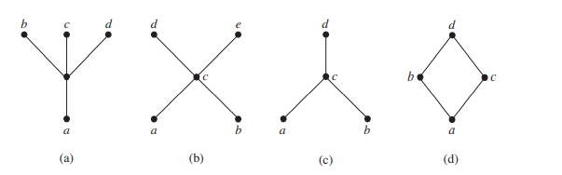
9.6.4 Example
Example 15:
Determine whether the posets represented by each of the Hasse diagrams in Figure have a greatest element and a least element.

Slide 27
9.6.4 Example
Solution: The least element of the poset with Hasse diagram (a) is a. This poset has no greatest element. The poset with Hasse diagram (b) has neither a least nor a greatest element. The poset with Hasse diagram (c) has no least element. Its greatest element is d. The poset with Hasse diagram (d) has least element a and greatest element d.

Slide 28
9.6.4 Extremal elements - upper(lower) bound
Example 17:
Is there a greatest element and a least element in the poset (Z+, ∣)?
Solution: The integer 1 is the least element because 1|n whenever n is a positive integer. Because there is no integer that is divisible by all positive integers, there is no greatest element.

Slide 29
9.6.4 Extremal elements - upper(lower) bound
LUB（最小上界） GLB（最大下界）
Consider a poset and a subset B of A.
An element a ∈ A is called a upper bound（上界） of B if b≤a for all b ∈ B.
An element a ∈ A is called a lower bound（下界）of B if a≤b for all b ∈ B.
An element a ∈ A is called a least upper bound (LUB) of B if a is an upper bound of B and a≤a’, whenever a’ is an upper bound of B.
An element a ∈ A is called a greatest lower bound (GLB) of B if a is an lower bound of B and a’≤a, whenever a’ is an lower bound of B.

Slide 30
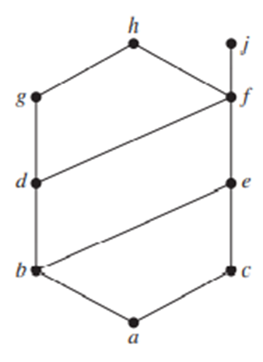
9.6.4 Extremal elements - upper(lower) bound
Example 18:
Find the lower and upper bounds of the subsets {a, b, c}, {j, h}, and {a, c, d, f } in the poset with the Hasse diagram shown in Figure.
Solution: The upper bounds of {a, b, c} are e, f, j, and h, and its only lower bound is a. There are no upper bounds of {j, h}, and its lower bounds are a, b, c, d, e, and f . The upper bounds of {a, c, d, f } are f , h, and j, and its lower bound is a.

Slide 31
9.6.4 Example
Example 19:
Find the greatest lower bound and the least upper
bound of {b, d, g}, if they exist, in the poset shown
in Figure.
Solution: The upper bounds of {b, d, g} are g and h. Because g ≺ h, g is the least upper bound.The lower bounds of {b, d, g} are a and b. Because a ≺ b, b is the greatest lower bound.

Slide 32
9.6.4 Example
Example 20:
Find the greatest lower bound and the least upper bound of the sets {3, 9, 12} and {1, 2, 4, 5, 10}, if they exist, in the poset (Z+, ∣).

Slide 33
9.6.4 Example
Solution: An integer is a lower bound of {3, 9, 12} if 3, 9, and 12 are divisible by this integer. The only such integers are 1 and 3. Because 1 ∣ 3, 3 is the greatest lower bound of {3, 9, 12}.The only lower bound for the set {1, 2, 4, 5, 10} with respect to ∣ is the element 1. Hence, 1 is the greatest lower bound for {1, 2, 4, 5, 10}.
An integer is an upper bound for {3, 9, 12} if and only if it is divisible by 3, 9, and 12. The integers with this property are those divisible by the least common multiple of 3, 9, and 12, which is 36. Hence, 36 is the least upper bound of {3, 9, 12}. A positive integer is an upper bound for the set {1, 2, 4, 5, 10} if and only if it is divisible by 1, 2, 4, 5, and 10. The integers with this property are those integers divisible by the least common multiple of these integers, which is 20. Hence, 20 is the least upper bound of {1, 2, 4, 5, 10}.

Slide 34
9.6.4 Extremal elements - Theorems
Let (A, ≤) be a poset
If A is a finite nonempty, then A has at least one maximal element and at least one minimal element.
A has at most one greatest element and at most one least element.
A subset B of A has at most one LUB and at most one GLB.

Slide 35
9.6.4 Extremal elements – Theorems 4
Suppose that (A, ≤) and (A’, ≤’) are isomorphic posets under the isomorphism f: A→A’.
If a is a maximal (minimal) element of (A, ≤), then f(a) is a maximal (minimal) element of (A’, ≤’).
If a is a greatest (least) element of (A, ≤), then f(a) is a greatest (least) element of (A’, ≤’).
If a is an upper bound (lower bound, least upper bound, greatest lower bound) of (A, ≤), then f(a) is an upper bound (lower bound, least upper bound, greatest lower bound) of (A’, ≤’).
If every subset of (A, ≤) has a LUB (GLB), then every subset of (A’, ≤’) has a LUB (GLB).

Slide 36
9.6.5 Introduction of Lattices
A lattice is a poset in which every subset {a,b} consisting of two elements has a least upper bound and a greatest lower bound.
denote LUB({a,b}) by a∨b and call it the join（并） of a and b.
denote GLB({a,b}) by a∧b and call it the meet（交） of a and b.

Slide 37
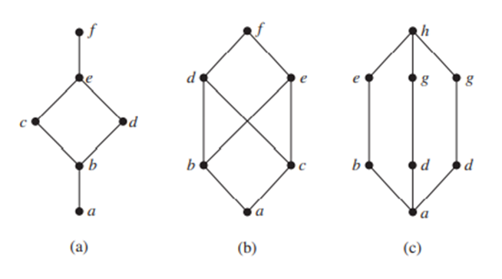
9.6.5 Lattices
Example 21:
Determine whether the posets represented by each of the Hasse diagrams in Figures are lattices.

Slide 38
9.6.5 Lattices
Solution: The posets represented by the Hasse diagrams in (a) and (c) are both lattices because in each poset every pair of elements has both a least upper bound and a greatest lower bound, as the reader should verify. On the other hand, the poset with the Hasse diagram shown in (b) is not a lattice, because the elements b and c have no least upper bound. To see this, note that each of the elements d, e, and f is an upper bound, but none of these three elements precedes the other two with respect to the ordering of this poset.

Slide 39
9.6.5 Example
Example 22:
Is the poset (Z+, ∣) a lattice?
Solution: Let a and b be two positive integers. The least upper bound and greatest lower bound of these two integers are the least common multiple and the greatest common divisor of these integers, respectively, as the reader should verify. It follows that this poset is a lattice.

Slide 40
9.6.5 Example
Example 23:
Determine whether the posets ({1, 2, 3, 4, 5}, ∣) and ({1, 2, 4, 8, 16}, ∣) are lattices.
Solution: Because 2 and 3 have no upper bounds in ({1, 2, 3, 4, 5}, ∣), they certainly do not have a least upper bound. Hence, the first poset is not a lattice. Every two elements of the second poset have both a least upper bound and a greatest lower bound. The least upper bound of two elements in this poset is the larger of the elements and the
greatest lower bound of two elements is the smaller of the elements,
as the reader should verify. Hence, this second poset is a lattice.

Slide 41
9.6.5 Example
Example 24:
Determine whether (P(S),⊆) is a lattice where S is a set.
Solution: Let A and B be two subsets of S. The least upper bound and the greatest lower bound of A and B are A ∪ B and A ∩ B, respectively, as the reader can show. Hence, (P(S),⊆) is a lattice.

Slide 42
9.6.5 Example
Example 25:
The Lattice Model of Information Flow
In many settings the flow of information from one person or computer program to another is restricted via security clearances. We can use a lattice model to represent different information flow policies. For example, one common information flow policy is the multilevel security policy used in government and military systems. Each piece of information is assigned to a security class, and each security class is represented by a pair (A, C) where A is an authority level and C is a category. People and computer programs are then allowed access to information from a specific restricted set of security classes.

Slide 43
9.6.5 Lattices - Theorem 1
Let L be a lattice. Then for every a and b in L,
a∨b = b if and only if a≤b.
a∧b = a if and only if a≤b.
a∧b = a if and only if a∨b = b

Slide 44
9.6.5 Lattices – Proof
Proof of a∨b = b if and only if a≤b.
⇒ only if
Suppose a∨b = b, so a∨b ≤ b (reflexive)
a∨b is an upper bound of a and b, so a ≤ a∨b
So, a ≤ b (transitive)
⇐ if
Suppose a≤b
b≤b (reflexive), b is an upper bound of a and b
So a∨b≤b (by definition of lub)
But, b≤a∨b (by definition of lub)
Therefore, a∨b = b (antisymmetric)

Slide 45
9.6.5 Lattices - Theorem 2
Let L be a lattice. Then
Idempotent Properties（等幂律）
(a) a∨a = a
(b) a∧a = a
Commutative Properties（交换律）
(a) a∨b = b∨a
(b) a∧b = b∧a
Associative Properties（结合律）
(a) a∨(b∨c) = (a∨b)∨c
(b) a∧(b∧c) = (a∧b) ∧c
Absorption Properties（吸收律）
(a) a∨(a∧b) = a
(b) a∧(a∨b) = a

Slide 46
9.6.5 Lattices - Theorem 3
Let L be a lattice. Then for every a, b, and c in L,
If a≤b, then
a ∨ c ≤ b∨c.
a∧c ≤ b∧c.
a≤c and b≤c if and only if a∨b≤c.
c≤a and c≤b if and only if c≤a∧b.
If a≤b and c≤d, then
a∨c ≤ b∨d.
a∧c ≤ b∧d.

Slide 47
9.6.5 Lattices - Proof of 3. (a)
Since a∧b≤a and a≤a, we see that a is an upper bound of a∧b and a; so a∨(a∧b)≤a. On the other hand, by the definition of LUB, we have a≤a∨(a∧b), so a∨(a∧b) = a.
Q.E.D
It follows from property 3 that we can write a∨(b∨c) and (a∨b) ∨c merely as a∨b∨c, and similarly for a∧b∧c.

Slide 48
9.6.5 Lattices - Theorem 4
Let L = {a₁, a₂, …, a_{n}} be a finite lattice. Then L is bounded.
Proof
The greatest element of L is a₁∨a₂ ∨ … ∨ a_{n},
and its least element is a₁∧a₂∧…∧a_{n}

Slide 49
9.6.5 Lattices - Theorem 5
A lattic L is nondistributive if and only if it contains a sublattice that is isomorphic to one of the above two lattices.
Proof:
omitted

Slide 50
9.6.5 Lattices - Theorem 6
Let L be a bounded distributive lattice. If a complement exists, it is unique.
(1₁ ,1₂)
(1₁ ,a)
(1₁ ,b)
(0₁ ,1₂)
(1₁ ,0₂)
(0₁ ,a)
(0₁ ,b)
(0₁ ,0₂)

Slide 51
9.6.5 Lattices - Proof of 6
Let a’ and a’’ be complements of the element a∈L. Then
a∨a’ = I, a∨a’’ = I, a∧a’ = 0, a∧a’’ = 0.
Using the distributive laws, we obtain
a’ = a’∨0 = a’∨(a∧a’’) = (a’∨a) ∧(a’∨a’’) = I∧(a’ ∨a’’) = a’∨a’’
Also
a’’ = a’’∨0 = a’’∨(a∧a’)= (a’’∨a)∧(a’’∨a’) = I∧(a’’∨a’) = a’∨a’’
Hence a’ = a’’.

Slide 52
9.6.6 Topological Sorting（拓扑排序）
If A is a poset with partial order ≤, we sometimes need to find a linear order for the set A that will merely be an extension of the given partial order in the sense that if a ≤ b, then a b.
The process of constructing a linear order such as is called topological sorting

Slide 53
9.6.6 Example

Slide 54
9.6.6 Topological Sorting - Theorem
Every finite nonempty poset (S, ) has at least one minimal element.
Proof:
Choose an element a0 of S. If a0 is not minimal, then there is an element a1 with a1 ≺ a0. If a1 is not minimal, there is an element a2 with a2 ≺ a1. Continue this process, so that if an is not minimal, there is an element an+1 with an+1 ≺ an. Because there are only a finite number of elements in the poset, this process must end with a minimal element an.

Slide 55
9.6.6 Topological Sorting – Sort Algorithm
procedure topological sort ((S, ≤): finite poset)
k := 1
while S ≠ ∅
ak := a minimal element of S {such an element exists by Lemma 1}
S := S − {ak}
k := k + 1
return a1, a2,… , an {a1, a2,… , an is a compatible total ordering of S}

Slide 56
9.6.6 Example
Example 26:
Find a compatible total ordering for the poset ({1, 2, 4, 5, 12, 20}, ∣).

Slide 57
9.6.6 Example
Solution: The first step is to choose a minimal element. This must be 1, because it is the only minimal element. Next, select a minimal element of ({2, 4, 5, 12, 20}, ∣). There are two minimal elements in this poset, namely, 2 and 5. We select 5. The remaining elements are {2, 4, 12, 20}.The only minimal element at this stage is 2. Next, 4 is chosen because it is the only minimal element of ({4, 12, 20}, ∣). Because both 12 and 20 are minimal elements of ({12, 20}, ∣), either can be chosen next. We select 20, which leaves 12 as the last element left. This produces the total ordering
1 ≺ 5 ≺ 2 ≺ 4 ≺ 20 ≺ 12.
The steps used by this sorting algorithm are displayed in Figure .

Slide 58
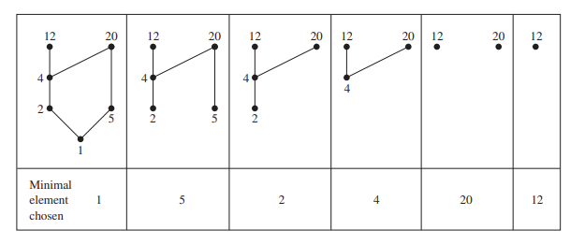
9.6.6 Example
Solution:

Slide 59
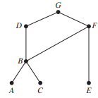
9.6.6 Example
Example 27:
A development project at a computer company requires the completion of seven tasks. Some of these tasks can be started only after other tasks are finished. A partial ordering on tasks is set up by considering task X ≺ task Y if task Y cannot be started until task X has been completed. The Hasse diagram for the seven tasks, with respect to this partial ordering, is shown in Figure . Find an order in which these tasks can be carried out to complete the project.

Slide 60
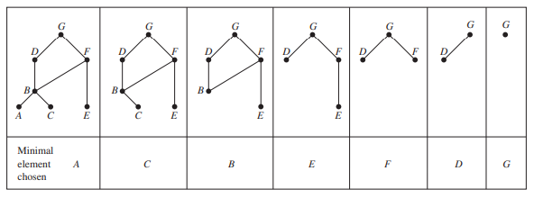
9.6.6 Example
Solution: An ordering of the seven tasks can be obtained by performing a topological sort. The steps of a sort are illustrated in Figure. The result of this sort, A ≺ C ≺ B ≺ E ≺ F ≺ D ≺ G, gives one possible order for the tasks.

Slide 61
9.6 Partial Orderings - Homework
作业
§9.1 – 40, 47, 48
§9.2 – 8, 20
§9.3 – 14, 32
§9.4 – 20, 22, 28
§9.5 – 16, 56, 60, 64
§9.6 – 12, 28, 36, 44

Slide 62
Semigroup and Groups
9.7 二元运算/Binary Operations Revisited
9.8 半群/Semigroups
9.9 乘积半群与商半群/Products and Quotients of Semigroups
9.10 群/Groups
9.11 乘积群与商群/Products and Quotients of Groups

Slide 63
9.7 Binary Operations Revisited
代数结构
代数结构是近世代数或抽象代数学研究的中心问题, 是数学中最重要的、基础的分支之一, 是在初等代数学的基础上产生和发展起来的. 它起始于19世纪初, 形成于20世纪30年代.
在这期间, 挪威数学家阿贝尔(N · H · Abell)法国数学家伽罗瓦(E · Galois)英国数学家德·摩根(A · De Morgan)和布尔(G · Boole)等人都做出了杰出贡献，荷兰数学家范德瓦尔登(B · L · Van DerWaerden)根据德国数学家诺特(A · E · Noether)和奥地利数学家阿廷(E · Artin)的讲稿, 于1930年和1931年分别出版了《近世代数学》一卷和二卷，标志着抽象代数的成熟.

Slide 64
9.7 Binary Operations Revisited
代数结构
代数结构是以研究数字、文字和更一般元素的运算的规律和由这些运算适合的公理而定义的各种数学结构的性质为中心问题. 它对现代数学如拓扑学、泛函分析等, 以及一些其他科学领域, 如计算机科学、编码理论等, 都有重要影响和广泛地应用.
本章给出代数结构的一般定义与实例, 讨论代数结构的基本性质, 介绍代数结构的主要概念, 如群、同态、同构、同余关系等.

Slide 65
9.7 Binary Operations Revisited
Mathematical structure（数学结构）
A collection of objects with operations defined on them and the accompanying properties form a mathematical structure or system.

Slide 66
9.7 Binary Operations Revisited
Example1:
The collection of sets with the operations of union, intersection, and complement and their accompanying properties is a (discrete) mathematical structure. We denote this structure by [sets, ∪, ∩, ⎺⎺ ].

Slide 67
9.7 Binary Operations Revisited
Example2:
The collection of 3 x 3 matrices with the operations of addition, multiplication, and transpose is a mathematical structure denoted by [ 3 x 3 matrices, +, *, T ].

Slide 68
9.7 Binary Operations Revisited
Closure（封闭）
A structure is closed with respect to an operation if that operation always produces another member of the collection of objects.

Slide 69
9.7 Binary Operations Revisited
Example:
The structure [5 x 5 matrices, +, *, T] is closed with respect to addition because the sum of two 5 x 5 matrices is another 5 x 5 matrix.
The structure [odd integers, +, *] is not closed with respect to addition.
The sum of two odd integers is an even integer.
This structure does have the closure property for multiplication, since the product of two odd numbers is an odd number.

Slide 70
9.7 Binary Operations Revisited
Binary operation（二元运算）
An operation that combines two objects is a binary operation.
An operation that requires only one object is a unary operation（一元运算）.
Binary operations often have similar properties, as we have seen earlier.
Example
(a) Set intersection is a binary operation since it combines two sets to produce a new set.
Producing the transpose of matrix is a unary operation.

Slide 71
9.7 Binary Operations Revisited
Commutative （交换律）
Common properties have been given names.
For example, if the order of the objects does not affect the outcome of a binary operation, we say that the operation is commutative.
That is, if x □ y = y □ x, where □ is some binary operation, □ is commutative .

Slide 72
9.7 Binary Operations Revisited
Commutative （交换律）
Example
(a) Join and meet for Boolean matrices are commutative operations.
A ∨ B = B ∨ A and A ∧ B = B ∧ A.
(b) Ordinary matrix multiplication is not a commutative operation AB ≠ BA.

Slide 73
9.7 Binary Operations Revisited
Note
An operation has a property means the statement of the property is true when the operation is used with any objects in the structure.
If there is even one case when the statement is not true, the operation does not have that property.

Slide 74
9.7 Binary Operations Revisited
Associative（结合律）
If n is a binary operation, then n is associative or has the associative property if (x □ y) □ z =x □ (y □ z).
Example
Set union is an associative operation, since (A ∪ B) ∪ C =
A∪ (B ∪ C) is always true.

Slide 75
9.7 Binary Operations Revisited
Distributive property（分配律）
If a mathematical structure has two binary operations, say □and ∇, a distributive property has the following pattern:
x □ (y ∇ z)= (x □ y) ∇(x □ z).
Example
(a) We are familiar with the distributive property for real numbers; if a, b, and c are real numbers, then a ⋅ (b + c) = a ⋅ b + a ⋅ c.
(b) The structure [sets, ∪, ∩,⎺⎺] has two distributive properties: A ∪(B ∩ C)=(A ∪ B) ∩(A ∪ C) and A ∩(B ∪ C)=(A ∩ B) ∪(A ∩ C) .

Slide 76
9.7 Binary Operations Revisited
De Morgan’s laws（德.摩根定理）
Several of the structures we have seen have a unary operation and two binary operations.
If the unary operation is * and the binary operations are and ∇. then De Morgan's laws are (x y)* =x* ∇ y* and (x ∇ y)* =x* y*.
Example 9
(a) (A ∪B )= A ∩ B and (A ∩ B ) = A ∪B .
(b) The structure [real numbers, +, *, ] does not satisfy De Morgan's laws. since

Slide 77
9.7 Binary Operations Revisited
Identity for an operation（单位元）
A structure with a binary operation may contain a distinguished object e, with the property x e = e x = x for all x in the collection.
We call e an identity for .
In fact, an identity for an operation must be unique.

Slide 78
9.7 Binary Operations Revisited
Theorem 1
If e is an identity for a binary operation , then e is unique.
Proof
Assume another object i also has the identity property, so x i = i x = x.
Then e i = e,but since e is an identity for n, i e = e i = i.
Thus, i = e.
There is at most one object with the identity property for .

Slide 79
9.7 Binary Operations Revisited
Example10:
For [n  n matrices, +, *, T] ,In is the identity for matrix multiplication and the n  n zero matrix is the identity for matrix addition.

Slide 80
9.7 Binary Operations Revisited
Inverse（逆元）
If a binary operation ⇨ has an identity e, we say y is a⇨ -inverse of x if x ⇨y=y ⇨ x=e.

Slide 81
9.7 Binary Operations Revisited
Theorem 2
If ⇨ is an associative operation and x has a⇨-inverse y, then y is unique.
Proof
Assume there is another ⇨ -inverse for x, say z.
Then (z ⇨ x) ⇨y = e ⇨ y = y and z ⇨ (x ⇨ y) = z ⇨ e = z.
Since ⇨ is associative, (z ⇨ x) ⇨y = z ⇨ (x ⇨ y) and so y=z.

Slide 82
9.7 Binary Operations Revisited
Example 11:
(a) In the structure [3  3 matrices, +, *,T] each matrix A = [ aij ] has a +-inverse, or additive inverse, -A = [ - aij ].
(b) In the structure [integers, +, *], only the integers l and -l have multiplicative inverses.

Slide 83

9.7 Binary Operations Revisited
Example 12:
Let ⇨ , ∇ and * be defined for the set {0, l} by the following tables.
Thus 1 ⇨ 0 = l, 0 ∇ 1 = 0, and 1* = 0. Determine if each of the following is true for [{0, l}, ⇨, ∇, *].
(a) ⇨ is commutative.
(b) ∇ is associative.
(c) De Morgan's laws hold.
(d) Two distributive properties hold for the structure.

Slide 84
9.7 Binary Operations Revisited
Example 12:
Solution
(a) The statement x ⇨ y = y ⇨ x must be true for all choices of x and y. Since both 0 ⇨ l and l ⇨ 0 are l, ⇨ is commutative.
(b) The eight possible cases to be checked are left as an exercise. ∇
(c) (0 ⇨ 0)*=0* = l 0 * ∇ 0*=1 ∇ 1= l.
(0 ⇨ 1)*=1* = 0 0 * ∇ 1*=1 ∇ 0= 0.
(1 ⇨ 1)*=0* = l 1 * ∇ 1*=0 ∇ 0= 0.
The last pair shows that De Morgan's laws do not hold in this structure.

Slide 85
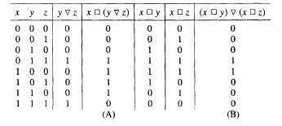
9.7 Binary Operations Revisited
Example 12:
(d) One possible distributive property is x ⇨ (y ∇ z) = (x ⇨ y) ∇ (x ⇨ z).
all possible cases must be checked.
We can show it in a table.

Slide 86
9.7 Binary Operations Revisited
Binary Operations
Definition
Properties of Binary Operations

Slide 87
9.7 Binary Operations Revisited
Binary operations(二元运算)
A binary operation on a set A is an everywhere defined function f:A × A → A.
A binary operation must satisfy:
f assigns an element f(a,b) of A to each ordered pair (a,b) in A × A.
Since a binary operation is a function. Only one element of A is assigned to each ordered pair.

Slide 88
9.7 Binary Operations Revisited
Note
It’s customary to denote binary operations by a symbol such as *, instead of f, and to denote the element assigned to (a, b) by a*b [instead of *(a, b)].
A is closed(封闭的) under the operation * , if a and b are elements in A, a*b ∈ A.

Slide 89
9.7 Binary Operations Revisited
Example 1:
Let A = Z. Define a*b as a + b.
* is a binary operation on Z.

Slide 90
9.7 Binary Operations Revisited
Example 2:
Let A = R . Define a*b as a/b.
* is not a binary operation, since it is not defined for every ordered pair of elements of A.
For example, 3*0 is not defined, since we can not divide by zero.

Slide 91
9.7 Binary Operations Revisited
Example 3:
Let A = Z⁺. Define a*b as a-b.
* is not a binary operation since it does not assign an element of A to every ordered pair of elements of A; for example,2*5 ∉ A.

Slide 92
9.7 Binary Operations Revisited
Example 4:
Let A = Z. Define a*b as a number less than both a and b.
* is not a binary operation, since it does not assign a unique element of A to each ordered pair of elements of A; for example, 8*6 could be 5, 4, 3, l, and so on.
in this case, * would be a relation from AA to A, but not a function

Slide 93
9.7 Binary Operations Revisited
Example 5:
Let A = Z. Define a*b as max{a, b}.
* is a binary operation; for example,2*4 = 4, -3*(-5)=-3.

Slide 94
9.7 Binary Operations Revisited
Example 6:
Let A = P(S), for some set S. If V and W are subsets of S, define V*W as V∪W.
* is a binary operation on A.
if we define V *' W as V∪W, then *' is another binary operation on A.
Note: It’s possible to define many binary operations on the same set.

Slide 95
9.7 Binary Operations Revisited
Example 7:
Let M be the set of all nn Boolean matrices for a fixed n. Define A*B as A∨B
* is a binary operation.
This is also true of A∨B.

Slide 96
9.7 Binary Operations Revisited
Example 8:
Let L be a lattice. Define a*b as a∨b.
* is a binary operation on L.
This is also true of a∨b

Slide 97
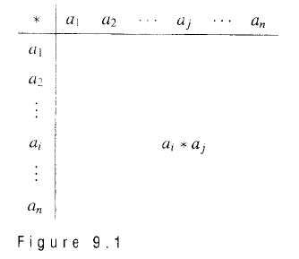
9.7 Binary Operations Revisited
Tables – 运算表
If A = {a_{l}, a₂,..., a_{n}} is a finite set, we can define a binary operation on A by means of a table

Slide 98
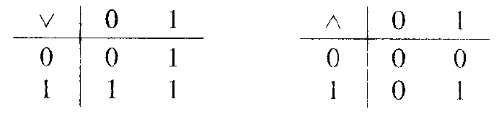
9.7 Binary Operations Revisited
Example 9:
Let
A = {0, l }.
Define binary operations ∨ and ∧ by the following tables:

Slide 99
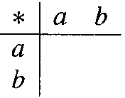
9.7 Binary Operations Revisited
How many operations?
If A = {a, b}, how many binary operations can be defined on A.
Every binary operation * on A can be described by a table
There are 2•2•2•2 = 2⁴ or 16 ways to complete the table.

Slide 100
9.7 Binary Operations Revisited
Properties of Binary Operations
For all elements a, b, and c in A
Commutative(交换律)
a*b = b*a
Associative(结合律)
a*(b*c) = (a*b)*c
Idempotent(等幂律)
a*a = a

Slide 101
9.7 Binary Operations Revisited
Commutative - 交换律
A binary operation on a set A is said to be commutative if a*b = b*a for all elements a and b in A.
Example:
The binary operation of addition on Z is commutative.
The binary operation of subtraction on Z is not commutative, since2-3 ≠ 3-2.

Slide 102
9.7 Binary Operations Revisited
Commutative - 交换律
A binary operation that is described by a table is commutative
if and only if
The entries in the table are symmetric with respect to the main diagonal.

Slide 103
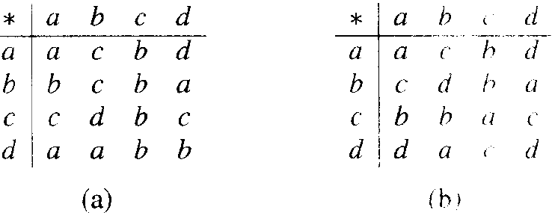
9.7 Binary Operations Revisited
Example 12:
Which of the fol1owing binary operations on A = {a, b, c, d} are commutative?

Slide 104
9.7 Binary Operations Revisited
Associative - 结合律
A binary operation * on a set A is said to be associative if a*(b*c) = (a*b)*c for all elements a, b, and c in A.
Example:
The binary operation of addition on Z is associative.
The binary operation of subtraction on Z is not associative, since2-(3-5) ≠ (2-3)-5.

Slide 105
9.7 Binary Operations Revisited
Example 15:
Let L be a lattice. The binary operation defined by a*b = a∧b is
commutative and
associative.
It also satisfies the idempotent property a∧a = a.

Slide 106
9.7 Binary Operations Revisited
Example 16:
Let * be a binary operation on a set A, and suppose that * satisfies the following properties for any a, b, and c in A:
a = a*a Idempotent property
a*b = b*a Commutative property
a*(b*c) = (a*b)*c Associative property

Slide 107
9.7 Binary Operations Revisited
Example 16:
Define a relation ≤ on A by
a  b
if and only if
a = a*b.
Show that (A, ≤ ) is a poset, and for all a, b in A, GLB(a, b) = a*b.

Slide 108
9.7 Binary Operations Revisited
Example 16:
Solution：
We must show that
≤ is reflexive, antisymmetric and transitive.
a*b = a∧b for all a and b in A.

Slide 109
9.7 Binary Operations Revisited
Example 16:
Solution：
≤ is reflexive
a ≤ b if and only if a = a*b
Since a = a*a,
a ≤ a for all a in A, and
≤ is reflexive.

Slide 110
9.7 Binary Operations Revisited
Example 16:
Solution：
≤ is antisymmetric
a ≤ b if and only if a = a*b
Now suppose that
a ≤ b and b ≤ a.
Then, by definition and property 2,
a = a*b = b*a = b,
so a = b.
Thus ≤ is antisymmetric.

Slide 111
9.7 Binary Operations Revisited
Example 16:
Solution：
≤ is transitive
a ≤ b if and only if a = a*b
If a ≤ b and b ≤ c,
then a = a*b = a*(b*c) = (a*b)*c = a*c,
so a ≤ c and
≤ is transitive.

Slide 112
9.7 Binary Operations Revisited
Example 16:
Solution：
a*b = a∧b, for all a and b in A
a ≤ b if and only if a = a*b
We have
a*b = a*(b*b) =(a*b)*b,
so a*b ≤ b.
In a similar way a*b ≤a.
so a*b is a lower bound for a and b.

Slide 113
9.7 Binary Operations Revisited
Example 16:
Solution：
Now, if c ≤ a and c ≤ b.
then c = c*a and c = c*b by definition.
Thus c = (c*a)*b = c*(a*b).
so c ≤ a*b.
This shows that a*b is the greatest lower bound of a and b.

Slide 114
9.7 Binary Operations Revisited
Homework
20 P323
24, 28 P324

Slide 115
9.7 Binary Operations Revisited
阿贝尔解决了构造任意次数的代数可解的方程的问题，却没能解决判定已知方程是否可用根式求解的问题。法国数学家伽罗瓦正是处在这样的背景下，开始接手阿贝尔未竞的事业。

Slide 116
9.7 Binary Operations Revisited
伽罗瓦在证明不存在一个五次或高于五次的方程的一般根式解法时，与拉格朗日相同，也从方程根的置换入手。当他系统地研究了方程根的排列置换性质后，提出了一些确定的准则以判定一个已知方程的解是否能通过根式找到，然而这些方法恰好导致他去考虑一种称之为“群”的元素集合的抽象代数理论。在1831年的论文中，伽罗瓦首次提出了“群”这一术语，把具有封闭性的置换的集合称为群，首次定义了置换群的概念。他认为了解置换群是解决方程理论的关键，方程是一个其对称性可用群的性质描述的系统。他从此开始把方程论问题转化为群论的问题来解决，直接研究群论。他引入了不少有关群论的新概念，从而也产生了他自己的伽罗瓦群论，因此后人都称他为群论的创始人。

Slide 117
9.7 Binary Operations Revisited
对有理系数的n次方程 x^{n}+ax^{n-1}+a₂x^{n-2}+…+a_{n-1}x+a_{n}=0 （1）
假设它的n个根x₁,x₂,…,x_{n}的每一个变换叫做一个置换，n个根共有n!个可能的置换，它们的集合关于置换的乘法构成一个群，是根的置换群。方程的可解性可以在根的置换群的某些性质中有所反映，于是伽罗瓦把代数方程可解性问题转化为与相关的置换群及其子群性质的分析问题。现在把与方程联系起的置换群（它表现了方程的对称性质）称为伽罗瓦群，它是在某方程系数域中的群。

Slide 118
9.7 Binary Operations Revisited
一个方程的伽罗瓦群是对于每一个其函数值为有理数的关于根的多项式函数都满足这个要求的最大置换群，也可以说成对于任一个取有理数值的关于根的多项式函数，伽罗瓦群中的每个置换都使这函数的值不变。伽罗瓦创立群论是为了应用于方程论，但他并不局限于此，而是把群论进行了推广，作用于其他研究领域。可惜的是，伽罗瓦群论的理论毕竟太深奥，对十九世纪初的人们来说是很难理解的，连当时的数学大师都不能理解他的数学思想和他的工作的实质，以至他的论文得不到发表。更不幸的是伽罗瓦在二十一岁时便因一场愚蠢的决斗而早逝，我们不得不为这位天才感到惋惜。到十九世纪六十年代，他的理论才终于为人们所理解和接受。

Slide 119

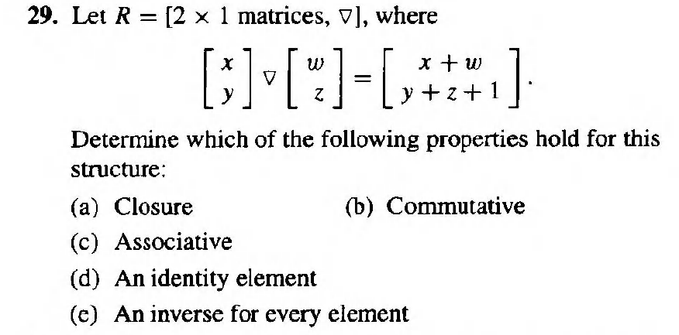
9.7 Binary Operations Revisited
单选题
10分
A
a
a,b,c,d,e
C
B
a,b,c
a,b,c,d
D
提交

Slide 120
9.7 Binary Operations Revisited
多选题
10分
Determine whether the description of * is a valid definition of a binary operation on the set.
A
On R,where a*b is ab(ordinary multiplication).
B
On Z⁺,where a*b is a/b.
C
On Z, where a*b is a^{b}.
D
On Z⁺，where a*b is a^{b}.
E
On Z⁺ where a*b is a-b.
F
On R where a*b is a√b.
G
On R,where a*b is the largest rational number that is less than ab.
H
On Z, where a*b is 2a+b.
提交

