Slide 1
离散数据及其应用 Discrete Mathematics and Its Applications （Eighth Edition/Kenneth H.Rosen） 郭少勇 (syguo@bupt.edu.cn) 北京邮电大学 2021.10

Slide 2
Advanced Counting Techniques
8.1 递推关系的应用/Applications of Recurrence Relations
8.2 求解线性递推关系/Solving Linear Recurrence Relations
8.3 分治算法和递推关系/Divide-and-Conquer Algorithms and Recurrence Relations
8.4 生成函数/Generating Functions
8.5 容斥/Inclusion–Exclusion
8.6 容斥原理的应用/Applications of Inclusion–Exclusion

Slide 3
8.1.1 Introduction
Recall from Chapter 2 that a recursive definition of a sequence specifies one or more initial terms and a rule for determining subsequent terms from those that precede them.
Also, recall that a rule of the latter sort (whether or not it is part of a recursive definition) is called a recurrence relation(递推关系) and that a sequence is called a solution of a recurrence relation if its terms satisfy the recurrence relation.

Slide 4
8.1.1 Introduction
In this section we will show that such relations can be used to study and to solve counting problems. For example, suppose that the number of bacteria in a colony doubles every hour. If a colony begins with five bacteria, how many will be present in n hours?
To solve this problem, let an be the number of bacteria at the end of n hours. Because the number of bacteria doubles every hour, the relationship a_{n} = 2a_{n−1} holds whenever n is a positive integer.

Slide 5
8.1.1 Introduction
This recurrence relation, together with the initial condition a₀ = 5, uniquely determines an for all nonnegative integers n. We can find a formula for an using the iterative approach followed in Chapter 2, namely that a_{n} = 5 ⋅ 2^{n} for all nonnegative integers n.
Some of the counting problems that cannot be solved using the techniques discussed in Chapter 6 can be solved by finding recurrence relations involving the terms of a sequence, as was done in the problem involving bacteria.

Slide 6
8.1.1 Introduction
In this section we will study a variety of counting problems that can be modeled using recurrence relations. In Chapter 2 we developed methods for solving certain recurrence relation.
In Section 8.2 we will study methods for finding explicit formulae for the terms of sequences that satisfy certain types of recurrence relations.
We conclude this section by introducing the algorithmic paradigm of dynamic programming. After explaining how this paradigm works, we will illustrate its use with an example.

Slide 7
8.1.2 Modeling With Recurrence Relations
We can use recurrence relations to model a wide variety of problems, such as finding compound interest (see Example 11 in Section 2.4), counting rabbits on an island, determining the number of moves in the Tower of Hanoi puzzle, and counting bit strings with certain properties.
Example 1 shows how the population of rabbits on an island can be modeled using a recurrence relation.

Slide 8
8.1.2 Modeling With Recurrence Relations
Example 1:
Rabbits and the Fibonacci Numbers(兔子和斐波那契数)
Consider this problem, which was originally posed by Leonardo Pisano, also known as Fibonacci, in the thirteenth century in his book Liber abaci.
A young pair of rabbits (one of each sex) is placed on an island. A pair of rabbits does not breed until they are 2 months old. After they are 2 months old, each pair of rabbits produces another pair each month, as shown in Figure 1. Find a recurrence relation for the number of pairs of rabbits on the island after n months, assuming that no rabbits ever die.

Slide 9
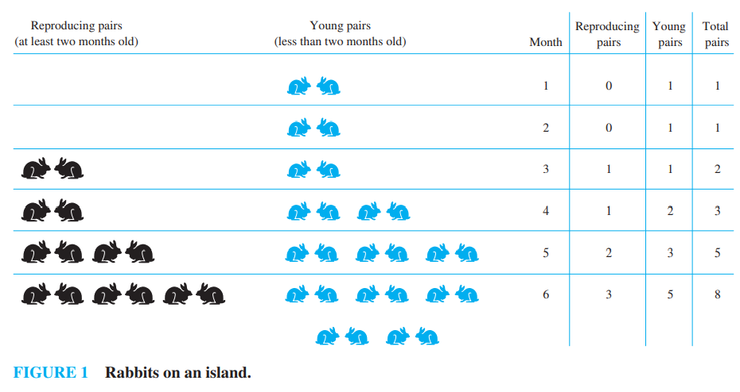
8.1.2 Modeling With Recurrence Relations
Example 1:

Slide 10
8.1.2 Modeling With Recurrence Relations
Solution:
Denote by f_{n} the number of pairs of rabbits after n months. We will show that f_{n}, n = 1, 2, 3, … , are the terms of the Fibonacci sequence.
The rabbit population can be modeled using a recurrence relation.
At the end of the first month, the number of pairs of rabbits on the island is f₁ = 1. Because this pair does not breed during the second month, f₂ = 1 also.
To find the number of pairs after n months, add the number on the island the previous month, f_{n−1}, and the number of newborn pairs, which equals f_{n−2}, because each newborn pair comes from a pair at least 2 months old.

Slide 11
8.1.2 Modeling With Recurrence Relations
Solution:
Consequently, the sequence {f_{n}} satisfies the recurrence relation
f_{n} = f_{n−1} + f_{n−2}
for n ≥ 3 together with the initial conditions f₁ = 1 and f₂ = 1.
Because this recurrence relation and the initial conditions uniquely determine this sequence, the number of pairs of rabbits on the island after n months is given by the nth Fibonacci number.

Slide 12
8.1.2 Modeling With Recurrence Relations
Example 2:
The Tower of Hanoi Puzzle(汉诺塔)
A popular puzzle of the late nineteenth century invented by the French mathematician Edouard Lucas, called the Tower of Hanoi, consists of three pegs mounted on a board together with disks of different sizes.
Initially these disks are placed on the first peg in order of size, with the largest on the bottom (as shown in Figure 2).
The rules of the puzzle allow disks to be moved one at a time from one peg to another as long as a disk is never placed on top of a smaller disk.

Slide 13
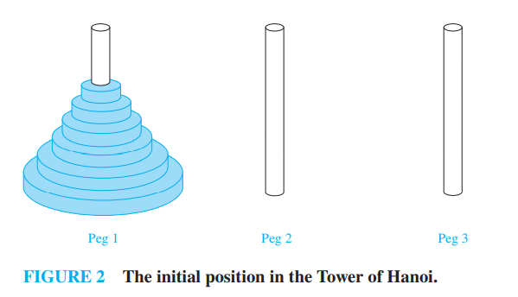
8.1.2 Modeling With Recurrence Relations
Example 2:
The goal of the puzzle is to have all the disks on the second peg in order of size, with the largest on the bottom.
Let Hn denote the number of moves needed to solve the Tower of Hanoi puzzle with n disks. Set up a recurrence relation for the sequence {H_{n}}.

Slide 14
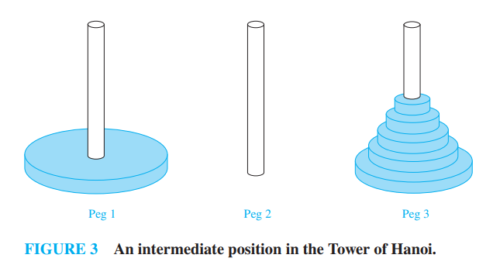
8.1.2 Modeling With Recurrence Relations
Solution:
Begin with n disks on peg 1.
We can transfer the top n−1 disks, following the rules of the puzzle, to peg 3 using H_{n−1} moves (see Figure 3 for an illustration of the pegs and disks at this point).

Slide 15
8.1.2 Modeling With Recurrence Relations
Solution:
We keep the largest disk fixed during these moves. Then, we use one move to transfer the largest disk to the second peg.
Finally, we transfer the n−1 disks on peg 3 to peg 2 using H_{n−1} moves, placing them on top of the largest disk, which always stays fixed on the bottom of peg 2.
This shows that we can solve the Tower of Hano puzzle for n disks using 2H_{n−1}+1 moves.

Slide 16
8.1.2 Modeling With Recurrence Relations
Solution:
We now show that we cannot solve the puzzle for n disks using fewer that 2H_{n−1}+1 moves.
Note that when we move the largest disk, we must have already moved the n−1 smaller disks onto a peg other than peg 1.
Doing so requires at least H_{n−1} moves. Another move is needed to transfer the largest disk.
Finally, at least H_{n−1} more moves are needed to put the n−1 smallest disks back on top of the largest disk. Adding the number of moves required gives us the desired lower bound.

Slide 17
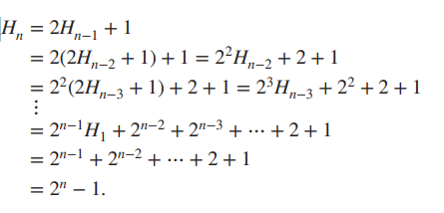
8.1.2 Modeling With Recurrence Relations
Solution:
We conclude that
H_{n} = 2H_{n−1} + 1.
The initial condition is H₁ = 1, because one disk can be transferred from peg 1 to peg 2, according to the rules of the puzzle, in one move.
We can use an iterative approach to solve this recurrence relation. Note that

Slide 18
8.1.2 Modeling With Recurrence Relations
Solution:
We have used the recurrence relation repeatedly to express H_{n} in terms of previous terms of the sequence. In the next to last equality, the initial condition H₁ = 1 has been used. The last equality is based on the formula for the sum of the terms of a geometric series, which can be found in Theorem 1 in Section 2.4.
The iterative approach has produced the solution to the recurrence relation Hn = 2H_{n−1} + 1 with the initial condition H₁ = 1. This formula can be proved using mathematical induction. This is left for the reader as Exercise 1.

Slide 19
8.1.2 Modeling With Recurrence Relations
Solution:
A myth created to accompany the puzzle tells of a tower in Hanoi where monks are transferring 64 gold disks from one peg to another, according to the rules of the puzzle.
The myth says that the world will end when they finish the puzzle.
How long after the monks started will the world end if the monks take one second to move a disk?

Slide 20
8.1.2 Modeling With Recurrence Relations
Solution:
From the explicit formula, the monks require
2⁶⁴ − 1 = 18,446,744,073,709,551,615
moves to transfer the disks. Making one move per second, it will take them more than 500 billion years to complete the transfer, so the world should survive a while longer than it already has.

Slide 21
8.1.2 Modeling With Recurrence Relations
Remarks
Many people have studied variations of the original Tower of Hanoi puzzle discussed in Example 2. Some variations use more pegs, some allow disks to be of the same size, and some restrict the types of allowable disk moves.
One of the oldest and most interesting variations is the Reve’s puzzle∗(雷夫难题), proposed in 1907 by Henry Dudeney in his book The Canterbury Puzzles.

Slide 22
8.1.2 Modeling With Recurrence Relations
Example 3:
Find a recurrence relation and give initial conditions for the number of bit strings of length n that do not have two consecutive 0s. How many such bit strings are there of length five?
Solution:
Let an denote the number of bit strings of length n that do not have two consecutive 0s. We assume that n ≥ 3, so that the bit string has at least three bits.
Strings of this sort of length n can be divided into those that end in 1 and those that end in 0.

Slide 23
8.1.2 Modeling With Recurrence Relations
Solution:
The bit strings of length n ending with 1 that do not have two consecutive 0s are precisely the bit strings of length n − 1 with no two consecutive 0s with a 1 added at the end. Consequently, there are a_{n−1} such bit strings.
Bit strings of length n ending with a 0 that do not have two consecutive 0s must have 1 as their (n − 1)st bit; otherwise they would end with a pair of 0s. Hence, the bit strings of length n ending with a 0 that have no two consecutive 0s are precisely the bit strings of length n − 2 with no two consecutive 0s with 10 added at the end. Consequently, there are a_{n−2} such bit strings

Slide 24
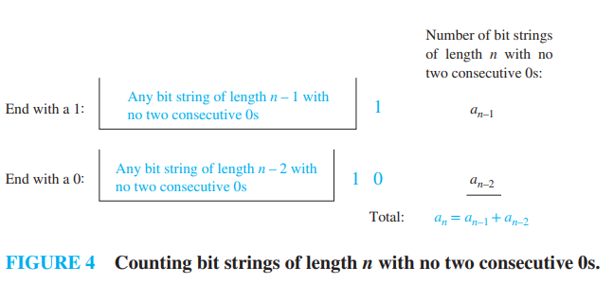
8.1.2 Modeling With Recurrence Relations
Solution:
We conclude, as illustrated in Figure 4, that for n ≥ 3
a_{n} = a_{n−1} + a_{n−2}
The initial conditions are a₁ = 2, because both bit strings of length one, 0 and 1 do not have consecutive 0s, and a₂ = 3, because the valid bit strings of length two are 01, 10, and 11. To obtain a₅, we use the recurrence relation three times to find that
a₃ = a₂ + a₁ = 3 + 2 = 5,
a₄ = a₃ + a₂ = 5 + 3 = 8,
a₅ = a₄ + a₃ = 8 + 5 = 13.

Slide 25
8.1.2 Modeling With Recurrence Relations
Remarks
Note that {a_{n}} satisfies the same recurrence relation as the Fibonacci sequence.
Because a₁ = f₃ and a₂ = f₄ it follows that a_{n} = f_{n+2}

Slide 26
8.1.2 Modeling With Recurrence Relations
Example 4:
Codeword Enumeration(编码字的枚举)
A computer system considers a string of decimal digits a valid codeword if it contains an even number of 0 digits. For instance, 1230407869 is valid, whereas 120987045608 is not valid.
Let a_{n} be the number of valid n-digit codewords. Find a recurrence relation for a_{n}.

Slide 27
8.1.2 Modeling With Recurrence Relations
Solution:
Note that a₁ = 9 because there are 10 one-digit strings, and only one, namely, the string 0, is not valid.
A recurrence relation can be derived for this sequence by considering how a valid n-digit string can be obtained from strings of n−1 digits.
There are two ways to form a valid string with n digits from a string with one fewer digit.

Slide 28
8.1.2 Modeling With Recurrence Relations
Solution:
Note that a₁ = 9 because there are 10 one-digit strings, and only one, namely, the string 0, is not valid.
A recurrence relation can be derived for this sequence by considering how a valid n-digit string can be obtained from strings of n−1 digits.
There are two ways to form a valid string with n digits from a string with one fewer digit.

Slide 29
8.1.2 Modeling With Recurrence Relations
Solution:
First, a valid string of n digits can be obtained by appending a valid string of n − 1 digits with a digit other than 0. This appending can be done in nine ways. Hence, a valid stringwith n digits can be formed in this manner in 9a_{n−1} ways.

Slide 30
8.1.2 Modeling With Recurrence Relations
Solution:
Second, a valid string of n digits can be obtained by appending a 0 to a string of length n−1 that is not valid. (This produces a string with an even number of 0 digits because the invalid string of length n−1 has an odd number of 0 digits.)
The number of ways that this can be done equals the number of invalid (n−1)-digit strings. Because there are 10^{n−1} strings of length n−1, and a_{n−1} are valid, there are 10^{n−1}−a_{n−1} valid n-digit strings obtained by appending an invalid string of length n−1 with a 0.

Slide 31
8.1.2 Modeling With Recurrence Relations
Solution:
Because all valid strings of length n are produced in one of these two ways, it follows that there are
a_{n} = 9a_{n−1} + (10^{n−1} − a_{n−1})
= 8a_{n−1} + 10^{n−1}
valid strings of length n.

Slide 32

8.1.2 Modeling With Recurrence Relations
Example 5:
Find a recurrence relation for C_{n}, the number of ways to parenthesize the product of n+1 numbers, x₀ ⋅ x₁ ⋅ x₂ ⋅…⋅ x_{n}, to specify the order of multiplication.
For example, C₃ = 5 because there are five ways to parenthesize x₀ ⋅ x₁ ⋅ x₂ ⋅ x₃ to determine the order of multiplication:

Slide 33
8.1.2 Modeling With Recurrence Relations
Solution:
To develop a recurrence relation for Cn, we note that however we insert parentheses in the product x₀ ⋅ x₁ ⋅ x₂ ⋅ … ⋅ x_{n}, one “⋅” operator remains outside all parentheses, namely, the operator for the final multiplication to be performed. [For example, in (x₀ ⋅ (x₁ ⋅ x₂)) ⋅ x₃, it is the final “⋅”, while in (x₀ ⋅ x₁) ⋅ (x₂ ⋅ x₃) it is the second “⋅”.]
This final operator appears between two of the n+1 numbers, say, x_{k} and x_{k+1}.

Slide 34
8.1.2 Modeling With Recurrence Relations
Solution:
There are C_{k}C_{n−k−1} ways to insert parentheses to determine the order of the n+1 numbers to be multiplied when the final operator appears between x_{k} and x_{k+1}, because there are C_{k} ways to insert parentheses in the product x₀ ⋅ x₁ ⋅…⋅ x_{k} to determine the order in which these k+1 numbers are to be multiplied and C_{n−k−1} ways to insert parentheses in the product x_{k+1} ⋅ x_{k+2} ⋅…⋅ x_{n} to determine the order in which these n−k numbers are to be multiplied.

Slide 35
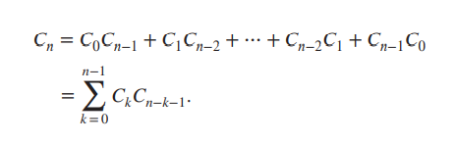
8.1.2 Modeling With Recurrence Relations
Solution:
Because this final operator can appear between any two of the n+1 numbers, it follows that
Note that the initial conditions are C₀ = 1 and C₁ = 1.

Slide 36
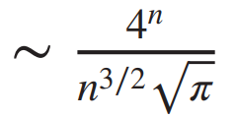
8.1.2 Modeling With Recurrence Relations
Solution:
The recurrence relation in Example 5 can be solved using the method of generating functions, which will be discussed in Section 8.4. It can be shown that C_{n} = C(2n, n)/(n + 1) (see Exercise 43 in Section 8.4) and that C_{n} (see [GrKnPa94]).
The sequence {C_{n}} is the Links sequence of Catalan numbers(卡塔兰数), named after Eugene Charles Catalan.
This sequence appears as the solution of many different counting problems besides the one considered here (see the chapter on Catalan numbers in [MiRo91] or [RoTe03] for details).

Slide 37
8.1.3 Algorithms and Recurrence Relations
Recurrence relations play an important role in many aspects of the study of algorithms and their complexity.
In Section 8.3, we will show how recurrence relations can be used to analyze the complexity of divide-and-conquer algorithms, such as the merge sort algorithm introduced in Section 5.4.

Slide 38
8.1.3 Algorithms and Recurrence Relations
As we will see in Section 8.3, divide-and-conquer algorithms recursively divide a problem into a fixed number of nonoverlapping subproblems until they become simple enough to solve directly.
We conclude this section by introducing another algorithmic paradigm known as dynamic programming(动态规划), which can be used to solve many optimization problems efficiently.

Slide 39
8.1.3 Algorithms and Recurrence Relations
An Example of Dynamic Programming
The problem we use to illustrate dynamic programming is related to the problem studied in Example 7 in Section 3.1. In that problem our goal was to schedule as many talks as possible in a single lecture hall.
These talks have preset start and end times; once a talk starts, it continues until it ends; no two talks can proceed at the same time; and a talk can begin at the same time another one ends.

Slide 40
8.1.3 Algorithms and Recurrence Relations
An Example of Dynamic Programming
We developed a greedy algorithm that always produces an optimal schedule, as we proved in Example 12 in Section 5.1. Now suppose that our goal is not to schedule the most talks possible, but rather to have the largest possible combined attendance of the scheduled talks.

Slide 41
8.1.3 Algorithms and Recurrence Relations
An Example of Dynamic Programming
We formalize this problem by supposing that we have n talks, where talk j begins at time t_{j}, ends at time e_{j}, and will be attended by w_{j} students. We want a schedule that maximizes the total number of student attendees.

Slide 42
8.1.3 Algorithms and Recurrence Relations
An Example of Dynamic Programming
That is, we wish to schedule a subset of talks to maximize the sum of wj over all scheduled talks. (Note that when a student attends more than one talk, this student is counted according to the number of talks attended.)
We denote by T(j) the maximum number of total attendees for an optimal schedule from the first j talks, so T(n) is the maximal number of total attendees for an optimal schedule for all n talks.

Slide 43
8.1.3 Algorithms and Recurrence Relations
An Example of Dynamic Programming
We first sort the talks in order of increasing end time. After doing this, we renumber the talks so that e₁ ≤ e₂ ≤ ⋯ ≤ e_{n}.
We say that two talks are compatible(相容的) if they can be part of the same schedule, that is, if the times they are scheduled do not overlap (other than the possibility one ends and the other starts at the same time).

Slide 44
8.1.3 Algorithms and Recurrence Relations
An Example of Dynamic Programming
We define p(j) to be largest integer i, i < j, for which e_{i} ≤ s_{j}, if such an integer exists, and p(j) = 0 otherwise.
That is, talk p(j) is the talk ending latest among talks compatible with talk j that end before talk j ends, if such a talk exists, and p(j) = 0 if there are no such talks.

Slide 45
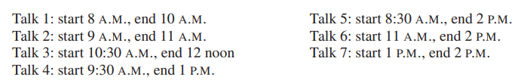
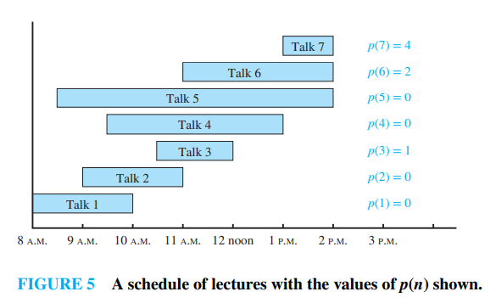
8.1.3 Algorithms and Recurrence Relations
Example 6:
Consider seven talks with these start times and end times, as illustrated in Figure 5
Find p(j) for j = 1, 2, … , 7.

Slide 46
8.1.3 Algorithms and Recurrence Relations
Solution:
We have p(1) = 0 and p(2) = 0, because no talks end before either of the first two talks begin. We have p(3) = 1 because talk 3 and talk 1 are compatible, but talk 3 and talk 2 are not compatible; p(4) = 0 because talk 4 is not compatible with any of talks 1, 2, and 3; p(5) = 0 because talk 5 is not compatible with any of talks 1, 2, 3, and 4; and p(6) = 2 because talk 6 and talk 2 are compatible, but talk 6 is not compatible with any of talks 3, 4, and 5.
Finally, p(7) = 4, because talk 7 and talk 4 are compatible, but talk 7 is not compatible with either of talks 5 or 6.

Slide 47
8.1.3 Algorithms and Recurrence Relations
To develop a dynamic programming algorithm for this problem, we first develop a key recurrence relation.
To do this, first note that if j ≤ n, there are two possibilities for an optimal schedule of the first j talks (recall that we are assuming that the n talks are ordered by increasing end time): (i) talk j belongs to the optimal schedule or (ii) it does not.

Slide 48
8.1.3 Algorithms and Recurrence Relations
Case (i): We know that talks p(j)+1, … , j−1 do not belong to this schedule, for none of these other talks are compatible with talk j. Furthermore, the other talks in this optimal schedule must comprise an optimal schedule for talks 1, 2, … , p(j). For if there were a better schedule for talks 1, 2, … , p(j), by adding talk j, we will have a schedule better than the overall optimal schedule. Consequently, in case (i), we have T(j) = wj + T(p(j)).

Slide 49

8.1.3 Algorithms and Recurrence Relations
Case (ii): When talk j does not belong to an optimal schedule, it follows that an optimal schedule from talks 1, 2, … , j is the same as an optimal schedule from talks 1, 2, … , j−1. Consequently, in case (ii), we have T(j) = T( j−1). Combining cases (i) and (ii) leads us to the recurrence relation

Slide 50
8.1.3 Algorithms and Recurrence Relations
Now that we have developed this recurrence relation, we can construct an efficient algorithm, Algorithm 1, for computing the maximum total number of attendees.
We ensure that the algorithm is efficient by storing the value of each T(j) after we compute it.
This allows us to compute T(j) only once. If we did not do this, the algorithm would have exponential worst-case complexity.

Slide 51
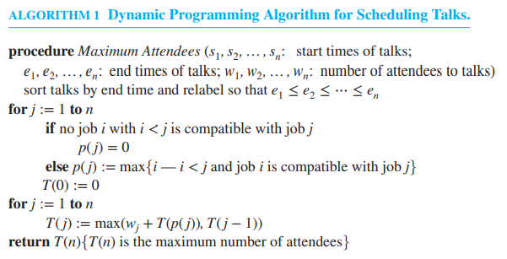
8.1.3 Algorithms and Recurrence Relations
The process of storing the values as each is computed is known as memorization(记忆) and is an important technique for making recursive algorithms efficient.

Slide 52
8.1.3 Algorithms and Recurrence Relations
In Algorithm 1 we determine the maximum number of attendees that can be achieved by a schedule of talks, but we do not find a schedule that achieves this maximum.
To find talks we need to schedule, we use the fact that talk j belongs to an optimal solution for the first j talks if and only if wj + T(p(j)) ≥ T(j−1). We leave it as Exercise 53 to construct an algorithm based on this observation that determines which talks should be scheduled to achieve the maximum total number of attendees.

Slide 53
8.1.3 Algorithms and Recurrence Relations
Algorithm 1 is a good example of dynamic programming as the maximum total attendance is found using the optimal solutions of the overlapping subproblems, each of which determines the maximum total attendance of the first j talks for some j with 1 ≤ j ≤ n−1.
See Exercises 56 and 57 and Supplementary Exercises 14 and 17 for other examples of dynamic programming.

Slide 54
8.1 Applications of Recurrence Relations-作业
§

Slide 55
8.2.1 Introduction
A linear homogeneous recurrence relation of degree k with constant coefficients is a recurrence relation of the form
a_{n} = c₁a_{n−1} + c₂a_{n−2} + ⋯ + c_{k}a_{n−k},
where c₁, c₂, … , c_{k} are real numbers, and c_{k} ≠ 0.

Slide 56
8.2.1 Introduction
The recurrence relation in the definition is linear(线性的) because the right-hand side is a sum of previous terms of the sequence each multiplied by a function of n. The recurrence relation is homogeneous(齐次的) because no terms occur that are not multiples of the a_{j}s. The coefficients of the terms of the sequence are all constants(常数), rather than functions that depend on n. The degree(阶) is k because an is expressed in terms of the previous k terms of the sequence.

Slide 57
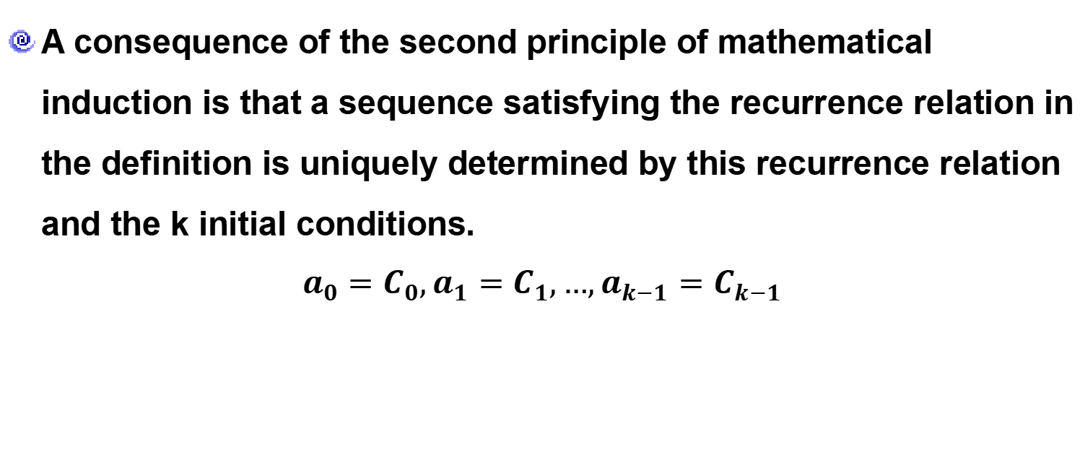
8.2.1 Introduction
A consequence of the second principle of mathematical induction is that a sequence satisfying the recurrence relation in the definition is uniquely determined by this recurrence relation and the k initial conditions.
$$a_{0}=C_{0},a_{1}=C_{1},…,a_{k−1}=C_{k−1}$$

Slide 58
8.2.1 Introduction
Example 1:
The recurrence relation P_{n} = (1.11)P_{n−1} is a linear homogeneous recurrence relation of degree one. The recurrence relation f_{n} = f_{n−1} + f_{n−2} is a linear homogeneous recurrence relation of degree two. The recurrence relation a_{n} = a_{n−5} is a linear homogeneous recurrence relation of degree five.

Slide 59

8.2.1 Introduction
Example 2:
The recurrence relation $a_{n}=a_{n−1}+a_{n−2}^{2}$ is not linear. The recurrence relation H_{n} = 2H_{n−1} +1 is not homogeneous. The recurrence relation B_{n} = nB_{n−1} does not have constant coefficients.

Slide 60
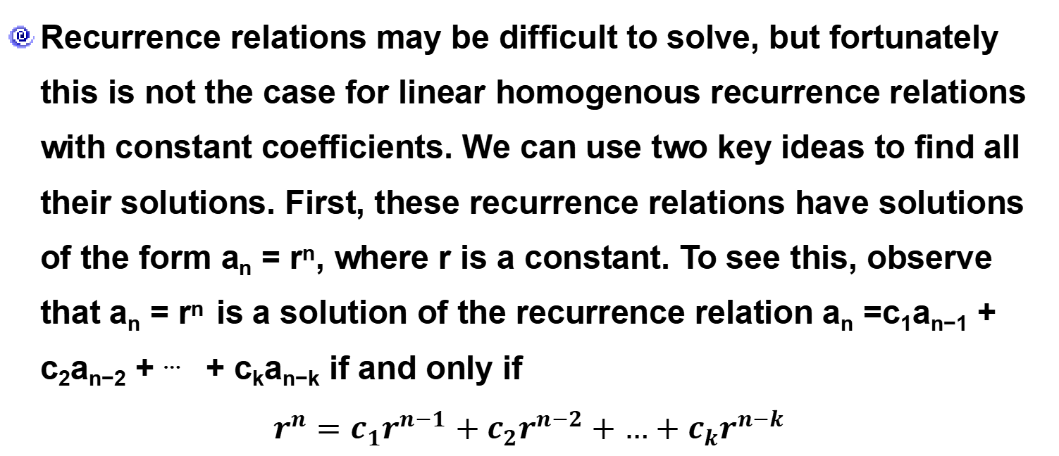
8.2.2 Solving Linear Homogeneous Recurrence Relations with Constant Coefficients
Recurrence relations may be difficult to solve, but fortunately this is not the case for linear homogenous recurrence relations with constant coefficients. We can use two key ideas to find all their solutions. First, these recurrence relations have solutions of the form a_{n} = r^{n}, where r is a constant. To see this, observe that a_{n} = r^{n} is a solution of the recurrence relation a_{n} =c₁a_{n−1} + c₂a_{n−2} + ⋯ + c_{k}a_{n−k} if and only if
$$r^{n}=c_{1}r^{n−1}+c_{2}r^{n−2}+…+c_{k}r^{n−k}$$

Slide 61
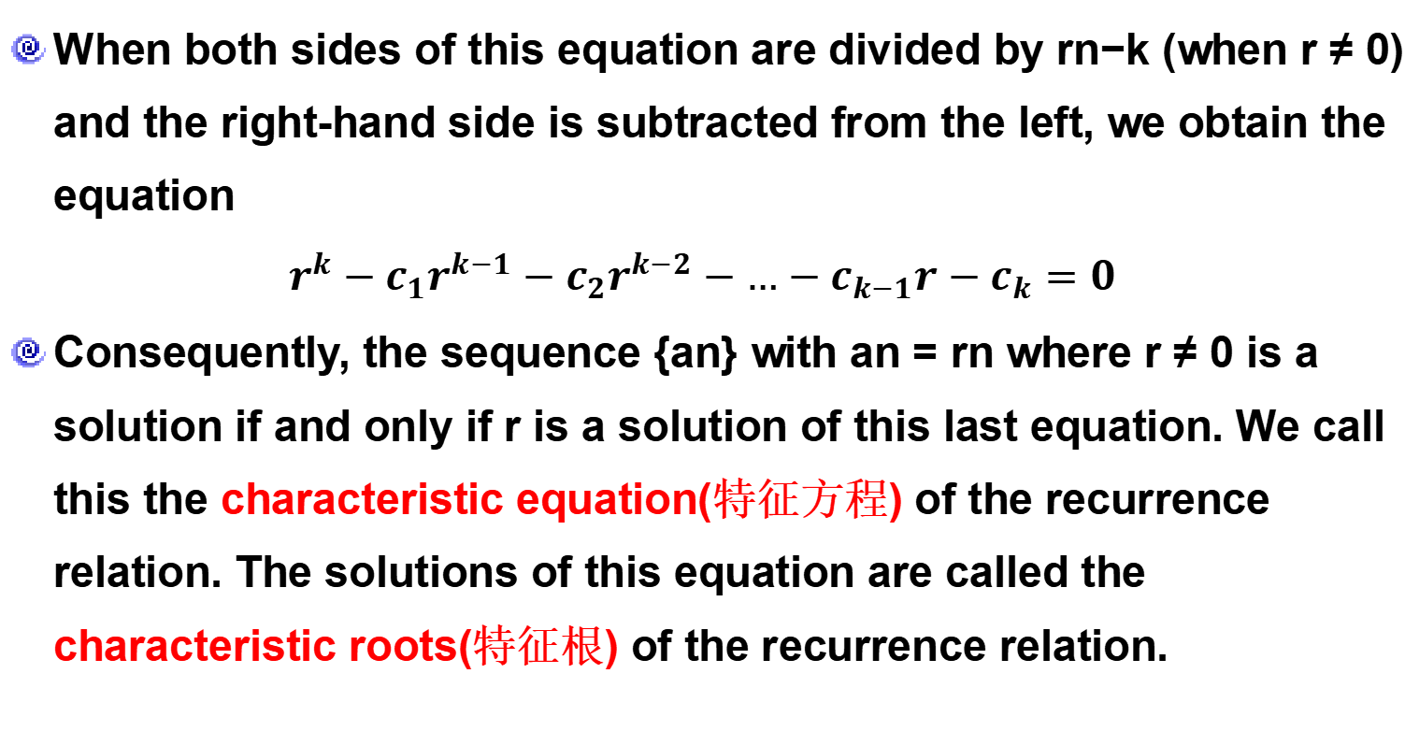
8.2.2 Solving Linear Homogeneous Recurrence Relations with Constant Coefficients
When both sides of this equation are divided by rn−k (when r ≠ 0) and the right-hand side is subtracted from the left, we obtain the equation
$$r^{k}−c_{1}r^{k−1}−c_{2}r^{k−2}−…−c_{k−1}r−c_{k}=0$$
Consequently, the sequence {an} with an = rn where r ≠ 0 is a solution if and only if r is a solution of this last equation. We call this the characteristic equation(特征方程) of the recurrence relation. The solutions of this equation are called the characteristic roots(特征根) of the recurrence relation.

Slide 62
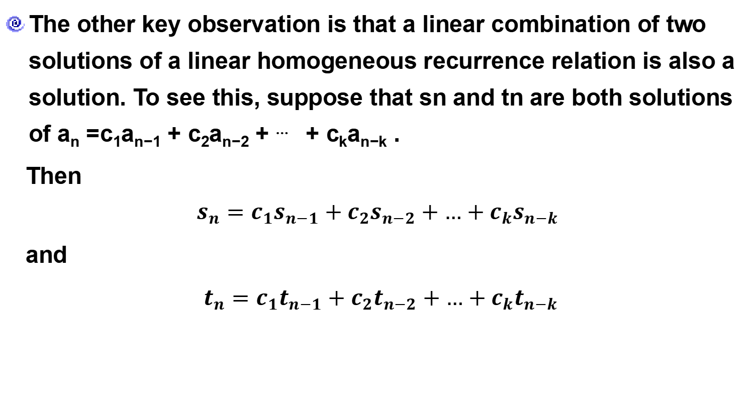
8.2.2 Solving Linear Homogeneous Recurrence Relations with Constant Coefficients
The other key observation is that a linear combination of two solutions of a linear homogeneous recurrence relation is also a solution. To see this, suppose that sn and tn are both solutions of a_{n} =c₁a_{n−1} + c₂a_{n−2} + ⋯ + c_{k}a_{n−k} .
Then
$$s_{n}=c_{1}s_{n−1}+c_{2}s_{n−2}+…+c_{k}s_{n−k}$$
and
$t_{n}=c_{1}t_{n−1}+c_{2}t_{n−2}+…+c_{k}t_{n−k}$

Slide 63
8.2.2 Solving Linear Homogeneous Recurrence Relations with Constant Coefficients
Now suppose that b1 and b2 are real numbers. Then
This means that b₁s_{n} + b₂t_{n} is also a solution of the same linear homogeneous recurrence relation.
$b_{1}s_{n}$+ $b_{2}t_{n}=b_{1}\left(c_{1}s_{n−1}+c_{2}s_{n−2}+…+c_{k}s_{n−k}\right)+b_{2}\left(c_{1}t_{n−1}+c_{2}t_{n−2}+…+c_{k}t_{n−k}\right)$
$=c_{1}\left(b_{1}s_{n−1}+b_{2}t_{n−1}\right)+c_{2}\left(b_{1}s_{n−2}+b_{2}t_{n−2}\right)+…+c_{k}(b_{1}s_{n−k}+b_{k}t_{n−k})$.

Slide 64
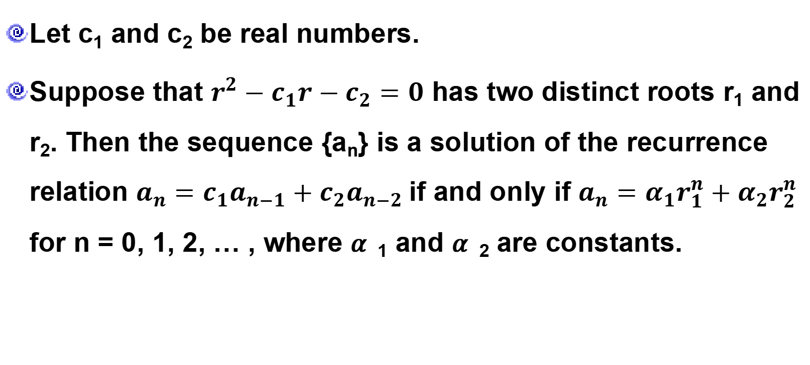
8.2.2 Solving Linear Homogeneous Recurrence Relations with Constant Coefficients
Theorem 1
Let c₁ and c₂ be real numbers.
Suppose that $r^{2}−c_{1}r−c_{2}=0$ has two distinct roots r₁ and r₂. Then the sequence {a_{n}} is a solution of the recurrence relation $a_{n}=c_{1}a_{n−1}+c_{2}a_{n−2}$if and only if $a_{n}=α_{1}r_{1}^{n}+α_{2}r_{2}^{n}$ for n = 0, 1, 2, … , where 𝛼₁ and 𝛼₂ are constants.

Slide 65
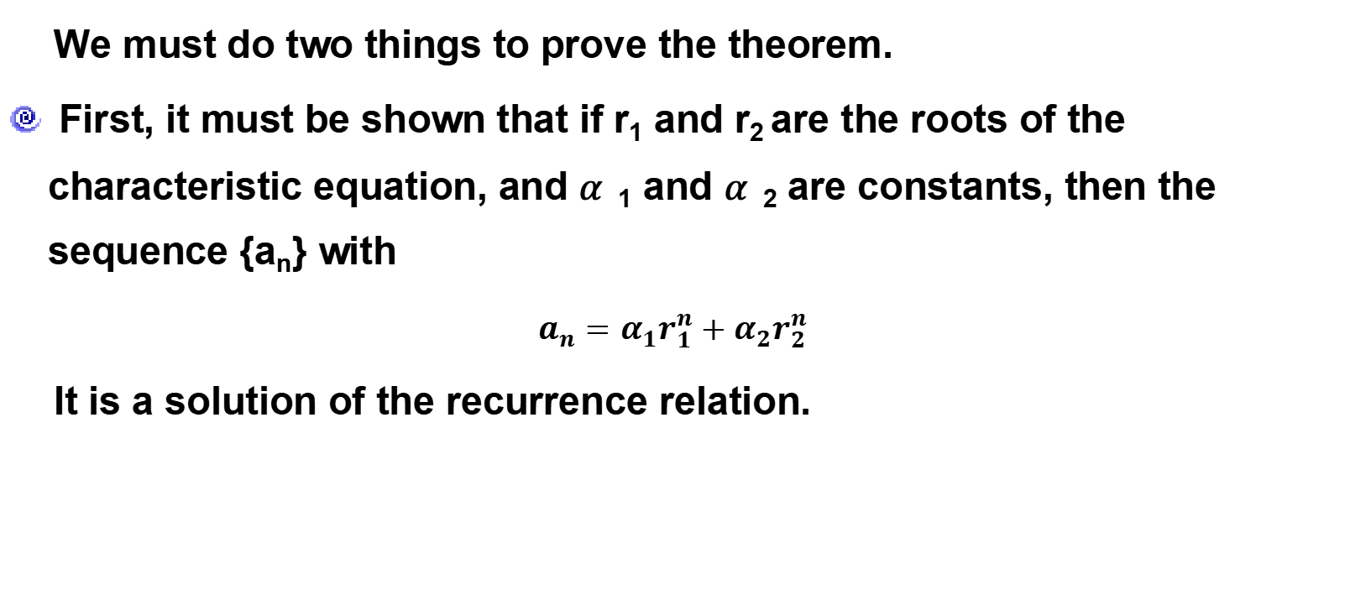
8.2.2 Solving Linear Homogeneous Recurrence Relations with Constant Coefficients
Proof
We must do two things to prove the theorem.
First, it must be shown that if r₁ and r₂ are the roots of the characteristic equation, and 𝛼₁ and 𝛼₂ are constants, then the sequence {a_{n}} with
$a_{n}=α_{1}r_{1}^{n}+α_{2}r_{2}^{n}$
It is a solution of the recurrence relation.

Slide 66
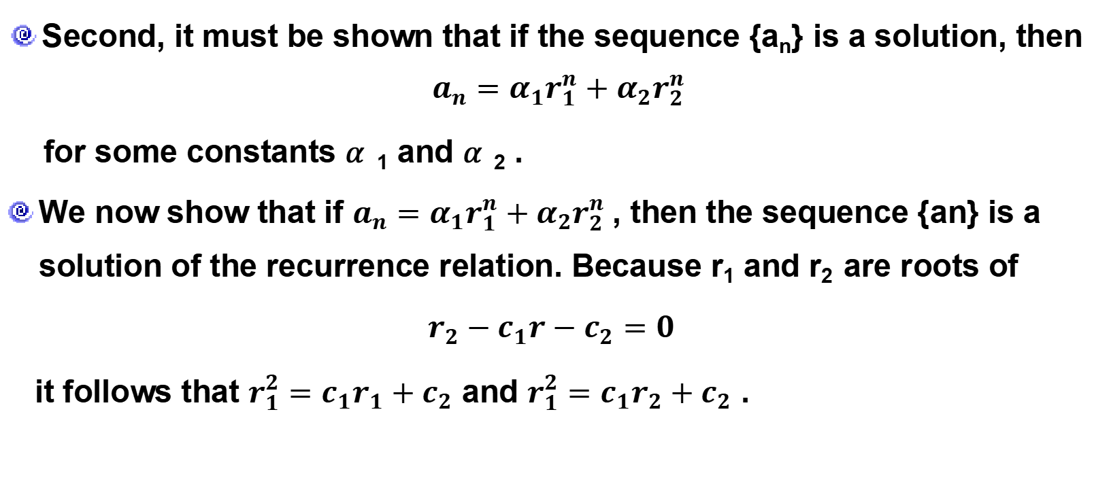
8.2.2 Solving Linear Homogeneous Recurrence Relations with Constant Coefficients
Proof
Second, it must be shown that if the sequence {a_{n}} is a solution, then $a_{n}=α_{1}r_{1}^{n}+α_{2}r_{2}^{n}$
for some constants 𝛼₁ and 𝛼₂ .
We now show that if $a_{n}=α_{1}r_{1}^{n}+α_{2}r_{2}^{n}$, then the sequence {an} is a solution of the recurrence relation. Because r₁ and r₂ are roots of
$r_{2}−c_{1}r−c_{2}=0$
it follows that $r_{1}^{2}=c_{1}r_{1}+c_{2}$ and $r_{1}^{2}=c_{1}r_{2}+c_{2}$ .

Slide 67
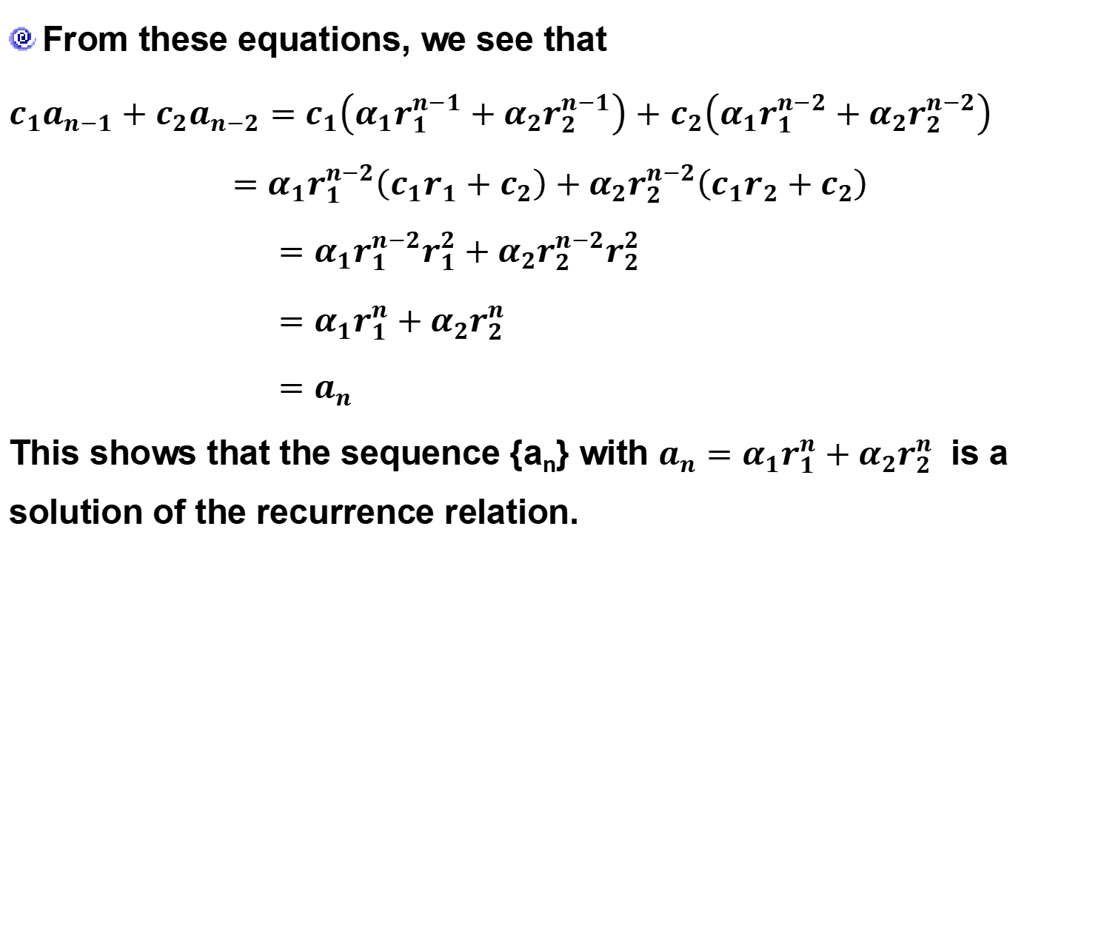
8.2.2 Solving Linear Homogeneous Recurrence Relations with Constant Coefficients
Proof
From these equations, we see that
$c_{1}a_{n−1}+c_{2}a_{n−2}=c_{1}\left(α_{1}r_{1}^{n−1}+α_{2}r_{2}^{n−1}\right)+$ $c_{2}\left(α_{1}r_{1}^{n−2}+α_{2}r_{2}^{n−2}\right)$
$$=α_{1}r_{1}^{n−2}\left(c_{1}r_{1}+c_{2}\right)+α_{2}r_{2}^{n−2}\left(c_{1}r_{2}+c_{2}\right)$$
$=α_{1}r_{1}^{n−2}r_{1}^{2}+α_{2}r_{2}^{n−2}r_{2}^{2}$
$=$ $α_{1}r_{1}^{n}+α_{2}r_{2}^{n}$
$=$ $a_{n}$
This shows that the sequence {a_{n}} with $a_{n}=α_{1}r_{1}^{n}+α_{2}r_{2}^{n}$ is a solution of the recurrence relation.

Slide 68
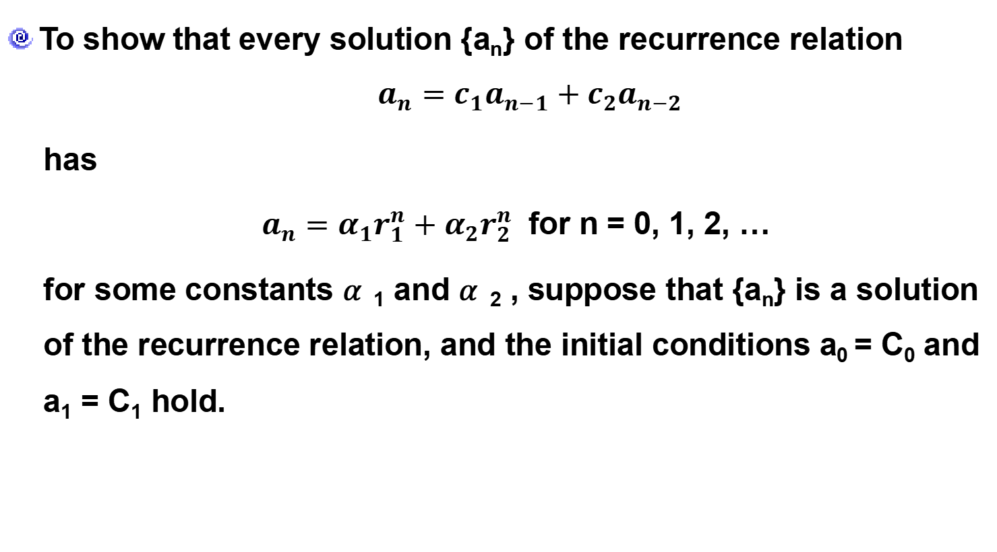
8.2.2 Solving Linear Homogeneous Recurrence Relations with Constant Coefficients
Proof
To show that every solution {a_{n}} of the recurrence relation
$$a_{n}=c_{1}a_{n−1}+c_{2}a_{n−2}$$
has
$a_{n}=α_{1}r_{1}^{n}+α_{2}r_{2}^{n}$ for n = 0, 1, 2, …
for some constants 𝛼₁ and 𝛼₂ , suppose that {a_{n}} is a solution of the recurrence relation, and the initial conditions a₀ = C₀ and a₁ = C₁ hold.

Slide 69
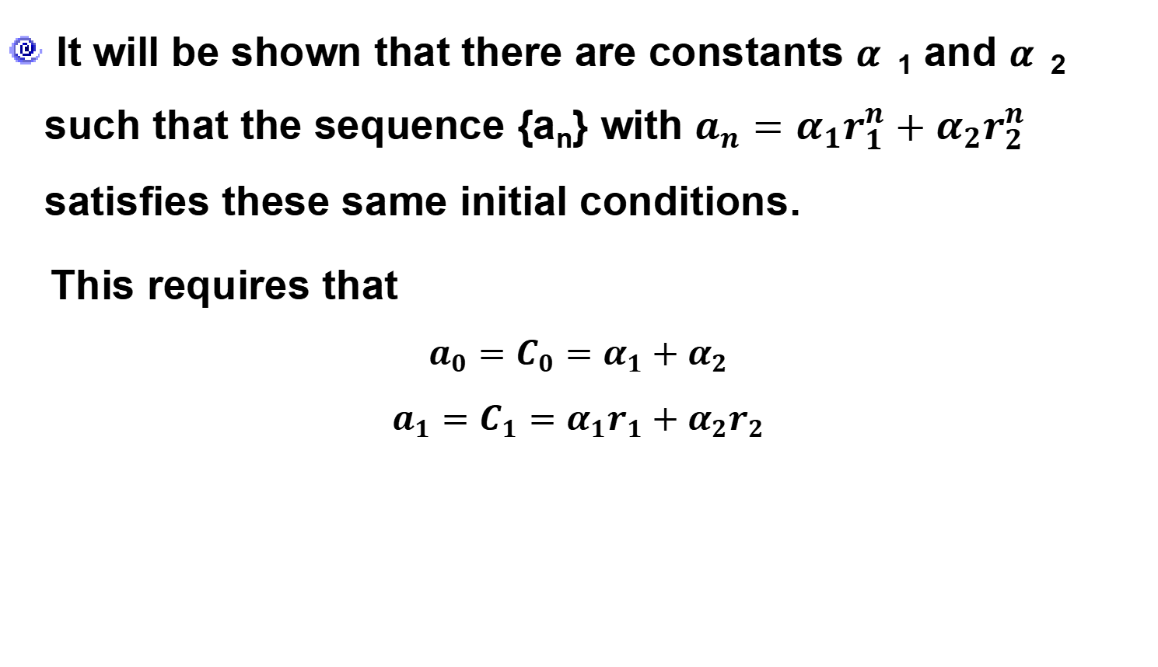
8.2.2 Solving Linear Homogeneous Recurrence Relations with Constant Coefficients
Proof
It will be shown that there are constants 𝛼₁ and 𝛼₂ such that the sequence {a_{n}} with $a_{n}=α_{1}r_{1}^{n}+α_{2}r_{2}^{n}$ satisfies these same initial conditions.
This requires that
$$a_{0}=C_{0}=α_{1}+α_{2}$$
$$a_{1}=C_{1}={α_{1}r}_{1}+{α_{2}r}_{2}$$

Slide 70
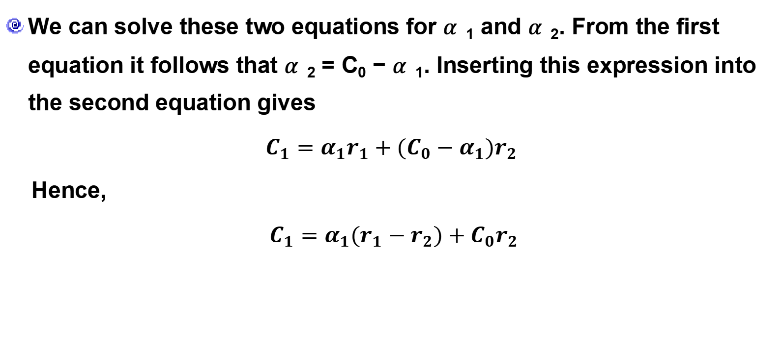
8.2.2 Solving Linear Homogeneous Recurrence Relations with Constant Coefficients
Proof
We can solve these two equations for 𝛼₁ and 𝛼₂. From the first equation it follows that 𝛼₂ = C₀ − 𝛼₁. Inserting this expression into the second equation gives
$C_{1}={α_{1}r}_{1}+{(C_{0}−α_{1})r}_{2}$
Hence,
$C_{1}={α_{1}(r}_{1}−r_{2})+{C_{0}r}_{2}$

Slide 71
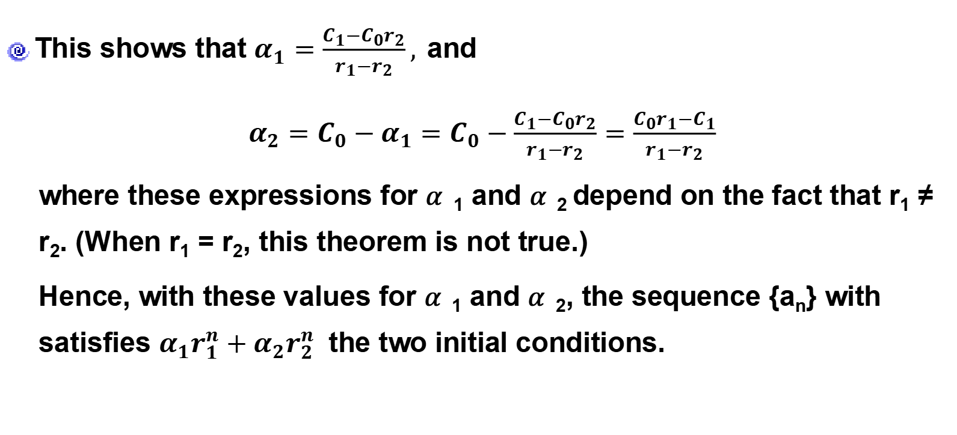
8.2.2 Solving Linear Homogeneous Recurrence Relations with Constant Coefficients
Proof
This shows that $α_{1}=\frac{C_{1}−C_{0}r_{2}}{r_{1}−r_{2}},$and
$α_{2}=C_{0}−α_{1}=C_{0}−\frac{C_{1}−C_{0}r_{2}}{r_{1}−r_{2}}=\frac{C_{0}r_{1}−C_{1}}{r_{1}−r_{2}}$
where these expressions for 𝛼₁ and 𝛼₂ depend on the fact that r₁ ≠ r₂. (When r₁ = r₂, this theorem is not true.)
Hence, with these values for 𝛼₁ and 𝛼₂, the sequence {a_{n}} with satisfies $α_{1}r_{1}^{n}+α_{2}r_{2}^{n}$ the two initial conditions.

Slide 72

8.2.2 Solving Linear Homogeneous Recurrence Relations with Constant Coefficients
Example 3:
What is the solution of the recurrence relation, $a_{n}=a_{n−1}+2a_{n−2}$,
with $a_{0}=2,a_{1}=7?$

Slide 73
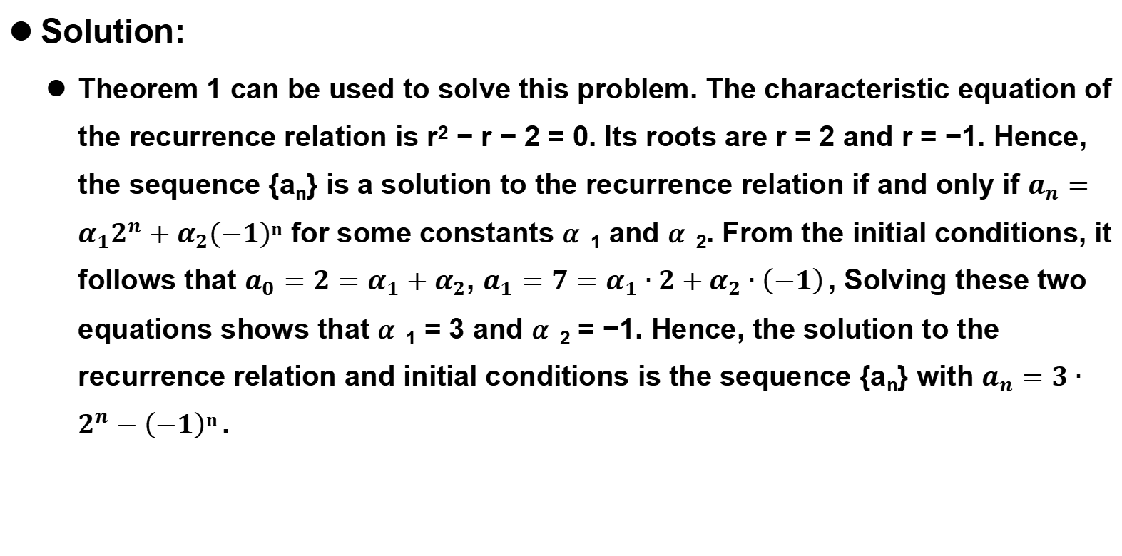
8.2.2 Solving Linear Homogeneous Recurrence Relations with Constant Coefficients
Solution:
Theorem 1 can be used to solve this problem. The characteristic equation of the recurrence relation is r² − r − 2 = 0. Its roots are r = 2 and r = −1. Hence, the sequence {a_{n}} is a solution to the recurrence relation if and only if $a_{n}=α_{1}2^{n}+α_{2}\left(−1\right)n$for some constants 𝛼₁ and 𝛼₂. From the initial conditions, it follows that $a_{0}={2=α}_{1}+α_{2}$, $a_{1}=7=α_{1}∙2+α_{2}∙\left(−1\right)$, Solving these two equations shows that 𝛼₁ = 3 and 𝛼₂ = −1. Hence, the solution to the recurrence relation and initial conditions is the sequence {a_{n}} with $a_{n}=3∙2^{n}−\left(−1\right)n$.

Slide 74
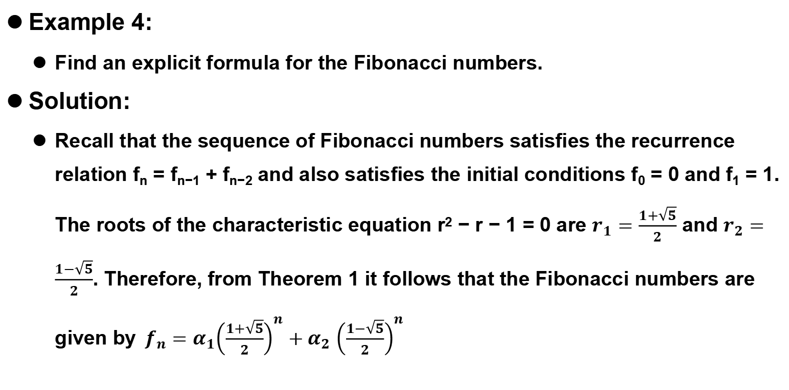
8.2.2 Solving Linear Homogeneous Recurrence Relations with Constant Coefficients
Example 4:
Find an explicit formula for the Fibonacci numbers.
Solution:
Recall that the sequence of Fibonacci numbers satisfies the recurrence relation f_{n} = f_{n−1} + f_{n−2} and also satisfies the initial conditions f₀ = 0 and f₁ = 1. The roots of the characteristic equation r² − r − 1 = 0 are $r_{1}=\frac{1+\sqrt{5}}{2}$ and $r_{2}=\frac{1−\sqrt{5}}{2}$. Therefore, from Theorem 1 it follows that the Fibonacci numbers are given by${ f}_{n}=α_{1}{\left(\frac{1+\sqrt{5}}{2}\right)}^{n}+α_{2}$ ${\left(\frac{1−\sqrt{5}}{2}\right)}^{n}$

Slide 75
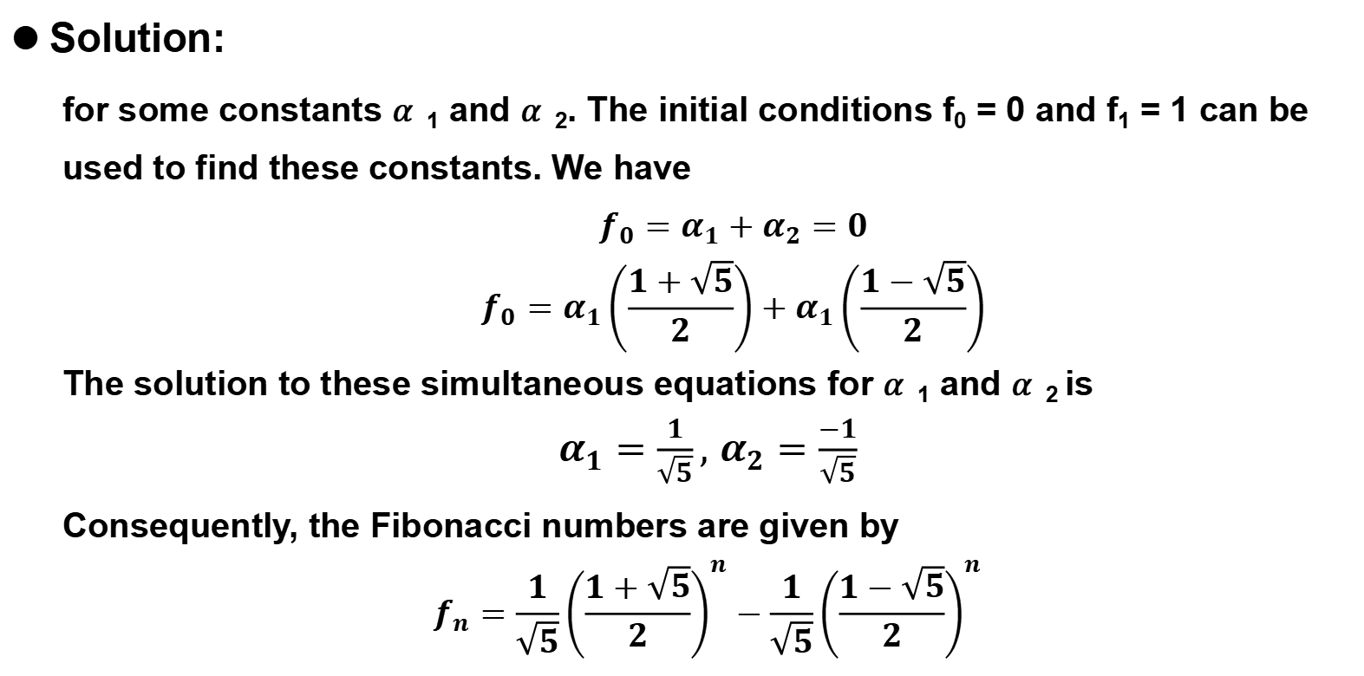
8.2.2 Solving Linear Homogeneous Recurrence Relations with Constant Coefficients
Solution:
for some constants 𝛼₁ and 𝛼₂. The initial conditions f₀ = 0 and f₁ = 1 can be used to find these constants. We have
$$f_{0}=α_{1}+α_{2}=0$$
$$f_{0}=α_{1}\left(\frac{1+\sqrt{5}}{2}\right)+α_{1}\left(\frac{1−\sqrt{5}}{2}\right)$$
The solution to these simultaneous equations for 𝛼₁ and 𝛼₂ is
$α_{1}=\frac{1}{\sqrt{5}},$ $α_{2}=\frac{−1}{\sqrt{5}}$
Consequently, the Fibonacci numbers are given by
$$f_{n}=\frac{1}{\sqrt{5}}{\left(\frac{1+\sqrt{5}}{2}\right)}^{n}−\frac{1}{\sqrt{5}}{\left(\frac{1−\sqrt{5}}{2}\right)}^{n}$$

Slide 76
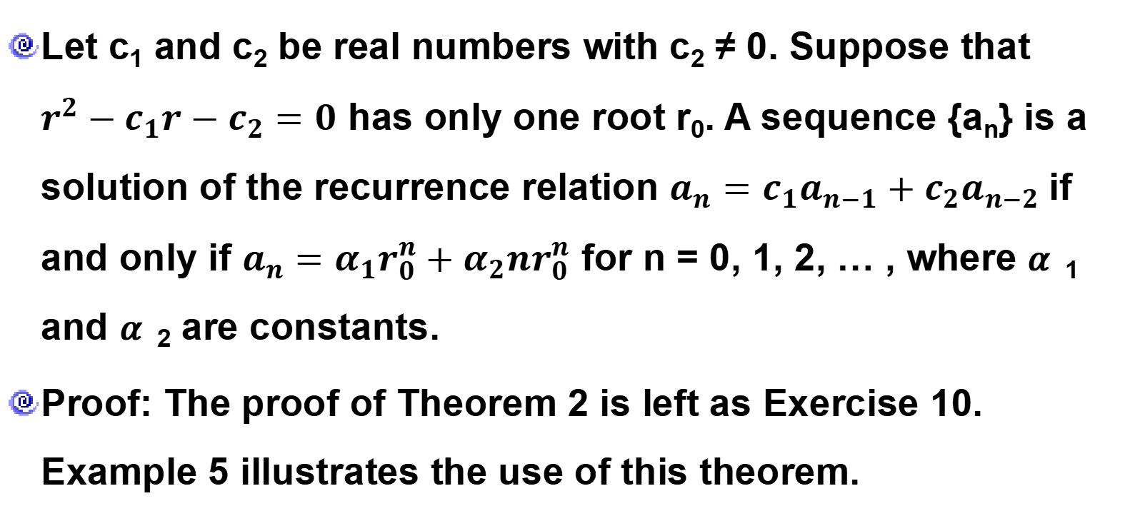
8.2.2 Solving Linear Homogeneous Recurrence Relations with Constant Coefficients
Theorem 2
Let c₁ and c₂ be real numbers with c₂ ≠ 0. Suppose that $r^{2}−c_{1}r−c_{2}=0$ has only one root r₀. A sequence {a_{n}} is a solution of the recurrence relation $a_{n}=c_{1}a_{n−1}+c_{2}a_{n−2}$if and only if $a_{n}=α_{1}r_{0}^{n}+α_{2}{nr}_{0}^{n}$ for n = 0, 1, 2, … , where 𝛼₁ and 𝛼₂ are constants.
Proof: The proof of Theorem 2 is left as Exercise 10. Example 5 illustrates the use of this theorem.

Slide 77

8.2.2 Solving Linear Homogeneous Recurrence Relations with Constant Coefficients
Example 5:
What is the solution of the recurrence relation $a_{n}={6a}_{n−1}−9a_{n−2}$, with initial conditions $a_{0}=1,a_{1}=6?$

Slide 78
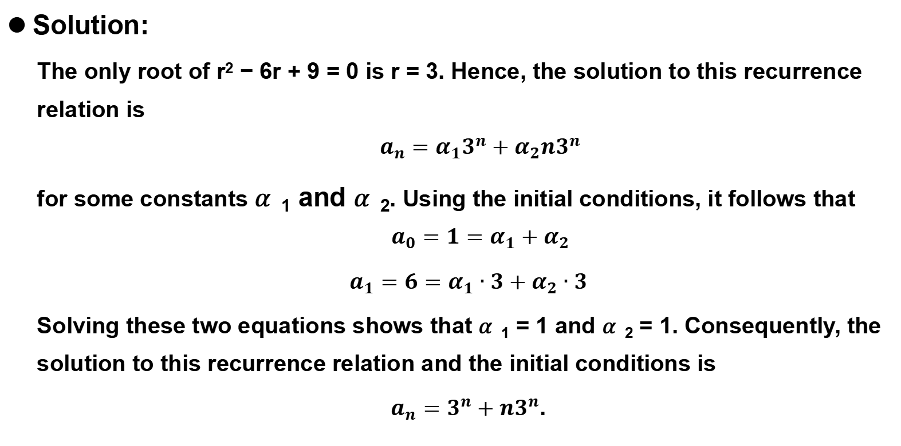
8.2.2 Solving Linear Homogeneous Recurrence Relations with Constant Coefficients
Solution:
The only root of r² − 6r + 9 = 0 is r = 3. Hence, the solution to this recurrence relation is
$$a_{n}=α_{1}3^{n}+α_{2}n3^{n}$$
for some constants 𝛼₁ and 𝛼₂. Using the initial conditions, it follows that
$$a_{0}={1=α}_{1}+α_{2}$$
$a_{1}=6=α_{1}∙3+α_{2}∙3$
Solving these two equations shows that 𝛼₁ = 1 and 𝛼₂ = 1. Consequently, the solution to this recurrence relation and the initial conditions is
$a_{n}=3^{n}+n3^{n}$.

Slide 79
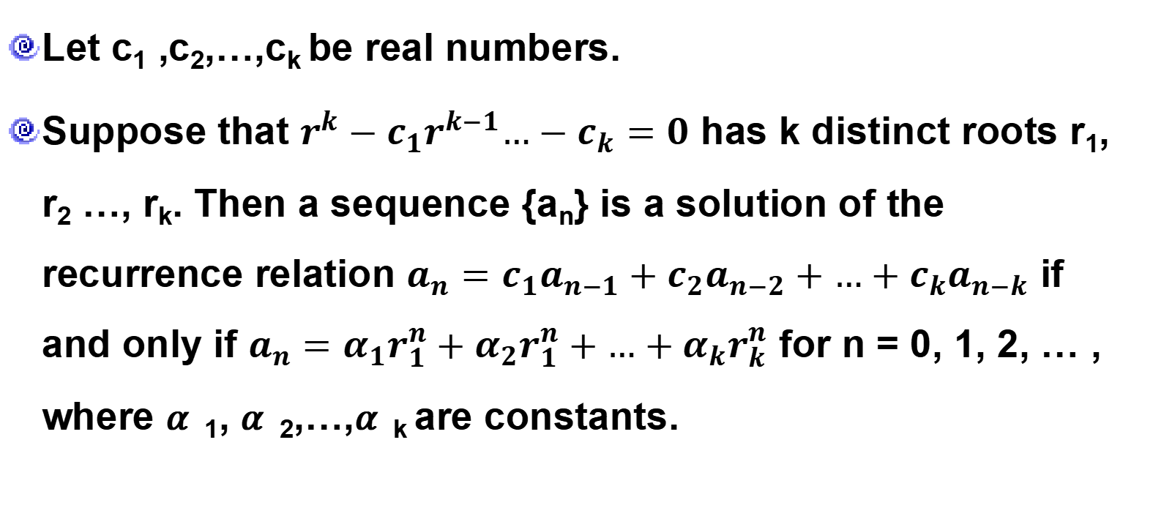
8.2.2 Solving Linear Homogeneous Recurrence Relations with Constant Coefficients
Theorem 3
Let c₁ ,c₂,…,c_{k} be real numbers.
Suppose that $r^{k}−c_{1}r^{k−1}…−c_{k}=0$ has k distinct roots r₁, r₂ …, r_{k}. Then a sequence {a_{n}} is a solution of the recurrence relation $a_{n}=c_{1}a_{n−1}+c_{2}a_{n−2}+…+c_{k}a_{n−k}$ if and only if $a_{n}=α_{1}r_{1}^{n}+α_{2}r_{1}^{n}+…+α_{k}r_{k}^{n}$ for n = 0, 1, 2, … , where 𝛼₁, 𝛼₂,…,𝛼_{k} are constants.

Slide 80

8.2.2 Solving Linear Homogeneous Recurrence Relations with Constant Coefficients
Example 6:
What is the solution of the recurrence relation $a_{n}={6a}_{n−1}−11a_{n−2}−{6a}_{n−3}$, with initial conditions $a_{0}=2,a_{1}=5,$ and $a_{2}=11.$

Slide 81
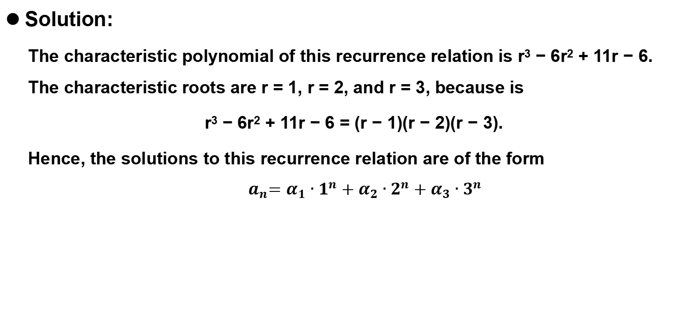
8.2.2 Solving Linear Homogeneous Recurrence Relations with Constant Coefficients
Solution:
The characteristic polynomial of this recurrence relation is r³ − 6r² + 11r − 6. The characteristic roots are r = 1, r = 2, and r = 3, because is
r³ − 6r² + 11r − 6 = (r − 1)(r − 2)(r − 3).
Hence, the solutions to this recurrence relation are of the form
$$a_{n}{=α}_{1}∙1^{n}+α_{2}∙2^{n}+α_{3}∙3^{n}$$

Slide 82
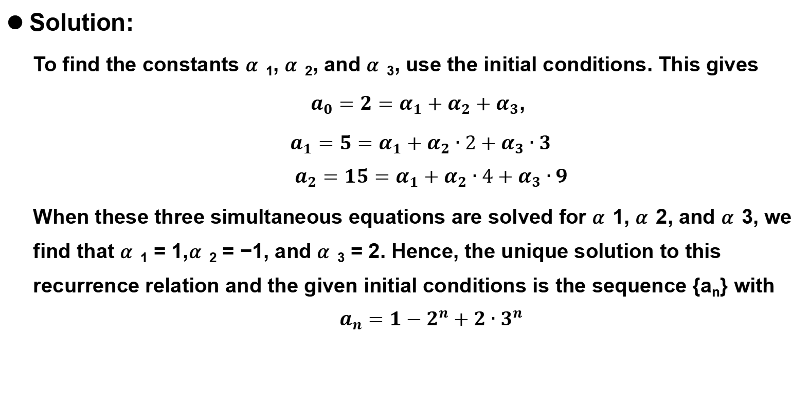
8.2.2 Solving Linear Homogeneous Recurrence Relations with Constant Coefficients
Solution:
To find the constants 𝛼₁, 𝛼₂, and 𝛼₃, use the initial conditions. This gives
$a_{0}={2=α}_{1}+α_{2}+α_{3}$,
$a_{1}=5=α_{1}+α_{2}∙2+α_{3}∙3$
$$a_{2}=15=α_{1}+α_{2}∙4+α_{3}∙9$$
When these three simultaneous equations are solved for 𝛼1, 𝛼2, and 𝛼3, we find that 𝛼₁ = 1,𝛼₂ = −1, and 𝛼₃ = 2. Hence, the unique solution to this recurrence relation and the given initial conditions is the sequence {a_{n}} with
$$a_{n}=1−2^{n}+2∙3^{n}$$

Slide 83
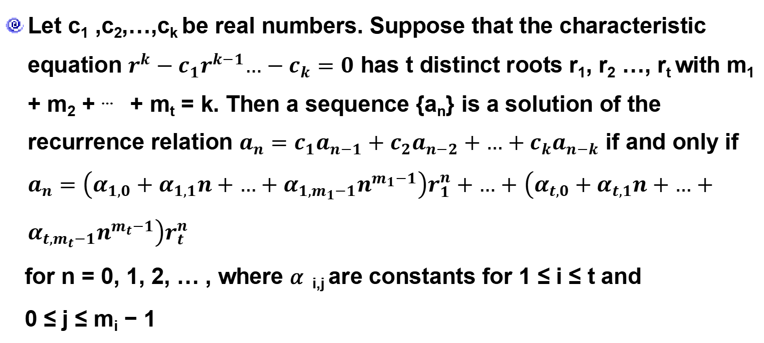
8.2.2 Solving Linear Homogeneous Recurrence Relations with Constant Coefficients
Theorem 4
Let c₁ ,c₂,…,c_{k} be real numbers. Suppose that the characteristic equation $r^{k}−c_{1}r^{k−1}…−c_{k}=0$ has t distinct roots r₁, r₂ …, r_{t} with m₁ + m₂ + ⋯ + m_{t} = k. Then a sequence {a_{n}} is a solution of the recurrence relation $a_{n}=c_{1}a_{n−1}+c_{2}a_{n−2}+…+c_{k}a_{n−k}$ if and only if $a_{n}=\left(α_{1,0}+α_{1,1}n+…+α_{1,m_{1}−1}n^{m_{1}−1}\right)r_{1}^{n}+…+$ $\left(α_{t,0}+α_{t,1}n+…+α_{t,m_{t}−1}n^{m_{t}−1}\right)r_{t}^{n}$
for n = 0, 1, 2, … , where 𝛼_{i,j} are constants for 1 ≤ i ≤ t and
0 ≤ j ≤ m_{i} − 1

Slide 84
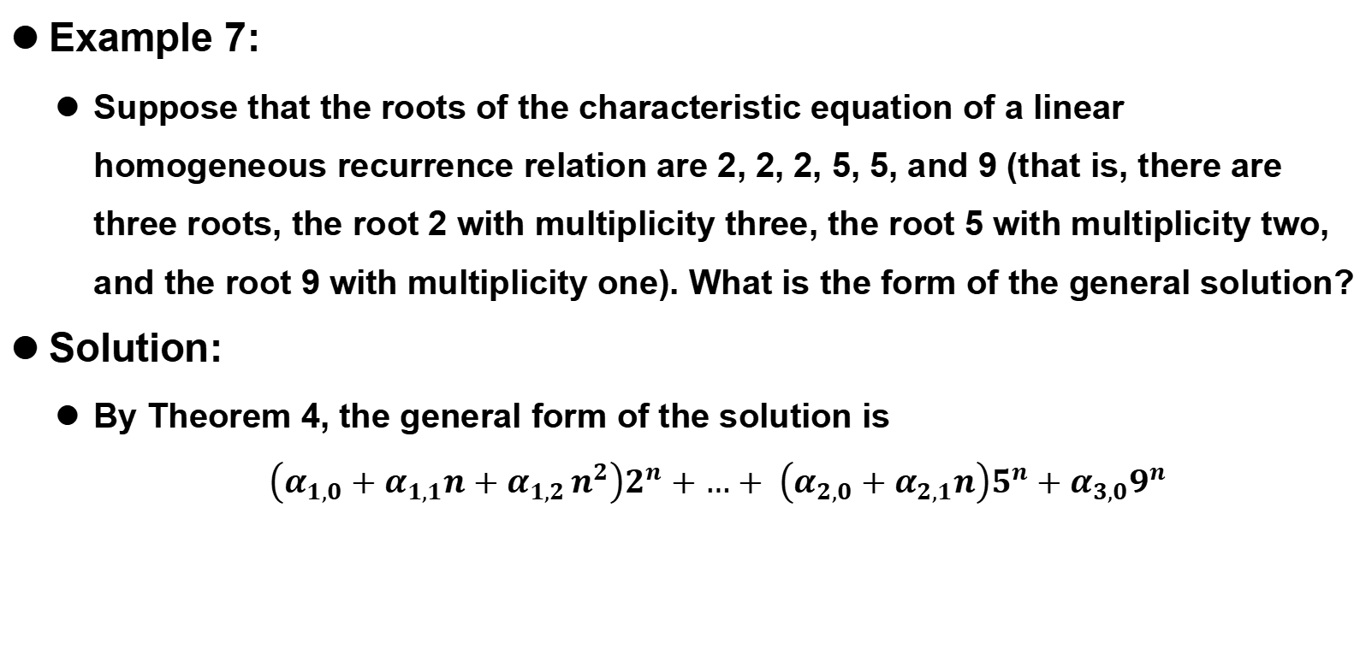
8.2.2 Solving Linear Homogeneous Recurrence Relations with Constant Coefficients
Example 7:
Suppose that the roots of the characteristic equation of a linear homogeneous recurrence relation are 2, 2, 2, 5, 5, and 9 (that is, there are three roots, the root 2 with multiplicity three, the root 5 with multiplicity two, and the root 9 with multiplicity one). What is the form of the general solution?
Solution:
By Theorem 4, the general form of the solution is
$$\left(α_{1,0}+α_{1,1}n+α_{1,2 }n^{2}\right)2^{n}+…+ \left(α_{2,0}+α_{2,1}n\right)5^{n}+α_{3,0}9^{n}$$

Slide 85

8.2.2 Solving Linear Homogeneous Recurrence Relations with Constant Coefficients
Example 8:
Find the solution to the recurrence relation $a_{n}={−3a}_{n−1}−3a_{n−2}−a_{n−3}$
with initial conditions $a_{0}=1,a_{1}=−2,$ and $a_{2}=−1.$

Slide 86
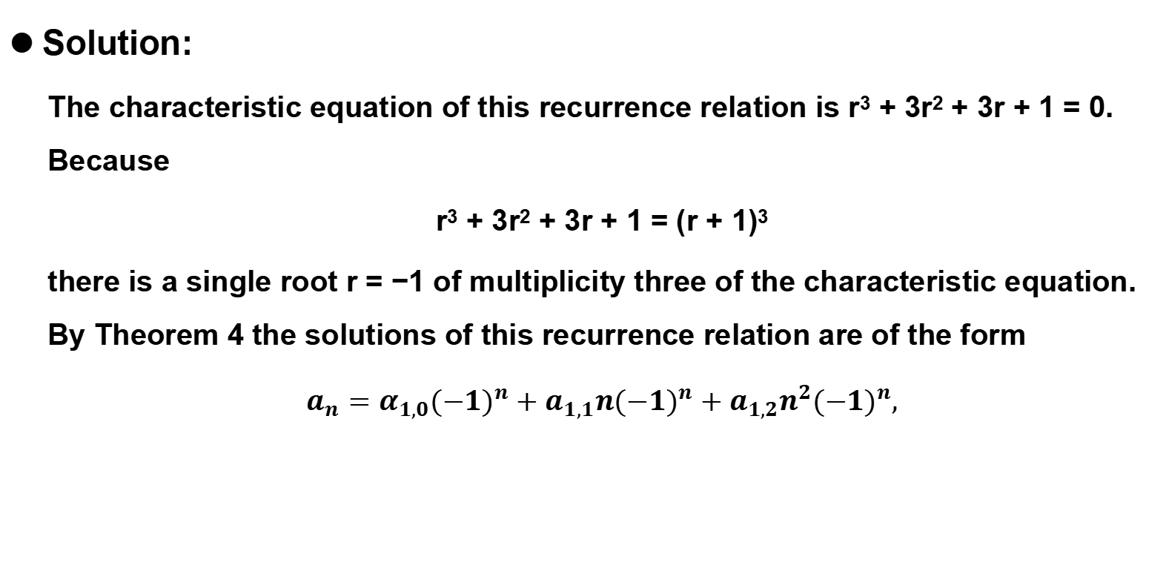
8.2.2 Solving Linear Homogeneous Recurrence Relations with Constant Coefficients
Solution:
The characteristic equation of this recurrence relation is r³ + 3r² + 3r + 1 = 0. Because
r³ + 3r² + 3r + 1 = (r + 1)³
there is a single root r = −1 of multiplicity three of the characteristic equation. By Theorem 4 the solutions of this recurrence relation are of the form
$a_{n}=$ $α_{1,0}{(−1)}^{n}+a_{1,1}n{(−1)}^{n}+a_{1,2}n^{2}{(−1)}^{n},$

Slide 87
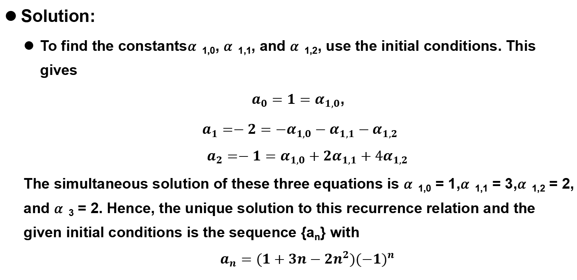
8.2.2 Solving Linear Homogeneous Recurrence Relations with Constant Coefficients
Solution:
To find the constants𝛼_{1,0}, 𝛼_{1,1}, and 𝛼_{1,2}, use the initial conditions. This gives
$a_{0}={1=α}_{1,0}$,
$a_{1}=−2={−α}_{1,0}−α_{1,1}−α_{1,2}$
$$a_{2}=−1=α_{1,0}+2α_{1,1}+4α_{1,2}$$
The simultaneous solution of these three equations is 𝛼_{1,0} = 1,𝛼_{1,1} = 3,𝛼_{1,2} = 2, and 𝛼₃ = 2. Hence, the unique solution to this recurrence relation and the given initial conditions is the sequence {a_{n}} with
$$a_{n}=(1+3n−{2n}^{2}){(−1)}^{n}$$

Slide 88
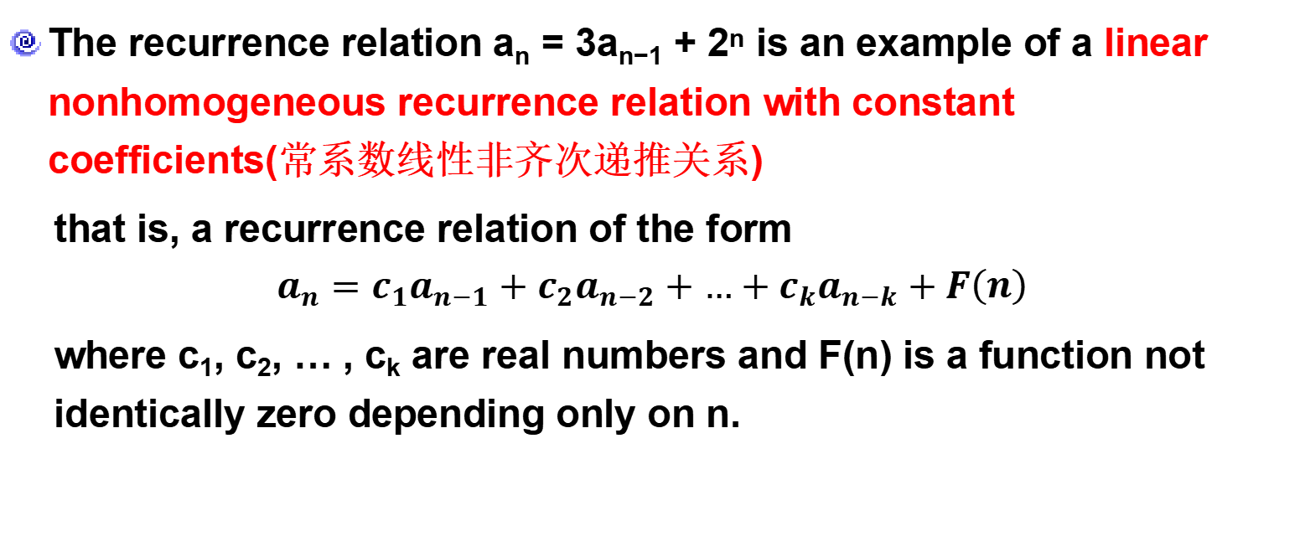
8.2.3 Linear Nonhomogeneous Recurrence Relations with Constant Coefficients
The recurrence relation a_{n} = 3a_{n−1} + 2^{n} is an example of a linear nonhomogeneous recurrence relation with constant coefficients(常系数线性非齐次递推关系)
that is, a recurrence relation of the form
$$a_{n}=c_{1}a_{n−1}+c_{2}a_{n−2}+…+c_{k}a_{n−k}+F\left(n\right)$$
where c₁, c₂, … , c_{k} are real numbers and F(n) is a function not identically zero depending only on n.

Slide 89
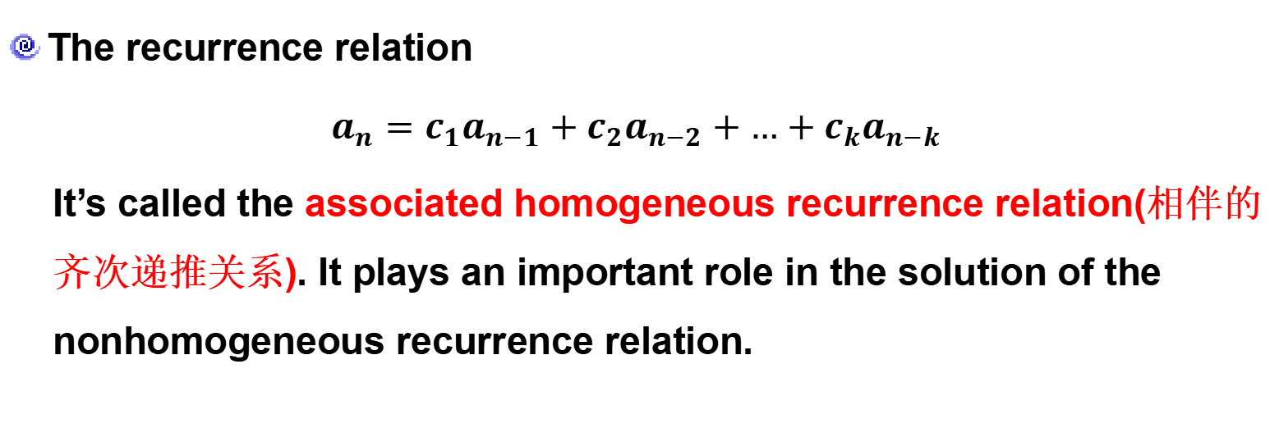
8.2.3 Linear Nonhomogeneous Recurrence Relations with Constant Coefficients
Linear Nonhomogeneous Recurrence Relations
with Constant Coefficients
The recurrence relation
$a_{n}=c_{1}a_{n−1}+c_{2}a_{n−2}+…+c_{k}a_{n−k}$
It’s called the associated homogeneous recurrence relation(相伴的齐次递推关系). It plays an important role in the solution of the nonhomogeneous recurrence relation.

Slide 90
8.2.3 Linear Nonhomogeneous Recurrence Relations with Constant Coefficients
Example 9:
Each of the recurrence relations a_{n} = a_{n−1} + 2^{n} , a_{n} = a_{n−1} + a_{n−2} + n² + n + 1,
a_{n} = 3a_{n−1} + n3^{n}, and a_{n} = a_{n−1} + a_{n−2} + a_{n−3} + n! is a linear nonhomogeneous recurrence relation with constant coefficients. The associated linear homogeneous recurrence relations are a_{n} = a_{n−1}, a_{n} = a_{n−1} + a_{n−2}, a_{n} = 3a_{n−1},
and a_{n} = a_{n−1} + a_{n−2} + a_{n−3} , respectively.

Slide 91
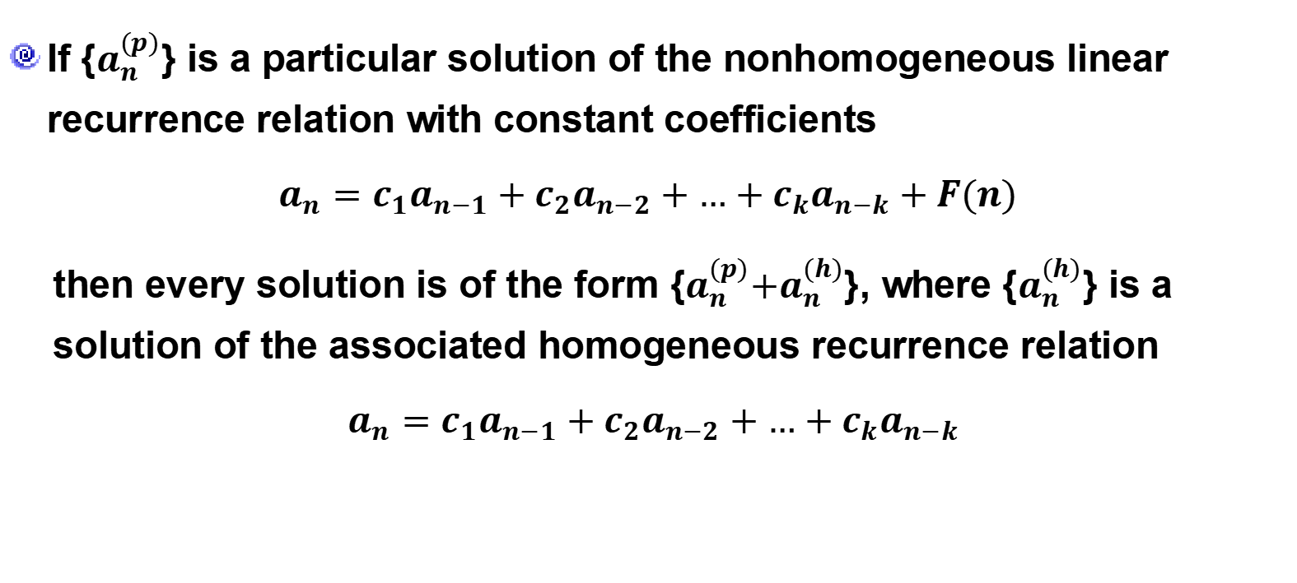
8.2.3 Linear Nonhomogeneous Recurrence Relations with Constant Coefficients
Theorem 5
If {$a_{n}^{(p)}$} is a particular solution of the nonhomogeneous linear recurrence relation with constant coefficients
$a_{n}=c_{1}a_{n−1}+c_{2}a_{n−2}+…+c_{k}a_{n−k}+F(n)$
then every solution is of the form {$a_{n}^{(p)}{+a}_{n}^{(h)}$}, where {$a_{n}^{(h)}$} is a solution of the associated homogeneous recurrence relation
$a_{n}=c_{1}a_{n−1}+c_{2}a_{n−2}+…+c_{k}a_{n−k}$

Slide 92
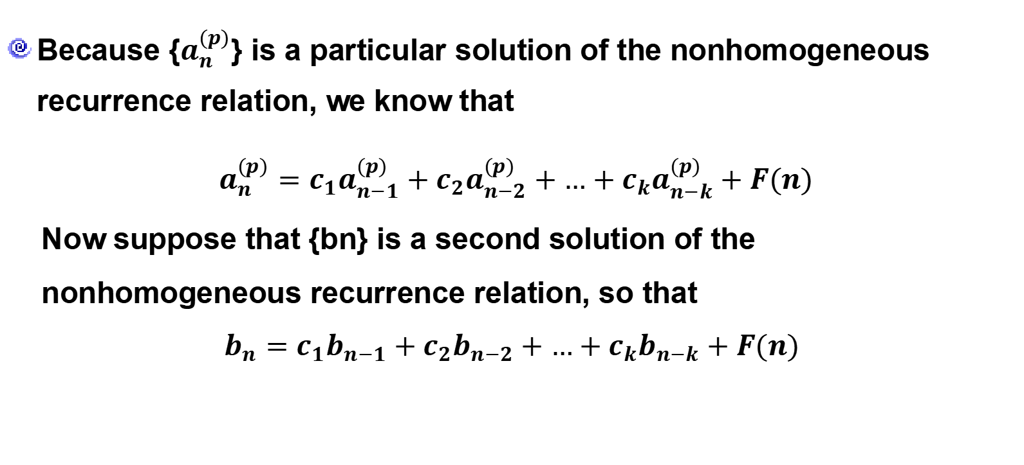
8.2.3 Linear Nonhomogeneous Recurrence Relations with Constant Coefficients
Proof
Because {$a_{n}^{(p)}$} is a particular solution of the nonhomogeneous recurrence relation, we know that
$a_{n}^{(p)}=c_{1}a_{n−1}^{(p)}+c_{2}a_{n−2}^{(p)}+…+c_{k}a_{n−k}^{(p)}+F(n)$
Now suppose that {bn} is a second solution of the nonhomogeneous recurrence relation, so that
$$b_{n}=c_{1}b_{n−1}+c_{2}b_{n−2}+…+c_{k}b_{n−k}+F(n)$$

Slide 93
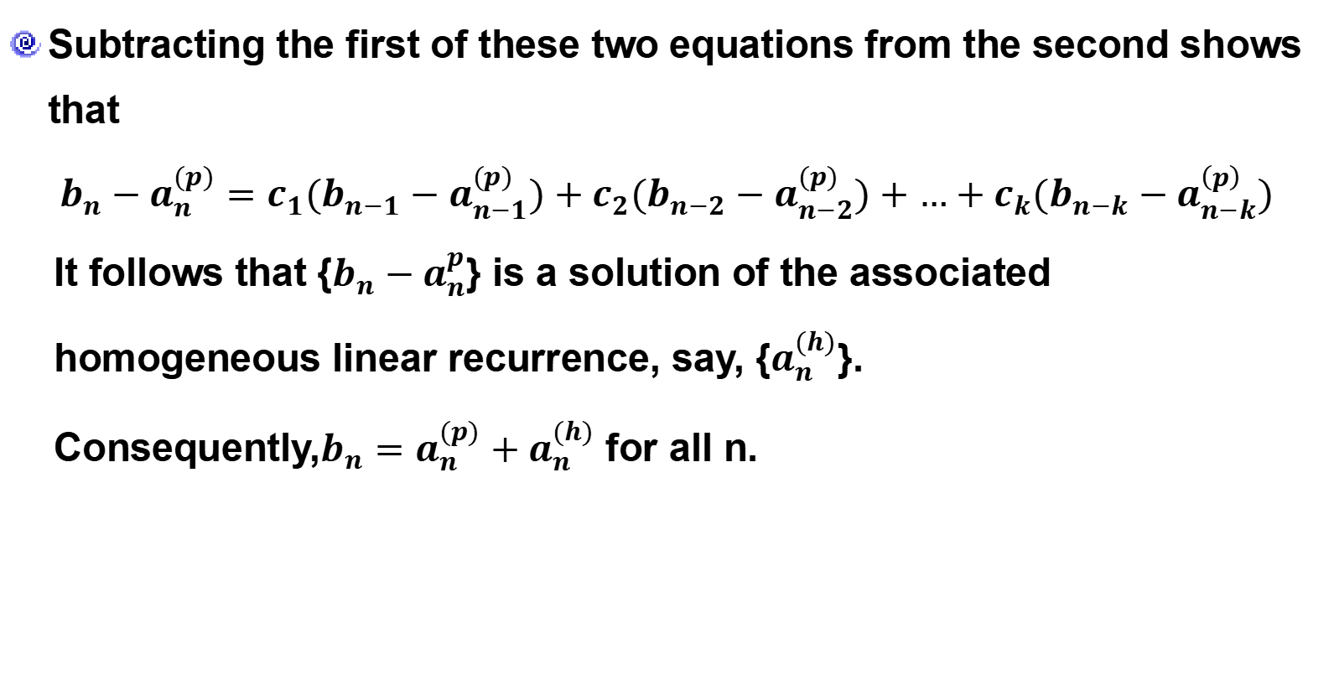
8.2.3 Linear Nonhomogeneous Recurrence Relations with Constant Coefficients
Proof
Subtracting the first of these two equations from the second shows that
$${b_{n}−a}_{n}^{(p)}=c_{1}{(b_{n−1}−a}_{n−1}^{(p)})+c_{2}{(b_{n−2}−a}_{n−2}^{(p)})+…+c_{k}{(b_{n−k}−a}_{n−k}^{\left(p\right)})$$
It follows that {${b_{n}−a}_{n}^{p}$} is a solution of the associated homogeneous linear recurrence, say, {$a_{n}^{(h)}$}.
Consequently,$b_{n}=a_{n}^{(p)}+a_{n}^{(h)}$ for all n.

Slide 94
8.2.3 Linear Nonhomogeneous Recurrence Relations with Constant Coefficients
By Theorem 5, we see that the key to solving nonhomogeneous recurrence relations with constant coefficients is finding a particular solution. Then every solution is a sum of this solution and a solution of the associated homogeneous recurrence relation. Although there is no general method for finding such a solution that works for every function F(n), there are techniques that work for certain types of functions F(n), such as polynomials and powers of constants. This is illustrated in Examples 10 and 11.

Slide 95

8.2.3 Linear Nonhomogeneous Recurrence Relations with Constant Coefficients
Example 10:
Find all solutions of the recurrence relation $a_{n}={3a}_{n−1}+2n$. What is the solution with $a_{1}=3$?

Slide 96
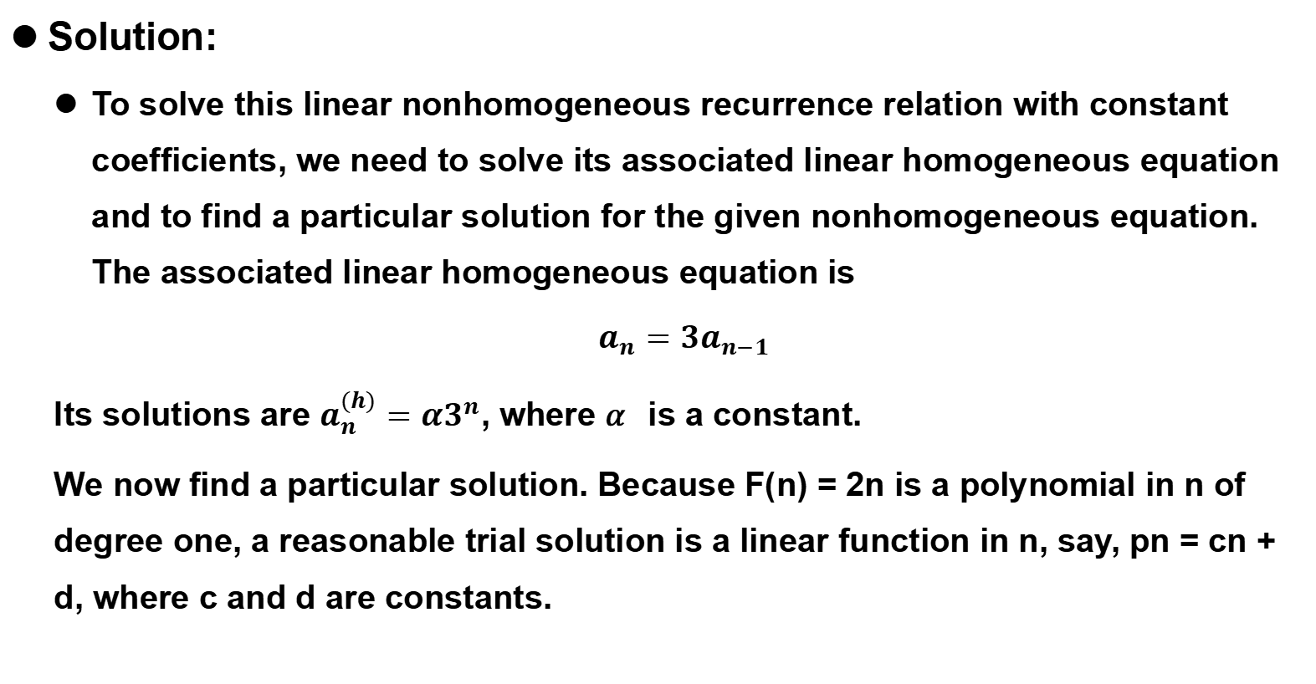
8.2.3 Linear Nonhomogeneous Recurrence Relations with Constant Coefficients
Solution:
To solve this linear nonhomogeneous recurrence relation with constant coefficients, we need to solve its associated linear homogeneous equation and to find a particular solution for the given nonhomogeneous equation. The associated linear homogeneous equation is
$a_{n}={3a}_{n−1}$
Its solutions are $a_{n}^{(h)}=α3^{n}$, where 𝛼 is a constant.
We now find a particular solution. Because F(n) = 2n is a polynomial in n of degree one, a reasonable trial solution is a linear function in n, say, pn = cn + d, where c and d are constants.

Slide 97
8.2.3 Linear Nonhomogeneous Recurrence Relations with Constant Coefficients
Solution:
To determine whether there are any solutions of this form, suppose that p_{n} = cn + d is such a solution. Then the equation a_{n} = 3a_{n−1} + 2n becomes
cn + d = 3(c(n − 1) + d) + 2n.
Simplifying and combining like terms gives
(2 + 2c)n+ (2d − 3c) = 0
It follows that cn + d is a solution if and only if 2 + 2c = 0 and 2d − 3c = 0.
This shows that cn + d is a solution if and only if c = −1 and d = −3/2. Consequently, a (p) n = −n − 3/2 is a particular solution.

Slide 98
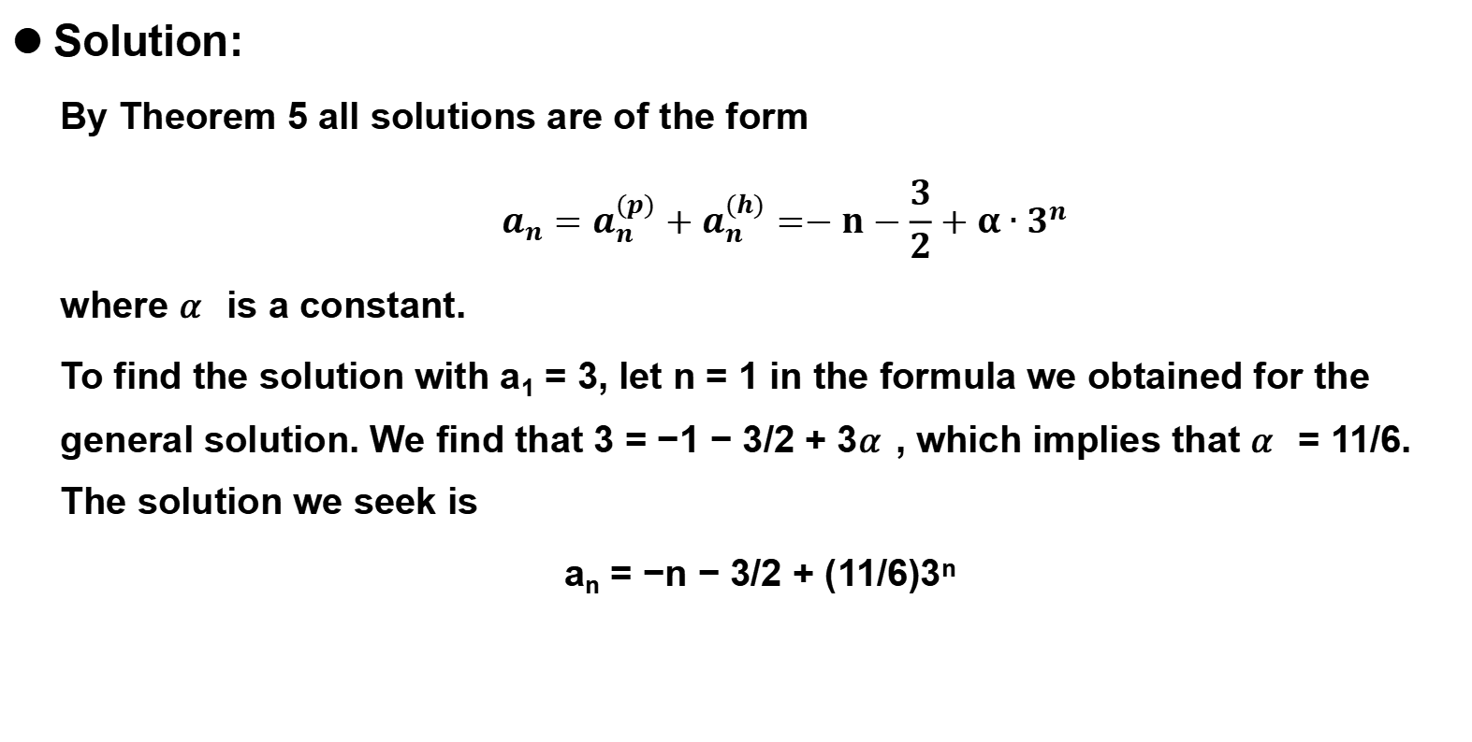
8.2.3 Linear Nonhomogeneous Recurrence Relations with Constant Coefficients
Solution:
By Theorem 5 all solutions are of the form
$$a_{n}=a_{n}^{(p)}+a_{n}^{(h)}=−n−\frac{3}{2}+α∙3^{n}$$
where 𝛼 is a constant.
To find the solution with a₁ = 3, let n = 1 in the formula we obtained for the general solution. We find that 3 = −1 − 3/2 + 3𝛼, which implies that 𝛼 = 11/6. The solution we seek is
a_{n} = −n − 3/2 + (11/6)3^{n}

Slide 99

8.2.3 Linear Nonhomogeneous Recurrence Relations with Constant Coefficients
Example 11:
Find the solution to the recurrence relation $a_{n}={5a}_{n−1}−6a_{n−2}+7^{n}$

Slide 100
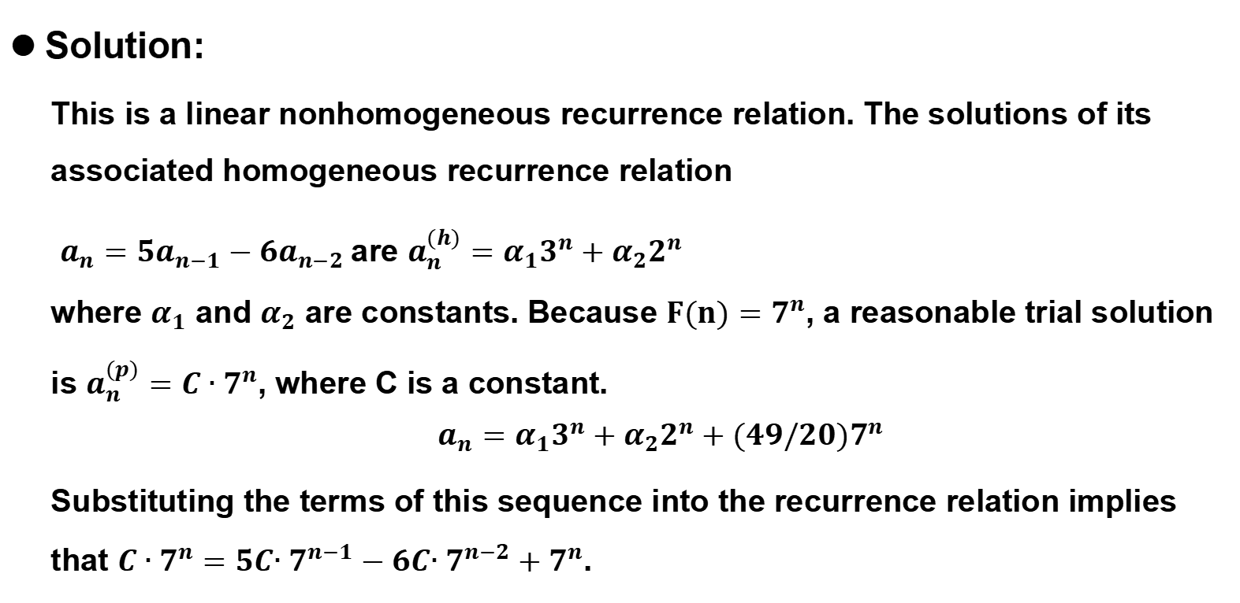
8.2.3 Linear Nonhomogeneous Recurrence Relations with Constant Coefficients
Solution:
This is a linear nonhomogeneous recurrence relation. The solutions of its associated homogeneous recurrence relation
$a_{n}={5a}_{n−1}−6a_{n−2}$are $a_{n}^{(h)}=α_{1}3^{n}+α_{2}2^{n}$
where $α_{1}$ and $α_{2}$ are constants. Because $F(n)=7^{n}$, a reasonable trial solution is $a_{n}^{(p)}=C∙7^{n}$, where C is a constant.
$$a_{n}=α_{1}3^{n}+α_{2}2^{n}+(49/20)7^{n}$$
Substituting the terms of this sequence into the recurrence relation implies that $C∙7^{n}=5C{∙7}^{n−1}−6C{∙7}^{n−2}+7^{n}$.

Slide 101
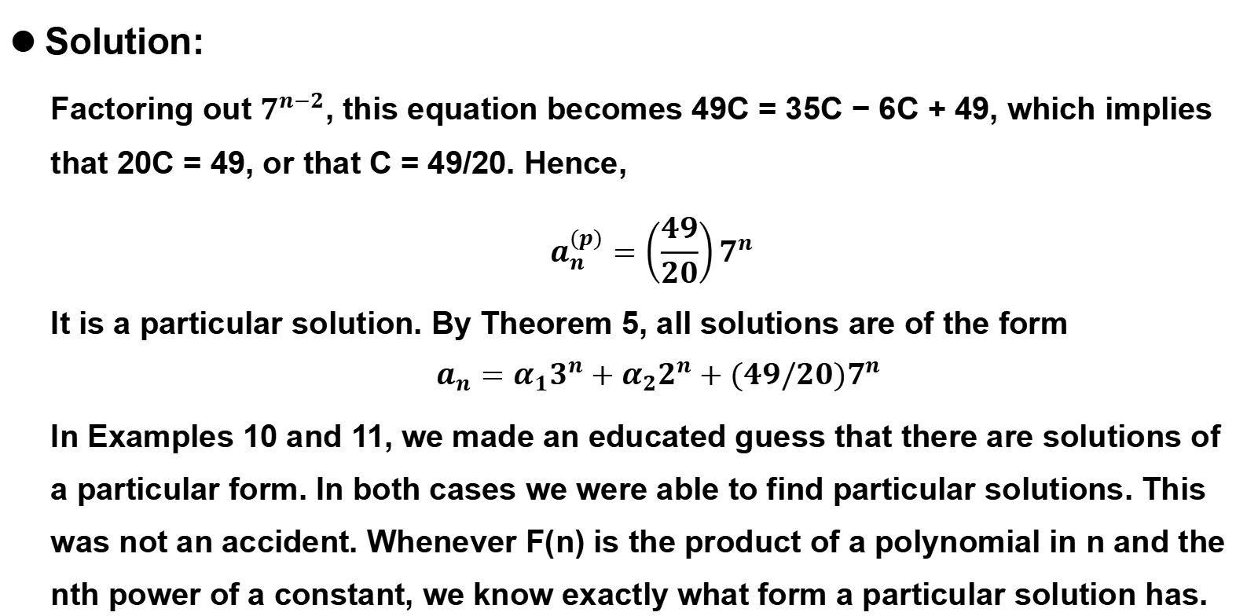
8.2.3 Linear Nonhomogeneous Recurrence Relations with Constant Coefficients
Solution:
Factoring out $7^{n−2}$, this equation becomes 49C = 35C − 6C + 49, which implies that 20C = 49, or that C = 49/20. Hence,
$$a_{n}^{(p)}=\left(\frac{49}{20}\right)7^{n}$$
It is a particular solution. By Theorem 5, all solutions are of the form
$$a_{n}=α_{1}3^{n}+α_{2}2^{n}+(49/20)7^{n}$$
In Examples 10 and 11, we made an educated guess that there are solutions of a particular form. In both cases we were able to find particular solutions. This was not an accident. Whenever F(n) is the product of a polynomial in n and the nth power of a constant, we know exactly what form a particular solution has.

Slide 102

8.2.3 Linear Nonhomogeneous Recurrence Relations with Constant Coefficients
Theorem 6
Suppose that {a_{n}} satisfies the linear nonhomogeneous recurrence relation $a_{n}=c_{1}a_{n−1}+c_{2}a_{n−2}+…+c_{k}a_{n−k}+F(n)$ , where c₁, c₂, … , c_{k} are real numbers, and $F\left(n\right)={(b}_{t}n^{t}+b_{t−1}n^{t−1}+…+b_{1}n+b_{0})s^{n}$, where b₀, b₁, … , b_{t} and s are real numbers. When s is not a root of the characteristic equation of the associated linear homogeneous recurrence relation, there is a particular solution of the form
$${(p}_{t}n^{t}+p_{t−1}n^{t−1}+…+p_{1}n+p_{0})s^{n}$$
When s is a root of this characteristic equation and its multiplicity is m, there is a particular solution of the form
${n^{m}(p}_{t}n^{t}+p_{t−1}n^{t−1}+…+p_{1}n+p_{0})s^{n}$

Slide 103
8.2.3 Linear Nonhomogeneous Recurrence Relations with Constant Coefficients
Note
Note that in the case when s is a root of multiplicity m of the characteristic equation of the associated linear homogeneous recurrence relation, the factor nm ensures that the proposed particular solution will not already be a solution of the associated linear homogeneous recurrence relation. We next provide Example 12 to illustrate the form of a particular solution provided by Theorem 6.

Slide 104
8.2.3 Linear Nonhomogeneous Recurrence Relations with Constant Coefficients
Example 12:
What form does a particular solution of the linear nonhomogeneous recurrence relation an = 6a_{n−1} − 9a_{n−2} + F(n) have when F(n) = 3n, F(n) = n3^{n}, F(n) = n²2^{n}, and F(n) = (n² + 1) 3^{n}?

Slide 105
8.2.3 Linear Nonhomogeneous Recurrence Relations with Constant Coefficients
Solution:
The associated linear homogeneous recurrence relation is a_{n} = 6a_{n-1} − 9a_{n-2}. Its characteristic equation, r² − 6r + 9 = (r − 3)² = 0, has a single root, 3, of multiplicity two. To apply Theorem 6, with F(n) of the form P(n)s^{n}, where P(n) is a polynomial and s is a constant, we need to ask whether s is a root of this characteristic equation.
Because s = 3 is a root with multiplicity m = 2 but s = 2 is not a root, Theorem 6 tells us that a particular solution has the form p₀n²3^{n} if F(n) = 3^{n}, the form n² (p₁n + p₀)3^{n} if F(n) = n3^{n}, the form (p₂n² + p₁n + p₀)2n if F(n) = n²2^{n}, and the form n²(p₂n² + p₁n + p₀)3^{n} if F(n) = (n² + 1) 3^{n}

Slide 106

8.2.3 Linear Nonhomogeneous Recurrence Relations with Constant Coefficients
Note
Care must be taken when s = 1 when solving recurrence relations of the type covered by Theorem 6. In particular, to apply this theorem with $F\left(n\right)=b_{t}n^{t}+b_{t−1}n^{t−1}+…+b_{1}n+b_{0}$, the parameter s takes the value s = 1 (even though the term 1^{n} does not explicitly appear). By the theorem, the form of the solution then depends on whether 1 is a root of the characteristic equation of the associated linear homogeneous recurrence relation. This is illustrated in Example 13, which shows how Theorem 6 can be used to find a formula for the sum of the first n positive integers.

Slide 107

8.2.3 Linear Nonhomogeneous Recurrence Relations with Constant Coefficients
Example 13:
Let an be the sum of the first n positive integers, so that
$$a_{n}=\sum_{k=1}^{n}{k}$$
Note that an satisfies the linear nonhomogeneous recurrence relation $a_{n}=a_{n−1}+n$, (To obtain an, the sum of the first n positive integers, from $a_{n−1}$, the sum of the first n − 1 positive integers, we add n.) Note that the initial condition is $a_{1}$ = 1.
The associated linear homogeneous recurrence relation for $a_{n}$ is $a_{n}=a_{n−1}.$

Slide 108

8.2.3 Linear Nonhomogeneous Recurrence Relations with Constant Coefficients
Example 13:
The solutions of this homogeneous recurrence relation are given by
$$a_{n}^{(h)}={c\left(1\right)}^{n}=c$$
where c is a constant.
To find all solutions of $a_{n}=a_{n−1}+n$, we need find only a single particular solution.
By Theorem 6, because F(n) = n = n ⋅ (1)^{n} and s = 1 is a root of degree one of the characteristic equation of the associated linear homogeneous recurrence relation.

Slide 109
8.2.3 Linear Nonhomogeneous Recurrence Relations with Constant Coefficients
Example 13:
There is a particular solution of the form
n(p₁n + p₀) = p₁n² + p₀n. P₀n²3^{n}
Inserting this into the recurrence relation gives
p₁n² + p₀n = p₁(n − 1)² + p₀ (n − 1) + n
Simplifying, we see that
n(2p₁ − 1) + (p₀ − p₁) = 0
which means that 2p₁ − 1 = 0 and p₀ − p₁ = 0, so p₀ = p₁ = 1/2.

Slide 110

8.2.3 Linear Nonhomogeneous Recurrence Relations with Constant Coefficients
Example 13:
Hence,
$$a_{n}^{(p)}=\frac{n^{2}}{2}+\frac{n}{2}=\frac{n(n+1)}{2}$$
is a particular solution.
Hence, all solutions of the original recurrence relation $a_{n}=a_{n−1}+n$ are given by
$a_{n}=a_{n}^{(h)}+a_{n}^{(p)}=c+n(n+1)/2$.
Because a₁ = 1, we have 1 = a₁ = c + 1 ⋅ 2/2 = c + 1, so c = 0. It follows that an = n(n + 1)/2.

Slide 111
8.2 Solving Linear Recurrence Relations
Homework
8.2
10 P551
42,46 P552

Slide 112
8.3.1 Introduction
Many recursive algorithms take a problem with a given input and divide it into one or more Links smaller problems. This reduction is successively applied until the solutions of the smaller problems can be found quickly. For instance, we perform a binary search by reducing the search for an element in a list to the search for this element in a list half as long. We successively apply this reduction until one element is left. When we sort a list of integers using the merge sort, we split the list into two halves of equal size and sort each half separately. We then merge the two sorted halves.

Slide 113
8.3.1 Introduction
Another example of this type of recursive algorithm is a procedure for multiplying integers that reduces the problem of the multiplication of two integers to three multiplications of pairs of integers with half as many bits.
This reduction is successively applied until integers with one bit are obtained. There procedures follow an important algorithmic paradigm known as divide-and-conquer, and are called divide-and-conquer algorithms(分治算法), because they divide a problem into one or more instances of the same problem of smaller size and they conquer the problem by using the solutions of the smaller problems to find a solution of the original problem, perhaps with some additional work.

Slide 114

8.3.1 Introduction
Suppose that a recursive algorithm divides a problem of size n into a subproblems, where each subproblem is of size n/b (for simplicity, assume that n is a multiple of b; in reality, the smaller problems are often of size equal to the nearest integers either less than or equal to, or greater than or equal to, n/b). Also, suppose that a total of g(n) extra operations are required in the conquer step of the algorithm to combine the solutions of the subproblems into a solution of the original problem. Then, if f(n) represents the number of operations required to solve the problem of size n, it follows that f satisfies the recurrence relation
$$f\left(n\right)=af\left(\frac{n}{b}\right)+g(n)$$
This is called a divide-and-conquer recurrence relation(分治的递推关系).

Slide 115

8.3.2 Divide-and-Conquer Recurrence Relations
Example 1:
This binary search(二分搜索) Extra Examples algorithm reduces the search for an element in a search sequence of size n to the binary search for this element in a search sequence of size n/2, when n is even. (Hence, the problem of size n has been reduced to one problem of size n/2.) Two comparisons are needed to implement this reduction (one to determine which half of the list to use and the other to determine whether any terms of the list remain). Hence, if f(n) is the number of comparisons required to search for an element in a search sequence of size n, then
$$f\left(n\right)=f\left(\frac{n}{2}\right)+2$$
when n is even.

Slide 116
8.3.2 Divide-and-Conquer Recurrence Relations
Finding the Maximum and Minimum of a Sequence
查找序列的最大和最小
Example 2:
Consider the following algorithm for locating the maximum and minimum elements of a sequence a₁, a₂, … , a_{n}. If n = 1, then a₁ is the maximum and the minimum. If n > 1, split the sequence into two sequences, either where both have the same number of elements or where one of the sequences has one more element than the other. The problem is reduced to finding the maximum and minimum of each of the two smaller sequences. The solution to the original problem results from the comparison of the separate maxima and minima of the two smaller sequences to obtain the overall maximum and minimum.

Slide 117

8.3.2 Divide-and-Conquer Recurrence Relations
Finding the Maximum and Minimum of a Sequence
查找序列的最大和最小
Example 2:
Let f(n) be the total number of comparisons needed to find the maximum and minimum elements of the sequence with n elements. We have shown that a problem of size n can be reduced into two problems of size n/2, when n is even, using two comparisons, one to compare the maxima of the two sequences and the other to compare the minima of the two sequences. This gives the recurrence relation
$$f\left(n\right)=f\left(\frac{n}{2}\right)+2$$
when n is even.

Slide 118

8.3.2 Divide-and-Conquer Recurrence Relations
Merge Sort - 归并排序
Example 3:
The merge sort algorithm (introduced in Section 5.4) splits a list to be sorted with n items, where n is even, into two lists with n/2 elements each, and uses fewer than n comparisons to merge the two sorted lists of n/2 items each into one sorted list. Consequently, the number of comparisons used by the merge sort to sort a list of n elements is less than M(n), where the function M(n) satisfies the divide-and-conquer recurrence relation
$$M\left(n\right)=2M\left(\frac{n}{2}\right)+n$$

Slide 119
8.3.2 Divide-and-Conquer Recurrence Relations
Fast Multiplication of Integers - 整数的快速乘法
One of these algorithms, which uses a divide-and-conquer technique, will be described here. This fast multiplication algorithm proceeds by splitting each of two 2n-bit integers into two blocks, each with n bits. Then, the original multiplication is reduced from the multiplication of two 2n-bit integers to three multiplications of n-bit integers, plus shifts and additions.

Slide 120

8.3.2 Divide-and-Conquer Recurrence Relations
Fast Multiplication of Integers - 整数的快速乘法
Example 4:
Suppose that a and b are integers with binary expansions of length 2n (add initial bits of zero in these expansions if necessary to make them the same length). Let
$a={(a_{2n−1}a_{2n−2}…a_{1}a_{0})}_{2}$ and $b={(b_{2n−1}b_{2n−2}…b_{1}b_{0})}_{2}$
Let
$a=2^{n}A_{1}+A_{0}$, $b=2^{n}B_{1}+B_{0}$
Where
${A_{1}=(a_{2n−1}…a_{n+1}a_{n})}_{2}$， ${A_{0}=(a_{n−1}…a_{1}a_{0})}_{2}$
${B_{1}=(b_{2n−1}…b_{n+1}b_{n})}_{2}$， ${B_{0}=(b_{n−1}…b_{1}b_{0})}_{2}$

Slide 121

8.3.2 Divide-and-Conquer Recurrence Relations
Fast Multiplication of Integers - 整数的快速乘法
Example 4:
The algorithm for fast multiplication of integers is based on the fact that ab can be rewritten as
$$ab={(2}^{2n}+2^{n})A_{1}B_{1}+2^{n}\left(A_{1}−A_{0}\right)\left(B_{0}−B_{1}\right)+(2^{n}+1)A_{0}B_{0}$$
The important fact about this identity is that it shows that the multiplication of two 2n-bit integers can be carried out using three multiplications of n-bit integers, together with additions, subtractions, and shifts.

Slide 122

8.3.2 Divide-and-Conquer Recurrence Relations
Fast Multiplication of Integers - 整数的快速乘法
Example 4:
This shows that if f(n) is the total number of bit operations needed to multiply two n-bit integers, then
$$f\left(2n\right)=f\left(3n\right)+Cn$$
The reasoning behind this equation is as follows. The three multiplications of n-bit integers are carried out using 3f(n)-bit operations. Each of the additions, subtractions, and shifts uses a constant multiple of n-bit operations, and Cn represents the total number of bit operations used by these operations.

Slide 123
8.3.2 Divide-and-Conquer Recurrence Relations
Example 5:
Fast Matrix Multiplication(快速矩阵乘法)
In Example 7 of Section 3.3 we showed that multiplying two n×n matrices using the definition of matrix multiplication required n3 multiplications and n2(n−1) additions.
Consequently, computing the product of two n×n matrices in this way requires O(n3) operations (multiplications and additions). Surprisingly, there are more efficient divide-and-conquer algorithms for multiplying two n×n matrices.

Slide 124
8.3.2 Divide-and-Conquer Recurrence Relations
Example 5:
Such an algorithm, invented by Volker Strassen in 1969, reduces the multiplication of two n×n matrices, when n is even, to seven multiplications of two (n/2)×(n/2) matrices and 15 additions of (n/2)×(n/2) matrices. (See [CoLeRiSt09] for the details of this algorithm.) Hence, if f(n) is the number of operations (multiplications and additions) used, it follows that
f(n) = 7f(n/2) + 15n²/4
when n is even.

Slide 125
8.3.2 Divide-and-Conquer Recurrence Relations
As Examples 1–5 show, recurrence relations of the form f(n) = af(n/b) + g(n) arise in many different situations.
It is possible to derive estimates of the size of functions that satisfy such recurrence relations.
Suppose that f satisfies this recurrence relation whenever n is divisible by b. Let n = b^{k}, where k is a positive integer.

Slide 126


8.3.2 Divide-and-Conquer Recurrence Relations
Then
Because n/b^{k} = 1, it follows that
We can use this equation for f(n) to estimate the size of functions that satisfy divide-and-conquer relations.

Slide 127



8.3.2 Divide-and-Conquer Recurrence Relations
Theorem 1
Let f be an increasing function that satisfies the recurrence relation
whenever n is divisible by b, where a ≥ 1, b is an integer greater than 1, and c is a positive real number. Then
Furthermore, when n = bk and a ≠ 1, where k is a positive integer,
where C1 = f(1) + c/(a−1) and C2 = −c/(a−1)

Slide 128

8.3.2 Divide-and-Conquer Recurrence Relations
Proof
First let n = b^{k}. From the expression for f(n) obtained in the discussion preceding the theorem, with g(n) = c, we have
When a=1 we have
f(n) = f(1) + ck .
Because n = b^{k}, we have k = log_{b}n. Hence,
f(n) = f(1) + clog_{b}n.

Slide 129
8.3.2 Divide-and-Conquer Recurrence Relations
Proof
When n is not a power of b, we have b^{k} < n < b^{k+1}, for a positive integer k.
Because f is increasing, it follows that f(n) ≤ f(b^{k+1}) = f(1)+c(k+1) = (f(1)+c)+ck ≤ (f(1)+c)+clog_{b}n.
Therefore, in both cases, f(n) is O(logn) when a=1.

Slide 130


8.3.2 Divide-and-Conquer Recurrence Relations
Proof
Now suppose that a > 1. First assume that n = b^{k}, where k is a positive integer. From the formula for the sum of terms of a geometric progression (Theorem 1 in Section 2.4), it follows that
because (see Exercise 4 in Appendix 2), where C₁ = f(1) + c/(a−1) and C₂ = −c/(a−1).

Slide 131


8.3.2 Divide-and-Conquer Recurrence Relations
Proof
Now suppose that n is not a power of b. Then b^{k} < n < b^{k+1}, where k is a nonnegative integer. Because f is increasing,
because k ≤ logb n < k + 1.
Hence, we have f(n) is .

Slide 132


8.3.2 Divide-and-Conquer Recurrence Relations
Example 6:
Let f(n) = 5f(n/2) + 3 and f(1) = 7. Find f(2^{k}), where k is a positive integer. Also, estimate f(n) if f is an increasing function.
Solution:
From the proof of Theorem 1, with a = 5, b = 2, and c = 3, we see that if n = 2^{k}, then
Also, if f(n) is increasing, Theorem 1 shows that f(n) is .

Slide 133
8.3.2 Divide-and-Conquer Recurrence Relations
We can use Theorem 1 to estimate the computational complexity of the binary search algorithm and the algorithm given in Example 2 for locating the minimum and maximum of a sequence.

Slide 134
8.3.2 Divide-and-Conquer Recurrence Relations
Example 7:
Give a big-O estimate for the number of comparisons used by a binary search.
Solution:
In Example 1 it was shown that f(n) = f(n/2) + 2 when n is even, where f is the number of comparisons required to perform a binary search on a sequence of size n.
Hence, from Theorem 1, it follows that f(n) is O(logn).

Slide 135
8.3.2 Divide-and-Conquer Recurrence Relations
Example 8:
Give a big-O estimate for the number of comparisons used to locate the maximum and minimum elements in a sequence using the algorithm given in Example 2.
Solution:
In Example 2 we showed that f(n) = 2f(n/2) + 2, when n is even, where f is the number of comparisons needed by this algorithm.
Hence, from Theorem 1, it follows that f(n) is O(n^{log2}) = O(n).

Slide 136
8.3.2 Divide-and-Conquer Recurrence Relations
We now state a more general, and more complicated, theorem, which has Theorem 1 as a special case.
This theorem (or more powerful versions, including big-Theta estimates) is sometimes known as the master theorem because it is useful in analyzing the complexity of many important divide-and-conquer algorithms.

Slide 137

8.3.2 Divide-and-Conquer Recurrence Relations
Theroem 2
Let f be an increasing function that satisfies the recurrence relation
f(n) = af(n/b) + cn^{d}
whenever n = b^{k}, where k is a positive integer, a ≥ 1, b is an integer greater than 1, and c and d are real numbers with c positive and d nonnegative. Then

Slide 138
8.3.2 Divide-and-Conquer Recurrence Relations
Proof
The proof of Theorem 2 is left for the reader as Exercises 29–33.

Slide 139
8.3.2 Divide-and-Conquer Recurrence Relations
Example 9:
Complexity of Merge Sort(归并排序的复杂度)
In Example 3 we explained that the number of comparisons used by the merge sort to sort a list of n elements is less than M(n), where M(n) = 2M(n/2)+n. By the master theorem (Theorem 2) we find that M(n) is O(n log n), which agrees with the estimate found in Section 5.4.

Slide 140
8.3.2 Divide-and-Conquer Recurrence Relations
Example 10:
Give a big-O estimate for the number of bit operations needed to multiply two n-bit integers using the fast multiplication algorithm described in Example 4.

Slide 141
8.3.2 Divide-and-Conquer Recurrence Relations
Solution：
Example 4 shows that f(n) = 3f(n∕2) + Cn, when n is even, where f(n) is the number of bit operations required to multiply two n-bit integers using the fast multiplication algorithm.Hence, from the master theorem (Theorem 2), it follows that f(n) is O(n^{log 3}).

Slide 142
8.3.2 Divide-and-Conquer Recurrence Relations
Solution：
Note that log3 ∼ 1.6. Because the conventional algorithm for multiplication uses O(n²) bit operations, the fast multiplication algorithm is a substantial improvement over the conventional algorithm in terms of time complexity for sufficiently large integers, including large integers that occur in practical applications.

Slide 143
8.3.2 Divide-and-Conquer Recurrence Relations
Example 11：
Give a big-Ο estimate for the number of multiplications and additions required to multiply two n × n matrices using the matrix multiplication algorithm referred to in Example 5.

Slide 144
8.3.2 Divide-and-Conquer Recurrence Relations
Solution：
Let f(n) denote the number of additions and multiplications used by the algorithm mentioned in Example 5 to multiply two n × n matrices. We have f(n) = 7 f(n ∕ 2) + 15n² ∕4, when n is even. Hence, from the master theorem (Theorem 2), it follows that f(n) is O(n^{log 7}).

Slide 145
8.3.2 Divide-and-Conquer Recurrence Relations
Solution：
Note that log 7 ∼ 2.8. Because the conventional algorithm for multiplying two n × n matrices uses O(n³) additions and multiplications, it follows that for sufficiently large integers n, including those that occur in many practical applications, this algorithm is substantially more efficient in time complexity than the conventional algorithm.

Slide 146
8.3.2 Divide-and-Conquer Recurrence Relations
THE CLOSEST-PAIR PROBLEM
We conclude this section by introducing a divide-and-conquer algorithm from computational geometry, the part of discrete mathematics devoted to algorithms that solve geometric problems.

Slide 147

8.3.2 Divide-and-Conquer Recurrence Relations
Example 12：
The Closest-Pair Problem：
Consider the problem of determining the closest pair of points in a set of n points (x₁, y₁), … , (x_{n}, y_{n}) in the plane, where the distance between two points (x_{i}, y_{i}) and (x_{j}, y_{j}) is the usual Euclidean distance $\sqrt{(xi − xj)2 + (yi − yj)2 }$ .
How can this closest pair of points be found in an efficient way?

Slide 148
8.3.2 Divide-and-Conquer Recurrence Relations
Solution：
To solve this problem we can first determine the distance between every pair of points and then find the smallest of these distances. However, this approach requires O(n²) computations of distances and comparisons because there are C(n, 2) = n(n − 1)∕2 pairs of points.

Slide 149
8.3.2 Divide-and-Conquer Recurrence Relations
Solution：
there is an elegant divide-and-conquer algorithm that can solve the closest-pair problem for n points using O(nlogn) computations of distances and comparisons. The algorithm we describe here is due to Michael Samos (see [PrSa85]).

Slide 150
8.3.2 Divide-and-Conquer Recurrence Relations
Solution：
For simplicity, we assume that n = 2^{k}, where k is a positive integer. (We avoid some technical considerations that are needed when n is not a power of 2.) When n = 2, we have only one pair of points; the distance between these two points is the minimum distance.

Slide 151
8.3.2 Divide-and-Conquer Recurrence Relations
Solution：
At the start of the algorithm we use the merge sort twice, once to sort the points in order of increasing x coordinates, and once to sort the points in order of increasing y coordinates. Each of these sorts requires O(nlogn) operations. We will use these sorted lists in each recursive step.

Slide 152
8.3.2 Divide-and-Conquer Recurrence Relations
Solution：
The recursive part of the algorithm divides the problem into two subproblems, each involving half as many points. Using the sorted list of the points by their x coordinates, we construct a vertical line 𝓁 dividing the n points into two parts, a left part and a right part of equal size, each containing n ∕ 2 points, as shown in Figure 1.

Slide 153

8.3.2 Divide-and-Conquer Recurrence Relations
In this illustration the problem of finding the closest pair in a set of 16 points is reduced to two problems of finding the closest pair in a set of eight points and the problem of determining whether there are points closer than d = min(d_{L}, d_{R}) within the strip of width 2d centered at .
FIGURE 1 The recursive step of the algorithm for solving the closest-pair problem.

Slide 154
8.3.2 Divide-and-Conquer Recurrence Relations
Solution：
At subsequent steps of the recursion we need not sort on x coordinates again, because we can select the corresponding sorted subset of all the points. This selection is a task that can be done with O(n) comparisons.

Slide 155
8.3.2 Divide-and-Conquer Recurrence Relations
Solution：
At subsequent steps of the recursion we need not sort on x coordinates again, because we can select the corresponding sorted subset of all the points. This selection is a task that can be done with O(n) comparisons.

Slide 156
8.3.2 Divide-and-Conquer Recurrence Relations
Solution：
There are three possibilities concerning the positions of the closest points:
(1) they are both in the left region L,
(2) they are both in the right region R
(3) one point is in the left region and the other is in the right region.

Slide 157
8.3.2 Divide-and-Conquer Recurrence Relations
Solution：
Apply the algorithm recursively to compute d_{L} and d_{R},where d_{L} is the minimum distance between points in the left region and d_{R} is the minimum distance between points in the right region. Let d = min(d_{L}, d_{R}).

Slide 158
8.3.2 Divide-and-Conquer Recurrence Relations
Solution：
shortest distances between points in the two regions separately, we have to handle the conquer part of the algorithm, which requires that we consider the case where the closest points lie in different regions, that is, one point is in L and the other in R. Because there is a pair of points at distance d where both points lie in R or both points lie in L, for the closest points to lie in different regions requires that they must be a distance less than d apart.

Slide 159
8.3.2 Divide-and-Conquer Recurrence Relations
Solution：
For a point in the left region and a point in the right region to lie at a distance less than d apart, these points must lie in the vertical strip of width 2d that has the line 𝓁 as its center. (Otherwise, the distance between these points is greater than the difference in their x coordinates,which exceeds d.)

Slide 160
8.3.2 Divide-and-Conquer Recurrence Relations
Solution：
At each recursive step, we form a subset of the points in the region sorted by their y coordinates from the already sorted set of all points sorted by their y coordinates, which can be done with O(n) comparisons.

Slide 161
8.3.2 Divide-and-Conquer Recurrence Relations
Solution：
To examine the points within this strip, we sort the points so that they are listed in order of increasing y coordinates, using the sorted list of the points by their y coordinates.

Slide 162
8.3.2 Divide-and-Conquer Recurrence Relations
Solution：
Beginning with a point in the strip with the smallest y coordinate, we successively examine each point in the strip, computing the distance between this point and all other points in the strip that have larger y coordinates that could lie at a distance less than d from this point.

Slide 163
8.3.2 Divide-and-Conquer Recurrence Relations
Solution：
Note that to examine a point p, we need only consider the distances between p and points in the set that lie within the rectangle of height d and width 2d with p on its base and with vertical sides at distance d from 𝓁.

Slide 164
8.3.2 Divide-and-Conquer Recurrence Relations
Solution：
We can show that there are at most eight points from the set, including p, in or on this 2d × d rectangle. To see this, note that there can be at most one point in each of the eight d∕2 × d∕2 squares shown in Figure 2.

Slide 165

8.3.2 Divide-and-Conquer Recurrence Relations
At most eight points, including p, can lie in or on the 2d × d rectangle
centered at because at most one point can lie in or on each of the eight (d/2) × (d/2) squares.
FIGURE 2 Showing that there are at most seven other points to consider for each pointin the strip.

Slide 166

8.3.2 Divide-and-Conquer Recurrence Relations
Solution：
This follows because the farthest apart points can be on or within one of these squares is the diagonal length d/$√2$ (which can be found using the Pythagorean theorem),which is less than d, and each of these$√$2 (which can be found using the Pythagorean d∕2 × d∕2 squares lies entirely within the leftregion or the right region. This means that at this stage we need only compare at most seven distances, the distances between p and the seven or fewer other points in or on the rectangle,with d.

Slide 167
8.3.2 Divide-and-Conquer Recurrence Relations
Solution：
Because the total number of points in the strip of width 2d does not exceed n (the total number of points in the set), at most 7n distances need to be compared with d to find the minimum distance between points. That is, there are only 7n possible distances that could be less than d.

Slide 168
8.3.2 Divide-and-Conquer Recurrence Relations
Solution：
Consequently, once the merge sort has been used to sort the pairs according to their x coordinates and according to their y coordinates, we find that the increasing function f(n) satisfying the recurrence relation
f(n) = 2 f(n∕2) + 7n
where f(2) = 1, exceeds the number of comparisons needed to solve the closest-pair problem for n points. By the master theorem (Theorem 2), it follows that f(n) is O(nlogn).

Slide 169
8.3.2 Divide-and-Conquer Recurrence Relations
Solution：
The two sorts of points by their x coordinates and by their y coordinates each can be done using O(nlogn) comparisons, by using the merge sort, and the sorted subsets of these coordinates at each of the O(logn) steps of the algorithm can be done using O(n) comparisons each. Thus, we find that the closest-pair problem can be solved using O(nlogn) comparisons.

Slide 170
8.3.2 Divide-and-Conquer Recurrence Relations
Homework
8.3
14 P561
28 P562

