Slide 1
离散数据及其应用 Discrete Mathematics and Its Applications （Eighth Edition/Kenneth H.Rosen） 郭少勇 (syguo@bupt.edu.cn) 北京邮电大学 2022.5
Notes:
1

Slide 2
Advanced Counting Techniques
8.1 递推关系的应用/Applications of Recurrence Relations
8.2 求解线性递推关系/Solving Linear Recurrence Relations
8.3 分治算法和递推关系/Divide-and-Conquer Algorithms and Recurrence Relations
8.4 生成函数/Generating Functions
8.5 容斥/Inclusion–Exclusion
8.6 容斥原理的应用/Applications of Inclusion–Exclusion

Slide 3
8.3.1 Introduction
This reduction is successively applied until integers with one bit are obtained. There procedures follow an important algorithmic paradigm known as divide-and-conquer, and are called divide-and-conquer algorithms(分治算法), because they divide a problem into one or more instances of the same problem of smaller size and they conquer the problem by using the solutions of the smaller problems to find a solution of the original problem, perhaps with some additional work.

Slide 4
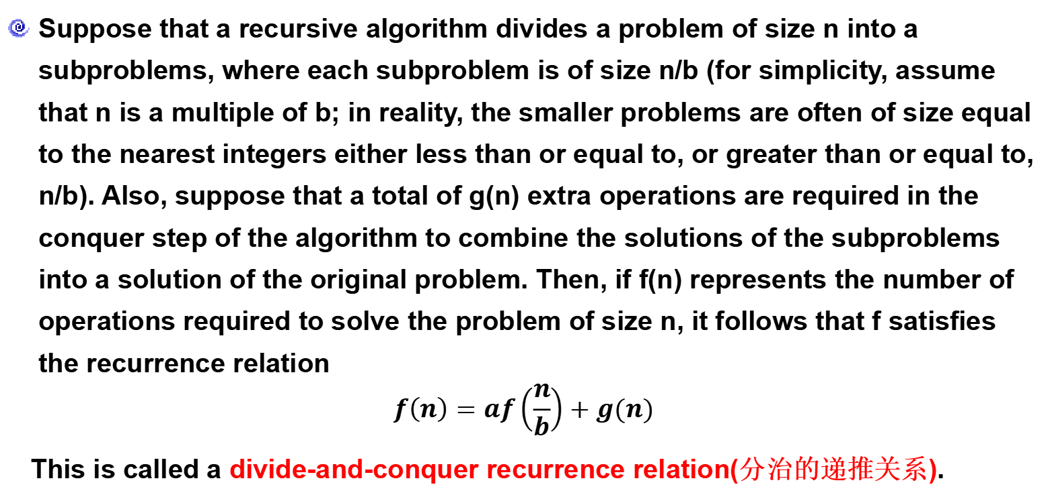
8.3.1 Introduction
Suppose that a recursive algorithm divides a problem of size n into a subproblems, where each subproblem is of size n/b (for simplicity, assume that n is a multiple of b; in reality, the smaller problems are often of size equal to the nearest integers either less than or equal to, or greater than or equal to, n/b). Also, suppose that a total of g(n) extra operations are required in the conquer step of the algorithm to combine the solutions of the subproblems into a solution of the original problem. Then, if f(n) represents the number of operations required to solve the problem of size n, it follows that f satisfies the recurrence relation
$$f\left(n\right)=af\left(\frac{n}{b}\right)+g(n)$$
This is called a divide-and-conquer recurrence relation(分治的递推关系).

Slide 5
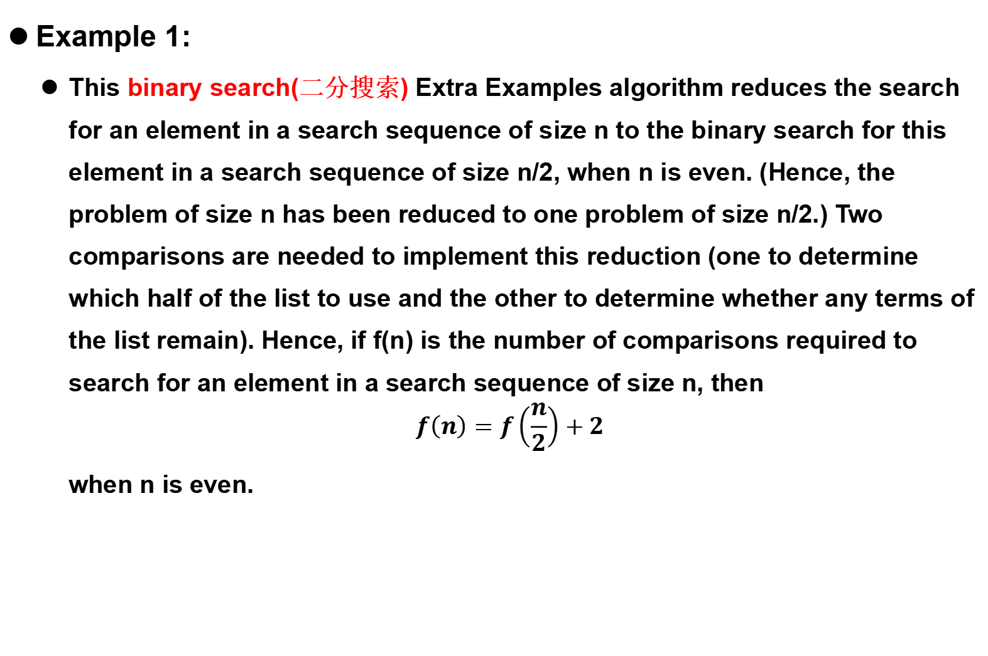
8.3.2 Divide-and-Conquer Recurrence Relations
Example 1:
This binary search(二分搜索) Extra Examples algorithm reduces the search for an element in a search sequence of size n to the binary search for this element in a search sequence of size n/2, when n is even. (Hence, the problem of size n has been reduced to one problem of size n/2.) Two comparisons are needed to implement this reduction (one to determine which half of the list to use and the other to determine whether any terms of the list remain). Hence, if f(n) is the number of comparisons required to search for an element in a search sequence of size n, then
$$f\left(n\right)=f\left(\frac{n}{2}\right)+2$$
when n is even.

Slide 6
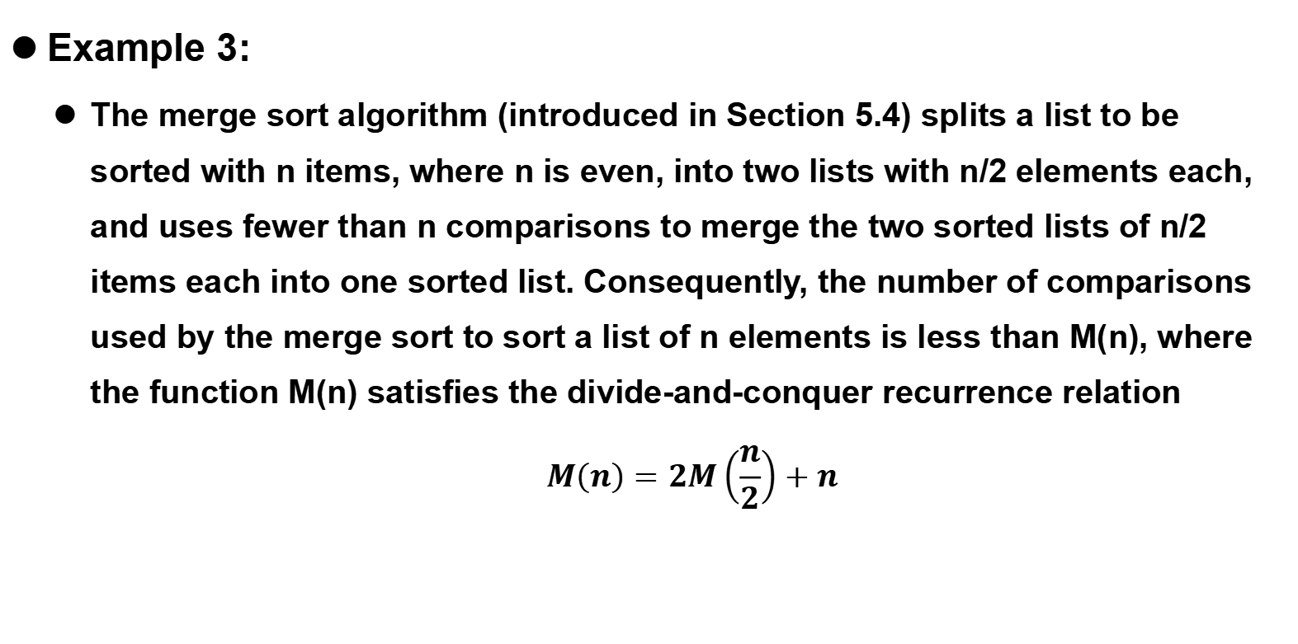
8.3.2 Divide-and-Conquer Recurrence Relations
Merge Sort - 归并排序
Example 3:
The merge sort algorithm (introduced in Section 5.4) splits a list to be sorted with n items, where n is even, into two lists with n/2 elements each, and uses fewer than n comparisons to merge the two sorted lists of n/2 items each into one sorted list. Consequently, the number of comparisons used by the merge sort to sort a list of n elements is less than M(n), where the function M(n) satisfies the divide-and-conquer recurrence relation
$$M\left(n\right)=2M\left(\frac{n}{2}\right)+n$$

Slide 7
8.3.2 Divide-and-Conquer Recurrence Relations
Fast Multiplication of Integers - 整数的快速乘法
One of these algorithms, which uses a divide-and-conquer technique, will be described here. This fast multiplication algorithm proceeds by splitting each of two 2n-bit integers into two blocks, each with n bits. Then, the original multiplication is reduced from the multiplication of two 2n-bit integers to three multiplications of n-bit integers, plus shifts and additions.

Slide 8
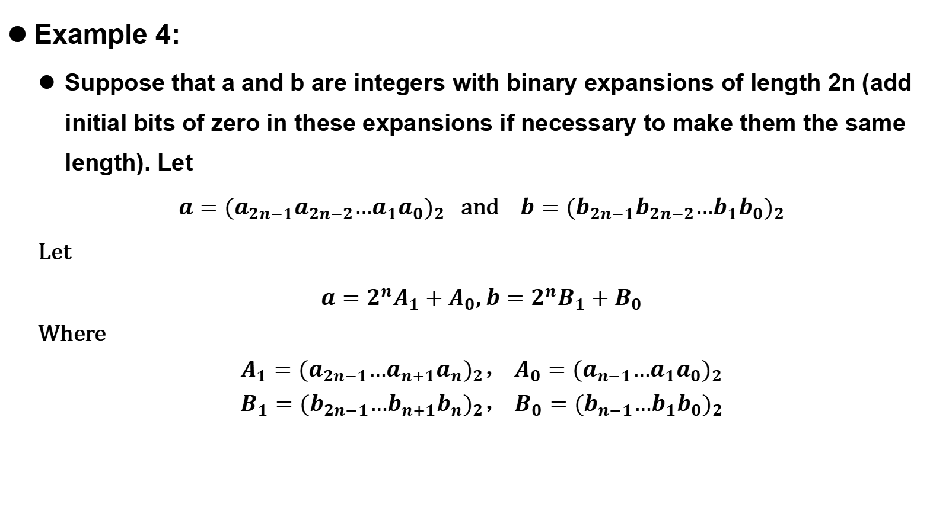
8.3.2 Divide-and-Conquer Recurrence Relations
Fast Multiplication of Integers - 整数的快速乘法
Example 4:
Suppose that a and b are integers with binary expansions of length 2n (add initial bits of zero in these expansions if necessary to make them the same length). Let
$a={(a_{2n−1}a_{2n−2}…a_{1}a_{0})}_{2}$ and $b={(b_{2n−1}b_{2n−2}…b_{1}b_{0})}_{2}$
Let
$a=2^{n}A_{1}+A_{0}$, $b=2^{n}B_{1}+B_{0}$
Where
${A_{1}=(a_{2n−1}…a_{n+1}a_{n})}_{2}$， ${A_{0}=(a_{n−1}…a_{1}a_{0})}_{2}$
${B_{1}=(b_{2n−1}…b_{n+1}b_{n})}_{2}$， ${B_{0}=(b_{n−1}…b_{1}b_{0})}_{2}$

Slide 9
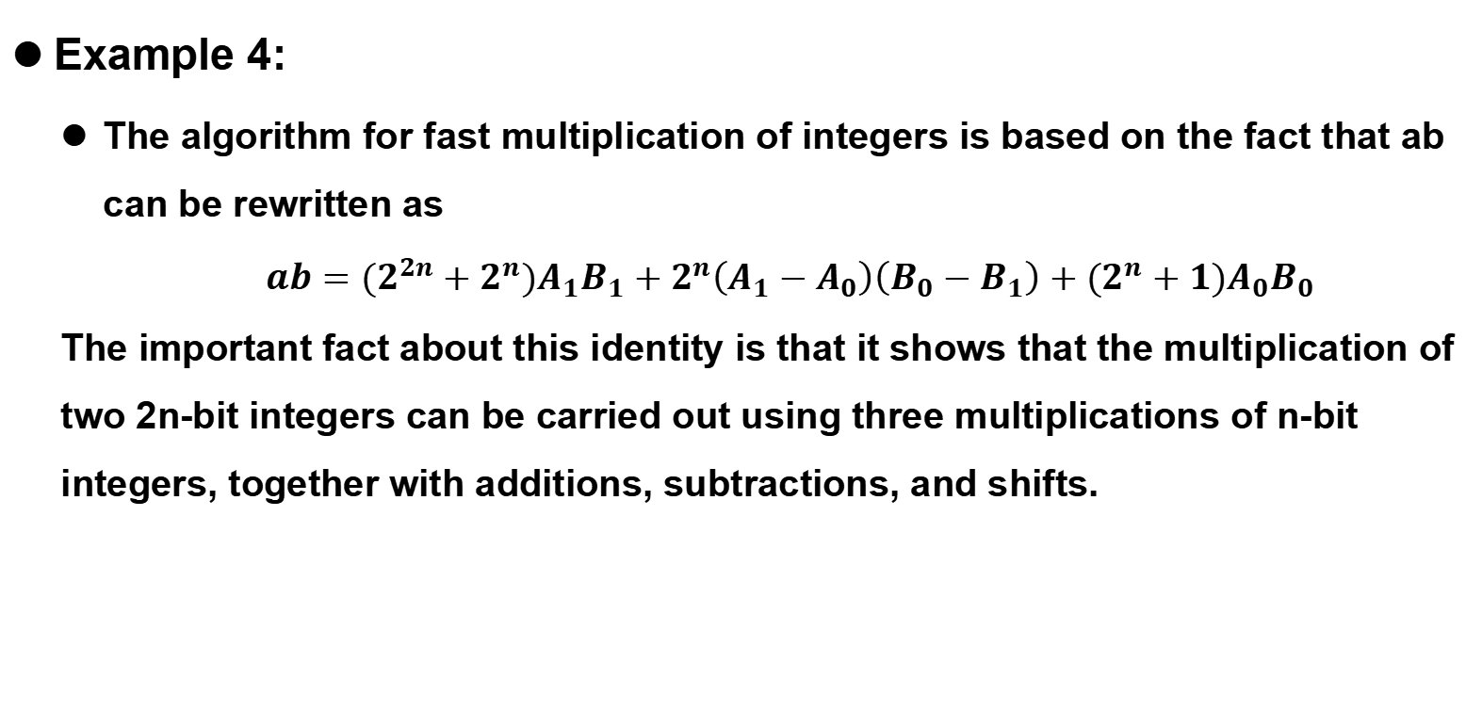
8.3.2 Divide-and-Conquer Recurrence Relations
Fast Multiplication of Integers - 整数的快速乘法
Example 4:
The algorithm for fast multiplication of integers is based on the fact that ab can be rewritten as
$$ab={(2}^{2n}+2^{n})A_{1}B_{1}+2^{n}\left(A_{1}−A_{0}\right)\left(B_{0}−B_{1}\right)+(2^{n}+1)A_{0}B_{0}$$
The important fact about this identity is that it shows that the multiplication of two 2n-bit integers can be carried out using three multiplications of n-bit integers, together with additions, subtractions, and shifts.

Slide 10
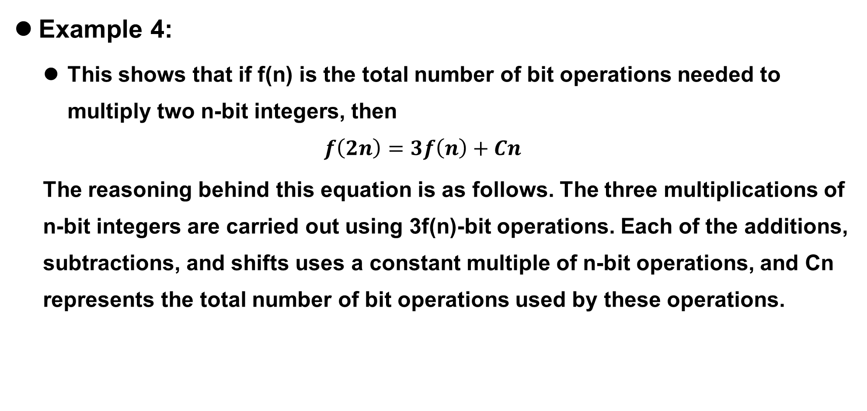
8.3.2 Divide-and-Conquer Recurrence Relations
Fast Multiplication of Integers - 整数的快速乘法
Example 4:
This shows that if f(n) is the total number of bit operations needed to multiply two n-bit integers, then
$$f\left(2n\right)=3f\left(n\right)+Cn$$
The reasoning behind this equation is as follows. The three multiplications of n-bit integers are carried out using 3f(n)-bit operations. Each of the additions, subtractions, and shifts uses a constant multiple of n-bit operations, and Cn represents the total number of bit operations used by these operations.

Slide 11



8.3.2 Divide-and-Conquer Recurrence Relations
Theorem 1
Let f be an increasing function that satisfies the recurrence relation
whenever n is divisible by b, where a ≥ 1, b is an integer greater than 1, and c is a positive real number. Then
Furthermore, when n = bk and a ≠ 1, where k is a positive integer,
where C1 = f(1) + c/(a−1) and C2 = −c/(a−1)

Slide 12
8.3.2 Divide-and-Conquer Recurrence Relations
Example 6:
Let f(n) = 5f(n/2) + 3 and f(1) = 7. Find f(2^{k}), where k is a positive integer. Also, estimate f(n) if f is an increasing function.

Slide 13
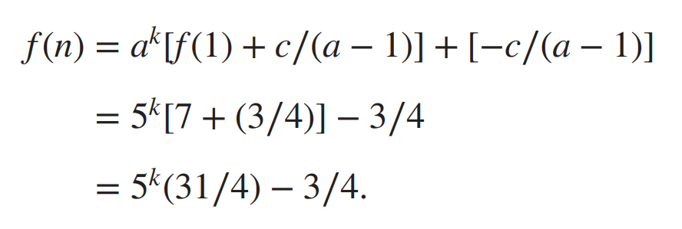

8.3.2 Divide-and-Conquer Recurrence Relations
Example 6:
Let f(n) = 5f(n/2) + 3 and f(1) = 7. Find f(2^{k}), where k is a positive integer. Also, estimate f(n) if f is an increasing function.
Solution:
From the proof of Theorem 1, with a = 5, b = 2, and c = 3, we see that if n = 2^{k}, then
Also, if f(n) is increasing, Theorem 1 shows that f(n) is .

Slide 14
8.3.2 Divide-and-Conquer Recurrence Relations
Example 7:
Give a big-O estimate for the number of comparisons used by a binary search.
Solution:
In Example 1 it was shown that f(n) = f(n/2) + 2 when n is even, where f is the number of comparisons required to perform a binary search on a sequence of size n.
Hence, from Theorem 1, it follows that f(n) is O(logn).

Slide 15
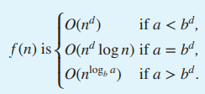
8.3.2 Divide-and-Conquer Recurrence Relations
Theroem 2
Let f be an increasing function that satisfies the recurrence relation
f(n) = af(n/b) + cn^{d}
whenever n = b^{k}, where k is a positive integer, a ≥ 1, b is an integer greater than 1, and c and d are real numbers with c positive and d nonnegative. Then

Slide 16
8.3 作业
8.3 作业
14
28

Slide 17
8.4.1 Introduction
Generating functions are used to represent sequences efficiently by coding the terms of a se- Links quence as coefficients of powers of a variable x in a formal power series.
Generating functions can be used to solve many types of counting problems, such as the number of ways to select or distribute objects of different kinds, subject to a variety of constraints, and the number of ways to make change for a dollar using coins of different denominations.
Generating functions can be used to solve recurrence relations by translating a recurrence relation for the terms of a sequence into an equation involving a generating function. This equation can then be solved to find a closed form for the generating function.

Slide 18

8.4.1 Introduction
Definition 1
The generating function for the sequence a₀, a₁, … , a_{k}, … of real numbers is the infinite series.
Remark: The generating function for {a_{k}} given in Definition 1 is sometimes called the ordinary generating function(普通生成函数) of {a_{k}} to distinguish it from other types of generating functions for this sequence.

Slide 19
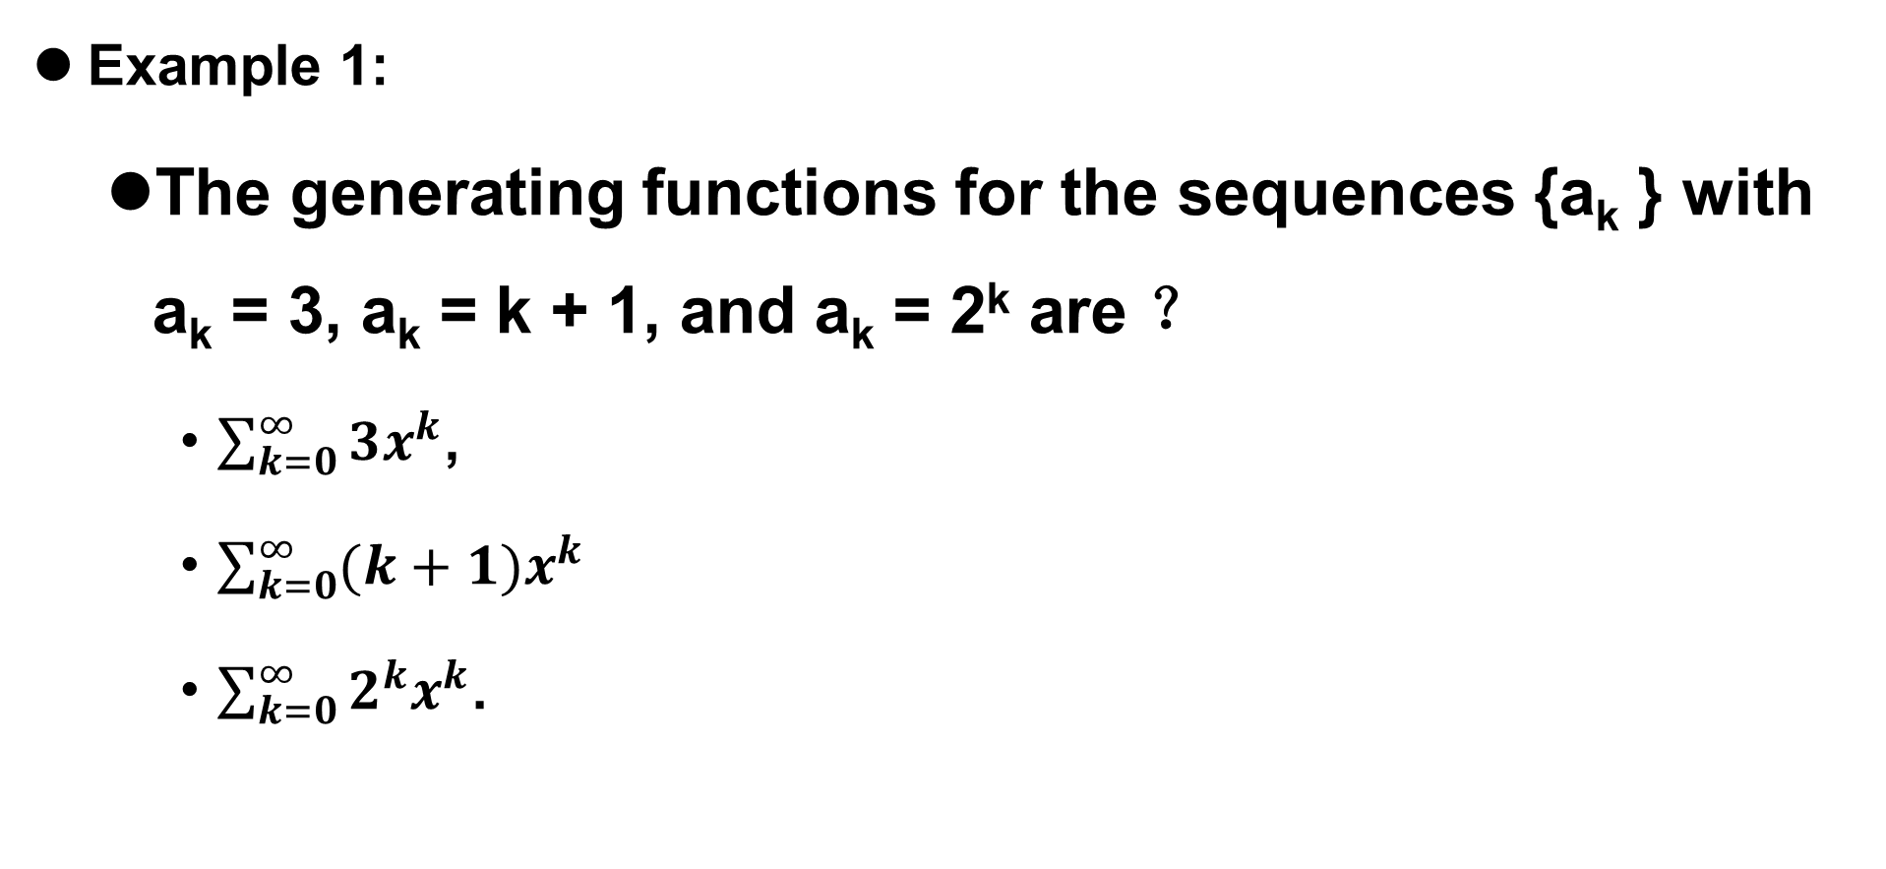
8.4.1 Introduction
Example 1:
The generating functions for the sequences {a_{k} } with a_{k} = 3, a_{k} = k + 1, and a_{k} = 2^{k} are ？
$\sum_{k=0}^{∞}{3x^{k}}$,
$\sum_{k=0}^{∞}{(k+1)x^{k}}$
$\sum_{k=0}^{∞}{2^{k}x^{k}}$.

Slide 20

8.4.1 Introduction
We can define generating functions for finite sequences of real numbers by extending a Extra Examples finite sequence a₀, a₁ , … , an into an infinite sequence by setting a_{n+1} = 0, a_{n+2} = 0, and so on. The generating function G(x) of this infinite sequence {a_{n}} is a polynomial of degree n because no terms of the form a_{j} x^{j} with j > n occur, that is,

Slide 21

8.4.1 Introduction
Example 2:
What is the generating function for the sequence 1, 1, 1, 1, 1, 1?
G(x) = (x⁶ − 1)∕(x − 1)是序列1, 1, 1, 1, 1, 1的生成函数。

Slide 22
8.4.1 Introduction
Example 2:
What is the generating function for the sequence 1, 1, 1, 1, 1, 1?
Solution:
The generating function of 1, 1, 1, 1, 1, 1 is
By Theorem 1 of Section 2.4 we have
when x ≠ 1. Consequently, G(x) = (x⁶ − 1)∕(x − 1) is the generating function of the sequence 1, 1, 1, 1, 1, 1. [Because the powers of x are only place holders for the terms of the sequence in a generating function, we do not need to worry that G(1) is undefined.]

Slide 23
8.4.1 Introduction
Example 3:
Let m be a positive integer. Let a_{k} = C(m, k), for k = 0, 1, 2, … , m. What is the generating function for the sequence a₀, a₁, … , a_{m}?
Solution:
The generating function for this sequence is
The binomial theorem shows that G(x) = (1 + x)^{m}.

Slide 24
8.4.2 Useful Facts About Power Series
When generating functions are used to solve counting problems, they are usually considered to be formal power series(形式幂级数). As such, they are treated as algebraic objects; questions about their convergence are ignored. However, when formal power series are convergent, valid operations carry over to their use as formal power series. We will take advantage of the power series of particular functions around x = 0. These power series are unique and have a positive radius of convergence.

Slide 25
8.4.2 Useful Facts About Power Series
Example 4:
The function f(x) = 1∕(1 − x) is the generating function of the sequence 1, 1, 1, 1, … , because
for |x| < 1.

Slide 26
8.4.2 Useful Facts About Power Series
Example 5:
The function f(x) = 1∕(1 − ax) is the generating function of the sequence 1, a, a2, a3, … , because
when |ax| < 1, or equivalently, for |x| < 1∕|a| for a ≠ 0.
We also will need some results on how to add and how to multiply two generating functions. Proofs of these results can be found in calculus texts.

Slide 27
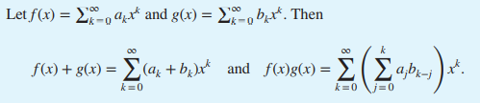
8.4.2 Useful Facts About Power Series
Theorem 1
Remark: Theorem 1 is valid only for power series that converge in an interval, as all series considered in this section do. However, the theory of generating functions is not limited to such series. In the case of series that do not converge, the statements in Theorem 1 can be taken as definitions of addition and multiplication of generating functions.

Slide 28

8.4.2 Useful Facts About Power Series
Example 6:
Let f(x) = 1∕(1 − x)². Use Example 4 to find the coefficients a₀, a₁, a₂, … in the expansion $f\left(x\right)=\sum_{k=0}^{∞}{a^{k}x^{k}}$.

Slide 29

8.4.2 Useful Facts About Power Series
Solution:
From Example 4 we see that
Hence, from Theorem 1, we have
Remark: This result also can be derived from Example 4 by differentiation. Taking derivatives is a useful technique for producing new identities from existing identities for generating functions.

Slide 30


8.4.2 Useful Facts About Power Series
Definition 2
Let u be a real number and k a nonnegative integer. Then the extended binomial coefficient ($\begin{matrix}u \\ k\end{matrix}$) is defined by

Slide 31

8.4.2 Useful Facts About Power Series
Example 7:
Find the values of the extended binomial coefficients $(\begin{matrix}−2 \\ 3\end{matrix})$ and ($\begin{matrix}1/2 \\ 3\end{matrix}$) .

Slide 32

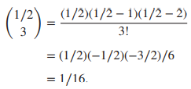
8.4.2 Useful Facts About Power Series
Solution:
Taking u = −2 and k = 3 in Definition 2 gives us
Similarly, taking u = 1∕2 and k = 3 gives us
Example 8 provides a useful formula for extended binomial coefficients when the top parameter is a negative integer.

Slide 33
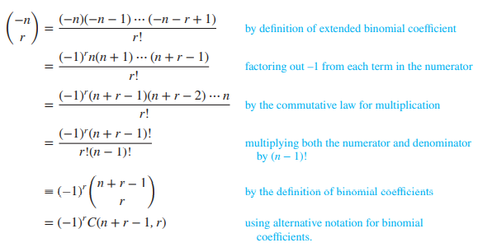
8.4.2 Useful Facts About Power Series
Example 8:
When the top parameter is a negative integer, the extended binomial coefficient can be expressed in terms of an ordinary binomial coefficient. To see that this is the case, note that

Slide 34

8.4.2 Useful Facts About Power Series
Theorem 2
The extended binomial Theorem(广义二项式定理)
Let x be a real number with |x| < 1 and let
Theorem 2 can be proved using the theory of Maclaurin series. We leave its proof to the reader with a familiarity with this part of calculus.

Slide 35
8.4.2 Useful Facts About Power Series
Example 9:
Find the generating functions for (1 + x)^{−n} and (1 − x)^{−n}, where n is a positive integer, using the extended binomial theorem.

Slide 36



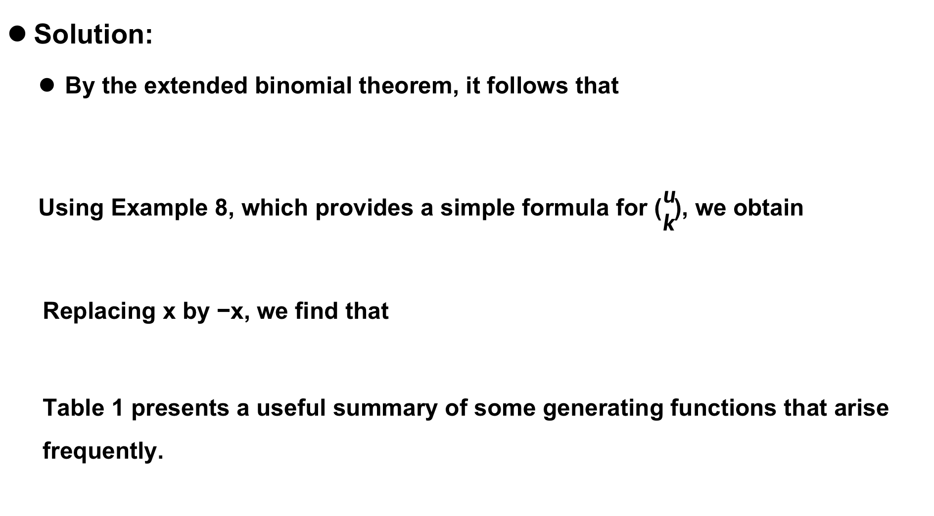
8.4.2 Useful Facts About Power Series
Solution:
By the extended binomial theorem, it follows that
Using Example 8, which provides a simple formula for ($\begin{matrix}u \\ k\end{matrix}$), we obtain
Replacing x by −x, we find that
Table 1 presents a useful summary of some generating functions that arise frequently.

Slide 37
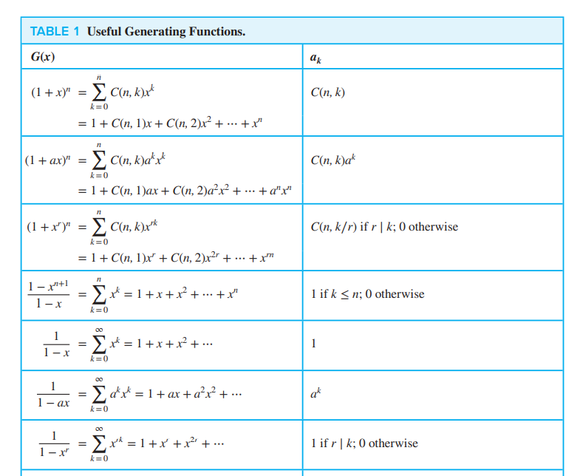
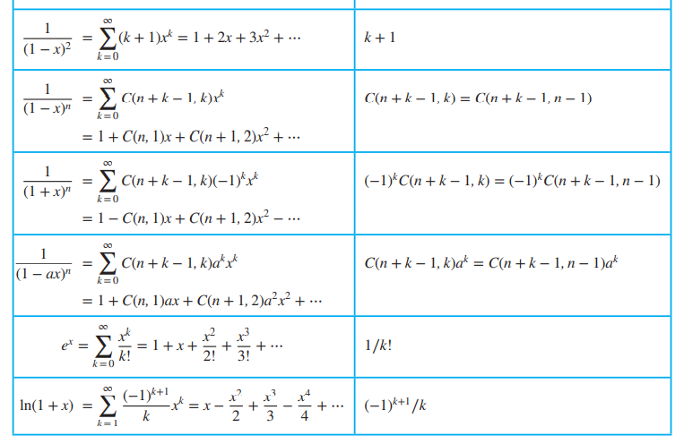
8.4.2 Useful Facts About Power Series
Useful Generating Functions.
Note: The series for the last two generating functions can be found in most calculus books when power series are discussed.

Slide 38
8.4.3 Counting Problems and Generating Functions
Such problems are equivalent to counting the solutions to equations of the form
e₁ + e₂ + ⋯ + e_{n} = C
where C is a constant and each ei is a nonnegative integer that may be subject to a specified constraint.
Generating functions can also be used to solve counting problems of this type, as Examples 10–12 show.

Slide 39
8.4.3 Counting Problems and Generating Functions
Example 10:
Find the number of solutions of
e₁ + e₂ + e₃ = 17
where e₁, e₂, and e₃ are nonnegative integers with 2 ≤ e₁ ≤ 5, 3 ≤ e₂ ≤ 6, and 4 ≤ e₃ ≤ 7.
Solution:
The number of solutions with the indicated constraints is the coefficient of x¹⁷ in the expansion of
(x² + x³ + x⁴ + x⁵)(x³ + x⁴ + x⁵ +x⁶)(x⁴ + x⁵+x⁶ + x⁷)

Slide 40
8.4.3 Counting Problems and Generating Functions
Solution:
This follows because we obtain a term equal to x¹⁷ in the product by picking a term in the first sum x^{e1} , a term in the second sum x^{e2} , and a term in the third sum x^{e3} ,
where the exponents e₁, e₂, and e₃ satisfy the equation e₁ + e₂ + e₃ = 17 and the given constraints.

Slide 41
8.4.3 Counting Problems and Generating Functions
Solution:
It is not hard to see that the coefficient of x¹⁷ in this product is 3. Hence, there are three solutions.
(Note that the calculating of this coefficient involves about as much work as enumerating all the solutions of the equation with the given constraints. However, the method that this illustrates often can be used to solve wide classes of counting problems with special formulae, as we will see. Furthermore, a computer algebra system can be used to do such computations.)

Slide 42
8.4.3 Counting Problems and Generating Functions
Example 11:
In how many different ways can eight identical cookies be distributed among three distinct children if each child receives at least two cookies and no more than four cookies?

Slide 43
8.4.3 Counting Problems and Generating Functions
Solution:
Because each child receives at least two but no more than four cookies, for each child there is a factor equal to
(x² + x³ + x⁴)
in the generating function for the sequence {c_{n}}, where c_{n} is the number of ways to distribute n cookies. Because there are three children, this generating function is
(x² + x³ + x⁴)³

Slide 44
8.4.3 Counting Problems and Generating Functions
Solution:
We need the coefficient of x8 in this product. The reason is that the x8 terms in the expansion correspond to the ways that three terms can be selected, with one from each factor, that have exponents adding up to 8.
Furthermore, the exponents of the term from the first, second, and third factors are the numbers of cookies the first, second, and third children receive, respectively.
Computation shows that this coefficient equals 6. Hence, there are six ways to distribute the cookies so that each child receives at least two, but no more than four, cookies.

Slide 45
8.4.3 Counting Problems and Generating Functions
Example 12:
Use generating functions to determine the number of ways to insert tokens worth $1, $2, and $5 into a vending machine to pay for an item that costs r dollars in both the cases when the order in which the tokens are inserted does not matter and when the order does matter.
(For example, there are two ways to pay for an item that costs $3 when the order in which the tokens are inserted does not matter: inserting three $1 tokens or one $1 token and a $2 token. When the order matters, there are three ways: inserting three $1 tokens, inserting a $1 token and then a $2 token, or inserting a $2 token and then a $1 token.)

Slide 46
8.4.3 Counting Problems and Generating Functions
Solution:
Consider the case when the order in which the tokens are inserted does not matter.
Here, all we care about is the number of each token used to produce a total of r dollars.
Because we can use any number of $1 tokens, any number of $2 tokens, and any number of $5 tokens, the answer is the coefficient of xr in the generating function
(1 + x + x² + x³ + ⋯)(1 + x² + x⁴ + x⁶ + ⋯)(1 + x⁵ + x¹⁰ + x¹⁵ + ⋯)

Slide 47
8.4.3 Counting Problems and Generating Functions
Solution:
(The first factor in this product represents the $1 tokens used, the second the $2 tokens used, and the third the $5 tokens used.)
For example, the number of ways to pay for an item costing $7 using $1, $2, and $5 tokens is given by the coefficient of x⁷ in this expansion, which equals 6.
When the order in which the tokens are inserted matters, the number of ways to insert exactly n tokens to produce a total of r dollars is the coefficient of x^{r} in
(x + x² + x⁵)^{n},

Slide 48
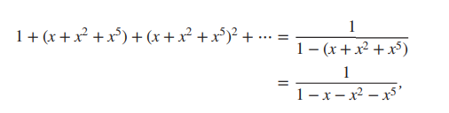
8.4.3 Counting Problems and Generating Functions
Solution:
because each of the r tokens may be a $1 token, a $2 token, or a $5 token. Because any number of tokens may be inserted, the number of ways to produce r dollars using $1, $2, or $5 tokens, when the order in which the tokens are inserted matters, is the coefficient of xr in

Slide 49
8.4.3 Counting Problems and Generating Functions
Solution:
Each element contributes this factor because it may be selected zero times, one time, two times, three times, and so on, when an r-combination is formed (with a total of r elements selected). Because there are n elements in the set and each contributes this same factor to G(x), we have
G(x) = (1+x+x² +⋯)^{n}.
As long as |x|<1,we have 1+x+x² +⋯=1∕(1−x),so
G(x) = 1∕(1−x)^{n} = (1−x)^{−n}.

Slide 50
8.4.3 Counting Problems and Generating Functions
Example 15:
Use generating functions to find the number of ways to select r objects of n different kinds if we must select at least one object of each kind.
Solution:
Because we need to select at least one object of each kind, each of the n kinds of objects contributes the factor (x + x² + x³ + ⋯) to the generating function G(x) for the sequence {a^{r}}, where a^{r} is the number of ways to select r objects of n different kinds if we need at least one object of each kind. Hence,
G(x) = (x+x² +x³ +⋯)^{n} = x^{n}(1+x+x² +⋯)^{n} = x^{n}∕(1−x)^{n}.

Slide 51
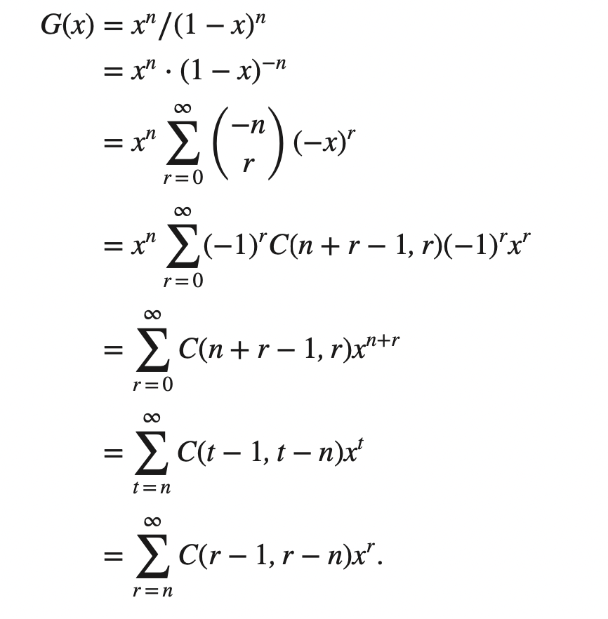
8.4.3 Counting Problems and Generating Functions
Solution:
Using the extended binomial theorem and Example 8, we have

Slide 52
8.4.4 Using Generating Functions to Solve Recurrence Relations
Example 16:
Solve the recurrence relation a_{k} = 3a_{k−1} for k = 1, 2, 3, ... and initial condition a₀ = 2.

Slide 53
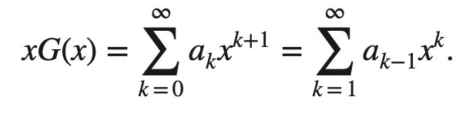
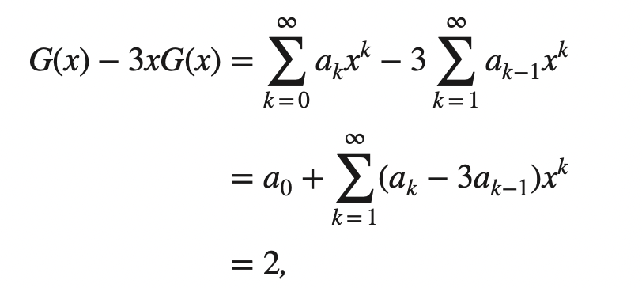
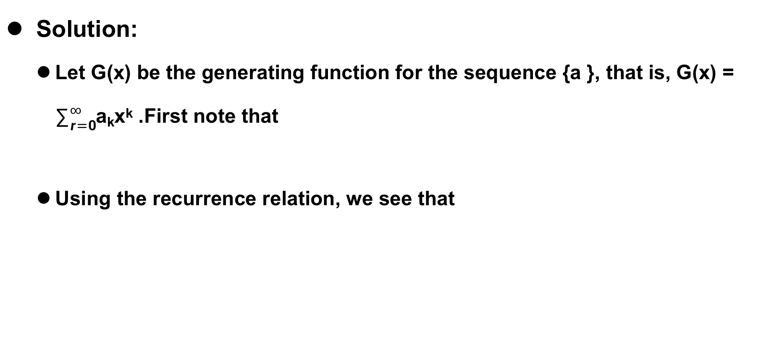
8.4.4 Using Generating Functions to Solve Recurrence Relations
Solution:
Let G(x) be the generating function for the sequence {a }, that is, G(x) = $∑_{r=0}^{∞}$a_{k}x^{k} .First note that
Using the recurrence relation, we see that

Slide 54
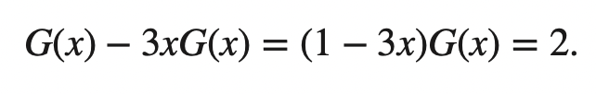
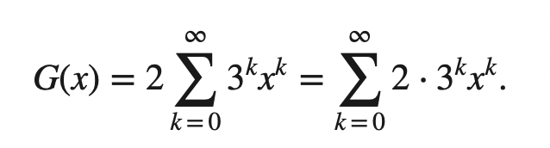
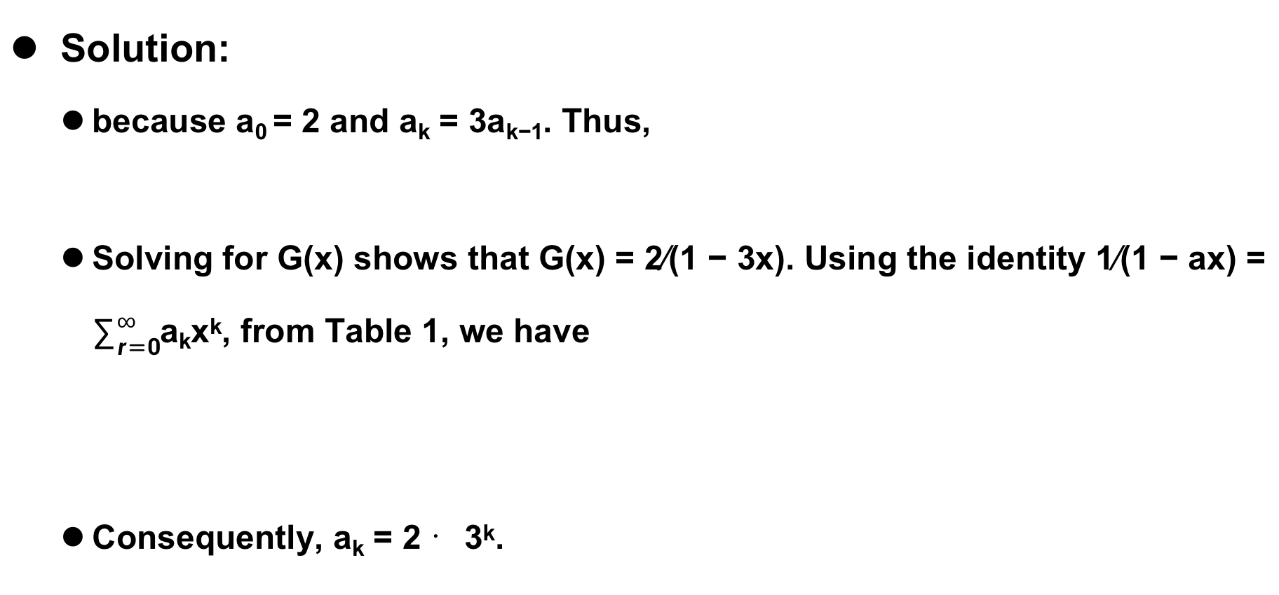
8.4.4 Using Generating Functions to Solve Recurrence Relations
Solution:
because a₀ = 2 and a_{k} = 3a_{k−1}. Thus,
Solving for G(x) shows that G(x) = 2∕(1 − 3x). Using the identity 1∕(1 − ax) = $∑_{r=0}^{∞}$a_{k}x^{k}, from Table 1, we have
Consequently, a_{k} = 2 ⋅3^{k}.

Slide 55
8.4.4 Using Generating Functions to Solve Recurrence Relations
Example 17:
Suppose that a valid codeword is an n-digit number in decimal notation containing an even number of 0s. Let an denote the number of valid codewords of length n. In Example 4 of Section 8.1 we showed that the sequence {a_{n}} satisfies the recurrence relation
a_{n} = 8a_{n−1} + 10^{n−1}
and the initial condition a₁ = 9. Use generating functions to find an explicit formula for a_{n}.

Slide 56

8.4.4 Using Generating Functions to Solve Recurrence Relations
Solution:
To make our work with generating functions simpler, we extend this sequence by setting a₀ = 1; when we assign this value to a₀ and use the recurrence relation, we have a₁ = 8a₀ + 10⁰ = 8 + 1 = 9, which is consistent with our original initial condition. (It also makes sense because there is one code word of length 0—the empty string.)
We multiply both sides of the recurrence relation by x^{n} to obtain

Slide 57
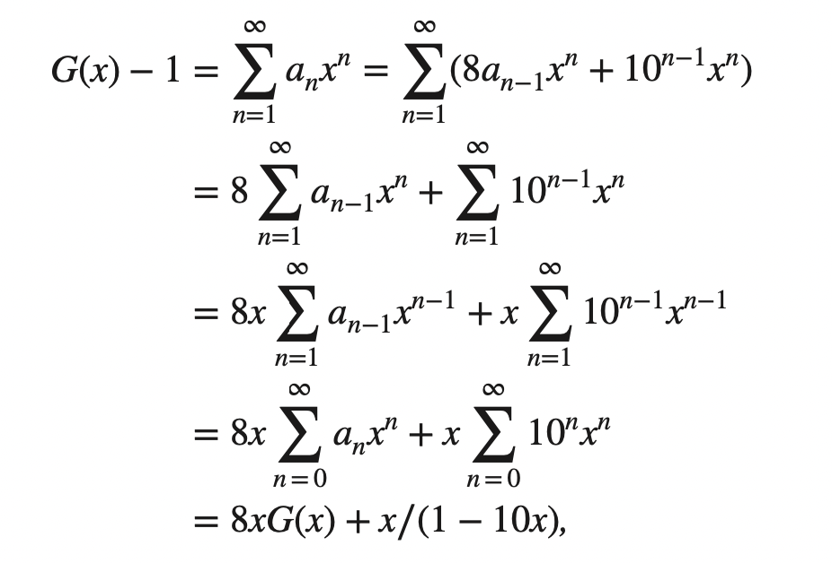

8.4.4 Using Generating Functions to Solve Recurrence Relations
Solution:
Let G(x) = $∑_{n=0}^{∞}$a_{n}x^{n}= 0 be the generating function of the sequence a₀, a₁, a₂, ... . We sum both sides of the last equation starting with n = 1, to find that

Slide 58

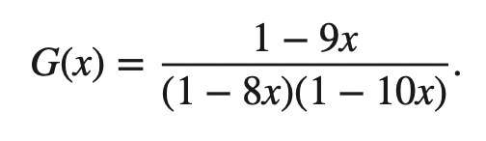
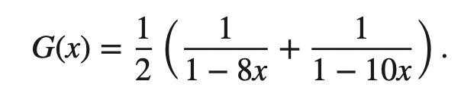
8.4.4 Using Generating Functions to Solve Recurrence Relations
Solution:
where we have used Example 5 to evaluate the second summation. Therefore, we have
Solving for G(x) shows that
Expanding the right-hand side of this equation into partial fractions (as is done in the integration of rational functions studied in calculus) gives

Slide 59
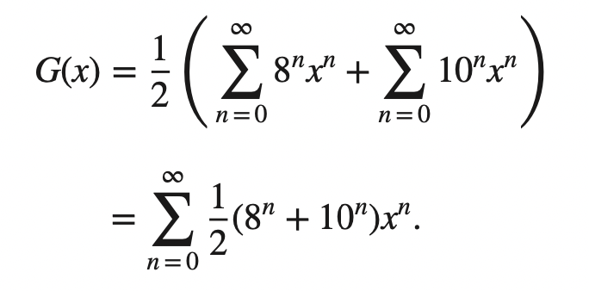
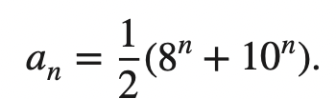
8.4.4 Using Generating Functions to Solve Recurrence Relations
Solution:
Using Example 5 twice (once with a = 8 and once with a = 10) gives
Consequently, we have shown that

Slide 60
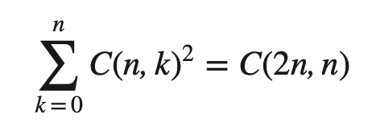
8.4.5 Proving Identities via Generating Functions
Example 18：
Use generating functions to show that
whenever n is a positive integer.

Slide 61
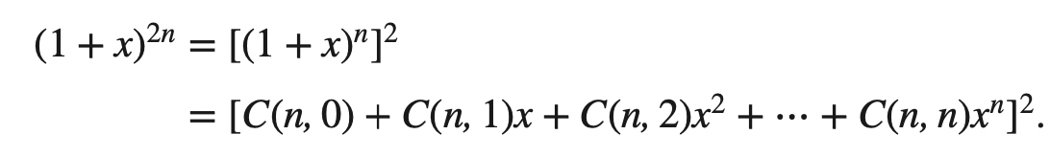
8.4.5 Proving Identities via Generating Functions
Solution:
First note that by the binomial theorem C(2n, n) is the coefficient of x^{n} in (1 + x)^{2n}. However, we also have

Slide 62
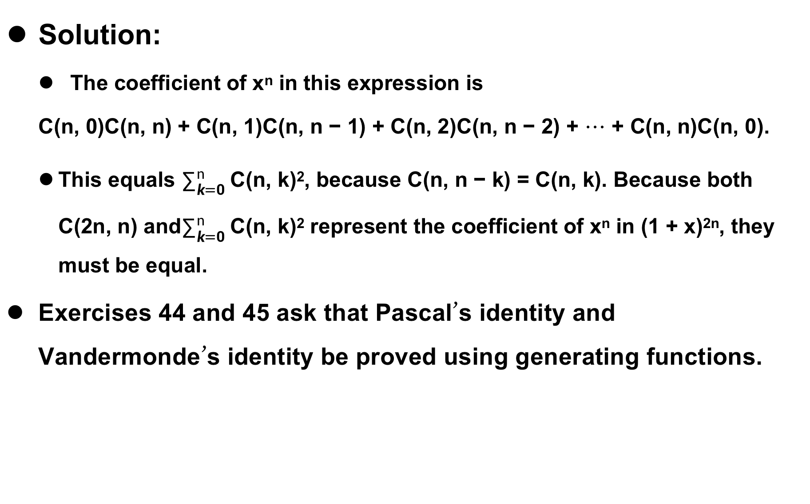
8.4.5 Proving Identities via Generating Functions
Solution:
The coefficient of x^{n} in this expression is
C(n, 0)C(n, n) + C(n, 1)C(n, n − 1) + C(n, 2)C(n, n − 2) + ⋯ + C(n, n)C(n, 0).
This equals $∑_{k=0}^{n}$ C(n, k)², because C(n, n − k) = C(n, k). Because both C(2n, n) and$∑_{k=0}^{n}$ C(n, k)² represent the coefficient of x^{n} in (1 + x)^{2n}, they must be equal.
Exercises 44 and 45 ask that Pascal’s identity and Vandermonde’s identity be proved using generating functions.

Slide 63
Homework
8.4
16，24，36.

Slide 64
8.4
单词表
generating function(生成函数)
formal power series(形式幂级数)
extended binomial Theorem(广义二项式定理)

